Slide 1


Slide 2
Insulin Analouges
Farzad Hadaegh ,M.D
Prevention of metabolic disorders research center,Obesity Research Center
Research Institute for Endocrine sciences
Shahid Beheshti University
of Medical Sciences
August , 2013
Tehran

Slide 3
Outline
Introduction
Insulin basal(Human Vs. analouges basal)
Premixed (Human Vs. analouges )
Premix vs. basal insulin
Premix Vs. Basal bolus
Guidelines
Conclusion
Practical points

Slide 4
Progressive beta cell damage
Type 2 diabetes is a progressive disease
At the time of diagnosis, patients with type 2 diabetes have an estimated loss of about 50% of their insulin-producing cells

Slide 5
Up to 50% loss of β-cell function occurs before diagnosis
100
Diagnosis of type 2 diabetes
80
60
β-cell function (%)
40
20
0
-10
-9
-8
-7
-6
-5
-4
-3
-2
-1
1
2
3
4
5
6
Time from diagnosis (years)
Holman RR. Diabetes Res Clin Prac 1998; 40 (Suppl.):S21–S25.
Notes:
5
Extrapolation of the observed rate of decline of β-cell function in diet-treated subjects in the UKPDS suggests that loss of β-cell function can begin at least 10 years before diagnosis.
In the UKPDS, long-term increases in fasting plasma glucose were accompanied by progressive β-cell dysfunction as assessed by HOMA.¹
Mean β-cell function was already less than 50% at diagnosis,² and none of the therapies used in the study (sulfonylureas, metformin and insulin) were able to prevent or delay the progressive deterioration of β-cell function.¹
On average, β-cell function declines by 1% per year with normal aging, compared with 4% per year in diabetes.^{1,3}
¹UKPDS Group. UKPDS 16. Diabetes 1995; 44:1249–1258.
²Holman RR. Diabetes Res Clin Prac 1998; 40 (Suppl.):S21–S25.
³Chiu KC, et al. Clin Endocrinol 2000; 53:569–575.

Slide 6
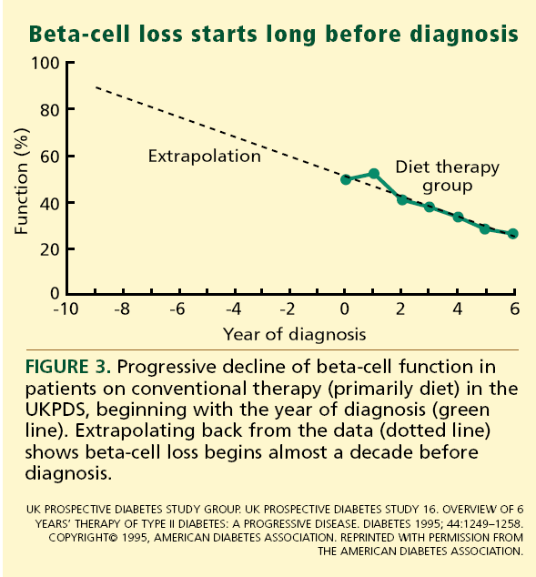

Slide 7
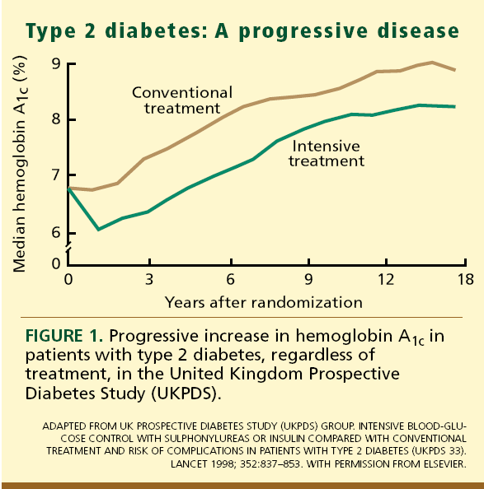

Slide 8
Need for Insulin
Insulin therapy is thus frequently required during the course of the disease to maintain glycemic control and prevent diabetes complications.
In the UK Prospective Diabetes Study, 9 years after diagnosis almost 80%of patients on oral agents required insulin supplementation

Slide 9
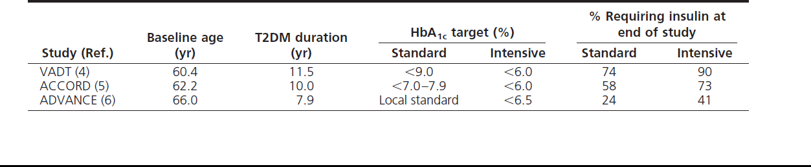
Insulin requirements in T2DM: disease duration and HbA1c target

Slide 10
? ? ?

Slide 11
Insulin remains the most potent antihyperglycemic agent available for uncontrolled T2DM patients
Intervention | Expected ↓ in HbA_{1c}
Insulin | No upper limit
Metformin | 1.5%
Sulfonylureas | 1.5%
Glinides | 1 to 1.5%ª
TZDs | 0.5 to 1.4%
α-Glucosidase inhibitors | 0.5 to 0.8%
GLP-1 agonist | 0.5 to 1.0%
Pramlintide | 0.5 to 1.0%
DPP-IV inhibitors | ~0.8%
ª Repaglinide is more effective than nateglinide
Adapted from Nathan DM et al. Diabetes Care 2006;29(8):1963-72.
Notes:
Key Point
To summarize, the greatest HbA_{1c} reductions are achieved with insulin, followed by metformin and sulfonylureas.
Reference:
Nathan DM et al. Management of hyperglycemia in type 2 diabetes: a consensus algorithm for
the initiation and adjustment of therapy. Diabetes Care 2006;29(8):1963-72.

Slide 12
Goal achievement?
Attainment of glycemic targets using insulin remains difficult
In a recent review of 48 randomized clinical trials using insulin in T2DM patients with a mean baseline HbA1c of 8.7%, only 40–54% achieved an HbA1c of less than7%
Diabetes Res Clin Pract2011, 92:1–10

Slide 13
Progressive beta cell damage
Type 2 diabetes is a progressive disease
At the time of diagnosis, patients with type 2 diabetes have an estimated loss of about 50% of their insulin-producing
In the UK Prospective Diabetes Study, 9 years after diagnosis almost 80%of patients on oral agents required insulin supplementation

Slide 14
Up to 50% loss of β-cell function occurs before diagnosis
100
Diagnosis of type 2 diabetes
80
60
β-cell function (%)
40
20
0
-10
-9
-8
-7
-6
-5
-4
-3
-2
-1
1
2
3
4
5
6
Time from diagnosis (years)
Holman RR. Diabetes Res Clin Prac 1998; 40 (Suppl.):S21–S25.
Notes:
14
Extrapolation of the observed rate of decline of β-cell function in diet-treated subjects in the UKPDS suggests that loss of β-cell function can begin at least 10 years before diagnosis.
In the UKPDS, long-term increases in fasting plasma glucose were accompanied by progressive β-cell dysfunction as assessed by HOMA.¹
Mean β-cell function was already less than 50% at diagnosis,² and none of the therapies used in the study (sulfonylureas, metformin and insulin) were able to prevent or delay the progressive deterioration of β-cell function.¹
On average, β-cell function declines by 1% per year with normal aging, compared with 4% per year in diabetes.^{1,3}
¹UKPDS Group. UKPDS 16. Diabetes 1995; 44:1249–1258.
²Holman RR. Diabetes Res Clin Prac 1998; 40 (Suppl.):S21–S25.
³Chiu KC, et al. Clin Endocrinol 2000; 53:569–575.

Slide 15
Risk of complications increases as HbA_{1c} increases
Microvascular disease
Incidence per
1000 patient-years
Myocardial infarction
Updated mean HbA_{1c} (%)
Stratton IM et al. BMJ 2000;321:405–12
Notes:
15
People with diabetes are at a greater risk of developing micro- and macrovascular disease than those without. The risk of these complications increases as glycaemic control decreases. For example, this slide shows that in a prospective observational study of 4585 patients with type 2 diabetes (UKPDS), the risk of microvascular disease and myocardial infarction increased as HbA_{1c} increased. This suggests that good blood glucose control is extremely important to prognosis.
References
Stratton IM, Adler AI, Neil AW, Matthews DR, Manley SE, Cull CA, Hadden D, Turner RC, Holman RR. Association of glycaemia with macrovascular and microvascular complications of type 2 diabetes (UKPDS 35): prospective, observational study. BMJ 2000;321:405–12.

Slide 16
Why should insulin be initiated?
Type 2 diabetes is a progressive disease; over time oral agents can no longer control glucose in most patients
Maintaining near-normal glucose
control is important in maximising outcomes
Notes:
16
So, as we’ve just seen, one of the key reasons for needing insulin is that, over time, oral agents often fail to control glucose due to progressive loss of beta-cell function.
Loss of glucose control is a problem because maintaining near-normal glucose control is very important in minimising complications and maintaining quality of life.

Slide 17
History
A 58- year- old women comes to see you for diabetes review. She has had type 2 diabetes for 8 years. She attended the local T2DM education programme at diagnosis.
Despite lifestyle modification, her BMI is 28
She is taking MFN 2g /daily , Gliclazide 320 mg/daily (good compliance) , atorvastatin 20 mg and ASA 80 mg
FBS 155 mg/dl ,HbA1c 8.5% , SMBG ?
No microalbuminuria , beginning of retinopathy, no cardiovascular complication
BP= 125/75 mmHg

Slide 18
History
A 58- year- old women comes to see you for diabetes review. She has had type 2 diabetes for 8 years. She attended the local T2DM education programme at diagnosis.
Despite lifestyle modification, her BMI is 28
She is taking MFN 2g /daily , Gliclazide 320 mg/daily (good compliance) , atorvastatin 20 mg and ASA 80 mg
FBS 155 mg/dl ,HbA1c 8.2% ,
No microalbuminuria , beginning of retinopathy, no cardiovascular complication
BP= 125/75 mmHg

Slide 19
Third line agent?
Oral agent (Triple therapy)
Different insulin regimens

Slide 20
Insulin therapy options
An unresolved issue
Prandial insulin supplementation
Basal insulin administration
Premixed formulations
Basal-bolus regimen

Slide 21
What is good glycaemic control?
Overall aim to achieve glucose levels as close to normal as possible
Minimise development and progression of microvascular and macrovascular complications
ADA¹
FPG
<130 mg/dL
HbA_{1c}
< 7.0%
PPG
<180 mg/dL
FPG
<110 mg/dL
HbA_{1c}
< 6.5%
PPG
<145 mg/dL
IDF²
1. American Diabetes Association Diabetes Care 2009;32 (Suppl 1):S1-S97
2. IDF Clinical Guidelines Task Force. International Diabetes Federation 2005.
Notes:
21
The glycaemic targets recommended by Diabetes organisations around the world are outlined on this slide. AS you can see, HbA1c targets are typically between 6.5 and 7.0% depending on the organisation. Although the targets differ between countries, in all countries the focus is on getting subjects to goal and ultimately reduce diabetes and it’s associated complications.

Slide 22
Once-daily basal insulin
Exact duration depends on the insulin
Insulin analogues may provide 24-hour cover
Intermediate human insulin preparations may only be active for ~8 hours and have a more pronounced peak activity
Insulin action
Time
basal human insulin
Insulin injection
basal analogue insulin
Schematic representation
Notes:
22
[slide is animated]
Once-daily basal insulin, often used in combination with oral agents, is one of the most commonly prescribed regimens for initiating insulin therapy. Basal insulin preparations provide a low level of insulin over several hours to keep blood glucose under control between meals. Traditional long-acting insulins, such as isophane (NPH) insulin, usually have a peak activity 4–8 hours after injection and can last 13–18 hours (Lindholm 2002). However, the newer insulin analogues, e.g., insulin detemir and insulin glargine, are more slowly absorbed after injection than NPH insulin and may provide sustained insulin coverage (for up to 24 hours) with less of a peak in activity.
References
Lindholm A. New insulins in the treatment of diabetes mellitus. Best Pract Res Clin Gastroenterol 2002;16:475–92.

Slide 23
MIMICKING NATURE WITH INSULIN THERAPY
The Basal/Bolus Insulin Concept
Basal Insulin
  Suppresses glucose production between meals and overnight
  Nearly constant levels
  50% of daily needs
Bolus Insulin (Mealtime or Prandial)
  Limits hyperglycemia after meals
  Immediate rise and sharp peak at 1 hour
  10% to 20% of total daily insulin requirement at each meal
6-20
Notes:
Slide 6-20
MIMICKING NATURE WITH INSULIN THERAPY
The Basal/Bolus Insulin Concept
Insulin is capable of restoring glycemia to nearly normal in most patients with type 2 diabetes. The basal/bolus insulin concept attempts to mimic, with insulin therapy, the patterns that normally control glucose in persons without diabetes. Basal insulin suppresses glucose production so that the levels remain nearly constant between meals and overnight. Basal insulin meets about half of the patient’s daily need for insulin and may be sufficient when considerable endogenous insulin remains. Bolus insulin (10% to 20% of the total daily insulin requirement given at each meal) limits hyperglycemia after meals. This tends to smooth the peaks of glucose that occur in response to these meals. Frequent glucose monitoring aids in determining the candidates for basal or mealtime regimens. Ideally, each component of insulin replacement therapy should come from a different type of insulin with a specific profile to fit the patient’s needs. Practical methods to accomplish this basal/bolus strategy will be illustrated later in this module.
Edelman SV, Henry RR. Insulin therapy for normalizing glycosylated hemoglobin in type II diabetes: applications, benefits, and risks. Diabetes Reviews. 1995;3:308-334; Kelley DB, ed. Medical Management of Type 2 Diabetes. 4th ed. Alexandria, Va: American Diabetes Association; 1998:56-72.

Slide 24
Ideal Basal Insulin
Closely mimic normal pancreatic basal insulin secretion
No distinct peak effect
Continued effect over 24 hours
Reduce nocturnal hypoglycemia
Once-daily administration for patient compliance
Predictable absorption pattern

Slide 25
Basal Insulin
Long acting (e.g. glargine)
- Provides optimal basal insulin coverage with a once daily dosing
- Lower risk of hypoglycemia
- Flat release profile
Intermediate acting (e.g. NPH)
Less optimal as a basal insulin, because it doesn’t have a flat insulin release profile
More hypoglycemic episodes
Notes:
25

Slide 26
Structure of Insulin Glargine:
A New Long-Acting Insulin Analogue
Modifications to human insulin chain
  Substitution of glycine at position A21
  Addition of two arginines at position B30
  Unique release pattern from injection site

Slide 27
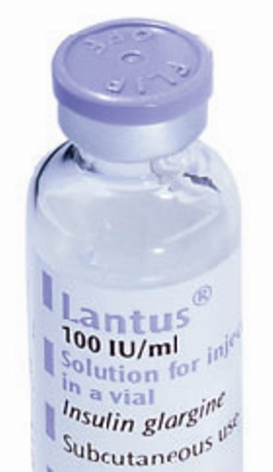
INSULIN GLARGINE
A-chain has an Asparagine to Glycine substituiation at position A21
Two positively charged Arginine are added at the C terminus of the B chain
G
l
y
-
A-Chain
Substitution
A
s
2
n
1
0
0
1
1
5
5
1
0
2
1
1
0
5
2
5
3
5
0
B-Chain
Extension
A
r
A
g
r
g

Slide 28
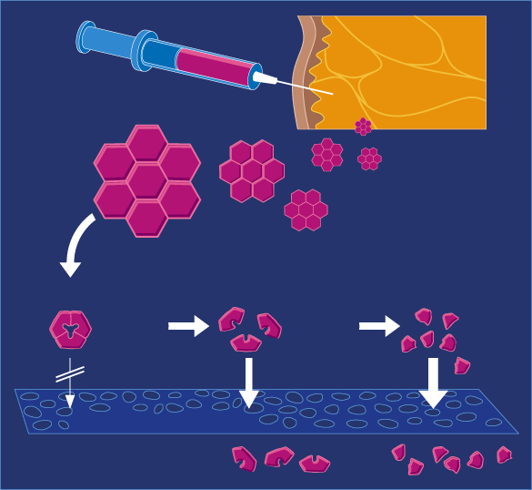
GLARGINE: Mechanism of Action
Clear Solution pH4
pH 7.4
Injection of an acidic solution
(pH 4.0)
Precipitation of insulin glargine in subcutaneous tissue (pH 7.4)
Slow dissolution of free insulin glargine hexamers from micro precipitates (stabilized aggregates)
Protracted action
Precipitation
Dissolution
Hexamers
Dimers
Monomers
10⁻³ M
10⁻⁵M
10⁻⁸ M
Capillary Membrane
Insulin in Blood

Slide 29
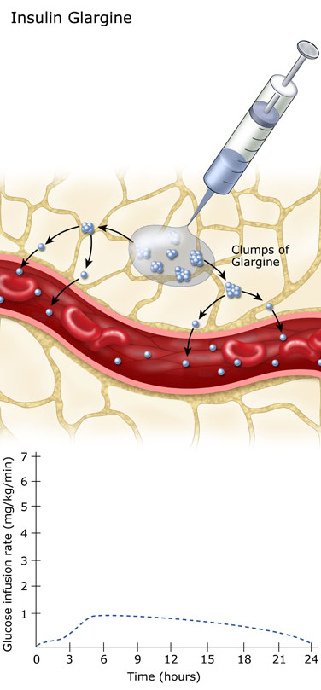
GLARGINE: PHARMACOKINETICS
Slow dissolution of the Glargine hexamers at the injection site results in a relatively constant release with no pronounced peak over a period of up to 24 hours.
  Onset of action= 2 hours
  Peak= flat
  Duration= 24 hours

Slide 30
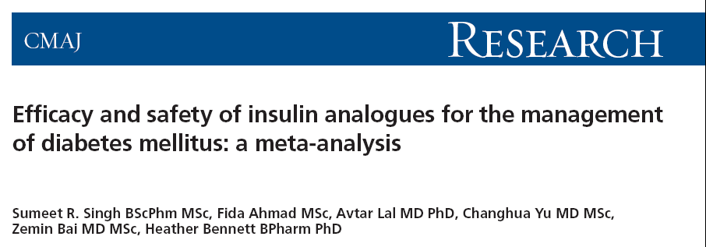
From the Canadian Agency for Drugs and Technologies in Health,,
Aim: To compare the outcomes of insulin analogues with conventional insulins in the treatment of DM₁, DM₂ and GDM
CMAJ 2009;180(4):385-97

Slide 31


Differences in glycemic control, as measured by hemoglobin A1c , between insulin analogues and other treatments in patients with DM₁
Long-acting insulin analogues
Singh SR, Ahmad F, LaI A, et al. CMAJ 2009; 180:385-397

Slide 32
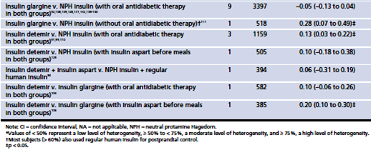
Differences in glycemic control, as measured by hemoglobin A1c , between insulin analogues and other treatments in patients with DM₂
Long-acting insulin analogues
Singh SR, Ahmad F, LaI A, et al. CMAJ 2009; 180:385-397

Slide 33

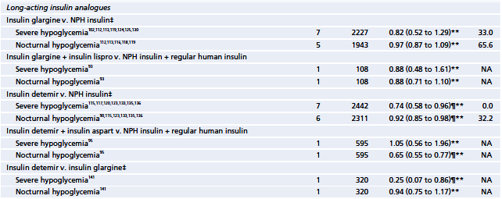

Efficacy and safety of insulin analogues for the management of diabetes mellitus: a meta-analysis
Singh SR, Ahmad F, LaI A, et al. CMAJ 2009; 180:385-397

Slide 34

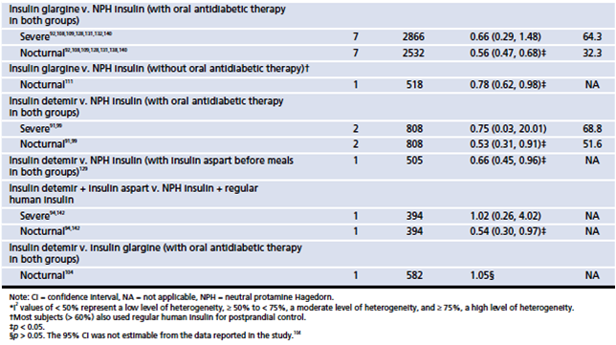
Efficacy and safety of insulin analogues for the management of diabetes mellitus: a meta-analysis
Singh SR, Ahmad F, LaI A, et al. CMAJ 2009; 180:385-397

Slide 35
Efficacy and safety of insulin analogues for the management of diabetes mellitus: a meta-analysis
  Interpretation
Most estimates of differences in HbA₁c between treatment groups were not statistically significant.
Where they were statistically significant in favor of insulin analogues, the differences were smaller than minimal clinically important differences described in the literature.
We found statistically significant benefits of insulin analogues over conventional insulins in terms of hypoglycemia
These agents may be an option for patients with problematic hypoglycemia despite optimization of conventional insulin therapy.
Singh SR, Ahmad F, LaI A, et al. CMAJ 2009; 180:385-397

Slide 36
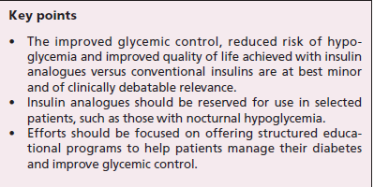

Slide 37
Premix insulins
Biphasic Human insulin (NPH +Regular )
Insulin analogues (Insulin Aspart 70/30, Lispro 75/25 and 50/50,)

Slide 38
Premix insulin
No need for self mixing
Minimizing dosing error
Less injections (attractive alternative to basal bolus)
  Fixed ratio (Less flexibility)

Slide 39
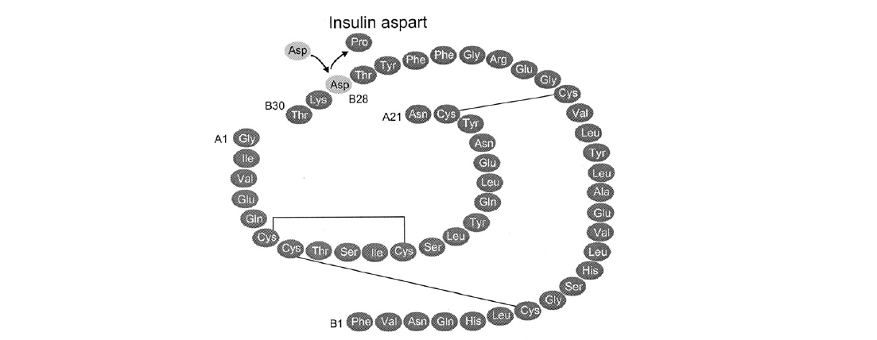
The American Journal of Medicine, Vol 121, No 6A, June 2008

Slide 40
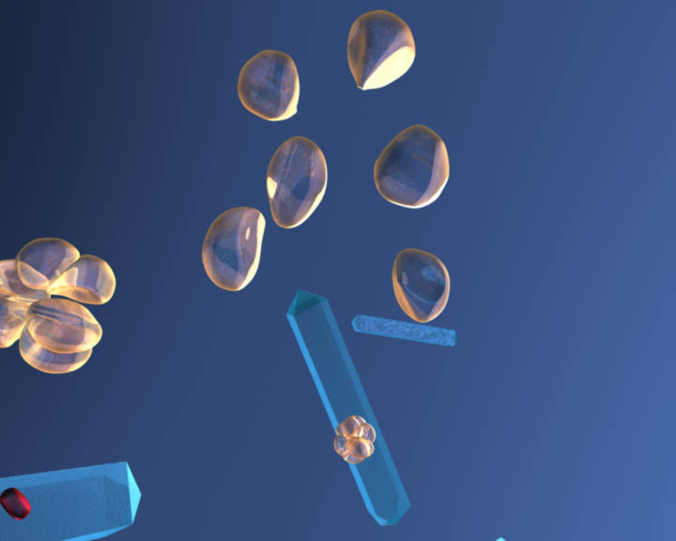
Formulation of premixes
Premixed suspension of:
Soluble insulin aspart
30%
30%
Soluble
human insulin
Protamine-crystallised
insulin aspart
NPH
NovoMix® 30 Premixed human
insulin

Slide 41
The dual-release insulin concept
Physiological insulin profile:
  - meal-related peak
  - basal component
Profiles are schematic
Rapid-acting insulin
analogue together with
a basal insulin analogue provide physiological insulin replacement
Premix analogues such as NovoMix® 30 mimic physiological insulin secretion
Physiological insulin profile
Soluble insulin aspart
Protamine crystallised insulin aspart
NovoMix® 30

Slide 42
Premixed insulin:
Once, twice or three-times daily
Premixed human insulin
Premixed analogue insulin
Premixed injection
Premixed injection
Contains:
Basal component
Short-acting component
Possible regimens:
Twice daily with dinner and breakfast (figure)
Once daily with the largest meal is also possible if a patient wants to get familiar with dosing
Three-times daily, with each meal
Insulin action
Breakfast
Lunch
Dinner
Schematic representation of twice-daily injections
Notes:
42
[slide is animated]
Premixed insulins contain both rapid-acting and long- (intermediate-) acting insulin in one preparation. The exact proportions of each insulin within the mixture can vary: a usual mix is 30% rapid-acting insulin and 70% long-acting insulin (e.g., NovoMix® 30) or 25% rapid-acting insulin and 75% long-acting insulin (e.g., Humalog® Mix 25).

Slide 43
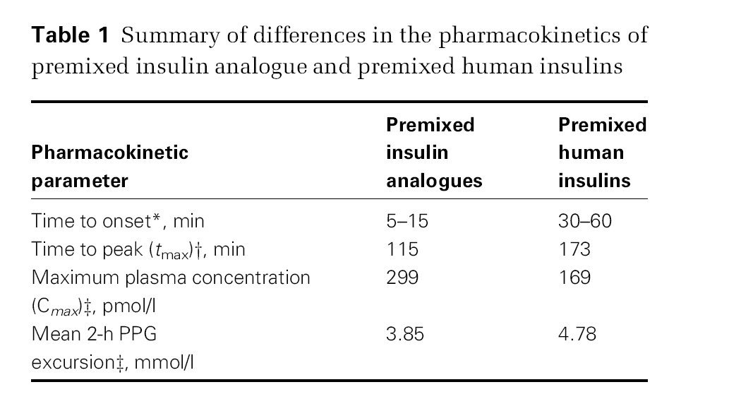

Slide 44
Basal–bolus therapy
Rapid-acting human insulin
Rapid-acting analogue insulin
Long-acting human insulin
Long-acting analogue insulin
Rapid insulin
Rapid insulin
Rapid insulin
Long
insulin
Insulin action
Meal
Meal
Meal
Bedtime
Schematic representation of four injections per day
(one long acting, three rapid acting)
Notes:
44
[slide is animated]
Basal–bolus therapy involves four/five injections of insulin per day; three* injections of rapid-acting insulin to cover mealtime needs with one or two injections of basal insulin covering insulin requirements between meals. Oral agents are generally discontinued when this regimen is started. In general, the size of the peaks of insulin activity, as shown on the slide, will vary depending on the insulin dose.
Not many patients with type 2 diabetes will be using basal–bolus regimens. They tend only to be used in patients with severe beta-cell failure.
*Note that if people are taking very long-meals (e.g., a Christmas dinner), more than one injection of rapid-acting analogue may be needed to cover the time span of the meal.

Slide 45
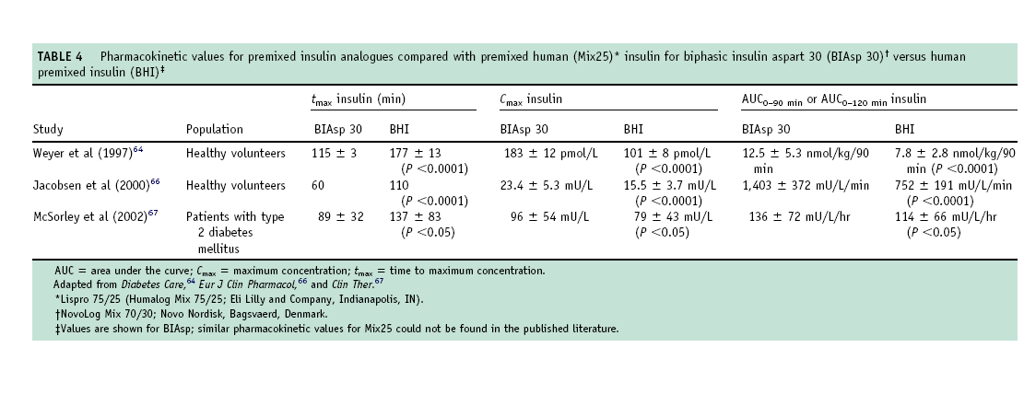
The American Journal of Medicine, Vol 121, No 6A, June 2008

Slide 46
FPG or PPG?
FPG and PPG have different contribution to HbA1c
With mild HbA1c elevations (7.3-8.4%), the proportion of HbA1c elevation attributable to postprandial hyperglycaemia increases to as much as 70% of the glycaemic load
To reach recommended HbA1c targets <6.5% it is important that postprandial hyperglycaemia is specifically addressed.
Monnier L, et al Diabetes Care 2003; 26: 881–885.

Slide 47
To normalise blood glucose both FPG and PPG must be reduced
Most insulin is initiated when
HbA_{1c} >8.5%
100
PPG
80
40%
30%
FPG
% contribution to HbA_{1c}
50%
45%
60
70%
40
70%
50%
55%
60%
20
30%
0
<7.3
7.3–8.4
8.5–9.2
9.3–10.2
>10.2
HbA_{1c} range (%)
  Adapted from Monnier L et al. Diabetes Care 2003;26:881–5
Notes:
In order to normalise blood glucose, there is a need to address both fasting and post prandial glucose abnormalities. As patients get closer to HbA1c targets, the relative importance of PPG increases.

Slide 48
Improved postprandial blood glucose compared with human insulin after 3 months
NovoMix® 30
12
*
Premixed human insulin
*
10
*
*
8
Blood glucose (mmol/l)
6
n = 294 type 1 and type 2 patients
* p < 0.05
0
Pre-
Post-
Pre-
Post-
Pre-
Post-
Bedtime
02.00 h
Breakfast
Lunch
Dinner
Boehm B, et al. Diabet Med 2002;19:393–399
Notes:
Boehm BO, Home PD, Behrend C, Kamp NM, Lindholm A. Diabet Med 2002;19:393–399
Premixed insulin aspart 30 versus premixed human insulin 30/70 twice daily: a randomized trial in type 1 and type 2 diabetic patients
AIM: To compare the efficacy and safety of premixed insulin aspart (30% free and 70% protamine-bound, BIAsp 30) with human insulin premix (BHI 30) used in a twice-daily injection regimen in people with Type 1 or Type 2 diabetes. METHODS: People with Type 1 or Type 2 diabetes (n = 294) using twice-daily insulin were randomized to a 12-week open-label comparison of BIAsp 30 and BHI 30. Efficacy was assessed by analysis of variance of 12-week data, adjusted for baseline level. RESULTS: BIAsp 30 was as effective as BHI 30 based on the primary efficacy measure, HbA1c, mean difference -0.01 (90% confidence interval (CI) -0.14; 0.12) %Hb. Meal-time self-measured blood glucose increment averaged over the three main meals was significantly lower in the BIAsp 30 group than in the BHI 30 group (-0.68 (-1.20; -0.16) mmol/l; P<0.02). Significant improvements were observed after breakfast, before lunch, after dinner and at bedtime (P < 0.02-0.05), with blood glucose around 1.0 mmol/l lower in the BIAsp 30 group. The number of major hypoglycaemic episodes with BIAsp 30 was half that with BHI 30. However, the overall risk of both minor and major hypoglycaemia did not differ significantly between treatments. CONCLUSION: Post-prandial glycaemic control was significantly improved, without increasing the risk of hypoglycaemia, and overall control was similar when people with Type 1 and Type 2 diabetes were treated on a twice-daily regimen with immediate premeal injections of BIAsp 30 compared with BHI 30.

Slide 49
Reduced major hypoglycaemia compared with human insulin
NovoMix® 30
12
p = 0.04
BHI 30
10
p = NS
8
n = 125 type 2 diabetes patients
Patients with at least one major
episode (%)
6
4
3
events
11
events
8
events
2
0
1st year
2nd year
Year of study
Boehm B, et al. Eur J Int Med 2004;15:496–502
Notes:
ANA 067
Boehm BO, Vaz JA, Brøndsted L, Home PD. Eur J Int Med 2004;15:496–502
Long-term efficacy and safety of biphasic insulin aspart 30 in type 2 diabetes
BACKGROUND: In this study, we sought to compare the long-term safety and efficacy of biphasic insulin aspart 30 (BIAsp 30) with that of biphasic human insulin 30 (BHI 30) over a period of 24 months in patients with type 2 diabetes. METHODS: Patients with type 2 diabetes (n = 125) were assigned to twice-daily BIAsp 30 or BHI 30 and participated in both a 3-month initial period and a 21-month extension of a randomized, controlled, multinational trial. RESULTS: No significant difference was found in mean HbA1c after 24 months [BIAsp 30, 8.35±0.20%; BHI 30 8.13±0.16%; adjusted mean difference (BIAsp 30–BHI 30) 0.03 (90% CI –0.29 to 0.34)%, P = 0.89]. The proportion of patients experiencing major hypoglycaemia was also similar during the first year (BIAsp 30, 5%; BHI 30, 8%; P = 0.72), but it was significantly lower with BIAsp 30 than with BHI 30 during the second year (BIAsp 30, 0%; BHI 30, 10%; P = 0.04). The proportion experiencing minor hypoglycaemia was not significantly different. No significant difference was recorded in changes in nonspecific insulin antibody levels after 24 months (BIAsp 30, 4.87±1.92%; BHI 30; 1.00±1.66%; P=0.13). Body weight change was 0.05±0.81 kg in the BIAsp 30 group and 2.00±0.69 kg in the BHI 30 group (P=0.07). CONCLUSIONS: Reduced major hypoglycaemia compared with BHI 30 during the second year of treatment and comparable HbA1c levels after 24 months appear to support the hypothesis that the improved pharmacokinetic profile of BIAsp 30 may favourably affect the balance between hypoglycaemia and hyperglycaemia in insulin-treated type 2 diabetes.

Slide 50
No difference in efficacy or safety between pre- or post-meal dosing of NovoMix® 30
After preprandial injection (63.0 ± 28.9 U)
After postprandial injection (64.6 ± 29.2 U)
240
220
200
n = 93 type 2 diabetes patients
180
Mean plasma glucose (mg/dl)
160
140
120
100
-15 60 120 180 240
Time (minutes)
Warren ML, et al. Diabetes Res Clin Pract 2004;66:23–29
Notes:
BIAsp 1239
Blood glucose levels (mg/dl):
Preprandial dosing (NovoMix® 30, bid) Postprandial dosing (NovoMix® 30, bid)
Before Breakfast 139 ± 43 134 ± 55
Dinner 143 ± 59 149 ± 65
2 h after Breakfast 159 ± 66 177 ± 61
Dinner 143 ± 60 175 ± 59
Overall, postprandial administration of NovoMix® 30 did not result in an increase in hypoglycaemic episodes compared with preprandial administration
Warren ML, Conway MJ, Klaff LJ, Rosenstock J, Allen E. Diabetes Res Clin Pract 2004;66:23–29.
Postprandial versus preprandial dosing of biphasic insulin aspart in elderly type 2 diabetes patients
Preprandial dosing (within 5 min before meal) and postprandial dosing (15-20 min after meal onset) of NovoLog Mix 70/30 (BIAsp 30, a biphasic formulation of insulin aspart, 30% soluble and 70% protamine-crystallized) were compared in elderly (> or =65 years) type 2 diabetes patients in this open-label, 12-week, crossover study. Ninety-three patients were treated with b.i.d. preprandial injections of BIAsp 30 during a 2-week run-in period and subsequently randomized to a 4-week treatment with either pre- or postprandial b.i.d. BIAsp 30, followed by crossover to the other regimen for 4 weeks. Mean plasma glucose values during a 4-h mealtest at the end of each treatment were similar for pre- and postprandial BIAsp 30 (153 +/- 58 mg/dl and 161 +/- 59 mg/dl, respectively, difference not significant). However, the mean blood glucose increment from self-measured blood glucose values was slightly but significantly greater after postprandial injection than after preprandial injection (treatment difference: 16.3mg/dl; 95% CI: [0.5, 29.3]). Fifty-six percent of patients reported a hypoglycemic episode; postprandial injection did not increase the incidence of hypoglycemia as compared to preprandial injection (113 episodes versus 125 episodes, respectively). For some elderly type 2 diabetes patients, postprandial injection of BIAsp 30 may be an acceptable alternative to standard preprandial injection.

Slide 51
Human Vs. Analogues

Slide 52
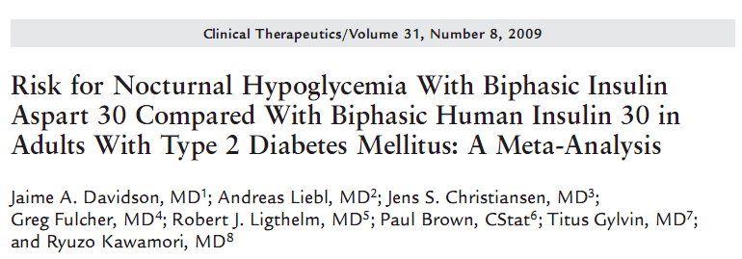
The aim of this study was to compare biphasic insulin aspart 30 (BIAsp 30) with biphasic human insulin 30 (BHI 30) with respect to glycemic control and the risk for hypoglycemia using a metaanalysis of clinical trials comparing these insulins in patients with type 2 diabetes mellitus (T2DM).
The predefined primary end point of the study was the overall rate of nocturnal hypoglycemia (major, minor, and symptoms-only hypoglycemia occurring from 12:00–6:00 am).

Slide 53
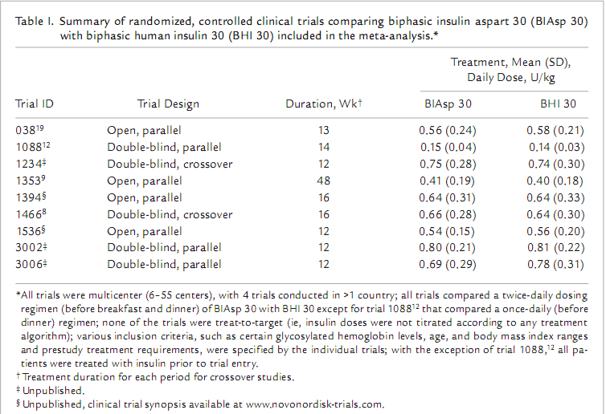

Slide 54
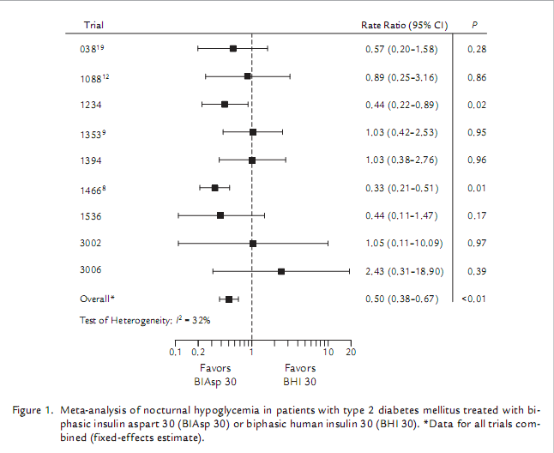

Slide 55
Meta-analysis: BIAsp 30 superior to BHI 30 for major hypoglycaemia
038
0.50 [0.12; 1.98], p=0.32
1234
0.34 [0.01; 8.28], p=0.50
Trial
1353
0.57 [0.16; 2.00], p=0.38
1394
0.53 [0.03; 8.63], p=0.66
1466
0.31 [0.06; 1.54], p=0.15
Odds ratio [95% CI]
3002
0.25 [0.01; 6.62], p=0.41
Overall
0.45 [0.22; 0.93], p<0.05
I² = 32%
0.01
0.1
1
10
100
Favours
BIAsp 30
Favours
BHI 30
Davidson J et al. Clin Ther 2009; 31 (8): 1641-51
Notes:
Speaker Notes:
A secondary safety endpoint of the Davidson study was to determine the rates of major hypoglycaemia for BIAsp 30 vs. BHI 30. Major hypoglycaemia can be potentially life threatening and incur high health care costs; therefore, reduction of the risk for such events is essential for both patient and the health care industry. The likelihood of major hypoglycaemia was significantly lower with BIAsp 30 compared with BHI 30. It is also worth noting that the reduced risk of nocturnal and major hypoglycaemia associated with BIAsp 30 was not achieved at the expense of overall glycaemic control
55

Slide 56
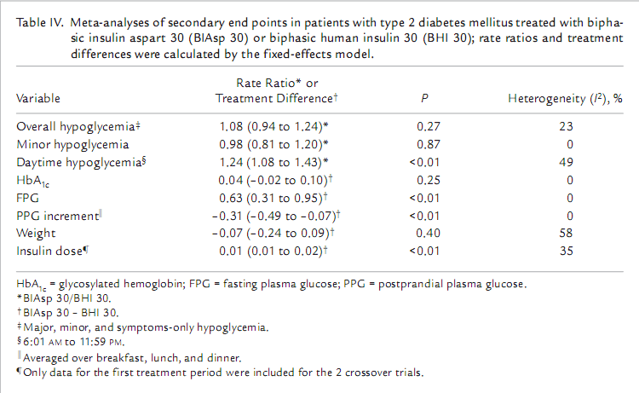

Slide 57
Key messages
This meta-analysis found BIAsp 30 to be associated with a significantly lower rate of nocturnal and major hypoglycemia, but a significantly increased risk for daytime hypoglycemia, compared with BHI 30 at a similar level of HbA1c in patients with T2DM.

Slide 58
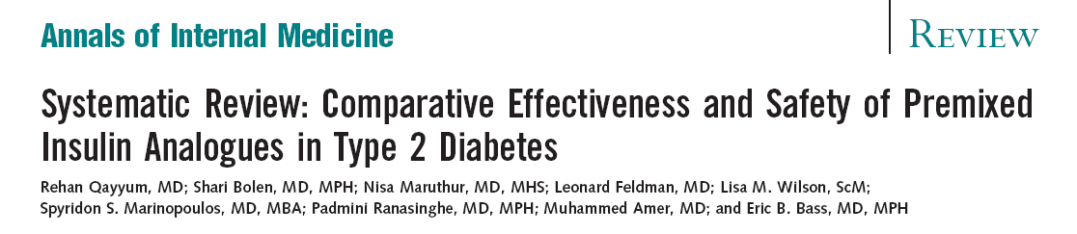
Ann Intern Med. 2008;149:549-559.

Slide 59
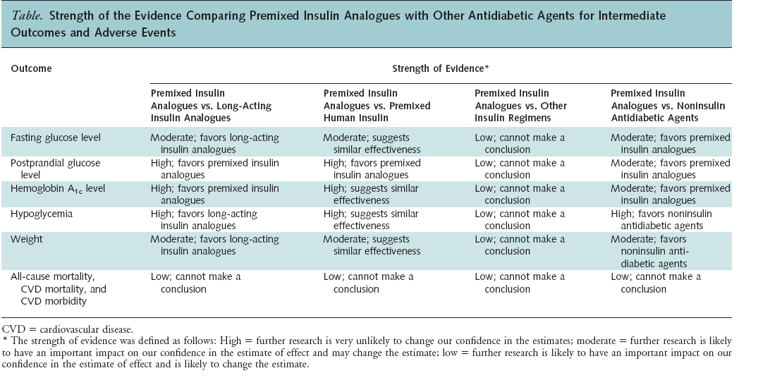

Slide 60
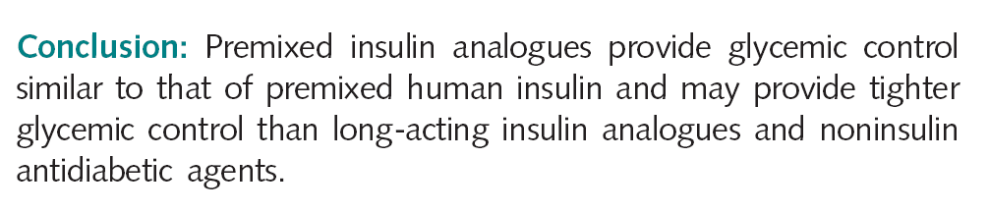

Slide 61
Premixed Vs. Basal

Slide 62
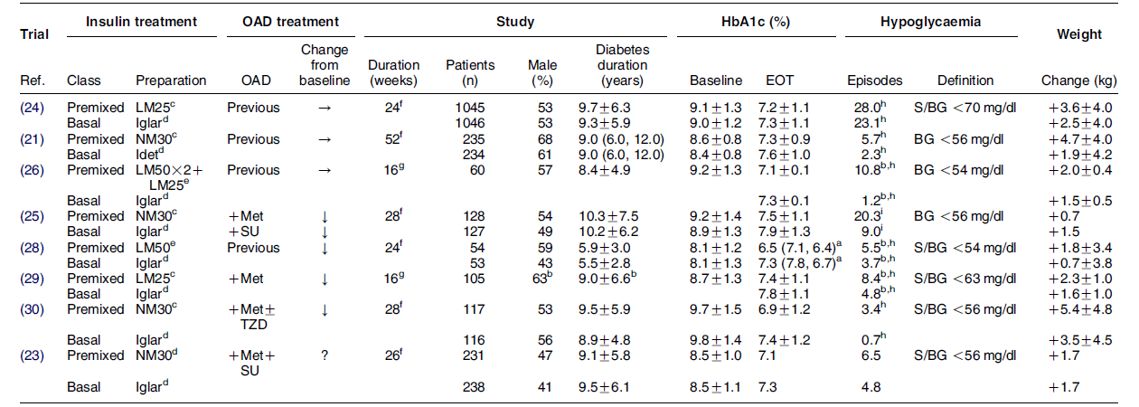
RCTs comparing basal and premixed insulin analogue regimens in previously insulin-naive patients with type 2 DM

Slide 63

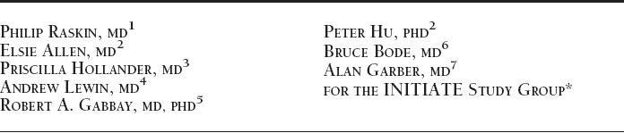
Diabetes Care 28:260–265, 2005

Slide 64
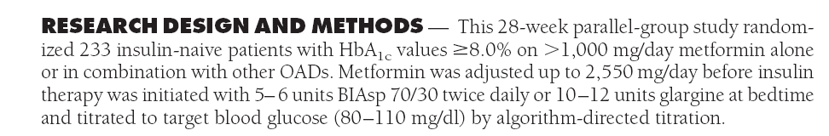

Slide 65
INITIATE: INITiation of Insulin to reach A1c TargEt
n = 233
Type 2 diabetes
on metformin +/- TZD
Glargine (12 U, bedtime) + metformin +/- pioglitazone
NovoMix® 30, pre-breakfast (6 U) and pre-dinner (6 U) + metformin +/- pioglitazone
4-week run-in:
Optimise metformin to ≥ 1500 mg/day
Switch rosiglitazone for 30 mg pioglitazone
-4 0 (Weeks) 28
Raskin P, et al. Diabetes Care 2005;28:260–265
Notes:
Raskin P, Allen E, Hollander P, Lewin A, Gabbay RA, Hu P, Bode B, Garber A; INITIATE Study Group. Diabetes Care 2005;28:260–265
Initiating insulin therapy in type 2 diabetes: a comparison of biphasic and basal insulin analogs
OBJECTIVE: Safety and efficacy of biphasic insulin aspart 70/30 (BIAsp 70/30, prebreakfast and presupper) were compared with once-daily insulin glargine in type 2 diabetic subjects inadequately controlled on oral antidiabetic drugs (OADs). RESEARCH DESIGN AND METHODS: This 28-week parallel-group study randomized 233 insulin-naive patients with HbA(1c) values >/=8.0% on >1,000 mg/day metformin alone or in combination with other OADs. Metformin was adjusted up to 2,550 mg/day before insulin therapy was initiated with 5–6 units BIAsp 70/30 twice daily or 10–12 units glargine at bedtime and titrated to target blood glucose (80–110 mg/dl) by algorithm-directed titration. RESULTS: A total of 209 subjects completed the study. At study end, the mean HbA(1c) value was lower in the BIAsp 70/30 group than in the glargine group (6.91 +/- 1.17 vs. 7.41 +/- 1.24%, P < 0.01). The HbA(1c) reduction was greater in the BIAsp 70/30 group than in the glargine group (-2.79 +/- 0.11 vs. -2.36 +/- 0.11%, respectively; P < 0.01), especially for subjects with baseline HbA(1c) >8.5% (-3.13 +/- 1.63 vs. -2.60 +/- 1.50%, respectively; P < 0.05). More BIAsp 70/30-treated subjects reached target HbA(1c) values than glargine-treated subjects (HbA(1c) </=6.5%: 42 vs. 28%, P < 0.05; HbA(1c) <7.0%: 66 vs. 40%, P < 0.001). Minor hypoglycemia (episodes/year) was greater in the BIAsp 70/30 group than in the glargine group (3.4 +/- 6.6 and 0.7 +/- 2.0, respectively; P < 0.05). Weight gain and daily insulin dose at study end were greater for BIAsp 70/30-treated subjects than for glargine-treated subjects (weight gain: 5.4 +/- 4.8 vs. 3.5 +/- 4.5 kg, P < 0.01; insulin dose: 78.5 +/- 39.5 and 51.3 +/- 26.7 units/day, respectively). CONCLUSIONS: In subjects with type 2 diabetes poorly controlled on OADs, initiating insulin therapy with twice-daily BIAsp 70/30 was more effective in achieving HbA(1c) targets than once-daily glargine, especially in subjects with HbA(1c) >8.5%.

Slide 66
INITIATE:
Treat-to-target with forced titration
FBG or pre-dinner SMBG (mg/dl) (mmol/l) |  | NovoMix® 30 dose adjustment | Glargine dose adjustment
< 80 | < 4.4 | −2 U | −2 U
80−110 | 4.4−6.1 | − | −
111−140 | 6.2−7.8 | +2 U | +2−4 U
141−180 | 7.83−10 | +4 U | +4−6 U
> 180 | > 10 | +6 U | +6−8 U
Raskin P, et al. Diabetes Care 2005;28:260–265

Slide 67
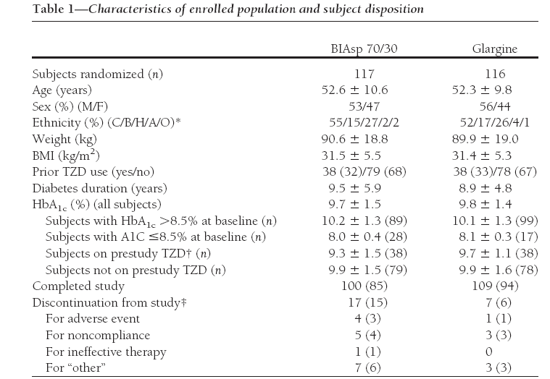

Slide 68
INITIATE: Improved blood glucose profiles with NovoMix® 30
NovoMix® 30
Week 28
14
Glargine
12
*
10
*
*
*
8
#
Blood glucose (mmol/l)
p < 0.05
6
p < 0.05
p < 0.05
p < 0.05
p < 0.05
4
0
Before
breakfast
Breakfast
+ 90
Before
lunch
Lunch
+ 90
Before
dinner
Dinner
+ 90
Bedtime
2.00 AM
Raskin P, et al. Diabetes Care 2005;28:260–265
Notes:
#at week 28, before breakfast BG values for glargine were significantly lower than in the NovoMix® 30 group (p = 0.0124)
*at week 28, BG values before lunch, before dinner, after dinner and at bedtime were significantly lower for NovoMix® 30 compared with glargine:
before lunch, p = 0.0002
before dinner, p = 0.0443
after dinner, p<0.0001
at bedtime, p<0.0001

Slide 69
INITIATE: Improved postprandial glucose with NovoMix® 30
* p < 0.05
** p < 0.01
Difference in prandial glucose increment between treatments (mmol/l)
1
NS
0.66
Favours glargine
0.5
0
-0.5
Favours
NovoMix® 30
-1
-0.59
*
-1.5
-1.17
-1.25
**
*
-2
Total mean prandial
glucose increment
-2.5
Breakfast Lunch Dinner
Raskin P, et al. Diabetes Care 2005;28:260–265
Notes:
For the total population, the mean prandial glucose increment (i.e., average taken for breakfast, lunch and dinner) was significantly less in patients treated with NovoMix® 30 than in those receiving Lantus.

Slide 70
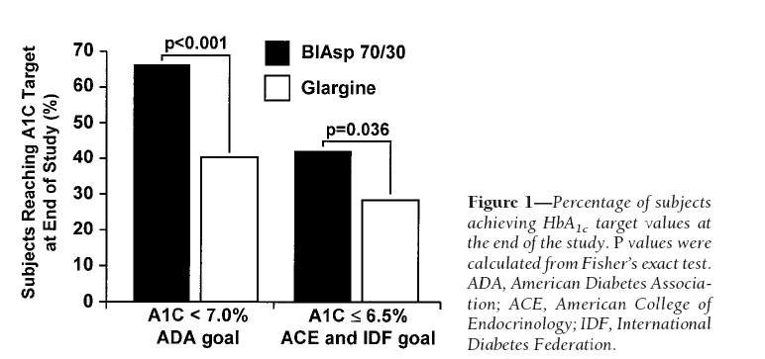

Slide 71
INITIATE:
Superior HbA_{1c} and comparable FPG with NovoMix® 30 vs. glargine
Greater reduction in HbA_{1c}
Comparable reduction in FPG
NovoMix® 30
n = 100
Glargine
n = 109
NovoMix® 30
n = 100
Glargine
(n = 109)
-2
0
-1
-2
Mean change HbA_{1c}%
-3
-2.5
-2.36
Mean change FPG (mmol/l)
-4
-5
-6
-2.79
-7
-3
-8
-6.94
-6.94
p = 0.0057
p = NS
End values HbA_{1c} (%):
NovoMix® 30 = 6.91
Glargine = 7.41
End values FPG (mmol/l)
NovoMix® 30 = 7.05
Glargine = 6.5
Raskin P, et al. Diabetes Care 2005;28:260–265
Notes:
At 28 weeks, the mean A1C value in the NovoMix® 30 group was lower than in the glargine group for the 171 patients completing the study to date
More NovoMix® 30-treated patients reached target A1C values 6.5% and <7.0% than did glargine-treated patients
The following models are used to calculate the p-values for EOS and EOS-baseline values, respectively:
EOS = baseline + treatment
EOS-baseline = baseline + treatment
Both models yield identical p-values when adjusting for baseline difference

Slide 72
INITIATE
Insulin doses at the end of the study were greater for the BIAsp 70/30 group than for the glargine group (total units: 78.5±39.5 vs. 51.3±26.7 units; for units by weight, 0.82± 0.40 vs. 0.55 ± 0.27 units/kg, P< 0.05)
weight gain was significantly greater in the BIAsp 70/30 group (5.6± 4.6 vs. 3.0 ± 4.3 kg, BIAsp 70/30 vs. glargine, respectively; P< 0.01)

Slide 73
INITATE
Minor hypoglycemia (episodes/year) was greater in the BIAsp 70/30 group than in the glargine group (3.4 ± 6.6 and 0.7± 2.0, respectively; P < 0.05)
Minor hypoglycemia was reported by 43% of subjects in the BIAsp 70/30 group and by 16% of subjects in the glargine group (P< 0.05)

Slide 74
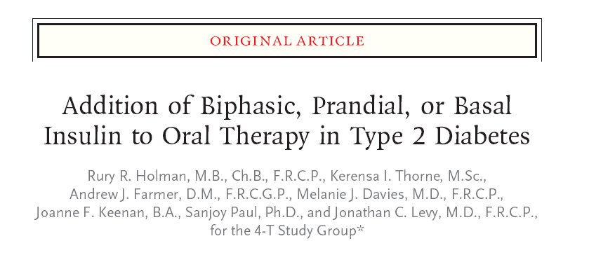
N Engl J Med 2007;357:1716-30.

Slide 75
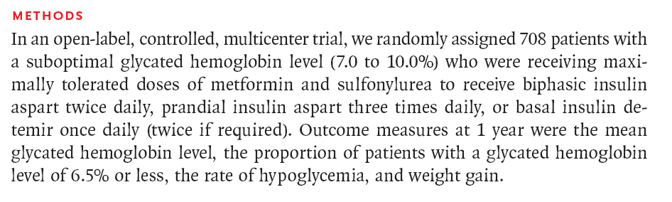

Slide 76
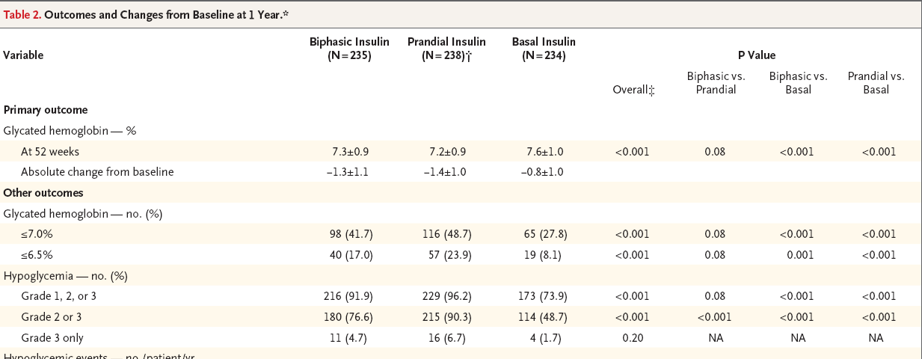

Slide 77
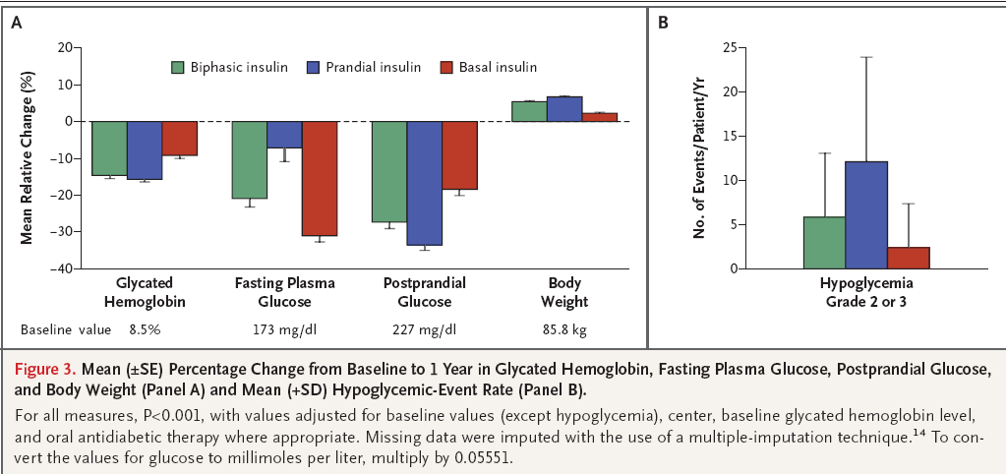

Slide 78
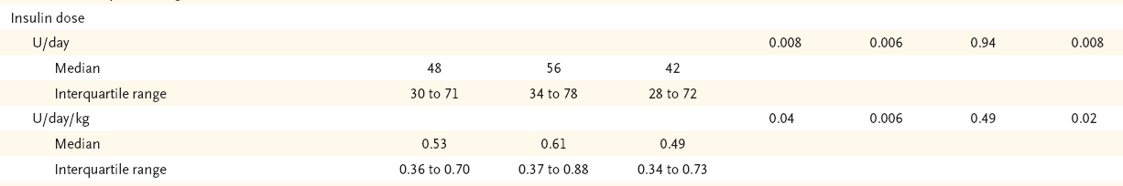

Slide 79
Key messages
A single analogue-insulin formulation added to metformin and sulfonylurea resulted in a glycated hemoglobin level of 6.5% or less in a minority of patients at 1 year.
The addition of biphasic or prandial insulin aspart reduced levels more than the addition of basal insulin detemir but was associated with greater risks of hypoglycemia and weight gain.
Basal insulin was equivalent to the other regimens after the first year in patients with a glycated hemoglobin level of 8.5% or less at the initiation of the study

Slide 80
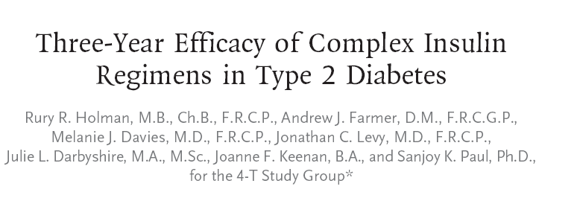
N Engl J Med 2009;361:1736-47.

Slide 81
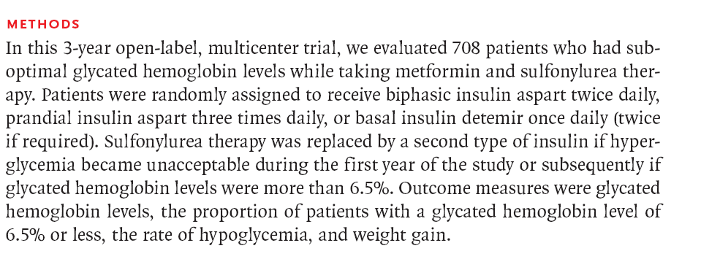

Slide 82
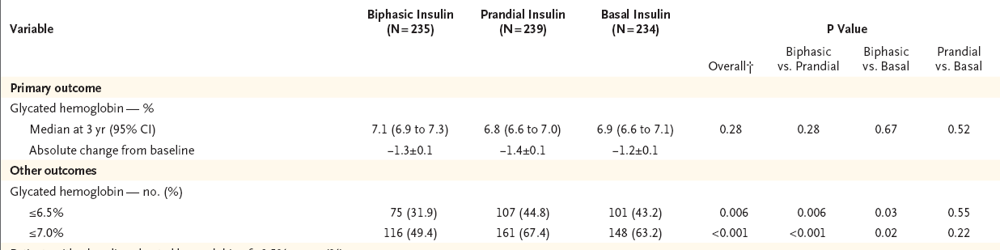

Slide 83
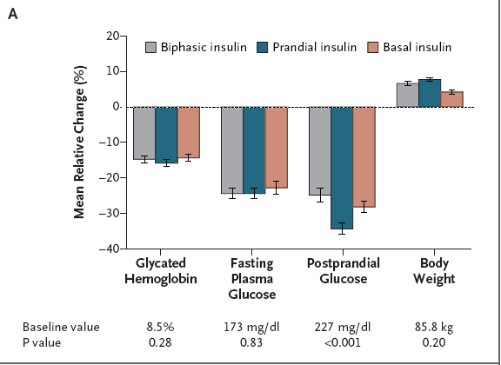

Slide 84
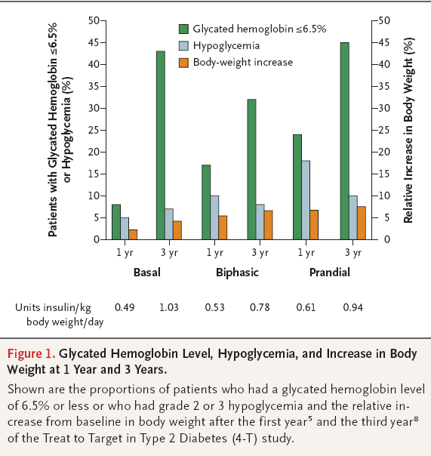

Slide 85
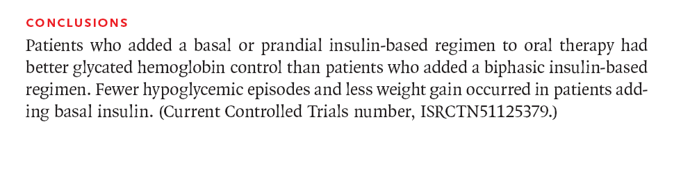

Slide 86
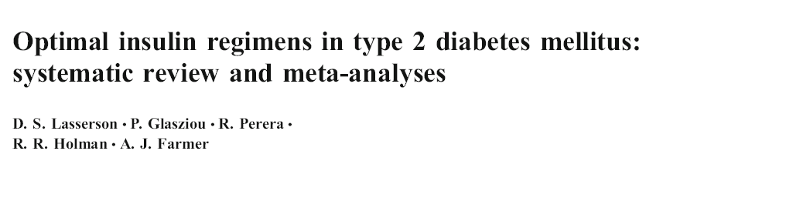
Twenty-two trials that randomised 4,379 patients were included.
Majority of them were shot term trials
High rate of heterogenity
Diabetologia (2009) 52:1990–2000

Slide 87
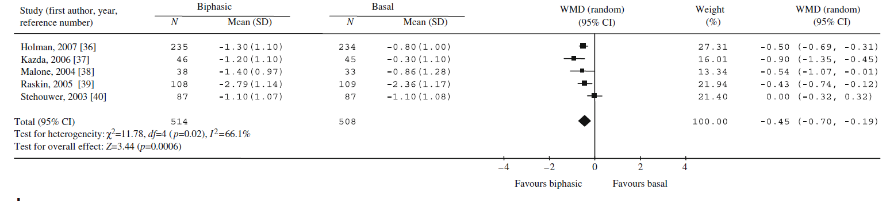
HbA1c
Biphasic insulin reduced HbA1c by a further 0.45% (95% CI 0.19–0.70)

Slide 88
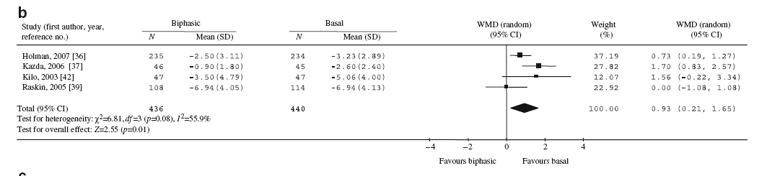
Fasting SMBG
Compared with biphasic insulin, basal insulin reduced fasting (SMBG) by a further 0.93 mmol/l (95% CI 0.21–1.65)

Slide 89
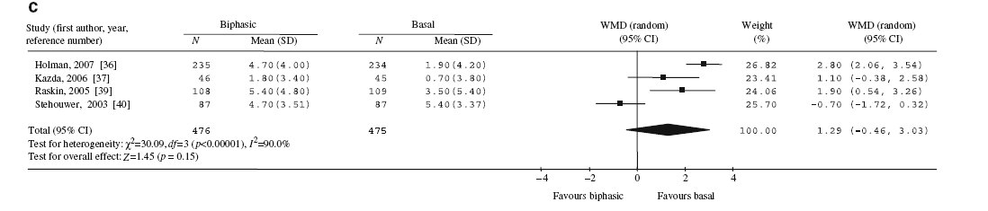
Weight
Compared with basal insulin, biphasic insulin was associated with a non-significant greater weight increase of 1.29 kg (95% CI −0.43, 3.03, p=0.15)

Slide 90
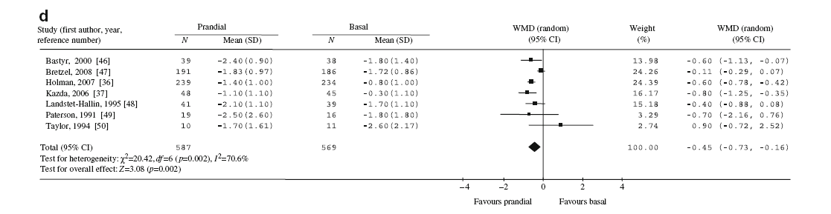
HbA1c

Slide 91
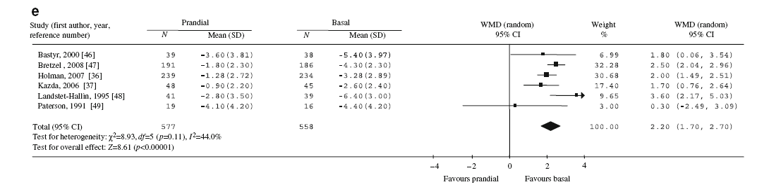
Fasting SMBG

Slide 92
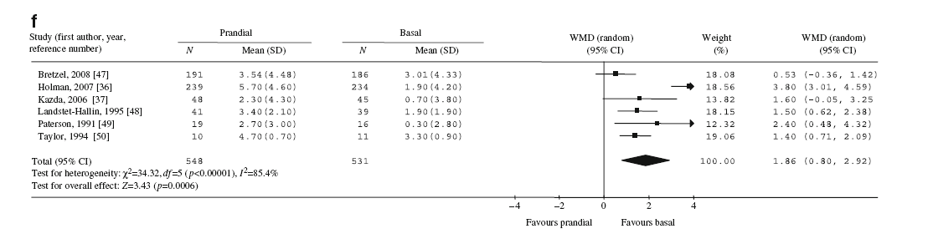
Weight

Slide 93
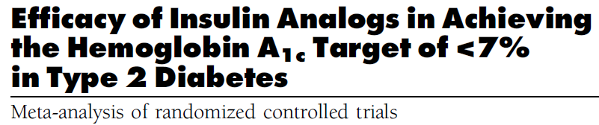
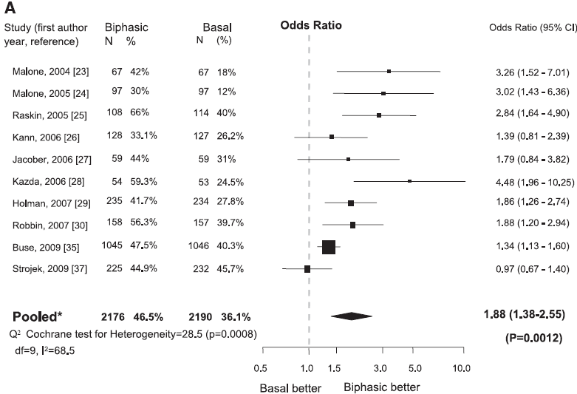
2
Diabetes Care 34:510–517, 2011

Slide 94
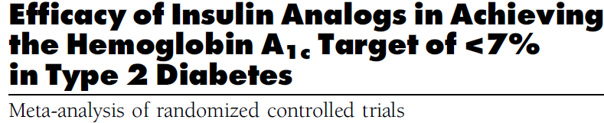
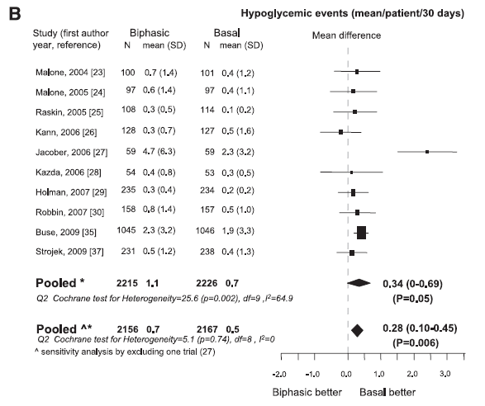

Slide 95
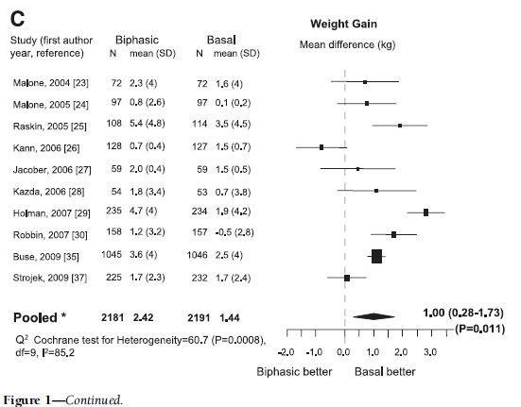

Slide 96


Slide 97


Slide 98

Editorial
NEJM 361;18 october 29, 2009

Slide 99

To assess the efficacy and safety of biphasic insulin aspart 70/30 (BIAsp 30) and insulin glargine, administered once daily in subjects with type 2 diabetes inadequately controlled with oral anti-diabetic drugs( Mean HBA1C at baseline 8.5%)
Curr Med Res Opin 2009; 25:2887–94

Slide 100


Slide 101
Results
In both treatment groups, approximately 45% of subjects achieved HbA1c<7.0%, and 25% of subjects achieved HbA1c < 6.5%
Reduction of HbA1c by >1% was achieved by 60% in the BIAsp 30 group and by 57% in the insulin glargine group

Slide 102

BIAsp 30 – insulin glargine = -0.16, 95% CI [-0.30; -0.02], p < 0.029)
7.1% vs. 7.3 %

Slide 103

No difference was observed between the treatments with respect to the proportion of subjects who achieved an HbA1c level of <7.0% without any major or minor hypoglycemia

Slide 104


Slide 105
Key messages
With respect to HbA1c, BIAsp 30 fulfilled the statistical criteria for non-inferiority and superiority to insulin glargine and, according to pre-defined criteria, the improvements in HbA1c are considered clinically equivalent
Subjects had an increased risk of minor nocturnal hypoglycemia with BIAsp 30

Slide 106
Unresolved issue
Are there patients who would benefit more from a premixed insulin analogue regimen than from a basal insulin analogue regimen or the reverse?

Slide 107

This analysis aimed to determine if measurable clinical characteristics prior to starting insulin could predict differences in improved glycemic control between these options
Current Medical Research & Opinion Vol. 26, No. 7, 2010, 1621–1628

Slide 108


Slide 109


Slide 110

Endpoint = HbA1c
In older individuals with higher bedtime PG, BIAsp 30 appeared to be more beneficial. In contrast, basal insulin appeared to be a better choice in younger individuals with lower bedtime PG

Slide 111

Endpoint = FPG
Basal insulin appeared to achieve better FPG in patients with lower BMI and higher post-breakfast PG while BIAsp 30 appeared to be better in patients with higher BMI and lower post-breakfast PG

Slide 112

Endpoint = PPG
The model demonstrated that there were fewer differences in mean average PPG between treatments in younger patients; however, in older patients, average PPG values were lower with BIAsp 30 than with basal insulin.

Slide 113
Key messages
Premix analog rather than basal insulin may be an appropriate choice to target HbA1c values in older individuals and those with higher bedtime PG, while basal insulin may be more appropriate to target FPG in patients with lower BMI and higher post-breakfast PG.

Slide 114

To compare the durability of glycemic control of twice-daily insulin lispro mix 75/25 and once-daily insulin glargine, added to oral antihyperglycemic drugs in type 2 diabetes patients
A 30-month,randomized, multicenter, multinational, open-label, two-arm, parallel study conducted at 242 centers in 11 countries
The trial enrolled 2091 insulin-naïve patients with type 2 diabetes, aged 30–80 years, A1C .7.0%
Diabetes Care 34:249–255, 2011

Slide 115


Slide 116


Slide 117
Results
A1C goal was maintained in 202 LM75/25-treated patients (43%) and in 147 glargine-treated patients (35%),P = 0.006

Slide 118

Median time of maintaining the A1C goal was 16.8 months for LM75/25 and 14.4 months for glargine (P = 0.040)

Slide 119

A1C reduction was greater in LM75/25-treated patients (21.6 ±
1.2%) versus glargine (21.4 ±1.2%, P = 0.017) and was lower with LM75/25 (7.1 ± 0.8%) than with glargine (7.2 ±0.8%, P = 0.017)

Slide 120

Early insulinization seems to be important

Slide 121

Early insulinization seems to be important

Slide 122


Slide 123
Results
After adjusting for baseline A1C, gender, thiazolidinedione, sulfonylurea use, HOMA-B, HOMA-IR, diabetes duration, and country, LM75/25-treated patients were more likely than glargine-treated patients to maintain the A1C goal longer, with a hazard ratio of losing glycemic control of 0.78 (95% CI 0.66–0.93;P = 0.010).

Slide 124
Safety
There was no difference between groups in overall, nocturnal, or severe hypoglycemia
LM75/25 patients had more weight gain (5.4 ± 5.8 vs. 3.7 ± 5.6kg) from baseline

Slide 125
Key messages
A modestly longer durability of glycemic control was achieved with LM75/25 compared with glargine
Patients with lower baseline A1C levels were more likely to maintain the goal, supporting the concept of earlier insulin initiation

Slide 126
Premixed Vs. Basal Bolus

Slide 127

To test the hypothesis: advancing insulin therapy with premixed insulin is noninferior to basal–bolus therapy (BBT) in patients with type 2 DM unable to achieve an HbA1c level ≤7.0% after 6 months of starter insulin therapy
Clinical Therapeutics/Volume 32, Number 5, 2010

Slide 128




Slide 129


Slide 130
Key message
The results suggest that premixed therapy, dosed 2 times per day (LM75/25) or 3 times per day (LM50/50), was noninferior to BBT (4 injections/d) in this population of adult patients with type 2 DM previously uncontrolled with OADs plus basal insulin or twice-daily premixed insulin
However, most patients (>80%) in this substudy did not achieve an HbA1c value <7.0% so it is difficult to interpret the clinical meaning of the noninferiority of the regimens

Slide 131

To compare two analog insulin therapies (prandial premixed therapy [PPT] versus basal/bolus therapy [BBT]) in type 2 diabetic patients previously treated with insulin glargine (30 units/day) plus oral agents, with the aim of demonstrating noninferiority of PPT to BBT.
Multicenter, open-label, noninferiority trial with 24-week of F/U
Diabetes Care 31:20–25, 2008

Slide 132


Slide 133

Noninferiority of PPT to BBT was not demonstrated based on the prespecified noninferiority margin of 0.3%.

Slide 134

The percentages of patients achieving target A1C 7.0% (PPT versus BBT, respectively) were 54 vs. 69% (P<0.009) and for target 6.5% were 35 vs. 50% (P< 0.01)

Slide 135
Key messages
Both insulin regimens demonstrated a clinically meaningful ability to improve glycemic control, although, based on the prespecified margin, noninferiority of PPT compared with BBT was not demonstrated
Rates of hypoglycemia were similar for both groups

Slide 136

To compare the efficacy and safety of an intensified insulin regimen, using insulin glargine (glargine) once daily and pre-meal insulin glulisine (glulisine) (basal-bolus), with a conventional therapy, using premixed insulin (premix) twice daily.
Open-label, randomized, multinational, multicentre trial included 310 subjects with type 2 diabetes with 52 week F/U

Slide 137


Slide 138


Slide 139


Slide 140


Slide 141


Slide 142
Key message
An intensified basal-bolus regimen using glargine/glulisine results in a significantly superior glycemic control vs. premix therapy in a population with long-standing insulin-treated T2D, with no increase in the rates of hypoglycaemia

Slide 143

Design: Retrospective cohort (Data were from >350 general practices from the United Kingdom)
Objective :To determine whether there were differences in HbA1c , weight change, hypoglycemia occurrence, and treatment discontinuation between patients treated with BIAsp-30 or BHI-30 in UK general practice
Clin Ther.2011;33:27–35)

Slide 144

Baseline Characteristics

Slide 145

The difference in HbA1c reduction was greater among those treated with BIAsp-30 compared with BHI-30 in all groups

Slide 146

No statistically significant differences in weight change in any cohort between BIAsp-30 and BHI-30

Slide 147

Incidence rate ratio for hypoglycemia was statistically significant in insulin-naive patients with type 2 DM (0.74; 95% CI, 0.62–0.89)

Slide 148

Adjusted HR for treatment discontinuation with BIAsp-30 vs. BHI-30 was significant in insulin-experienced patients with type 2 diabetes (0.693; 95% CI, 0.543–0.884)

Slide 149
Key message
BIAsp-30 was associated with improved HbA1c compared with BHI-30 in insulin-naive patients with type 1 or type 2 diabetes and insulin-experienced patients with type 2 diabetes
BIAsp-30 was associated with reduced hypoglycemia in insulin-naive patients with type 2 diabetes and lower rates of treatment discontinuation in insulin-experienced patients with type 2 diabetes

Slide 150

…We suggest that, in some patients, the glycaemic benefits of biphasic or prandial insulin regimens outweigh the risk of hypoglycaemia and these regimens should be positioned as alternatives for initial insulin therapy according to an individualized approach…..

Slide 151
Premix analogous
Initial insulin therapy ?
Insulin intensification

Slide 152
OAD Failure
Basal Insulin ± OAD OR premix insulins
*Insulin intensification
Premixed Human or Analogue
Basal Bolus
*Preferred based on effectiveness and expense

Slide 153
Guidelines

Slide 154


Slide 155


Slide 156

Glycemic targets and glucose-lowering therapies must be individualized
Diabetes Care Publish Ahead of Print, published online April 19, 2012

Slide 157
Individualization of treatment
Recommendation should be considered within the context of the needs, preferences, and tolerances of each patient
Recommendations are less prescriptive than and not as algorithmic as prior guidelines

Slide 158
In an international survey16 and a clinical practice review,17 PCPs and diabetes specialists reported that insulin initiation was prevented by lack of:
■ time required to train patients
■ clear guidelines and definitions
■ support, as represented by Certified Diabetes Educators
experience in taking a proactive role in insulin initiation
■ coordination of care between PCPs and endocrinologists
■ motivation

Slide 159
Basal insulin analogs have pharmacokinetic and pharmacodynamic advantages over NPH insulin—namely,
a less pronounced peak effect,
less variable absorption profiles,
and a longer duration of action
Insulin analogs are also associated with lower rates of hypoglycemia, particularly nocturnal hypoglycemia, compared with NPH, which may at least partly offset the overall higher treatment costs related to insulin analogs

Slide 161
For most patients basal insulin analogs, the average insulin dose is <50 U/d.
Targeting FBG levels first will solve most glycemic control problems in patients with T2DM
if HbA1c levels are still in excess of 8.5%, reductions in both FBG levels and postprandial glucose levels may be required to achieve the glycemic goal.

Slide 162
Starting Basal Insulin:Fix the Fasting First
“Overbasalization”: Too Much Basal
Insulin, Too Little Effect

Slide 163
Overbasalization occurs when FBG is not controlled with up-titration of basal insulin and HbA1c targets remain elusive.
Providers must understand the concept of overbasalization because it should trigger progression to mealtime insulin intensification in patients.

Slide 164
Maximal amounts of basal insulin can be achieved but should not comprise more than 50% of the total daily insulin calculation.
Violating 50/50 rule may lead to overbasalization.
At this point, administering additional basal insulin may change the pharmacokinetics of the basal insulin from having a profile without pronounced peaks of activity to a profile with an insulin peak

Slide 166
Adding to Basal Insulin:
A Stepwise Approach
Rapid-acting insulin analogs closely mimic physiologic meal-stimulated insulin release, with faster absorption, higher maximum concentration, shorter duration, and a lower risk of hypoglycemia than regular insulin.
Rapid-acting premixed insulin analogs—such as biphasic insulin aspart 30 (30% soluble insulin aspart and 70% protamine-crystallized insulin aspart)—have been developed, which can prevent excessive postprandial glucose levels whether injected at the beginning of a meal or 15 to 20 minutes after starting a meal.

Slide 167
During mealtime insulin intensification, the patient continues to receive basal insulin therapy but also administers a rapid-acting insulin at the largest meal of the day to manage glucose excursions after meals.

Slide 169


Slide 170
It is important to check glucose levels just before the first bite of the meal and 2 hours after the meal to assess the effectiveness of the mealtime insulin and to provide guidance for further insulin titration.
There is no absolute need for carbohydrate counting with this method.

Slide 171
Stepwise approach to insulin intensification may lead to less hypoglycemia than premixed insulin, with similar proportions of patients achieving the glycemic control goal of HbA1c levels below 7%, as well as lower blood glucose levels.

Slide 172
Insulin bolus dose adjustment
Insulin-Carbohydrate ratio (ICR):
It calculates how much bolus units are required for each unit of carbohydrate.
ICR= Total daily dose (TDD) ÷ 30
Example: TDD=60, ICR = 60 ÷ 30 = 2
It means that each unit of carbohydrate requires 2 units of regular insulin
Gabric

Slide 173
Insulin Sensitivity Factor (ISF)
Calculates how much blood glucose decreases for each unite of bolus insulin
ISF (For human insulin)= 1500 ÷ TDD
ISF (For analogue insulin)= 1800 ÷ TDD
Example: TDD= 50 (human insulin), ISF = 1500 ÷ 50 = 30
It means that each unit of bolus decreases blood glucose by 30 mg/dl
Gabric

Slide 174
Bolus dose calculation
Carbohydrate counting of the meal:
Number of units of carbohydrate in the meal × ICR
Example: 10 spoon of rice + 1 apple = 3 units of carbohydrate, ICR = 2.
Bolus dose required for the meal = 3 × 2 = 6 units
Gabric

Slide 175
Pre-prandial blood glucose
Correction dose = Pre-prandial glucose – desired blood glucose ÷ ISF
Example: Pre-prandial glucose 230, correction dose= 230 – 130 ÷ 50 = 2
It means that 2 units of bolus are required to correct pre-parandial hyperglycemia
Total number of bolus = 6 + 2 = 8 units
Gabric

Slide 176
Another option for intensifying a basal regimen
Is to add a dose of a rapid-acting analogue with the biggest meal, e.g., a dose of 0.1 U/kg (6 U is a good approximation).
The basal insulin dose may need to be decreased by an equivalent amount

Slide 177
Initiation & titration of prandial insulin
Can usually begin with ~4 units
Adjust by 2 units every 3 days until plasma glucose
is in range
When prandial insulin is started, insulin secretagogues (SU or glinides) should be discontinued
Nathan DM, et al. Diabetes Care 2009;32 193-203.
Notes:
177
Key Point
For the second injection, physicians can begin with approximately 4 units of insulin and adjust by 2 units every 3 days until blood glucose is in range.
Reference:
Nathan DM et al. Management of hyperglycemia in type 2 diabetes: a consensus
algorithm for the initiation and adjustment of therapy. Diabetes Care 2006;29(8):1963-72.

Slide 178


Slide 179


Slide 180


Slide 181
Insulin regimens
The most precise and flexible prandial coverage is possible with “basal-bolus” therapy, involving the addition of premeal rapid-acting insulin analog to ongoing basal insulin
A second, perhaps more convenient but less adaptable method involves “premixed” insulin, consisting of a fixed combination of an intermediate insulin with regular insulin or a rapid analog
In comparison with basal insulin alone, premixed regimens tend to lower HbA1c to a larger degree, but often at the expense of slightly more hypoglycemia and weight gain

Slide 182
Premixed regimen
This strategy may be appropriate for certain patients who eat regularly and may be in need of a simplified approach beyond basal insulin
Disadvantages: inability to titrate the shorter- from the longer-acting component

Slide 183
Pros and cons of premixed analogue
No need for self mixing
Minimizing dosing error
Less injections (attractive alternative to basal bolus)
  Dosing immediately before or after meal
  Less flexibility
  cost

Slide 184
Pros and cons of premixed analogue
Higher FPG
Lower PPG
Lower HbA1C
More weight gain
More minorhypoglycemia

Slide 185
Conclusion
Individualization of treatment is the cornerstone of success

Slide 186
Case Presentations

Slide 187
Case 1
Ms. Hosseini

Slide 188
History
A 58- year- old women comes to see you for diabetes review. She has had type 2 diabetes for 8 years. She attended the local T2DM education programme at diagnosis.
Despite lifestyle modification, her BMI is 28
She is taking MFN 2g /daily , Gliclazide 320 mg/daily (good compliance) , atorvastatin 20 mg and ASA 80 mg
FBS 155 mg/dl ,HbA1c 8.5% , SMBG ?
No microalbuminuria , beginning of retinopathy, no cardiovascular complication
BP= 125/75 mmHg

Slide 189
What would you do next?
Life style intensification
Prescribe Pioglitazone
Prescribe Basal Insulin
Prescribe premixed insulin
Prescribe prandial insulin

Slide 190
Case 2
Mr. Mohamadi

Slide 191
Demography | Male; aged 63
Height & weight | Height: 164cm Weight: 60 kg BMI: 22.3 kg/m²
Medical history | Hypertension MI 2 years ago
Family history | Hypertension and MI in both parents Mother died of CVA at age 60
Treatment | Metformin 500 mg BID; Glibenclamide 20 mg/day; pioglitazone 15 mg OD
Glycaemic control | T2DM diagnosed 6 years ago Most recent HbA_{1c}: 8.8% (3 months ago) Past HbA_{1c}: 8.8% six months ago; 7.9% 1 year ago

Slide 192
More information
Mr Mohamadi is a farm laborer and is therefore very active
He has limited time for lunch but eats a large breakfast, snacks throughout the day when he is able and then eats a large but healthy evening meal
  You have asked him to test his blood sugar frequently over the next 2 weeks in order to get a sense of his pre- and post-meal glucose values
He is motivated to get his blood sugar under control because he finds that he is frequently tired and struggles with his physically demanding job when his blood sugar is high
He is willing to try insulin as he understands that there are limited OAD options left to consider

Slide 193
SMBG
Fasting | Post-Bfast | Before lunch | Post lunch | Before dinner | Post dinner | Before bedtime | HdA1c%
140 | 280 | 155 | 170 | 130 | 265 | 155 | 8.8%
135 | 275 | 150 | 160 | 140 | 250 | 160
Values are mg/dl

Slide 194
What is your recommendation?
Start the patient on basal insulin
Start the patient on BIAsp 30 OD
Start the patient on BIAsp 30 BID
Start the patient on basal-bolus
therapy

Slide 195
INITIATING INSULIN WITH PREMIXED
ANALOGUES
Aonce-daily regimen in cases where hyperglycemia is not severe, or with a twice-daily regimen when HbA1c values are> 8.5%.
When 1 injection is used, the oral antidiabetic drugs are maintained, but when starting with a twice-daily regimen sulfonylureas can be stopped.
When an analogue mix is used once daily it is typically added before the evening meal
In the 1-2-3 Study, the addition of predinner premixed analogue insulin to oral antidiabetic drugs allowed 41% of patients to attain HbA1c levels 7.0% in only 16 weeks

Slide 196
To start an analogue mix;
For once daily, the patient begins on 12 U before the evening meal and patient increases the insulin by 2 U every 3 days until fasting blood glucose is <110 mg/dL.
To use the twice-daily regimen, 6 U of analogue mix are started at breakfast and dinner ; then
The patient is told to titrate up the predinner dose first, using fasting glycemia as the end point, by adding 2 U every 3 days until fasting blood glucose is <110 mg/dL. Thereafter, the morning dose is increased by titrating against the predinner glucose. The patient increases the dose by 2 U every 3 days until the predinner glucose is also 110 mg/dL

Slide 197
Practical Strategy to Implement a Multi-Injection Insulin Regimens
Dose Calculation
  Split-mixed regimen in obese patients uses 70/30 premixed insulin with an initial total daily dose (0.4-0.8 u/kg) equally split between the prebreakfast and predinner meals
  Lower doses (total daily dose 0.2-0.5 u/kg) in thin patients
Dose Adjustment
  Dose is increased by 2-4 u increment every 3-4 days until the morning FPG and predinner blood glucose concentration are consistently in the range of 80-120 mg/dL

Slide 198
Case 3
Mr Ahmadi

Slide 199
History
A 60-year-old man comes to you with history of type 2 DM for 9 years.
PMH : MI, CHF
Two main complaints were increasing arthritis in his hands and decreasing vision due to cataracts.
Medications : Aspirin, Statin, Captopril, Glibenclamide 10 mg/dl, Metformin 2000mg/dl
BMI =31 Kg/m2. No evidence of nephropathy
Laboratory findings : LDL = 60 mg/dl, TG=270 mg/dl, HBA1C=8.2%

Slide 200
History..
SMBG records revealed a fairly flat curve of moderate hyperglycemia throughout the day with blood glucose values between 160 and 230 mg/dL, reflecting her 3 balanced meals.
He has severe fear from insulin therapy and weight gain

Slide 201
SMBG
Fasting | Post Bfast | Before lunch | Post lunch | Before dinner | Post dinner | Bedtime | HbA1c
160 | 220 | 140 | 230 | 150 | 210 | 140 | 8.2%
155 | 210 | 135 | 220 | 145 | 230 | 150
Values are mg/dl

Slide 202
What is your recommendation?
1-Add pioglitazone
2-Add basal insulin at bedtime
3-Add basal-bolus therapy
4-Add biphasic insulin

Slide 203
Case 4
Mr. zare

Slide 204


Slide 205
More information
Over the past 6 months you have increased Mr. zare dose of insulin from 0.4 U/kg to 0.8 U/kg which has resulted in improved glycemic control by also reports of several episodes of nocturnal hypoglycemia
Mr. zare does not like to be regimented and considers insulin injections and blood glucose monitoring a bother. Blood glucose control has been suboptimal over these past 2 years, but you have finally convinced him that a change in his insulin regimen is required.

Slide 206

SMBG
HbA1c 9.1%

Slide 207
What would you do next?
Start the patient on BIAsp 30 OD
Start the patient on BIAsp 30 BID
Start the patient on basal-bolus
therapy

Slide 209
Conclusion
The reduced frequency of insulin injections and glucose monitoring, associated with its inherent simplicity, has led to put the basal insulin regimen as the first option in initiating insulin therapy in recent guidelines .
Basal insulin was unable for reaching the <7% HbA1c target in about 60% of patients starting with basal insulin.

Slide 210
Conclusion
The escalation in insulin regimens (from the simple basal to the complex basal-bolus) may result in a further gain of success rate, ranging roughly from 12% to 14%, which still leaves many patients not at goal???

Slide 211
Practical Guideline on
Changing Human Insulin to
Basal Analogue
August 2013
Special thanks to the board of experts: (alphabetical order)
Dr. A. Aminorroaya
Dr. M. Afkhami Ardakani
Dr. A. Bahrami
Dr. A. Esteghamati
Dr. F. Hadaegh
Dr. F. Hossein Panah
Dr. ME. Khamseh
Dr. M. Malek
Dr. Z. Mousavi
Dr. M. Niafar
Dr. Gh. Pishdad
Dr. M. Sanjari

Slide 212
Special thanks to the board of experts: (alphabetical order)
Dr. A. Aminorroaya
Dr. M. Afkhami Ardakani
Dr. A. Bahrami
Dr. A. Esteghamati
Dr. F. Hadaegh
Dr. F. Hossein Panah
Dr. ME. Khamseh
Dr. M. Malek
Dr. Z. Mousavi
Dr. M. Niafar
Dr. Gh. Pishdad
Dr. M. Sanjari

Slide 213
Once Daily NPH ± OADs
NPH Once daily
± OADs
HbA1c on Target
HbA1c > Target
Fasting Controlled
(90-130 mg/dl)
Uncontrolled Fasting
(≥ 130 mg/dl)
Lantus +10% dose increase*
Lantus 1/1
+1 Prandial (based on SMBG)
Lantus 1/1
* In case of HbA1c< 8.5%, titrate basal insulin.
In HbA1c ≥ 8.5%: Consider prandial insulin based on SMBG.

Slide 214
Twice daily NPH ± OADs
NPH Twice Daily ± OADs
HbA1c on Target
Lantus: 80% of NPH total daily dose
HbA1c > Target
Fasting Controlled
(90-130 mg/dl)
Uncontrolled Fasting
(≥ 130 mg/dl)
Lantus:1/1 NPH total daily dose
± 1 Prandial (based on SMBG)*
Lantus: 80% of NPH total daily dose and titrate, then
+ 1 Prandial (based on SMBG)
* In case of HbA1c< 8.5%, titrate basal insulin.
In HbA1c ≥ 8.5%: Consider prandial insulin based on SMBG.
214

Slide 215
NPH /Regular Twice Daily (Self-Mix) ± OAD
NPH/Regular Twice daily
HbA1c on Target*
Fasting Controlled
(90-130 mg/dl)
Fasting Uncontrolled (≥ 130)
Lantus: 80% NPH total daily dose
+ Prandial (based on SMBG)
Lantus: 80% of NPH total daily dose
± Prandial (based on SMBG)
Lantus: 1/1 of NPH total daily dose
± Prandial (based on SMBG)*
HbA1c > Target
Switch recommended in case of patient preference or hypoglycaemia.
* In case of HbA1c< 8.5%, titrate basal insulin.
In HbA1c ≥ 8.5%: Consider prandial insulin based on SMBG.
215

Slide 216
Thank you for your attention!

Slide 217

INITIATION

Slide 218

Start and stay with NovoMix® 30
NovoMix® 30 Summary of Product Characteristics.
Garber A et al. The 1-2-3 study. Diabetes, Obesity and Metabolism 2006; 0: 1–10.
Raskin P et al. On behalf of the INITIATE Study Group. Basal insulin or premix analogue therapy in type 2 diabetes patients. Euro J Int Med 2007; 18: 56–62.

Slide 219


Slide 220

Staying on NovoMix® 30
Intensification from NovoMix® 30 twice daily to three times daily:
Add 2-6 units or 10% of total daily dose of NovoMix® 30 before lunch

Slide 221
INTENSIFICATION

Slide 222
Step up with NovoMix® 30
When Basal Insulin is no longer enough

Slide 223
NovoMix® 30: A consensus statement
Simple algorithms for intensification
Basal insulin OD or BID
HbA1c 7-8%
HbA1c > 8.0%
FPG > 6mmol/L
(FPG > 110 mg/dL)
FPG: 4-6 mmol/L
(FPG > 73-110 mg/dL)
Titrate basal to achieve FPG <6 mmol/L
(110 mg/dL)
Switch TO BIAsp 30 BID
*If recurrent hypoglycaemia limits up-titration of the basal dose, or the daily dose reaches 0.5 U/kg (insulin units per kg body weight), switching to BIAsp 30 twice daily can be considered

Slide 224
Switching from basal insulin OD or BID to BIAsp 30 BID
1:1 total dose transfer to BIAsp 30
Split the dose 50:50 pre-breakfast and pre-dinner
Titrate the dose preferably once a week
Discontinue sulfonylureas (SUs)
Continue metformin
Consider discontinuing thiazolidinediones (TZDs) as per local guidelines and practice
Administer BIAsp 30 just before meals

Slide 225
NovoMix® 30: A consensus statement
Simple algorithms for intensification
BIAsp 30 OD (pre-dinner) or BIAsp 30 BID
FPG and/or pre-dinner BG: 4–6 mmol/L
(73-110 mg/dL)
FPG and/or pre-dinner BG >6 mmol/L (110 mg/dL)
Titrate BIAsp 30 OD or BID to achieve FPG and/or pre-dinner BG <6 mmol/L
(110 mg/dL)
HbA_{1c} >7%
If hypoglycaemia occurs
Switch to BIAsp 30 BID or TID
Unnikrishnan et al. Int J Clin Pract 2009: 63(11):1571-77

Slide 226
Switching from BIAsp OD to BID, or BID to TID
OD to BID
BID to TID
    Add 2–6 U or 10% of total daily BIAsp 30 dose before lunch
    Down-titration of morning dose (−2 to 4 U) may be needed after adding the lunch dose
    Titrate the doses preferably once a week according to the algorithm below
    Continue metformin
    Consider discontinuing TZDs as per local guidelines and practice
    Administer BIAsp 30 just before meals
Split the OD dose into equal breakfast and dinner doses (50:50)
Titrate the doses preferably once a week according to the algorithm
Discontinue SUs
Continue metformin
Consider discontinuing thiazolidinediones (TZDs) as per local guidelines and practice
Administer BIAsp 30 just before meals
Notes:
Fix Builds
226

