Slide 1
Case Presentations
Moderator: Dr Hosseinpanah

Slide 2
Panel Members
Dr Sarvghadi
Dr Hadaegh
Dr Kalbasi
Dr Jahed

Slide 3
Case 1
Ms. Hosseini

Slide 4
History
A 58- year- old women comes to see you for diabetes review. She has had type 2 diabetes for 8 years. She attended the local T2DM education programme at diagnosis.
Despite lifestyle modification, her BMI is 28
She is taking MFN 2g /daily , Gliclazide 320 mg/daily (good compliance) , atorvastatin 20 mg and ASA 80 mg
FBS 155 mg/dl ,HbA1c 8.5% , SMBG ?
No microalbuminuria , beginning of retinopathy, no cardiovascular complication
BP= 125/75 mmHg

Slide 5
What would you do next?
Life style intensification
Prescribe Pioglitazone
Prescribe Basal Insulin
Prescribe premixed insulin
Prescribe prandial insulin

Slide 6
Case 2
Mr Ahmadi

Slide 7
History
A 60-year-old man comes to you with history of type 2 DM for 9 years.
PMH : MI, CHF
Two main complaints were increasing arthritis in his hands and decreasing vision due to cataracts.
Medications : Aspirin, Statin, Captopril, Glibenclamide 10 mg/dl, Metformin 2000mg/dl
BMI =31 Kg/m2. No evidence of nephropathy
Laboratory findings : LDL = 60 mg/dl, TG=270 mg/dl, HBA1C=8.2%

Slide 8
History..
SMBG records revealed a fairly flat curve of moderate hyperglycemia throughout the day with blood glucose values between 160 and 230 mg/dL, reflecting her 3 balanced meals.
He has severe fear from insulin therapy and weight gain

Slide 9
SMBG
Fasting | Post Bfast | Before lunch | Post lunch | Before dinner | Post dinner | Bedtime | HbA1c
160 | 220 | 140 | 230 | 150 | 210 | 140 | 8.2%
155 | 210 | 135 | 220 | 145 | 230 | 150
Values are mg/dl

Slide 10
What is your recommendation?
1-Add pioglitazone
2-Add basal insulin at bedtime
3-Add basal-bolus therapy
4-Add biphasic insulin

Slide 11
Case 3
Mr. Mohamadi

Slide 12
Demography | Male; aged 63
Height & weight | Height: 164cm Weight: 60 kg BMI: 22.3 kg/m²
Medical history | Hypertension MI 2 years ago
Family history | Hypertension and MI in both parents Mother died of CVA at age 60
Treatment | Metformin 500 mg BID; Glibenclamide 20 mg/day; pioglitazone 15 mg OD
Glycaemic control | T2DM diagnosed 6 years ago Most recent HbA_{1c}: 8.8% (3 months ago) Past HbA_{1c}: 8.8% six months ago; 7.9% 1 year ago

Slide 13
More information
Mr Mohamadi is a farm laborer and is therefore very active
He has limited time for lunch but eats a large breakfast, snacks throughout the day when he is able and then eats a large but healthy evening meal
  You have asked him to test his blood sugar frequently over the next 2 weeks in order to get a sense of his pre- and post-meal glucose values
He is motivated to get his blood sugar under control because he finds that he is frequently tired and struggles with his physically demanding job when his blood sugar is high
He is willing to try insulin as he understands that there are limited OAD options left to consider

Slide 14
SMBG
Fasting | Post-Bfast | Before lunch | Post lunch | Before dinner | Post dinner | Before bedtime | HdA1c%
140 | 280 | 155 | 170 | 130 | 265 | 155 | 8.8%
135 | 275 | 150 | 160 | 140 | 250 | 160
Values are mg/dl

Slide 15
What is your recommendation?
Start the patient on basal insulin
Start the patient on BIAsp 30 OD
Start the patient on BIAsp 30 BID
Start the patient on basal-bolus
therapy

Slide 16
Case 4
Mr. zare

Slide 17
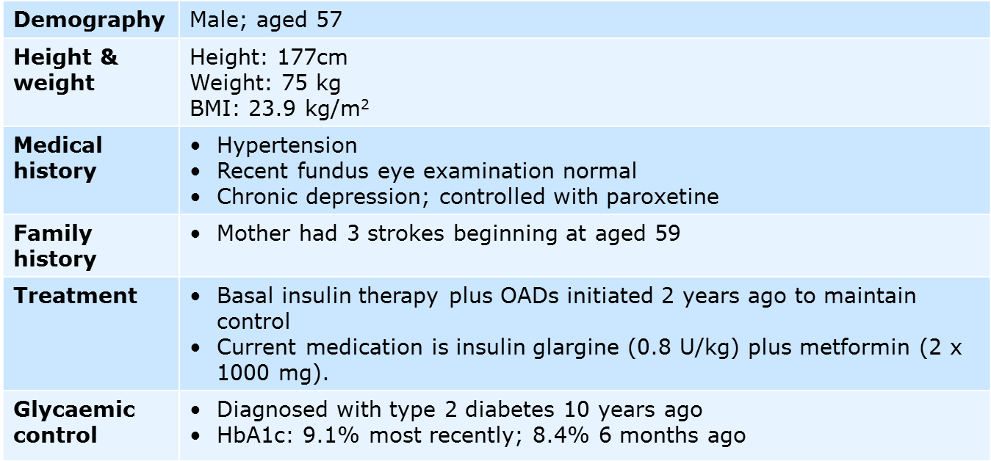

Slide 18
More information
Over the past 6 months you have increased Mr. zare dose of insulin from 0.4 U/kg to 0.8 U/kg which has resulted in improved glycemic control by also reports of several episodes of nocturnal hypoglycemia
Mr. zare does not like to be regimented and considers insulin injections and blood glucose monitoring a bother. Blood glucose control has been suboptimal over these past 2 years, but you have finally convinced him that a change in his insulin regimen is required.

Slide 19
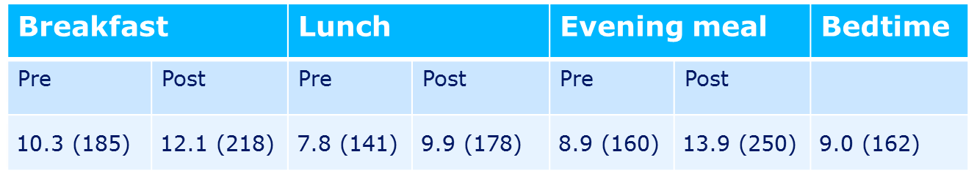
SMBG
HbA1c 9.1%

Slide 20
What would you do next?
Start the patient on BIAsp 30 OD
Start the patient on BIAsp 30 BID
Start the patient on basal-bolus
therapy

Slide 21
Lunch is ready!
Have a nice weekend

