Slide 1
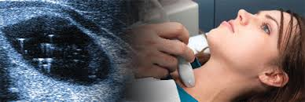
The accuracy of thyroid nodule ultrasound to predict thyroid cancer

Slide 2
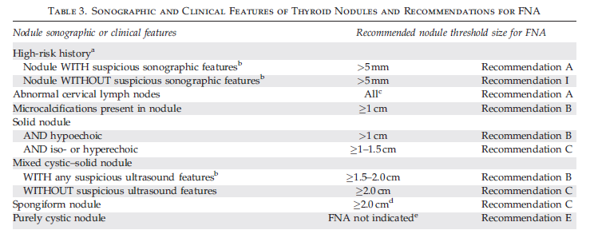
ATA gildline
Suspicious features: microcalcifications; hypoechoic; increased nodular vascularity; infiltrative margins; taller than wide on transverse view.

Slide 3
Can thyroid sonography predict malignancy in thyroid nodule?

Slide 4
Eur Thyroid J 2013;2:37–48 DOI: 10.1159/000347144

Slide 5
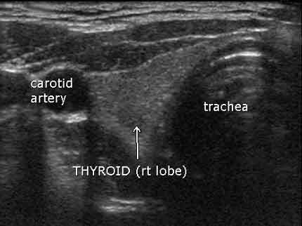

Slide 6
Position
each thyroid lobe can be divided into three portions: one third superior
one thirdmedium
one third inferior
each portion can be further subdivided into two sub-portions: anterior
posterior
Isthmus can be divided into: right parahistmic
left parahistmic
central part
Seldom, thyroid nodules are located in the pyramidal lobe and more rarely they can be ectopic.

Slide 7
Extracapsular Relationships
The thyroid capsule may be simply deformed by nodules without interruption of its hyperechogenicity

Slide 8
Invasion:crosses the thyroid capsule invading the nearby structures.

Slide 9
Shape
Thyroid nodules can be classified as:
ovoid (when the anteroposterior diameter of a nodule is less than its transverse diameter on a transverse or longitudinal plane)

Slide 10
round (when the anteroposterior diameter of a nodule is equal to its transverse diameter on a transverse or longitudinal plane)
taller-than-wide (when the anteroposterior
diameter of a nodule is longer than its transverse diameter on a transverse or longitudinal plane)

Slide 11
Internal Content
based on the ratio of the cystic portion to the solid portion of the lesion:
solid
mixed predominantly
solid

Slide 12
mixed predominantly cystic
cystic

Slide 13
spongiform

Slide 14
irregular (when a nodule is neither ovoid/round nor taller-than wide) .

Slide 15
Echogenicity
hypoechoic

Slide 16
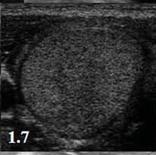
Isoechoic
hyperechoic

Slide 17
anechoic

Slide 18
Presence of Calcifications
Calcifications should be classified in: microcalcifications
macrocalcifications

Slide 19
peripheral rim calcifications (also called ‘eggshell’ calcifications )

Slide 20
Margins
well defined
ill defined

Slide 21
irregular (when a nodule is neither ovoid/round nor taller-than wide) .

Slide 22
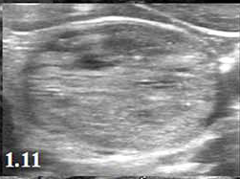
Regular
spiculated
irregular
microlobulated

Slide 23
halo sign
regular thin
Halo
irregular thick halo

Slide 24
Vascularity
absent
perinodular
intranodular
peri-intranodular divided by PD in two subtypes:
(a) moderate (b) increased :

Slide 25
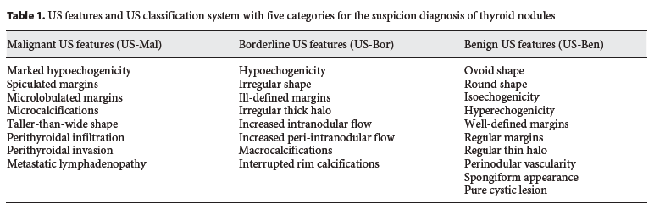

Slide 26
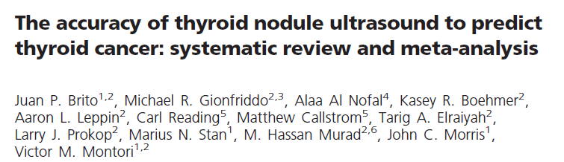
J Clin Endocrinol Metab. 2013

Slide 27
Objective: To summarize the available literature related to the accuracy of thyroid nodule ultrasound (US) in the prediction of thyroid cancer.
Methods: We searched multiple databases and reference lists for cohort studies that enrolled adults with thyroid nodules with reported diagnostic measures of sonography. A total of 14 relevant US features were analyzed.

Slide 28
included 31 studies published between 1985 and 2012.
13,736 adult patients
mean age of 47 years
were mostly women( 82%) .
The total number of nodules evaluated was 18,288.
The average size of these nodules was 15 mm
the pooled frequency of thyroid cancer was 20%.
The most common type of cancer was papillary thyroid cancer(84%)
follicular carcinoma (13%).

Slide 29
Outcomes of interest were the diagnostic accuracy of sonographic
features of thyroid nodules.
diagnostic odds ratio (OR) (DOR):
as our main outcome measure.
for the discriminative power of a diagnostic test
odds of a positive test result among diseased
odds of a positive test result among the nondiseased
it reflects the test’s performance compared the reference standard value of a DOR ranges from 0 to infinity, with higher values indicating better discriminatory test performanceit.

Slide 31
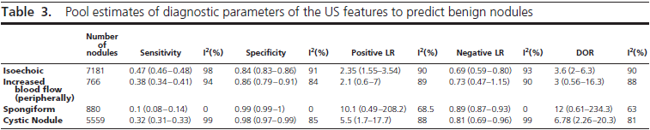

Slide 32
Diagnostic US features, when utilized in nodules with
indeterminate cytologies,have a lower predictive value.
In this study,
internal calcifications, echogenecity, infiltrative margins, and solid vs. cystic content of the nodule were poor indicators of malignancy while increased internal vascularity was more predictive.
The explanation for
this most likely lies in the increased frequency of follicular neoplasm within the analyzed population.
that it is most frequently encapsulated with regular margins, contains high cellularity providing variation in echogenicity

Slide 33
Key massage
Low to moderate quality evidence suggests that individual ultrasound features are not accurate predictors of thyroid cancer.
Two features–cystic content and spongiform appearance-,
however, might predict benign nodules but this has limited applicability to clinical practice due to their infrequent occurrence

Slide 35
IMPORTANCE There is wide variation in the management of thyroid nodules identified on ultrasound imaging.
OBJECTIVE To quantify the risk of thyroid cancer associated with thyroid nodules based on ultrasound imaging characteristics.
METHODS Retrospective case-control study of patients who underwent thyroid ultrasound from January 1, 2000, through March 30, 2005. Thyroid cancers were identified through linkage with the California Cancer Registry.
thyroid cancers diagnosed through March 30, 2007, allowing a minimum 2 years of follow-up after the last enrolled.
patient’s ultrasound imaging. patient records (radiology,pathology, and surgery) were reviewed.

Slide 36
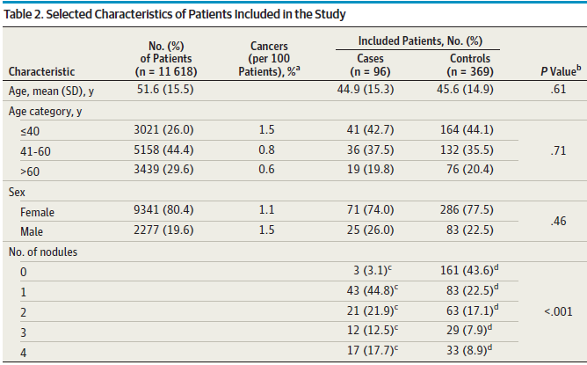

Slide 41
KEY MASSAGE
Thyroid ultrasound imaging could be used to identify patients who have a low risk of cancer for whom biopsy could be deferred.
On the basis of these results, these findings should be validated in a large prospective cohort.

Slide 42
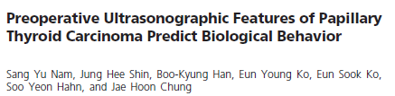
jcem.endojournals.org J Clin Endocrinol Metab, April 2013, 98(4):1476–1482

Slide 43
Background: Although ultrasound (US) features of papillary thyroid carcinoma (PTC) are well established, little is known regarding biological behavior according US features. We investigated whether there was a difference in biological behavior between PTCs that did and did not meet malignant US criteria.
Patients and Methods: From March 2006 to December 2006, All patients
who underwent surgery were preoperatively diagnosed as PTC after fine-needle aspiration (FNA) for several reasons
including suspicious US findings (n318), a request from the patient or physician (n168), or symptomatic mass (n58).
We retrospectively reviewed clinical records and histological and US findings of the index tumors in 488 patients who underwent surgery for PTC.
Malignantlooking PTCs (M-PTCs) and B-PTCs were compared in terms of patients’ age, sex, tumor size, histological subtype, multifocality, lymph node (LN) metastasis, extrathyroidal extension, stage, recurrence,and distant metastasis.

Slide 44
Malignant-looking PTCs (M-PTCs)
at least 1 accepted sonographic criterion:
taller than wide shape,
microcalcifications
marked hypoechogenicity
infiltrative border.
Benign-looking PTCs (B-PTC)
tumors without any of the accepted US criteria.

Slide 45
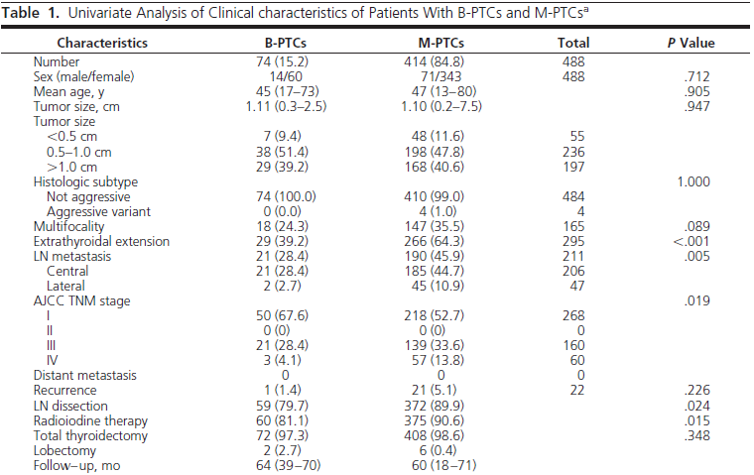

Slide 46
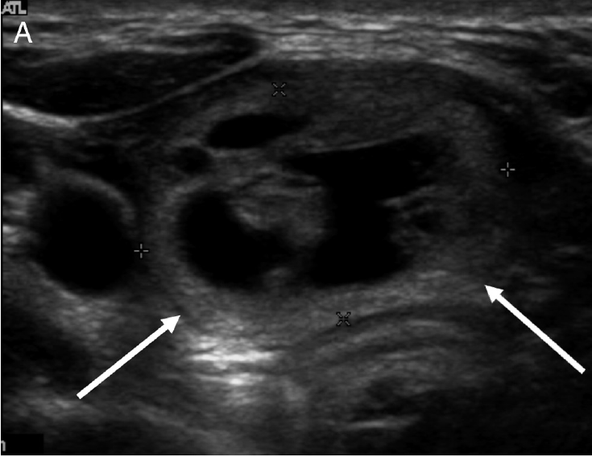

Slide 47
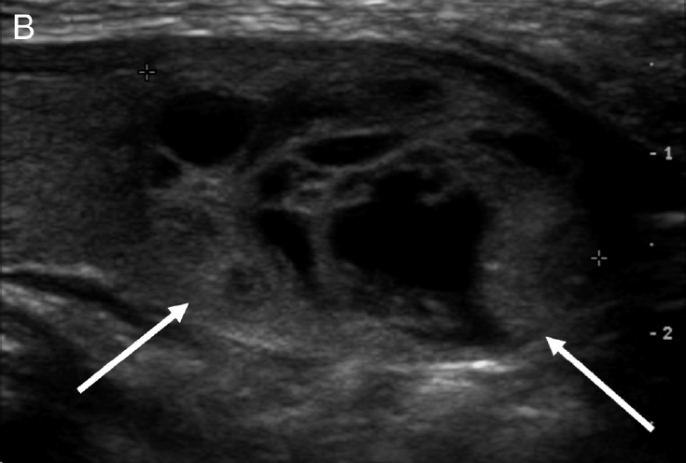

Slide 48
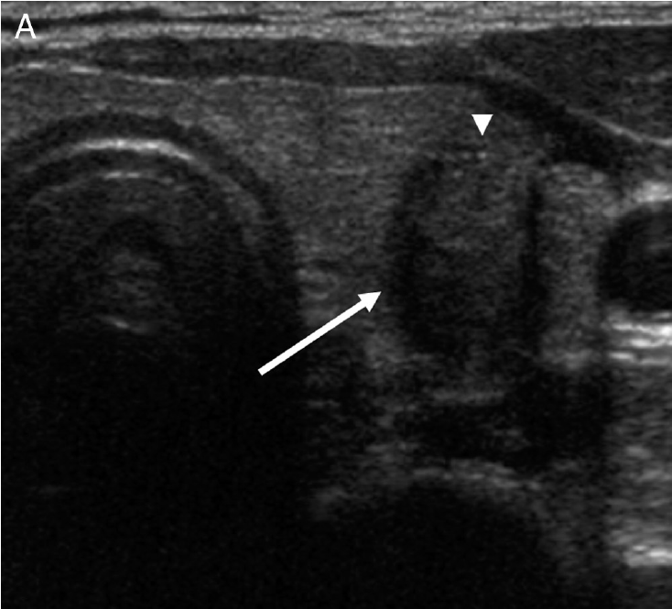

Slide 49
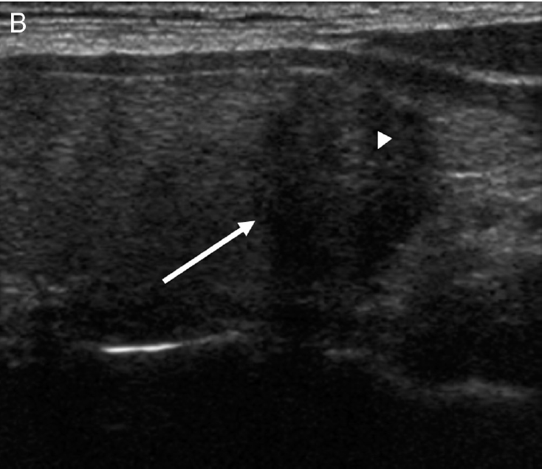

Slide 50
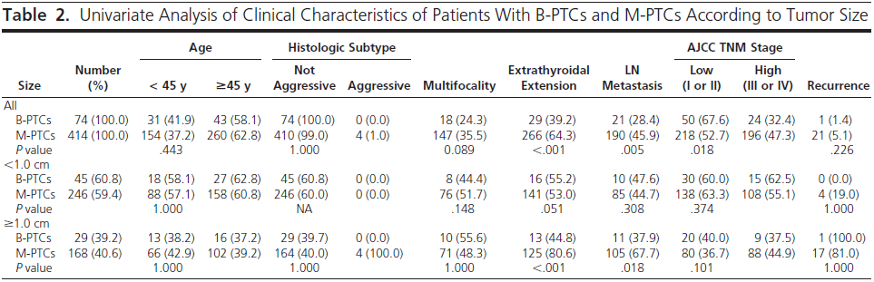


Slide 51
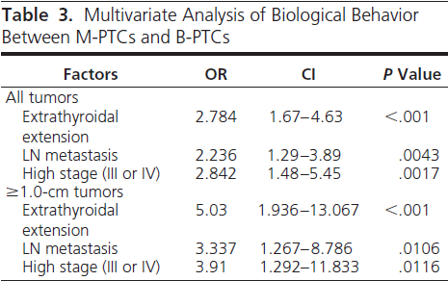

Slide 52
In a multivariate analysis, a greater number of suspicious US findings was independently associated with
OR CI PValue
multifocality 1.253 95%CI1.06–1.482 .008
Extrathyroidal extension 1 .38 95%CI1.171–1.625 .0001
LN metastasis 1.246 95% CI 1.04–1.492 .017
high stage 1.341 95%CI1.076–1.671 .009
A taller than wide shape was correlated with a higher stage (P .009).
Nodules with marked hypoechogenicity showed a high frequency of extrathyroidal extension (P.005) and a higher stage (P .006).
Microcalcifications and infiltrative border were associated with extrathyroidal extension (P .036 and P .001, respectively) and LN metastasis (P .001 and P .001, respectively).
However, there was no statistically significant difference in comparison of each US finding that could predict poor prognostic factors .

Slide 53
KEY MASSAGE
PTCs that did not meet malignant US criteria had better prognostic indicators than PTCs that met US criteria.
Therefore, US features at the time of diagnosis can serve as a useful tool for predicting biological behavior in PTC.

Slide 54

individual ultrasound features are not accurate predictors of thyroid cancer.

