Slide 1
NONFUNCTIONAL PITUITARY ADENOMA
S.BAHRI

Slide 2
Endocrinol Metab Clin N Am 44 (2015) 79–87

Slide 3
Agenda
Introduction
Preoperative management of NFPA:
Observation
Surgical resection
Postoperative follow-up of NFPA
Post operative management of NFPA:
Surgical resection
Radiation therapy
Medical therapy
Conclusion

Slide 4
NFPA
Prevalence of pituitary adenoma is 80–100 cases per 100,000of the population.
NFPA accounts for 15–30% of these.
Annual incidence is 1 new case per 100,000 of the population.
Gonadotroph adenomas account for 25% to 35% of pituitary adenomas overall and 43% to 64% of silent adenomas.
Null-cell adenomas are nearly as common.

Slide 5
Nonfunctioning, or silent, pituitary adenoma
Clinically silent:
Can be classified by immunocytochemistry or can be detected by biochemical testing but do not cause clinical signs or symptoms.
Totally silent:
Can be classified by immunocytochemistry but do not secrete a sufficient amount of their hormonal products.
Null cell : Those that do not stain for any hormone by immunocytochemistry and do not secrete any hormonal products.

Slide 7
Gonadotroph Adenomas
In men:
An elevated FSH associated with low testosterone and LH that is not elevated.
An elevated serum FSH (with or without elevated alpha subunit) in up to one-quarter of these patients an isolated elevated alpha subunit concentration occurred in 7%.
An elevated testosterone and LH, with or without an elevated FSH
An increase in LH beta subunit in response to synthetic TRH

Slide 8
Gonadotroph Adenomas
In Pre menopause women:
Clinical manifestations : oligomenorrhea or amenorrhea and large ovarian cysts.
Biochemical testing: elevated FSH, normal or low LH, and markedly elevated estradiol.
In Post menopause women:
Elevated FSH concentration in the setting of a low or low normal LH
LH beta subunit response to synthetic TRH also occurs in women
LH beta subunit response to synthetic TRH also occurs in women.

Slide 9
PEREOPERATIVE MANAGEMENT

Slide 10
MICROADENOMA
Essential biological assessment :
systematic prolactin and IGF1 assay is recommended in case of micro adenoma.
Systematic explore for cortisol hypersecretion is not recommended because there are no reported cases of infra clinical Cushing’s syndrome associated with pituitary microadenoma.

Slide 11
MICROADENOMA
Biochemical assessment:
Systematic exploration for anterior pituitary insufficiency is not recommended.
Exploration for anterior pituitary insufficiency, and for somatotropic insufficiency in particular, may be considered in 6–9 mm pituitary micro incidentaloma if GH replacement therapy is likely to be prescribed.

Slide 12
MICROADENOMA
Visual assessment :
Not useful in suspected micro adenoma;
Nor is it recommended if the lesion is remote from the optic chiasm;
It is recommended if the lesion is close to the optic chiasm or is seen to be compressing it on MRI

Slide 13
SURGERY IN MICROADENOMA
Only progression indicates surgery;
No threshold size increase can be specified,
Age ,co morbidity and proximity to the chiasm are also to be taken into account.

Slide 14
MACROADENOMA
Biochemical assessment:
Screening for silent pituitary adenoma:

Slide 15
MACROADENOMA
Biochemical assessment:
Exploration of preoperative pituitary deficiency:
deficiency in at least one axis in 60–85% of cases.
Only the corticotroph axis should undergo dynamic exploration
The thyrotroph axis should undergo static exploration, TSH and free T4 assay.
In case of amenorrhea, even in women of menopausal age, FSH assay can guide diagnosis toward a peripheral or gonadotropin deficiency.
In male, LH, FSH and plasma total testosterone should be assayed.
Screening for somatotroph deficiency is not recommended

Slide 16
SURVEILLANCE IN MACROADENOMA
If there is a safety margin with respect to the chiasm (2–3 mm), especially in elderly patients and/or in case of co morbidity.
Invasion of cavernous space is not a reason for active primary treatment, as surgery will not cure the patient.

Slide 19
Objective: To characterize the natural history of patients with NFPAs managed conservatively.
Study Design : Retrospective analysis of patients presenting to a tertiary referral center between 1986 and 2009in London.
Study population : 66 patients were managed conservatively for a mean follow-up period of 4.3 years (range: 1–14.7). 47 (71%) had a macroadenoma, and 19 (29%) had a microadenoma.

Slide 20
Inclusion Criteria:
Patients with pituitary adenomas and no clinical or biochemical evidence of hormonal hypersecretion were included.
Exclusion Criteria:
Those presenting with apoplexy or a radiological follow-up period of less than 1 year were excluded.

Slide 25
Conclusion
Patients with NFPAs without optic chiasm compression can be managed conservatively.
All patients need pituitary function assessment, irrespective of tumour size.

Slide 27
Objective :To elucidate the natural history of nonfunctioning pituitary adenomas managed conservatively.
Study Design : Retrospective study between 2003 and 2013 in Queensland Australia .
Study population:50 Patients with nonfunctioning pituitary adenomas (mean age 49, range 17–85 years) who underwent at least 2 serial pituitary MRI scans over ≥6 months prior to any intervention

Slide 28
Primary end-point: was a ≥20% increase in volume or surgery.
Secondary end-points: were rate of pituitary dysfunction and pituitary apoplexy.
Exclusion Criteria:
(i) age younger than 16 years at baseline;
(ii) functioning adenoma,
(iii) radiological appearance suggestive of pituitary pathology other than pituitary adenoma,
(iv) less than6 months of serial imaging;
(v) previous surgical resection or radiation therapy
(vi) presentation with mass effect, such as visual field defect or pituitary apoplexy.

Slide 32
RESULTS
A high proportion of patients with NF macro adenomas without visual deficit at presentation eventually demonstrate an increase in volume and require surgical intervention.
In contrast, micro adenomas rarely progress; fewer than 10% increase in volume by ≥20% after 3–5 years of follow-up in this study.

Slide 33
RESULTS
A growth rate of >10 mm3/month over the initial 2 years of follow-up was highly predictive of either requiring surgery or ultimately exceeding a 20% increase in tumour volume.
Larger tumours at baseline were more likely to grow.

Slide 34
Conclusion
In macro adenomas where an increase in volume of more than 10 mm3/month occurs across the first 2 years of follow-up, consideration should be given to surgical intervention before visual or hormonal deficits arise.
Conversely, micro adenomas may be safely imaged at less frequent intervals
Based on our data, a micro adenoma which has not changed at 2 years may not need further imaging.

Slide 35
SURGERY IN MACROADENOMA
Asymptomatic macro adenoma
Tumor progression (no specified threshold)
Non-compliant patient liable to escape follow-up;
Associated NFPA, male gender , proximity to chiasm and anticoagulation therapy, as this entails elevated risk of apoplexy
Patient age:
In young patients without awaiting progression,
Given the low risk of postoperative visual impairment;
Risk of postoperative recurrence was lower with early surgery

Slide 36
SURGERY IN MACROADENOMA
Symptomatic adenoma
Visual disorders :
Improved vision is reported in some 80–90% of cases (including both partial and total recovery)
Recovery may be progressive, over a period of up to 1 year after surgery.
Some studies highlighted a correlation between percentage recovery and duration and severity of campimetric disorder

Slide 37
SURGERY IN MACROADENOMA
Pituitary deficiency :
The risk of onset of further pituitary deficiency associated with macro adenoma is estimated at 12% per year.
Surgery provided recovery of normal anterior pituitary function in about 30% of cases, at a mean of 1-year follow-up. the rate was higher for earlier management.
The risk of postoperative deterioration in pituitary function is about 10%.

Slide 38
SURGERY IN MACROADENOMA
Headaches :
classically due to distension of the dural envelopes
Retro-orbital or vertex locations suggest pituitary etiology.

Slide 39
Young women with or without pituitary deficiency:
NFA is rare in young women
In a patient hoping for pregnancy, the decision to operate may be based on gonadotroph deficiency
surgery provides pituitary recovery in about 30% of cases, while deficiency is found at diagnosis in more than 80% of cases .

Slide 40
pregnancy
maximum pituitary gland height can increase by 12 mm during pregnancy
When the adenoma is close to the optic pathways surgery should be considered;
In abstention from surgery
clinical surveillance should be at least 3 monthly, with visual field test and MRI without contrast

Slide 41
POST OPERATIVE MANAGEMENT

Slide 42
Factors for recurrence
Clinical factors:
The best identified recurrence factor is postoperative adenomatous residue.
Young age, gender and initial tumor size are non-systematic recurrence factors .
Histologic factors :
Prognosis is classically poorer in silent corticotroph adenoma . when it occurs, is earlier and more aggressive .
Prognosis in silent mixed GH-PRL adenoma is poor.

Slide 43
Factors for recurrence
Histologic factors:
Ki67 :predicted recurrence with high specificity(89%) but poor sensitivity (54%), which suggests that new thresholds need to be identified in these adenomas.
New studies showed Ki67 is not predictive of recurrence risk but could be an effective index of progression risk in postoperative adenomatous residue.
Expression of subtype 2 and 5 somatostatin receptors is lower in recurrent adenoma.

Slide 44
Postoperative follow-up of NFPA
Biochemical assessment :
In the immediate (7–10 days) postoperative period, the focus should be on the assessment and correction of corticotroph deficiency and on screening for DI.
An alternative may be to systematically perform dynamic exploration 4–6 weeks post-surgery.
Corticotroph deficiency may resolve within 3 months of surgery so we can repeat corticotroph axis exploration at 3 months in case of initial deficiency

Slide 45
Postoperative follow-up of NFPA
Biochemical assessment :
Thyrotroph and gonadotroph axes should be assessed during the postoperative period.
Although systematically performed 4–6 weeks after surgery.
In case of initial deficiency, it is therefore recommended to repeat exploration at 3, 6 and 12 months.

Slide 46
Postoperative follow-up of NFPA
Biochemical assessment :
In the absence of residual tumor and postoperative pituitary deficiency : there is no need to explore for secondary onset
In case of tumoral recurrence or residual tumor progression : pituitary exploration should be repeated at least once yearly in the absence of complementary treatment
In case of complementary radiation therapy pituitary function test should be done, at least once yearly for at least 10 years

Slide 48
Postoperative follow-up of NFPA
Ophthalmologic follow-up :
In case of preoperative ophthalmologic abnormality: a check-up is made 3 months after surgery. The examination is repeated every 6 months until maximum improvement is achieved.
In the absence of any visual impairment on the first postoperative examination: follow-up can be stopped if there is no supra sellar residue close to the optic pathways.
If (RT) is performed: Systematic 6-monthly ophthalmologic monitoring during the first 4 years and then annually for 10 years should be implemented.

Slide 49
What treatment can be offered for residue or recurrence?
Surgical revision :
Between 30 and 48% of NFPAs undergo surgical revision on a TSS approach either early for large residue , or later during tumoral progression.
Surgery indication:
progressive residue accessible for complete resection.
In case of persistent or recurrent symptomatic optic pathway compression; to obtain anatomic conditions allowing stereotactic RT (3–5 mm)safety margins
In case of post-RT tumor progression.

Slide 50
What treatment can be offered for residue or recurrence?
Radiation therapy:
After postoperative RT, 10-year progression-free survival being greater than 90% in most series .
Indication for RT:
Aggressive tumors
Large supra or extra sellar residual tumor
Confirmed recurrence.

Slide 51
Complications of RT
New pituitary hormonal deficiencies in up to 70% of patients at10 years.
Optic neuropathy in 0.8% of patients at 10 years
Secondary intracranial tumors affecting nearly 2% of patients at 20 years.
Increased risk of stroke in both men and women.

Slide 52
J Neurosurg October 30, 2015

Slide 53
Objective : To evaluate whether GKRS should be used early after surgery or radio surgery should be withheld until there is evidence of radiographic progression of tumor.
Study Design : Retrospective review of patients with NFPA who underwent TSS surgery followed by GKRS between 1996 and 2013 at the University of Virginia.

Slide 54
Study population:
64 patients were grouped based on early (n = 32) or late (n = 32) GKRS following TSS resection; with a median radiographic follow-up period of 68.5 months.

Slide 55
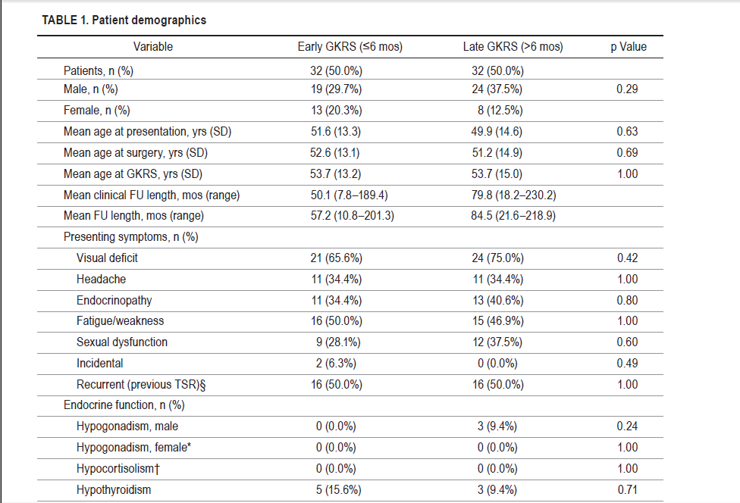

Slide 58
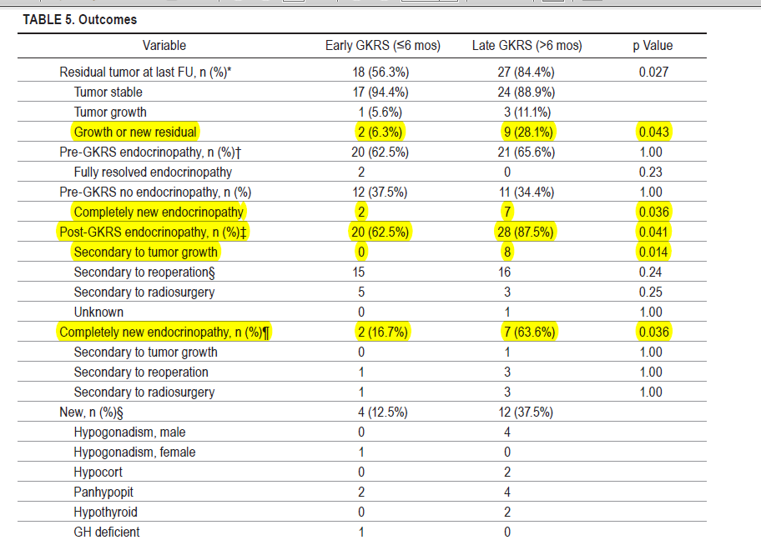

Slide 59
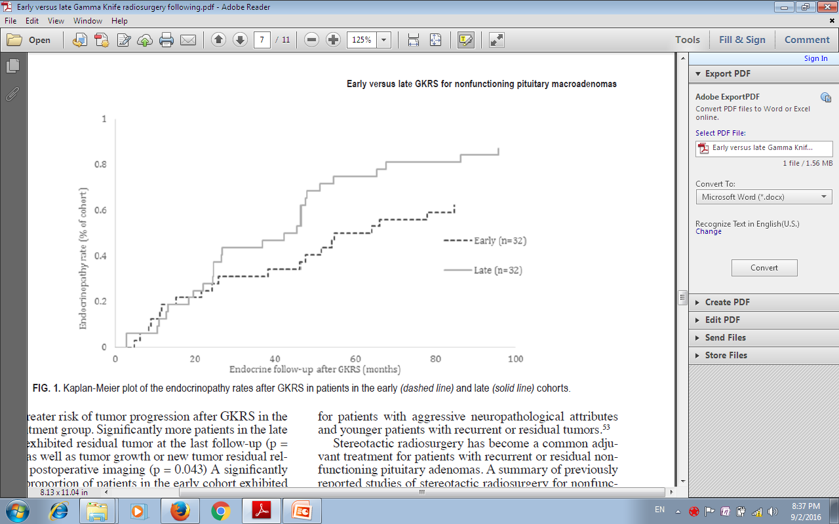

Slide 60
Conclusion
Early treatment with GKRS: Decrease the rate of radiographic and symptomatic progression of subtotally resected NFPA.
Delaying radiosurgery :may place the patient at increased risk for adenoma progression and endocrinopathy.

Slide 61
MEDICAL TREATMENT
Gn-RH agonists and antagonists : have been proved ineffective for reducing NFPA volume.
Dopaminergic agonists : bromocriptine, and cabergoline, doses (up to 3 mg/day for cabergoline)
Volume reduction has been reported
Improvement in ophthalmologic disorders, even if there is no significant reduction in tumoral volume

Slide 62
MEDICAL TREATMENT
Somatostatin analogs :
Volume reduction in a small percentage of cases.
may provide rapid relief of headache and visual field defect, independently of an anti tumoral action.
Combination therapy: No improving in efficacy

Slide 63
2016 European Society of Endocrinology.

Slide 64
Objective : To evaluated dopamine for preventing growth of post-surgical pituitary tumor remnants.
Study Design : Historical cohort analysis of clinical results at two pituitary referral centers with different standard practices for post-operative NFPA management: DA therapy or conservative follow-up.

Slide 65
METHODS
Study population:79 patients followed for 8.8 ― 6.5 years.
Preventive treatment (PT) :DA Initiated upon residual tumor detection on postoperative MRI group, N=55.
remedial treatment (RT) :when tumor growth was subsequently detected during follow-up group, N=24.
The control group: received no medication N=60.

Slide 67
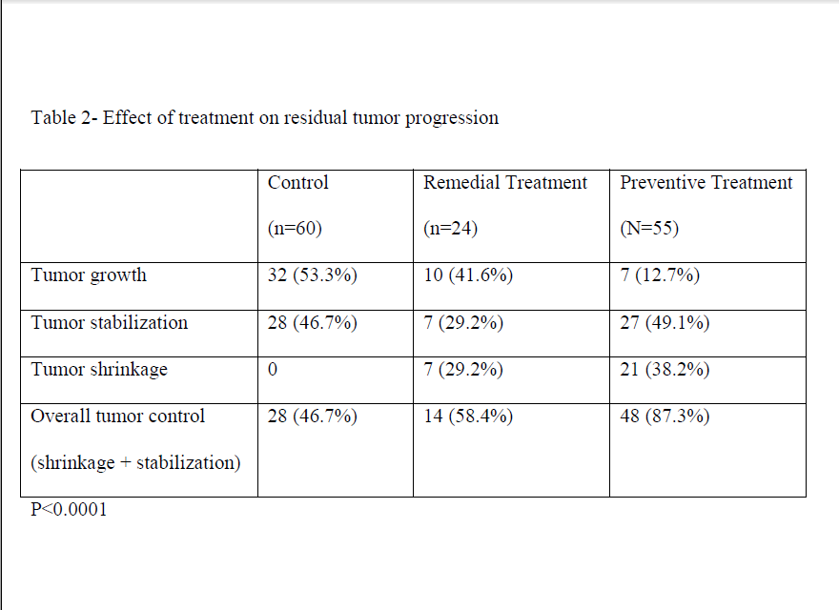

Slide 68
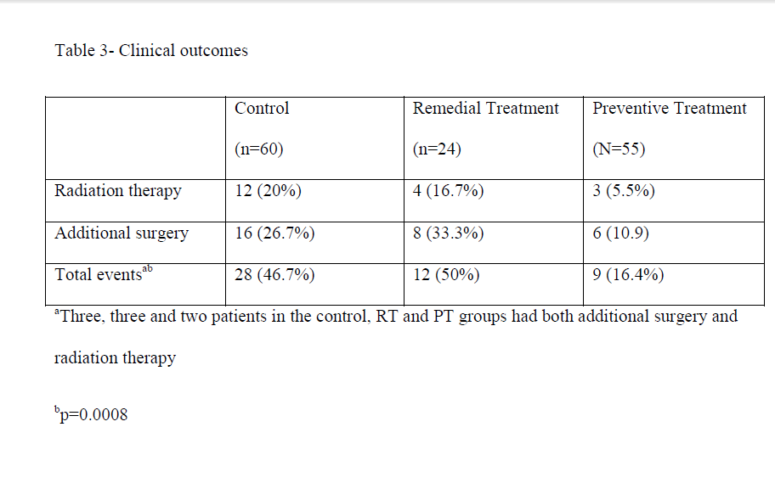

Slide 69
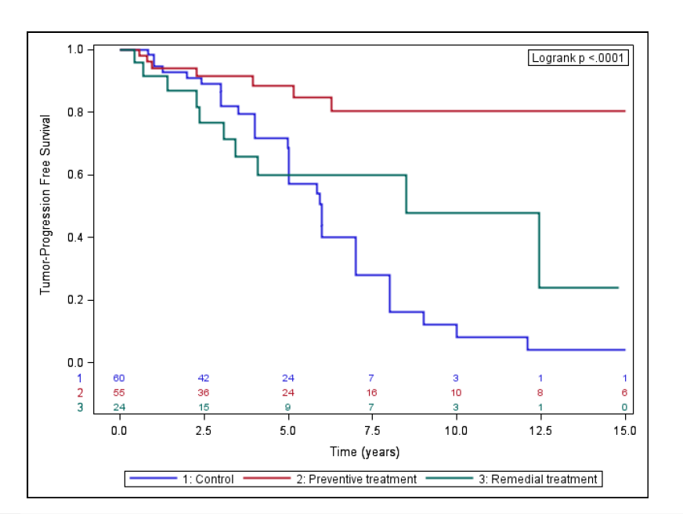

Slide 70
Conclusion
Dopamine agonist therapy was associated with decreased incidence of post-operative residual tumor enlargement in patients with NFPA.
We propose that this treatment modality be considered for management of these patients even in the absence of evident mass effects on vital structures.

Slide 71
KEY MESSAGE
Nonfuctional microadenoma can be managed conservatively due to rare progression to macroadenoma
Asymptomatic macroadenoma remote from optic nerve should be monitored
In tumor size enlargement ,and symptomatic macroadenoma TSS is treatment of choice.

Slide 72
KEY MESSAGE
After complete resection, NFPA may recur in some patients .
radiation therapy being proposed in case of growth of the relapsing tumor or tumoral residue and its better to be done soon after the diagnosis.
Medical therapy with DA is recommended in tumoral residue even in the absence of evident mass effects on vital structures.

