Slide 1
IN THE NAME OF GOD
MONA TALASCHIAN
MAY,2023

Slide 2
Patient description
Gender:male
Age:36
No married
Wase born In Tehran
Living in Tehran

Slide 3
Chief complaint:
36 y/o man ,known case of hyperparathyroidism referred for follow up

Slide 4
Present illness
A 36-year-old man who has been treated for depression and concentration disorder since 10 years ago
Fatigue, constipation, Anorexia
No polyurea, polydipsia, nocturia
No nephrolithiasis,peptic ulcer

Slide 5
Due to the family history of hyperparathyroidism and the recent surgery of his siblings, he is under investigation.
With the diagnosis of hyperparathyroidism, it is placed under parathyroidectomy .

Slide 6
 | 1401/06/15 | 1401/11/27
Calcium(mg/dl) | 10.2 | 9.5
Phosphorus(mg/dl) | 1.6 | 5.1
25 oH vitD(ng/ml) | 32 | 24
Mg(mg/dl) | 2.1
PTH intact(pg/ml) | 142 | 28

Slide 7
Pathology report
Inferior parathyroid nodule excision:
Parathyroid adenoma

Slide 8
His mother:Parathyroidectomy was performed 20 years ago.
Bone pain.fx history.
Repeated surgery due to recurrence last year.(bone pain,abnormal
BMD).

Slide 9
 | Before surgery | After surgery(1401)
Calcium(mg/dl) | 10.1 | 10
Phosphorus(mg/dl) | 2.6 | 3
25 oH vitD(ng/ml) | 32 | 32
PTH intact(pg/ml) | 173 | 80
PTH intact(pg/ml)

Slide 10
Brother 42 years old
Nephrolithiasis history for 8 years and bone pain.
Parathyroidectomy last year.(3 adenoma)

Slide 11
 | Before surgery | After surgery(1401)
Calcium(mg/dl) | 13 | 8
Phosphorus(mg/dl) | 2.6 | 3.9
25 oH vitD(ng/ml)
PTH intact(pg/ml) | 297 | 54
PTH intact(pg/ml)

Slide 12
Sister 40 years old
Nephrolithiasis history for 4 years and bone pain.
Parathyroidectomy and thyroid left lobectomy last year.

Slide 13
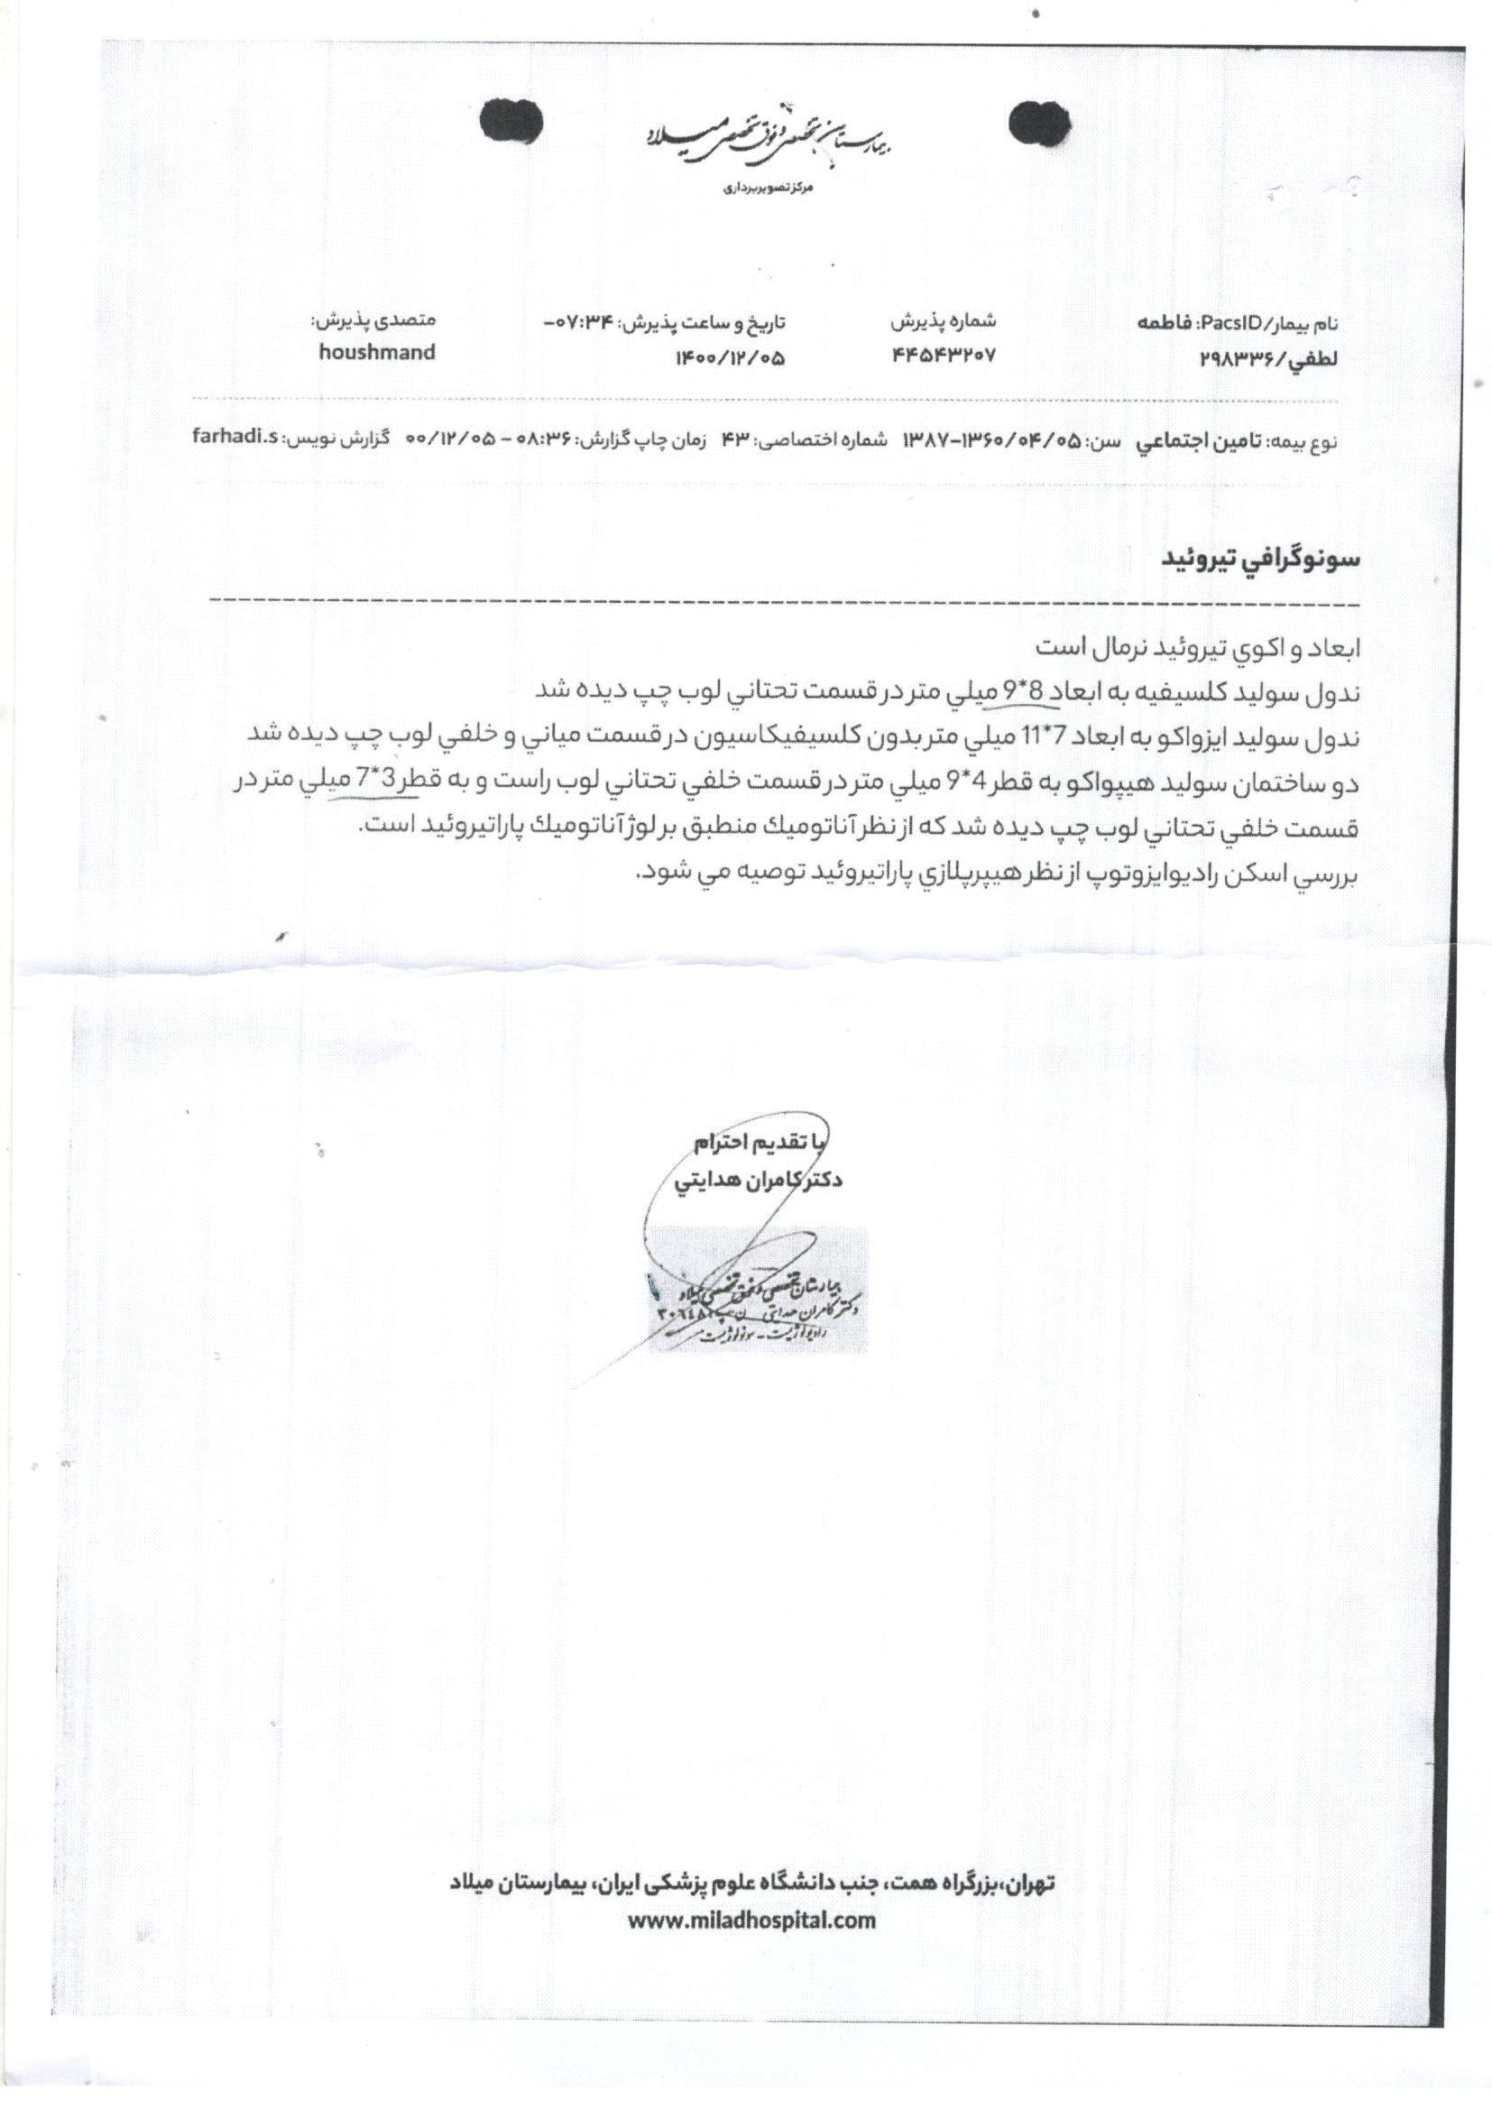

Slide 14
 | Before surgery | After surgery(1401)
Calcium(mg/dl) | 11.1 | 10.4
Phosphorus(mg/dl) | 2.6 | 3.9
25 oH vitD(ng/ml) | 42 | 30
PTH intact(pg/ml) | 119 | 93
PTH intact(pg/ml)

Slide 16
Brother 38 years old
depression and concentration disorder since 6 years ago
Parathyroidectomy and thyroid lobectomy.(3 adenoma)

Slide 17
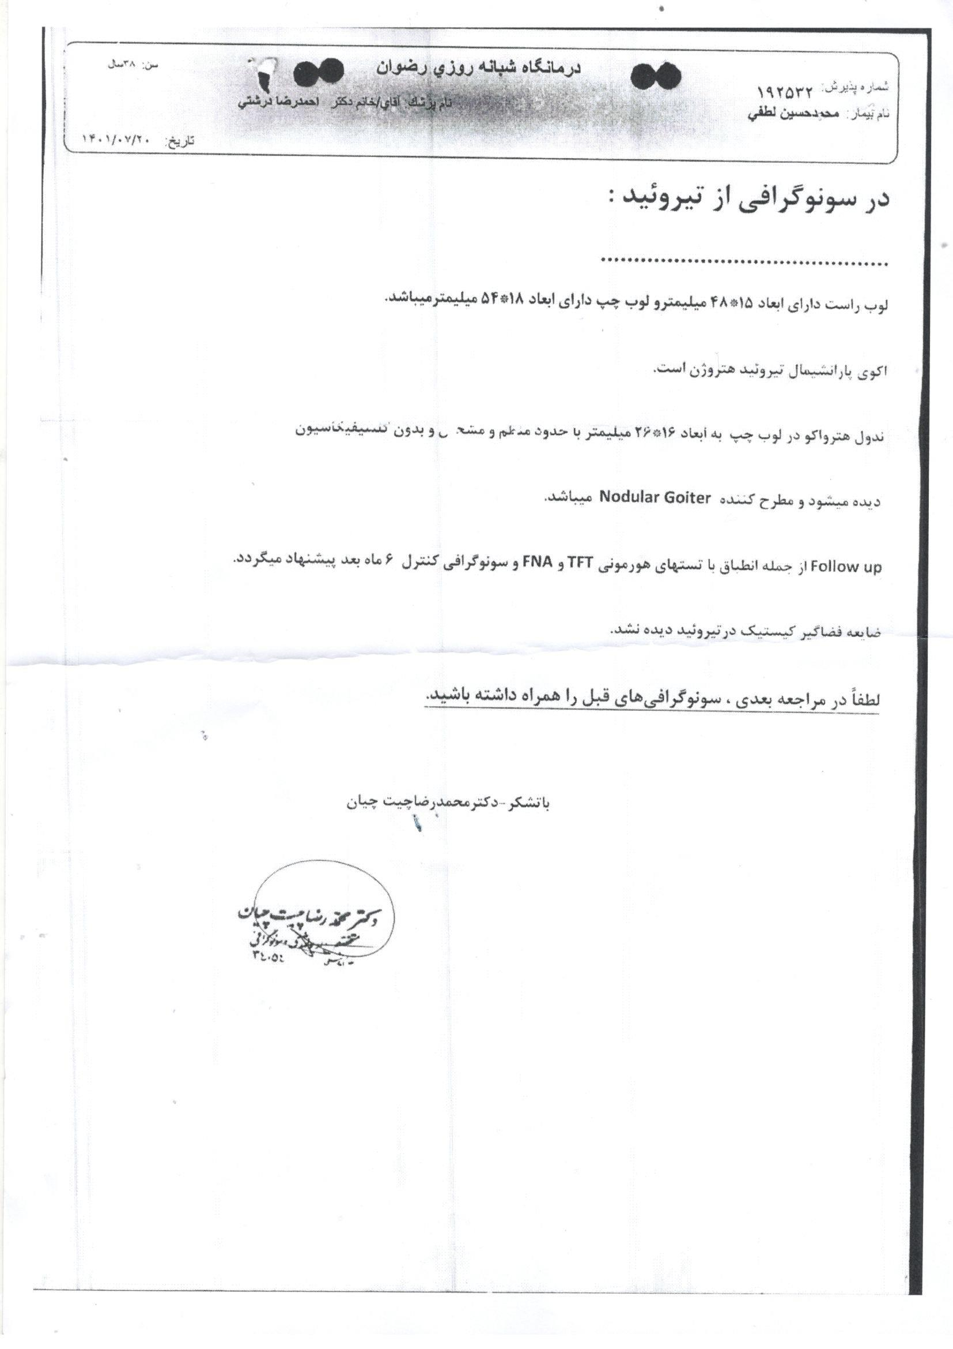

Slide 18
 | Before surgery | After surgery(1401)
Calcium(mg/dl) | 12.4 | 9
Phosphorus(mg/dl) |  | 3.7
25 oH vitD(ng/ml) | 31 | 36
PTH intact(pg/ml) | 324 | 55
PTH intact(pg/ml)

Slide 19
Problem list
36 years old man
Hyperparathyroidism and Parathyroidectomy history last year.
Family history of hyperparathyroidism and surgery.
Negative history of exteraparathyroide symptom.

Slide 20
Primary Hyperparathyroidism
In about 10% of cases, PHPT may be part of hereditary syndromic or nonsyndromic:
syndromic (MEN1, MEN2, and MEN4), hereditary hyperparathyroidism– jaw tumor syndrome (HPT–JT), or
nonsyndromic (familial isolated hyperparathyroidism, familial hypocalciuric hypercalcemia [FHH], and neonatal severe hyperparathyroidism) forms of the disease, in which multigland involvement is more common.
Primer on the Metabolic Bone Diseases and Disorders of Mineral Metabolism,

Slide 21
The clonal origin of most parathyroid adenomas suggests a defect at the level of the gene controlling growth of the parathyroid cell or the expression of PTH .
Several genes have been shown to be involved:
Germline mutations are found in hereditary forms.
Somatic mutations usually occur in sporadic forms, even though in
some cases germline mutations have been described.

Slide 24
FAMILIAL ISOLATED HYPERPARATHYROIDISM
FIHPT is clinically defined as familial PHPT without the extraparathyroid manifestations of another syndromal category .
The diagnosis of FIHPT should therefore be changed, if features of another PHPT syndrome develop.

Slide 25
Pathogenesis/genetics
FIHPT is genetically heterogeneous and can be caused by incomplete expression from germline mutation in MEN1, HRPT2, or CASR .
Recently, activating variants of the glial cells missing 2 (GCM2) gene, which encodes a parathyroid‐ specific transcription factor, have also been reported in some patients with FIHPT.
However, the majority of families do not have a detectable mutation in any of these genes.

Slide 26
Management
Management is very similar to that in common PHPT.
Monitoring and management must recognize that additional features of a genetically defined PHPT syndrome or a previously unidentified PHPT syndrome could become detectable .
For example, the heightened risk of parathyroid carcinoma must be borne in mind in FIHPT, when occult HPT–JT is possible.

Slide 27
OVERLAPPING CONSIDERATIONS AMONG ALL FORMS OF FAMILIAL PHPT
Multifocal parathyroid gland hyperfunction.
For three hereditary PHPT syndromes (MEN1, MEN2A, and HPT–JT), the germline mutation in the parathyroid cell causes susceptibility to postnatal and gradual over growth of mono‐ or oligoclonal parathyroid tumor .
For two others (FHH and NSHPT), the phenotype is fully expressed around birth.

Slide 28
Stated differently, an underlying feature of these five multiorgan syndromes is that every parathyroid cell carries the same syndromal germline mutation.
this is either sufficient to cause the overfunction phenotype in all parathyroid cells immediately or to put each parathyroid cell at risk to yield clonal proliferation many years later.

Slide 29
Detection of asymptomatic carriers
Once a PHPT syndrome has been diagnosed, testing for carriers among asymptomatic relatives should be considered.
Testing of germline DNA is often the gold standard for detection of carriers.

Slide 30
Gene Testing for Primary Hyperparathyroidism in Clinical Practice
Genetic testing for germ line mutations, which are found in ∼10% of all PHPT patients, is helpful in clinical practice in several ways that include:
(1) confirmation of the clinical diagnosis so that appropriate screening
for associated tumors can be undertaken.

Slide 31
(2) implementation of appropriate treatment such as early parathyroidectomy for patients with HPT-JT syndrome because of increased occurrence of parathyroid carcinomas.
avoidance of minimally invasive parathyroid surgery in MEN 1 patients who generally have multigland disease requiring open neck exploration.
early prophylactic thyroidectomy in MEN 2 patients,and avoidance of surgery in FHH patients.

Slide 32
(3) identification of family members who may be asymptomatic but harbor the mutation and therefore require screening for tumor detection and early/appropriate treatment.
(4) identification of the 50% of family members who do not harbor the familial germ line mutation and can therefore be reassured and alleviated of the anxiety burden of developing tumors

Slide 33
Clinical Approach to Gene Testing in a Patient with Primary Hyperparathyroidism
PHPT patients in whom there is a high suspicion of a genetic etiology (e.g., young age of onset, multigland disease, parathyroid carcinoma, atypical parathyroid adenoma) should be offered genetic counseling and germline mutation testing of the MEN 1, CaSR, AP2S1, GNA11, HRPT2 (CDC73), CDKN1A, CDKN1B, CDKN2B, CDKN2C, RET, and PTH genes using DNA obtained from nontumor cells (e.g., leukocytes).

Slide 34
First-degree relatives of a PHPT patient with a germ line mutation should be identified and offered genetic counseling and appropriate gene testing, and individuals who have inherited the mutation should be offered periodic screening, even if asymptomatic.

Slide 35
First-degree relatives who have not inherited the causative mutation require no further follow-up and may be alleviated of the anxiety associated with the development of MEN- or HPT-JT–associated tumors.

Slide 36
it is important to note that >5% of patients with nonfamilial (sporadic) PHPT presenting in the sixth to ninth decade of life with solitary parathyroid adenoma may have a germ line mutation involving CDKN1A, CDKN2B, or CDKN2C, thereby implicating a higher risk for developing PHPT in first-degree relatives.

Slide 39
Guidelines for MEN1 recommend MEN1 mutational analysis in
patients with PHPT occurring before the age of 30 years, and ~10% of
PHPT patients below the age of 45 years have been reported to have
a germline mutation involving the MEN1, CASR or HRPT2 (CDC73)
genes.

Slide 40
CASR, AP2S1, GNA11, HRPT2 (CDC73), CDKN1B, and RET mutations are associated with FHH1, FHH3, FHH2, HPT–JT, MEN4, and MEN2, respectively.
GCM2 activating variants may occur in some FIHPT patients without MEN1, CDC73, or CASR mutations.
Specific associated variants are of undetermined penetrance, with their role in clinical management not yet established.

Slide 41
Special approaches in surgery for familial parathyroid tumors
Efforts to identify all four parathyroid glands and remove several glands result in increased frequency of postoperative hypoparathyroidism.
To minimize Permanent hypoparathyroidism:
Small fragments of the most normal‐appearing parathyroid tumor
are autografted immediately to the nondominant forearm.

Slide 42
the surgeon leaves a small remnant of parathyroid in the neck, attached to its own vascular pedicle.
It can sustain euparathyroidism for many years. The potential for malignancy of any parathyroid tissue in HPT–JT argues against the autografting option there.

Slide 43
True recurrent PHPT is a late complication that is much more frequent in MEN1 and other familial PHPT, than in common adenoma .
True recurrence is defined for convenience as PHPT after a 3‐ to 6‐month postoperative period of documented euparathyroidism. It could arise when a small tumorous remnant becomes overactive or when a previously normal parathyroid cell progresses into a tumor clone.

