Slide 2
Issues in the Management of Thyrotoxicosis in the Third Trimester and Post-partum Period
Fereidoun Azizi
Research Institute for Endocrine Sciences
Shahid Beheshti University of Medical Sciences
Tehran, I.R. Iran

Slide 3
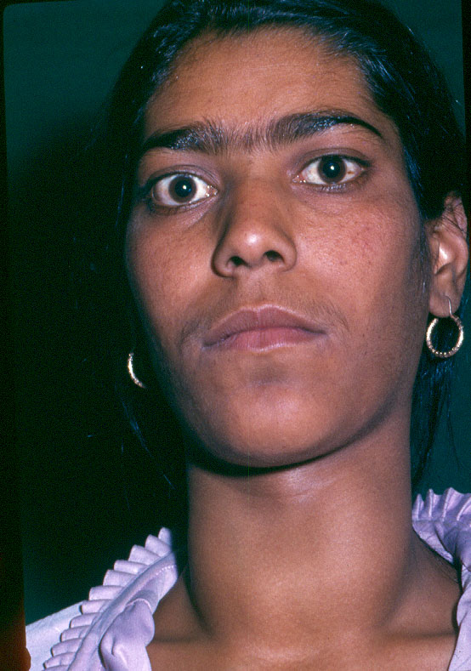
Thyrotoxicosis in pregnancy
Occurs in 0.2% of women
Mostly caused by Graves’ disease

Slide 4
Causes of hyperthyroidism in pregnant women
Graves’ disease
Gestational transient thyrotoxicosis
Molar pregnancy
Subacute or silent thyroiditis
Toxic adenoma
Multinodular toxic goitre
Iodine-induced thyrotoxicosis
Thyrotoxicosis factitia
Lao TT. Current Opin Obstet Gyne 2005; 17: 123

Slide 5
Guideline of the American Thyroid Association for the diagnosis and Management of Thyroid Disease during Pregnancy and Postpartum
The American Thyroid Association Taskforce on Thyroid Disease During Pregnancy and postpartum
Alex Stargnaro-Green (Chair), Marcos Abalovich, Erik Alexander, Fereidoun Azizi,
Jorge Mestman, Roberto Negro, Angelina Nixon, Elizabeth N. Pearce, Office P.
Soldin, Scott Sullivan and Wilmar Wiersinga
84 Questions
76 Recommendations
Thyroid 2011; 21: 1081-1125

Slide 6
Management of Thyroid Dysfunction during Pregnancy and Postpartum: An Endocrine Society Clinical Practice Guideline Leslie De Groot, Marcos Abalovich, Erik K. Alexander, Nobuyuki Amino, Linda Barbour, Rhoda H. Cobin, Creswell J. Eastman, John H. Lazarus, Dominique Luton, Susan J. Mandel, Jorge Mestman, Joanne Rovet, and Scott Sullivan J Clin Endocrinol Metab, August 2012; 97 (8): 2543-2565

Slide 7
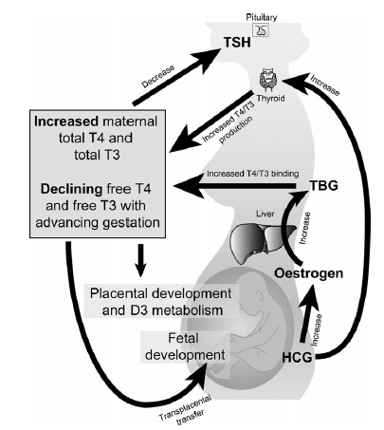
Maternal thyroid physiology
Chan SH, Boelaert K. Optimal management of hypothyroidism, hypothyroxinaemia and euthyroid TPO antibody positivity preconception and in. Pregnancy. Clinical Endocrinology 2015; 82: 313–326.

Slide 8
Physiologic changes in pregnancy that influence thyroid function tests
Physiologic change | Thyroid function test change
↑ Thyroid-binding globulin | ↑ Serum total T4 and T3
First trimester hCG elevation | ↑ Free T4 and ↓ TSH
↑ Plasma volume | ↑ T4 and T3 pool size
↑ Type III 5-deiodinase (inner-ring deiodination) due to increased | ↑ T4 and T3 degradation (resulting in requirement for increased hormone production)
Thyroid enalrgement (in some women) | ↑ Serum thyroglobulin
↑ Iodine clearance | ↓ Hormone production in iodine-deficient areas
hCG= human chorionic gonadotropin; TSH= Thyroid-stimulating hormone; T3= triiodothyronine; T4= thyroxine; ↑= increased; ↓=decreased
Lazarus JH. Treat Endocrinol 2005; 4:31

Slide 9
20
5.0
15
FT4(pmol/L)
FT3(pmol/L)
4.0
10
0
0
1.5
50
40
1.0
TSH (mU/L)
30
hCG (I.Ux1000/L)
20
0.5
10
0
0
10
20
30
40
Postmenstrual age in weeks
Glinoer, Endocr Rev 1997;18:404-433

Slide 10
Sample trimester-specific reference intervals for TSH*
Reference | Year | 1st trimester | 2nd trimester | 3rd trimester
Stricker | 2007 | 1.04 (0.09-2.83) | 1.02 (0.20-2.79) | 1.14 (0.31-2.90)
Haddow |  | 0.94 (0.08-2.73) | 1.29 (0.39-2.70)
Panesar | 2001 | 0.80 (0.03-2.30) | 1.10 (0.03-3.10) | 1.30 (0.13-3.50)
Soldin | 2004 | 0.98 (0.24-2.99) | 1.09 (0.46-2.95) | 1.20 (0.43-2.78)
Bocos-Terraz | 2009 | 0.92 (0.03-2.65) | 1.12 (0.12-2.64) | 1.29 (0.23-3.56)
Blatt | 2012 | 1.01 (0.10-2.50) | 1.14 (0.35-2.75) | 1.26 (0.43-2.91)
Azizi | 2013 | 1.7 (0.2-3.9) | 1.9 (0.5-4.1) | 1.8 (0.6-4.1)
* median TSH mIU/L with 5th and 95th centiles or P2.5 and P 97.5 between brackets.
Soldin OP et al. Clin Chem Acta 2004; 349: 181
Haddow JE et al. J Med Screen 2004; 11: 170
Panesar NS et al. Ann Clin Biocliem 2001; 34: 67
Stricker R, et al. Eur J Endocrinol 2007; 157: 509
Bocos-Terraz JP, et al. BMC Res Notes 2009; 2: 237
Blatt AJ, et al. J Clin Endocrinol Metab 2012; 97: 777
Azizi f, et al. Thyroid 2013; 23: 354

Slide 11
Guidelines for Serum TSH During Pregnancy
Recommendation 1 Trimester-specific reference ranges for TSH, as defined in populations with optimal iodine intake, should be applied
Recommendation 2 If trimester-specific reference ranges for TSH are not available in the laboratory, the following references ranges are recommend: 1st trimester, 0.1-2.5 mIU/L; 2nd trimester, 0.2-3.0 mIU/L; 3rd trimester, 0.3-3.0 mIU/L
Thyroid 2011; 21: 1081-1125

Slide 12
Problems with FT4 in pregnancy
High TBG concentrations result in higher FT4 values. Low albumin in serum will yield lower FT4 values.
In pregnant women higher concentrations of TBG and NEFA and lower concentrations of albumin relative to sera of non-pregnant
Seven commercial FT4 immunoassays in 23 euthyroid women at term:
Albumin-dependent methods showed marked negative bias with up to 50% of subnormal values
Other methods gave values above their non-pregnant reference values
Herbomes M et al. Clin Chem Lab 2003; 41: 942
Roti E. J Endocrinol Invest 1991; 14: 1-9

Slide 13
Accurate Measurement of FT4
The latest development in the field of FT4 analysis is to measure free thyroid hormones in the dialysate or ultrafiltrate using online solid phase extraction - liquid chromatography/tandem mass spectrometry.
The 95% FT4 reference intervals decreased gradually with advancing gestational age: from 1.08-1.82 ng/dL in week 14 to 0.86-1.53 ng/dl in week 20
Yue et al. Clin Chem 2008; 54: 642

Slide 14
Complications of thyrotoxicosis
in pregnancy
Maternal | Neonatal
Miscarriage Abruptio placenta Preterm delivery Preeclampsia CHF Thyroid storm | Hyperthyroidism Central hypothyroidism Prematurity IGR Fetal death ? Abnormalities
Adopted from Laurberg P et al. Europ J Endocrinol 2009; 160:1

Slide 15
WHAT IS THE RECOMMENDED MANAGEMENT OF GRAVES’ HYPERTHYROIDISM IN PREGNANCY?
Antithyroid drugs are the mainstay of therapy for hyperthyroidism during pregnancy
Azizi F. Expert Opin Daug saf 2006; 5: 107
Mandel SJ et al. J Clin Endocrinol Metab 2001; 86: 2354

Slide 16
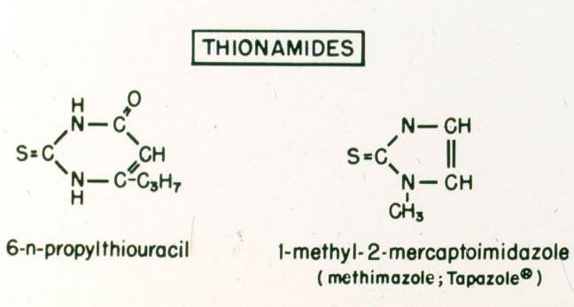
Notes:
Number 22

Slide 17
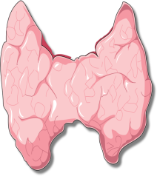
Mother
Placenta
Fetus
TRH
TRH
TSH
T3
T3
TSH
T4
T4
Stimulate
TSH receptor antibodies
Block
TPOAb & TgAb
Anti-thyroid drugs
Block
Spencer CA 2006

Slide 18
Notes:
Number 23

Slide 19
Management of hyperthyroidism during pregnancy in Asia Azizi F, Amouzegar A, Mehran L, Alamdari SH, Subekti I, Bijay V, Poppe K, Sarvghadi F, San Luis Jr T, Akamizu T Endocrin Journal, 2014; 61 (8): 751-758

Slide 20
A 26 year old woman is newly diagnosed with Graves’ disease. She has no goitre or thyroid eye disease and expresses her wish to become pregnant soon. Provided that the patient’s preference is neutral, how would you treat her thyrotoxicosis?
Methimazole/carbimazole
Propylthiouracil
Refer for definitive treatment with surgery before pregnancy
Refer to definitive treatment with radioiodine before pregnancy

Slide 21
A 26 year old woman is newly diagnosed with Graves’ disease. She has no goitre or thyroid eye disease and expresses her wish to become pregnant soon. Provided that the patient’s preference is neutral, how would you treat her thyrotoxicosis?
Variable | %
A. Methimazole/carbimazole | 40
B. Propylthiouracil | 52
C. Refer for definitive treatment with surgery before pregnancy | 4
D. Refer to definitive treatment with radioiodine before pregnancy | 4

Slide 22
Reported cases of severe liver failure in pregnancy occurring secondary to PTU
Report | Country | Duration of PTU exposure (gestation) | Management | Maternal outcom | Fetal outcome
Parker | Canada | 6 months (20 weeks) | PTU discontinued; treated with MMI and propranolol | Recovered | Not described
Morris et al. | USA | Unclear (25 weeks) | PTU discontinued; treated with MMI and propranolol; required liver transplant | Recovered | Growth retardation, premature, jaundice, fetal death
Kontoleon et al. | Greece | Unclear | Cessation of PTU at 12 weeks; conversion to CBZ | Recovered Uneventful | Recovered Uneventful
Ruiz et al. | Chile | 5 months (4 months) | Liver failure requiring ICU, initial recovery; however, subsequent miscarriage and recurrence of liver failure and death | Death | Death
Sequeira et al. | Kenya/ USA | 7 weeks (17 weeks) | Liver transplant at 18 weeks’ gestation. Thyroidectomy | Recovered | MRI features suggestive of antenatal ischemic encephalopathy. Developmental delay
Taylor et al. | UK | 16 weeks (20 weeks) | Immediate cessation of PTU; started CBZ 3 weeks later. Transplant considered but not required | Recovered | Healthy baby at term
Taylor PN, et al. Side effects of anti-thyroid drugs and their impact on the choice of treatment for thyrotoxicosis in pregnancy. Eur Thyroid J 2012; 1: 176-85

Slide 23
Major adverse reactions to propylthiouracil
22 serious liver injury over the past 20 years
(FDA Adverts Event Reporting System)
9 death
5 liver transplants
16 adults liver transplants for PTU-related liver failure
(United Network for Organ Sharing)
Ocurrence:
1: 10,000 adults
1: 2,000 children
Liver failure can occur any time over the course of therapy
Bahn et al. Thyroid 2009; 19: 673

Slide 24
Reported cases of agranulocytosis secondary to antithyroid drugs during pregnancy and subsequent outcomes
Taylor PN, et al. Side effects of anti-thyroid drugs and their impact on the choice of treatment for thyrotoxicosis in pregnancy. Eur Thyroid J 2012; 1: 176-85

Slide 25
Comparison of recommendations of American Thyroid Association and Endocrine Society on the treatment of hyperthyroidism in pregnancy
Topic | Recommendations
 | American Thyroid Association (2011) | Endocrine Society (2012)
Antithyroid (ATD) treatment | PTU is preferred for the treatment of hyperthyroidism in the first trimester, patients on MMI should be switched to PTU if pregnancy is confirmed in the first trimester. Following the first trimester, consideration should be given to switching to MMI | Propylthiouracil (PTU), if available, is recommended as the first-line drug for treatment of hyperthyroidism during the first trimester of pregnancy because of the possible association of methimazole (MMI) with specific congenital abnormalities that occur during first trimester organogenesis, MMI may also be prescribed if PTU is not available or if a patient cannot tolerate or has an adverse response to PTU. Practitioners should use their clinical judgment in choosing the ATD therapy, including the potential difficulties involved in switching patients from one drug to another, If switching from PTU to MMI, thyroid function should be assessed after 2 wk and then at 2-to 4-wk intervals.

Slide 26
The following recommendation is based on limited or inconsistent scientific evidence (Level B):
Either propylthiouracil or methimazole, both thioamides, can be used to treat pregnant women with overt hyperthyroidism.
The American College of Obstetricians and Gnecologists, 2015

Slide 27
What tests would you use to monitor the dose of antithyroid drugs in pregnancy?
Free T4 alone TSH and Free T4 TSH alone | D. TSH, and total T4 E. TSH, total T4 and total T3 F. Other

Slide 28
What tests would you use to monitor the dose of antithyroid drugs in pregnancy?
Variable | %
A. Free T4 alone | 9
B. TSH and Free T4 | 53
C. TSH Alone | 20
D. TSH, and total T4 | 5
E. TSH, total T4 and total T3 | 9
F. Other | 4

Slide 29
What are the target thyroid test results you aim to achieve with antithyroid drugs in pregnancy?
TSH and FT4 (or TT4) in the normal range
Low TSH and FT4 (or TT4) in the normal range
Low TSH and FT4 (or TT4) in the upper end of the normal range
Low TSH, independent of FT4 (or TT4) levels
Other (please specify)

Slide 30
What are the target thyroid test results you aim to achieve with antithyroid drugs in pregnancy?
Variable | %
TSH and FT4 (or TT4) in the normal range | 24
B. Low TSH and FT4 (or TT4) in the normal range | 6
C. Low TSH and FT4 (or TT4) in the upper end of the normal range | 66
D. Other (please specify) | 4

Slide 31
Should anithyroid drug therapy be discontinued in the last part of pregnancy?
Can postpartum recurrence of Graves’ disease be prevented by the continuation of antithyroidis during pregnancy?

Slide 32
Postpartum recurrence and exacerbation of Graves’ hyperthyroidism
Nekagawa et al. Clin Endocrinol 57: 467,2002

Slide 33
What are the long-term effects of antithyroid treatment in pregnancy on growth, intellectual development and thyroid function of the offspring?

Slide 34
Wechsler tests scores in children whose mothers were taking methimazol (MMI)
( ), and in control ( )
20
control
case
15
IQ (verbal)
10
5
0
Information
Vocabulary
Mathe matics
Similarities
Comprehension
Sentences
Azizi et al.J Endocrinol Invest 2002;25:586

Slide 35
In a pregnant woman with Grvave’s disease treated with antithyroid drug, do you routinely chack TSH receptor antibodies?
No
Yes, in each trimester
Yes, in the 26 weeks
Yes, in the first trimester, and if positive repeat in the third trimester

Slide 36
TSH receptor antibody tests: Diagnostic use
True GD hyperthyroidism can not occur without TRAb
The use of TRAb as the primary test in the workup?!
Differential diagnostic test of hyperthyroidism:
Radioiodine uptake and scan $1000
Third generation TRAb test $70
TBI assays: 99% specificity and 97% sensitivity in untreated hyperthyroids
Differential test from:
Subacute painless thyroiditis
Postpartum thyroiditis
Interferon induced thypotoxicosis
Amiodaron-induced thyrotoxocosis (type 1)
Barbesino G, et al. J Clin Endocrinol Metab 2013; 98: 2247.
Kahaly GJ, Thyroid 2011; 21: 585–591.
Davies TF, J Clin Endocrinol Metab 1998; 83: 3777–3785.

Slide 37
TSH receptor antibody tests: Prognostic use
Excellent predictive value of TSH for relapse in the first 6 months
Positive predictive value of 97% for relapse of hyperthyroidism in 8 weeks
Overall, 53% relapse in TRAb positive and 39% relapse in TRAb negative
Testing TRAb in euthyroid GD to select those with active disease
>90% of euthyroid Go have positive TSI
Feldt-Rasmussen U, et al. J Clin Endocrinol Metab 1994;78:98–102.
Davies TF, et al. Lancet 1977; 1: 1181–1182.
Carella C, et al. Thyroid 2006; 16:295–30.

Slide 38
TSH receptor antibody in pregnancy
A significant decrease in TRAb during pregnancy
Euthyroid or hypothyroid GD patients may still have high TRAb
High TRAb is more common after radioiodine therapy
Fetal and neonatal thyrotoxicosis occur in 1-5% of mothers with current or past GD.
TRAb is the best predictor (predictive value 42%)
Over 3 times UNL of TRAb at 24-28 weeks →close follow-up of the fetus.
Barbesino G, et al. J Clin Endocrinol Metab 2013; 98: 2247.
Kamijo K. Endocr J 2007;54:619–624.
Laurberg P, et al. Eur J Endocrinol 2009; 160: 1–8.

Slide 39
WHAT IS THE VALUE OF TSHRAB MEASUREMENT IN THE EVALUATION OF A PREGNANT WOMAN WITH GRAVES’ HYPERTHYROIDISM?
If the patient has a past or present history of Graves’ disease, a maternal serum measure of TSHRAb should be obtained at 24-28 weeks gestation.
Lution O et al. J Clin Endocrinol Metab 2005; 90: 6093
Laurberg P et al. Europ J Endocrinol 2009;160: 1-8
Zwaveling- Soonawala N et al. Thyroid 2009; 19: 661-2.

Slide 40
TSH receptor autoimmunity in Graves’ disease after therapy
70
60
50
40
TRAb %
30
Radioiodine
20
Surgery
10
Medication
0
0 1 2 3 4 5
Laurberg et al EJE 2008
Years

Slide 41
UNDER WHAT CIRCUMSTANCES SHOULD ADDITIONAL FETAL ULTRASOUND MONITORING FOR GROWTH, HEART RATE, AND GOITER BE PERFORMED IN WOMEN WITH GRAVES’ HYPERTHYROIDISM IN PREGNANCY?
Fetal surveillance should be performed in women who have uncontrolled hyperthyroidism or who have highly elevated TSHRAb titers. Such monitoring may include ultrasound monitoring for heart rate, growth, and fetal goiter.
Papendieck P et al. J Ped Endocrinol Metabol 2009; 22: 547

Slide 42
Management of thyrotoxicosis in pregnancy
Confirm diagnosis
Start propylthiouracil in first trimester; methimazole in the 2nd and 3nd trimester
Render patient euthyroid: continue with low-dose ATD up to and during labor and postpartum
Monitor thyroid function:
Throughout gestation; adjust ATD if necessary to maintain
T4 at upper level of normal
Check TSHRAb at 26 weeks
Discuss treatment with patient
effect on patient
effect on fetus
breast feeding
Inform obstetrician and pediatrician
Review postpartum-check for exacerbation

Slide 43
Algorithm for the detection of thyroid dysfunction in pregnancy based on initial serum TSH determination
Serum TSH determination in early gestation
First trimester reference range
Below
Above
Within
Measure FT4I or free T4
No further action
Hyperthyroidism
Hypothyroidism
T4 status elevated measure TR-Ab TPO-Ab usually positive
T4 status normal
( or moderately elevated) TPO-Ab usually negative
T4 status subnormal TPO-Ab positive or negative
T4 status normal
TPO-Ab positive
TPO-Ab negative
Overt thyrotoxicosis
( probable cause: gestational transient thyrotoxicosis)
Subclinical thyrotoxicosis ( probable cause: gestational transient thyrotoxicosis)
Overt hypothyroidism
Subclinical hypothyroidism
Isolated hypo- T4
Antithyroid drugs Monitor TR- Ab ( for risk of fetal hyperthyroidism)
No treatment needed in most cases
Levothyotoxine
Levothyotoxine
Glinoer D, Spencer CA. Nat Rev Endocrinol 2010; 6: 526

Slide 44
Characteristics of major causes of postpartum thyrotoxicosis
Characteristic† | Graves’ Disease | Postpartum Thyroiditis
Etiology | Autoimmune | Autoimmune
Frequency | Common | Most common
Symptoms | Moderate to severe | Mild to moderate
ESR | Normal | Normal
RAI uptake | High | Low
TPO antibodies | High | High
TSH-R antibodies | Present | Absent
T₃/T₄ ratio | High | Low
† ESR denotes erythrocyte sedimentation rate, RAI radioiodine, TPO thyroid peroxidase, and TSH-R antibodies thyrotropin receptor-stimulating antibodies
Azizi F. J Endocrinol Invest 2006; 29: 244-247.

Slide 45
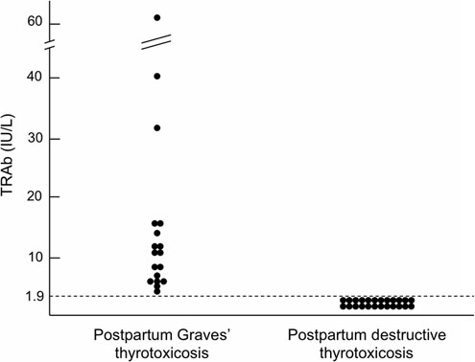
Comparison of antithyrotropin receptor antibodies (TRAb) between postpartum Graves’ thyrotoxicosis and postpartum destructive thyrotoxicosis
Ide A, et al. Thyroid 2014; 24: 1027-31.

Slide 46
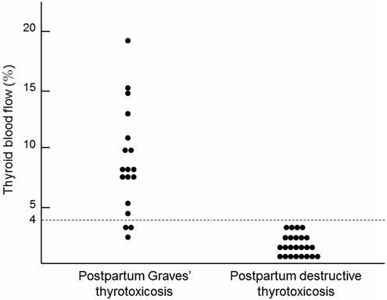
Comparison of thyroid blood flow between postpartum Graves’ thyrotoxicosis and postpartum destructive thyrotoxicosis
Ide A, et al. Thyroid 2014; 24: 1027-31.

Slide 47
A 30 year old woman is 3 months postpartum and lactating. She has a relapse of Graves’ disease. What advise will you give?
Start methimazole/carbimazole and stop lactation
Start methimazole/carbimazole but continue lactation
Start propylthiouracil and stop lactation
Start propylthiouracil but continue lactation
Other (please specify)

Slide 48
A 30 year old woman is 3 months postpartum and lactating. She has a relapse of Graves’ disease. What advise will you give?
Method | %
A. Start methimazole/carbimazole and stop lactation | 16
B. Start methimazole/carbimazole but continue lactation | 54
C. Start propylthiouracil and stop lactation | 6
D. Start propylthiouracil but continue lactation | 24

Slide 49
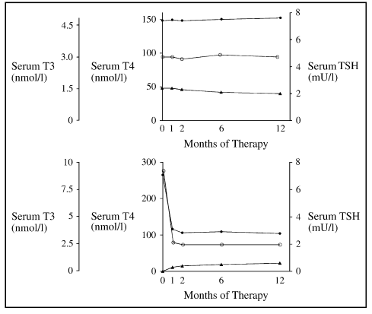
Thyrotoxic lactating mothers were treated with an initial dose of 20–30 mg methimazole daily. The dose of methimazole was 10 mg in the second month and 5–10 mg thereafter and continued until the end of first year of treatment. Values for all infants were in the normal range up to 12 months after treatment of their mothers
Azizi F, et al. Current Opinion in Endocrinology and Diabetes 2005, 12: 471—476

Slide 50
HOW SHOULD GRAVES’ HYPERTHYROIDISM BE TREATED IN LACTATING WOMEN?
Methimazole in doses up to 20-30 mg daily is safe for lactating mothers and their infants.
PTU is a second-line agent due to concerns about severe hepatotoxicity, but is safe for lactating mothers and their infants in doses up to 300 mg daily.
Azizi F et al J Endocrinol Invest 2006; 29:244
Azizi F et al. J Ped Endocrinol Metab 2003; 16: 1239
Azizi F et al. J Clin Endocrinol Metab 2000; 85: 3233

Slide 51
Conclusion
Thyroid diseases, both clinical and subclinical, are common during pregnancy and postpartum and influence the health of mother, fetus and infant.
Effective evidence based strategies for both detection and management should be developed for the benefit of both mother and child.
Prompt and appropriate treatment of thyroid disease could dramatically improve the pregnancy outcome and ensure health promotion for mother and infant.

Slide 53
Thyrotoxicosis complications (in pregnancy)
Intervening growth retardation
Congestive heart failure
Feval hydrops
Placenta abruption
Preterm Delivery Abruption
Preterm delivery
Miscarriages
Pre-eclampsia

