Slide 1
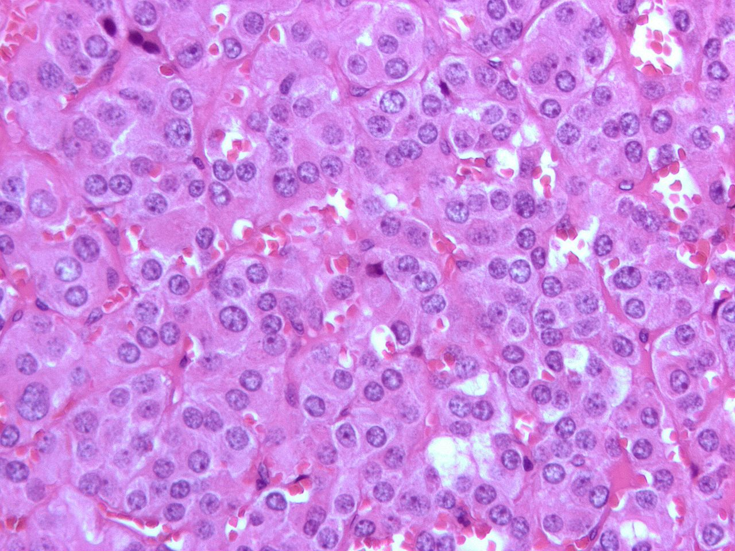
In The Name of God
Pheochromocytoma and Paraganglioma: An Endocrine Society Clinical Practice Guideline
J Clin Endocrinol Metab, June 2014,
jcem.endojournals.org
Sheila Afsharian
MD Research Institute for Endocrine Sciences
Shahid Beheshti University of Medical Sciences

Slide 2
Aim
Formulate clinical practice guidelines for pheochromocytoma and paraganglioma (PPGL).
Evidence:
  This evidence-based guideline was developed using the (GRADE) system to describe both the strength of recommendations and the quality of evidence.
    Grading of Recommendations
    Assessment
    Development
    Evaluation

Slide 3
METHOD OF DEVELOPMENT OF EVIDENCEBASED
CLINICAL PRACTICE GUIDELINES
In terms of the strength of the recommendation,
  Strong recommendations use the phrase “we recommend” and the numbe1.
  Weak recommendations use the phrase “we suggest and the number 2.
Cross-filled circles indicate the quality of the evidence, such
  QEEE denotes very low quality evidence
  QQEE, low quality
  QQQE, moderate quality
  QQQQ, high quality

Slide 4
METHOD OF DEVELOPMENT OF EVIDENCEBASED
CLINICAL PRACTICE GUIDELINES
Linked to each recommendation is a description of the Evidence and the values that panelists considered in making the recommendation
In some instances, there are remarks, a section in which panelists offer
  technical suggestions for testing conditions
  dosing
  monitoring.

Slide 5
Definition of pheochromocytoma and paraganglioma (PPGL)
Pheochromocytoma
  Tumor arising from adrenomedullary chromaffin cells.
  Commonly produces one or more catecholamines: E,NE, and dopamine.
  Rarely, these tumors are biochemically silent.
Paraganglioma
  Tumor derived from extra-adrenal chromaffin cells of the sympathetic paravertebral ganglia of thorax, abdomen, and pelvis.
  Paragangliomas also arise from parasympathetic ganglia located along the glossopharyngeal and vagal nerves in the neck and at the base of the skull; these do not produce catecholamines.
About 80 to 85% of chromaffin-cell tumors are pheochromocytomas, whereas 15 to20%are paragangliomas . Together they will be referred to here as PPGL.

Slide 6
The prevalence of PPGL
The prevalence of PPGL
  In patients with HTN in general outpatient clinics varies between 0.2 and 0.6%
  In children with HTN, the prevalence of PPGL is approximately 1.7% .
Nearly 5% of patients with incidentally discovered adrenal masses on imaging have a pheochromocytoma.
The prevalence of PPGL in individuals carrying a germline mutation in PPGL may be around 50%.
Patients with hereditary PPGLs typically present with multifocal disease and at a younger age than those with sporadic neoplasms

Slide 7
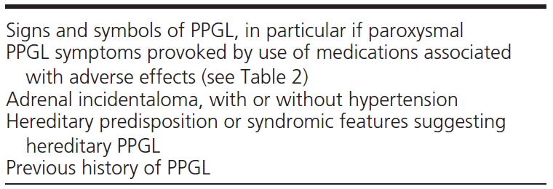
Table 1. Clinical Settings for Testing for PPGL

Slide 8
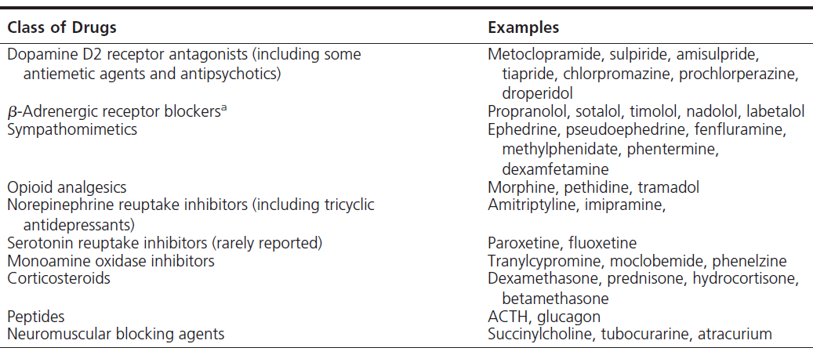
Table 2. Medications That Are Implicated in Adverse Reactions in Patients with Pheochromocytoma and That Can Precipitate a Crisis

Slide 9
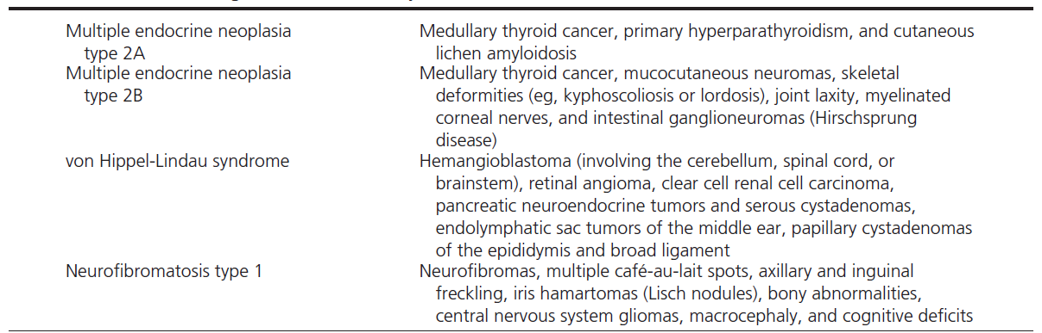
Table 3. Clinical Findings Associated with Syndromic PPGL

Slide 10
Biochemical Testing for Diagnosis of
Pheochromocytoma and Paraganglioma
(1QQQQ)Recommendation ,We recommend that initial biochemical testing for PPGLs should include
  Measurements of plasma free metanephrines or
  Urinary fractionated metanephrines.
  The free metanephrines are produced within adrenal chromaffin cells by membrane-bound catecholamine O-methyltransferase. Lack of this enzyme in sympathetic nerves, the major site of initial norepinephrine metabolism, means that the O-methylated metabolites are relatively specific markers of chromaffin tumors.

Slide 11
Biochemical Testing for Diagnosis of
Pheochromocytoma and Paraganglioma
There can be no recommendation that one test (plasma and urinary measurements by “gold standard” mass spectrometric methods) is superior to the other.
All measurements of fractionated metanephrines remain recommended as initial screening tests.

Slide 12
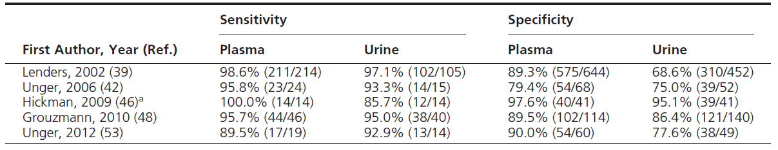
Table 5. Comparison of Diagnostic Performance of Plasma Free Versus Urinary Fractionated Metanephrines from 5 Available Studies

Slide 13
Measurement methods
(2QQEE)Recommendation
  We suggest using liquid chromatography with mass spectrometric or electrochemical methods rather than other methods to establish a biochemical diagnosis of PPGL.

Slide 14
Preanalytical sampling conditions and reference intervals
(2QQEE) Recommendation
  For measurements of plasma metanephrines, we
  suggest drawing blood with the patient in the sup position and use of reference intervals established in the sam position :
    This recognizes the rapid circulatory clearances of the metabolites.
    The strong influence of sympathetic activation and upright posture to stimulate release of norepinephrine and metabolism to normetanephrine.
    Likely the lack of response in patients with PPGLs.

Slide 15
Remarks
For drawing blood in the supine position for measurement of plasma metanephrines, patients should be fully recumbent for at least 30 minutes before sampling.
Age adjustments for Upper cutoffs to both maintain diagnostic sensitivity and minimize false-positives associated with higher plasma concentrations of normetanephrine in older patients.

Slide 16
Interpretation of test results and follow-up
(1QQEE)Recommendation
  We recommend that all patients with positive test results should receive appropriate follow-up according to the extent of increased values and clinical presentation.

Slide 17
Evidence
The positive test result are borderline :
  In most situations this is due to inappropriate sampling and is easily dealt with by repeat sampling in the supine position.
  If results remain elevated, the clonidine suppression test with measurements of plasma normetanephrine provides one method to distinguish true-positive from false-positive borderline elevations of that metabolite

Slide 18
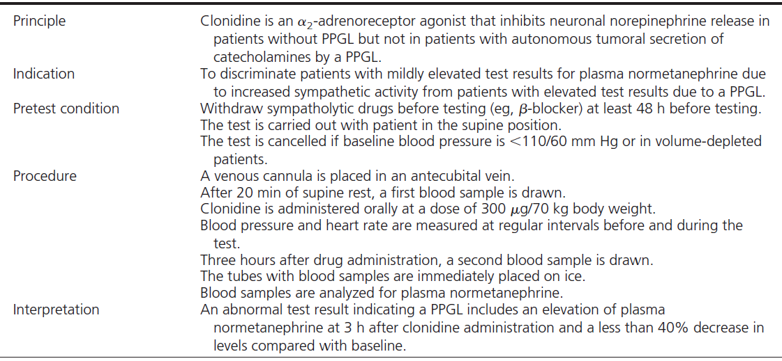
Table 6. Protocol for Clonidine Suppression Test

Slide 19
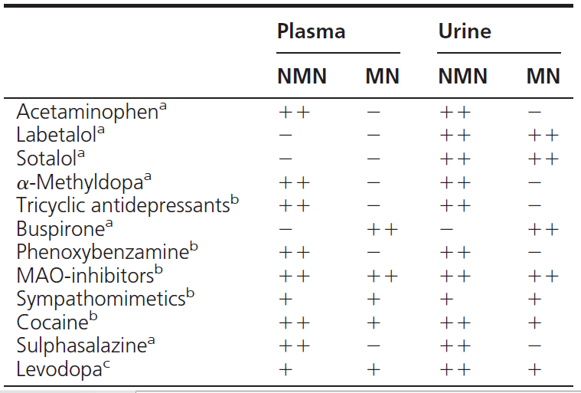
Table 7. Major Medications That May Cause Falsely
Elevated Test Results for Plasma and Urinary Metanephrines

Slide 20
Values and preferences
The committee recommends that all positive results should be followed up.
Adopt a wait and-retest approach, or proceed directly to imaging studies remains a matter of clinical judgment based on the pretest probability of the tumor and the extent and pattern of increases in test results.

Slide 21
Imaging Studies
(1QQEE) Recommendation
We recommend that imaging studies to locate PPGLs should be initiated once there is clear biochemical evidence of a PPGL.
Clinicians should be aware of where PPGL can be biochemically negative, even when collections of specimens and biochemical measurementsare correctly employed:
  Skull base and neck paragangliomas, often biochemically silent .
  Paragangliomas in patients with SDHx mutations.
  These paraganglioma consequently can reach a large size. Thus, only imaging studies can detect the presence of these tumors.

Slide 22
Recommendation
We suggest CT rather than MRI as the first-choice
imaging modality because of its excellent spatial resolutio for thorax, abdomen, and pelvis. (2QQQE)
CT with contrast provides an excellent initial method for the localization of PPGLs, with sensitivity between 88 and 100%.

Slide 23
Evidence
On CT:
  PPGLs may be homogeneous or heterogeneous, necrotic with some calcifications, solid, or cystic.
  Although between 87 and 100% of PPGLs exhibit a mean attenuation of >10 Hounsfield units on unenhanced CT.
  PPGLs can occasionally >60% washout of contrast agents on 15-minute delayed scanning.
Contrast CT can be performed in patients without adrenergic receptor blockade.
CT scan of the abdomen and pelvis should be the first option.
Sensitivity of CT for extra-adrenal, residual, recurrent, or metastatic tumors can be <57% and inferior to MRI .
CT is preferred to MRI for detection of lung metastatic lesions.

Slide 24
Recommendation
(1QQQE) We recommend MRI in:
  Patients with metastatic PPGLs.
  Detection of skull base and neck paragangliomas.
  Patients with surgical clips causing artifacts when using CT.
  Patients with an allergy to CT contrast.
  Patients in whom radiation exposure should be limited (children, pregnant women, patients withknown germline mutations, and those with recent excessive radiation exposure).
  MRI should not be performed in patients who have intracranial aneurysm clips.

Slide 25
Recommendation
(2QEEE) We suggest the use of 123I-metaiodobenzylguanidine (MIBG) scintigraphy as a functional imaging modality in :
  Patients with metastatic PPGLs detected by other imaging modalities when radiotherapy using 131I-MIBG is planned.
  Occasionally in some patients with an increased risk for metastatic disease due to:
    Large size of the primary tumor
    Extra-adrenal
    Multifocal (except skull base and neck PPGLs)
    Recurrent disease

Slide 26
Evidence
123I-MIBG has better sensitivity than 131-IMIBG for detection of PPGLs.
Because up to 50% of normal adrenal glands demonstrate physiological uptake of 123I-MIBG, false positive results can be a problem.

Slide 27
Evidence
Sensitivity of 123I-MIBG is <50% For:
  SDHB-related PPGLs
  The detection of skull base , neck, thoracic, bladder paraganglioma
  Recurrent paragangliomas
123IMIBG is inferior to 18F-FDG-PET, 18F-FDOPA, or somatostatin receptor imaging with 111In-diethylene triamine pentaacetic acid-pentetreotide for:
  Paragangliomas or
  Metastatic disease including SDHx-related tumors
Patients with metastatic PPGLs surgery is not an option, 123I-MIBG scintigraphy is useful because, if positive, treatment with 131I-MIBG may be considered.

Slide 28
Remarks
  Accumulation of 123I-MIBG can decreased :
  Necrotic tumors
Several drugs:
  Sympathomimetics.
  Agents that block catecholamine transport via the norepinephrine transporter, such as cocaine and TCA.
  Agents such as CCB and some combined α- and β -adrenergic receptor blockers such as labetalol.
  Most of these drugs should be withheld for about 2 weeks before 123I-MIBG scintigraphy.
Use of 123I-MIBG scintigraphy and PET is contraindicated in pregnant women.

Slide 29
Recommendation
(2QQQE) We suggest the use of 18F-FDG PET/CT scanning in patients with metastatic disease.
Study of Shulkin et al showed a superiority of 18F-FDG PET compared with 131I-MIBG scintigraphy for detection of metastatic PPGLs.
Sensitivity of 18F-FDG PET was shown to be between 74 and 100%, with the highest performance for metastatic, particularly SDHB-related.
The committee recognizes that some studies indicated that 18F-FDG PET is complementary with other functional imaging studies in some patients.

Slide 30
Recommendation
(1QQQE)We recommend that all patients with PPGLs should be engaged in shared decision making for genetic testing.

Slide 31
Evidence
There are several reasons to consider genetic testing in all patients who present wit PPGLs:
  At least 1/3of all patients with PPGLs have disease-causing germline mutations.
  Mutations of SDHB lead to metastatic disease in 40% of affected patients.
  Establishing a hereditary syndrome in the proband may result in
    Earlier diagnosis and treatment of PPGLs and
    Other syndromic manifestations in relatives.

Slide 32
Genetic Testing
Genetic testing has limited incremental value in:
  Patients with unilateral pheochromocytoma.
  No syndromic .
  No malignant features.
  No positive family history.

Slide 33
Genetic Testing
The highest frequencies of germline mutations are for:
  SDHB (10.3%)
  SDHD (8.9%)
  VHL (7.3%)
  RET (6.3%)
  NF1 (3.3%)
  Germline mutation frequencies of less than 2% are found for SDHC,SDHA,MAX, and TMEM127 .

Slide 34
Recommendation
(1QQQE) We recommend the use of a clinical feature-driven diagnostic algorithm to establish the priorities for specific genetic testing in PPGL patients with suspected germline mutations with Considerations of :
  Young age at PPGL presentation.
  Positive family history.
  Presentation of multifocal PPGLs.
  Bilateral adrenal tumors are also recommended for prioritizing patients for testing.

Slide 35
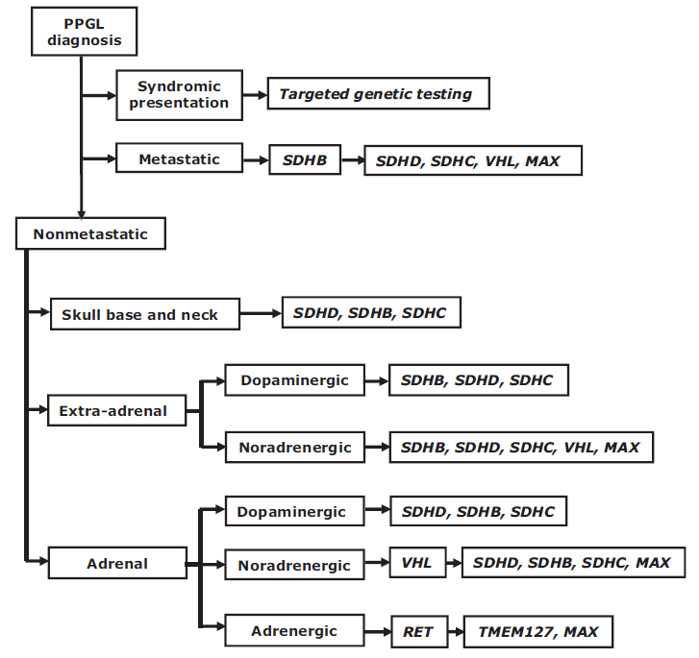
Figure 1. Decisional algorithm for genetic testing in patients with a proven PPGL.
Dopaminergic, noradrenergic, and adrenergic phenotypes are defined as significant productions of respective 3-methoxytyramine, normetanephrine, and metanephrine relative to combined production of all three metabolites.

Slide 36
Evidence
SDHD-related PPGL
  Multiple skull base and neck tumors or
  A family history of PPGL in the paternal branch.
SDHB-related PPGLs
  Single extra-adrenal tumor without any family history.
SDHC mutation carriers are rare but may develop all the stigmata of the disease.
SDHA and SDHAF2 mutation were described in only a few patients.
Negative SDHB immunohistochemistry in tumoral tissue suggests the presence of a mutation in one of the SDHx genes.
SDHx-related PPGLs are detected by measurements of normetanephrine and methoxytyramine.

Slide 37
Evidence
Hereditary PPGL due to TMEM127 or MAX mutations are:
  Infrequent.
  Typically diagnosed later in life.
  Preferentially adrenal in location.
  Patients frequently have a positive family history.
  TMEM127-related PPGLs typically produce epinephrine.
  MAX-related tumors is intermediate between adrenergic and noradrenergic

Slide 38
Recommendation
We suggest that (2QQQE)
  Patients with paraganglioma undergo testing of SDH mutations.
  Patients with metastatic disease undergo testing for SDHB mutations.
Pretest and post-test counseling should be available.All tests for PPGL genetic testing should be performed by accredited laboratories.

Slide 39
Perioperative Medical Management
Recommendation
  We recommend,All patients with a hormonally functional PPGL should undergo preoperative blockade to prevent perioperative cardiovascular complications. (1QQEE)
  We Suggest alpha adrenergic receptor blockers as the first choice. (2QQEE)

Slide 40
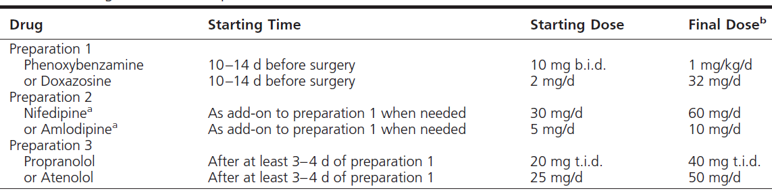
Table 9. Presurgical Medical Preparation

Slide 41
Perioperative Medical Management
Evidence:
α-adrenergic receptor blockers as the first-choice drug to minimize peri operative complications and associated with:
  Lower preoperative diastolic pressure.
  Lower intra operative heart rate.
  Better postoperative hemodynamic recovery .
  Fewer adverse effects such as
    Reactive tachycardia and
    Sustained postoperative hypotension than nonselective adrenergic blockers .

Slide 42
Perioperative Medical Management
Calcium channel blockers are the most often used add-on drug class to further improve BPcontrol in patients already treated with α -adrenergic receptor.
Monotherapy with CCB is not recommended unless
  Patients have very mild preoperative HTN .
  Have severe orthostatic hypotension with α-adrenergic receptor blockers.
  Highe doses usually unnecessary.
α -Methyl-paratyrosine (metyrosine)
  Inhibits catecholamine synthesis and may be used in combination with α -blockers for a short period before surgery to further stabilize BP to reduce blood loss and volume depletion during surgery.

Slide 43
Perioperative Medical Management
β-blockers
  Control tachycardia only after administration of α –blockers.
  Because of the potential for hypertensive crisis due to unopposed stimulation of α -adrenergic receptors.
  There is no evidence to support the preference of B1-selective blockers over nonselective-blockers.
  Labetalol :more potent β than α antagonistic activities (α: β of 1:5) should not be used as the initial therapy because it can result in paradoxical HTN or even hypertensive crisis.

Slide 44
Recommendation
(1QQEE)We recommend preoperative medical treatment for 7 to 14 days to allow adequate time to normalize BP and heart rate.
Evidence:
α-blockers
  Should be started at least 7 days preoperatively to normalize BP and reverse blood volume contraction.
  Intravenous infusion of phenoxybenzamine for 5 hours per day for 3 days before surgery has been reported as one effective approach.

Slide 45
Evidence
Treatment should also include a high-sodium diet and fluid intake to reverse catecholamine- induced blood volume contraction preoperatively to prevent severe hypotension after tumor removal.
High-sodium diet a few days after the start of α-adrenergic receptor blocked:
  Adeverses blood volume contraction.
  Prevents orthostatic hypotension before surgery.
  Reduces the risk of significant hypotension after surgery . Continuous administration of saline (1–2 L) is also helpful if started the evening before surgery.
  Treatment with α-blockers alone was shown to reverse blood volume contraction in only about 60% of patients.

Slide 46
Evidence
Caution is required for volume loading in patients with heart or renal failure.
BP< 130/80 mmHg while seated and systolic >90 mm Hg while standing seems reasonable.
Target heart rate of 60–70 bpm seated and 70–80 bpm standing . These targets should be modified in each patient according to age and accompanying cardiovascular diseases .

Slide 47
Recommendation
We recommend monitoring BP, heart rate, and blood glucose levels with adjustment of associated therapies in the immediate postoperative period. (1QQEE)
Evidence
The major potential postoperative complications are hypertension, hypotension, and rebound hypoglycemia. Our recommendation that blood pressure, heart rate and plasma glucose levels should be closely monitored for 24–48h.

Slide 48
Evidence
Because of potential adrenal insufficiency, particular attention needs to be paid to patients who undergo:
  Bilateral adrenalectomy.
  Bilateral cortical-sparing adrenalectomy.
  Unilateral cortical-sparing adrenalectomy of a sole remaining adrenal gland.

Slide 49
Recommendation
(2QQEE) We suggest measuring plasma or urine levels of metanephrines on follow-up to diagnose persistent disease.
We suggest lifelong annual biochemical testing to assess for
  Recurrent
  Metastatic disease.
Remark To document successful tumor removal, biochemical testing should be performed upon recovery of the patient from surgery (2–4 wk after surgery).

Slide 50
Recommendation Surgery
(1QQEE)We recommend minimally invasive adrenalectomy (laparoscopic) for most adrenal pheochromocytomas.
(1QEEE)We recommend open resection for
  Large ( >6 cm)
  Invasive pheochromocytomas to ensure complete tumor resection, prevent tumor rupture, and avoid local recurrence.
(2QEEE)We suggest open resection for paragangliomas, but laparoscopic resection can be performed for
  Small, noninvasive paragangliomas in surgically favorable locations.

Slide 51
Evidence
Laparoscopic adrenalectomy
  Mortality rate is about 1%
  Conversion rate and transfusion rate are about 5% (rate of conversion to open resection is influenced by
    Tumor size
    Surgeon experience
Paragangliomas
  More likely to be malignant
  Frequently found in areas difficult fo laparoscopic resection

Slide 52
Remarks
Paragangliomas are more likely than pheochromocytomas to require open resection.
Laparoscopic adrenalectomy can be performed
  Transperitoneally
  Retroperitoneally
Seeding and recurrence of tumors in the adrenal bed or throughout the abdominal cavity can occur if
  Pheochromocytomas are fractured during dissection

Slide 53
Recommendation
(2QEEE) We suggest partial adrenalectomy for selected patients,such as
  Hereditary pheochromocytoma,
  Small tumors who have already undergone a contralateral complete adrenalectomy to spare adrenal cortex to prevent permanent hypocortisolism.
Successful partial adrenalectomy preserving sufficient adrenal cortex can prevent postoperative adrenal insufficiency
Larger tumors result in
  Smaller remnants
  Lower chance for steroid independence.
Partial adrenalectomy increases the risk for tumor recurrence from the remnant

Slide 54
Remarks
Partial adrenalectomy for
  Smaller tumors
  Periphery
  Away from the main adrenal vein is more likely to result in sufficient functioning of adrenal cortex.
Usually 1/3 (if central vein is preserved) to 1/2 of one adrenal gland is needed to preserve cortical function and avoid hypocortisolism, although as little as 15% of an adrenal gland has been found to be sufficient.

Slide 55
Personalized Management
Recommendation
  In recognition of the distinct genotype-phenoty presentations of hereditary PPGLs, we recommend a personalized approach to patient management (Ungraded recommendation).
    Biochemical testing
    Imaging
    Surgery
    Follow-up

Slide 56
Evidence
Mutations of RET and NF1 genes are almost always associated with
  Adrenal tumors that produce normetanephrine and metanephrine .
Tumors due to mutations of VHL and SDHx genes
  Lack significant production of metanephrine.
Characterize 70% of tumors in patients with mutations of SDHx genes
  Additional increases in methoxytyramine, the metabolite of dopamine.
  An increase in plasma methoxytyramine is also a common feature of patients with metastatic PPGLs.

Slide 57
Evidence
VHL-associated tumors occur principally at adrenal locations.
Tumors due to mutations of SDHxgenes
  occur mainly at extra-adrenal locations and include skull base and neck paragangliomas.
Patients with mutations of the SDHB gene deserve attention high risk of malignant disease.
  Typically large sizes
  Extra-adrenal location of associated tumors .
Malignant PPGLs
  Large tumor size and
  Extra-adrenal location

Slide 58
Remarks
All mutation carriers should receive annual biochemical surveillance for PPGLs.
The penetrance of PPGLs in NF1 is low, screening for these tumors need not be considered unless indicated by signs or symptoms.
High morbidity associated with undiagnosed PPGLs in patients with SDHB mutations mandates closer attention
  Biochemical testing
  Periodic imaging with MRI should be considered to detect biochemically silent tumors.

Slide 59
Recommendation
We recommend that patients with PPGLs should be evaluated and treated by multidisciplinary teams at centers with appropriate expertise.
Patients should be referred to such centers should there be
  Pregnancy
  Metastatic disease
  Complexity or difficulty in biochemical diagnosis; localization; performance, and interpretation of genetic testing preoperative preparation surgical treatment. (Ungraded recommendation)

Slide 60
Summary of Recommendations
Biochemical Testing for Diagnosis of Pheochromocytoma and Paraganglioma (PPGL).
Imaging Studies.
Genetic Testing.
Perioperative Medical Management.
Surgery.
Personalized Management.

Slide 61
Biochemical Testing for Diagnosis of Pheochromocytoma and Paraganglioma (PPGL)
We recommend that initial biochemical testing for PPGLs should include measurements of plasma free metanephrines or urinary fractionated metanephrines.
We suggest using liquid chromatography with mass spectrometric or electrochemical detection methods rather than other laboratory methods to establish a biochemical diagnosis of PPGL.
For measurements of plasma metanephrines, we suggest drawing blood with the patient in the supine position and use of reference intervals established in the same position.
We recommend that all patients with positive test results should receive appropriate follow-up according to the extent of increased values and clinical presentation.

Slide 62
Imaging Studies
We recommend that imaging studies to locate PPGL should be initiated once there is clear biochemical evidence of a PPGL.
We suggest (CT) rather than (MRI) as the first-choice imaging modality because of its excellent spatial resolution for thorax, abdomen, and pelvis.
We recommend MRI in patients with metastati PPGL, for detection of skull base and neck paragangliomas, in patients with surgical clips that cause artifacts when using CT, in patients with an allergy to CT contrast, and in patients in whom radiation exposure should be limited (children, pregnant women, patients with known germline mutations, and those with recent excessive radiation exposure).
We suggest the use of 123I-metaiodobenzylguanidine (MIBG) scintigraphy as a functional imaging modality in patients with metastatic PPGL detected by other imaging modalities when radiotherapy using 131I-MIBG is planned, and occasionally in some patients with an increased risk for metastatic disease due to large size of the primary tumor or to extra-adrenal, multifocal (except skull base and neck PPGLs), or recurrent disease.
We suggest the use of 18F-fluorodeoxyglucose (18FFDG) positron emission tomography (PET)/CT scanning in patients with metastatic disease. 18F-FDGPET/CTis the preferred imaging modality over 123I-MIBG scintigraphy in patients with known metastatic PPGL.

Slide 63
Genetic Testing
Were commend that all patients with PPGLs should be engaged in shared decision making for genetic testing.
We recommend the use of a clinical feature-driven diagnostic algorithm to establish the priorities for specific genetic testing in PPGL patients with suspected germline mutations.
We suggest that patients with paraganglioma undergo testing of succinate dehydrogenase (SDH) mutations and that patients with metastatic disease undergo testing for SDHB mutations.
We recommend that genetic testing for PPGL be delivered within the framework of health care. Specifically, pretest and post-test counseling should be available.

Slide 64
Perioperative Medical Management
We recommend that all patients with a hormonally functional PPGL should undergo preoperative blockade to prevent perioperative cardiovascular complications. We suggest -adrenergic receptor blockers as the first choice.
We recommend preoperative medical treatment for 7 to 14 days to allow adequate time to normalize blood pressure and heart rate. Treatment should also include a high-sodium diet and fluid intake to reverse catecholamine- induced blood volume contraction preoperatively to prevent severe hypotension after tumor removal.
We recommend monitoring blood pressure, heart rate, and blood glucose levels with adjustment of associated therapies in the immediate postoperative period.
We suggest measuring plasma or urine levels of metanephrines on follow-up to diagnose persistent disease.We suggest lifelong annual biochemical testing to assess for recurrent or metastatic disease.

Slide 65
Surgery
We recommend minimally invasive adrenalectomy (eg, laparoscopic) for most adrenal pheochromocytomas. (We recommend open resection for large (eg, 6 cm) or invasive pheochromocytomas to ensure complete tumor resection, prevent tumor rupture, and avoid local recurrence. We suggest open resection for paragangliomas, but laparoscopic resection can be performed for small, noninvasive paragangliomas in surgically favorable location.
We suggest partial adrenalectomy for selected patients, such as those with hereditary pheochromocytoma, with small tumors who have already undergone a contralateral complete adrenalectomy to spare adrenal cortex to prevent permanent hypocortisolism.

Slide 66
Personalized Management
In recognition of the distinct genotype-phenotype presentations of hereditary PPGLs, we recommend a personalized approach to patient management (ie, biochemical testing, imaging, surgery, and follow-up).
We recommend that patients with PPGLs should be evaluated and treated by multidisciplinary teams at centers with appropriate expertise to ensure favorable outcome. In particular, patients should be referred to such centers should there be pregnancy, metastatic disease, or issues concerning the complexity or difficulty in biochemical diagnosis; localization; performance and interpretation of genetic testing; preoperative preparation; surgical treatment; and follow-up

