Slide 1
Perioperative Management In Patient With Hypothyroidism
Prof. Ashraf Aminorroaya
Isfahan Endocrine and Metabolism Research
Center, Isfahan University of Medical Sciences

Slide 2
Prevalence of Hypothyroidism
Hypothyroidism is a common endocrinopathy, and is more prevalent in women and
with increasing age.
Primary hypothyroidism accounts for 95% of all cases.
The overall prevalence of hypothyroidism was 4.8%)Subclinical = 3.1(% in men and 12.8%
)Subclinical = 8.6 (%in women in Isfahan, Iran, 2006.
Within a 6-year follow-up, the incidence rate of hypothyroidism was 3.3 in women and 2.1 in men per 1000 (person-year)
Higher TPOAb concentration is its strong predictor of this incident.
Eur J Med Res (2017) 22:21 Arch Iran Med. 2009 May;12(3):262-70

Slide 3
Perioperative Management In Patient With Hypothyroidism
A significant number of patients who are undergoing surgery may have concomitant thyroid disease.
Due to the effects of thyroid hormone throughout the body, the effects of thyroid dysfunction are may complicate surgical procedures and postoperative recovery.
*Palace MR. Perioperative Management of Thyroid Dysfunction. Health service Insight 2017:1-5

Slide 4
Should perioperative TSH be measured routinely?
No
Routine screening to detect thyroid disease is not indicated in patients.
*where there is no index of suspicion hypothyroidism .
*Patients with taking thyroid medication on stable dose and euthyroidism was documented within the past 3 to 6 months.
* Manzullo Fe, Ross Ds. Nonthyroid surgery in the patient with thyroid disease. 2018: Available at https://www.uptodate.com/contents /nonthyroid-surgery-in-the-patient-with-thyroid-disease

Slide 5
Should perioperative TSH be measured?
YES
* History and physical examination are suggestive of thyroid disease.
* Poorly controlled symptom in patient with known hypothyroidism.
* Manzullo Fe, Ross Ds. Nonthyroid surgery in the patient with thyroid disease. 2018: Available at https://www.uptodate.com/contents /nonthyroid-surgery-in-the-patient-with-thyroid-disease

Slide 7
Cardiovascular System
* Decrease the Heart Rate
* Decrease the contractility
* Decrease the cardiac output (30-50%)
# ECG Abnormalities:
Slow Heart Rate
Long QT Interval and Ventricular Tachycardia
Nonspecific ST Change
Low Voltage
* Zaib H, Shan E. Undetected hypothyroidism and its anesthetic implications . Anesthesia, Pain & Intensive Care. 2012:16(2). 205-10
0

Slide 8
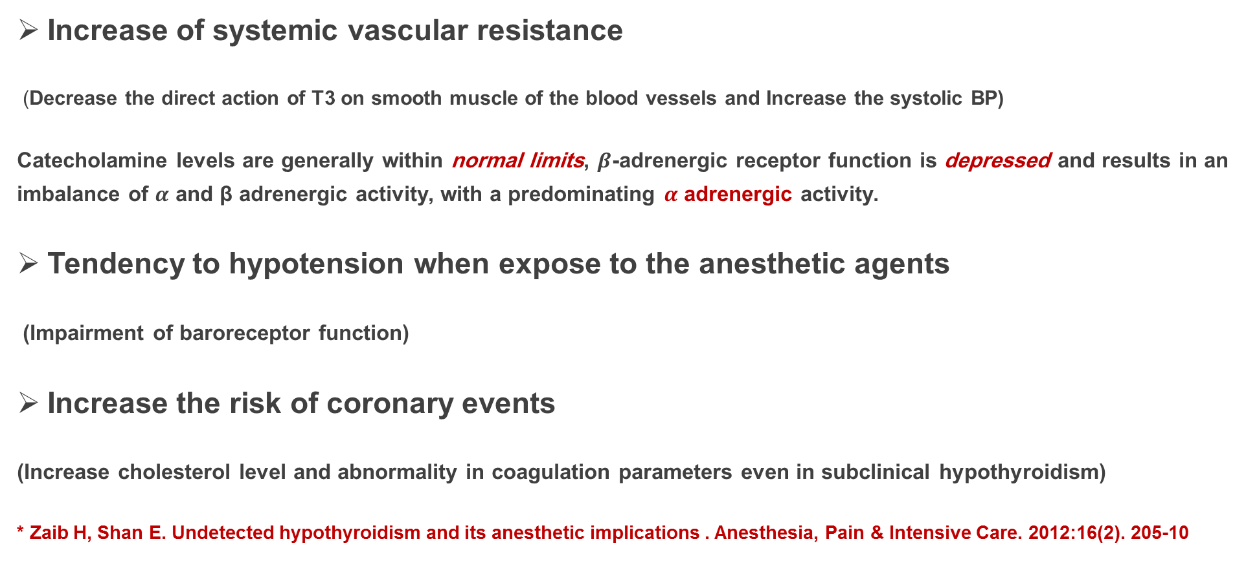
Cardiovascular System (cont.)
Increase of systemic vascular resistance
(Decrease the direct action of T3 on smooth muscle of the blood vessels and Increase the systolic BP)
Catecholamine levels are generally within normal limits, $β$-adrenergic receptor function is depressed and results in an imbalance of $α$ and β adrenergic activity, with a predominating $α$ adrenergic activity.
Tendency to hypotension when expose to the anesthetic agents
(Impairment of baroreceptor function)
Increase the risk of coronary events
(Increase cholesterol level and abnormality in coagulation parameters even in subclinical hypothyroidism)
* Zaib H, Shan E. Undetected hypothyroidism and its anesthetic implications . Anesthesia, Pain & Intensive Care. 2012:16(2). 205-10

Slide 9
Respiratory System
Decrease in hypoxic ventilatory drive (no increase in minute ventilation even at low alveolar oxygen tension)
Impaired Hypercapneic ventilatory drive
Diminished diffusing capacity for carbon monoxide
low maximal breathing capacity
Respiratory muscle weakness
* Zaib H, Shan E. Undetected hypothyroidism and its anesthetic implications . Anesthesia, Pain & Intensive Care. 2012:16(2). 205-10

Slide 10
Respiratory System (cont.)
Sleep apnea (can adversely influence surgical outcome or make postoperative extubation problematic)
Direct obstruction of the upper airway (increased tongue size)
Decrease the surfactant production
Decrease drug metabolism such as sedatives and anesthetics (precipitate respiratory failure)
*Zaib H, Shan E. Undetected hypothyroidism and its anesthetic implications . Anesthesia, Pain & Intensive Care. 2012:16(2). 205-10

Slide 11
Renal Function
Decrease Renal Perfusion
Decrease Atrial Natriuretic Factor
Decrease Activity of RAAS Hyponatremia
Increase ADH level
*Zaib H, Shan E. Undetected hypothyroidism and its anesthetic implications . Anesthesia, Pain & Intensive Care. 2012:16(2). 205-10

Slide 12
Renal Function (cont.)
Worsening of Renal Function
(Due to Intraoperative hypotension)
None pitting edema
( increase the capillary permeability and shift of water and albumin and deposition of glycosaminoglycans in severe hypothyroidism)
There have been some reports in the literature of hypothyroidism presenting as chronic renal failure, resolving completely with restoration of euthyroidism
*Zaib H, Shan E. Undetected hypothyroidism and its anesthetic implications . Anesthesia, Pain & Intensive Care. 2012:16(2). 205-10

Slide 13
Hemopoietic and Coagulation Systems
Anemia
Decrease of erythropoiesis (low metabolic rate, decreased oxygen consumption and erythropoietin level)
Iron deficiency
Menorrhagia
Pernicious anemia
Few changes in other blood cellular elements
*Zaib H, Shan E. Undetected hypothyroidism and its anesthetic implications . Anesthesia, Pain & Intensive Care. 2012:16(2). 205-10

Slide 14
Coagulation System
Decrease in plasma factor VIII
Acquired von Willebrand’s disease
little impact on
platelet counts but qualitative defect in platelet function
Hemorrhagic tendency
* Zaib H, Shan E. Undetected hypothyroidism and its anesthetic implications . Anesthesia, Pain & Intensive Care. 2012:16(2). 205-10

Slide 15
Coagulation System
Reduced clearance of vitamin K-dependent clotting factors
such as factor II, VII, and X
results in higher warfarin requirements during hypothyroidism and falling requirement during treatment with thyroid hormone.
*Zaib H, Shan E. Undetected hypothyroidism and its anesthetic implications . Anesthesia, Pain & Intensive Care. 2012:16(2). 205-10

Slide 16
Gastrointestinal System
Decreased GI motility:
Constipation
Increase the tendency for postoperative ileus
This is of increased concern considering that postoperative pain management regimens commonly use opioids which independently promote constipation.
*Palace MR. Perioperative Management of Thyroid Dysfunction. Health service Insight 2017:1-5

Slide 17
Myxedema Coma
A rare and dangerous complication of surgery in hypothyroid patients
The mortality as high as 80%
Manifestations: altered mental status (coma or seizure), and hypothermia, bradycardia, hyponatremia, heart failure, and hypopnea
It is commonly associated with a precipitant such as surgery, infection, cold exposure, and administration of sedatives.
*Palace MR. Perioperative Management of Thyroid Dysfunction. Health service Insight 2017:1-5

Slide 18
Recommendations For Recently Diagnosed Hypothyroid Patients
Surgical outcomes vary with the degree of underlying hypothyroidism.
Management of patients with recently diagnosed hypothyroidism who require surgery is based upon observational data and clinical experience .
* Manzullo Fe, Ross Ds. Nonthyroid surgery in the patient with thyroid disease. 2018: Available at https://www.uptodate.com/contents /nonthyroid-surgery-in-the-patient-with-thyroid-disease

Slide 19
Mild Hypothyroidism
Includes patients with subclinical hypothyroidism :
biochemically as a normal serum free T4 concentration in the presence of
an elevated serum TSH concentration.
There are few data on surgical outcomes in subclinical hypothyroid patients
* Manzullo Fe, Ross Ds. Nonthyroid surgery in the patient with thyroid disease. 2018: Available at https://www.uptodate.com/contents /nonthyroid-surgery-in-the-patient-with-thyroid-disease

Slide 20
There were no significant differences in primary outcomes (major adverse cardiovascular events) and secondary outcomes such as wound problems, mediastinitis,
leg infection, respiratory complications, delirium, or reoperation during the same hospitalization

Slide 21
Recommendations for subclinical hypothyroidism Patients
Based upon the studies, we suggest not postponing surgery in patients with
subclinical hypothyroidism
* Manzullo Fe, Ross Ds. Nonthyroid surgery in the patient with thyroid disease. 2018: Available at https://www.uptodate.com/contents /nonthyroid-surgery-in-the-patient-with-thyroid-disease

Slide 22
Moderate Hypothyroidism
Overt hypothyroidism (elevated TSH, low free T4) without
the features of severe hypothyroidism
Surgical Outcomes
Several studies have investigated the safety of general anesthesia and surgery in patients with untreated or inadequately treated hypothyroidism.
* Manzullo Fe, Ross Ds. Nonthyroid surgery in the patient with thyroid disease. 2018: Available at https://www.uptodate.com/contents /nonthyroid-surgery-in-the-patient-with-thyroid-disease

Slide 23
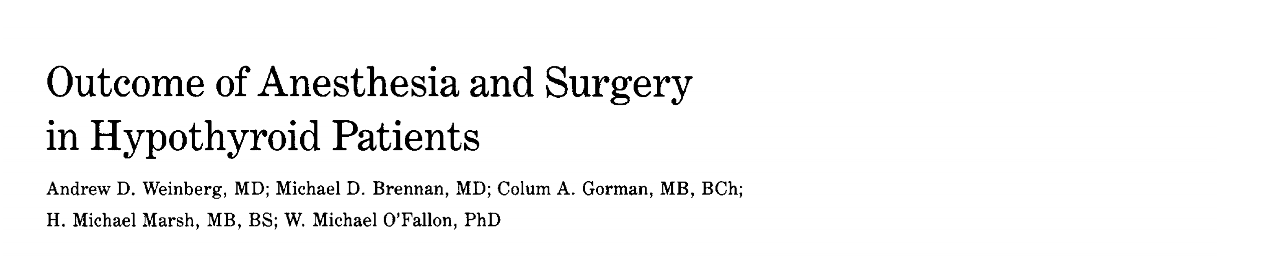
Hypothyroid patients had more preoperative risk factors but did not differ as a group from controls with regard to duration of surgery or anesthesia, lowest temperature and BP recorded during surgery, need for vasopressors, time to extubation, fluid and electrolyte imbalances, incidence of arrhythmias, pulmonary and myocardial infarction, sepsis, need for postoperative respiratory assistance, bleeding complications, or time to hospital dismissal. Analysis of subsets of hypothyroidism (thyroxine level, <1 , <3 , and > 3 µ/dL) also failed to disclose any significant differences compared with matched controls. Among patients with mild or moderate hypothyroidism, we found no evidence to justify deferring needed surgery until the hypothyroidism has been corrected.

Slide 24
https://doi.org/10.1016/j.arth.2017.10.053
.
Result
A total of 2,369,594 primary TKAs were identified between 2005 and 2014. After age and gender
matching, each cohort consisted of 98,555 patients. Hypothyroidism was associated with greater odds of
postoperative complications compared to matched controls (odds ratio 1.367, 95% confidence interval
1.322-1.413). The 90-day incidence of multiple postoperative medical and surgical complications,
including periprosthetic joint infection, was higher among patients with hypothyroidism.Day of surgery an
90-day episode of care costs were significantly higher in the hypothyroidism cohort.

Slide 26
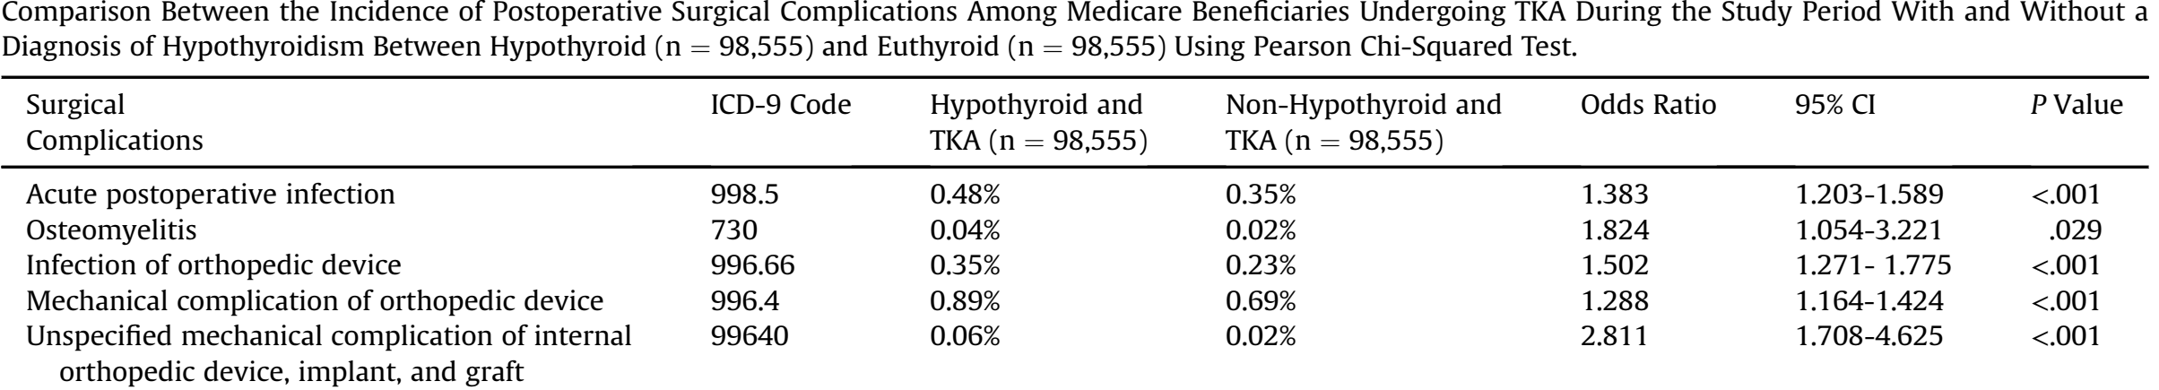

Slide 27
Recommendations for overt hypothyroidism Patients
Elective Surgery
Elective surgery is best postponed until a euthyroid
state is achieved
* Manzullo Fe, Ross Ds. Nonthyroid surgery in the patient with thyroid disease. 2018: Available at https://www.uptodate.com/contents /nonthyroid-surgery-in-the-patient-with-thyroid-disease
,

Slide 28
Recommendations for overt hypothyroidism Patients
Urgent Surgery
Undergo surgery without delay.
Levothyroxine should be started preoperatively.
Young patients are started on close to full replacement doses of levothyroxine (1.6 mcg/kg daily),
older patients or patients with cardiopulmonary disease are started on 25 to 50 mcg daily
with an increase in dose every 2 to 6 weeks.
* Manzullo Fe, Ross Ds. Nonthyroid surgery in the patient with thyroid disease. 2018: Available at https://www.uptodate.com/contents /nonthyroid-surgery-in-the-patient-with-thyroid-disease

Slide 29
Urgent surgery
There should be increased awareness of the possibility of minor postoperative complications such as intraoperative hypotension, gastrointestinal and neuropsychiatric complication, less likely to be febrile in postoperative infection.
*Palace MR. Perioperative Management of Thyroid Dysfunction. Health service Insight 2017:1-5

Slide 30
Severe Hypothyroidism
Includes patients with:
myxedema coma; with severe clinical symptoms of chronic
hypothyroidism such as altered mentation, pericardial effusion, or heart failure; or those with very low levels of total thyroxine (T4) (eg, less than 1.0 mcg/dL) or free T4 (eg, less than 0.5 ng/dL)
* Manzullo Fe, Ross Ds. Nonthyroid surgery in the patient with thyroid disease. 2018: Available at https://www.uptodate.com/contents /nonthyroid-surgery-in-the-patient-with-thyroid-disease.

Slide 31
Outcome in severe hypothyroidism
Based on the results of the some case reports:
1- Intraoperative hypotension
2- Cardiovascular collapse
3- Extreme sensitivity to opioids, sedatives, and anesthesia
4- Myxedema Coma (Rare)
* Manzullo Fe, Ross Ds. Nonthyroid surgery in the patient with thyroid disease. 2018: Available at https://www.uptodate.com/contents /nonthyroid-surgery-in-the-patient-with-thyroid-disease.

Slide 32
Management in severe hypothyroidism
Today, there is a rare condition and these patients should be considered as a very high risk patients.
Elective surgery should be delayed until hypothyroidism has been treated.
* Manzullo Fe, Ross Ds. Nonthyroid surgery in the patient with thyroid disease. 2018: Available at https://www.uptodate.com/contents /nonthyroid-surgery-in-the-patient-with-thyroid-disease.
Elective surgery

Slide 33
Thyroid hormone levels should be normalized as rapidly as possible
Using IV levothyroxine in a loading dose of 200 to 500 μg followed by 50 to 100 μg IV daily
T3 is given simultaneously in a dose of 5 to 20 mcg IV followed by 2.5 to 10 mcg every eight hours depending upon the patient's age and coexistent cardiac risk factors.
* Manzullo Fe, Ross Ds. Nonthyroid surgery in the patient with thyroid disease. 2018: Available at https://www.uptodate.com/contents /nonthyroid-surgery-in-the-patient-with-thyroid-disease.
Emergent Surgery

Slide 34
Oral administration of T4 through NG tube has proved to be equally effective
with a drawback that gastric atony may prevent absorption
and put the patient at risk for aspiration.
*P. Dutta, A. Bhansali, S. Masoodi, S. Bhadada, N. Sharma, and R. Rajput, “Predictors of outcome in myxoedema coma: a study from a tertiary care centre,” Critical Care, vol. 12, no. 1, p. R1, 2008.

Slide 35
Dutta and colleagues compared 500 μg of oral loading dose of T4 with 150 μg of maintenance dose orally and 200 μg of T4 intravenously followed by 100 μg T4 intravenously until they regained their vital functions and were able to take oral medications in patients with myxedema crisis
Didn’t find any difference in outcome among the patients.
* P. Dutta, A. Bhansali, S. Masoodi, S. Bhadada, N. Sharma, and R. Rajput, “Predictors of outcome in myxoedema coma: a study from a tertiary care centre,” Critical Care, vol. 12, no. 1, p. R1, 2008.

Slide 36
Adrenal Insufficiency
Rarely, Addison's disease will be present in a patients with primary hypothyroidism (due to Hashimoto's thyroiditis) or with central hypothyroidism ( inadequate pituitary adrenal reserve).
If the status of the pituitary adrenal axis is uncertain and deficiency is considered likely, patients should be given stress doses of corticosteroids until the integrity of the axis is ascertained.
If the clinical situation permits (ie, surgery can be delayed for an hour), a cosyntropin stimulation test should be performed prior to administering steroids.
If the results of the cosyntropin test are normal, stress steroids are not needed and can be discontinued if already given.
* Manzullo Fe, Ross Ds. Nonthyroid surgery in the patient with thyroid disease. 2018: Available at https://www.uptodate.com/contents /nonthyroid-surgery-in-the-patient-with-thyroid-disease.

Slide 37
If there is any suspicion for concurrent adrenal
insufficiency, glucocorticoids should be administered in stress
doses prior to or together with thyroid hormone.
* Palace MR. Perioperative Management of Thyroid Dysfunction. Health service Insight 2017:1-5

Slide 38
Management Of Patient Who Taking Chronic T4 Medication
If the patient is to fast on the day of surgery, the patient may miss the dose of levothyroxine that day, as it has a long half-life of approximately 7 days.
If oral medications can not be given postoperatively, the dose may be missed for several days. However, if there is still no ability to administer the drug enterally after 5 days, intravenous (IV) levothyroxine should be administered at a dose between 60% - 80% of the oral dose.
* Palace MR. Perioperative Management of Thyroid Dysfunction. Health service Insight 2017:1-5

Slide 39
Conclusion(1)
Management of patients with recently diagnosed hypothyroidism who require surgery is based upon observational data and clinical experience.
Elective
Mild
not postponing surgery
Emergent

Slide 40
Conclusion(2)
Elective
postponed until a
euthyroid state
is achieved
Moderate
Emergent
Undergo surgery without delay
Levothyroxine should be started preoperatively.

Slide 41
Conclusion(3)
Elective
postponed until a
euthyroid state
is achieved
Severe
Thyroid hormone levels should be normalized as rapidly as possible.
Emergent
Glucocorticoids should be administered in stress
doses, if there is any suspicion for concurrent adrenal
insufficiency.

Slide 42


