Slide 1
Treatment of amenorrhea
A.Amouzegar
Research Institute for Endocrine Science
13 Aban 97
Tehran

Slide 2
Objectives
Why HRT
Type of preparations
How to begin
Treatment side effects
How to follow up
Conclusion

Slide 3
Introduction
In girls with hypogonadism the optimal ERT route, dose and dosing tempo should be individualized.
No consensus regarding optimal approach.

Slide 4
Why HRT?
In contrast to postmenopausal women in their fifties and older, the need for HRT in younger women with amenorrhea extends beyond the need for symptom relief.
Protect against serious morbidity and earlier mortality related to prolonged estrogen deficiency.

Slide 5
Need Estrogen
Estrogen’s direct effects on the cardiovascular system Protection:
Acceleration of endothelial cell growth
Inhibition of vascular smooth muscle cell growth
Increase nitric oxide, leading to vasodilation, and prevention of ischemia
Decreasing total cholesterol and LDL, and increasing HDL
Vasodilation
Otherwise premature atherosclerosis

Slide 6
Cond’t
Estrogens are essential for bone health
variety of actions in the brain
Effects on skin

Slide 7
The aim of treatment
Allow the development of secondary sexual characteristics (particularly breast).
Allow the growth of the uterus to an adult size and shape.
Achieve a good adolescent growth spurt.
Achieve normal peak bone mass by late 20’s.
Support psychological maturation and adjustment.
long-term medical conditions are associated with a higher prevalence of psychological and mental health difficulties.

Slide 8
!!NOT OCPs
The main goal of HRT for women with primary amenorrhea is to mimic normal physiological endocrinology with regard to estrogen replacement.
Ocps contain the potent synthetic estrogen (EE), which in effect provides more steroid hormone than is needed for physiologic replacement, with unfavourable effects on lipid profile, on haemostatic factors and with an increased risk of thromboembolic events.

Slide 9
Existing evidence
As a consequence of the sparse evidence, recommendations for HRT in amenorrhea must necessarily be based on:
Theoretical knowledge about physiology and endocrinology, and extrapolated from the evidence of HRT in normal menopause.
Thus recommendations today are primarily based on “best clinical practice” supplemented by evidence where it exists.

Slide 10
Patient preference
Patient preference is important for compliance and must therefore be taken into consideration when prescribing.
Continue treatment up to age of normal menopause to maintain feminization and prevent osteoporosis.

Slide 11
HRT in young adolescent
Phase 1: Induction breast development
Phase 2: Induction of menses
Phase3: Long term maintenance of normal estrogen state

Slide 12
Type of preparations

Slide 13
Estrogens
There are 3 types of estrogen that are available for hormone replacement:
Estradiol (the main ovarian estrogen 17β-estradiol is the active component)
Ethinylestradiol (a synthetic estrogen)
Conjugated equine estrogens (CEE - derived from pregnant mare urine)

Slide 14
eight carbon side chain on carbon-17 of ring D side chain on carbon-17
two angular methyl groups at the junctures of
the A:B (carbon-10) and C:D rings (carbon-13).
Cyclohexane A, B, and C rings
cyclopentane D ring

Slide 15
Estrogens

Slide 17
Conjugated estrogen
Conjugated estrogens (CEs), or conjugated equine estrogens (CEEs), sold under the brand name Premarin (a contraction of "pregnant mares' urine")
contains a mixture of estrogen hormones
Estrone sulfate (50-70% of total)
Equillin sulfate ( 20-30% of total)

Slide 18
Conjugated Estrogen
Equilin sulfate
Estrone sulfate,
Esterone sulfate is easily absorbed into the blood and can be converted to estradiol.

Slide 19
Route of administration
Orally
Transdermal patches and gels
Estrogen-releasing vaginal ring
Estrogen-based vaginal creams and pessaries
Subcutaneous implants
Nasal sprays
Injectable estrogen preparations( new)

Slide 20
Oral Vs transdermal
The transdermal route can achieve higher plasma levels of circulating estradiol with a lower treatment dose.
The oral route is subject to a high first-pass effect, which results in high levels of estradiol and consequent estrogenic effects in the liver and low potency due to first-pass hepatic and intestinal metabolism into metabolites like estrone and estrogen conjugates.
Conversely, this is not the case for parenteral routes, which bypass the intestines and liver.

Slide 21
Progesterone
E-induced endometrial hyperplasia mandates the addition of a progestogen to the HRT regimen for endometrial protection and cancer risk reduction.

Slide 22
PUBERTY INDUCTION

Slide 23
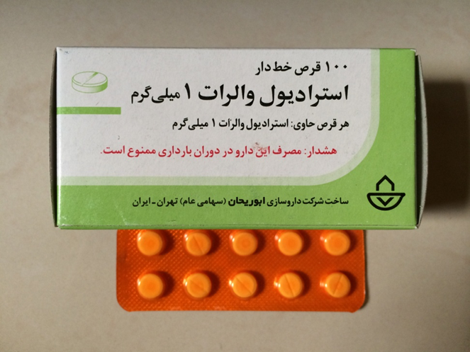
Estradiol

Slide 24
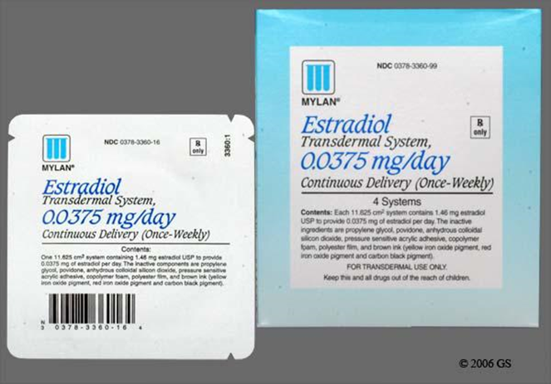
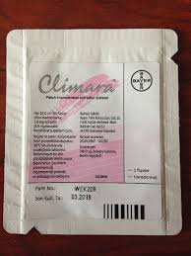
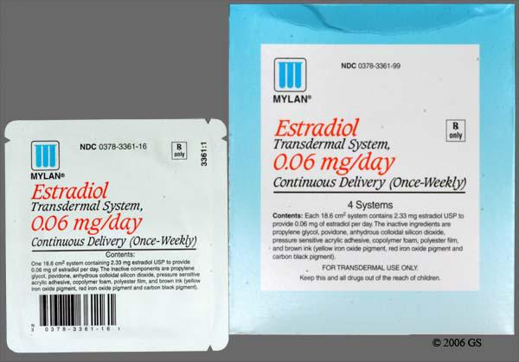
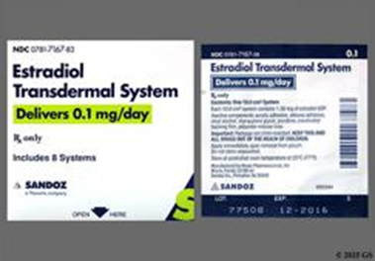
Each patch has 8 mg 17β Estradiol and release rate 0.1mg /24h

Slide 25
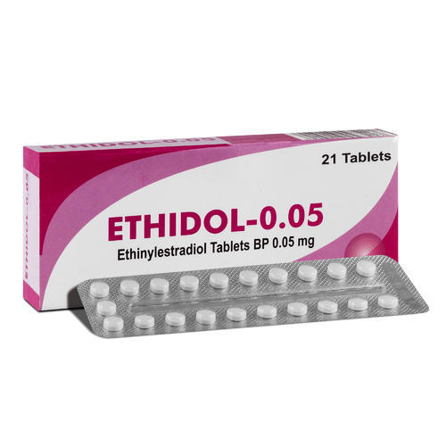
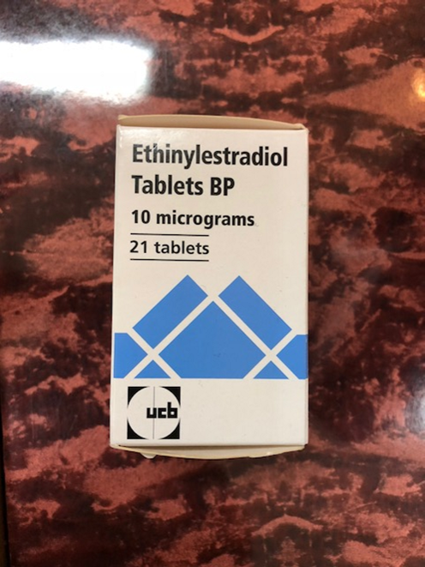

Slide 27
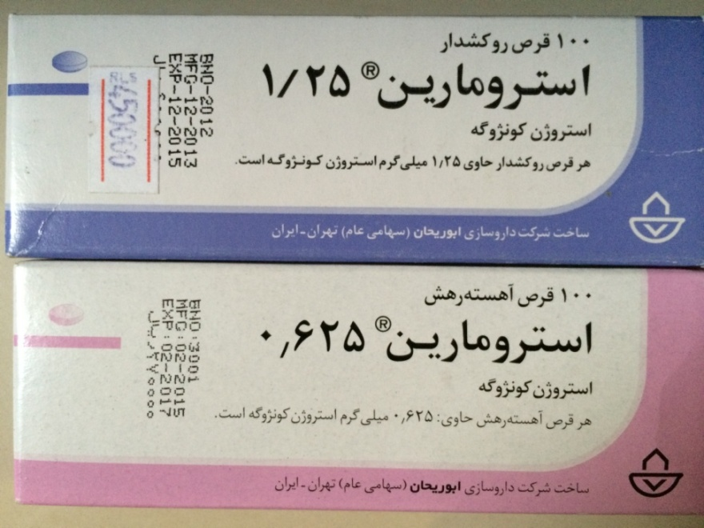
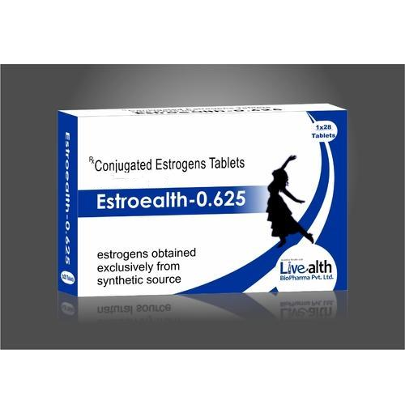

Slide 28
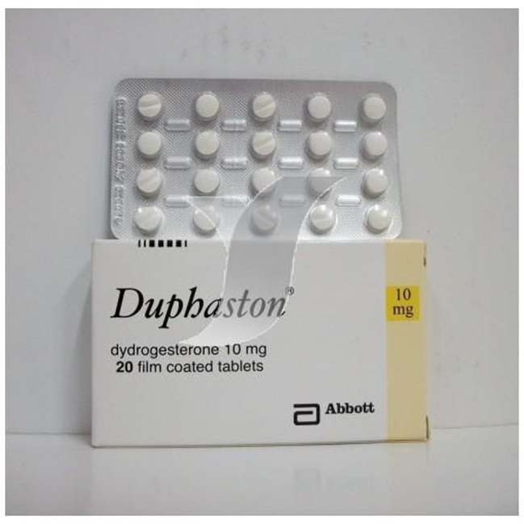
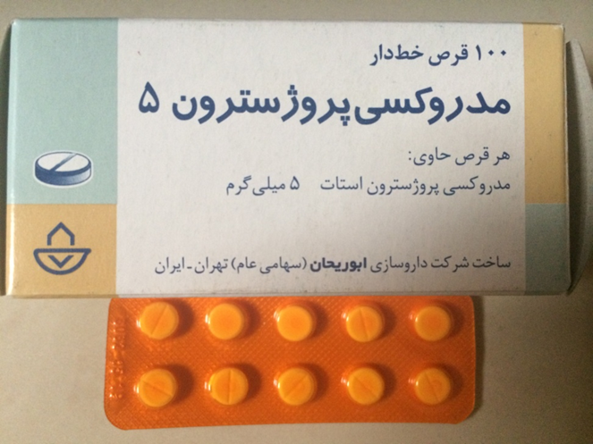
Progesterone

Slide 29
Comparison of the products
There is no hard evidence to favour the use of either oral/transdermal 17β-oestradiol or oral ethinyloestradiol for pubertal induction.
There are no RCTs comparing final height, normalisation of breast development, cardiovascular risk or patient satisfaction.
However, micronized oestradiol is identical to the natural product of the ovary and is the most physiological form of oestrogen available, and there is a trend towards the use of more natural products.

Slide 30
Daily dose equivalency
50/100mcg Transdermal (applied twice weekly and left in situ) = 2mg oral 17β (per day) = 20 mcg ethinylestradiol (per day).
0.625 mg of CE = 1 mg micrinized Estradiol=0.05 mg transdermal estradiol= 0.05 mg Ethinyl estradiol
E2 matrix patch is the first choice of pubertal HRT
Can be cut to achieve physiological E2 concentration seen in spontanous puberty.

Slide 31
How to start Estrogen?
Although the appropriate starting dose has yet to be determined, estrogen replacement is usually begun at one-tenth to one-eighth of the adult replacement dose and then increased gradually over a period of 2 (to 4 )years.
To allow for normal breast and uterine development.
It seems advisable to delay the addition of progestin at least 2 years after starting estrogen or until breakthrough bleeding occurs.

Slide 32
When and how to start estrogens
Start estrogen supplementation from the age of 12 years in the absence of a spontaneous start or progression of breast development (12-13 years).
Oral ethinylestradiol and micronized estradiol have both been used for puberty induction.
Puberty is a relatively slow process and the replacement therapy in the induction process should mimic this.

Slide 33
Adult dose
100–200 μg transdermal E2
2–4 mg micronized E2
20 μg EE2
1.25–2.5 mg CEE

Slide 34
Dosage
phase I
A typical regimen consists of an estrogen with a dosage equivalent to 6.25-25 mcg/day of transdermal estradiol (approximately 0.15/0.3 mg of CEE) given unopposed (ie, no progesterone) daily for 6 months with incremental dose increases at 6-month intervals until the required maintenance dose is achieved.
Estradiol 0.25-0.5 mg increasing over 2 years to an adult dose of 2 mg.
Ethinyl Estradiol 0.005-0.015 mg /d

Slide 35
Cond’t
Typically, 6-18 months are allowed in this phase and is individualized depending on patient`s age, pubertal stage prior to start of therapy, height, and response to therapy.

Slide 36
Cond’t
phase II
is the induction of menses.
During this phase, doses of estrogen are further increased.
They suggested use of oral CE (0.625 mg, daily) or a patch of equivalent strength (0.025 mge0.05 mg, 2*week).
Progestins are added, in general with breakthrough bleeding, and/or when breast development is complete, in a dose of 10 mg per day for 7-10 days for each month, to induce menses.

Slide 37
Cond’t
Phase III is described as a long term maintenance
Oral Premarin 0.625-1.25 mg daily
Ethniyl estradiol 20-35 mcg daily
Transdermal patch 0.075 mg- 0.1 mg, 2* week) with progestins

Slide 38
Patches
Estradiol comes in the form of a patch which is applied directly to the skin. It then passes slowly into the blood stream through the skin
‘25’ releases 25 micrograms of estradiol every day.
‘50’ releases 50 micrograms of estradiol every day.
May be given continuously if patient does not have an intact uterus or cyclically (3 weeks on, 1 week off) in patients with intact uterus. Rotate application sites.

Slide 39
Regimens
Continuous estrogen replacement
Cyclical regime

Slide 40
Conclusion
Treatment should be individualized
Mimic normal physiologic
Consider patient preference
Begin with Estrogen then add progesterone
Follow your patient with clinical signs
Treatment should be continued till menopause age

Slide 41
Do not forget psychosocial support!

