Slide 1
TSH (Standardization Challenges)
Thursday, November 24, 2016
Mohammad Reza Bakhtiari, DCLS, PhD
Member to IFCC TFT Standardization Committee
Iranian Research Organization for Science & Technology (IROST)
Tehran, Iran

Slide 2
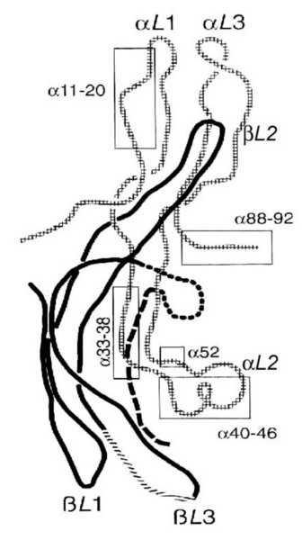
Thyroid Stimulating Hormone (Characteristics)
A heterodimeric glycosylated peptide (92+118)
28- to 30- kDa
Synthesized & secreted from thyrotrophs of the anterior pituitary
Turnover: 40-150 mU/day
Half Life: 1 hour
Major role: Regulates the growth and function of thyroid gland
Grossmann, M., Weintraub, B.D.& Szkudlinski, M.W.. Novel insights into the molecular mechanisms of human thyrotropin action: structural, physiological, and therapeutic implications for the glycoprotein hormone family. Endocr Rev , 18 , 476-501. (1997)
Notes:
Figure 4-2 Schematic drawing of human TSH, based on a molecular homology model built on the template of a hCG model 14 . The α-subunit is shown as checkered, and the β-subunit as a solid line. The two hairpin loops in each subunit are marked L1, L3; each subunit has also a long loop (L2), which extends from the opposite site of the central cystine knot. The functionally important α-subunit domains are boxed. Important domains of the β-subunit are marked directly within the line drawing (crossed line, beaded line and dashed line): For further details the reader is referred to Grossman et al. 2 . (Reproduced from Grossman at al. (2) , with permission).

Slide 3
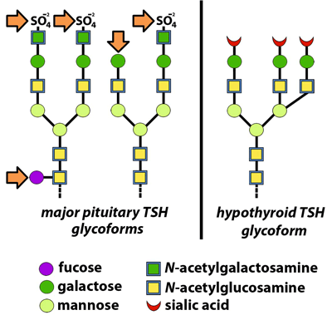
Thyroid Stimulating Hormone (Glycobiology)
https://www.aacc.org/publications/cln/articles/2013/may/tsh-harmonization. Last seen: 4/23/2016
Notes:
In euthyroid individuals, the pituitary gland produces a wide variety of TSH glycoforms. The majority have carbohydrate side chains terminating with sulfated N-acetylgalactosamine or galactose, and some have internal fucosylation as well (arrows). The liver recognizes all of these moieties and removes TSH bearing them from circulation. By contrast, TSH glycoforms produced by hypothyroid patients have side chains lacking fucose and terminating with sialic acid residues. These are not removed by the liver and they have a longer half-life.

Slide 4
Thyroid Stimulating Hormone (Assay Generations)
http://www.healthcare.siemens.com.. Last seen: 4/23/2016

Slide 5
TSH Assays Evolving Performance Characteristics
http://www.healthcare.siemens.com.. Last seen: 4/23/2016

Slide 6
Thyroid Stimulating Hormone (Assay Standardization)
Goal: Measurement results be comparable between laboratories and methods, over time, with common reference ranges. (Very challenging for TSH)
Definition: Calibration traceable to International System of Units using an RMP
(to cause to conform with a standard)
Requirements:
Reference Measurement Procedure (RMP)
Not Available for TSH
Certified Standard Reference Material (CRM)
WHO Standard: NIBSC code: 81/565 ???
Traceability
No
Commutability
No
Broad Range Coverage
?
The Joint Committee The best data is available from the database of: The Joint Committee for Traceability in Laboratory Medicine (JCTLM)

Slide 7
Assay Standardization (Full Metrological Traceability)

Slide 8
Assay Standardization (Commutability)

Slide 9
TSH Harmonization (Standardization Not Available)
Goal: Measurement results be close to each other.
Definition: To bring into an agreement, (to reach to a consensus)
Requirements:
Applying Statistical Methods (All-Procedure Trimmed Mean=APTM)
Recalibration of Methods / Kits against consensus values
Manufactures contribution
Aldo Clerico , et.al., Clin Chem Lab Med; 53(3): 377–382, 2015

Slide 10
TSH Harmonization Steps
(IFCC C-STFT)
https://www.aacc.org/publications/cln/articles/2013/may/tsh-harmonization. Last seen: 4/23/2016
Notes:
The C-STFT’s proposed scheme for TSH alters the steps usually followed when attempting to standardize a clinical laboratory assay. Because there is no reference measurement procedure (RMP) for TSH and because the WHO reference material does not appear to be commutable, a panel of single-donor samples will be used to establish target values for calibration and the all-procedure trimmed mean derived from a method comparison study including manufacturers’ master calibrators. This alternative approach has been referred to as “harmonization,” rather than standardization

Slide 11
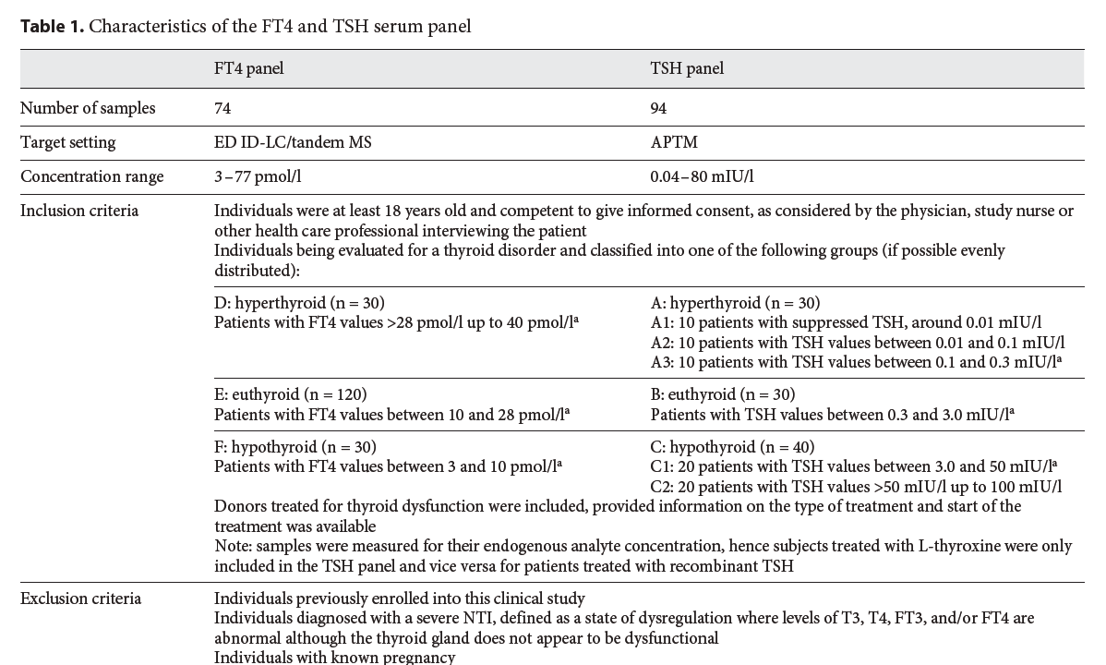
TSH Harmonization (A Progress Report of the IFCC Committee for Standardization of Thyroid Function Tests)
Linda M. Thienpont, et.al., Eur Thyroid J; 3:109–116, 2014

Slide 12
TSH Harmonization (A Progress Report of the IFCC Committee for Standardization of Thyroid Function Tests)
Linda M. Thienpont, et.al., Eur Thyroid J; 3:109–116, 2014

Slide 13
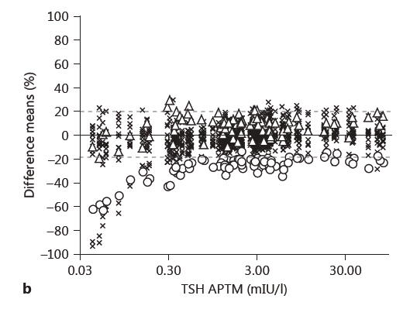
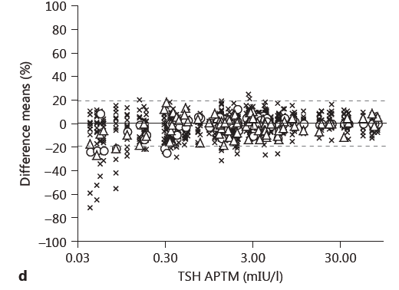
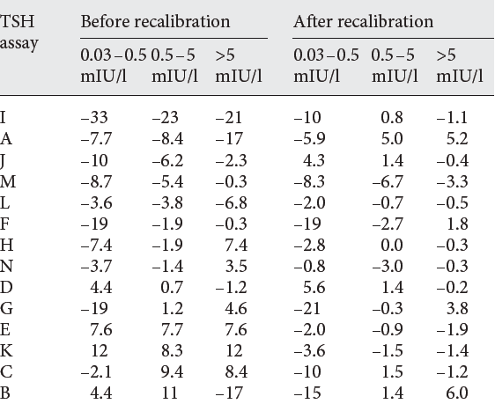
TSH Harmonization (A Progress Report of the IFCC Committee for Standardization of Thyroid Function Tests)
Before Recalibration After Recalibration
Linda M. Thienpont, et.al., Eur Thyroid J; 3:109–116, 2014
Notes:
Fig. 1. a–d Plots showing the %-difference before (FT4: a , TSH: b ) and after recalibration (FT4: c , TSH: d ). The most discrepant assays before recalibration are highlighted by special symbols (FT4: K, circles; M, triangles; TSH: I, circles; K, triangles); all other assays are indicated with the same symbol X. e , f Interassay CV (FT4: e , TSH: f ) before (squares) and after (triangles) recalibration by IVD manufacturers.

Slide 14
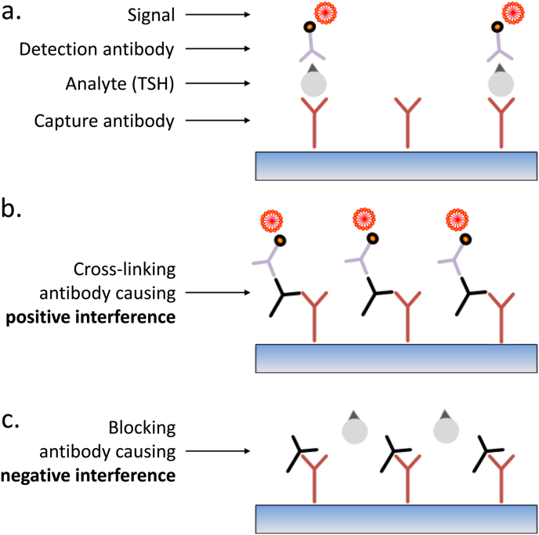
Thyroid Stimulating Hormone (Assay Interference)
Best Pract Res Clin Endocrinol Metab. Dec 2013; 27(6): 745–762
Notes:
http://scantibodies.com/hbr.html

Slide 15
TSH Reference Interval
Age
Gender
BMI
Ethnicity
Smoking Status
I2 Intake
Subclinical States
Various Isoforms
J Clin Endocrinol Metab 90: 5483–5488, 2005)

Slide 16
TFTs in Pregnancy
(Reference Intervals)
ATA Iran Endocrine Society
TSH (mIU/L):
1st T: 0.1 – 2.5 < 3.9
2nd T: 0.2 – 3.0 < 4.1
3rd T: 0.3 – 3.0 < 4.1
TT4 (µg/dL):
Adult RI * 1.5

Slide 17
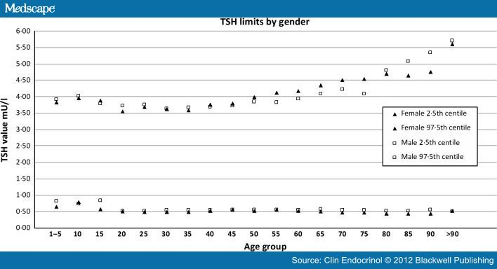
Aging and TSH Reference Interval
Age Specific RI: for >70 years up to 6.0

Slide 18
Thank you for your Attention!
Questions?
Bakhtiari.09@gmail.com
reza-bakhtiari.persianblog.ir
Mohammad Reza Bakhtiari, DCLS, PhD
Iranian Research Organization for Science & Technology (IROST)
Tehran, Iran

