Slide 2
Approach to Follow-up of the Patient With Differentiated Thyroid Cancer and Positive
Anti-Thyroglobulin Antibodies
F. Hadaegh MD. Endocrinologist

Slide 3
Agenda
Case presentation
Thyroglobulin Antigen
Frequency and Measurement of Anti-Tg Abs
Concordance of Positive Anti-Tg Antibodies
Among Different Assays
Alternative Methods of Detecting Tg Antibody
Interference
Assays That Are Unaffected by Anti-Tg
Antibody Interference

Slide 4
Agenda
Management of Patients with DTC Who Are
Anti-Tg Antibody Positive
Clinical Approach to DTC Patients With Anti-Tg
Antibodies
Areas Where Further Information Is Needed to
Optimize Clinical Management
Summary
Back to the Patient

Slide 5
Case Presentation
A36-year-old woman was seen in follow-up for further management of PTC.
She initially presented with a right lobe thyroid nodule in 2002. FNA revealed a follicular neoplasm, and she underwent a right hemi-thyroidectomy that revealed a 4.6-cm follicular variant of PTC with peri-vascular lymphatic invasion and lymphocytic thyroiditis.

Slide 6
Case Presentation
She had completion thyroidectomy that revealed lymphocytic thyroiditis and was then treated with 157 mCi of I-131 therapy after levothyroxine (LT4) withdrawal.

Slide 7
Case Presentation
Anti-Tg antibodies were elevated at the time of treatment, and Tg levels were undetectable. Pre- and post-therapy whole body radioiodine scans revealed uptake in the thyroid bed with no evidence of regional or distant metastases

Slide 8
Case Presentation
The patient was placed on TSH-suppressive doses of L-T4 and was monitored thereafter with a combination of neck USG, TSH, Tg, and anti-Tg Ab levels with persistently positive anti-Tg Ab

Slide 9
Case Presentation
She also had a 4-mCi I-131 whole body scan after L-T4 withdrawal in 2004 with no uptake. Since 2006, the Tg and anti-Tg antibody measurements have been performed in the same laboratory using a single assay system (Immulite 2000 and L2KTG, respectively; Siemens, Deerfield, Illinois).

Slide 10
Case Presentation
Tg levels have been measured yearly since 2006 and have been persistently undetectable. The anti-Tg antibody levels are as follows (IU/ml):
- February 2006, 209; - October 2006, 159;
- September 2007, 162; - January 2009, 152;
- July 2010, 74; - August 2011, 53;
and August 2012, 37.6 (reference range,40; lower limit of detection,20)

Slide 11
Case Presentation
Chest computed tomography (CT) scans without iv contrast in 2010 and 2012 revealed 2 stable tiny lung nodules that were not felt to be consistent with metastases.
Thus, at this time the patient has dropping anti-Tg antibodies and no certain radiographic or functional evidence of residual thyroid cancer.

Slide 12
Case Presentation
Chest computed tomography (CT) scans without iv contrast in 2010 and 2012 revealed 2 stable tiny lung nodules that were not felt to be consistent with metastases.
Thus, at this time the patient has dropping anti-Tg antibodies and no certain radiographic or functional evidence of residual thyroid cancer.

Slide 13
1.Thyroglobulin Antigen
Tg is a storage form of T4 and T3.
It is synthesized only by thyroid follicular cells and released into serum along with the thyroid hormones.

Slide 14
1.Thyroglobulin Antigen
Given the cellular specificity of Tg, its detection in biopsy specimens provides proof of the thyroid origin of the tissue.
In addition, measurements of serum Tg provide important information about the presence or absence of residual, recurrent, or metastatic disease in patients with DTC.

Slide 15
1.THYROGLOBULIN ASSAY, Methodology
THYROGLOBULIN ASSAY — Testing of serum thyroglobulin (Tg) should be done using a sensitive assay, ideally using the same assay for each sample.

Slide 16
1.THYROGLOBULIN ASSAY, Methodology
Methodology — Serum Tg is now generally measured by two-antibody “sandwich” immunometric assays (the antigen is sandwiched between the two antibodies) in which the capture antibody is bound to a solid support and the detection antibody is labeled with either an isotopic (immunoradiometric assay, IRMA) or non-isotopic (usually immuno-chemiluminescent assay, ICMA) marker.

Slide 17
1.THYROGLOBULIN ASSAY, Methodology
The values in normal subjects in most laboratories range from 1 to about 30 ng/mL. These immunometric assays are quicker, readily automated, and have greater sensitivity (0.1 to 1 ng/mL) than most radioimmunoassays .

Slide 18
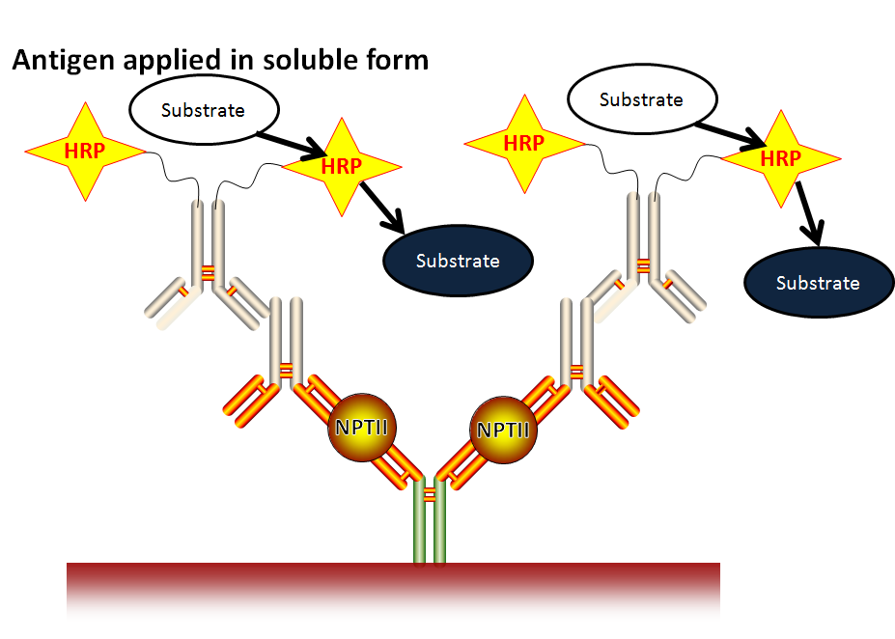
Sandwich indirect immunodetection

Slide 19
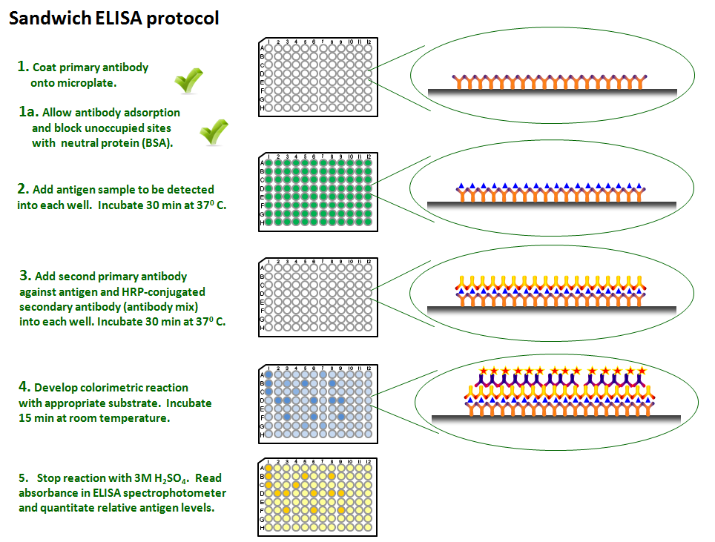

Slide 20
1.Inter-assay variation of Tg
Despite a trend toward assay standardization, serum Tg values obtained with different assays cannot be directly compared, as inter-assay variability remains substantial. The variability in assay results is due to :
1. Variations in the anti-Tg antibodies used.
2. The heterogeneity of Tg, a consequence of alternative processing and differences in iodination of Tg.

Slide 21
1.Inter-assay variation of Tg
3. Tg produced by thyroid cancer cells can be even more heterogeneous (because of dysregulation of the enzymatic glycosylation and iodination within malignant thyroid cells) and occasionally has enough conformational difference that it may not be recognized by a standard Tg assay.
4. The net effect can be widely variable antigen (Tg) detection among different assays.

Slide 22
1.Inter-assay variation of Tg
Serial Tg measurements in thyroid cancer patients be performed using the same assay.

Slide 23
Intraassay variation &Functional sensitivity of serum Tg
Even using the same assay, between run variability can affect the comparability of serial determinations over time While these differences are far less than the between-assay differences, they can be responsible for small fluctuations in Tg measurements over time within the same patient.

Slide 24
Intraassay variation &Functional sensitivity of serum Tg
Functional sensitivity is defined as the lowest Tg concentration that an assay can reliably and consistently measure under clinically relevant conditions with less than 20 percent CV. For many years, the functional sensitivity of most Tg assays had been about 0.9 ng/mL. However, several assays with functional sensitivities of 0.2 ng/mL are commercially available.

Slide 25
TSH suppressed vs. stimulated Tg
When using the less sensitive assays (functional sensitivities of approximately 1 ng/mL), TSH stimulation will result in a previously undetectable serum Tg value becoming measurable in as many as 20 to 25 percent of patients.
In the newer, more sensitive Tg assays, serum Tg concentrations measured while receiving LT4 correlate with rhTSH-stimulated Tg concentrations and, therefore, may decrease the need for rhTSH-stimulated measurements .

Slide 26
TSH suppressed vs. stimulated Tg
Patients with a TSH-suppressed serum Tg concentration <0.1 ng/mL (measured with an assay with a functional sensitivity of 0.05 ng/mL) were unlikely to have an rhTSH stimulated Tg above 2.0 ng/mL.

Slide 27
Thyroglobuln Measurement
Similar findings were noted in a study of 178 low-risk patients that compared basal and post thyroid hormone withdrawal Tg levels. Basal serum Tg levels were <0.1 ng/mL in 130 patients. After withdrawal of thyroid hormone, 5 of 130 (3.8 percent) had a Tg >1 ng/mL and recurrence was diagnosed in only 1 patient.
Among the 48 patients with Tg >0.1 ng/mL, 42 percent had Tg >1 ng/mL after withdrawal and 11 percent had recurrences.

Slide 28
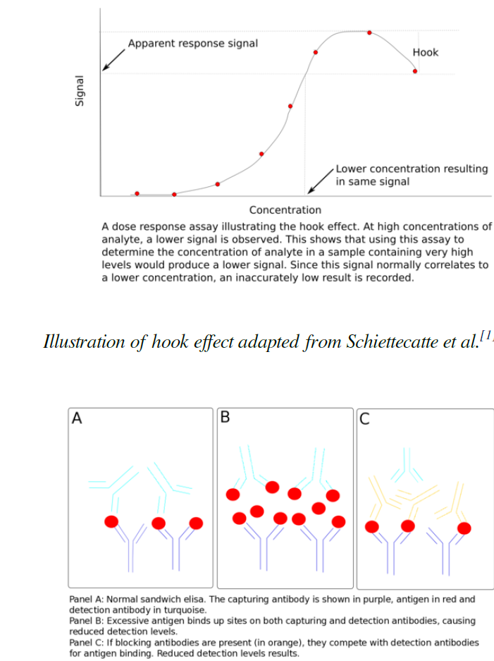
(Hook effect, Prozon effect)
Occasionally, immunometric assays may fail to detect very high serum Tg concentrations due to the so-called "hook effect," in which extremely high concentrations of Tg bind to each antibody, preventing the formation of the two-antibody sandwich upon which the assay depends .
If this effect is suspected, the sample should be reanalyzed after dilution to obtain a reliable Tg measurement

Slide 29
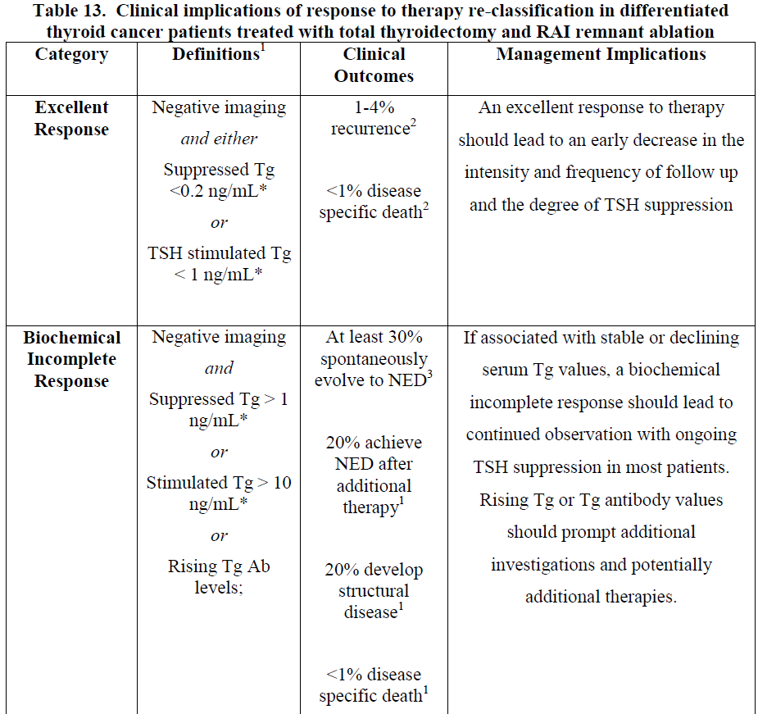
ATA 2015

Slide 30
Abnormal Thyroglobulin Levels
The specific cut point that defines an “abnormal Tg” is dependent on:(In the absence of Anti-Tg Ab)
1.The corresponding TSH value,
2.The amount of residual normal thyroid tissue remaining after thyroidectomy,
3.Whether or not RAI ablation was performed,
4. Duration of time since ablation since Tg values often decline for months to years after ablation.

Slide 31
2. Frequency and Measurement of Anti-Tg Antibodies
Tg is a critical biochemical marker used to monitor patients with DTC of follicular cell-derived thyroid cancer.
Tg measurement can be affected by the presence of anti-Tg antibodies causing inaccurate results, thereby limiting its usefulness in patients with circulatinganti-Tg antibodies .

Slide 32
2. Frequency and Measurement of Anti-Tg Antibodies
The frequency of these antibodies in patients with DTC varies,( 20–25% > 10% in general population) depending on the assay used and the particular study population.
Different anti-Tg antibody assays?
Differences in the frequency of lymphocytic thyroiditis?

Slide 33
2. Frequency and Measurement of Anti-Tg Antibodies
The prevalence of anti-Tg antibodies was higher in those with DTC and lymphocytic thyroiditis (29.2–50%) >>>in those with DTC alone (1.9–6.7%), depending on the assays used.
The effects of anti-Tg antibodies on measured Tg levels vary according to the type of Tg assay.

Slide 34
2. Frequency and Measurement of Anti-Tg Antibodies
Anti-Tg antibodies tend to cause an underestimation of Tg when IMA is used, whereas they can cause either an under- or overestimation of RIA measurements

Slide 35
2. Frequency and Measurement of Anti-Tg Antibodies
most laboratories use IMAs to measure Tg. Importantly, with this type of assay, undetectable Tg levels in the presence of anti-Tg Ab may not correlate with the absence of disease.

Slide 36
3. Concordance of Positive Anti-Tg Antibodies Among Different Assays
The correlation was higher between assays using the same methodology (IMA vs. RIA) and also in patients with lymphocytic thyroiditis.
Among 143 patients in whom + anti-Tg Ab were detected using a semi-automated RIA, only 35–62.2% were detected on 1 or more of 3 IMAs.

Slide 37
3. Concordance of Positive Anti-Tg Antibodies Among Different Assays
In clinical practice, this variability presents a challenge when determining whether an individual patient has an accurate Tg measurement and also whether anti-Tg Ab levels are used as a biochemical marker of tumor progression or persistence.

Slide 38
3. Concordance of Positive Anti-Tg Antibodies Among Different Assays
It is important to recognize that the lower limit of detection of anti- Tg Ab is a possible partial cause of the discordance.
Indeed, when the “cutoff” was lowered to the lowest limit of accurate assay detection, >>>>>rather than the reference range for an individual assay (often used to identify patients with ( Hashimoto Thyroiditis), greater concordance was observed .

Slide 39
3. Concordance of Positive Anti-Tg Antibodies Among Different Assays
For patients with thyroid cancer, the approach is to use the lower limit of detection, rather than the lower part of the normal range to define the presence of anti-Tg antibodies

Slide 40
3. Concordance of Positive Anti-Tg Antibodies Among Different Assays
Another potential cause of discordance is the heterogeneity of Tg epitopes to which the antibodies are directed and their recognition in the different anti-Tg antibody assays .

Slide 41
3. Concordance of Positive Anti-Tg Antibodies Among Different Assays
In patients with proven or suspected DTC who have undetectable Tg and anti-Tg Ab results, it is reasonable to repeat the measurements using a different method to enhance confidence that undetected anti-Tg antibodies are not the cause of the discordance.

Slide 42
4. Alternative Methods of Detecting Tg Antibody Interference
If there is concern regarding inaccuracy of Tg measurement, recovery assays to detect interference in Tg measurement have been advocated. Indeed, a reduced recovery result often correlates with the presence of interference.
The routine use of recovery assays has been limited due to the relative insensitivity <<<<<<measurement of anti-Tg antibodies.

Slide 43
4. Alternative Methods of Detecting Tg Antibody Interference
A second, less common type of antibody, heterophile antibodies against Tg, can also occur .These are nonhuman antibodies that cross-react with Tg.

Slide 44
4. Alternative Methods of Detecting Tg Antibody Interference
In comparison with human anti-Tg Ab, heterophile antibodies tend to IMA results for Tg and do not typically cause positive anti-Tg antibody measurements.

Slide 45
4. Alternative Methods of Detecting Tg Antibody Interference
Heterophile antibodies are suspected when:
1. results do not match clinical course
2.or radiographic findings, such as when Tg levels are in the absence of identifiable residual or recurrent thyroid tissue,
3.When Tg levels are inexplicably variable despite stable TSH levels,
4. and when there is no rise of Tg level with TSH stimulation

Slide 46
4. Alternative Methods of Detecting Tg Antibody Interference
This type of interfering antibody can often be detected using proprietary antiheterophile antibody tubes, by performing recovery assays, or by performing serial dilutions of Tg samples if levels are high enough to be reliably measured.

Slide 47
5. Assays That Are Unaffected by Anti-Tg Antibody Interference
Peptide immunoaffinity enrichment in concert with liquid chromatography–tandem mass spectrometry has been used to measure Tg, and it appears not to be influenced by the presence of anti-Tg antibodies .

Slide 48
5.Assays That Are Unaffected by Anti-Tg Antibody Interference
At this time, this method appears to lack adequate sensitivity to detect low Tg levels
A second approach evaluated by several groups has been to detect thyroid or thyroid cancer- specific m RNA or DNA transcripts from circulating blood.

Slide 49
6.Management of Patients with DTC Who Are Anti-Tg Antibody Positive
(Following patients with anti-Tg antibodies)
Whether the presence of anti-Tg antibodies should influence a decision on administering I-131 after thyroidectomy is not well-studied??
A potential advantage of I-131 treatment in these patients is the theoretical possibility that this treatment will eliminate thyroid tissue, the antigen source for anti-Tg antibodies, thereby leading to antibody disappearance. ??

Slide 50
6. Management of Patients with DTC Who Are Anti-Tg Antibody Positive
(Following patients with anti-Tg antibodies)
The current data do NOT support the hypothesis that the presence of anti-Tg antibodies alone should primarily drive the indication or approach to treatment with I-131, but rather that this should be considered along with other clinical and pathological data in the decision-making process.

Slide 51
6. Management of Patients with DTC Who Are Anti-Tg Antibody Positive
(Following patients with anti-Tg antibodies)
The presence of the antibodies leads to greater reliance on the pathology, postsurgical ultrasound, and diagnostic scan results (if performed) to inform therapeutic decisions.

Slide 52
6. Management of Patients with DTC Who Are Anti-Tg Antibody Positive
(Following patients with anti-Tg antibodies)
Anti-Tg Ab , levels themselves may serve as a surrogate biochemical marker of disease persistence and response to therapy.
The timing of testing and the duration to see a maximal response appear to differ from Tg levels in patients without anti-Tg antibodies.

Slide 53
6.Management of Patients with DTC Who Are Anti-Tg Antibody Positive
(Following patients with anti-Tg antibodies)
There may be an initial transient rise in anti-Tg Ab after radioactive iodine treatment.
it has been shown that the eventual disappearance of Tg antibodies takes approximately 2–3 years on average.

Slide 54
6. Management of Patients with DTC Who Are Anti-Tg Antibody Positive
(Following patients with anti-Tg antibodies)
& preferably consistent
laboratories
ATA 2015

Slide 55
6. Management of Patients with DTC Who Are Anti-Tg Antibody Positive
(Following patients with anti-Tg antibodies)
The variability in the rate of disappearance of antibodies may reflect:
1.the heterogeneity in the population studied
2. and may be influenced by factors such as
a- Duration
b- Height of anti-Tg antibody levels
c- and potential differences in patients with underlying chronic lymphocytic thyroiditis vs those with tumor-associated lymphocytic infiltrates

Slide 56
6. Management of Patients with DTC Who Are Anti-Tg Antibody Positive
(Following patients with anti-Tg antibodies)
There is evidence that decrement in anti-Tg Ab after I-131 therapy may predict rates of residual thyroid cancer.
Kim et al reported that patients who were positive for anti-Tg antibodies that either became negative or had 50% decline vs the pretreatment value over 6–12 months after I-131 therapy had a lower recurrence rate than patients with lesser reductions or increased anti-Tg antibodies

Slide 57
6. Management of Patients with DTC Who Are Anti-Tg Antibody Positive
(Following patients with anti-Tg antibodies)
There is no consensus on the extent of the workup that should be performed for patients with persistently elevated anti-Tg Abs.
One approach could be that if anti-Tg Ab remain detectable without dropping or if levels are rising, this should prompt an evaluation similar to a patient with persistent or rising Tg in the absence of antibodies.

Slide 58
6.Management of Patients with DTC Who Are Anti-Tg Antibody Positive
(Following patients with anti-Tg antibodies)
The likelihood of finding thyroid CA in this setting and the best methods for disease localization are not firmly established.
Individualization of therapy based on their overall risk of recurrent or persistent disease

Slide 59
6. Management of Patients with DTC Who Are Anti-Tg Antibody Positive
(Following patients with anti-Tg antibodies)
In this group of thyroid cancer patients with positive anti-Tg Abs, TSH stimulation of Tg did not predict the presence or absence of residual or recurrent thyroid cancer.

Slide 60
6. Management of Patients with DTC Who Are Anti-Tg Antibody Positive
(Following patients with anti-Tg antibodies)
Neck USG , perhaps in combination with other imaging (DxWBS ) based on risk of metastatic disease determined by risk features of individual patients, should be performed in an effort to identify disease in patients with persistent or rising anti-Tg antibodies.

Slide 61
6. Management of Patients with DTC Who Are Anti-Tg Antibody Positive
(Following patients with anti-Tg antibodies)
It remains uncertain whether the degree of elevation of anti-Tg Ab or the degree of change in levels correlates with radiographic disease.
If suspicious lesions are detected on imaging, FNA for cytology can be performed if indicated, and Tg can be measured FNA samples.(Although it is not certain whether anti-Tg Abs can alter Tglevels in nodes, the data support its usefulness as a diagnostic test in this population)

Slide 62
7. Clinical Approach to DTC Patients With Anti-Tg Antibodies
Approach is based on :
The pattern of change in anti-Tg Ab levels
Correlation with clinical or radiographic findings tailored to the clinical-pathological risk of an individual patient.

Slide 63
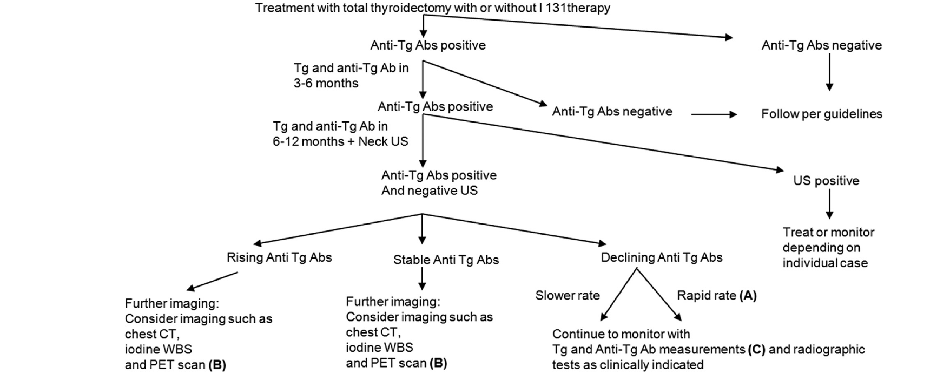

Slide 64
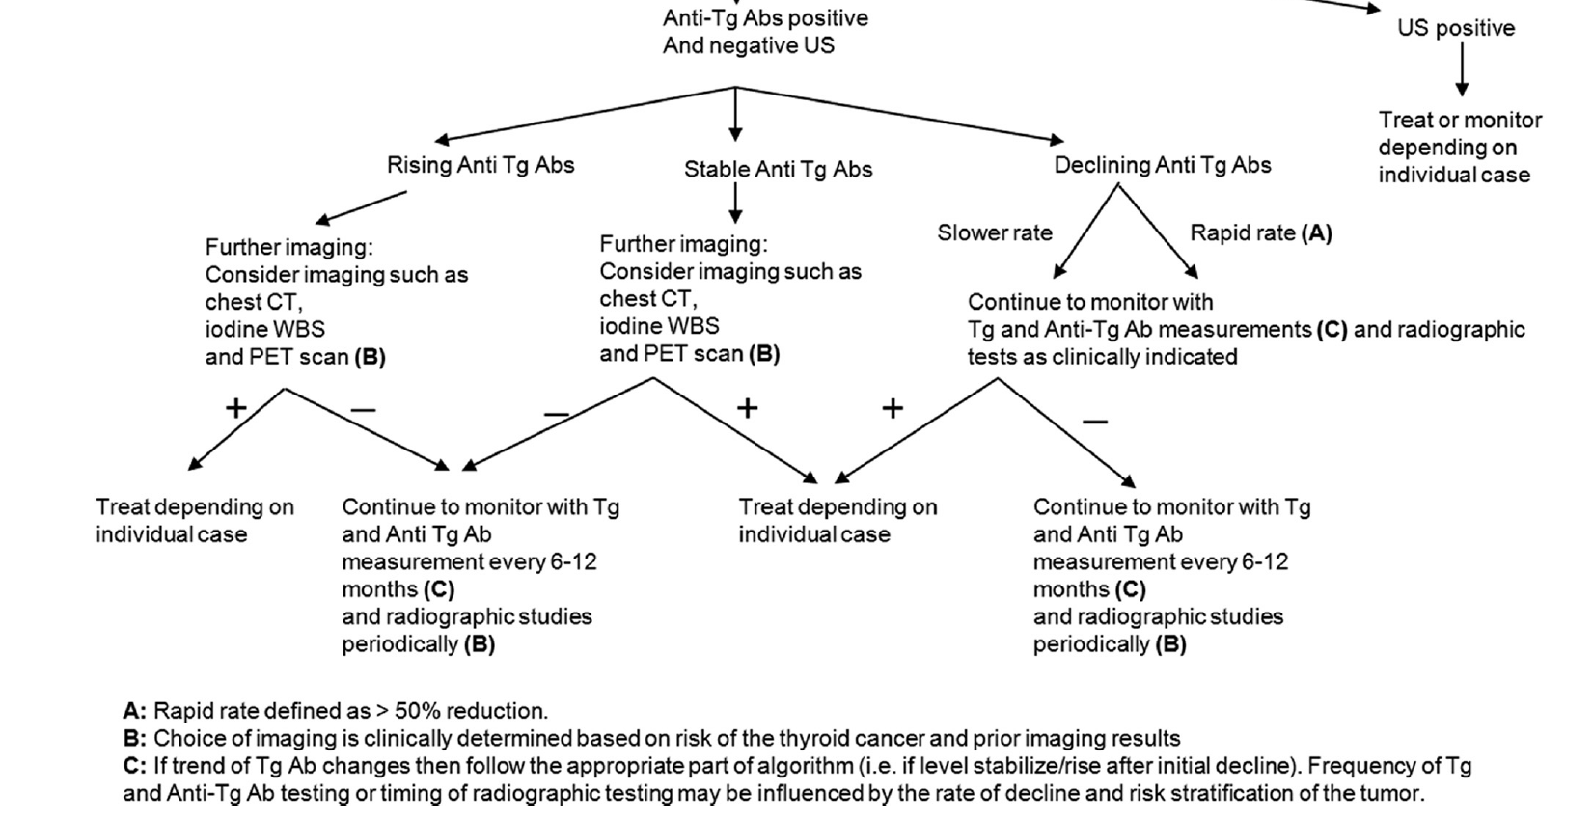

Slide 65
7. Clinical Approach to DTC Patients With Anti-Tg Antibodies
For patients with low-risk PTC, periodic neck USG seems most appropriate for imaging.
In patients with low-risk FTC without metastatic disease on post-therapy whole body scan if treated with I-131, neck USG still may be useful to monitor presumed residual normal thyroid tissue depending on the comfort level and experience of the ultrasound operator.

Slide 66
7. B-Patients with rising anti-Tg antibodies or those who become positive for anti-Tg antibodies after being negative)
These patients are more concerning for progressive or recurrent thyroid cancer, and a more aggressive approach to imaging is generally performed.
In our practice, the approach is similar to that of patients with elevated Tg levels, which usually include neck USG, CT scans, DxWBS, or PET/CT scans depending on:

Slide 67
7. B-Patients with rising anti-Tg antibodies or those who become positive for anti-Tg antibodies after being negative)
- the stage of the tumor,
- prior imaging,
- the presence of poorly differentiated features,
Do not perform empiric I-131 therapy if imaging tests are unrevealing, other than in highly selected high-risk situations

Slide 68
7. C-Patients whose anti-Tg antibody levels have reached a plateau after declining )
When anti-Tg Abs stop declining, it is unclear whether this correlates with a residual benign thyroid tissue or thyroid cancer or whether it is related to the immune response.

Slide 69
7. C-Patients whose anti-Tg antibody levels have reached a plateau after declining )
Depending on the clinical scenario, these patients should be evaluated as for patient group 1 or 2 above.
It is important also to monitor stable anti-Tg Abs over an extended period of time to be confident the level is not changing.

Slide 70
7. D-Patients who are considered biochemically free of disease because of undetectable Tg levels in the absence of anti-Tg antibodies but who have suspicious or proven disease on imaging
Inaccurate Tg because of failure to detect anti-Tg antibodies that are interfering?
A tumor secreting Tg that is not measured by the assay?
A tumor that does not express or secrete Tg?

Slide 71
7. D-Patients who are considered biochemically free of disease because of undetectable Tg levels in the absence of anti-Tg antibodies but who have suspicious or proven disease on imaging
In such cases, it may be helpful to immunostain the tumor for Tg.
In cases of DTC or a confirmed Tg-expressing tumor, the primary option is to run the same sample on Different Assays , optimally including 1 that uses a different Method.

Slide 72
7. D-Patients who are considered biochemically free of disease because of undetectable Tg levels in the absence of anti-Tg antibodies but who have suspicious or proven disease on imaging
If thyroid cancer is confirmed and the Tg is undetectable with both a low and high TSH, Tg levels will be insensitive for monitoring that particular patient.

Slide 73
7. E-Patients who have no evidence of disease clinically or radiographically but have erratic Tg levels that do not rise with TSH stimulation
This situation raises suspicion for the presence of heterophile antibodies against Tg.
These can be directly measured or assessed using serial dilutions of the Tg samples.

Slide 74
7.F- Patients who have negative anti-Tg antibodies on 1 assay but then are positive by a different assay
In this scenario, it is important to confirm the results of both assays by repeating the test.
Then one can consider a recovery study to prove whether anti-Tg antibodies are truly present and whether they are interfering.

Slide 75
7. F- Patients who have negative anti-Tg antibodies on 1 assay but then are positive by a different assay
When it is not clear whether anti-Tg Abs are truly positive, the general approach would be similar to other patients with positive anti-Tg antibodies in whom there is greater reliance on imaging testing.

Slide 76
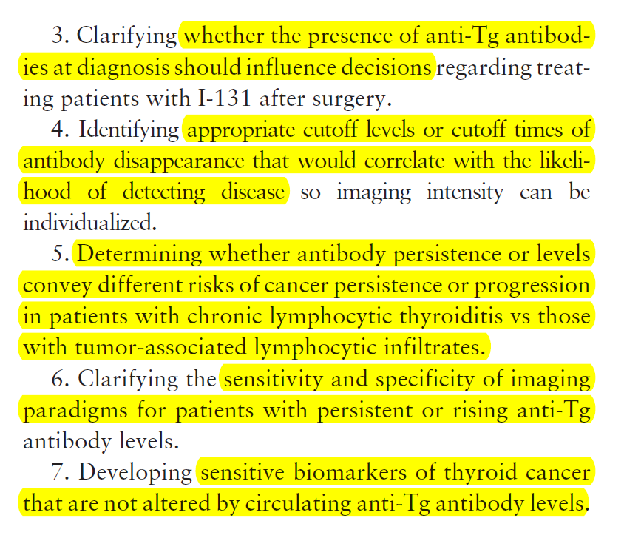
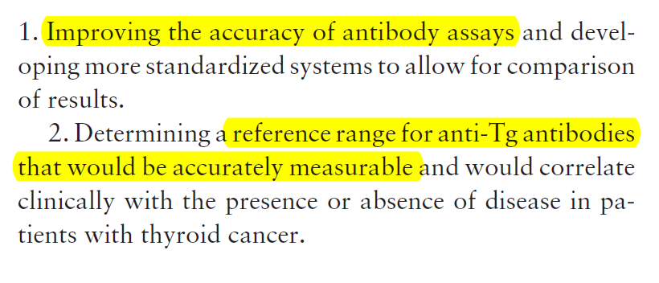
8. Areas Where Further Information Is Needed to Optimize Clinical Management

Slide 77
Summary
Patients with elevated anti-Tg Abs should initially be treated in away similar to other thyroid cancer patients based on clinical and pathological characteristics.
If radioactive iodine therapy is indicated based on pathology staging and other characteristics, it may take up to a few years before the anti-Tg Abs become undetectable.

Slide 78
Summary
For patients with low-risk DTC who are not treated with I-131, the levels of Anti-Tg Ab should be monitored, and imaging can be performed based on the pattern of antibody level change.
It is important whenever possible to employ a consistent anti-Tg antibody assay over time to enable comparison of results.

Slide 79
Summary
It is also important for clinicians to consider that anti-Tg Abs may not be detected by 1 assay in situations where there is a mismatch between clinical findings of disease and undetectable Tg and anti-Tg antibodies.
Rising levels of anti-Tg Abs maybe a harbinger of cancer progression and warrant further assessment

Slide 80
Summary
Dropping levels may be associated with reduced tumor burden, and persistent stable levels may warrant imaging, depending on the clinical situation.
The best imaging approach is uncertain, and more data are needed in this area.
If recurrent or residual disease is localized, then treatment or active surveillance should be employed as for other patients with thyroid cancer.

Slide 81
Back to the Patient
Although it is not possible to definitively state that our patient is in a complete biochemical remission, it is reassuring that the anti-Tg antibody level is declining and there is no obvious residual thyroid cancer on imaging 10 years from her diagnosis.
We will continue to perform periodic neck USG, if her anti-Tg antibodies become undetectable, will consider performing a TSH-stimulated Tg level

Slide 82
Thanks for your patience, dear colleagues!

