Slide 2
A 35-Year-Old Woman with Thyrotoxicosis
(with fatigue & frequent syncope)

Slide 3
Patient History
The patient is a 35-year-old woman who presented to a physician with complaints associated with hyperthyroidism 5 years ago, for first time and has been treated initially with Methimazole and then with radioactive iodine with a diagnosis of Graves' disease.
Despite a high RAIU (always > 40%), Radioiodine therapy was repeated 3 times due to RAI resistance and disease recurrence.
After the third round of radioiodine therapy, severe Graves ophthalmopathy has occurred that has been controlled with multiple injections of intravenous glucocorticoid (Methyl Prednisolone).
Finally, thyroidectomy was performed 4 years ago due to resistant hyperthyroidism and thereafter, replacement therapy with LT4 (700 µg/week) was started.

Slide 4
Patient History
Six months after starting treatment with LT4, the patient returned complaining of severe headache and 5kg weight gain.
Physical Exam | Lab. Results
Mild puffiness | TSH : 40 mIU/L
Nonpalpable thyroid | T4 : 2.5 µg/dL
LT4 was restarted and the importance of taking medication regularly was emphasized to the patient.

Slide 5
Patient History
After 2 months, the patient referred with complaints of hyperthyroidism symptoms.
Lab. Results
TSH : <0.01 mIU/L
fT4 : 3 ng/dL
Despite stopping LT4, TSH was suppressed and fT4 was elevated.
Lab. Results
TRAb : 3.93 IU/L (NL. <1.75 )

Slide 6
Patient History
Based on a diagnosis of recurrence of Graves’ Disease, the patient was treated with Methimazole 10 mg/day and this treatment was continued for 3 years.
Lab. Results
(Average) fT4 : 2.16 ng/dL
(Average) T3 : 210 ng/dL
What is your plan/recommendation ?

Slide 8
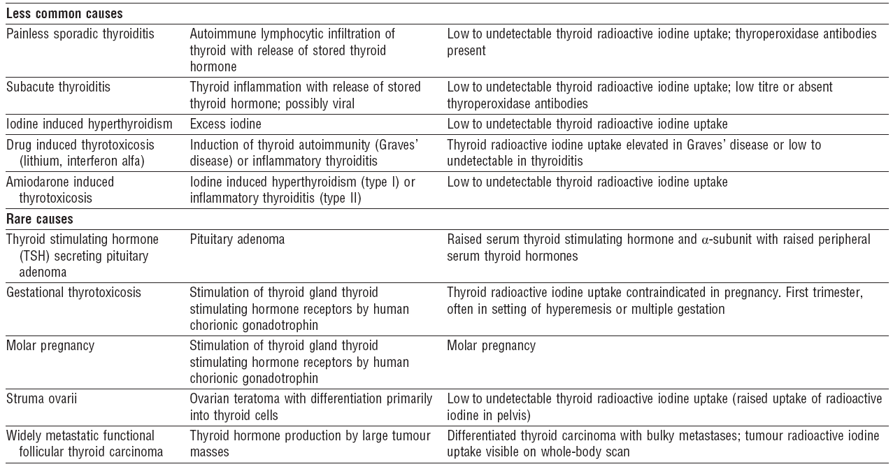

Slide 9
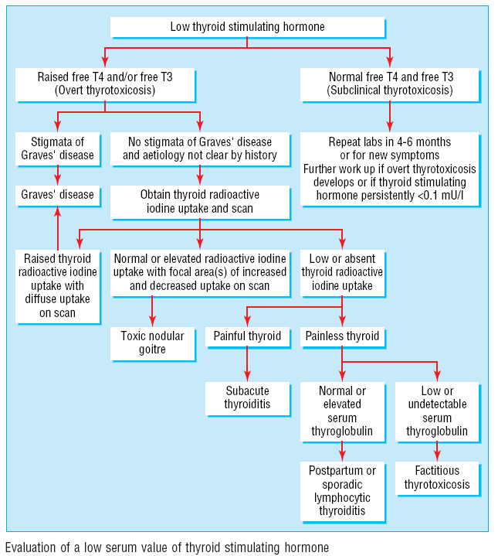

Slide 10
179 patients between 1983 and 1990 with hyperthyroidism caused by Graves’ disease.
Young adult : 20-34 Yr.
Old adult : 35-55 Yr.

Slide 11
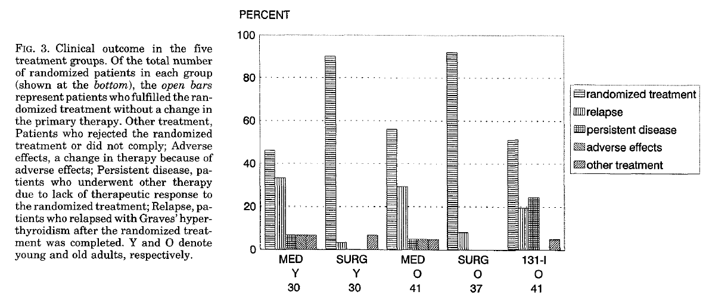
Clinical outcome in the five treatment groups

Slide 12
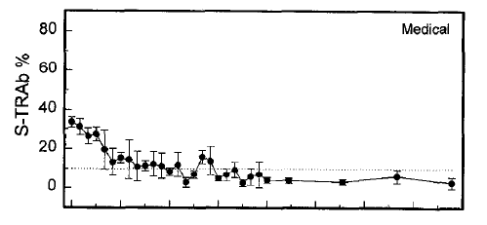
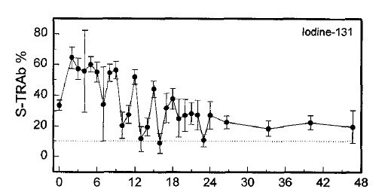
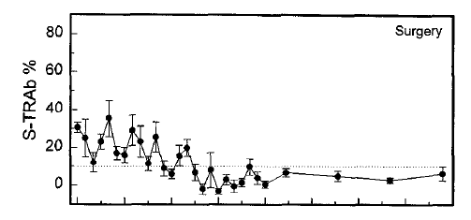

Slide 14
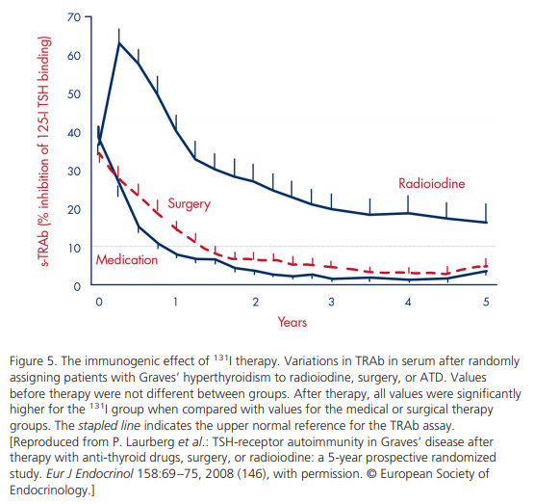

Slide 15
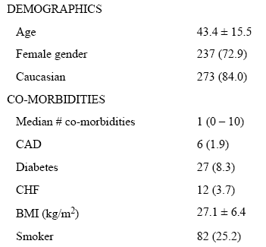
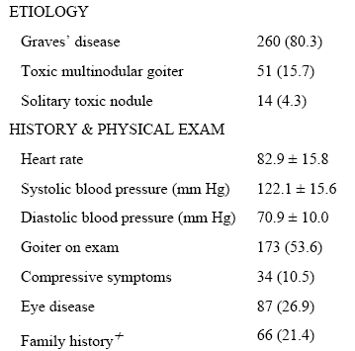
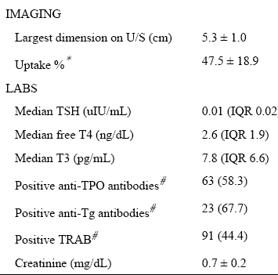
A retrospective review of patients treated with RAI from 2007–2010.
Patient Characteristics (n = 325)

Slide 16
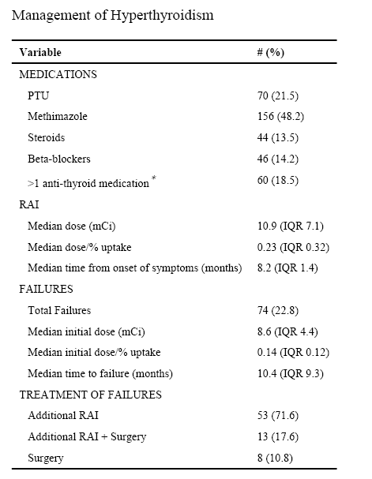
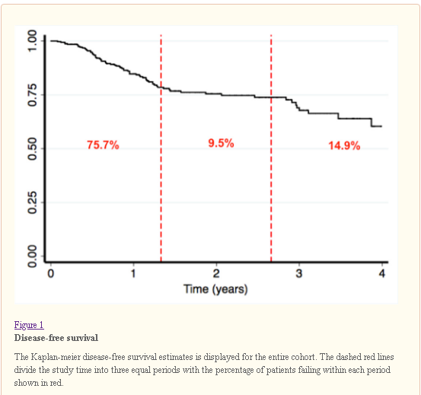

Slide 17
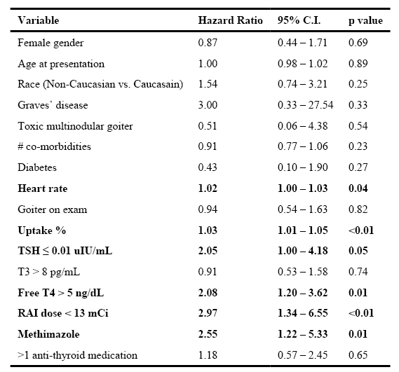
Final Multivariate Model for failure
Conclusions
Laboratory values at presentation can predict which patients with hyperthyroidism are at risk for failing RAI treatment.
Higher doses of RAI or surgical referral may prevent the need for repeat RAI in selected patients.

Slide 18
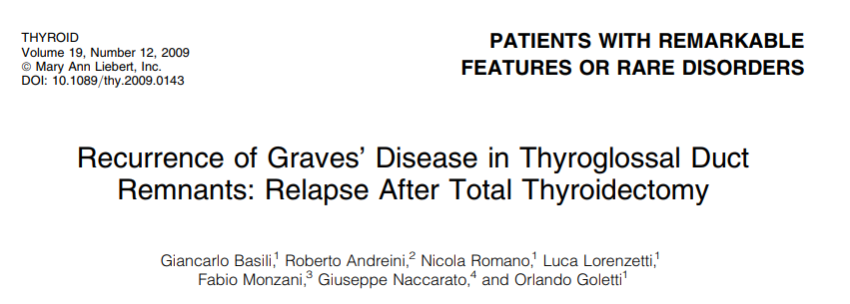
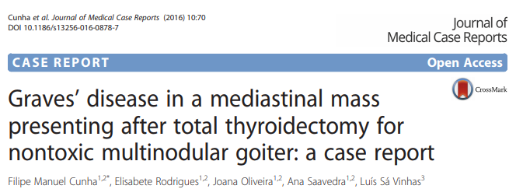
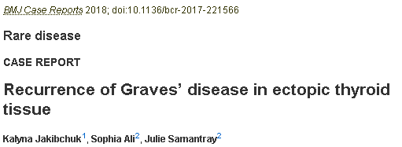

Slide 19
Color echo-doppler of the thyroid lodge in 102 patients who had undergone TT for benign thyroid pathologies:
Significant thyroid tissue remnants after TT in 34 cases of 102 (33%).
Only 67% were really total thyroidectomy.
12% had near total thyroidectomy( leaving tissue remnants < 1 cm )
21% had subtotal thyroidectomy( with tissue remnants ≥ 1 cm)

Slide 20
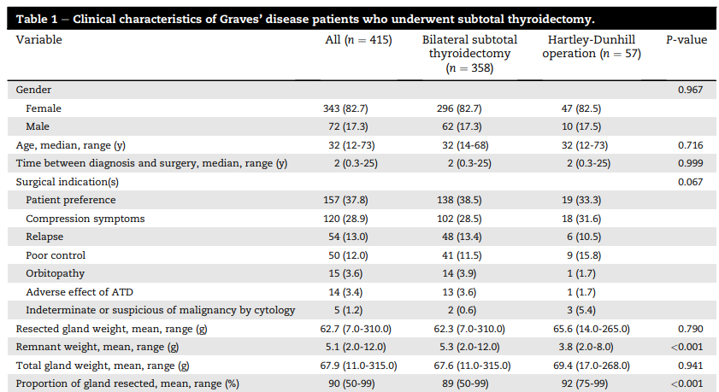

Slide 22
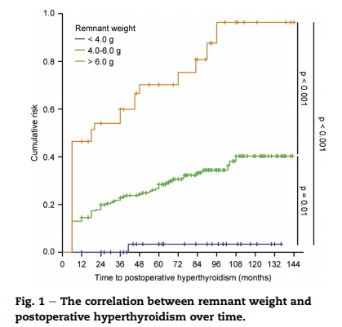
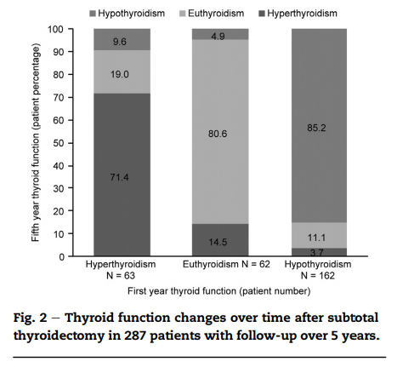

Slide 23
Methods: Patients with hypothyroidism were selected in a cross-sectional study, followed prospectively for 12 months, and classified as subclinical or overt hypothyroidism.
The patients were divided into two groups: with and without HAH.
34%

Slide 24
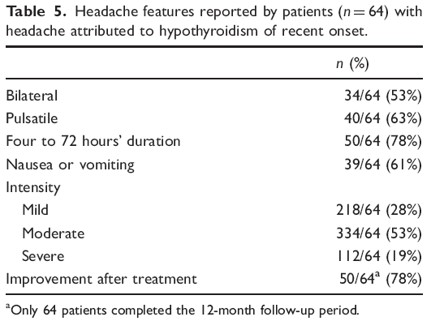
Involving areas
Fronto-orbital : 49%
Temporal : 37%
Posterior part of the head : 15%
Conclusion
Patients with HAH may present with unilateral, pulsatile, episodic pattern, and nausea/vomiting, which is at odds with the criteria for HAH established by ICHD 3 beta.

Slide 25
Patient History
Six months ago, the patient had symptoms compatible with hyperthyroidism and the decision was taken to have another round of treatment with RAI.
Lab. Results
TSH : <0.1 mIU/L
fT4 : 2.1 ng/dL
24H-RAIU : <5%
One month after discontinuation of Methimazole 24H-RAIU : <5%
Whole body scan with RAI :No absorption was found in any point.
Neck, Chest and Abdomen CT Scan: Normal findings.
The thyroid gland was not seen.

Slide 26
What is your plan/recommendation ?

Slide 27
The aim of the present study was to assess the apparent diffusion coefficient (ADC) in diffusion-weighted imaging (DWI), thyroid radioactive iodine uptake (RAIU), thyroid scintigraphy and thyrotropin receptor antibody (TRAb) levels in the differential diagnosis between Graves' disease (GD) and painless thyroiditis (PT). A total of 102 patients with GD and 37 patients with PT were enrolled in the study.

Slide 28
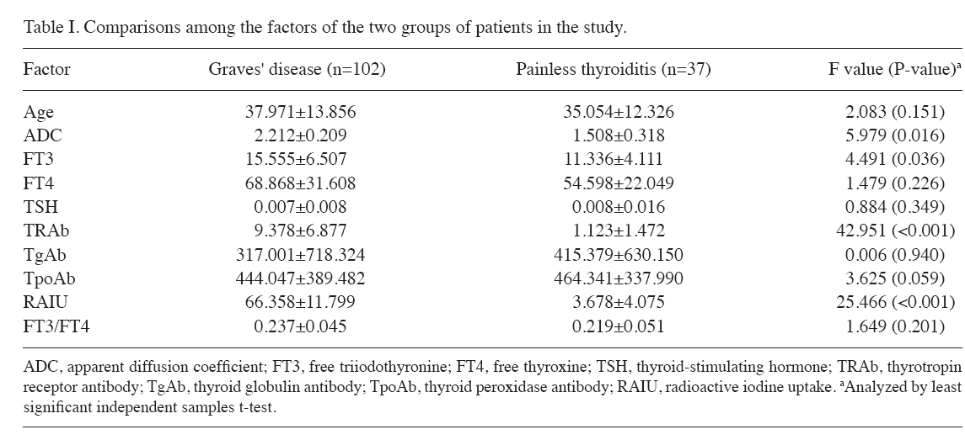

Slide 29
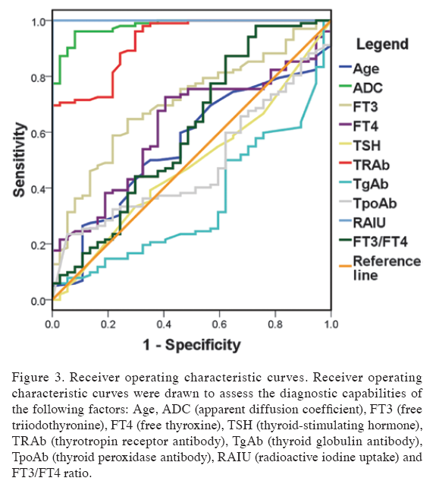
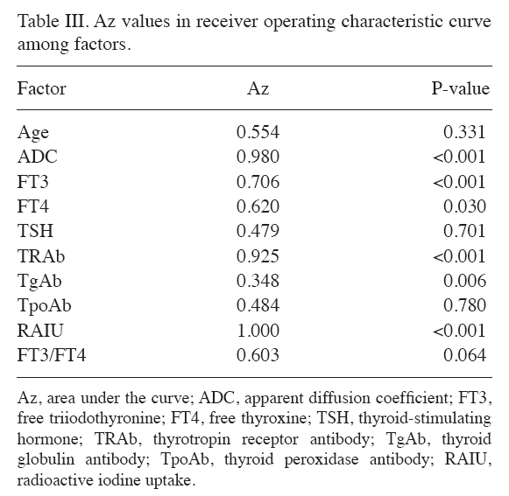

Slide 30
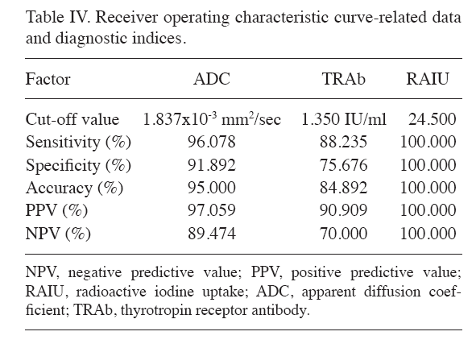
The present study showed that RAIU, ADC and TRAb are all of diagnostic value for reliably differentiating
between GD and PT.

Slide 31
The clinical data on 2543 patients were retrospectively reviewed.
Patients were divided into 2 groups depending on present or absent with rapid 131I turnover defined as a 4-hour to 24-hour 131I uptake ratio of ≥1.
Overall, 590 cases (23.2%) had a rapid 131I turnover.

Slide 32
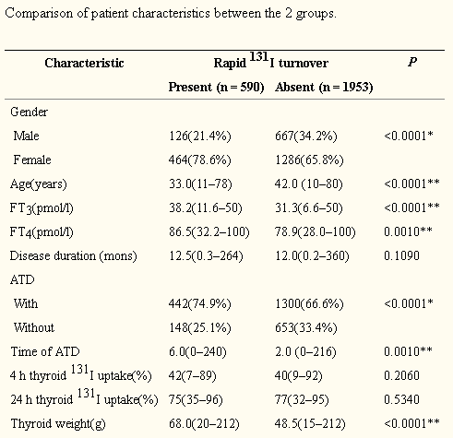
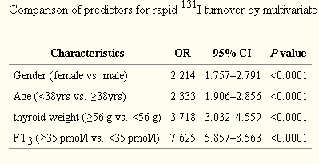

Slide 33
Patient History
Lab. Results
TSH : <0.01 mIU/L
fT4 : 2.3 ng/dL
T3 : 225 ng/dL
Thyroglobulin : 0.7 ng/ml (NL. 4-70) × 3 Times
Although repeatedly asked, the patient has denied taking thyroid hormones.
?

Slide 34
40 untreated patients with Graves' disease
Anti-Tg antibody (Tg-Ab) was positive in 34 out of 40 (85%) untreated cases and its level decreased after treatment.
Anti-thyroid peroxidase antibody (TPO-Ab) was positive in 32 of the 40 (80%) untreated Graves' patients and its level significantly decreased after treatment.

Slide 35
We studied 1050 subjects:
233 were euthyroid (Eu),
239 hypothyroid (Hypo) with initial TSH levels >15 mU/L,
273 hypothyroid on substitution therapy with L-thyroxine alone (hypoRx),
236 hyperthyroid (hyper)
69 in the acute phase of sub acute thyroiditis De Quervain’s (DQ).

Slide 37
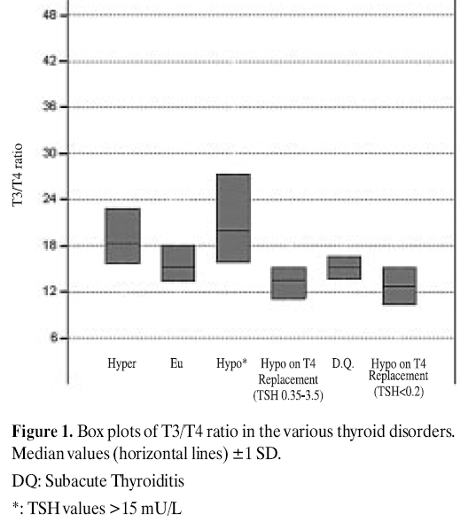

Slide 38
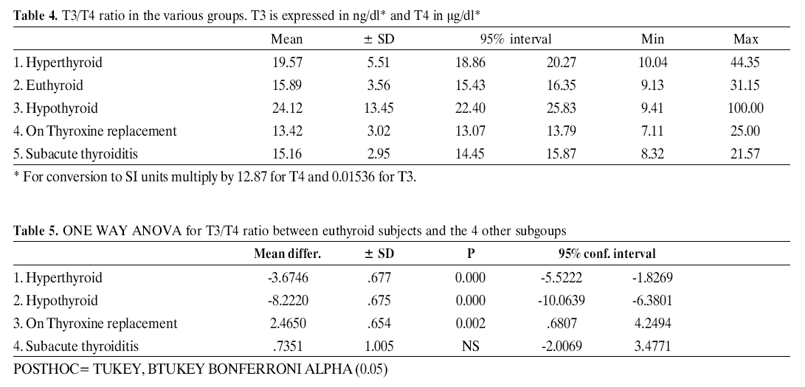

Slide 39
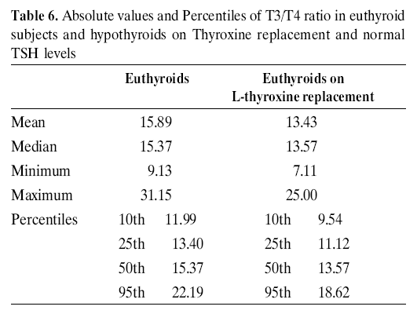
This finding means that in order to achieve normal T3 levels in hypothyroid patients, we have to give higher doses of L-Thyroxine as replacement therapy.
Conclusions
In Thyrotoxicosis, a ratio of total T3/T4 >18.9 suggests Graves’ Disease or toxic multinodular goiter whereas T3/T4 <16 suggests thyroiditis (sub acute or silent).

Slide 40
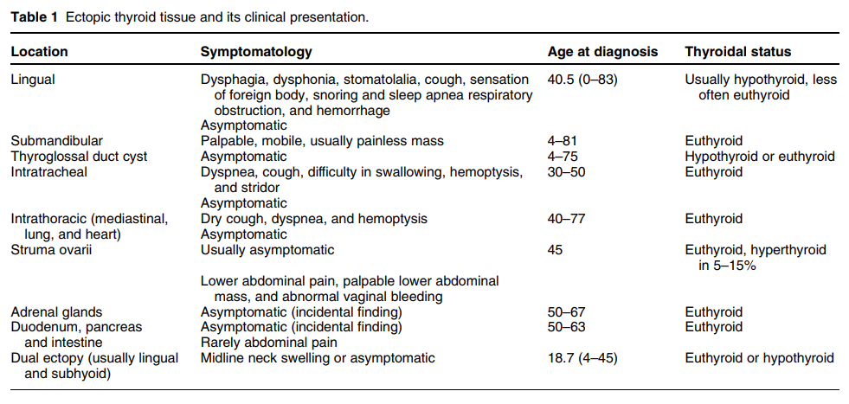

Slide 41
A retrospective pathological analysis of 1390 surgically removed ovarian tumors at 2 major academic centers.

Slide 42
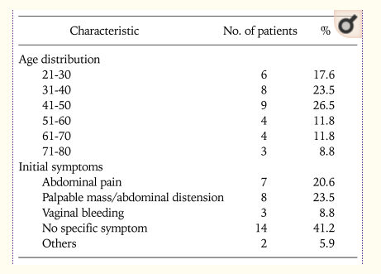
This study was conducted from 1994 to 2007, and included 25 patients with histologically confirmed struma ovarii whose medical records were retrospectively reviewed.

Slide 43
From January 1990 to January 2012, a total of 68 patients were diagnosed struma ovarii .
RESULTS:
The median age of patients was 42 years old (17-81 years).
[Struma ovarii is most common between the ages of 40 and 60 years.] Uptodate
94% were diagnosed benign struma ovarii and 6% were malignant struma ovarii.
47% patients were identified with pelvic mass by ultrasonic test, 41% had clinical abdominal pain, 12% touched a mass from abdominal wall. Ascites was present in 6% patients.
75% were mulitcystic lesions, 4% solid lesions and 21% solid-cystic tumors.
No patient had hyperthyroidism presentation.
[Approximately 5 to 15 percent of women with struma ovarii have hyperthyroidism due to a thyroid adenoma in the struma]Uptodate

Slide 44
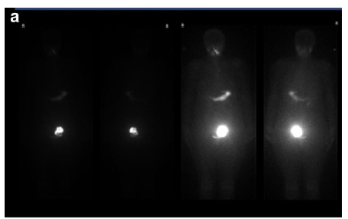
Scintigraphy performed with either iodine-123 or iodine-131 is useful for diagnosing a hyperfunctioning struma ovarii on the basis of higher uptake of the radionuclide by the ovarian mass compared with the thyroid gland.
a Whole-body I-123 imaging shows significantly increased I-123
uptake within the left hemi-pelvis in a 61-year-old woman with a history of thyrotoxicosis treated with radioiodine treatment twice over the last 30 years, who ultimately had a thyroidectomy which showed Graves disease but who remained thyrotoxic post surgery.

Slide 46
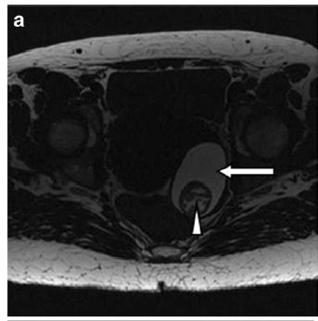
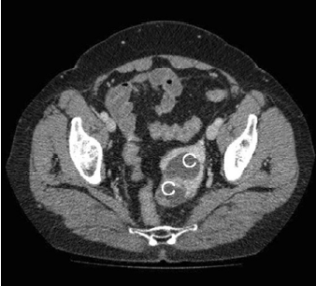
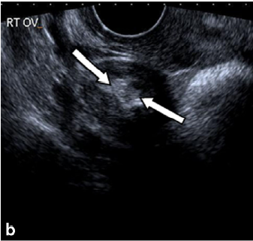
struma ovarii

Slide 47
Patient History
The patient was treated with Cholestyramine 4 gr. QID for 2 months.
Lab. Results
TSH : 0.8 mIU/L
fT4 : 1.2 ng/dL
T3 : 110 ng/dL
?

Slide 48
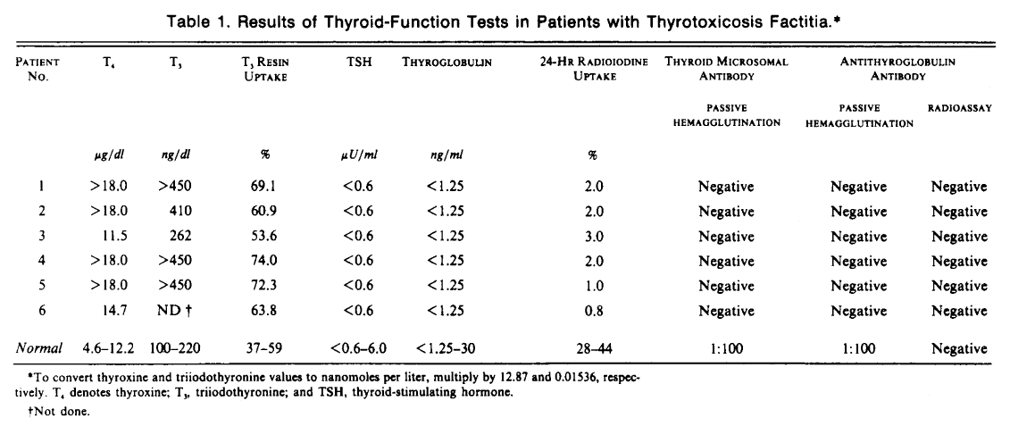

Slide 49
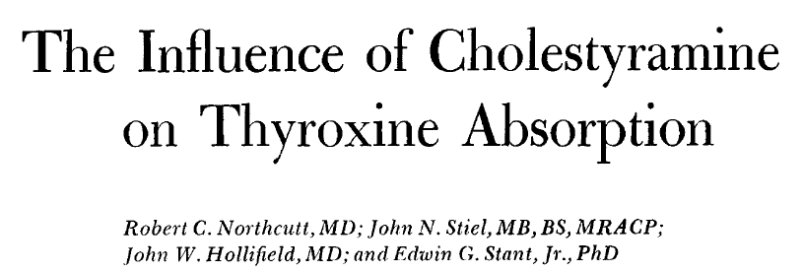
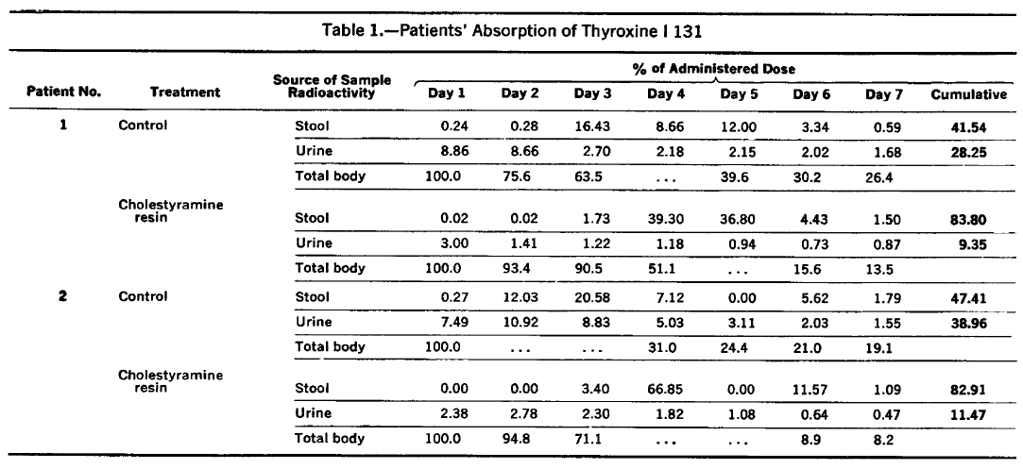
In order to evaluate the effect of Cholestyramine administration on the absorption of thyroxine, absorption studies with thyroxine I 131 were performed on both patients 1 and 2 during Cholestyramine administration and during control periods without Cholestyramine. Each period was of seven days' duration.

Slide 50
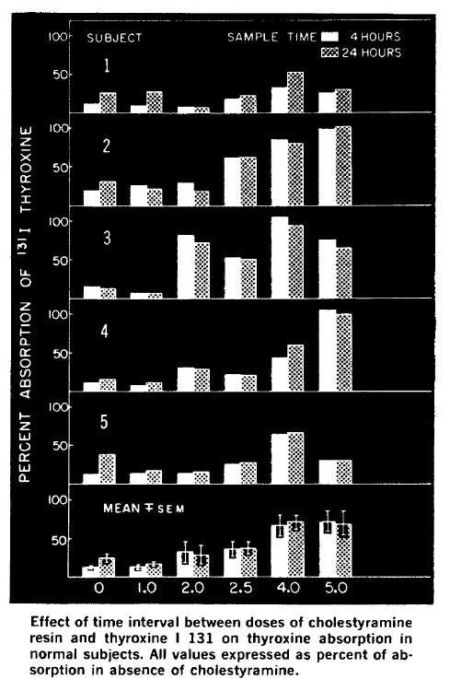
Malabsorption of thyroxine can be avoided to a large extent by allowing a time interval of four to five hours to elapse between the ingestion of the two drugs.

Slide 51
Mean plasma concentration-time profiles for levothyroxine administered alone or with colesevelam. (A) Unsubtracted levothyroxine plasma concentration-time curve. (B) Baseline-subtracted levothyroxine plasma concentration-time curve.

Slide 52
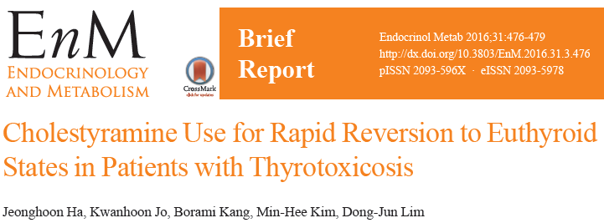
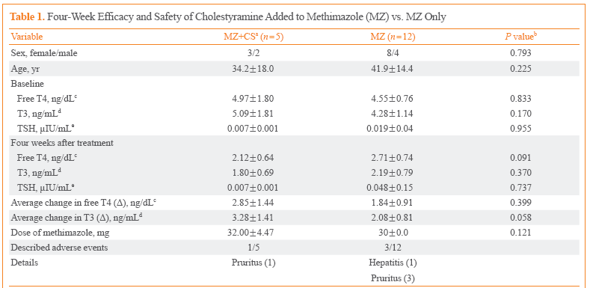

Slide 53
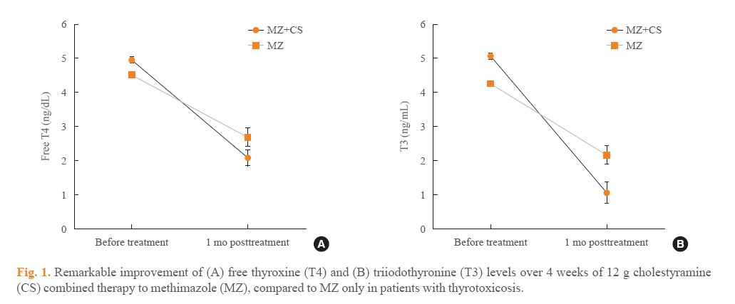
In conclusion, CS could be safely applicable adjunctive therapy for 4 weeks when first-line antithyroid medications are not enough to adequately control severe thyrotoxicosis or side effects of antithyroid drug would be of great concern at the initial stage of treatment.

Slide 54
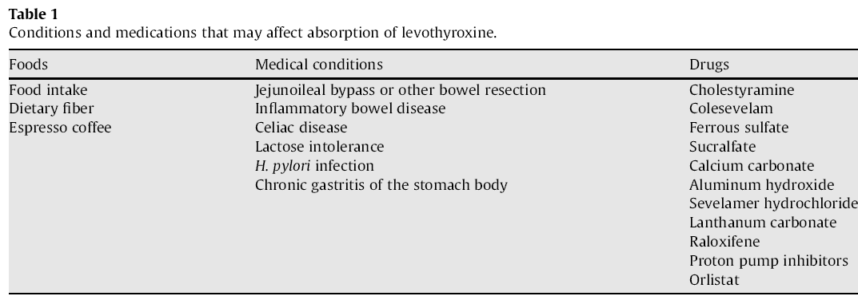

Slide 55
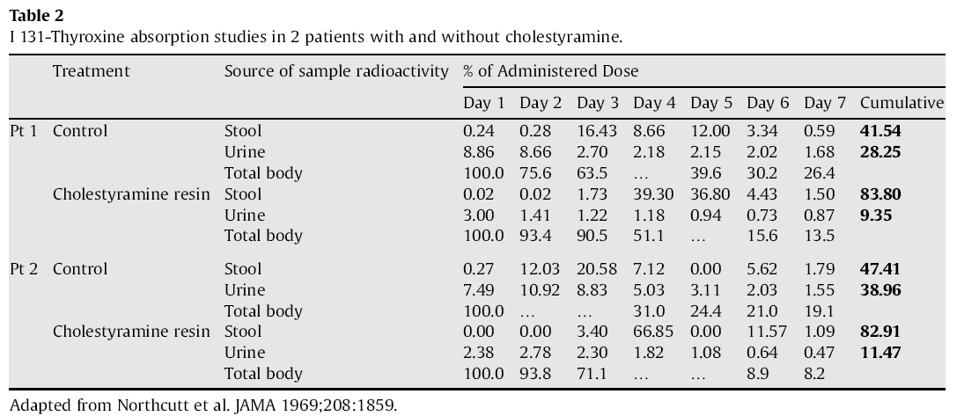
In two patients who were on thyroid hormone replacement therapy, absorption tests were conducted by administering I131- thyroxine with and without cholestyramine. A scanning-bed whole-body counter was used to determine the amount of 131I-thyroxine retained within the body. Urine and stool samples were collected and analysed for 131I-thyroxine. Treatment with cholestyraminewas associated with a twofold increase in total stool radioactivity and decrease in urinary radioactivity, representing decreased intestinal absorption and subsequent loss of I131-thyroxine.

Slide 56
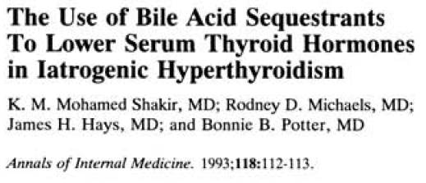
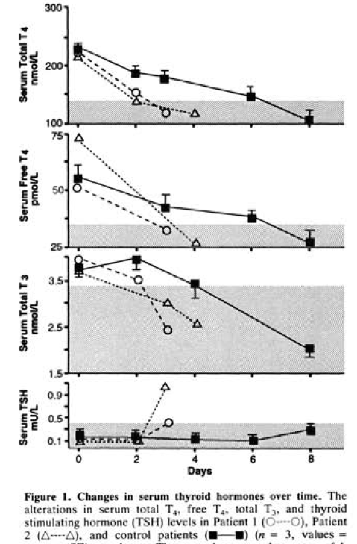

Slide 57
Diagnosis was supported by the finding of
elevated free thyroxine (FT4)
elevated free triiodothyronine (FT3)
Undetectable TSH
absent anti-thyroid antibodies
undetectable serum thyroglobulin
very low/suppressed thyroidal radioiodine uptake
normal/low urinary iodine excretion.
Five women with thyrotoxicosis factitia were evaluated by CFDS (age range 40-72 yr., mean 58 yr.).

Slide 58
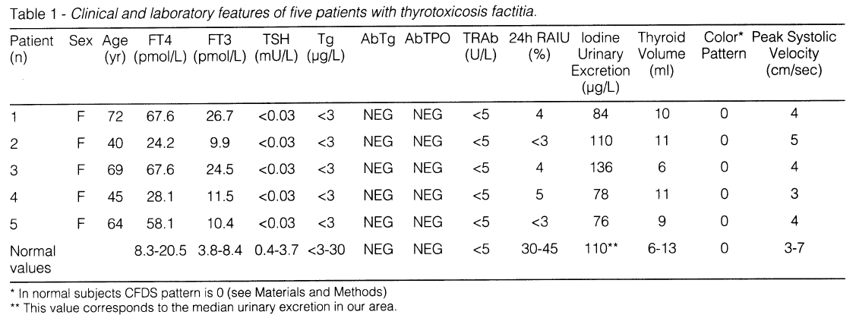

Slide 59
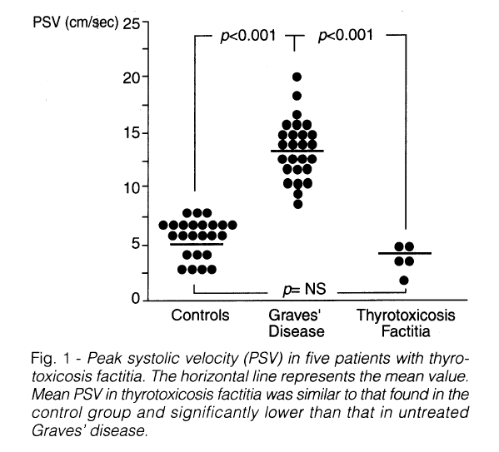
CFDS showing an absent intrathyroidal hypervascularity in spite of elevated circulating free thyroid hormones.
CFDS can be used as an additional, rapid and noninvasive aid to confirm the diagnosis.

Slide 60
Two patients with prolonged thyrotoxicosis are presented with
low radioiodine uptake,
low-normal serum thyroglobulin concentrations,
and low iodide content of the neck on x-ray fluorescence studies.
The surreptitious intake of thyroid hormone was directly proven by
a high fecal concentration of T4 (12.38 and 23.99 nmol/g)
compared with low concentrations in healthy subjects (1.03 ± 0.64 nmol/g; mean ± SD, = 6)
and in patients with hyperthyroidism due to Graves' disease (1.93 ± 1.86; = 8).

Slide 61
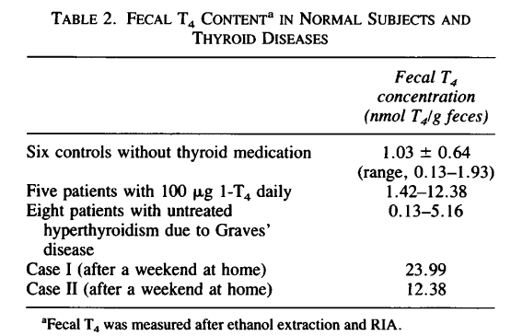
The measurement of fecal T4 is technically simple and reliable and could help in clarifying the origin of difficult cases of thyrotoxicosis.

Slide 62
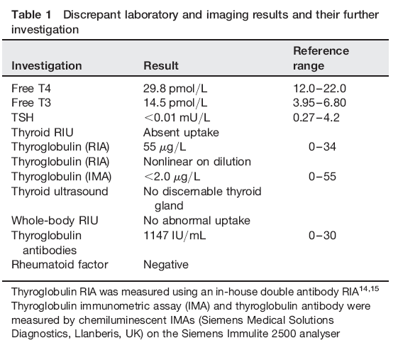

Slide 63
All 25 patients were women.
Analysis was restricted to 17 patients who were born and lived in Tuscany (our region).
Diagnosis of thyrotoxicosis factitia was based on the following parameters:
Elevated serum total and/or free thyroid hormone levels
Undetectable serum thyrotropin levels
Low/undetectable serum thyroglobulin concentration
Normal urinary iodine excretion
Low/suppressed thyroidal RAIU
Absence of goiter
Absence of circulating anti-thyroid antibodies.
Age at diagnosis was >50 yr. in 7/17 patients (41%).
Patients older than 60 yr. were 5/17 (29%).

Slide 66
Advanced age is not a sufficient reason to rule out thyrotoxicosis factitia.

Slide 70
Thyrotoxicosis factitia
Clues to this diagnosis :
Absence of goiter
Suppressed serum TG
Decreased RAIU
Distinction between painless thyroiditis and factitious thyrotoxicosis in Anti TG Positive :
Elevated levels of T4
A high T4/T3 ratio (with exogenous levothyroxine)
A small thyroid
A low thyroidal RAIU
Thyroid ultrasound may be helpful
painless thyroiditis: The thyroid has a heterogeneous echo
Normal sized or slightly enlarged
Ingesting thyroid hormone : Small with a normal echo
Fecal levothyroxine
A disproportionately elevated T3 level suggests that the patient may be ingesting Liothyronine or a combination T4/T3 preparation.

