Slide 1
Interactive case study
Courtesy of Dr. Maria Fleseriu
Oregon Health and Science University, Portland, OR, USA

Slide 2
Presentation:
27-year-old male with seizure disorder for 10 years
3-year history of snoring, constant sweating, increase in shoe size (EU: 42 to 45), headaches and diffuse joint aches
Physical examination: Tall, frontal bossing, coarse facial features, teeth spacing, protruding mandible, large hands/feet
PMH: Lower lip revision and bilateral breast reduction; OSA on CPAP
OSA: Obstructive Sleep Apnea
CPAP: Continuous Positive Airway Pressure

Slide 3
Lab data:
IGF-I: 1250 ng/mL (normal 115–350)
OGTT:
OGTT: 75 g oral glucose

Slide 4
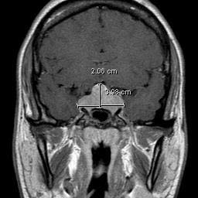
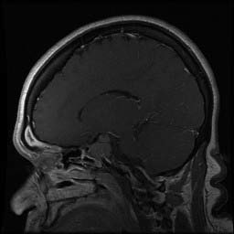
GAD-enhanced MRI

Slide 5
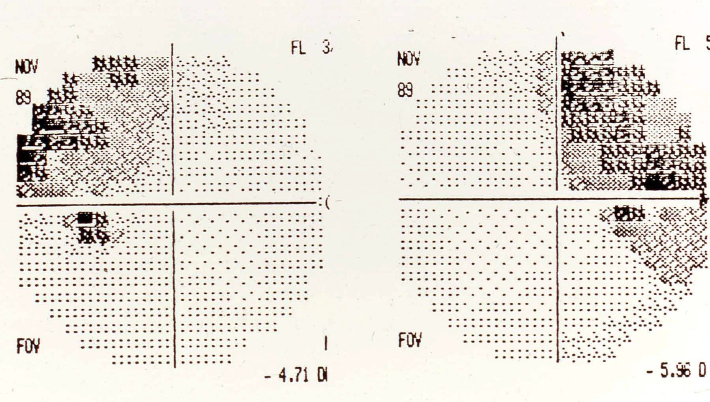
Perimetry: Bitemporal hemianopsia

Slide 6
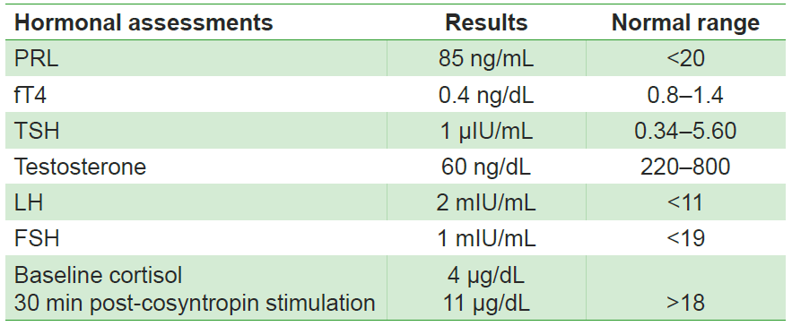
Complete hormonal evaluation

Slide 7
Please discuss about the therapeutic approach to this patient?

Slide 8
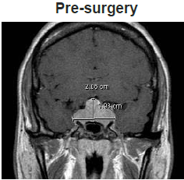
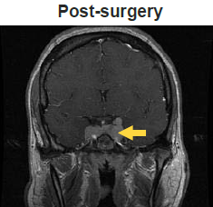
Transsphenoidal surgery after hormonal replacement
Marked symptom improvement except persistent sweating
3-month post-operative follow-up: IGF-I: 345 ng/mL (normal 36–237)
GH post-OGTT: 3 ng/mL

Slide 9
What further therapeutic options would you consider and why?
Repeat surgery
Medical therapy
Radiation
Radiation and medical therapy

Slide 10
Octreotide LAR 30 mg/28 days for 3 months
Symptoms improved further
Biochemical evaluation:
IGF-I: 280 ng/mL (normal 36–237)
Random GH: 1.8 ng/mL

Slide 11
What do you do for him?

Slide 12
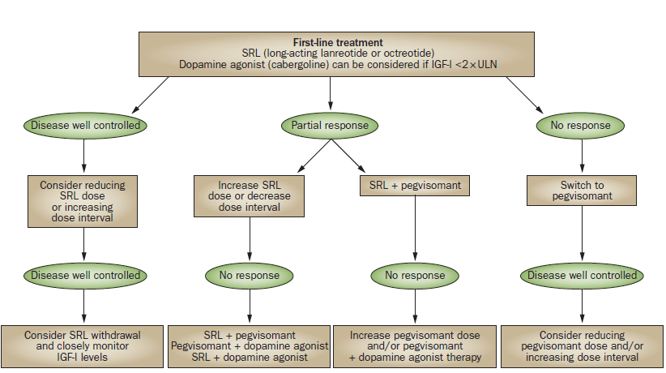
Adapted from Giustina A et al. Nat Rev Endocrinol 2014;10:243–248

Slide 13
Addition of pegvisomant 10 mg/day
After 2 months of treatment:
IGF-I: 180 ng/mL (normal 36–237)
Patient continues on octreotide LAR and pegvisomant 10 mg/day.
IGF-1 remained normal.
No liver abnormalities

Slide 14
Good Luck!

