Slide 1
A Pituitary Society update to acromegaly management guidelines
Pituitary 2021 Feb;24(1):1–13
Presented by: Dr. Elahe Sheklabadi
1400.10.20
Maria Fleseriu1 · Beverly M. K. Biller2 · Pamela U. Freda3 · Monica R. Gadelha4 · Andrea Giustina5 · Laurence Katznelson6 · Mark E. Molitch7 · Susan L. Samson8 · Christian J. Strasburger9 · A. J. van der Lely10 · Shlomo Melmed11 Accepted: 28 September 2020

Slide 2
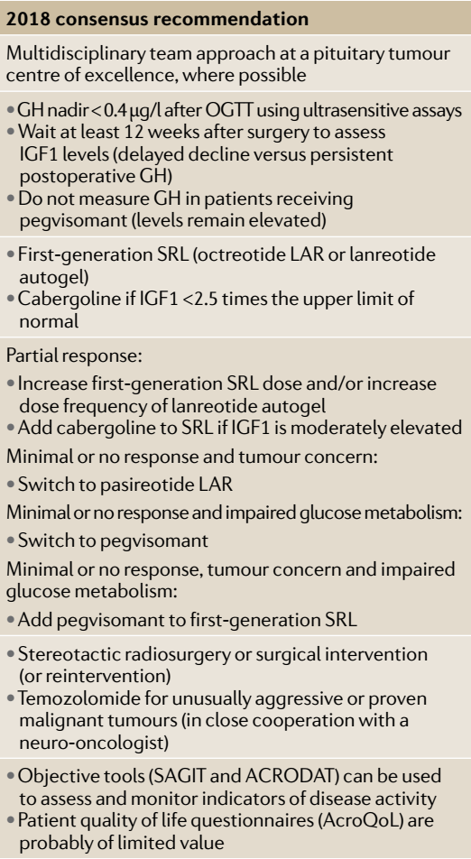
2018
Nature Reviews Endocrinology volume 14, pages552–561 (2018)

Slide 3
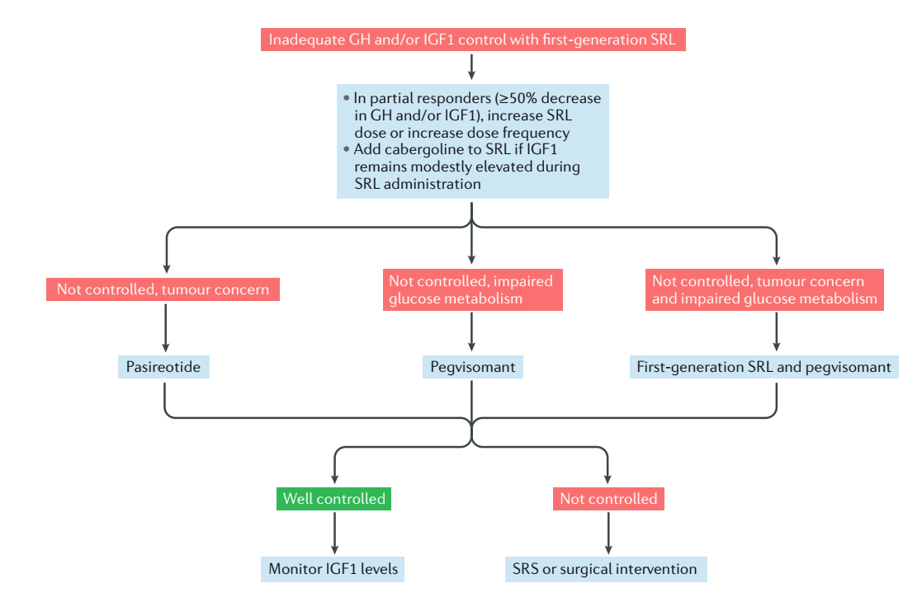
2018

Slide 4
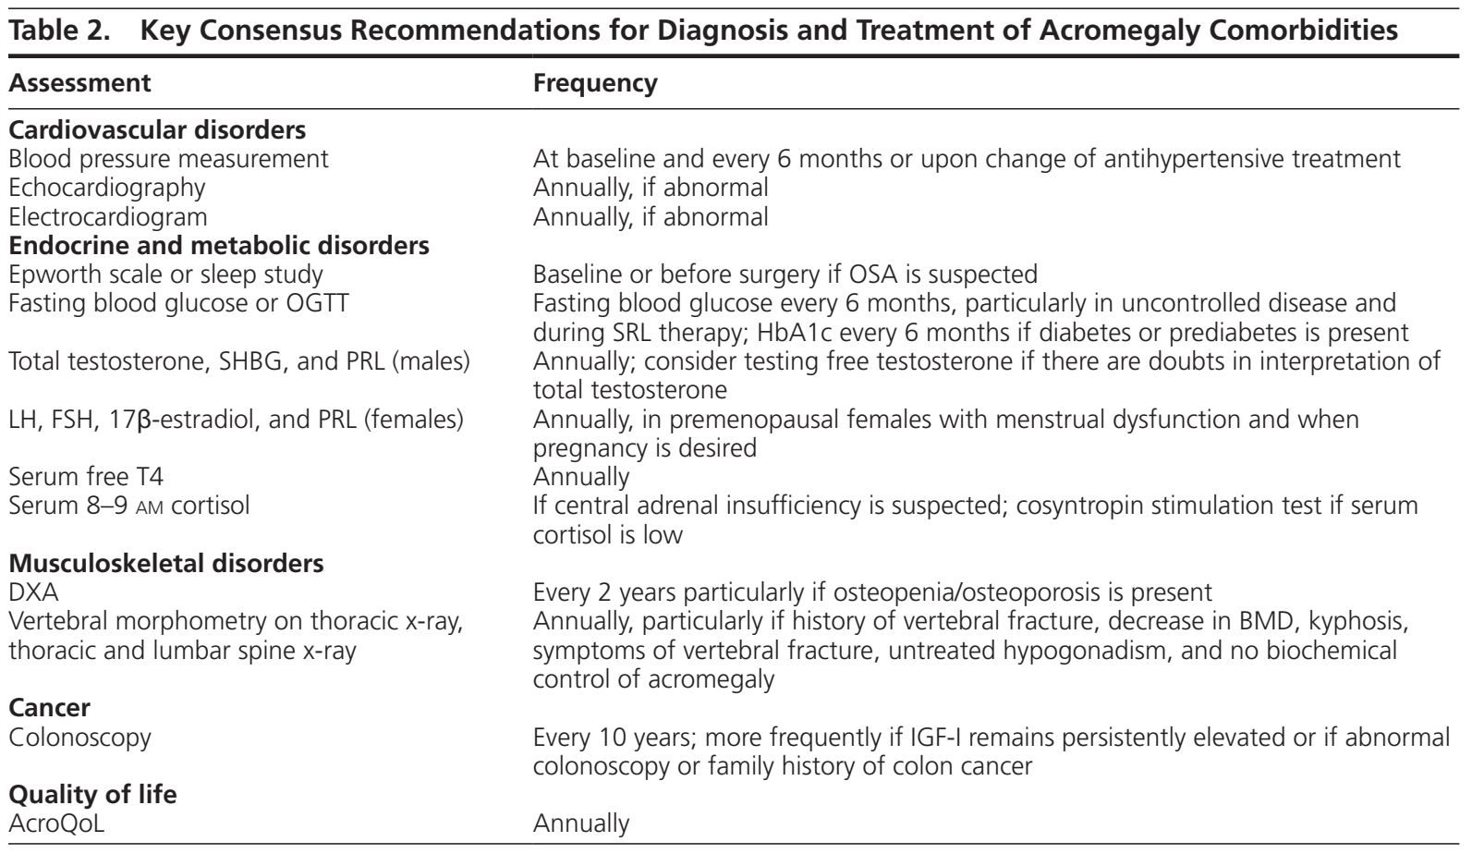
2019
The Journal of Clinical Endocrinology & Metabolism, Volume 105, Issue 4, April 2020, Pages e937–e946

Slide 5
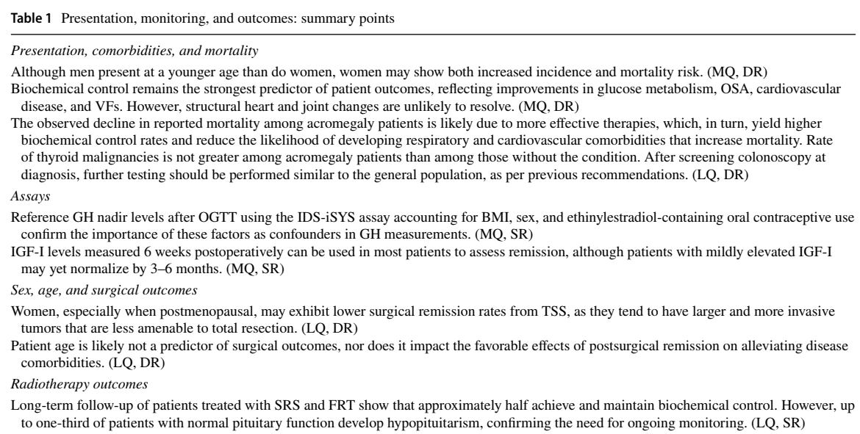
2020

Slide 6
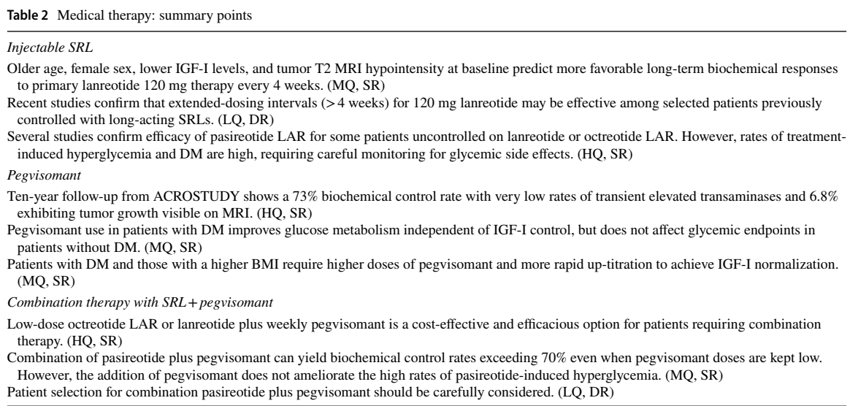
2020

Slide 7
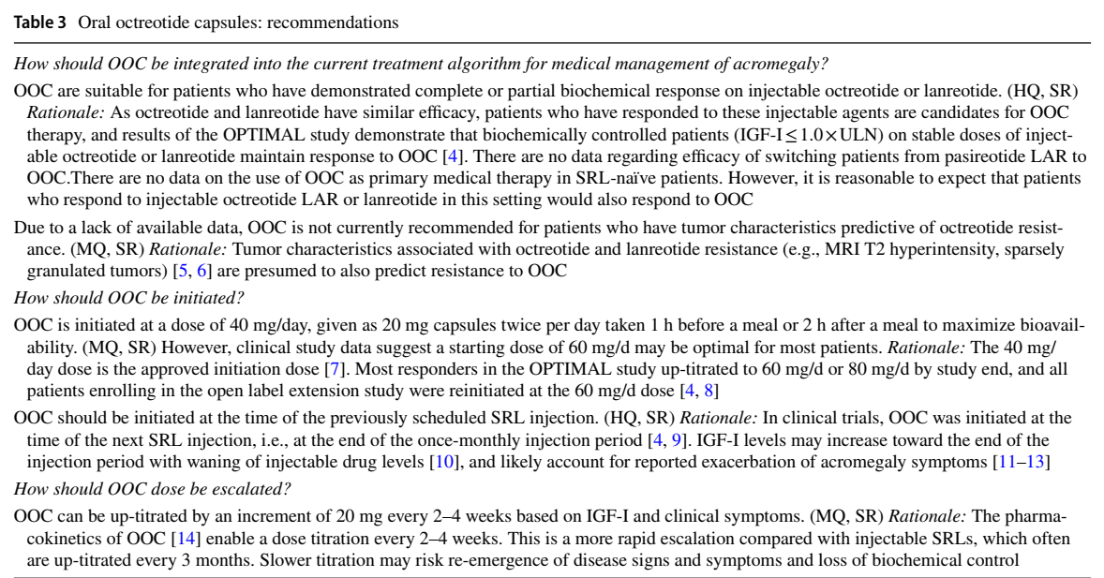
2020
OOC

Slide 8
AGENDA
What’s new ?
Presentation, Comorbidities, Mortality, Sex, Age& Surgical outcomes
Assays
Injectable SRL
Oral octreotide capsules(OOC)
Pegvisomant
Combination therapy with SRL + pegvisomant
Radiotherapy

Slide 9
Presentation, Comorbidities, Mortality, Sex, Age& Surgical outcomes

Slide 10
Presentation, comorbidities, mortality
Although men present at a younger age than do women, women may show both increased incidence and mortality risk. (MQ, DR)

Slide 11
Evidence and recommendations grading

Slide 12
Sex, age, and surgical outcomes
Women, especially when postmenopausal, may exhibit lower surgical remission rates from TSS, as they tend to have larger and more invasive tumors that are less amenable to total resection. (LQ, DR)

Slide 13
Sex, age, and surgical outcomes
Patient age is likely not a predictor of surgical outcomes, nor does it impact the favorable effects of postsurgical remission on alleviating disease comorbidities. (LQ, DR)

Slide 14
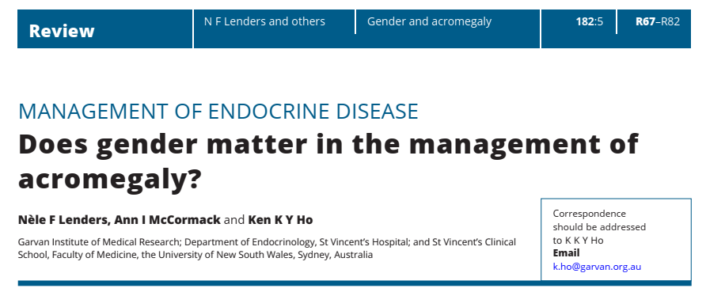
This review examines whether there is a gender difference in epidemiology, presentation, QoL, morbidity, treatments and mortality of acromegaly.

Slide 15
Epidemiology
incidence: slightly higher in females

Slide 16
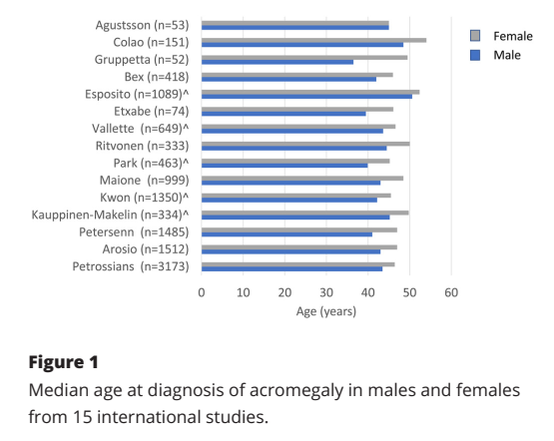
Age at diagnosis
Of the 15 studies surveyed: 10 reported that men were significantly younger than women at diagnosis, by a median of 4.5 years.
Total n=10372.
Range 1.8–6.6 y.

Slide 17
Diagnostic delay
In the Liege Acromegaly Database (n=3143), reported that female patients had a median delay to diagnosis of 2 years longer than their male counterparts.
Similarly, data from the Swedish National Patient registry (n=135) demonstrated that median time to diagnosis was 4.6 years earlier in men than in women

Slide 18
Diagnostic delay

Slide 19
Biochemistry at diagnosis
GH secretion & action are modulated by gonadal steroids.
Testosterone enhances GH secretion & responsiveness.
Estrogens attenuate GH action reducing IGF-1 production.
These regulatory effects of sex steroids result in women having higher levels of GH than men but with similar levels of IGF-I.
There is strong evidence for a gender effect on the biochemistry of acromegaly, characterized by a lower IGF-I in women for equivalent GH status, likely explained by an attenuating effect of estrogens on the action of GH.

Slide 20
Tumour size
Several studies have found that women presented with significantly larger & more invasive tumours than men. Similarly, reported significantly larger tumours in women than in men within the younger age group (age< 40 years)
In a large multicenter registry study, observed that men had significantly larger tumours than women at diagnosis. In this study, tumour size was inversely proportional to age and larger tumours were not observed in patients older than 30 years.

Slide 21
Tumour size
Several studies have not found a significant difference in tumour size between genders.
Further studies are required to investigate the interaction between patient age, gender and tumour size in acromegaly

Slide 22
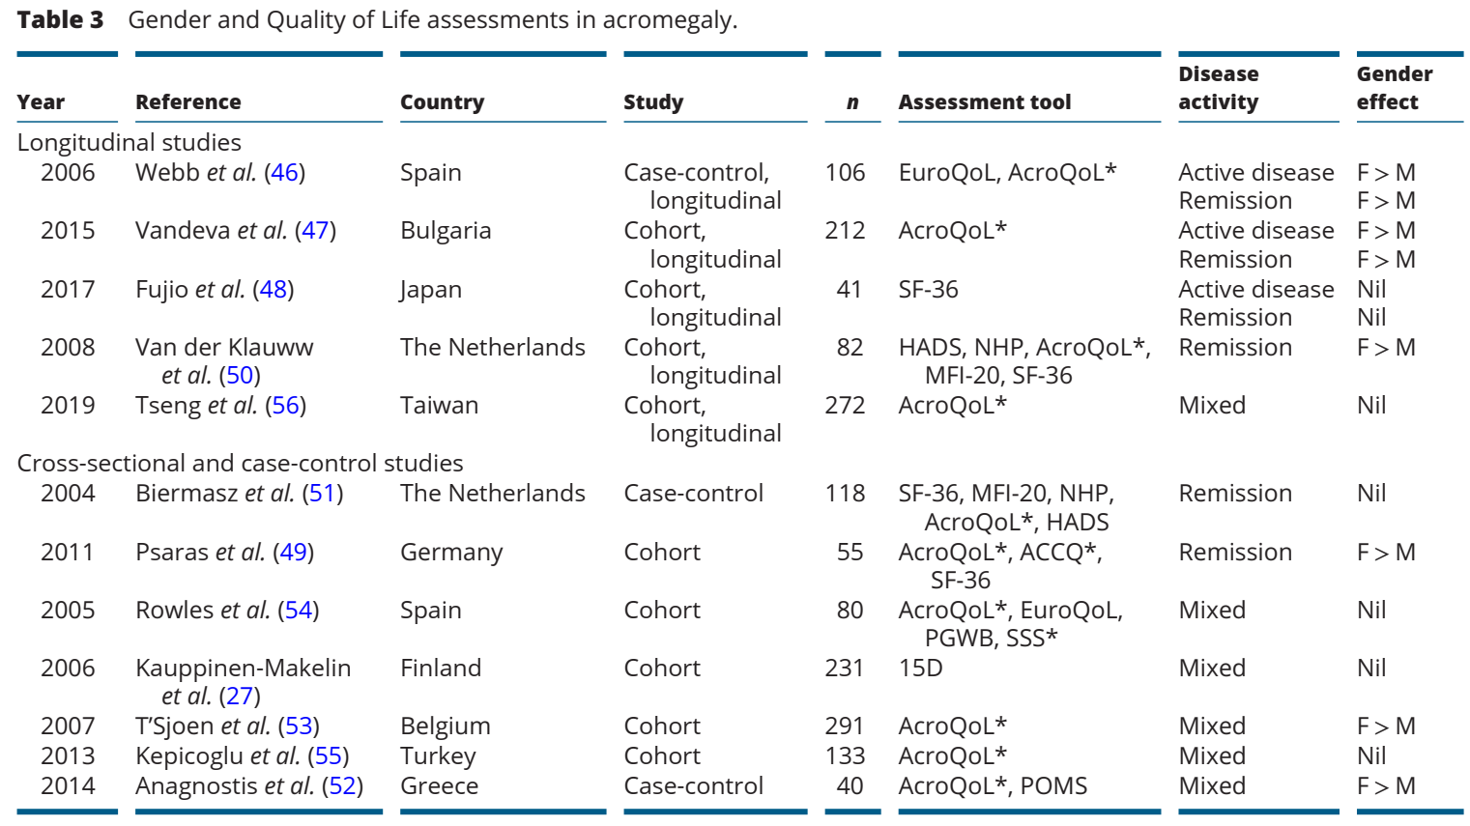
QOL
Morbidity
In the Liege Acromegaly Database (n=3143), reported that female patients had a median delay to diagnosis of 2 years longer than their male counterparts.
Similarly, data from the Swedish National Patient registry (n=135) demonstrated that median time to diagnosis was 4.6 years earlier in men than in women

Slide 23
Morbidity
Cardiovascular risk:
There are limited data regarding gender distribution in cardiovascular risk in acromegaly, from studies in largely heterogenous patient groups, with controlled and uncontrolled disease.

Slide 24
Morbidity
Hypertension:
In a large Mexican registry study (n=2057), the prevalence of hypertension was significantly higher in women compared with men (32% vs 24%).
Overall, evidence from retrospective studies suggests a higher prevalence of hypertension among women with acromegaly, which is opposite to that of the general population.

Slide 25
Morbidity
DM:

Slide 26
Morbidity
Sleep disordered breathing(SDB):
Studies on gender differences in the severity and prevalence of SDB in acromegaly are scant and insufficient to ascertain whether they are different from that in the general population.

Slide 27
Morbidity
Malignancy:
Thyroid cancers have a five-fold increased risk when compared with sex and age-matched controls.
Increased risk of colorectal cancer has been demonstrated in multiple studies, without gender dimorphism.

Slide 28
Morbidity
Malignancy:
Breast cancers are significantly more common in the women with acromegaly (5%) compared with the general population, although study numbers are small.
In summary, data regarding gender dimorphism in malignancy with acromegaly are scant. Larger studies are required for clinically meaningful conclusions to be drawn.

Slide 29
Morbidity
Bone health:
Some data have demonstrated increased BMD ,some decreased & others unchanged bone density.
Several studies have shown increased prevalence of vertebral fractures in acromegaly, independent of bone mineral density, bone turnover and disease control.
Male predominance has been reported, albeit particularly in the presence of concomitant hypogonadism.
Overall, there is insufficient evidence to ascertain whether there is a gender dimorphism in acromegalic bone disease

Slide 30
Outcomes of treatment
Surgery:
The single largest study investigating this directly suggests more aggressive natural history and hence worse treatment outcomes in premenopausal women.
Further prospective age-matched data are required to elucidate whether surgical outcomes are influenced by gender.
Age- and Sex-Specific Differences as Predictors of Surgical Remission Among Patients With Acromegaly
Se Hee Park, Cheol Ryong Ku, Ju Hyung Moon, Eui Hyun Kim, Sun Ho Kim, Eun Jig Lee
The Journal of Clinical Endocrinology & Metabolism, Volume 103, Issue 3, March 2018

Slide 31
Outcomes of treatment
Surgery:
Recent studies suggest that female sex, but not age, may impact surgical outcomes.
A large retrospective single center study of 463 patients who underwent TSS found that women had lower pre-operative IGF-I compared with men, yet were older at surgery and had larger adenomas and more cavernous sinus invasion.
Rates of total tumor resection were significantly higher in men than in women, as were rates of remission postsurgery.

Slide 32
Outcomes of treatment
Surgery:
Data on acromegaly in the elderly are sparse. One tertiary care center study of 57 patients age≥65 years reported a surgical remission of 73.7%.
These patients tended to have smaller adenomas with lower invasion rates, which may explain why other studies did not show age as a predictor of remission.
Acromegaly in the elderly patients
Maria Rosaria Ambrosio, Irene Gagliardi, Sabrina Chiloiro, Ana Gonçalves Ferreira, Marta Bondanelli, Antonella Giampietro, Antonio Bianchi, Laura De Marinis, Maria Fleseriu & Maria Chiara Zatelli ; Endocrine volume 68, pages16–31 (2020)

Slide 33
Outcomes of treatment
Surgery:
Of note, a study of 87 consecutive patients who underwent TSS showed no significant between-group differences in perioperative complications and/or endocrinological remission comparing those younger and older than 65 years.
Incidence of new postoperative pituitary deficiency was also similar, and remission enabled one-third of patients over age 65 years to stop medication for hypertension and DM
Transsphenoidal Surgery for Elderly Patients with Acromegaly and Its Outcomes: Comparison with Younger Patients
panelYasuoSasagawa1YasuhikoHayashi1OsamuTachibana3AtsushiNakagawa4MasahiroOishi1ToshinariTakamura2HideakiIizuka3MitsutoshiNakada:
World Neurosurg 118:e229–e234

Slide 34
Outcomes of treatment
Somatostatin Analogues (SSAs):
Although there are proposed mechanistic reasons for better efficacy of SSA in female patients, study data are conflicting.

Slide 35
Outcomes of treatment
GH receptor antagonist(Pegvisomant):
In women, for an equivalent concentration of Pegvisomant, the reduction in IGF-I was lower, indicating that sensitivity were lower in women.
Male patients had significantly greater decline in their IGF-1 from baseline than did women.

Slide 36
Outcomes of treatment
GH receptor antagonist(Pegvisomant):.
More male patients were controlled at the end of treatment than were women.
The mean dose of pegvisomant was significantly higher in women than in men, although significance was lost when corrected for weight.

Slide 37
Outcomes of treatment
Radiotherapy:
There is no substantial and consistent evidence to suggest that gender does affect remission of disease following radiation therapy.

Slide 38
Mortality
Radiotherapy:
There is no substantial and consistent evidence to suggest that gender does affect remission of disease following radiation therapy.

Slide 39
Conclusion
Acromegaly is more common in women who present at an older age with longer diagnostic delay.
At presentation, women have a higher GH relative to IGF-1 level than men.
QoL is more adversely affected in women both before and after treatment.
Prevalence of HTN & DM are greater in women than in men with acromegaly.

Slide 40
Conclusion
Treatment outcomes with SSAs are comparable between sexes, but women may require a higher dose of Pegvisomant for equivalent response.
Mortality in untreated acromegaly is more profoundly affected in women; however, improved treatments in recent decades have resulted in normalization of standard mortality ratios in both sexes.
Nearly all studies concur that men are significantly younger than women at diagnosis, by a median of 4.5 years

Slide 41
Take MORE care of women

Slide 42
Presentation, comorbidities, mortality
Biochemical control remains the strongest predictor of patient outcomes, reflecting improvements in glucose metabolism, OSA, cardiovascular disease, and VFs. However, structural heart and joint changes are unlikely to resolve. (MQ, DR)

Slide 43
Presentation, comorbidities, mortality
The observed decline in reported mortality among acromegaly patients is likely due to more effective therapies, which, in turn, yield higher biochemical control rates and reduce the likelihood of developing respiratory and cardiovascular comorbidities that increase mortality.

Slide 44
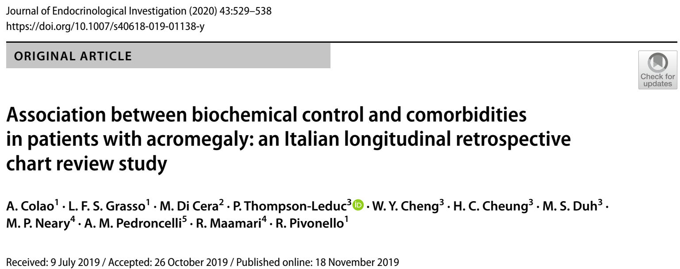
A retrospective study
150 patients treated at a single center for a median of 10.4 years assessed treatment and disease control impact on acromegaly comorbidities.
Biochemical control status was assessed annually and defined as IGF-1 ≤ the upper limit of normal, or GH ≤ 2.5 µg/L in the few cases where IGF-1 was unavailable

Slide 45
Study design scheme

Slide 46
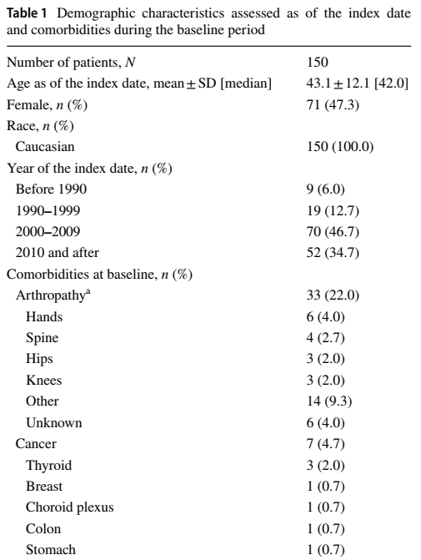
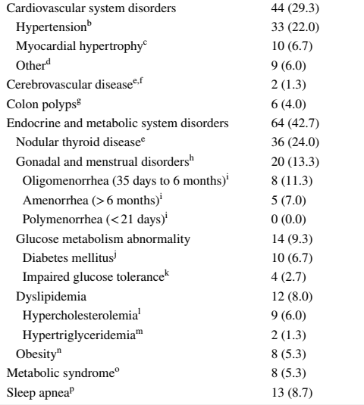

Slide 47
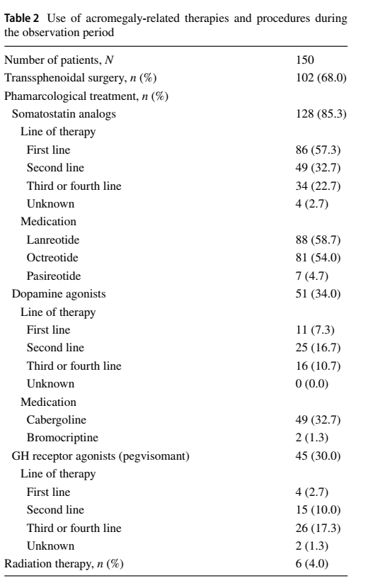

Slide 48
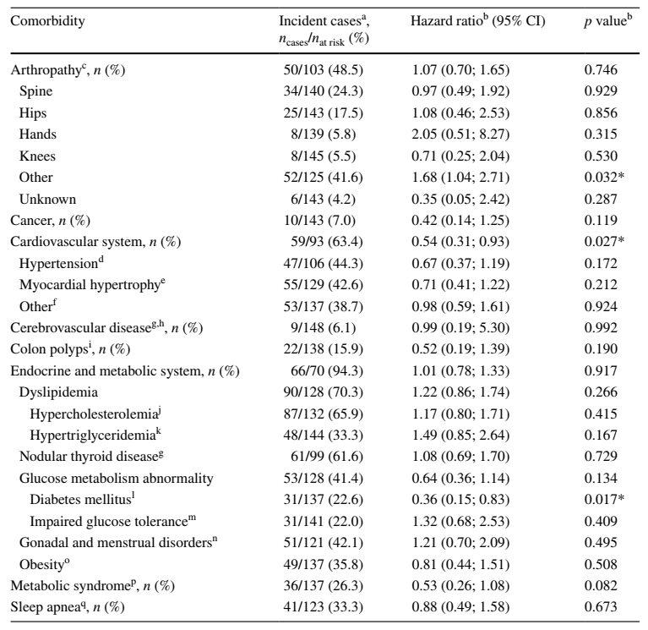
Association between
biochemical control &
comorbidities

Slide 49
Conclusion
Results further support the importance of achieving biochemical control, as this may reduce the risk of high burden conditions, including diabetes and cardiovascular system disorders. the risks of developing arterial hypertension and myocardial hypertrophy were not different.
The association for arthropathy suggests irreversibility of this impairment.

Slide 50
Presentation, comorbidities, mortality
Rate of thyroid malignancies is not greater among acromegaly patients than among those without the condition.
After screening colonoscopy at diagnosis, further testing should be performed similar to the general population, as per previous recommendations. (LQ, DR)

Slide 51
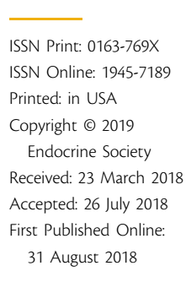

Slide 52
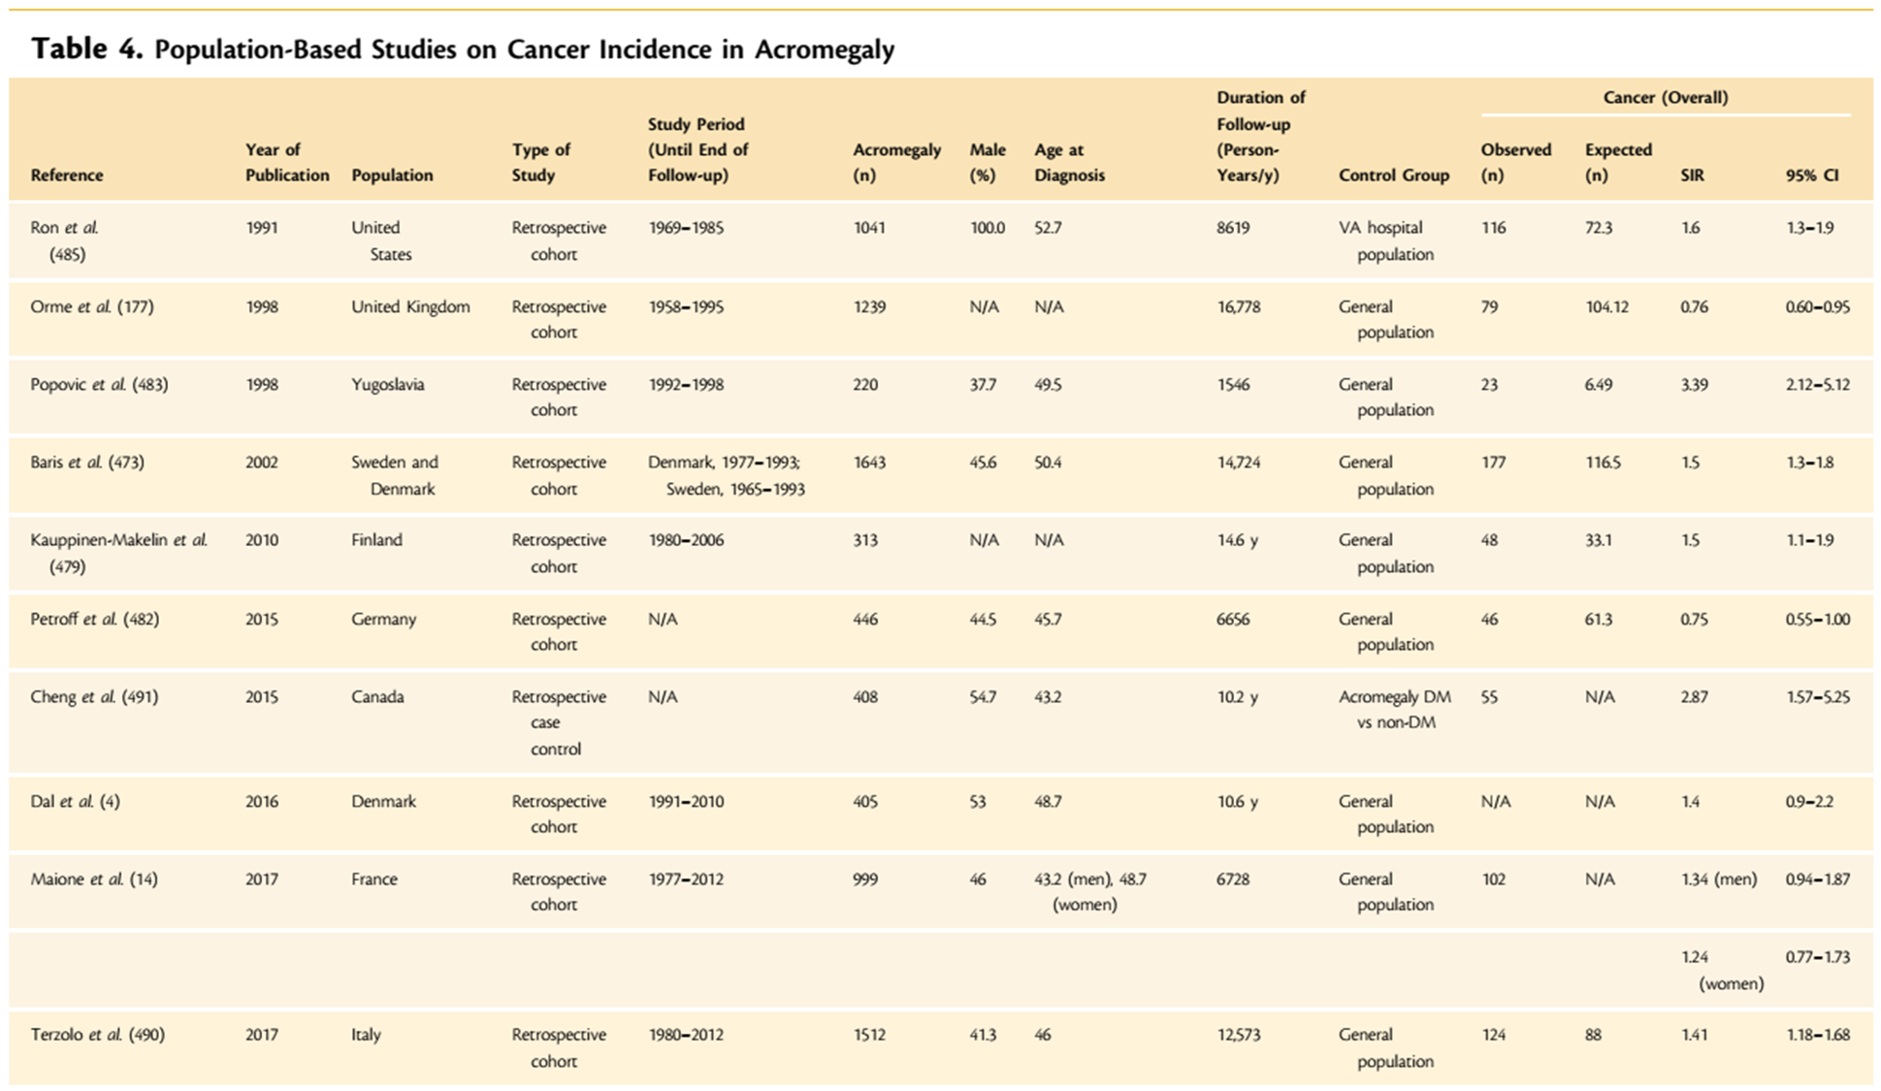
A retrospective study of 150 patients treated at a single center for a median of 10.4 years assessed treatment and disease control impact on acromegaly comorbidities.
Biochemical control, assessed only by a random growth hormone (GH) level < 2.5 μg/L, was associated with a lower hazard ratio (HR) of developing DM (HR 0.36; 95% CI 0.15, 0.83; p = 0.017) as well as cardiovascular system disorders overall (HR 0.54; 95% CI 0.31, 0.93; p = 0.027) compared to those not controlled. However, the risks of developing arterial hypertension and myocardial hypertrophy were not different.

Slide 53
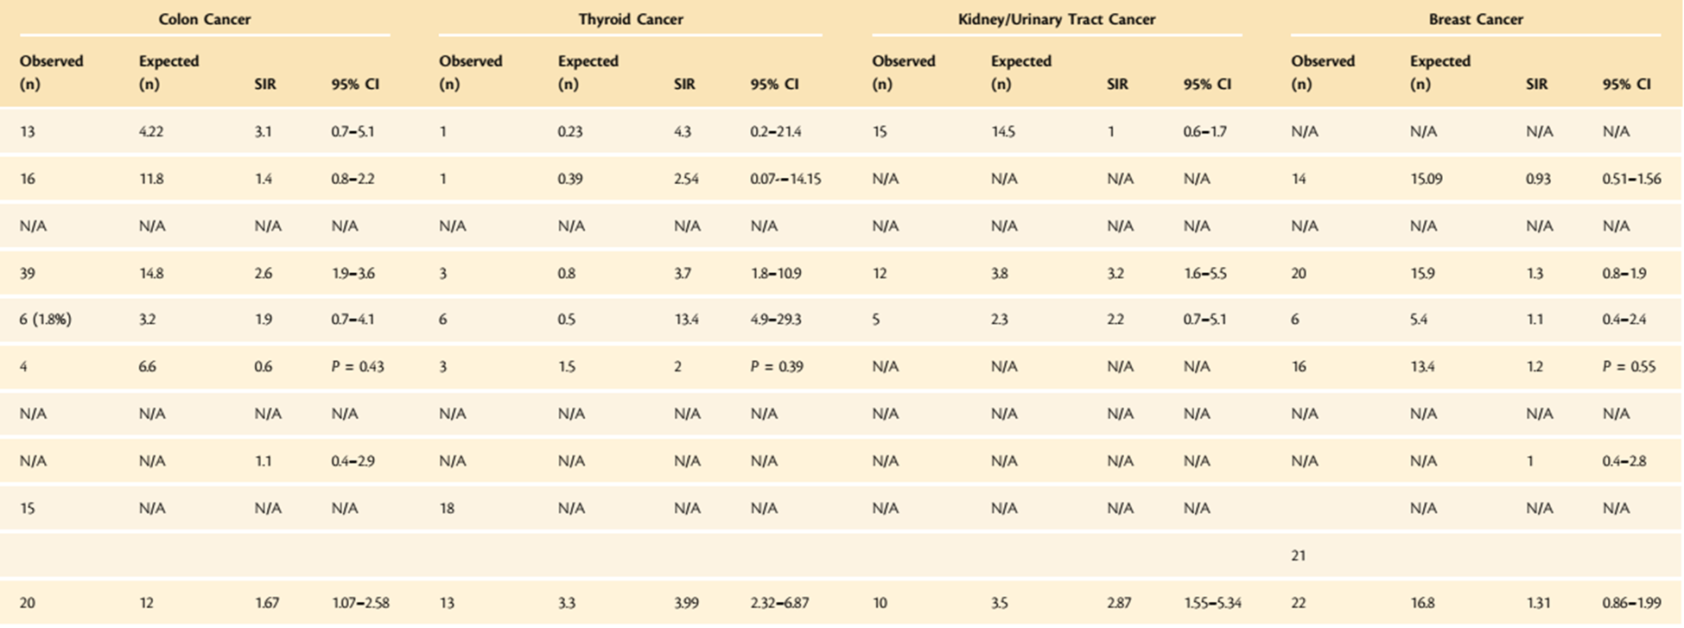

Slide 54
Recommendation
Current guidelines for screening for colorectal cancer in patients with acromegaly suggest that at least one colonoscopy should be done at the time of diagnosis, followed by appropriate surveillance depending on findings from initial colonoscopy and disease activity.
However, in younger patients, the age at which screening should start remains controversial . Some have proposed that colonoscopy only be offered starting at age 40 years.

Slide 55
Recommendation
Screening at diagnosis be performed regardless of age, as up to a fifth of acromegaly patients ,<40years of age have been found to have colonic neoplasia vs 5% of controls in one study.
If initial colonoscopy is normal, then patients should be screened in a similar manner to the general population every 10 years, provided acromegaly is biochemically controlled.
More frequent screening may be required in patients with persistently active disease, but the optimal frequency is yet to be determined . Some have recommended colonoscopy every 3 to 5 years in patients with either a polyp or persistently elevated IGF-I

Slide 56
Recommendation
More recently, there have been increasing calls for routine surveillance for both thyroid nodules and cancer in patients with acromegaly.
In the absence of symptoms, or patient-observed goiter, clinical examination for thyroid nodules should be performed yearly, followed by ultrasonography in those with palpable nodules.
Current guidelines recommend a cut-off of 1.5cm as an indication for FNAB in low suspicion nodules , based on the other studies, most of which employed the older recommended cut-off of 1 cm, it may be prudent to consider a 1 cm threshold for FNAB in acromegaly patients.

Slide 57
Other studies
A study of the two cancers most associated with acromegaly, namely colon and thyroid cancer, suggest that this risk might not be clinically significant.
Comparing 178 patients and 356 controls, colorectal polyps were found in 67% of patients in the acromegaly group and in 24% of the control group (p < 0.001), but there was no difference in histology subtypes.
No Benefit of Dedicated Thyroid Nodule Screening in Patients with Acromegaly
Ngan Betty Lai, M Dave Garg, M Anthony P. Heaney, MD, Ph Marvin Bergsneider, M Angela M. Leung, MD, MSc;
Endocr Pract 26(1):16–21
Clinicopathological features of colorectal polyps and risk of colorecta cancer in acromegaly in European Journal of Endocrinology
Authors: Yorinari Ochiai1,6, Naoko Inoshita2,3,6, Toshiro Iizuka1, Hiroshi Nishioka4, Shozo Yamada4,5, Masanobu Kitagawa6, and Shu Hoteya;
Eur J Endocrinol 182(3):313–318.

Slide 58
Conclusion
Although controversial, cancer incidence seems to be increased in acromegaly, and routine screening is recommended for colon cancer starting at acromegaly diagnosis and for other cancers depending on clinical features.

Slide 59
Cause of mortality
Mortality in patients with acromegaly has been mainly attributed to cardiovascular disease in previous studies.
Nevertheless, a finding that is also reflected in the changes in causes of mortality in patients with acromegaly in more recent studies.

Slide 60
Cause of mortality
In four studies published in the last decade encompassing 3391 patients, malignancies were the leading cause of death, with cardiovascular disease as the second cause, but these causes were not different from the general population.

Slide 61
Cause of mortality
This table reported in studies published in the last decade, reiterating that malignancy is the main cause of death in patients with acromegaly, surpassing cardiovascular diseases.
Mortality changed from CV in the first decade to cancer deaths (35%) in the next two decades

Slide 62
Assays

Slide 63
Assays
Other markers of GH action such as IGF binding protein 3 or acid-labile subunit have been suggested to assess discrepant GH and IGF-I results.

Slide 64
Assays
Arch Endocrinol Metab 63(6):618–629
Review article
Described the evolution of analytical methods to measure biomarkers of GH action, the impact of the methodological changes on laboratory results and the need to include biological variables in their interpretation.

Slide 65
Laboratory investigation
Large variability exists among different growth hormone (GH) assays owing to:
Differences in calibration
Antibody specificity
Isoform recognition((e.g. 20 kDa GH, placental GH)
Interference from GH binding protein (GHBP)
Reference preparations & sensitivity
GH has pulsatile secretion and short half-life.
Concentration is modified by acute factors such as stress, exercise and sleep, intake of oral estrogens and anthropometric factors (e.g. BMI).
The GH receptor antagonist Pegvisomant presents a new challenge because Pegvisomant interferes with many GH assays.

Slide 66
Laboratory investigation
IGF-I assays:
Binding protein interference
Pubertal development
Age
Making detailed reference intervals mandatory for interpretation

Slide 67
Discrepant results from GH-nadir and IGF-I analysis can also delay diagnosis.

Slide 68
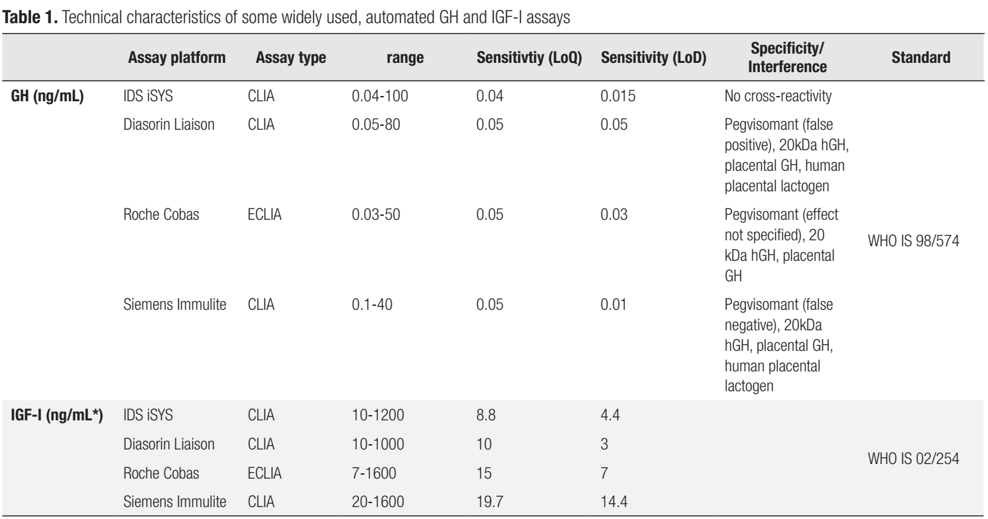
Laboratory investigation
The Klotho gene was originally identified as an ageing suppressor gene of restricted expression (predominantly in the kidney, brain, and parathyroid and pituitary glands), encoding a transmembrane protein, mKlotho.
mKlotho serves as a co-receptor in fibroblast growth factor 23 (FGF23) signalling.

Slide 69
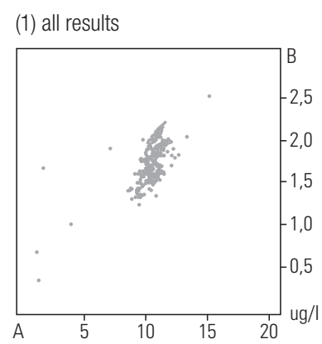
Measurement of GH in the same two samples A and B by different laboratories (n=208).
Reported concentrations vary by more than 100%

Slide 70
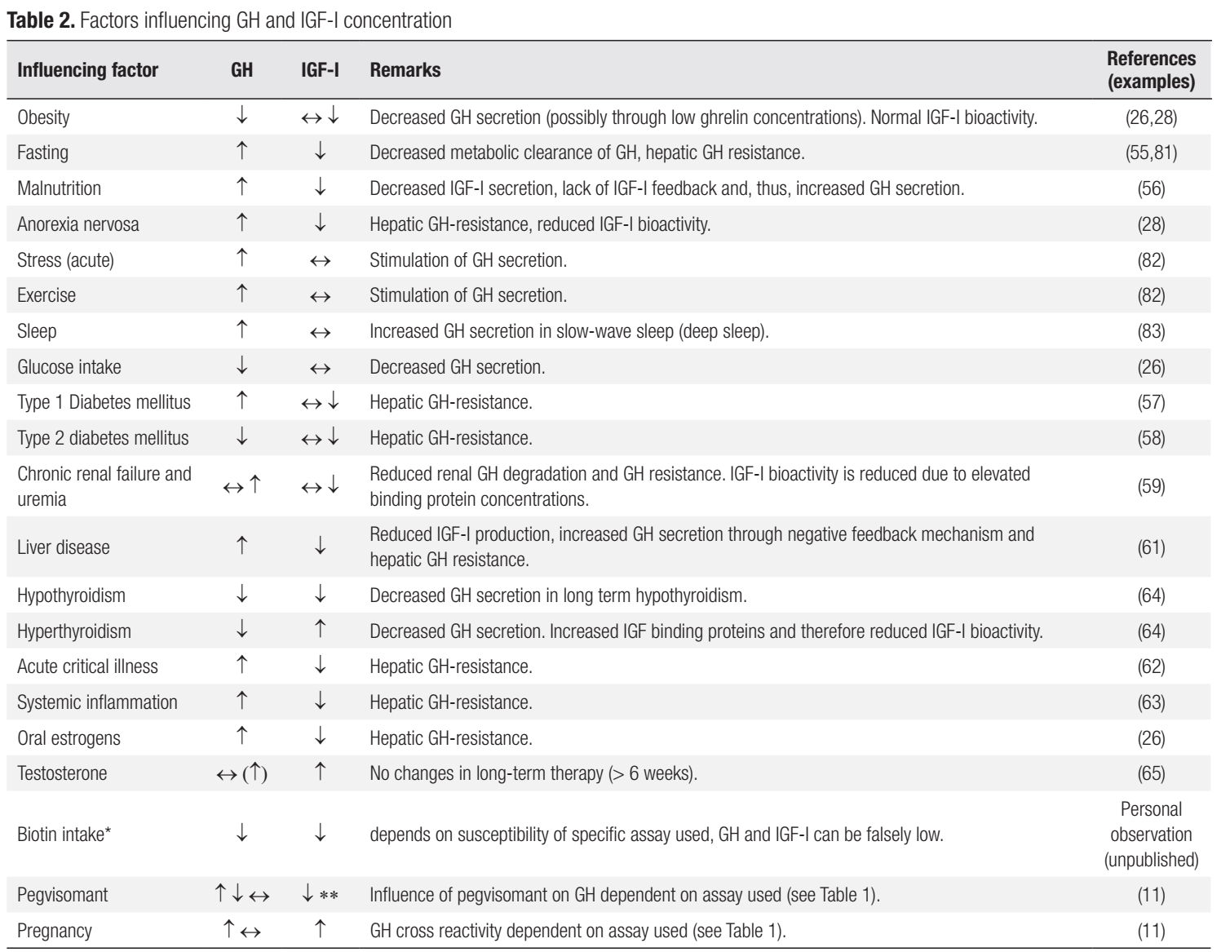
Laboratory investigation
The Klotho gene was originally identified as an ageing suppressor gene of restricted expression (predominantly in the kidney, brain, and parathyroid and pituitary glands), encoding a transmembrane protein, mKlotho.
mKlotho serves as a co-receptor in fibroblast growth factor 23 (FGF23) signalling.

Slide 71
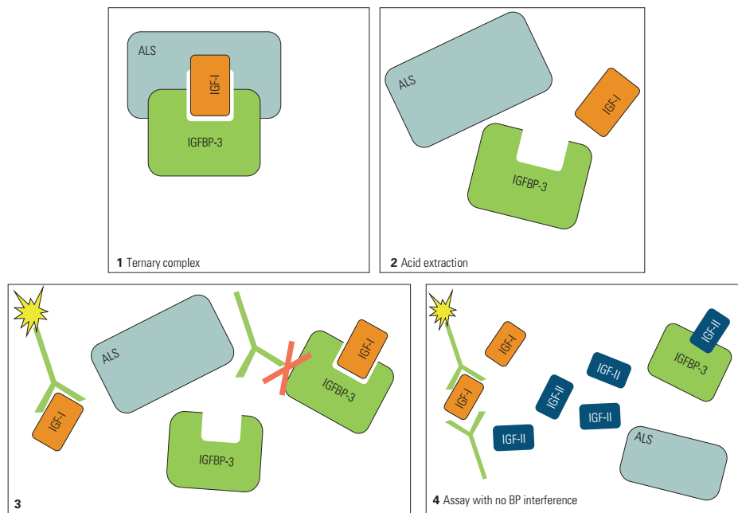
Laboratory investigation

Slide 72
Laboratory investigation
Other GH dependent biomarkers:
- Free IGF-I
- IGF binding protein 3 (IGFBP 3)
- Acid labile subunit (ALS)

Slide 73
IGFBP 3
In patients with acromegaly, correlation with GH secretion and IGF-I concentrations is also fairly good , but overall, the diagnostic value of IGFBP 3 seems limited.
Measurement of IGFBP 3 adjusted with: assay- age- and sex-specific, to Tanner stages in adolescents.

Slide 74
IGFBP 3
The age-related pattern of IGFBP 3 concentrations largely mirrors that of IGF-I, though the decline in adults is less obvious.
IGFBP 3 concentrations have been reported to be decreased in liver disease and fasting & increased in chronic renal failure.

Slide 75
IGFBP 3
Advantage:
Especially in young children (<3 years)(seems more sensitive than IGF-I in the diagnosis of GHD).

Slide 76
Acid labile subunit(ALS)
Synthesized in a GH-dependent manner in the liver
A part of the ternary complex with high affinity for the binary IGF-I/IGFBP 3 complex
Correlated with IGF-I in GHD & acromegaly
Its measurement seems not to add significant information to measurements of IGF-I or IGFBP 3.

Slide 77
Free IGF-I
IGF-I assays used in clinical routine measure total IGF-I.
Only in specific clinical conditions where concentrations of binding protein concentrations can be significantly altered (i.e. chronic renal failure, starvation), total IGF-I might no longer be the most reliable biomarker.
In such cases, measurement of free IGF-I (or bioactive IGF-I) has been shown to provide additional information .

Slide 78
Free IGF-I
Direct measurement of “free IGF-I” requires sophisticated analytical methods which are available in very few laboratories only.
As an easier available surrogate marker, the IGF-I/IGFBP-3 molar ratio has been suggested.

Slide 79
GHBP
Approximately half of the circulating GH is bound to GHBP.
In cases of short stature with growth hormone insensitivity, it is diagnostically relevant, as it might differentiate between GHD and GH insensitivity(GHPB is very low or undetectable).
There are also genetic defects of the GHR with normal or even elevated GHBP.

Slide 80
GHBP
GHBP concentrations are influenced by age, sex, body composition and oral estrogen intake, which has to be taken into account in evaluation.

Slide 81
Conclusion
Measurements of different biomarkers have been proposed for the diagnosis of diseases related to the GH-IGF-I axis, as well as for monitoring of therapy.
Currently, IGF-I is considered the most important and reliable surrogate parameter reflecting GH secretory status, and its measurement is recommended in the guidelines for acromegaly and GHD.
Measurement of integrated, stimulated or suppressed GH is used as the most important confirmatory parameter.

Slide 82
Conclusion
Critical aspects of GH and IGF-I assay quality:
Calibration
Removal of binding protein interference
Long-term stability of assay performance
Quality of intervals or cut-offs
Meaningful interpretation of data is also possible only when the biological variability and a wide variety of potential confounders are taken into account.

Slide 83
Conclusion
Determination of other parameters such as IGFBP-3, ALS, alpha soluble klotho and GHBP have not been shown to add significant information in the majority of cases.
However, their measurement might be useful in certain age groups, in diagnostically ambiguous cases or in the diagnostic workup of rare genetic diseases.

Slide 84
Assays
Reference GH nadir levels after OGTT using the IDS-iSYS assay accounting for BMI, sex, and ethinylestradiol-containing oral contraceptive use confirm the importance of these factors as confounders in GH measurements. (MQ, SR)

Slide 85
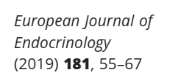
Assays
Multicenter study with prospective and retrospective cohorts (525 healthy adults: 405 females and 120 males).
Exclusion criteria: DM, impaired glucose metabolism, known pituitary disease, history of irradiation of the head, pregnancy, CAH, PCOS, alcohol and drug abuse until 6 months prior to inclusion, BMI <18kg/m2 & >30kg/m2.
GH concentrations were measured by the IDS-iSYS immunoassay after oral application of 75 g glucose.

Slide 86
IDS-iSYS immunoassay
A monoclonal antibody automated 22-kD growth hormone-specific assay without interference from Pegvisomant& not affected by GHBP.
As GH and IGF-I assessments remain the standard for measuring acromegaly disease activity at diagnosis and follow-up, strategies are being developed to improve current assays.
Measuring very low GH concentrations is possible with more recent GH assays, but reliable data on normal suppression, as measured with such assays, are scarce.
Automated 22-kD growth hormone-specific assay without interference from Pegvisomant
Jenny Manolopoulou 1, Younes Alami, Stephan Petersenn, Jochen Schopohl, Zida Wu, Christian J Strasburger, Martin Bidlingmaier
Clin Che . 2012 Oct;58(10):1446-56. doi: 10.1373/clinchem.2012.188128. Epub 2012 Aug 20

Slide 87
IDS-iSYS immunoassay
As a first step to define more appropriate cut-offs specific for GHnadir for a modern, highly sensitive and specific, widely available GH assay, designed a study to assess GHnadir during OGTT and the impact of biological variables in a larger number of subjects without pituitary disease.

Slide 88
IDS-iSYS immunoassay
Limit of quantification (LoQ) of the assay under routine conditions is 0.05µg/L.
For calculations, GH values <0.05µg/L were arbitrarily set to 0.04µg/L.
All samples with GHnadir ≥0.4µg/L were re-assayed after pre-treatment in heterophilic antibody and non-specific blocking tubes .

Slide 89
Assays
IGF-I (CLIA, IDS-iSYS) was measured before glucose load. If IGF-I was above the assay-specific upper limit of normal (ULN) for age and sex, measurement was repeated to verify the concentration.
The main groups:
- Males (M)
- Premenopausal females without OC-EE intake (FPRE)
- Premenopausal females with OC-EE intake (FPREOC)
- Postmenopausal females (FPOST)

Slide 90
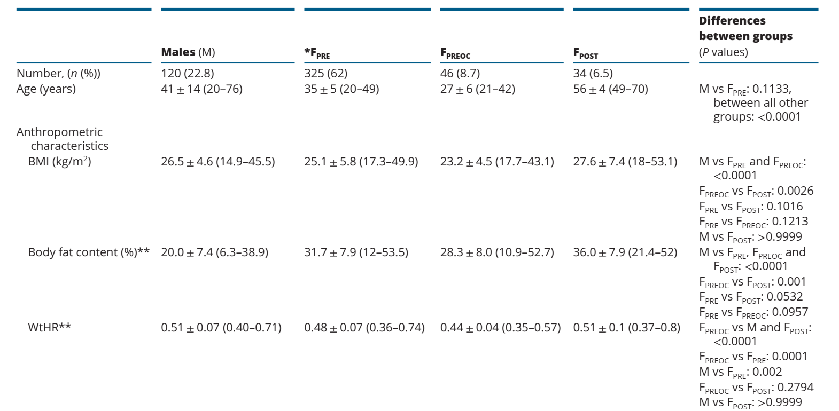
Characteristics of subjects presented as total numbers & percent or mean & range

Slide 91
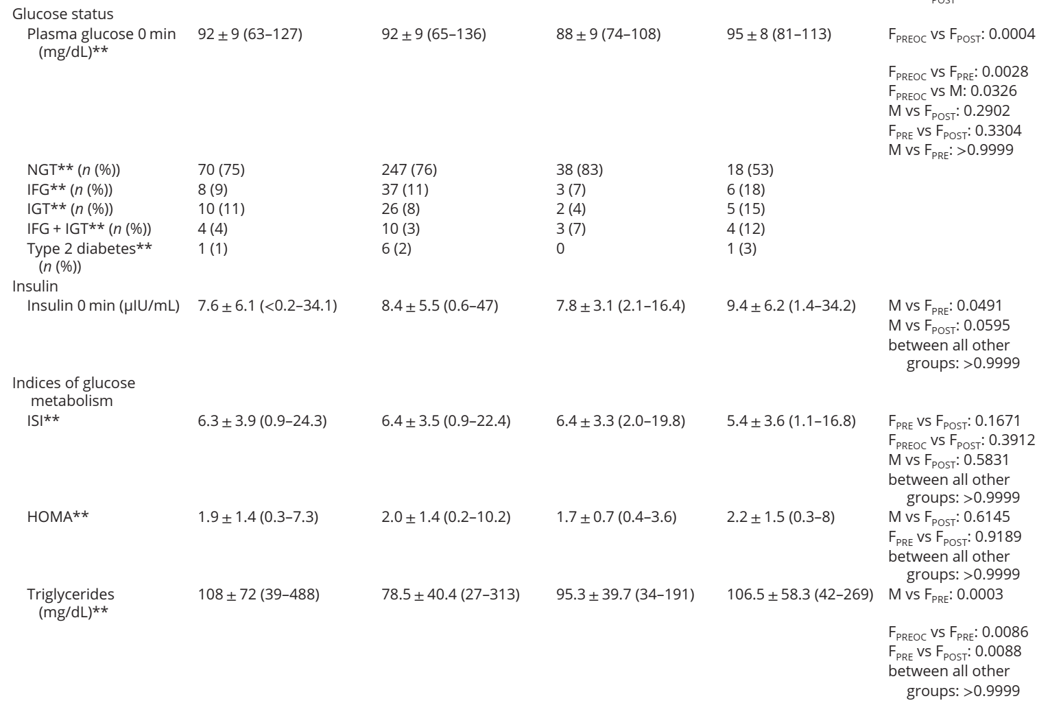

Slide 92
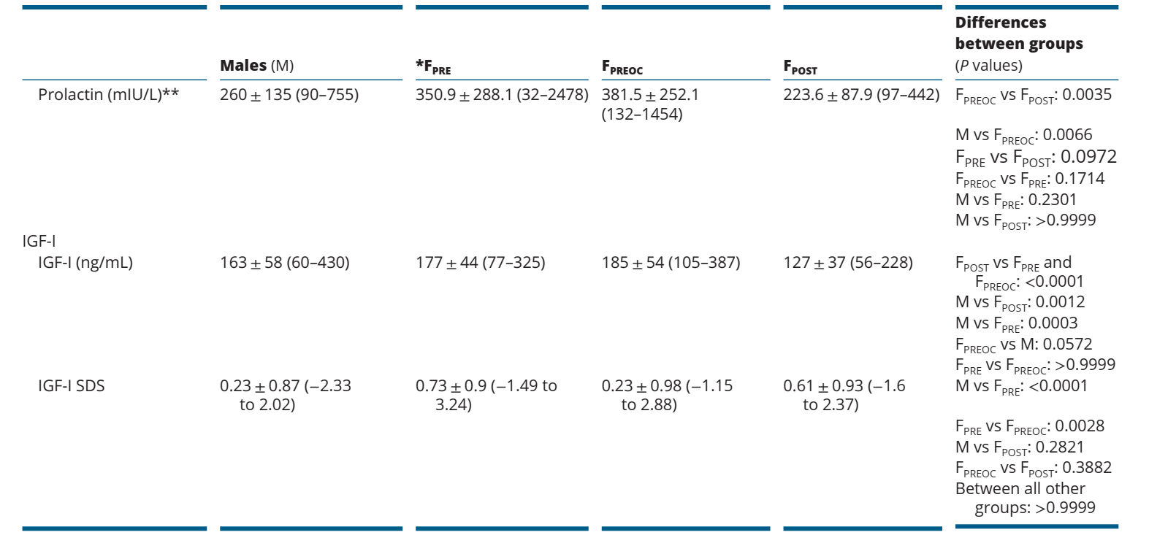

Slide 93
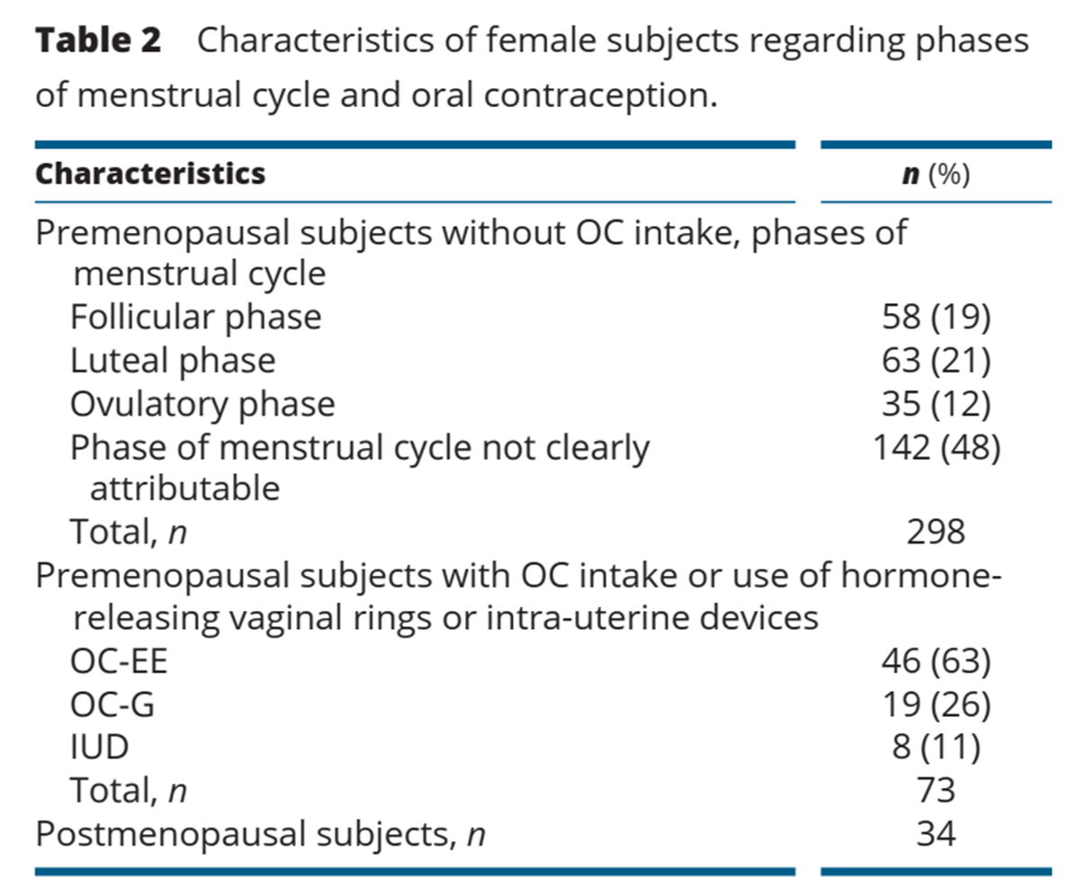
(Gestagen)

Slide 94
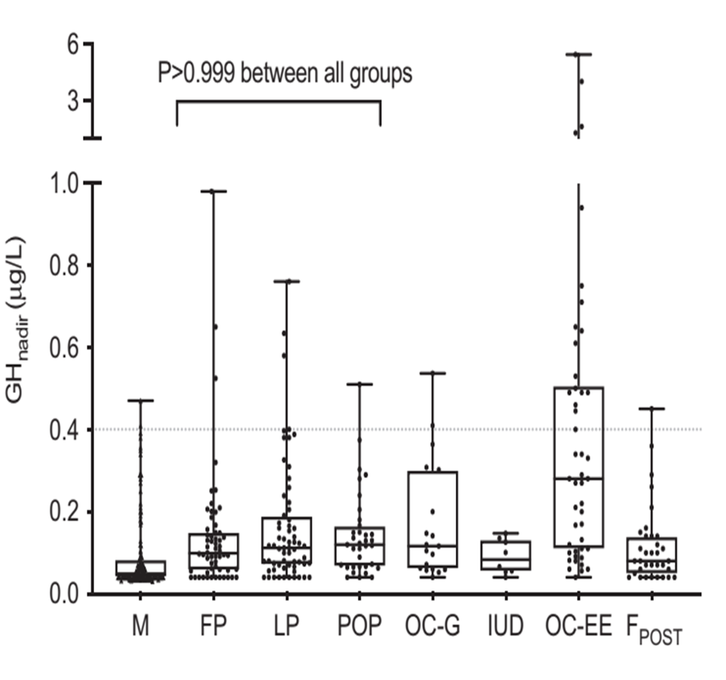
Mean GHnadir no difference in GH-nadir between the different phases in premenopausal women.
GH-nadir also did not differ between pre- and postmenopausal women not on OC-EE
In males, mean GH-nadir was lower compare to premenopausal women with or without OC-EE but did not differ from postmenopausal women
Among women, GHnadir was lower in FPRE vs FPREOC and FPOST vs FPREOC (all P<0.0001)
(

Slide 95
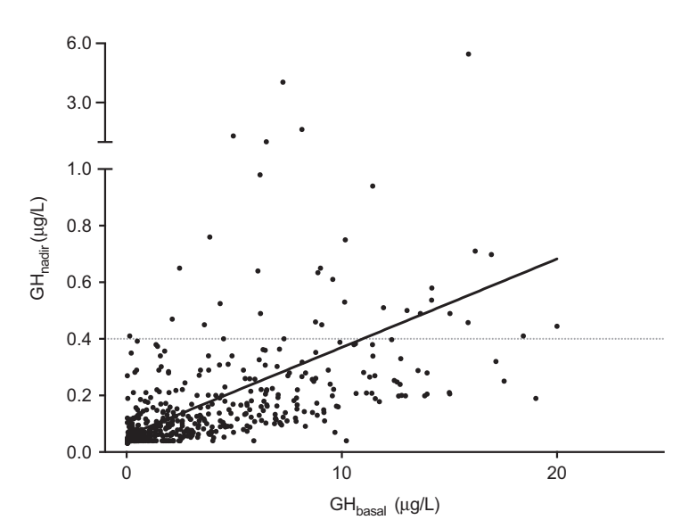
GH basal and GH-nadir were weakly correlated

Slide 96
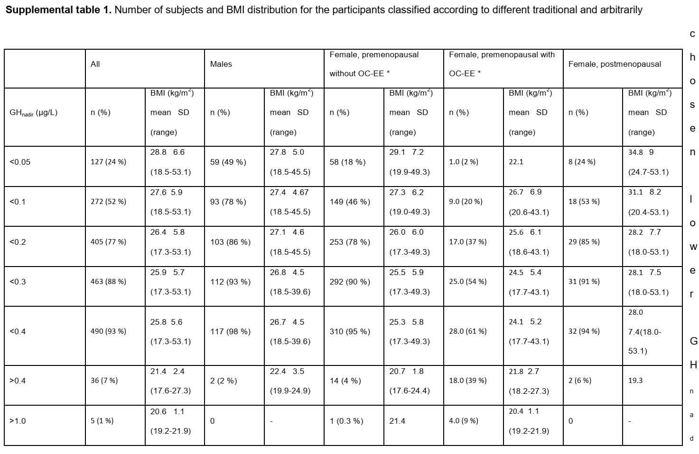
Female participants taking OC-G or using IUD are included in the premenopausal group without OC-EE because there is no difference between
the GHnadir in subjects taking no OC or OC-G and using IUD

Slide 97
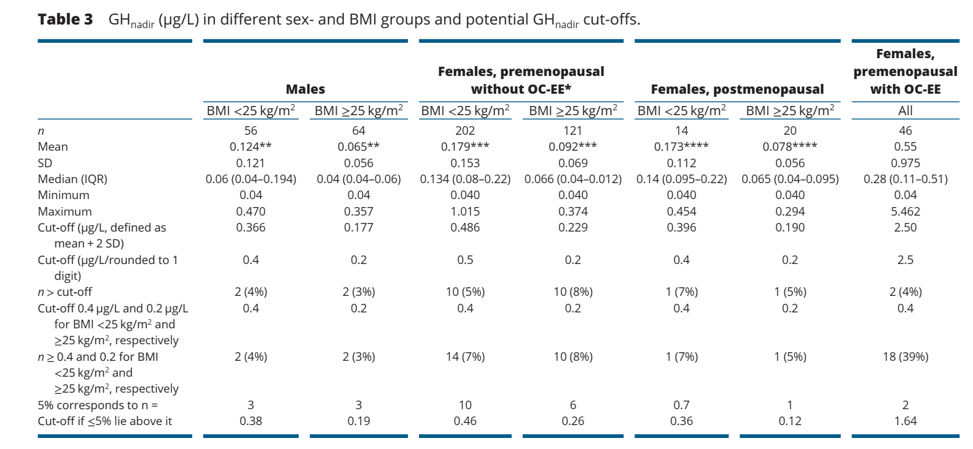
Assays
Reference GH nadir levels after OGTT using the IDS-iSYS assay accounting for BMI, sex, and ethinylestradiol-containing oral contraceptive use confirm the importance of these factors as confounders in GH measurements. (MQ, SR)

Slide 98
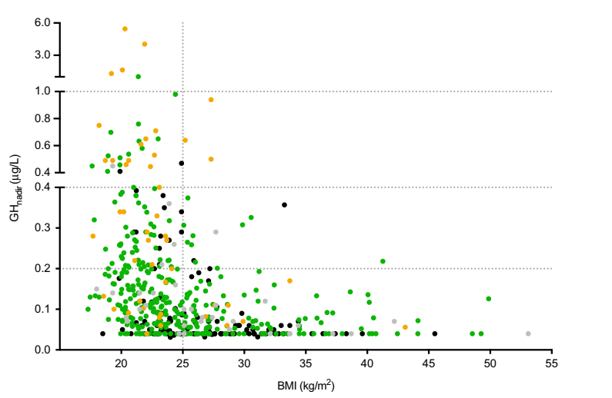
Male
Premenopausal females without
estrogen-containing oral contraception
Premenopausal
females with intake of estrogen-containing oral contraception
Postmenopausal women
Considering all subjects, BMI and GH-nadir were negatively correlated.
The males and about 98% of the females with a BMI above 25kg/m exhibited GH-nadir <0.4, while 12% of the subjects with a BMI <25kg/m2 had GH-nadir concentrations above 0.4µg/L

Slide 99
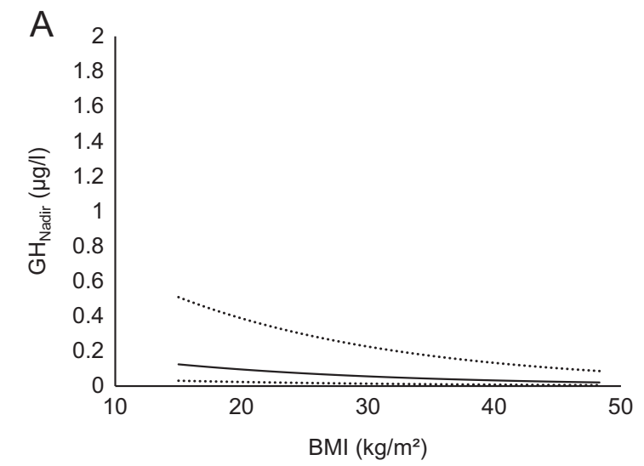
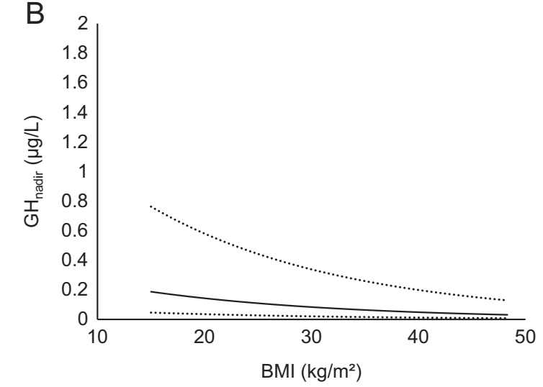
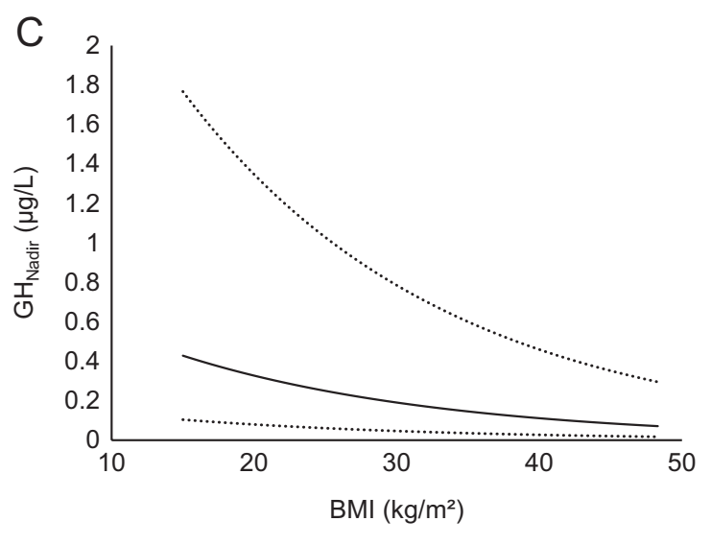
BMI, OC use and sex are the three major determinants of the GH-nadir concentration in healthy subjects. Taken together, the three factors explain about 30% of the variability in GH-nadir concentrations. BMI accounted for 12%, OC intake for 10% and sex for 8%, respectively.

Slide 100
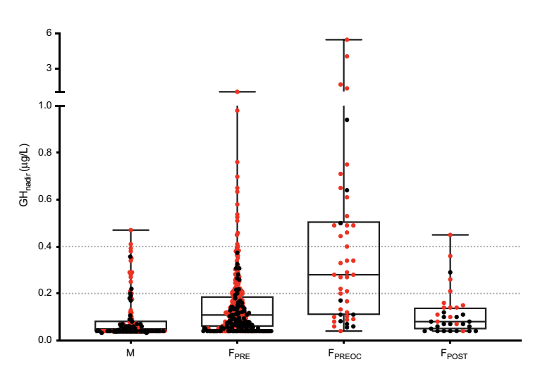
BMI <25 kg/m2
The degree of suppression of GH during OGTT highly depends on BMI.
Mean BMI of all subjects with GH nadir ≥0.4µg/L was 21.3kg/m2.

Slide 101
Conclusion
In BMI < 25 vs ≥ 25 kg/m2: the leaner group had GH nadirs more than twice as high as the heavier.
Pre- but not postmenopausal women had higher GH nadir vs men.
Mean GH nadir in OC-using females exceeded by more than threefold the GH nadir mean of premenopausal women not using OC.

Slide 102
Conclusion
Age, glucose metabolism and menstrual cycle had no impact on GHnadir.
BMI had no impact on GHnadir in FPREOC

Slide 103
Conclusion
BMI, sex and OC-EE intake are the major determinants for the GHnadir during OGTT in healthy adults.
Using a modern sensitive GH assay, GHnadir concentrations in healthy subjects are distinctly lower than cut-offs used in previous guidelines for diagnosis and monitoring of acromegaly.

Slide 104
Assays
Soluble Klotho, predominantly expressed in the kidney , correlates with GH levels over a wide concentration range , and has been suggested to correlate with QOL improvements.

Slide 105
Klotho
The Klotho gene:
- An ageing suppressor gene
- Restricted expression (predominantly in the kidney, brain, and parathyroid and pituitary glands)
- Encoding a transmembrane protein, mKlotho.
mKlotho serves as a co-receptor in FGF23 signalling.
Growth hormone and Klotho
Christoph Schmid1, Marian C Neidert2, Oliver Tschopp1, Lisa Sze1,3 and Rene´ L Bernays2,4

Slide 106
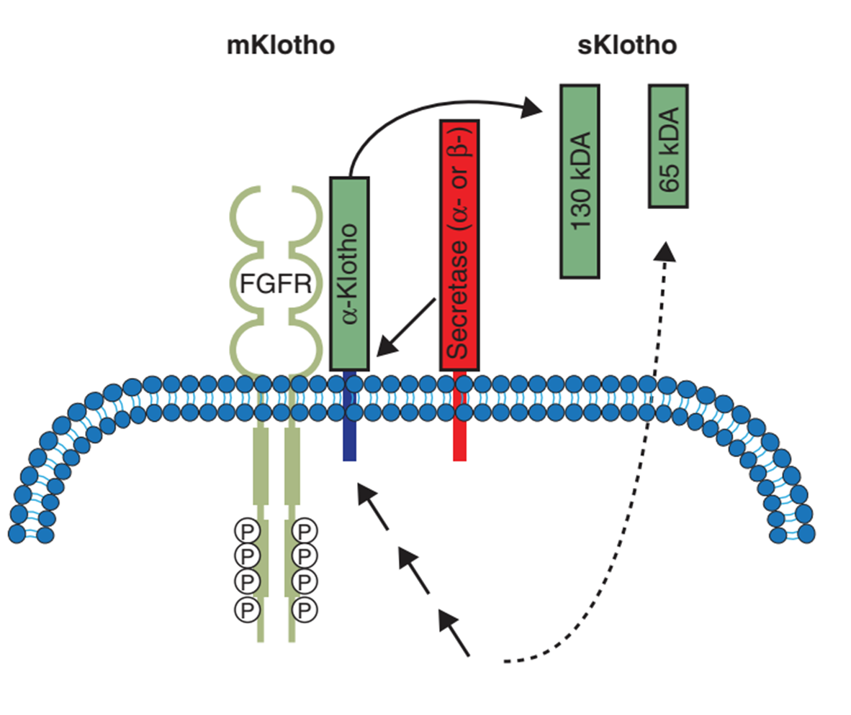
The extracellular domain of mKlotho is found as a circulating soluble α-Klotho (sKlotho) into blood, CSF,& urine.

Slide 107
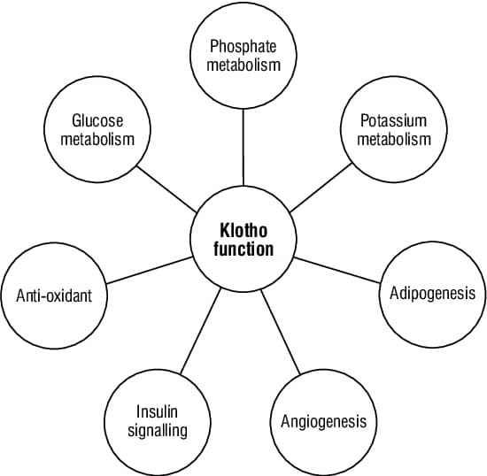
Klotho
sαKL may have effects on:
Calcium handling
Nitric oxide synthesis
Insulin and (e.g. insulin-like) growth factor signaling (suppressing insulin/IGF-I receptor phosphorylation & downstream signaling events, such as tyrosine phosphorylation of insulin receptor substrates & phosphoinositide 3-kinase, thereby inhibiting insulin and IGF-I signaling)

Slide 108
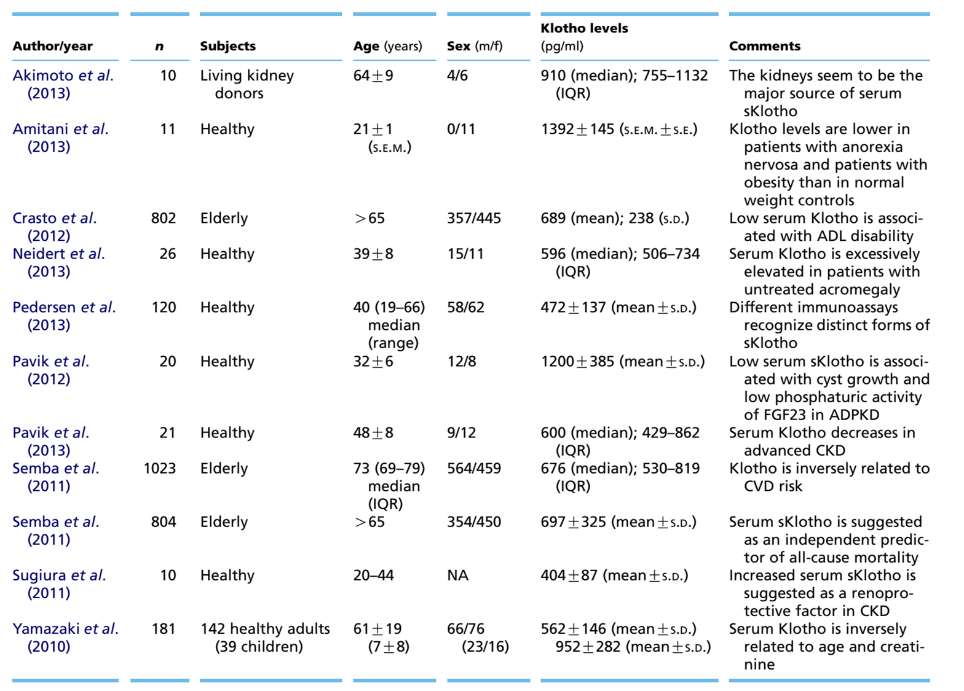
↓Activities of daily living
Soluble serum Klotho levels in healthy human subjects as assessed by ELISA

Slide 109
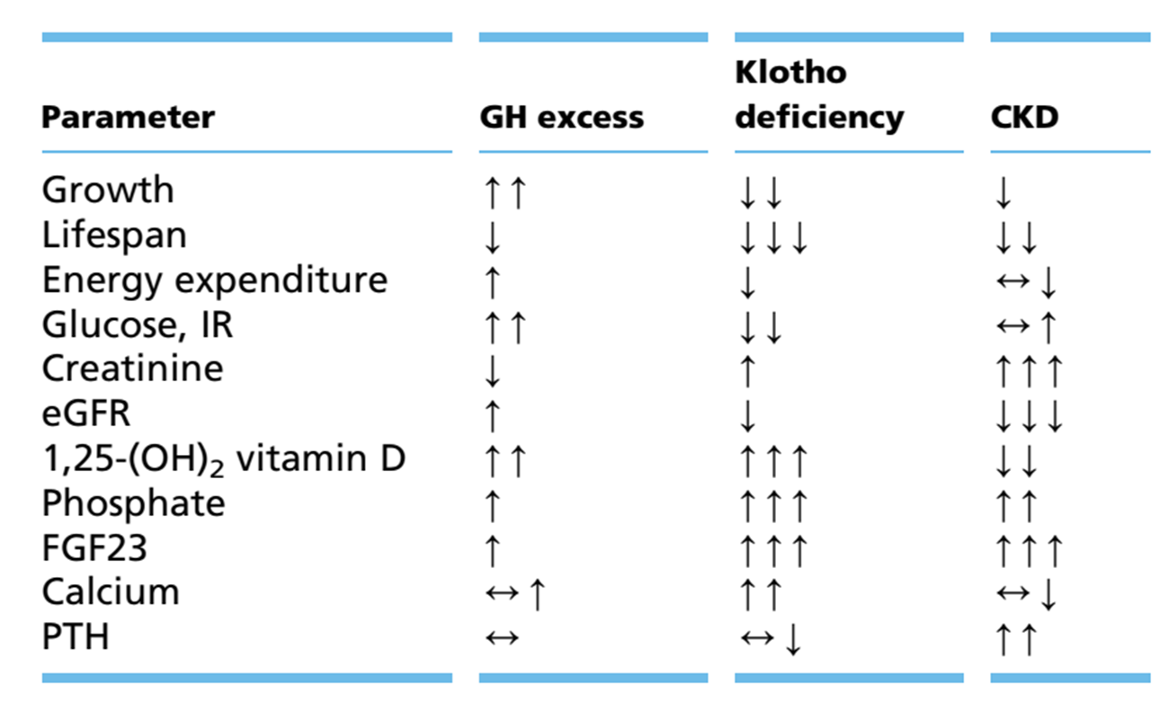
Klotho
Parameters & phenotypes characterizing GH excess, Klotho deficiency and CKD.

Slide 110
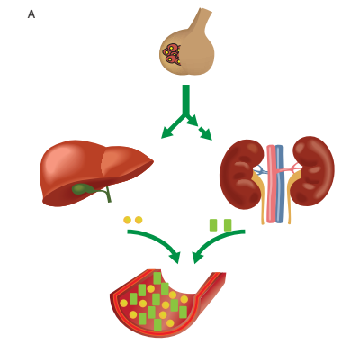
Klotho & GH
Excessive GH markedly increased serum sKlotho levels
Concomitant & parallel changes in serum sKlotho and IGF-1 in acromegaly.
sKlotho and IGF-1 appeared to be similarly dependent on GH.
IGF1
sKlotho

Slide 111
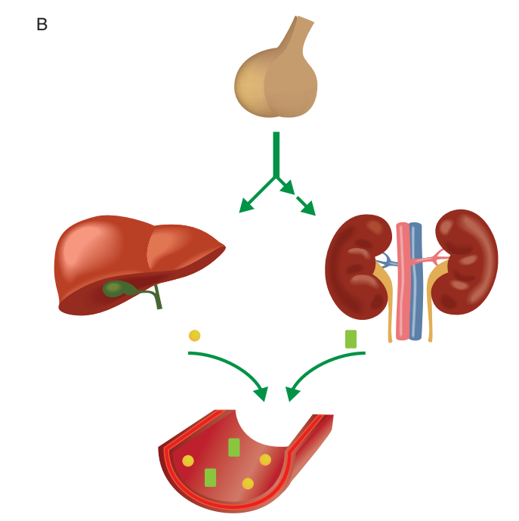
Klotho & GH
Postoperatively(alone or in combination with first-generation SRLs) NL GH action
IGF1 & sKlotho levels returned
towards normal

Slide 112
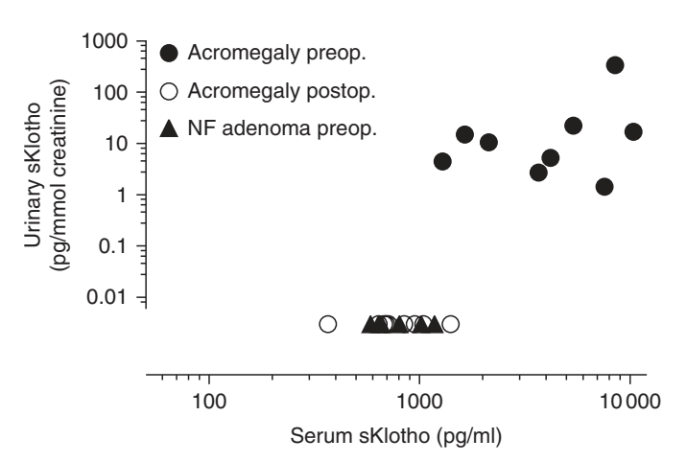
Klotho & GH
Patients with active acromegaly have higher serum and urinary sKlotho levels than patients without active acromegaly.

Slide 113
Klotho & GH
sKlotho is most likely of renal origin, but the mechanism (direct/indirect) by which GH excess results in increased release of kidney derived sKlotho has not yet been elucidated.

Slide 114
Klotho & GH
sKlotho seems to be a new player in the intricate regulation of the GH and IGF-1 axis.
As sKlotho concentrations appear to reflect:
- Acromegaly disease activity
- Disease-specific QoL.

Slide 115
Klotho & GH
It might be useful as a surrogate parameter at diagnosis and during follow up, particularly if GH and IGF-I are discrepant.
αKL has potential advantages over IGF-I as it seems to be unaffected by age and sex, and remains correlated to GH hypersecretion at very high GH concentrations
Alpha Klotho as a Marker of Disease Activity in Acromegaly
Junia Schweizer, MD, Michael Haenelt, MA, Katharina Schilbach, MD, Alexandre Giannetti, PhD, Mariana Bizzi, MD, Beatriz Rocha, MD, PhD, Joche Schopohl, MD, Antonio Ribeiro-Oliveira, MD, PhD, Martin Bidlingmaier, MD
Journal of the Endocrine Society, Volume 3, Issue Supplement_1, April-May 2019, OR32-2,

Slide 116
Assays
This retrospective study at 2 academic centers included 109 acromegaly patients.
sαKL was measured by immunoassay(IDS-ISYS) and compared with traditional biomarkers (random and nadir GH, IGF-I, IGF binding protein 3). Associations with activity& potential impact of biological variables and somatostatin analogues (SSA) on sαKL concentrations were assessed.

Slide 117
Treatment-naïve patients with acromegaly before (A) and after surgery controlled without medication (B1), discordant (B2) and uncontrolled (B3) or on SSA controlled (C1), discordant (C2) and uncontrolled (C3), non-functioning pituitary adenoma; NFPA (D) and healthy controls (E).

Slide 118
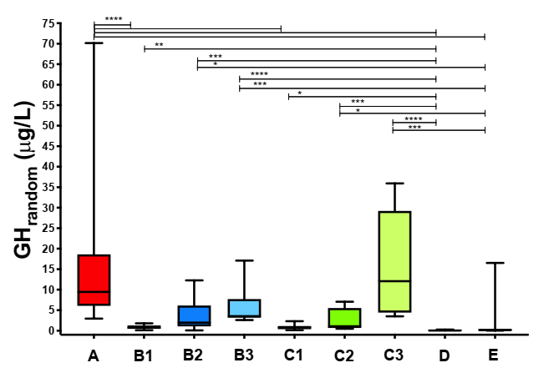
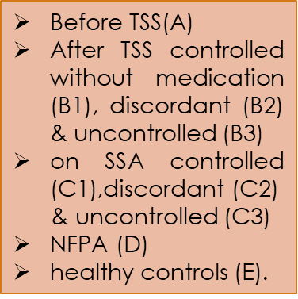
Traditional Biomarkers and Disease Activity
Random GH
* p<0.05
** p<0.01
*** p<0.001
**** p<0.0001

Slide 119
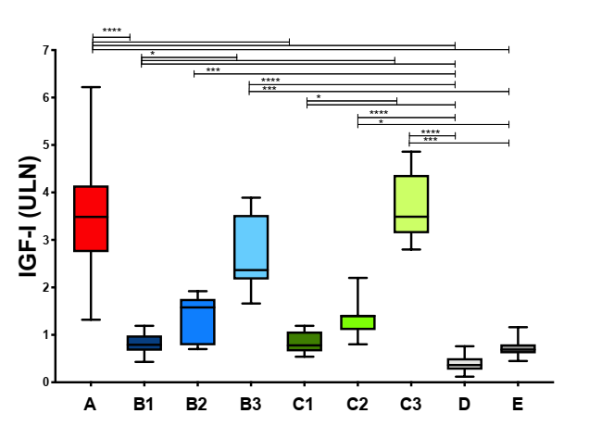
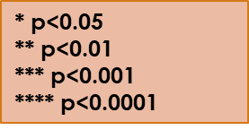
IGF-I
Before TSS(A)
After TSS controlled without medication (B1), discordant (B2) & uncontrolled (B3)
on SSA controlled (C1),discordant (C2)
& uncontrolled (C3)
NFPA (D)
healthy controls (E).

Slide 120
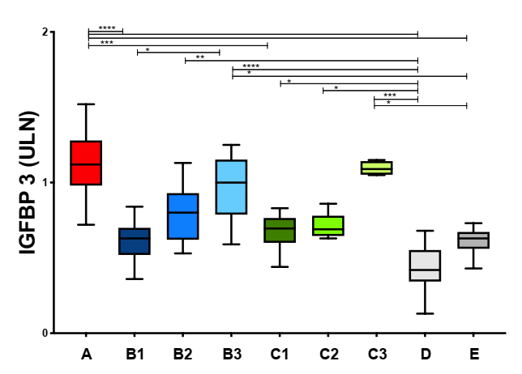
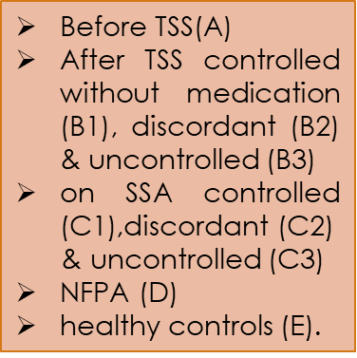
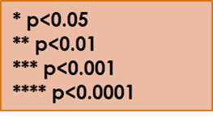
IGFBP-3

Slide 121
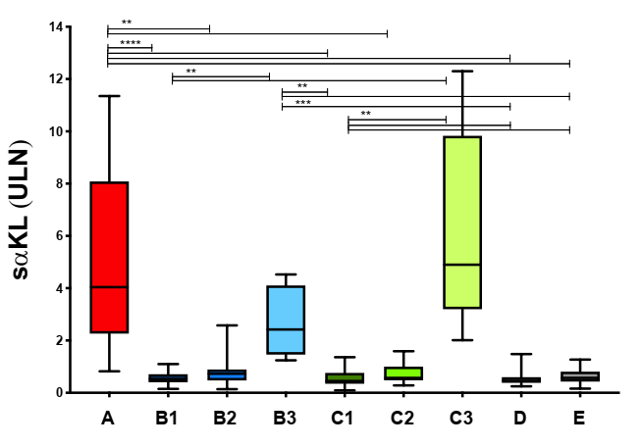
Soluble Alpha Klotho and Disease Activity

Slide 122
Correlation of Soluble Alpha Klotho to Traditional Biomarkers of Disease Activity
If GH-random concentrations > 10 µg/L, there was no more correlation between GH random and IGF-I, while correlation between GH random and sαKL was maintained.

Slide 123
In all groups, the strongest correlation was found between sαKL&IGF-I.

Slide 125
Intra-Individual Comparisons Before and After Surgery

Slide 126
Cutoffs for αKL Concentrations From ROC Analysis
Soluble alpha klotho (sαKL) ROC curve: before surgery, treatment-naïve (A) vs healthy controls (E).
Cutoff: 1641 pg/mL, AUC 0.98 (0.96-1.00), P < 0.000
Soluble alpha klotho (sαKL) ROC curve: controlled (B1, C1) vs uncontrolled(B3,C3) acromegaly after surgery.
Cutoff: 1548 pg/mL, AUC 0.99 (0.98-1.00), P < 0.0001
Soluble alpha klotho (sαKL) ROC curve: controlled acromegaly after surgery (B1, C1), NFPA (D) and healthy controls (E) vs uncontrolled patients before or after surgery (A, B3, C3).
Cutoff: 1548 pg/mL, AUC 0.99 (0.98-1.00), P < 0.0001

Slide 127
Soluble Alpha Klotho and Biological Variables

Slide 128
*rs = -0.22
**rs = 0.67
***rs = 0.80
****rs = - 0.39
*****there was no GH random and IGF-I correlation, p=0.43
****** there was GH random and IGF-I correlation, p=0.03.

Slide 129
Soluble alpha klotho (pg/mL) in patients of different ages (by decade)
Observed a weak negative correlation of sαKL concentrations with age when analyzing all patients with acromegaly together .
There was no correlation of sαKL concentrations with age in patients with NFPA and in healthy controls.
when patients with acromegaly, NFPA, and healthy controls were divided into age groups by decade, there was no difference in sαKL concentrations between the age groups.

Slide 130
Conclusion
This data support sαKL as a biomarker to assess disease activity in acromegaly, with high sensitivity and specificity.
sαKL exhibits close association with GH secretory status, large dynamic range, and robustness toward biological confounders.
Its measurement could be helpful particularly when GH and IGF-I provide discrepant information.

Slide 131
Assays
The prospective cohort study
54 acromegaly patients biochemically well-controlled on combination treatment with first-generation SRLs & PEGV at baseline and 9 months after switching to Pasireotide LAR (PAS-LAR; either as monotherapy n = 28; or in combination with PEGV, n = 26).

Slide 132
Soluble Klotho: a possible predictor of quality of life in acromegaly patients

Slide 133
QoL questionnaires
+ Paresthesia

Slide 134
QoL questionnaires
AcroQoL

Slide 135
Assays
Soluble Klotho, predominantly expressed in the kidney , correlates with GH levels over a wide concentration range , and has been suggested to correlate with QOL improvements.

Slide 136
At baseline, serum sKlotho levels were not significantly different between patients receiving 9 months of PAS-LAR mono- versus patients using PAS-LAR + PEGV combination therapy.
When comparing follow-up to baseline, we observed a significant increase in sKlotho levels in the combination therapy group, but no significant change in the monotherapy group. During follow-up, sKloth levels were not different between the two treatment groups.
White: PAS-LAR monotherapy
Gray: PAS + PEGV

Slide 137
GH levels at baseline were significantly higher in the patients who did receive combination therapy during the next 9 months when compared with patients who did receive PAS-LAR monotherapy during the next 9 months.
Due to the PEGV dose reduction or discontinuation during the study, GH levels were significantly lower in both group when compared with baseline.

Slide 138
Total IGF-1 levels at baseline were significantly higher in the patients who did receive combination therapy during the next 9 months when compared with patients who did receive PAS-LAR monotherapy during the next 9 months.
Total and age-dependent serum IGF-1 levels showed a significant increase between baseline and follow-up in the combination therapy group No changes in serum IGF-1 were seen in the monotherapy group.

Slide 139
Serum IGF-1 x(ULN) levels at baseline, however, were not significantly different between the two groups and were within the age-adjusted normal range.

Slide 140
AcroQoL and PASQ scores were not significantly different between the PAS-LAR mono- and combination therapy group at baseline,
Significant differences in the total cohort between baseline and during 9 months of PAS-LAR treatment were detected in the individual PASQ scores for headache and fatigue.
Significant improvements were observed in all AcroQoL subdimensions; physical, psychological& appearance , except for personal relations.

Slide 141
Neither the change in IGF-1 nor the baseline and/or change in GH levels correlated with changes in QoL.
In sKlotho levels correlated with PASQ total, headache, osteo-arthralgia, and soft tissue swelling score, which are all QoL entities that reflect increased GH actions.

Slide 142
Changes in sKlotho levels correlated with the observed improvements in QoL by the AcroQoL global and the physical subdimension , PASQ fatigue and excessive perspiration & the AcroQoL personal relations subdimension.
Changes in sKlotho were positively correlated with changes in total IGF-1 levels adjusted for age.

Slide 143
Conclusion
Significant improvements in QoL in biochemically well-controlled acromegaly patients during first-generation SRLs in combination with PEGV after switching to PAS-LAR treatment.
sKlotho showed a positive correlation with improvements in QoL.
Soluble Klotho concentrations appear to be a new useful marker of QoL in acromegaly patients but the underlying mechanisms remain to be investigated.

Slide 144
Conclusion
improvements in QoL were not accompanied by a significant change in IGF-1 levels, which challenges the importance of serum IGF-1 as a reliable parameter to monitor QoL from a patient’s perspective.
Patients experienced improved QoL during PAS-LAR, either as monotherapy or in combination with PEGV.

Slide 145
Assays
IGF-I levels measured 6 weeks postoperatively can be used in most patients to assess remission, although patients with mildly elevated IGF-I may yet normalize by 3–6 months. (MQ, SR)

Slide 146
Conclusion
Retrospective review of 57 patients with newly diagnosed acromegaly who had surgery between 2013 and 2020 and had postoperative IGF-1(IDS-iSYS, LC-MS/MS )measured by 6 weeks and 3 to 6 months.
Patients were excluded if they had received medical treatment for acromegaly before surgery or had liver or renal impairment.

Slide 147
IGF-1 index was calculated (IGF-1 value/maximal normal value for the assay)

Slide 148
37 (65%)had an IGF-1 index of 1 or more at 6 weeks (abnormal) and at 3 to 6 months (persistent).

Slide 149
The single patient who had an IGF-1 index of 1 or more at 6 weeks (abnormal) and IGF-1 less than 1 at 3 to 6 months (remission)

Slide 150
20 (35%) had an IGF-1 index less than 1 at 6 weeks (normal) and at 3 to 6 months (remission).

Slide 151
The single patient with an IGF-1 index less than 1 at 6 weeks (normal) and IGF-1 of 1 or more at 3 to 6 months (persistent)

Slide 152
There was a significant reduction in median IGF-1 concentration and median IGF-1 index 6 weeks after surgery.
A statistically significant further reduction in median IGF-1 concentration and median IGF-1 index was also noted at 3 to 6 months compared with 6 weeks after surgery the mean difference in the absolute value was small.

Slide 153
Receiver operating characteristic curves were used to assess the performance of IGF-1 concentration or index at baseline, IGF-1 concentration or index at 6 weeks, and percent decrease in IGF-1 concentration or index from baseline to 6 weeks from both assays in predicting surgical outcome at 3 to 6 months.
IGF-1 index at 6 weeks (AUC = 0.99) followed by IGF-1 concentration at 6 weeks (AUC = 0.987) outperformed the other variables at predicting surgical outcome at 3 to 6 months.

Slide 154
Conclusion
This data suggest that IGF-I measured 6 weeks postoperatively may be an early indicator of disease activity in most patients, but repeat assessment is warranted at 3–6 months for those with IGF-I levels mildly elevated above the age-related normal range, no cavernous sinus invasion, and postoperative GH < 1 ng/mL, as IGF-I may yet normalize.

Slide 155
Conclusion
Determination of surgical outcome, as assessed by IGF-1 at 6 weeks and 3 to 6 months, remained unchanged in most patients and was the best predictor of surgical outcome.
Findings suggested that measurement of IGF-1 at 6 weeks can be used to assess surgical outcome in most patients.

Slide 156
Injectable SRL

Slide 157
Injectable SRL
Older age, female sex, lower IGF-I levels, and tumor T2 MRI hypointensity at baseline predict more favorable long-term biochemical responses to primary Lanreotide 120 mg therapy every 4 weeks. (MQ, SR)

Slide 158
Injectable SRL
The several factors may influence the response to SRLs:
- Age & sex.
- Pre-treatment & early post-treatment TV, GH, and IGF-1 levels.
Tumor histopathology (SG/DG, Ki-67, somatostatin receptor subtype 2 expression, AIP expression, granularity, β-arrestin expression).
Imaging characteristics (T2-weighted MRI signal intensity)
Genetic factors
Treatment history

Slide 159
Injectable SRL
PRIMARYS (9 countries), 48-week, open-label, phase IIIb study.
Age: 18-75 years.
Evaluating treatment with the Lanreotide autogel (stable dose: 120 mg/28 days) in treatment-naïve patients with GH-secreting pituitary macroadenoma.
This study aimed to evaluate factors predictive of long-term responses.

Slide 160
Methods
Potential predictive factors evaluated were:
Sex, age & BMI at baseline
GH, insulin-like growth factor-1 (IGF-1)
Tumor volume (TV) at baseline and week 12
Hormone levels and TVs were assessed centrally at screening, at day 1 (baseline; hormone levels only) and weeks 12, 24, and 48
Treatment responses were defined;
Hormonal control (GH ≤2.5 µg/L and age- and sex-normalized IGF-1)
Tight hormonal control (GH <1.0 µg/L and normalized IGF-1)
≥ 20% TV reduction (TVR).

Slide 161
Methods
Exclusion criteria:
Undergone or were likely to require pituitary surgery or RT
They had received treatment with SRL, dopamine agonist, or GH receptor antagonist previously, or were likely to require any of these treatments (except lanreotide autogel).
Prolactin co-secretion > 100 µg/L

Slide 162
Results

Slide 163
patients receiving at least one injection of study medication and with at least one baseline assessment of tumor volume

Slide 164
Results

Slide 165
Results

Slide 166
Results
Hormonal control
Proportions of patients achieving GH ≤2.5 µg/L and IGF-1 levels within normal ranges at LVA(last post-baseline value available)

Slide 167
Results
Tight Hormonal control
Proportions of patients achieving GH < 1.0 µg/L and IGF-1 levels within normal ranges at LVA
the proportions of patients who achieved hormonal control at LVA were generally greater for those with lower baseline hormone levels

Slide 168
Results
Analyses of the proportions of patients with ≥ 20% reduction in tumor volume from baseline to week 48/LVA (primary endpoint; ITT and PP populations)
Tumor volume reductions for individual patients (ITT population)

Slide 169
Results
Time course of changes in tumor volume reductions (ITT population) with an illustrative MRI series from one patient

Slide 170
Results
Proportions of patients achieving TV responder status at LVA according to baseline TV
There was no clear relationship between TV responder status at LVA and TV at baseline; however, the majority of patients who achieved a TV response had a baseline TV of < 5000 mm3

Slide 171
Results
Univariate logistic regression analyses for hormonal control defined as GH ≤ 2.5 µg/L and IGF-1 levels within normal ranges
Associations were significant between three baseline factors and hormonal control

Slide 172
Results
Univariate logistic regression analyses for tight hormonal control defined as GH < 1.0 µg/L and IGF-1 levels within normal range

Slide 173
Results
Univariate logistic regression analyses for TV responder status

Slide 174
Results
The baseline factors of IGF-1 level, age, and sex were significant in univariate analyses. However, using ROC curves, these factors were associated with relatively poor AUCs: 0.64 for IGF-1, 0.74 for age, and 0.63 for sex

Slide 175
Results
Hormonal control
Week-12 GH and IGF-1 levels were associated with high AUCs.
In contrast, the AUC for TV in the final model was poor (0.65)

Slide 176
Results
This model was not greatly improved by the addition of change-from-baseline factors (AUC : 0.95)
Hormonal control was associated with an optimal cut-off of –55.3% in IGF-1 levels from baseline to week 12 and − 80.3% in GH levels..

Slide 177
Results
Tight Hormonal control
The final model with week-12 factors had an AUC of 0.95
Twelve-week GH and IGF-1 levels in this model were associated with high AUCs and with optimal cut-off values of 1.11 μg/L and 125% ULN, respectively

Slide 178
Results
In contrast, the AUC for TV in the final model was poor (0.68)
This model was not greatly improved by the addition of change-from-baseline factors (AUC of 0.95)
Tight hormonal control was associated with an optimal cutoff of − 55.3% in IGF-1 levels from baseline to week 12 and − 72.6% in GH levels

Slide 179
Results
TV responder status
The final model with week-12 factors had an AUC of 0.69
A TV response was associated with an optimal cut-off of − 68.6% in GH levels from baseline to week 12, − 61.0% in IGF-1 levels, and 21% for TV.
Twelve-week GH and IGF-1 levels in the final model were associated with AUCs of 0.59 and 0.70, respectively.

Slide 180
Results
This model was improved by the addition of change-from-baseline factors (AUC, 0.94)

Slide 181
Conclusion
The treatment-naïve patients with GH/ IGF-1 hypersecretion and GH-secreting macroadenomas were more likely to achieve hormonal control at 12 months if:
- Female
Older age(more likely to achieve tight hormonal control (GH
levels < 1.0 µg/L and normalized IGF-1 levels).
- Lower IGF-1 levels at baseline
- GH levels <1.2 µg/L ( < 1.11 µg/L for tight control)
- IGF-1 levels <110% ULN at week 12 (< 125% ULN for tight control).

Slide 182
Conclusion
At week 12, TV response was not an accurate predictive factor for either hormonal control or tight hormonal control & subsequent tumor volume control.
The use of predictive factors at baseline and week 12 of treatment could inform clinical expectations of the long-term efficacy of Lanreotide autogel.

Slide 183
Conclusion
These results suggest that patient- and tumor-specific factors at baseline may predict long-term biochemical response to primary SRL treatment, while early tumor response may not.

Slide 184
Conclusion
A meta-analysis of 622 patients from two European cohorts using multivariable regression models found that lower IGF-1 concentration at baseline & lower body weight were associated with biochemical response.
Younger patients were more likely to be nonresponsive.
Multivariable prediction model foR biochemical response to first-generation somatostatin receptor ligands in acromegaly
Coopmans EC, Korevaar TIM, van Meyel SWF, Daly AF, Chanson P, Brue T et a
(2020) J Clin Endocrinol Metab 105(9):387.

Slide 185
Injectable SRL
Prospective multicenter, open-label, single-arm PRIMARYS study.
In patients with treatment-naïve GH-secreting pituitary macroadenomas received fixed-dose Lanreotide autogel (120 mg) every 4 weeks for 48 weeks without visual field defects.
Associations between adenoma T2-signal hypo/iso/hyperintensity and treatment responses (hormonal control (GH ≤2.5 μg/L & IGF-1 normalization) & tumor response (TVR) ≥20%) at week 48/LVA.

Slide 186
Conclusion
MRI could provide non-invasive insight into tumor features & associations with clinical outcomes.
DG tumors tend to be T2 signal hypointense.
Hypointense tumors: smaller, less cavernous sinus invasion, less frequent optic chiasm compression, higher IGF-1 levels than iso-/hyperintense tumors, better IGF-1 response in patients receiving SSAs.

Slide 187
Classification of T2 signal intensity of a pituitary macroadenoma by 1 qualitative & 2 quantitative methods
Methods for assess MRI T2-signal intensities of each macroadenoma relative to surrounding tissue
(Region Of Interest)
(Signal Ratio)
The visual assessment and signal-ratio methods used gray matter as comparator for adenoma tissue
The three-tissue method used gray and white matter as comparator tissues

Slide 188
ROIs : signal intensity is quantified (left to right): white matter (290), adenoma (349), gray matter (451)
Visual assessment method
Signal-ratio & three-tissue methods
The adenoma is hypointense (the signal appears less intense than the gray matter)
According to the signal-ratio method, the adenoma is hypointense because the ratio of adenoma/gray matter signals = 0.77.
according to the three-tissue method, the T2 signal intensity of the adenoma is isointense because the signal of the adenoma (349) lies between those of white matter (290) and gray matter (451)

Slide 189
Baseline characteristics according to T2 signal intensity category by visual assessment

Slide 191
Tumor volume of GH-secreting pituitary macroadenomas at baseline in each MRI T2 signal intensity category as defined by three methods.
Baseline tumor volume tended to be lower in the hypointense tumor group than the other groups.
A difference that was most pronounced when tumors were categorized by visual assessment

Slide 192
Extrasellar extension tended to be more frequent in non-controlled vs controlled patients.

Slide 193
Association between MRI findings and response to treatment
Proportion of patients that gained hormonal control & tumor volume response according to MRI T2-signal at baseline.

Slide 194
Associations between T2 signal intensity & change from baseline in GH, IGF-1& TV
In univariate analyses of TVR from baseline to week 48, significant associations were identified with T2 signal intensity (by each method).
In the visual assessment model, there was an estimated additional 16.8% TVR by week 48/LVA for patients with hypo- vs iso-intense tumors.

Slide 195
Associations between T2 signal intensity & change from baseline in GH, IGF-1& TV
For change from baseline to week 48/LVA in IGF-1 level, univariate analyses found significant associations with T2 signal intensity by visual assessment, signal-ratio & three-tissue methods.
In the multivariate (visual assessment) model, there was an estimated 65 μg/L greater reduction in IGF-1 level between baseline and week 48/LVA for patients with hypo- vs isointense tumors.

Slide 196
Change in T2 signal intensity
Most adenomas were assigned to the same signal intensity category at baseline, week 24 and week 48.
Comparisons between baseline and week 48 or LVA in signal intensity category did not reach statistical significance (for either method).

Slide 197
Conclusion
Patients with hypointense vs isointense GH-secreting macroadenomas had greater reductions in IGF-1 following primary treatment with Lanreotide autogel and were more likely to achieve tumor shrinkage.
Assessment of T2 signal intensity at baseline may help to predict long-term responses to primary treatment with SSAs.

Slide 198
Injectable SRL
Recent studies confirm that extended-dosing intervals (> 4 weeks) for 120 mg Lanreotide may be effective among selected patients previously controlled with long-acting SRLs. (LQ, DR)

Slide 199
In a prospective international study, 88.7% of patients well controlled on octreotide LAR 10 and 20 mg every 4 weeks who switched to Lanreotide 120 mg every 6 weeks achieved normal IGF-I levels after 24 weeks. Such extended-dosing intervals may be effective in patients who have achieved good biochemical control with long-acting SRLs.
Lanreotide Autogel 120 mg at extendedosing intervals in patients with acromegaly biochemically controlled with octreotide LAR: the LEAD study
Neggers SJ, Pronin V, Balcere I, Lee MK, Rozhinskaya L Bronstein MD et al (2015).
Eur J Endocrino 173(3):313–323
A Consensus Statement on acromegaly therapeutic outcomes
Melmed S, Bronstein MD, Chanson P, Klibanski A, Casanueva FF, Wass JAH et al (2018).
Nat Rev Endocrinol 14(9):552–561

Slide 200
Injectable SRL
Several studies confirm efficacy of Pasireotide LAR for some patients uncontrolled on Lanreotide or octreotide LAR. However, rates of treatment induced hyperglycemia and DM are high, requiring careful monitoring for glycemic side effects. (HQ, SR)

Slide 201
In the Phase III PAOLA study, enrolled patients had uncontrolled acromegaly despite ≥6 months of Octreotide/Lanreotide treatment before study start.
111Patients receiving Pasireotide 40mg & Efficacy and safety are reported to 304 weeks (~5.8 years) 37% achieved control(GH < 1.0 μg/L and normal IGF-I)(65.5%achieved a first response after at least 6 months)(DM: 32%).
62 Patients receiving Pasireotide 60mg(escalated) &Efficacy and safety are reported to 268 weeks(5.2years) 28% to achieve disease control(DM:40%)
Pasireotide for acromegaly: long-term outcomes from an extension to the Phase III PAOLA study
Annamaria Colao1, Marcello D Bronstein2, Thierry Brue3, Laura De Marinis4, Maria Fleseriu5, Mirtha Guitelman6, Gerald Raverot7, Ilan Shimon8, Jürgen Fleck9, Pritam Gupta10, Alberto M Pedroncelli9 and Mônica R Gadelha1(2020)
Eur J Endocrinol 182(6):583

Slide 202
An open-label study switched uncontrolled patients from Octreotide/Lanreotide to Pasireotide.
Biochemical control: GH < 1.0 μg/L and normal age-matched IGF-I levels) for 36-week.
123 patients treated with 40mg: 15% achieved normal GH and IGF-I and 31% achieved only normal IGF-I(higher rates among those with GH 1.0–2.5 μg/L at baseline).
At baseline: 42% were diabetic & 49% pre-diabetic.
During the study:42% reported new-onset hyperglycemia & 24% DM.
Generally, the degree of hyperglycemia associated with Pasireotide is largely dependent on glycemic control at baseline.
Evaluation of the efficacy and safet of switching to pasireotide in patients with acromegaly inadequately controlled with first-generation somatostatin analogs.
Gadelha M, Bex M, Colao A, Pedroza Garcia EM, Poiana C, Jimenez-Sanchez M et al (2019)
Front Endocrinol (Lausanne) 10:931

Slide 203
Recommendation
Results of these studies support current recommendations for Pasireotide use, which note the need for careful screening and monitoring of glycemic side effects and a preference for use in Octreotide/Lanreotide-refractory patients with normal glucose metabolism.
Blood levels of glucose should be monitored weekly for the first 3 months of treatment & in the first 4–6 weeks after dose increases.
A Consensus Statement on acromegaly therapeutic outcomes
Melmed S, Bronstein MD, Chanson P, Klibanski A, Casanueva FF, Wass JAH et al (2018).
Nat Rev Endocrinol 14(9):552–561

Slide 204
Oral octreotide capsules (OOC)

Slide 205
How should OOC be integrated into the current treatment algorithm for medical management of acromegaly?

Slide 206
OOC
OOC are suitable for patients who have demonstrated complete or partial biochemical response on injectable Octreotide or Lanreotide. (HQ, SR)

Slide 207
OOC
There are no data on the use of OOC as primary medical therapy in SRL-naïve patients. However, it is reasonable to expect that patients who respond to injectable octreotide LAR or Lanreotide in this setting would also respond to OOC.

Slide 208
OOC
Due to a lack of available data, OOC is not currently recommended for patients who have tumor characteristics predictive of octreotide resistance. (MQ, SR)

Slide 209
OOC
Tumor characteristics associated with octreotide and Lanreotide resistance (e.g., MRI T2 hyperintensity, sparsely granulated tumors) are presumed to also predict resistance to OOC.

Slide 210
OOC
There are no data regarding efficacy of switching patients from Pasireotide LAR to OOC.

Slide 211
How should OOC be initiated?

Slide 212
OOC
OOC is initiated at a dose of 40 mg/day, given as 20 mg capsules twice per day taken 1 h before a meal or 2 h after a meal to maximize bioavailability. (MQ, SR)
However, clinical study data suggest a starting dose of 60 mg/d may be optimal for most patients.

Slide 213
OOC
The 40 mg/ day dose is the approved initiation dose. Most responders in the OPTIMAL study up-titrated to 60 mg/d or 80 mg/d by study end, and all patients enrolling in the open label extension study were reinitiated at the 60 mg/d dose.

Slide 214
OOC
OOC should be initiated at the time of the previously scheduled SRL injection. (HQ, SR)

Slide 215
OOC
In clinical trials, OOC was initiated at the time of the next SRL injection, i.e., at the end of the once-monthly injection period.
IGF-I levels may increase toward the end of the injection period with waning of injectable drug levels &likely account for reported exacerbation of acromegaly symptoms.

Slide 216
OOC
OOC can be up-titrated by an increment of 20 mg every 2–4 weeks based on IGF-I and clinical symptoms. (MQ, SR)

Slide 217
OOC
The pharmacokinetics of OOC enable a dose titration every 2–4 weeks.
This is a more rapid escalation compared with injectable SRLs, which often are up-titrated every 3 months.
Slower titration may risk re-emergence of disease signs and symptoms and loss of biochemical control

Slide 218
Oral octreotide capsules (OOC) received regulatory approval from the US Food and Drug Administration in June 2020 for long-term maintenance treatment in acromegaly patients who have responded to and tolerated treatment with octreotide or Lanreotide

Slide 219
MYCAPSSA(Delayed-release capsules: 20 mg)
An enteric-coated capsule filled with an oily octreotide suspension.
Take with a glass of water on an empty stomach, at least 1 hour before a meal or at least 2 hours after a meal.
Initiate dosage: 40 mg daily (20 mg twice daily).
Monitor IGF- levels & patient’s signs and symptoms every two weeks
Increase the dosage in increments of 20 mg.

Slide 220
Octreotide capsules with transient permeability enhancer (TPE) containing sodium caprylate plus inert excipients remain intact until they reach the small intestine. TPE transiently and reversibly opens tight junctions in the intestinal barrier, which enhances absorption of the drug and enables sustained circulating therapeutic levels of octreotide.

Slide 221
MYCAPSSA(Delayed-release capsules: 20 mg)
20 mg OOC has similar pharmacokinetics to subcutaneous injection of 0.1 mg of subcutaneous (SC) octreotide, with comparable half-lives of 2.25 and 2.38 h respectively.
Oral Octreotide Absorption in Human Subjects,Comparable Pharmacokinetics to Parentera,Octreotide and Effective Growth Hormon,Suppression S. Tuvia, J. Atsmon, S. L. Teichman, S. Katz, P. Salama, D. Pelled, I. Landau,I. Karmeli, M. Bidlingmaier, C. J. Strasburger, D. L. Kleinberg, S. Melmed,and R. Mamluk , J Clin Endocrinol Metab, July 2012, 97(7):2362–2369

Slide 222
MYCAPSSA
The maximum dosage: 80 mg daily.
For patients with ESRD, initiate dosage: 20 mg orally once daily.(No dosage adjustment)
Contraindication: Hypersensitivity to octreotide.
Warnings and precautions(for periodic monitoring) : Cholelithiasis & Complications of Cholelithiasis, Hypoglycemia or Hyperglycemia, Hypothyroidism, Bradycardia, arrhythmia, or conduction abnormalities, Decreased Vitamin B12 Levels.

Slide 223
MYCAPSSA
Most common adverse reactions (incidence >10 %): Nausea, diarrhea, headache, arthralgia, asthenia, hyperhidrosis, peripheral swelling, blood glucose increased, vomiting, abdominal discomfort, dyspepsia, sinusitis, osteoarthritis.
Drug interactions: PPIs, H2-B, or Antacids, Cyclosporine, Insulin & Antidiabetic Drugs, Digoxin, Lisinopril (monitor patient’s blood pressure), Levonorgestrel, Bromocriptine, BB & CCBs, Drugs Metabolized by CYP 450 Enzymes.

Slide 224
Conclusion
Multicenter, open-label, dose-titration, baseline- controlled study.
Switched to 40 mg/d oral octreotide capsules (OOCs), and the dose escalated to 60 and then up to 80 mg/d to control IGF-1. Subsequent fixed doses were maintained for a 7-month core treatment, followed by a voluntary 6-month extension.
155 complete or partially controlled patients (IGF-1 X 1.3 < ULN, & 2-h integrated GH< 2.5 ng/ml; IDS-iSYS) receiving injectable somatostatin receptor ligand (SRL) for ≥3 month.

Slide 225
Flowchart of study
138 (89%) experienced an AE.

Slide 226
Conclusion
The pharmacokinetics of OOC enable a dose titration every 2–4 weeks.
This is a more rapid escalation compared with injectable SRLs, which often are up-titrated every 3 months.
Slower titration may risk re-emergence of disease signs and symptoms and loss of biochemical control

Slide 228
The degree of baseline control on injectable SRLs predicted subsequent response to OOCs.
The combination of IGF-1X 1 ULN/GH 2.5 ng/mL and low to mid doses of injectable SRLs (octreotide 30 mg or Lanreotide 120 mg) at screening yielded an OOC response rate of 84.5%

Slide 229
Mean IGF-1 levels were stably maintained between the beginning & the end of the fixed-dose period, up to 13 months in both the mITT and fixed-dose populations.
The slight increase in mean values from baseline toward the end of the dose-escalation period in the mITT population reflects those subjects failing to be controlled on OOCs and discontinuing the study early, all of whom were included in the mITT analysis.
Median GH levels at baseline (0.77 ng/mL) were attenuated within 2 hours of the first OOC dose to 0.40 ng/mL and remained suppressed by the end the extension (0.49 ng/ mL).
In the fixed-dose population, median GH levels were 0.77 ng/mL at baseline and 0.43 ng/mL at the end of treatment.

Slide 231
Conclusion

Slide 232
Conclusion
Mean plasma octreotide concentrations increased dose dependently.

Slide 233
Safety
Gastrointestinal AEs mostly occurred within the first 2 months of treatment and mostly resolved with treatment continuation (median AE duration,13 days)
138 (89%) experienced an AE.
Hypoglycemia was reported in seven subjects (4.5%), and hyperglycemia was reported in 11 subjects (7%), neither of which led to early discontinuation.

Slide 234
Conclusion
OOC, an oral therapeutic peptide, achieves efficacy in controlling IGF-1 and GH after switching from injectable SRLs for up to 13 months, with a safety profile consistent with approved SRLs.
OOC appears to be effective and safe as an acromegaly monotherapy.

Slide 235
The phase 3 CHIASMA OPTIMAL trial(Octreotide capsules vs Placebo Treatment In MultinationAL centers).
Prospective, randomized, double-blind, placebo-controlled.
56 patients.
The primary end point: Maintenance of biochemical control at the end of treatment (mean IGF-1 ≤ 1.0 ×ULN; weeks 34 and 36).

Slide 236
SRLs Disadvantage
Deep tissue injection Site pain, nodules, bruising, inflammation, & scarring.
Injections at home Only 17% of patients.
Injections in the health care delivery setting Burden to their everyday life, lost work.
Negatively affect patient QOL Anxiety, frustration, &loss of independence.

Slide 237
Study design
Age: 18 years or older
IGF-1 ≥ 1.3 × ULN following ≥ 3 months from the most recent pituitary surgery, if performed, to ensure there was active disease prior to medical therapy
Received SRLs (octreotide or Lanreotide): monotherapy ≥ 6 months & to be on a stable dose for ≥ 3 or months of therapy.
Biochemical control defined as IGF-1 ≤ 1.0 × ULN based on the average of 2 assessments at screening visit (SV)1 and SV2(within 2 weeks)(4, 6, or 8 weeks from their last SRL injection).

Slide 239
Study design
Recommendations for titration included an increase of IGF-1 levels compared to baseline (defined as IGF-1 increase by ≥ 30% to > 1.0 × ULN, or IGF-1 levels > 1.0 × ULN for 2 consecutive visits), or new or worsening of acromegaly signs and symptoms.
To discontinue study drug treatment: if IGF-1 ≥ 1.3 × ULN for 2 consecutive assessments after 2 or more weeks with oral treatment on the maximum number of capsules per day (4 capsules/80mg daily) and exacerbation of acromegaly clinical signs/symptoms for 2 consecutive assessments.

Slide 240
median time to loss of response of 16 weeks

Slide 241
Low dose: octreotide 10 mg every 4 weeks; Lanreotide 60 mg every 4 weeks or 120 mg every 8 weeks
Medium dose: octreotide 20 mg every 4 weeks;Lanreotide
90 mg every 4 weeks or 120 mg every 6 weeks

Slide 242
Results

Slide 243
Results

Slide 244
Results

Slide 245
Safety analysis

Slide 246
Safety analysis
Most patients (55/56) experienced at least one adverse event.
In OOCs group: hypoglycemia 1 (3.6%), blood glucose increase 3 (10.7%) & hyperglycemia1 (3.6%).
Most were mild or moderate in intensity.
The median time to onset of GI AEs was 68 days and most resolved on treatment (median duration, 8 days).

Slide 247
Safety analysis

Slide 248
Conclusion
As Octreotide and Lanreotide have similar efficacy, patients who have responded to these injectable agents are candidates for OOC therapy, and results of the OPTIMAL study demonstrate that biochemically controlled patients (IGF-I ≤1.0× ULN) on stable doses of injectable Octreotide or Lanreotide maintain response to OOC.
OOC were safe and well tolerated

Slide 249
Pegvisomant

Slide 250
Pegvisomant
Ten-year follow-up from ACROSTUDY shows a 73% biochemical control rate with very low rates of transient elevated transaminases and 6.8% exhibiting tumor growth visible on MRI. (HQ, SR)

Slide 251
Pegvisomant
ACROSTUDY, the international, longitudinal surveillance study of patients treated with Pegvisomant, continues to yield data important for optimizing Pegvisomant use in clinical practice.
Long-term treatment with pegvisomant: observations from 2090 acromegaly patients in ACROSTUDY.
Buchfelder M, van der Lely AJ, Biller BMK, Webb SM, Brue T, Strasburger CJ et al (2018)
Eur J Endocrinol 179(6):419–42

Slide 252
Pegvisomant
At 10 years of follow-up, 73% of 2,090 patients had normal IGF-I levels.

Slide 253
Pegvisomant
The updated analyses also confirm no new safety signals with long-term Pegvisomant use.
Most patients (72%) had no change visible on MRI, with 6.8% showing increased tumor size compared to prior scans.

Slide 254
Pegvisomant
In patients with normal liver function tests (LFTs) at baseline, 3% reported at least one transaminase elevation > 3 × ULN, and there were no cases of liver failure.
Most elevations were transient and < 1% withdrew because of abnormal LFTs.

Slide 255
Pegvisomant
Pegvisomant use in patients with DM improves glucose metabolism independent of IGF-I control, but does not affect glycemic endpoints in patients without DM. (MQ, SR)

Slide 256
Pegvisomant
Patients with DM and those with a higher BMI require higher doses of Pegvisomant and more rapid up-titration to achieve IGF-I normalization.(MQ, SR)

Slide 257
Pegvisomant
ACROSTUDY, an international, observational, prospective safety surveillance study.
Patients were retrospectively divided into two cohorts, with (DM group: HbA1c ≥ 6.5%, or glucose >200 mg/dl or antidiabetic medication before PEGV start) or without diabetes mellitus (no-DM).
Parameters of glucose metabolism & IGF-I values were analyzed yearly for 4 years and longitudinally at 1 year and at least 4 years after PEGV start.

Slide 259
The median duration of acromegaly before PEGV start was similar in DM and no-DM groups (4.7 and 4.1 years respectively).
Mean duration of PEGV treatment was also similar in both groups (5.2 ± 2.7 yr vs. 5.4 ± 2.7 yr, respectively).

Slide 260
FBS & HbA1C remained stable in the no-DM cohort throughout the follow-up period
FBS in DM group they decreased from 140.0 ± 57.8 mg/dl at baseline to 116.4 ± 44.8 mg/dl at year 1, & 120.0 ± 44.3 mg/dl at year 4.
In DM group HbA1c was above 6.5% in 61.9% of patients at baseline, 45.4% at year 1 and 47.1–53.8% of patients at subsequent yearly time points over 4 years.

Slide 261
Mean glucose levels changed from 136.3 ± 49.9 mg/dl at baseline to 116.1 ± 39.2 mg/dl at year 4 in the DM group& and from 94.3 ± 20.2 mg/dl to 90.5 ± 15.2 mg/dl in the no-DM group.
In 127 DM patients with available values, HbA1c changed by 0.13 ± 1.5%, from 7.0 ± 1.4% to 6.8 ± 1.4% (NS).

Slide 262
Conclusion
PEGV monotherapy group
combination group
Change in DM treatment from PEGV start to last observation (6 months to 4 years)

Slide 263
Conclusion
Between baseline and yearly evaluations, the proportion of patients with normalized IGF-I increased from 16.1% to 52.6–58.9% in the DM group, and from 12.4% to 60.8–62.0% in the no-DM group (NS).
53% of patients with DM and elevated IGF-I at baseline achieved IGF-I normalization by year 4, but decrease in IGF-I and glycemic change were not correlated.

Slide 264
Conclusion
In patients with increased IGF-I, PEGV dose was 16.4 ± 9.3 mg vs 14.7 ± 7.8 mg in DM vs non-DM groups, respectively at yr. 1, and 19.9 ± 11.4 mg vs 18.8 ± 9.3 mg at yr. 4
This difference was even more pronounced in patients treated with insulin (22.8 vs 17.2 mg/day for those treated with oral antidiabetic drugs).
Of note, a higher mean dose of Pegvisomant was needed in patients with DM (18.2 vs 15.3 mg/day), who also had a higher mean BMI compared with non-diabetic patients.

Slide 265
Conclusion
Patients with DM had a moderate decrease in mean fasting glucose values during PEGV treatment.
FBG and HbA1c remained stable in patients without DM, but prevalence of impaired glucose tolerance decreased from 11 to 8% at year 1 and 6.4% at year 4.
The efficacy was similar in diabetes and non-diabetes patients.
The safety profile was similar in both groups, without any unexpected adverse event.
Due to these effects on glucose metabolism, PEGV appears to be a favorable therapeutic option in diabetes patients with acromegaly.

Slide 266
Conclusion
An earlier ACROSTUDY report that found that the 56 patients who needed > 30 mg/ day Pegvisomant to achieve IGF-I normalization were younger, had higher BMI, and were also more likely to have DM, OSA, and hypertension
These results suggest that dose up-titration may be needed in patients with DM and/or obesity to achieve normal IGF-I
Treatment with high doses of pegvisomant in 56 patients with acromegaly: experience from ACROSTUDY.
van der Lely AJ, Jonsson P, Wilton P, Akerblad AC, Cara J, Ghigo E (2016)
Eur J Endocrinol 175(4):239–245.

Slide 268
Combination therapy with SRL + Pegvisomant

Slide 269
Combination therapy with SRL + Pegvisomant
Low-dose octreotide LAR or Lanreotide plus weekly Pegvisomant is a cost-effective and efficacious option for patients requiring combination therapy. (HQ, SR)

Slide 270
Combination therapy with SRL + Pegvisomant
In a single-center prospective study of 51 patients , a novel combination of low-dose monthly octreotide LAR (10 mg) or Lanreotide (60 mg) combined with weekly Pegvisomant (40 mg-160 mg/week) achieved a biochemical control rate of 96% in controlled and uncontrolled patients at considerably lower cost compared with combination regimens of higher-dose SRL and weekly Pegvisomant or low-dose SRL and daily Pegvisomant. Only 30% required up-titration of Pegvisomant.
Increasing frequency of combination medical therapy in the treatment of acromegaly with the GH receptor antagonist pegvisomant.
Strasburger CJ, Mattsson A, Wilton P, Aydin F, Hey-Hadavi J, Biller BMK (2018)
Eur J Endocrinol 178(4):321–329.

Slide 271
Combination therapy with SRL + Pegvisomant
ACROSTUDY, a long-term global non-interventional study
Initiated in 2004 documenting clinical practice in acromegaly patients treated

Slide 272
Combination therapy with SRL + Pegvisomant
Pegvisomant monotherapy has been shown to normalize IGF-I levels in 63–97% of patients.
The efficacy of SSA monotherapy varies, and it has been reported that 17–55% of acromegaly patient had normal IGF-I levels on this treatment.
Patients who do not demonstrate a satisfactory response to SSA treatment may be switched to Pegvisomant monotherapy.
Combination therapy with Pegvisomant plus SRL is increasingly being used in real-world settings(rather Than substituting Pegvisomant for the SSA).
Some clinicians combine Pegvisomant with dopamine agonist (DA).

Slide 273
Combination therapy with SRL + Pegvisomant
Reasons for use of combination therapy of SSA or DA with Pegvisomant

Slide 274
Combination therapy with SRL + Pegvisomant
Treatment for acromegaly before Pegvisomant start.

Slide 275
Combination therapy with SRL + Pegvisomant

Slide 276
Treatment modalities at Pegvisomant start by calendar year

Slide 277
Treatment modalities at Pegvisomant start in countries with over 100 ACROSTUDY patient

Slide 279
Combination therapy with SRL + Pegvisomant
Before visit:
Serum IGF-I levels
Liver tests
Pituitary MRI
Evaluating all adverse events

Slide 280
Combination therapy with SRL + Pegvisomant
Before visit:
Serum IGF-I levels
Liver tests
Pituitary MRI
Evaluating all adverse events

Slide 281
Conclusion
This analysis describes real-world clinical care and shows favorable efficacy and safety for Peg mono and combinations.
Novel findings include an increased use of combination therapy over time and variability in treatment modalities between countries.

Slide 282
Combination therapy with SRL + Pegvisomant
Combination of Pasireotide plus Pegvisomant can yield biochemical control rates exceeding 70% even when Pegvisomant doses are kept low.
However, the addition of Pegvisomant does not ameliorate the high rates of Pasireotide-induced hyperglycemia. (MQ, SR)

Slide 283
Combination therapy with SRL + Pegvisomant
Patient selection for combination Pasireotide plus Pegvisomant should be carefully considered. (LQ, DR)

Slide 284
Conclusion
Prospective, open-label study.
61 patients with IGF-I ≤1.2 X ULN during treatment with PEGV& 30 mg octreotide LAR or 120 mg lanreotide ATG for at least 6 months prior to study.

Slide 285
Trial profile

Slide 286
Conclusion
Study design
Pegvisomant dose was reduced by 50% up to 12 weeks.
When IGF-I remained ≤1.2 X ULN after 12 weeks, patients were switched to PAS-LAR 60 mg monotherapy.
When IGF-I was > 1.2 X ULN, patients were switched to PAS-LAR 60 mg, and they continued with the 50% reduced Pegvisomant dose.

Slide 287
Study design
15 (25%) biochemically controlled patients were switched to 60 mg Pasireotide monotherapy.
46 (75%) uncontrolled patients were switched to the same dose of Pasireotide but continued the 50% reduced Pegvisomant dose (mean, 61 mg/week).

Slide 288
RESULT

Slide 289
Efficacy
At baseline, the mean IGF-I was 0.97 3 ULN with a mean PEGV dose of 134 mg/wk.
At 12 weeks, as by protocol, the mean PEGV dose was decreased to 61 mg/wk & IGF-I levels increased to 1.59 x ULN.
After 24 weeks from baseline, IGF-I levels dropped back to within the normal range in 45 (73.8%) patients.
After 24 weeks from baseline, the mean PEGV dose could be further decreased to 48 mg/wk, whereas PEGV could be discontinued in 67.8% of patients.

Slide 290
At 24 weeks, or 12 weeks after switching, IGF-I was normalized in 73.8% of patients, including: 93% of patients in the monotherapy & 67% of patients in the combination , despite decreasing mean Pegvisomant to 48 mg/week and Pegvisomant discontinuation in 68% of patients.

Slide 291
GH levels decreased significantly during the study.
At baseline, the mean GH level was 9.3 mg/L and significantly decreased to 7.4 mg/L after 12 weeks, whereas IGF-I levels increased significantly in the same time period.
After 24 weeks, after subsequent treatment with PAS-LAR, mean GH levels further decreased significantly to 5.5 mg/L.
In the PAS-LAR monotherapy group, mean GH levels decreased from 2.5 mg/L (baseline) to 0.6 mg/L (24 weeks).
In the PAS-LAR/PEGV combination group, mean GH levels decreased from 11.5 mg/L (baseline) to 7.3 mg/L (24 weeks)

Slide 293
Hyperglycemia and diabetes
Diarrhea improvement with temporary pancreatic enzyme supplementation

Slide 294
Hyperglycemia and diabetes

Slide 295
Mean FBS& HbA1c increased significantly after the start of PAS-LAR treatment

Slide 296
Hyperglycemia and diabetes
The rate of hyperglycemia was high, with significant increases between weeks 12 and 24 :
- Mean fasting plasma glucose (6.1 to 9.1 mmol/L)
- Mean HbA1c (6.1% to 7.3%).
New-onset DM was reported in 36.1%, doubling the prevalence of DM from 32.8% at baseline to 68.9% at 24 weeks.

Slide 297
Hyperglycemia and diabetes
Although only 25% were receiving antidiabetic medication at baseline, after 24 weeks, 69% required at least one antidiabetic medication, most commonly metformin and/or a DDP4inh.
Of note, HbA1c levels were similar at both 24 and 48 weeks among those on Pasireotide monotherapy and Pasireotide plus Pegvisomant combination therapy.

Slide 298
Hyperglycemia and diabetes

Slide 299
Conclusion
Switching to PAS-LAR, either as monotherapy or combination with Pegvisomant, can control IGF-I levels in most patients.
PAS-LAR is a viable treatment option in patients previously controlled with combination treatment of first-generation LA-SSA and PEGV.
PAS-LAR demonstrated a Pegvisomant-sparing effect of 66% compared with the combination with LA-SSAs.

Slide 300
Conclusion
Switching to PAS-LAR enables a reduction in the necessary PEGV dose and/or in a lower number of injections.
Hyperglycemia was the most important safety issue.

Slide 301
Radiotherapy

Slide 302
Radiotherapy outcomes
Long-term follow-up of patients treated with SRS and FRT show that approximately half achieve and maintain biochemical control.
Up to one-third of patients with normal pituitary function develop hypopituitarism, confirming the need for ongoing monitoring. (LQ, SR)

Slide 303
A retrospective analysis of 352 patients (4126 patient-years)
Analyzed outcomes from both fractionated radiotherapy (FRT; n = 233) and SRS (n = 119)
Followed for 1- 45.1 years.
Therapeutic success was defined by low or normal IGF-1 according to center-specific reference ranges without (= remission) or on (= controlled disease) suppressive medication

Slide 304
Radiotherapy
This is the first report containing data on the use of FRT and SRS for the treatment of acromegaly obtained from routine endocrinological practice.

Slide 306
Radiotherapy
Fractionated radiotherapy (FRT): conventional, conformal, and stereotactic.
Stereotactic, single-session radiosurgery (SRS): gamma-knife, LINAC, and cyber-knife.

Slide 307
The mean observation time of 13.0 years for the FRT group was 4 years longer than for the SRS group.

Slide 308
A total of 1428 transitions were observed that included transitions between all three states (uncontrolled, controlled, and remission) and 12 deaths).
The first transition took place at a median of 1.9 years (IQR 1.4–3.3 years) after radiotherapy after which 60, 7, and 33% of the FRT group were in the uncontrolled, controlled, and remission states respectively compared to 50, 13, and 37% in the SRS group (P=0.14).
The transitions occurred in 42/119 (35%) SRS and 96/227 (42%) FRT patients(P=0.21).

Slide 309
The multi-state models show that the mean time in the uncontrolled state is 3.0 years for FRT and 2.1 for SRS (95% CI for the difference is 0.1–1.6 years, P=0.021)

Slide 310
Radiotherapy Complication
In the FRT group 132/165 (80%) had at least one insufficiency compared to 56/89 (63%) in the SRS group.

Slide 311
The dots at the bottom of the plot represent data points for patients without any insufficiencies at the last visit and those at the top with at least one insufficiency.

Slide 312
Radiotherapy Complication
In undergoing different modes of FRT, insufficiency rates were 39.2% for adrenocorticotropic, 32.1% for thyreotropic, and 56.2% for gonadotropic insufficiencies. Prior to radiation and rose to 60.8, 59.8, and 71.9% at last follow-up after a mean of 13.0 years.
In the cohort of patients undergoing different modes of SRS, insufficiency rates were almost equal compared to the FRT group (39% for adrenocorticotropic, 35% for thyreotropic, and 51% for gonadotropic) prior to radiation, which rose to 45, 40, and 55% at last follow-up (after a mean of 8.9 years)

Slide 313
Conclusion
Median time to achieve disease control was 3.0 years for FRT and 2.1 years for SRS, and the 10-year remission rate was 48% and 52% for FRT and SRS, respectively.(P=0.7)
Both after FRT and SRS about 75% of patients with acromegaly are in remission or controlled after 10 years.
A slightly faster achievement of target values was observed after SRS.
The rate of pituitary insufficiency in FRT patients is significantly higher.
Adrenocorticotropin (ACTH) and thyrotropin (TSH) deficiencies were more common with FRT than with SRS.

Slide 314
A single-center retrospective study of patients treated with single-fraction Gamma Knife stereotactic radiosurgery (SRS).
Between 1990 and 2017.
Followed for a median 63 months.
The primary outcome: biochemical remission(IGF-1i ≤ 1),off suppression therapy.

Slide 315
Radiotherapy
Factors that may predict biochemical remission after SRS include:
- Pre-SRS insulin-like growth factor-1 (IGF-1) levels
- IGF-1 index (IGF-1i)
- Use of pituitary suppressive medications at the time of SRS
- Radiation dose

Slide 316
Radiotherapy
Biologically effective dose (BED) is a radiobiological parameter that estimates the stochastic risk of injury to the target tissue.
This study is the first investigation of BED in a pituitary adenoma cohort.

Slide 317
IGF-1i:
The patient laboratory value divided by their age- and sex-adjusted ULN.

Slide 318
Radiotherapy
Biochemical remission off all pituitary suppressive medications was achieved in 58 patients (57%) at a median 19 months.
22 patients(22%) achieved medication-controlled disease, for an overall control rate of 78%.

Slide 319
Radiotherapy
On univariate analysis, IGF-1i, number of isocenters, margin dose, and BED were significantly associated with biochemical remission.
Pre-SRS IGF-1i ≥ 2.25 was the strongest predictor of treatment failure.

Slide 320
Radiotherapy
IGF-1i modeled as a categorical variable was considered the strongest independent predictor of biochemical remission, as it demonstrated the most extreme statistically significant effect size.

Slide 321
After adjusting for sex and baseline IGF-1i, only BED remained significant and was independently associated with outcome in continuous(P = 0.02) & Binary models(P = 0.002)

Slide 322
Radiotherapy
The patients whose IGF-1i levels were above the tested threshold demonstrating an increased risk of treatment failure in all 4 studies.

Slide 323
Radiotherapy Complication
29% of patients with normal pre-SRS anterior pituitary function developed hypopituitarism at a median of 29.5 months with SRS.
Based on univariate analysis, no statistically significant association between baseline characteristics or dosimetric variables and new deficits was observed.
BED was not associated with increased risk of hypopituitarism.

Slide 324
Conclusion; IGF-1i As a Prognostic Factor for SRS
IGF-1i is a reliable predictor of biochemical remission after SRS.
Patients with an IGF-Ii ≤ 2.25 had a remission rate almost 3 times higher than patients with an IGF-Ii > 2.25.

Slide 325
Conclusion; BED As a Predictor of Radiosurgery Outcomes
BED appears to predict biochemical outcome more reliably than radiation dose, but confirmatory study is needed.

