Slide 1
به نام خدا

Slide 2
Interventions for Hirsutism

Slide 3
Hirsutism affects 5% to 11% of women of reproductive age.
The most common cause: increased production of androgens,
increased sensitivity to androgens in the hair follicles.
Androgens appear to induce vellus follicles in sex-specific areas to develop into terminal hairs, which are larger and more heavily pigmented.
Hairs grow in nonsynchronous cycles, and the growth (anagen)
phase, which varies with body area, is about 4 months for facial
hair.
It is because of the long hair-growth cycle that the effects of
hormonal therapy require about 6 months for detection and
about 9 months to become maximal.

Slide 4
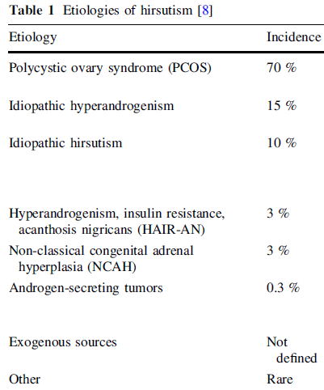

Slide 5
What medical therapies are associated with greatest efficacy and fewest adverse events for treating hirsutism?

Slide 6
OCP
Antiandrogens
Insulin Sensitizers

Slide 7
OCP

Slide 8
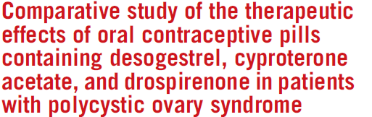
Design: Double-blind randomized controlled trial.
Patient(s): Women with PCOS
Intervention(s): The three-arm trial involved 58, 56, and 57 cases in desogestrel, cyproterone acetate, and drospirenone groups, respectively.
Length to F/U: 6 - 12 months
Main Outcome Measure(s): change in the Free Androgen,SHBG and change in the clinical (FGS)between the three groups.

Slide 9
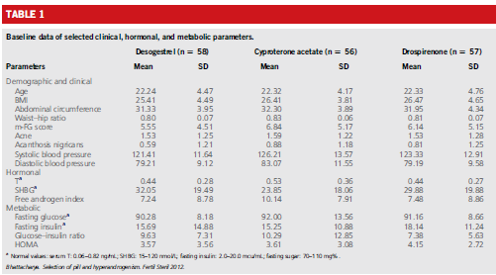

Slide 10
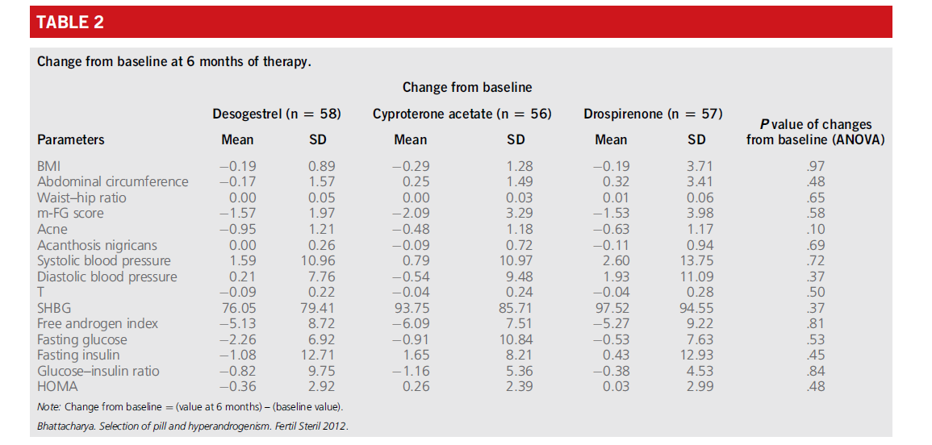

Slide 11
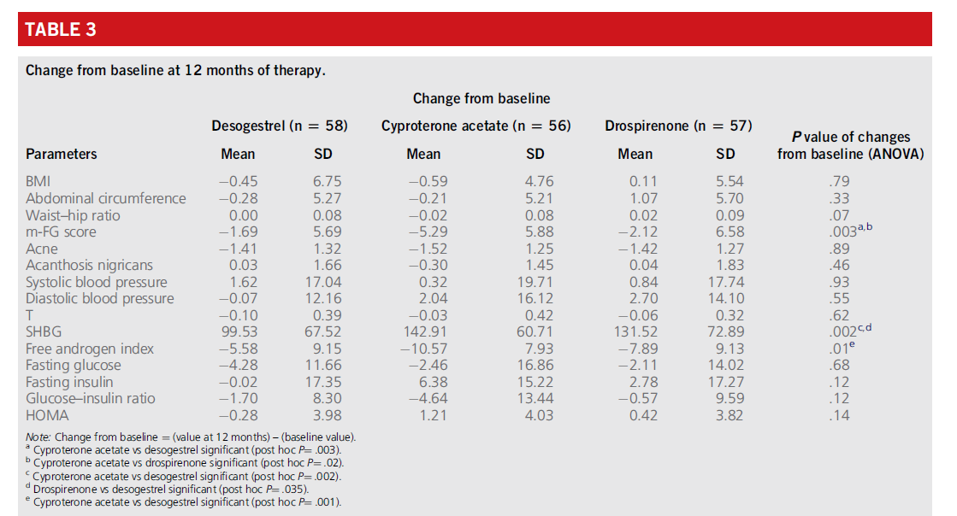

Slide 12
Key massage
The efficacy of CPA, desogestrel and drospirenone is comparable after the first 6 months of treatment. But certainly, at 12 months of treatment, the CPA shows much stronger antiandrogen effects compared with drospirenone and lowest with the desogestrel.

Slide 13
Antiandrogens

Slide 14
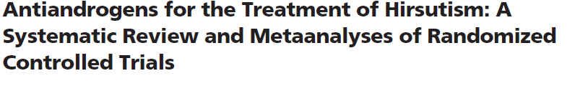
Data Sources: MEDLINE, EMBASE, and Cochrane CENTRAL (up to May 2006).
Eligibility criteria: Eligible studies were RCTs of at least 6 months of antiandrogen use in women at least 12 yr old with varying degrees of hirsutism.
Exclude study: RCTs that enrolled women who received GnRH, clomiphene, or glucocorticoids, and women in whom hirsutism was secondary to etiologies other than idiopathic hirsutism,PCOS, or presumed NCCAH.
Data Synthesis: Of 348 candidate studies, 12 were eligible. Their methodological quality was low.
Outcomes : self-assessed, assessed by a health care professional (FGS), or assessed through laboratory measurements (e.g. hair diameter measurement).
jcem.endojournals.org

Slide 15
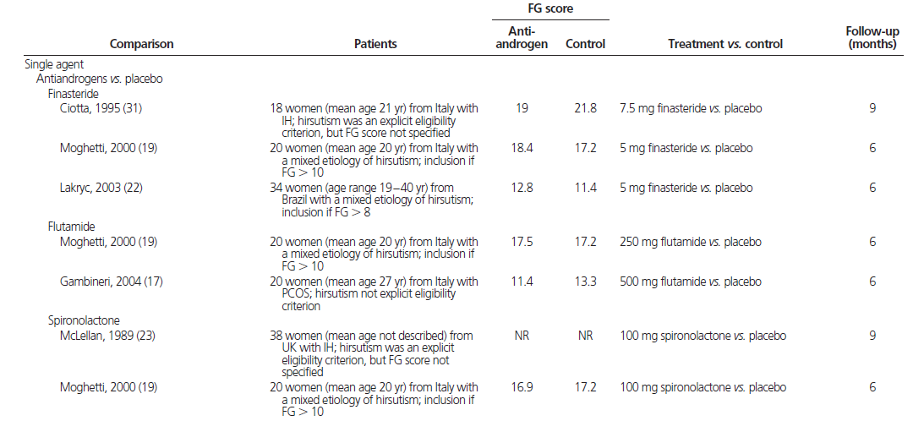
Antiandrogens vs. placebo

Slide 16
Antiandrogens vs. placebo
Metaanalysis showed the antiandrogen group had significantly lower hirsutism scores than the placebo group
(-3.9; CI, -5.4 to- 2.3) with no inconsistency across studies
(I2 : 0%).
There were no significant type-treatment interactions (spironolactone vs. finasteride, P=0.29; spironolactone vs. flutamide, P > 0.99; finasteride vs. flutamide, P = 0.25).

Slide 17
Antiandrogens vs. OCPs

Slide 18
Antiandrogens vs. OCPs
There was no significant difference in hirsutism score between the finasteride group and the group receiving combination EE+CPA(2 mg)(2.5; CI,- 0.4 to 5.4).

Slide 19
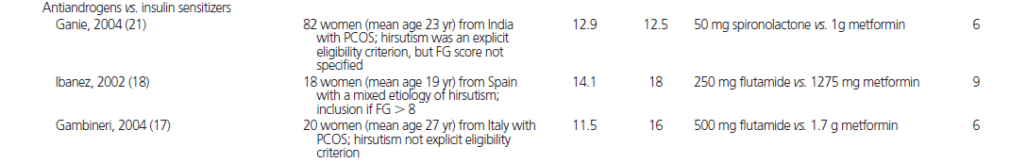
Antiandrogens vs. metformin

Slide 20
Antiandrogens vs. metformin
Antiandrogen group had significantly lower hirsutism scores than the metformin group (-3.7; CI,- 6.8 to- 0.6) but with large inconsistency across studies (I2 = 80%).
A significant type-treatment interaction partly explains this inconsistency (test of interaction, P = 0.002).
The flutamide trials reported a greater treatment effect
(-5.0; CI, -7.0 to -3.0; I2 = 0%) than the spironolactone trial
(-1.3; CI,- 2.6 to -0.03).

Slide 21
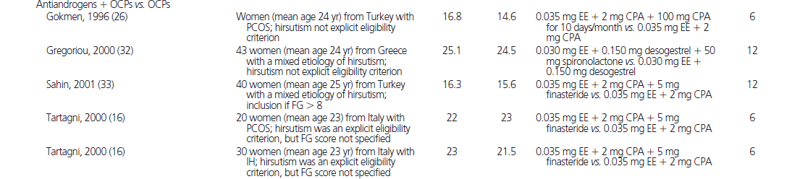
Antiandrogens and OCPs vs. OCPs

Slide 22
Antiandrogens and OCPs vs. OCPs
A metaanalysis of these comparisons showed no significant difference in end-of-study hirsutism scores between treatment groups (-0.8; CI, -2.3 to 0.7, I2 =32%).
Subgroup analyses by type of antiandrogen:the effect of spironolactone or finasteride vs. the effect of high-dose CPA(100 mg) (test of interaction, P = 0.02), with no difference between the spironolactone and finasteride comparisons
(test of interaction, P = 0.57).
Pooling of the spironolactone and finasteride comparisons revealed a significant effect compared with OCPs alone
(-1.7; CI, -3.3 to - 0.1; I2 =0%).

Slide 23
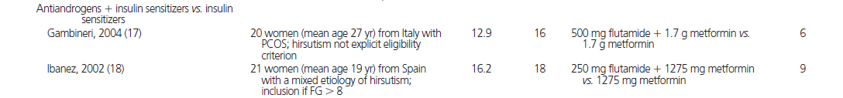
Antiandrogens and metformin vs. metformin

Slide 24
Antiandrogens and metformin vs. metformin
Meta-analysis of the two eligible trials showed the patients receiving the combination flutamide and metformin had significantly lower hirsutism scores than patients receiving metformin alone (-4.6; CI, -7.9 to -1.3; I2 = 40%).

Slide 25
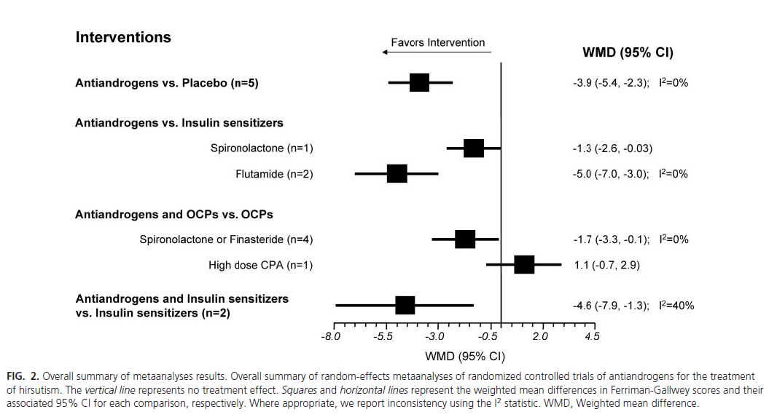
J Clin Endocrinol Metab, April 2008, 93(4):1153–1160

Slide 26
Key massage
Antiandrogens appear to be mildly effective agents for the
treatment of hirsutism. They appear more efficacious than placebo and metformin, and some antiandrogens appear to demonstrate additional improvements when added to OCPs or metformin regimens. However, the currently available evidence is of low to very low quality.
J Clin Endocrinol Metab, April 2008, 93(4):1153–1160

Slide 27
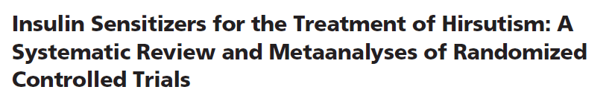
Data Sources: MEDLINE, EMBASE, and Cochrane CENTRAL (up to May 2006).
Data Synthesis: Of 348 candidate studies, 16 trials were eligible.
Eligibility criteria: Women of age 12 yr and older with varying degrees of hirsutism,with hirsutism due to etiologies PCOS, idiopathic hirsutism, or presumed NCCAH.
Exclude study:RCTs were not randomized,had F/U <6 months,patients<12 years old.
Intervention : treatment with metformin or TZDs, alone or incombination with OCPs or antiandrogens, or with placebo.
Length of F/U : 6-12 months.
Outcome : measure hirsutism :subjective methods (FGS) or objective methods (e.g. measurement of hair diameter, length, or rate of growth).
jcem.endojournals.org

Slide 28
The quality of evidence informing the use of insulin sensitizers for the treatment of hirsutism is low to very low and this therefore weakens clinical inferences and the corresponding clinical practice recommendations.

Slide 29
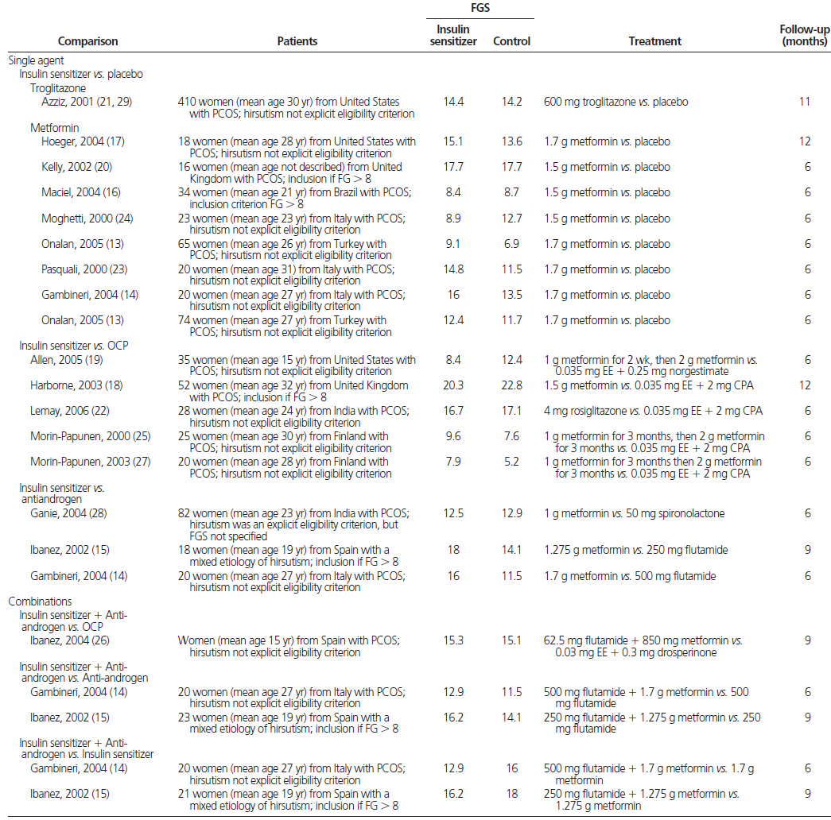

Slide 30
Insulin sensitizers vs. placebo: small effect of insulin sensitizers on hirsutism [pooled weighted mean difference (WMD) of -1.5; CI,- 2.8 to
-0.2), with large inconsistency across the trials (I2 = 75%).
Insulin sensitizers vs. OCPs : no significant difference in FGS between these treatments (-0.5; CI,- 5.0, 3.9) but with large inconsistency across these studies (I2 =79%).
Metformin vs. antiandrogens : significant difference in favor of antiandrogens (-3.7; CI, -6.8 to-0.6) but with large inconsistency across trials (I2 =80%).
Metformin and flutamide vs. OCPs : no significant difference in hirsutism between the two groups (-0.5; CI,-2.7, 1.7).
metformin and flutamide vs. flutamide alone :also found no difference between groups (0.9; CI,0.4, 2.2; I2 = 0%).
Metformin and flutamide vs. metformin alone :found that
the combination led to significantly lower hirsutism scores than
metformin alone (-4.6; CI,-7.9 to-1.3; I2=40%).

Slide 31
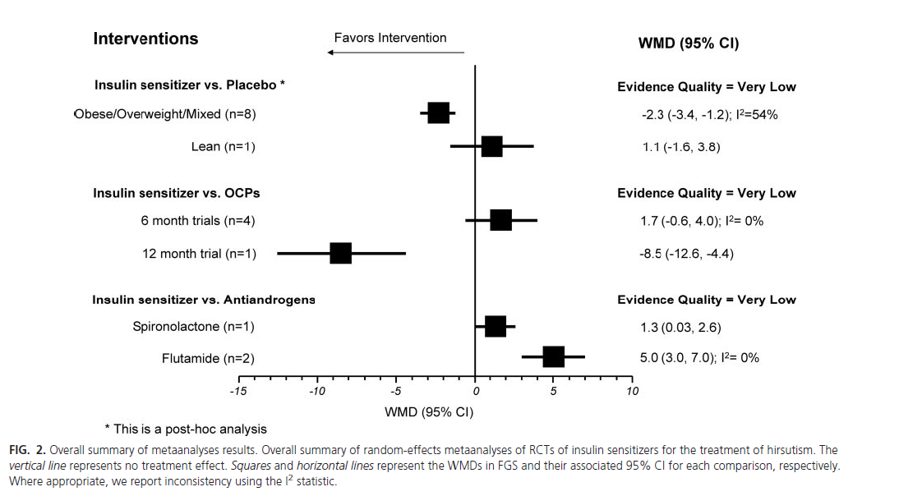

Slide 32
Key massage
Imprecise and inconsistent evidence of low to very low quality suggests that insulin sensitizers provide limited or no important benefit for women with hirsutism.

Slide 33
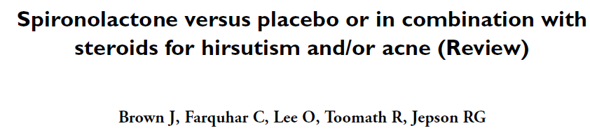
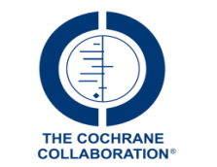
Search: MEDLINE, EMBASE, CINAHL, PsycINFO and CENTRAL, handsearching of 20 relevant journals and conference proceedings.
Exclusion: women with Hirsutism secondary to a functional androgenic tumour,
Iatrogenic causes of hyperandrogenism,Non-endocrine causes of hyperandrogenism.
Intervention: Spironolactone compared to placebo,finasteride ,metformin.
M E T H O D S: randomised controlled trial.
Inclusion: women of reproductive years or postmenopausal women with hirsutism and/or acne.
Major outcome: subjective observations(FGS), hormonal and biochemical parameters, side effects.

Slide 34
Two trials compared spironolactone (100 mg) with placebo.
Significant differences were reported for subjective improvements in hair growth (OR 7.18, 95% CI 1.96 to 26.28).

Slide 35
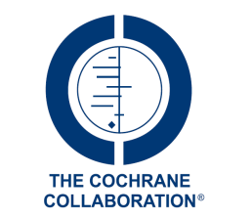
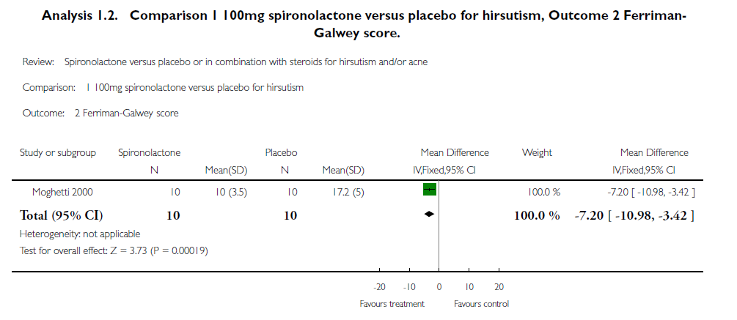

Slide 36
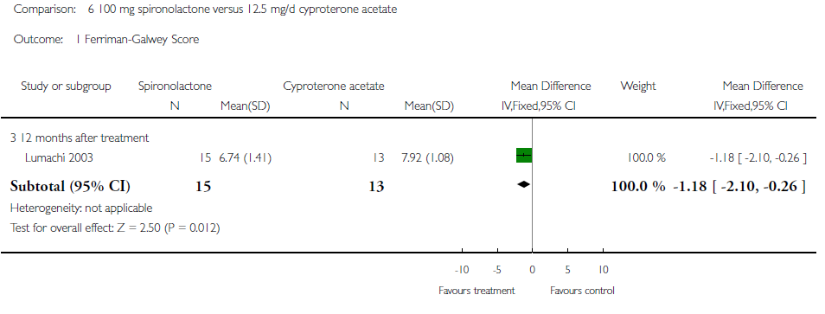

Slide 37
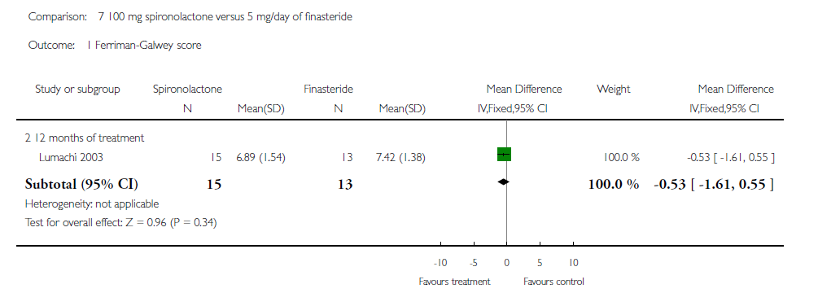

Slide 38
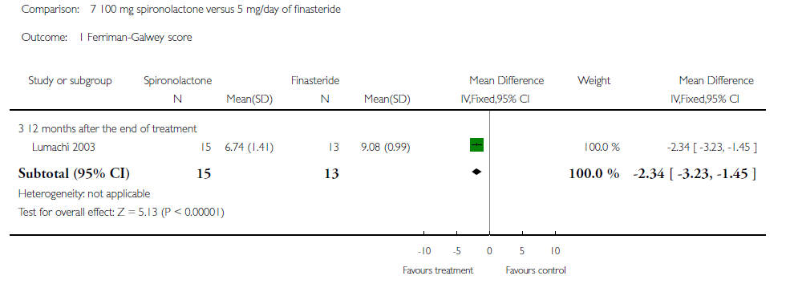

Slide 39
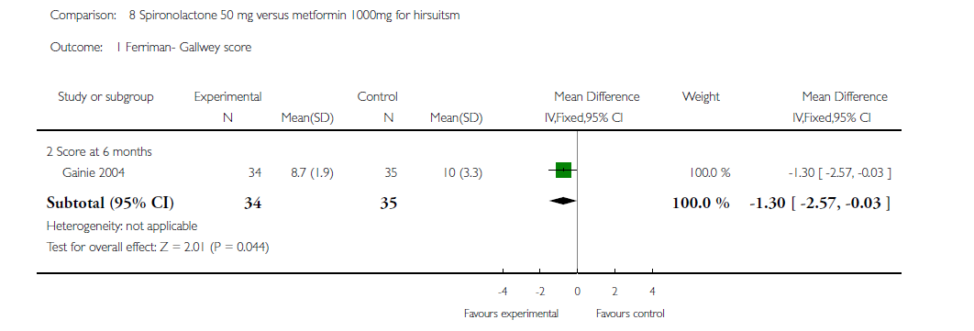

Slide 40
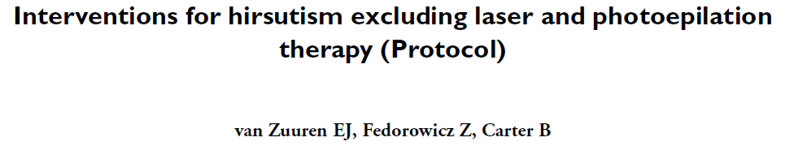
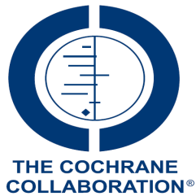
SEARCH METHODS: Cochrane Skin Group Specialised Register,CENTRAL (2014, Issue 6), MEDLINE (from 1946), EMBASE (from 1974), and five trials registers.
SELECTION CRITERIA: RCTs in hirsute women with PCOS, idiopathic hirsutism, or idiopathic hyperandrogenism.
Participants: women (mean age 25 years).
Length of F/U: 6-12 mounths.
Primary outcomes: participant-reported improvement of hirsutis, adverse event throughout the study period.
Secondary outcomes: Clinician’s assessment of improvement of hirsutism(FGS), Change in serum androgen levels, Change in BMI, Improvement of other clinical signs of hyperandrogenism (e.g. acne, female pattern hair loss, ovulatory dysfunction).

Slide 41
Result
There was low quality evidence for the effect of two OCPs (EE+ CPA versus EE+ desogestrel) on change from baseline of FGS The mean difference (MD) was -1.84 (95% confidence interval (CI) -3.86 to 0.18).
There was very low quality evidence that flutamide 250 mg, twice daily, reduced FGS more effectively than placebo (MD -7.60, 95% CI -10.53 to -4.67 and MD -7.20, 95% CI -10.15 to -4.25).
Spironolactone 100 mg daily was more effective than placebo in reducing FGS (MD -7.69, 95% CI -10.12 to -5.26) (low quality evidence). It showed similar effectiveness to flutamide in two studies.
There was very low quality evidence of a difference in reduction of FGS for finasteride 5 mg to 7.5 mg daily versus placebo (MD -5.73, 95% CI -6.87 to -4.58), it was clinically meaningful.
Metformin demonstrated no benefit over placebo in reduction of FGS (MD 0.05, 95% CI -1.02 to 1.12), but the quality of evidence was low.

Slide 42

Addition of cyproterone acetate to OCPs provided greater reductions in Ferriman-Gallwey scores.
Two studies, comparing finasteride 5 mg and spironolactone 100 mg, did not show differences in participant assessments and reduction of FGS (low quality evidence).
One study comparing flutamide 250 mg twice daily with metformin 850 mg twice daily for 12 months, showed flutamide to be more effective (MD -6.30, 95% CI -9.83 to -2.77) (very low quality evidence).
Studies examining effects of hypocaloric diets did not result in reductions in FGS.

Slide 43
Key massage
For mild hirsutism there is evidence of limited quality that OCPs are effective.
Flutamide 250 mg twice daily and spironolactone 100 mg daily appeared to be effective and safe, albeit the evidence was low to very low quality.
Finasteride 5 mg daily showed inconsistent results in different comparisons, therefore no firm conclusions can be made.
There was low quality evidence that metformin was ineffective for hirsutism .

Slide 44
Evaluation and Treatment of Hirsutism in
Premenopausal Women: An Endocrine Society Clinical Practice Guideline
J Clin Endocrinol Metab, April 2008, 93(4):1105–1120 jcem.endojournals.org

Slide 45
Treatment of hirsutism in premenopausal women
For women with patient-important hirsutism despite cosmetic
measures, we suggest either pharmacological therapy or
direct hair removal methods (2 ).
J Clin Endocrinol Metab, April 2008, 93(4):1105–1120 jcem.endojournals.org

Slide 46
Pharmacological treatments (Monotherapy)
For the majority of women, we recommend oral contraceptives
to treat patient-important hirsutism (2 ).
Because of antiandrogen teratogenic potential, we recommend against antiandrogen monotherapy unless adequate contraception is used
(1 ).
For women who cannot or choose not to conceive, we suggest the use of either oral contraceptive preparations (OCPs) or antiandrogens
(2 ). The choice between these options depends on patient preferences regarding efficacy, side effects, and costs.
We suggest against the use of flutamide therapy (2 ).
We suggest against the use of topical antiandrogen therapy for hirsutism (2 ).
J Clin Endocrinol Metab, April 2008, 93(4):1105–1120 jcem.endojournals.org

Slide 47
We suggest against using insulin-lowering drugs as therapy for hirsutism (2 ).
For women with hirsutism who do not have classic or nonclassic congenital adrenal hyperplasia due to 21-hydroxylase deficiency (CYP21A2), we suggest against glucocorticoid therapy (2 ). We suggest glucocorticoids for women with hirsutism due to NCCAH who have a suboptimal response to OCPs and/or antiandrogens, cannot tolerate them, or are seeking ovulation induction (2 ).
We suggest against using GnRH agonists except in women with severe forms of hyperandrogenemia, such as ovarian hyperthecosis, who have a suboptimal response to OCPs and antiandrogens
(2 ).
For all pharmacological therapies for hirsutism, we suggest a trial of at least 6 months before making changes in dose, changing medication, or adding medication (2 ).
J Clin Endocrinol Metab, April 2008, 93(4):1105–1120 jcem.endojournals.org

Slide 48
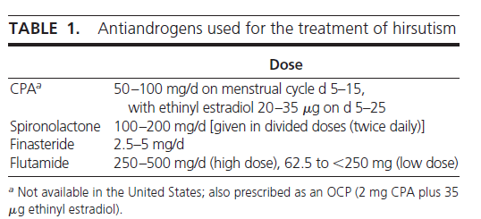
J Clin Endocrinol Metab, April 2008, 93(4):1105–1120 jcem.endojournals.org

Slide 49
Monotherapy: antiandrogens
Drospirenone
Drospirenone: a progestin used in several OCPs, is also an antiandrogen, but a very weak one. For example,
3 mg drosperinone (the dose used in OCPs) is roughly equivalent to 25 mg spironolactone and 1mg CPA .

Slide 50
Monotherapy: insulin-lowering drugs
The place of insulin reduction therapies in treating hirsutism, particularly in the absence of the menstrual or metabolic disturbances typically seen in conjunction with PCOS, is controversial.

Slide 51
Values
Our suggestion not to use flutamide for the routine management of hirsutism places a high value on avoiding potential hepatotoxicity and medication costs in women.
The suggestion not to offer glucocorticoid therapy as first-line therapy to hirsute women with NCCAH places a relatively higher value on avoiding the potential for adverse effects of glucocorticoids and a relatively lower value on the potential benefits of suppressing endogenous androgens .

Slide 52
Remarks
There are no clinical trials of 20-micg OCPs for hirsutism, but 20-micg OCPs appear to be as effective as the 30- to 35-micg preparations for acne.
We do not recommend one antiandrogen over another, except that we recommend against the use of flutamide.

Slide 53
Combination therapy
If patient-important hirsutism remains despite 6 or more months of monotherapy with an oral contraceptive, we suggest adding an antiandrogen (2 ).

Slide 54
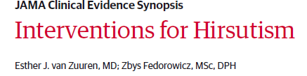
No. of randomized clinical trials: 157
Study years: Published, 1982-2014
No. of patients: 10 550
Women: 100%
Age, mean (range): 25.4 years (15-47)
Countries: Europe (97 trials), United States and Canada (23 trials), Central and South America (10 trials), Asia (20 trials), Africa (3 trials), and Australia and New Zealand (4 trials)
Comparisons: Treatments against placebo or active treatment
Primary outcomes: Participant-reported improvement, quality of life (using validated scales), and adverse events
Secondary outcomes: Clinician-assessed improvement, androgen levels, BMI, and improvement of hyperandrogenic clinical signs

Slide 55
OCP(EE+CPA) vs another OCP (EE+desogestrel) showed both OCPs to be associated with lower FGS with no difference between the 2 OCPs (mean difference [MD], −1.84 [95%CI, −3.86 to 0.18]; 3 studies [n = 164]; low-quality evidence).
Data for OCPs combined with CPA could not be pooled due to heterogeneity but were associated with greater improvements in hirsutism than OCP alone.
OCPs, particularly with antiandrogenic activity, are associated with improvement in mild hirsutism.

Slide 56
Flutamide (250 mg) twice daily was associated with clinically meaningful declines in FGS compared with placebo (MD for flutamide vs placebo: −7.60 [95% CI, −10.33 to −4.87] for 12 months and −7.20 [95% CI, −10.15 to −4.25] for 6 months; very low–quality evidence).
One study (n = 20) showed spironolactone was associated with a lower FGS than placebo (MD, −7.69 [95%CI, −10.12 to −5.26]; low-quality evidence).
Spironolactone and flutamide were each associated with lower FGS, but were not different from each other (MD for spironolactone vs flutamide: 0.49 [95% CI, −1.99 to 2.9] for 6 months; 2 studies [n = 40] ; very low–quality evidence).

Slide 57
Metformin was not associated with lower FGS compared with
placebo (MD, −0.27 [95% CI, −1.46 to 0.91]; 7 studies [n =264];
low-quality evidence).
Hypocaloric diets were not associated with improved hirsutism.

Slide 58
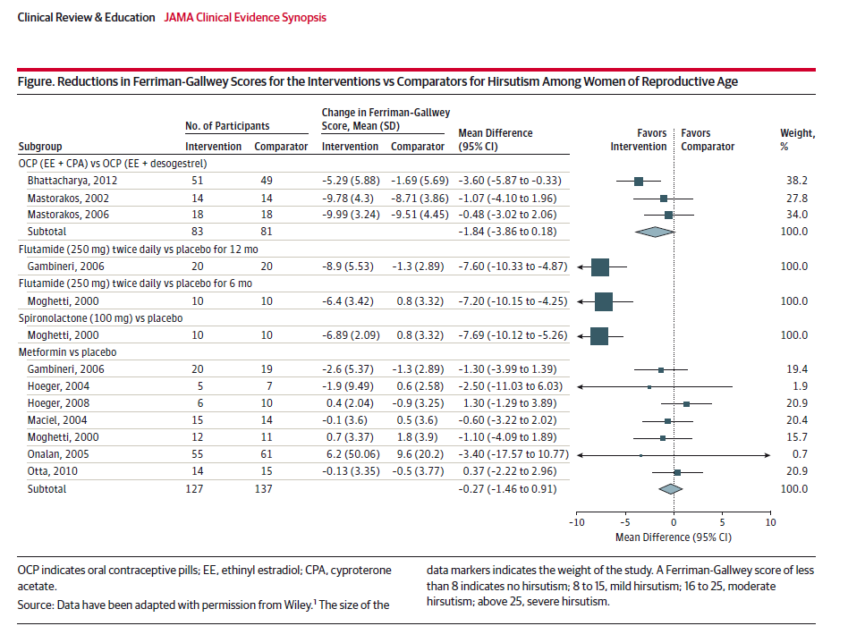

Slide 59
Key message
OCPs, particularly with antiandrogenic activity, are associated with improvement in mild hirsutism .
antiandrogens (ie, flutamide [250mg] twice daily and spironolactone [100mg]) for more severe hirsutism.
Both finasteride and gonadotropin-releasing analogues were associated with inconsistent results, ranging from small (not clinically meaningful) to clinically meaningful benefits.
Insulin sensitizers used to treat polycystic ovary syndrome are not associated with improved hirsutism.

Slide 60
What medical therapies are associated with greatest efficacy and fewest adverse events for treating hirsutism?

Slide 61
Conclusion
Oral contraceptive pills (OCPs) have been associated with improvement for mild hirsutism(first line).
spironolactone (100mg) or finasteride (5 mg) for more severe hirsutism.
Not to use flutamide for the routine management of hirsutism (hepatotoxicity).
Metformin :no benefit.
For all pharmacological therapies for hirsutism:a trial of at least 6 months before making changes in dose, changing medication, or adding medication.

Slide 62
Thank you for attention

