Slide 1
Novel dressings and adjuvant topical treatments for diabetic foot ulcer
Anita Eftekharzadeh M.D
Research Center for Endocrine Sciences
October 2017

Slide 2
Agenda
Aim & Scope of this presentation
Role of dressings
Types of dressings
Moisture retentive dressings: Films, Foams, Hydrocolloids, Alginates, Hydrogels
Silver
Honey
Other adjuvant topical treatments
Growth factors
Negative pressure wound treatment
Topical oxygen therapy
Laser therapy
Ozone therapy

Slide 3
Aim & Scope
Aim:
To review available dressings and adjuvant therapies for diabetic foot ulcer (DFU)
To review the available guidelines recommendations
Scope
A brief overview of available topical treatments for DFU
We will not go through topical antibiotics and systemic adjuvant therapies

Slide 4
Role of dressings
Most dressings are designed to create a moist wound environment and support progression towards wound healing.
It is thought that a moist wound environment physiologically favors cell migration and matrix formation.
They are not a substitute for sharp debridement, managing systemic infection, offloading devices and diabetic control.
Some dressings also can help to manage wound exudate optimally and promote a balanced environment, thus play a key role to improve outcomes.

Slide 5
Criteria for selecting a dressing
Several criteria that should be considered include the cost, potential for iatrogenic injury, and wound exudate management.
First, dressings should not damage the wound. If the wound and surrounding tissue have continuous contact with wound exudate, the local tissue can become macerated and impede healing.
Likewise, dressings that are not secure can cause friction injuries to the surrounding skin or wound bed.
The cost of health care provider time, healing rate, and the unit cost of dressings should be considered when determining cost efficacy.
Randomized clinical studies have not yet identified that any dressing approach is more effective than others to facilitate wound healing.

Slide 7
Wound Healing Society (WHS) 2016 DFU treatment guideline
The guideline levels:
Level I: Meta-analysis of multiple randomized controlled trials (RCTs) or at least two RCTs supporting the intervention of the guideline.
Level II: Less than Level I, but at least one RCT and at least two significant clinical series or expert opinion papers with literature reviews supporting the intervention. Experimental evidence that is quite convincing, but not yet supported by adequate human experience.
Level III: Suggestive data of proof of principle, but lacking sufficient data such as meta-analysis, RCT, or multiple clinical series.

Slide 8
Wound Healing Society (WHS) 2016 guideline
Recommendation #5.1:
Use a dressing that will maintain a moist wound-healing environment. (Level III)
Principle:
A moist wound environment physiologically favors cell migration and matrix formation while accelerating healing of wounds by promoting autolytic debridement.
Wound Rep Reg (2016) 24:112–126

Slide 9
Recommendation #5.2:
Use clinical judgment to select a moist wound dressing. (Level III)
Principle:
Wet-to-dry dressings are not considered continuously moist. Continuously moist saline gauze dressings are as effective as other types of moist wound healing in terms of healing rate. This guideline has not changed since the 2006 recommendations. However, additional information on adjuvant agents and dressings is available in Guideline 5.6.
Wound Rep Reg (2016) 24:112–126

Slide 10
Recommendation #5.3:
Select a dressing that will manage the wound exudates and protect the peri-ulcer skin. (Level I)
Principle:
Peri-wound maceration and continuous contact with wound exudates can enlarge the wound and impede healing.
Wound Rep Reg (2016) 24:112–126

Slide 11
Recommendation #5.4:
Select a dressing that stays in place, minimizes shear and friction, and does not cause additional tissue damage. (Level II)
Principle:
Wound location, peri-wound skin quality, and patient activity can all affect the choice of dressing.
Wound Rep Reg (2016) 24:112–126

Slide 12
Recommendation #5.5:
Select a dressing that is cost effective. (Level I)
Principle:
Because of their low unit cost, moist saline gauze dressings are often viewed as the least expensive and, therefore, most cost-effective dressing. However, when determining cost efficacy, it is important to take into consideration health care provider time, ease of use, and healing rate, as well as the unit cost of the dressing.
Wound Rep Reg (2016) 24:112–126

Slide 13
Adjuvant agents
Recommendation #5.6:
Selectively use adjuvant agents (topical, device, and/or systemic) after evaluating a patient and their ulcer characteristics and when there is a lack of healing progress in response to more traditional therapies. (Level I)
Principle:
Emerging therapies through recombinant technologies and cell-based devices may offer benefit and increase healing in selected patients or difficult wounds. These therapies are quite diverse and are discussed in detail in the Adjuvant Agents Guidelines.

Slide 14
Moisture-retentive dressings
The moist wound environment more effectively contains growth factors, increases angiogenesis, and decreases fibrosis.
Dressings also serve as a barrier from trauma and infection, promote patient functionality with activities of daily living, and are also associated with less scar formation.
From the patient perspective, this translates to reduced pain, less frequent dressing changes, and less scar tissue formation.
The five classic types of moisture-retentive dressings are films, foams, hydrocolloids, alginates, and hydrogels

Slide 15
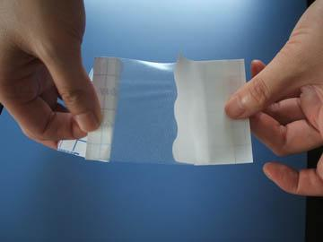
Films

Slide 16
Films
Films are thin, elastic transparent sheet of polyurethane, which are gas permeable and often have acrylic adhesive on one side for adherence.
These sheets are effective at keeping bacteria and fluids out but allowing atmospheric gases and water to pass through.
Films have the advantage of permitting easy visualization without disturbing the wound.
Because they adhere to the wound, they are easy to apply and do not require a second dressing. However, their lack of absorptive capacity leads to fluid collections in any wound with significant exudate.

Slide 17
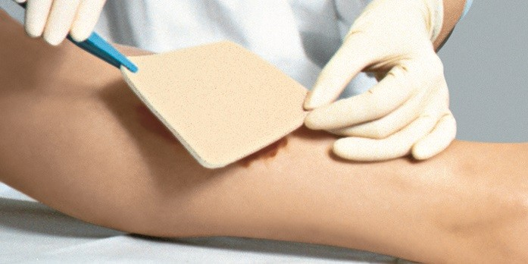
Foams

Slide 18
Foams
Foams are semi-occlusive, bilaminate dressings comprised of hydrophobic polyurethane foam sheets, which have hydrophilic surface coating materials to prevent leakage and bacterial contamination.
They are typically nonadhesive and thicker than other dressings, but these features may vary. If nonadherent, they require a secondary dressing to hold in place.
Because of their bulk, foams can be used to pack cavities and to provide padding over bony prominences.
Disadvantages for foams are that they may fail to stay in place if patients are more mobile; in addition, they may dehydrate dry wounds and are completely opaque so no visualization is possible through the dressing. Adhesive foams can cause contact dermatitis in some patients.

Slide 19
Cochrane review on foam dressings for DFU
Six studies (157 participants) were included.
Meta analysis of two studies indicated that foam dressings do not promote the healing of diabetic foot ulcers compared with basic wound contact dressings (RR 2.03, 95%CI 0.91 to 4.55). Pooled data from two studies comparing foam and alginate dressing found no statistically significant difference in ulcer healing (RR 1.50, 95% CI 0.92 to 2.44).
There was no statistically significant difference in the number of diabetic foot ulcers healed when foam dressings were compared with hydrocolloid (matrix) dressings. All included studies were small and/or had limited follow-up times.

Slide 20
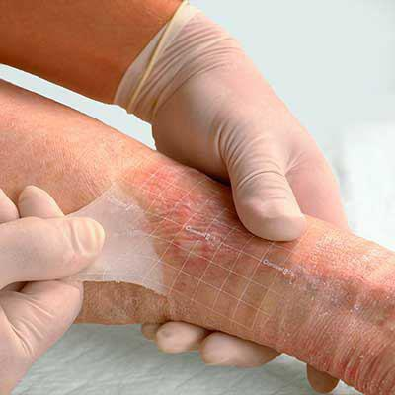
Hydrocolloids

Slide 21
Hydrocolloids
Hydrocolloids are typically gels or foams impregnated into self-adhesive polyurethane films resulting in dressing sheets with the ability to conform to different surface shapes.
Because of their colloidal nature, these dressings trap any exudates on the underside, turning them into gels, which promotes autolytic debridement and deters leakage.
Hydrocolloids are impermeable to water, oxygen, and carbon dioxide, conferring a “water-proof” status to these popular dressings.
Disadvantages of hydrocolloids include the presence of a malodorous gel on the dressing underside, the risk of overgranulation, the potential for maceration around the edges of the wound, and the potential for contact dermatitis since these dressings tend to be left in place for longer than a day

Slide 22
Cochrane review on hydrocolloid dressings for DFU
Five studies (535 participants) were included in the review: these compared hydrocolloids with basic wound contact dressings, foam dressings, alginate dressings and a topical treatment.
Meta-analysis of two studies indicated no statistically significant difference in ulcer healing between fibrous-hydrocolloids and basic wound contact dressings: risk ratio 1.01 (95% CI 0.74 to 1.38). One of these studies found that a basic wound contact dressing was more cost-effective than a fibrous-hydrocolloid dressing. One study compared a hydrocolloid-matrix dressing with a foam dressing and found no statistically significant difference in the number of ulcers healed.
There was no statistically significant difference in healing between an antimicrobial (silver) fibrous-hydrocolloid dressing and standard alginate dressing; an antimicrobial dressing (iodine-impregnated) and a standard fibrous hydrocolloid dressing and a topical cream containing plant extracts.

Slide 23
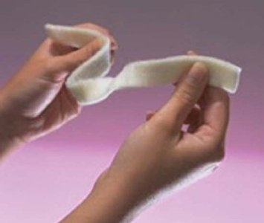
Alginates

Slide 24
Alginates
Alginates are comprised of cellulose-like polysaccharides derived from algae or kelp, which have impressive absorptive abilities.
Although these dressings are insoluble in water, in the sodium-filled wound environment, they exchange algae-based calcium ions and for sodium ions to form a sodium salt and hydrophilic gel that can absorb significant amounts of fluid.
They are typically very dry-appearing sheets, but may also appear as ribbons, beads, or pads. Alginates also uniquely exhibit hemostatic properties.
Alginates can be difficult to remove if they are placed on dry wounds, which can lead to significant pain at dressing changes unless saline is used to moisten dressings before. In addition, they typically require a secondary dressing to keep in place, especially if they are place inside deep sinuses.

Slide 25
Alginates (Cont’d)
Alginates are the most powerful absorptive dressings for heavily exudative, deep wounds. In addition to deep pressure ulcers, alginates are helpful for pyoderma gangrenosum, deeper diabetic wounds, and heavily exudative venous leg ulcers.
If used on the leg, they are often used underneath a multilayer compression wrap. Many patients also do well with alginate dressings until the exudate is under control, at which point, they may be switched to other dressing types.

Slide 26
Cochrane review on alginate dressings for DFU
Six studies (375 participants) were included in this review; these compared alginate dressings with basic wound contact dressings, foam dressings and a silver-containing, fibrous-hydrocolloid dressing.
Meta analysis of two studies found no statistically significant difference between alginate dressings and basic wound contact dressings. Pooled data from two studies comparing alginate dressings with foam dressings found no statistically significant difference in ulcer healing.
There was no statistically significant difference in the number of diabetic foot ulcers healed when an anti-microbial (silver) hydrocolloid dressing was compared with a standard alginate dressing.
All studies had short follow-up times (six to 12 weeks), and small sample sizes.

Slide 27
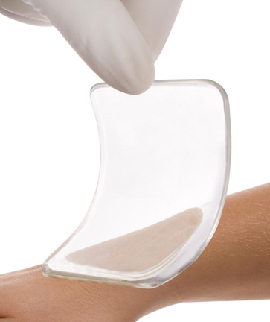
Hydrogels

Slide 28
Hydrogels
Hydrogels are firm sheets or liquid gel dressings, which are comprised of 96% water inside a cross-linked hydrophilic polymer network of polyvinyl alcohol, polyacrylamides, polyethylene, and poly-vinyl pyrrolidone.
These dressings are comfortable, absorbent dressings that bathe tissues in water-rich gels, promoting autolytic debridement. Because they are cool, they can be very soothing to patients.
They may macerate surrounding skin if used in wounds that are already highly moist, and the gel forms are particularly nonadherent.

Slide 29
Hydrogels (Cont’d)
Hydrogels are ideal for very dry necrotic wounds such as arterial ulcers, dry venous ulcers, which have been left to “dry out,” rheumatologic ulcers, lesions secondary to coumadin necrosis, calciphylaxis, and other wounds secondary to coagulopathic processes.
They should be cut to the size of the wound and placed down after removing the protective back.
If in gel form known as “amorphous gel,” the hydrogel may simply be squeezed into the cavity and covered with a secondary dressing such as a film, foam, or hydrocolloid.

Slide 30
Cochrane review on hydrogel dressings for DFU
Five studies (446 participants) were included in this review.
Meta analysis of three studies comparing hydrogel dressings with basic wound contact dressings found significantly greater healing with hydrogel: risk ratio (RR) 1.80, 95% confidence interval (CI) 1.27 to 2.56. The three pooled studies had different follow-up times and also evaluated ulcers of different severities.
One study compared a hydrogel dressing with larval therapy and found no statistically significant difference in the number of ulcers healed and another found no statistically significant difference in healing between hydrogel and platelet-derived growth factor. There was also no statistically significant difference in number of healed ulcers between two different brands of hydrogel dressing.

Slide 31
Cochrane review (Cont’d)
All included studies were small and at unclear risk of bias and there was some clinical heterogeneity with studies including different ulcer grades. No included studies compared hydrogel with other advanced wound dressings.
There is some evidence to suggest that hydrogel dressings are more effective in healing (lower grade) diabetic foot ulcers than basic wound contact dressings however this finding is uncertain due to risk of bias in the original studies.

Slide 32
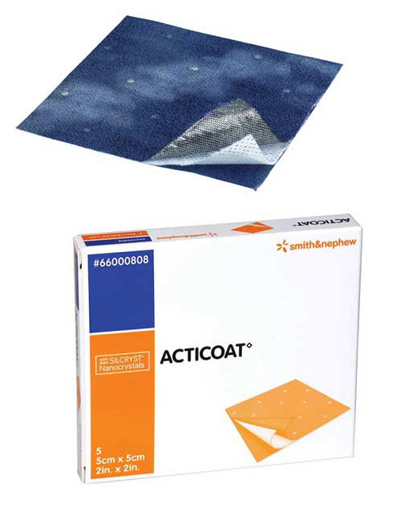
Silver

Slide 33
Silver dressings
Silver has a long-standing history as an antimicrobial agent in everything from water vessels to silver sulfadiazine cream in burn care. Silver is thought to bind to bacterial cell membranes, interfere with bacterial electron transport, bind to bacterial DNA, and to bind up key building blocks in the cell. Clinical efficacy for such dressings is yet being assessed.
A systematic review and meta-analysis of silver treatments and silver-impregnated dressings for the healing of leg wounds found strong evidence for wound size reduction but no evidence for complete wound healing or improved healing rates.

Slide 34
Silver dressings (Cont’d)
A Cochrane Review article looking at use of silver-containing dressings and topical agents for diabetic foot ulcers demonstrated that such interventions have not been appropriately validated, but more studies are needed.
Moreover, there is no good evidence to demonstrate that silver containing dressings can prevent wound infection.
At this time, silver-coated dressings may be used when other antimicrobial approaches appear ineffective or cost is not a major concern.

Slide 35
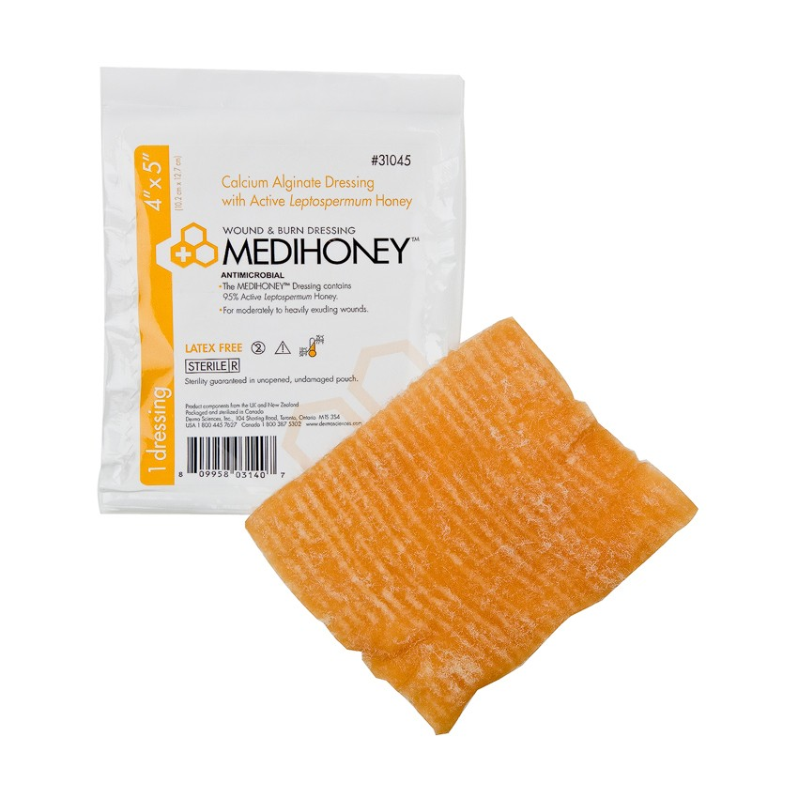
Honey

Slide 36
Honey dressings
Honey, particularly of the medical variety, has became a hot topic in the wound care field, present both as a topical wound salve as well as the basis for impregnated dressings.
A Cochrane Review of honey to treat a variety of wounds in 19 trials showed that honey may improve healing times in mild to moderate superficial and partial thickness burns; however, there is no demonstrable benefit for other types of ulcers.
There is little data showing that honey is harmful to wounds, but at this point, this remains more of an experimental therapeutic for chronic wounds for which data is building.

Slide 37
Cochrane review on topical honey for DFU
The effects of honey relative to comparators are unclear for diabetic foot ulcers (2 trials, n=93, low quality evidence)
Honey appears to heal partial thickness burns more quickly than conventional treatment (which included polyurethane film, paraffin gauze, soframycin-impregnated gauze, sterile linen and leaving the burns exposed) and infected post-operative wounds more quickly than antiseptics and gauze.
Beyond these comparisons any evidence for differences in the effects of honey and comparators is of low or very low quality and does not form a robust basis for decision making.

Slide 38
Types of wound dressing available

Slide 39
Adjuvant therapy
Many agents have been suggested to be used as adjuvants to dressings and off-loading therapy in the treatment of diabetic ulcers.
These adjuvant agents can be divided into topical agents to be applied to the ulcer, devices aimed at accelerating ulcer healing, and systemic drugs to treat the patient. Several of these agents have enough evidence to allow guidelines regarding their use.

Slide 40
WHS guideline
Guideline #7.1.1:
Application of Platelet-derived growth factor (PDGF) reduces the time to heal and increases the proportion of ulcers that heal. (Level I)
Principle:
Cytokine growth factors are messengers/mediators in wound healing. Diabetic foot wounds are deficient in growth factors. Addition of growth factors to nonhealing wounds can therefore accelerate wound healing.
Wound Rep Reg (2016) 24:112–126

Slide 41
Guideline #7.1.2:
Cytokines and growth factors have demonstrated with improved DFW healing. (Level I)
Principle:
Cytokines and growth factors are messengers/mediators in wound healing.
Wound Rep Reg (2016) 24:112–126

Slide 42
Guideline #7.1.3:
Platelet-rich plasma (Level l) and epidermal growth factor (Level II) have not demonstrated an increase in the proportion of wounds that heal and the healing rate of DFUs.
Principle:
There is one systematic review and four RCTs with autologous and blood bank sourced platelet rich plasma that together suggest no improved wound healing effects.
Wound Rep Reg (2016) 24:112–126

Slide 43
Guideline #7.2.1:
Negative pressure wound therapy (NPWT) has been shown to increase the proportion of wounds that heal and the rate of wound healing compared with standard wound care in diabetic lower extremity wounds. (Level I)
Principle:
NPWT treatment may improve wound healing by reducing edema, removing bacterial products, and drawing together the edges of the wound, and should be considered when other treatments are not effective.
Wound Rep Reg (2016) 24:112–126

Slide 44
Guideline #7.2.2:
Cellular and Acellular skin equivalents improve DFU healing. (Level I)
Principle:
Healthy living skin cells assist in healing DFUs by releasing therapeutic amounts of growth factors, cytokines, and other proteins that stimulate the wound bed.
Wound Rep Reg (2016) 24:112–126

Slide 45
Guideline #7.2.3:
Electrical stimulation is recommended to accelerate wound closure. (Level I)
Principle:
Application of electric current to diabetic foot wounds increases local tissue perfusion and may affect protein synthesis, cell migration, and bacterial growth to improve wound healing.
Wound Rep Reg (2016) 24:112–126

Slide 46
Guideline #7.2.4:
Extracorporeal shock wave therapy (ESWT) accelerates diabetic ulcer healing (Level I).
Principle:
Extracorporeal shock wave therapy has been used in a variety of clinical application for fracture repair, tendon injuries and wound healing. Four RCTs evaluated shock wave therapy for patients with diabetic foot ulcers.
Wound Rep Reg (2016) 24:112–126

Slide 47
Guideline #7.3:
Hyperbaric oxygen therapy should be used to improve wound healing and reduce major amputation (Level I).
Principle:
Hyperbaric oxygen therapy may increase the amount of oxygen delivered to a wound in diabetic patients and thereby improve healing.
Wound Rep Reg (2016) 24:112–126

Slide 48
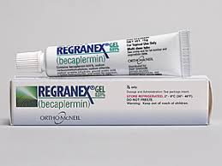
Growth Factors

Slide 49
Growth factors
Growth factors can stimulate fibroblasts, promote angiogenesis, and encourage cellular proliferation of keratinocytes. Topical application of these growth factors to human wounds has shown some benefits in animal models and clinical trials.
Clinical trials in humans showed efficacy with PDGF-derived gel, becaplermin, increasing the incidence of complete wound closure by 43%, which allowed for Food and Drug Association (FDA) approval of this gel for diabetic ulcers extending to subcutaneous tissue.

Slide 50
Growth factors (Cont’d)
Of note, a black box warning has been placed on this product because of increased mortality secondary to malignancy in patients who use more than three tubes of this product, thus this is not advised in patients with a history of malignancy.
Although cost-benefit analyses have justified becaplermin’s cost, the clinical experience has not met the high expectations and insurance coverage can be difficult to obtain.
FGF topical agents are not yet commercially available or FDA approved in the United States, but a clinical study in diabetic ulcers showed significant decrease in surface area compared to placebo.

Slide 51
Cochrane review on growth factor for DFU
A heterogeneous group of trials assessed 11 different growth factors for diabetic foot ulcers (28 trials, 2365 participants) was included.
They found evidence suggesting that growth factors may increase the likelihood that people will have complete healing of foot ulcers in people with diabetes. However, this conclusion is based on randomized clinical trials with high risk of systematic errors (bias).
Assessment of the quality of the available evidence (GRADE) showed that further trials investigating the effect of growth factors are needed before firm conclusions can be drawn.
The safety profiles of the growth factors are unclear. Future trials should be conducted according to SPIRIT statement and reported according to the CONSORT statement by independent investigators and using the Foundation of Patient-Centered Outcomes Research recommendations.

Slide 52
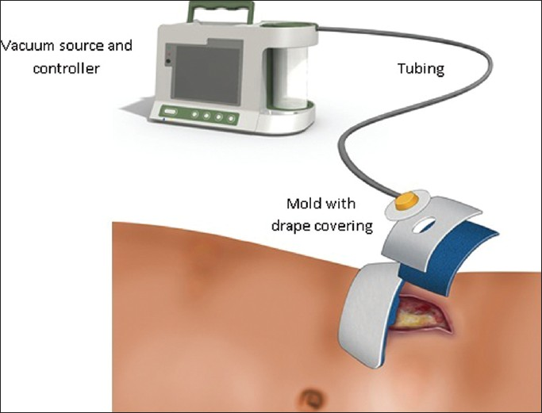
Negative Pressure Wound Therapy (NPWT)

Slide 53
Systematic review on Negative pressure wound therapy (NPWT)
A total of eleven randomized controlled trials, which included a total of 1,044 patients, were selected from 691 identified studies.
Compared with standard dressing changes, NPWT had a higher rate of complete healing of ulcers, shorter healing time, greater reduction in ulcer area, greater reduction in ulcer depth, fewer amputations, and no effect on the incidence of treatment-related adverse effects
Meanwhile, many analyses showed that the NPWT was more cost-effective than standard dressing changes
Ther Clin Risk Manag. 2017 Apr 18;13:533-544 53

Slide 54
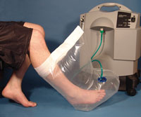
Topical Oxygen Therapy

Slide 55
Topical (Hyperbaric) oxygen
With topical oxygen an airtight chamber or polyethylene bag is sealed around a limb or the trunk by either a constriction/tourniquet device or by tape and high flow (usually 10 liters per minute) oxygen is introduced into the bag and over the wound. Pressures just over 1.0 atmospheres absolute (atm abs) (typically 1.004 to 1.013 atm abs) are recommended because higher pressures could decrease arterial/capillary inflow.

Slide 56
The International Working Group of the Diabetic Foot (IWGDF) review on TOT
Three studies were identiﬁed for this review, which evaluated the use of topical hyperbaric oxygen therapy (HBOT). One was randomized and reported no apparent reduction in the cross-sectional area of ulcers at either 7 or 14 days. The other was only partially randomized but reported an apparent beneﬁt at 4 weeks.
The third one was a small cohort study and reported an apparent improvement in healing at 90 days in the intervention group, but it was marred by the fact that patients chose the intervention, and there were differences between groups in the number of contacts with healthcare professionals.
At present, therefore, the evidence from these three studies does not support the use of topical oxygen therapy to enhance the healing of diabetic foot ulcers.

Slide 57
Systematic review on Low Level Laser Therapy (LLLT) for DFU
Four RCTs involving 131 participants were suitable for inclusion based upon our criteria.
All reviewed RCTs demonstrated therapeutic outcomes with no adverse events using LLLT for treatment of DFU. This systematic review reports that LLLT has significant potential to become a portable, minimally invasive, easy-to-use, and cost effective modality for treatment of DFU. To enthusiastically recommend LLLT for treatment of DFU, additional studies with comparable laser parameters, screening period to exclude rapid healers, larger sample sizes and longer follow-up periods are required.

Slide 58
Cochrane review on Ozone Therapy for DFU
Three studies (212 participants) were included in this review. The overall risk of bias was high for two trials and unclear for one.
The meta-analysis results did not show evidence of a difference between groups for the outcomes of reduction of ulcer area.
The available evidence was three small RCTs with unclear methodology, so they were unable to draw any firm conclusions regarding the effectiveness of ozone therapy for foot ulcers in people with DM.

Slide 60
IWGDF systematic review
In 2016, the International Working Group of the Diabetic Foot (IWGDF) working group on wound healing updated its previous systematic reviews of the evidence to inform protocols for routine care.
Selected studies fell into the following ten categories: sharp debridement and wound bed preparation with larvae or hydrotherapy; wound bed preparation using antiseptics, applications and dressing products; resection of the chronic wound; oxygen and other gases, compression or negative pressure therapy; products designed to correct aspects of wound biochemistry and cell biology associated with impaired wound healing; application of cells, including platelets and stem cells; bioengineered skin and skin grafts; electrical, electromagnetic, lasers, shockwaves and ultrasound and other systemic therapies, which did not ﬁt in the aforementioned categories.

Slide 61
30 papers were selected for grading following full text review.
The present report is an update of the earlier IWGDF systematic reviews, and the conclusion is similar: that with the possible exception of negative pressure wound therapy in post-operative wounds, there is little published evidence to justify the use of newer therapies.
Analysis of the evidence continues to present difﬁculties in this ﬁeld as controlled studies remain few and the majority continue to be of poor methodological quality.

Slide 62
Take home messages
Guidelines have not yet recommended any dressing approach to facilitate diabetic ulcers healing.
For selecting dressings consider the cost, potential for iatrogenic injury, and wound exudate management.
There is little published evidence to support use of topical adjuvant therapies for diabetic foot ulcers
Negative pressure wound therapy may possibly be an exception.

Slide 63
References
Best Practice Guidelines: Wound Management in Diabetic Foot Ulcers. Available from: https://www.researchgate.net/publication/256462903_Best_Practice_Guidelines_Wound_Management_in_Diabetic_Foot_Ulcers [accessed Sep 29, 2017].
Lavery LA, Davis KE, Berriman SJ, Braun L, Nichols A, Kim PJ, Margolis D, Peters EJ, Attinger C (2016) WHS guidelines update: Diabetic foot ulcer treatment guidelines. Wound repair and regeneration : official publication of the Wound Healing Society [and] the European Tissue Repair Society 24 (1):112-126
Powers JG, Morton LM, Phillips TJ (2013) Dressings for chronic wounds. Dermatologic therapy 26 (3):197-206.
Dumville JC, Deshpande S, O'Meara S, Speak K (2013) Foam dressings for healing diabetic foot ulcers. The Cochrane database of systematic reviews (6):CD009111
Dumville JC, Deshpande S, O'Meara S, Speak K (2013) Hydrocolloid dressings for healing diabetic foot ulcers. The Cochrane database of systematic reviews (8):CD009099
Dumville JC, O'Meara S, Deshpande S, Speak K (2013) Alginate dressings for healing diabetic foot ulcers. The Cochrane database of systematic reviews (6):CD009110
Dumville JC, O'Meara S, Deshpande S, Speak K (2013) Hydrogel dressings for healing diabetic foot ulcers. The Cochrane database of systematic reviews (7):CD009101
Marti-Carvajal AJ, Gluud C, Nicola S, Simancas-Racines D, Reveiz L, Oliva P, Cedeno-Taborda J (2015) Growth factors for treating diabetic foot ulcers. The Cochrane database of systematic reviews (10):CD008548

Slide 64
Jull AB, Cullum N, Dumville JC, Westby MJ, Deshpande S, Walker N (2015) Honey as a topical treatment for wounds. The Cochrane database of systematic reviews (3):CD005083.
Zhao D, Luo S, Xu W, Hu J, Lin S, Wang N (2017) Efficacy and Safety of Hyperbaric Oxygen Therapy Used in Patients With Diabetic Foot: A Meta-Analysis of Randomized Clinical Trials. Clinical therapeutics. doi:10.1016/j.clinthera.2017.08.014
Tchanque-Fossuo CN, Ho D, Dahle SE, Koo E, Li CS, Isseroff RR, Jagdeo J (2016) A systematic review of low-level light therapy for treatment of diabetic foot ulcer. Wound repair and regeneration : official publication of the Wound Healing Society [and] the European Tissue Repair Society 24 (2):418-426
Game FL, Apelqvist J, Attinger C, Hartemann A, Hinchliffe RJ, Londahl M, Price PE, Jeffcoate WJ (2016) Effectiveness of interventions to enhance healing of chronic ulcers of the foot in diabetes: a systematic review. Diabetes/metabolism research and reviews 32 Suppl 1:154-168.
Feldmeier JJ, Hopf HW, Warriner RA, 3rd, Fife CE, Gesell LB, Bennett M (2005) UHMS position statement: topical oxygen for chronic wounds. Undersea & hyperbaric medicine : journal of the Undersea and Hyperbaric Medical Society, Inc 32 (3):157-168
Liu J, Zhang P, Tian J, Li L, Li J, Tian JH, Yang K (2015) Ozone therapy for treating foot ulcers in people with diabetes. The Cochrane database of systematic reviews (10):CD008474
Liu S, He CZ, Cai YT, Xing QP, Guo YZ, Chen ZL, Su JL, Yang LP (2017) Evaluation of negative-pressure wound therapy for patients with diabetic foot ulcers: systematic review and meta-analysis. Therapeutics and clinical risk management 13:533-544.

Slide 65
Thank you for your attention

