Slide 1
Insulin Therapy in T2DM : Intensification
Farzad Hadaegh, MD.
Professor of Internal Medicine & Endocrinology
Prevention of Metabolic Disorders Research Center,
Research Institute for Endocrine Sciences
Shahid Beheshti University of Medical Sciences
Kish,November,2014

Slide 2
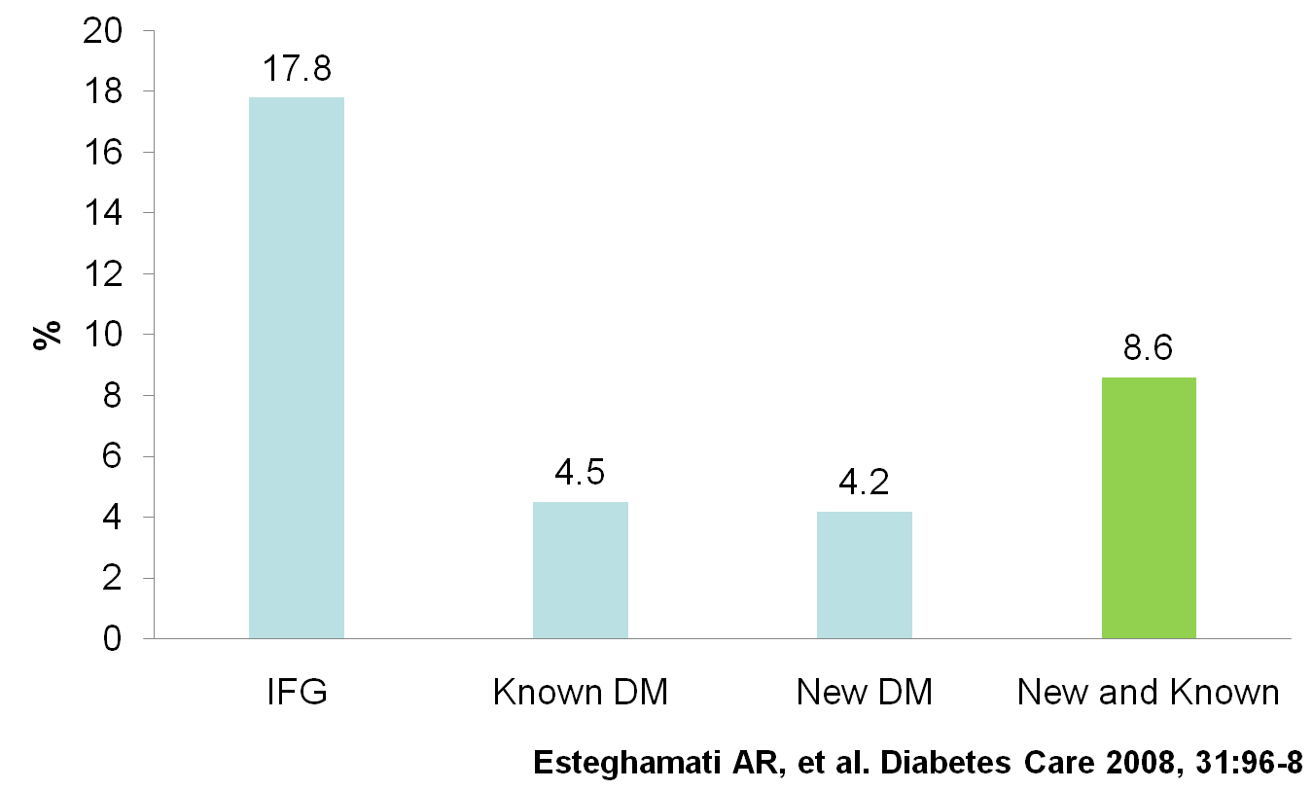
Prevalence of Diabetes and Impaired Fasting Glucose in the adult (20-64 years) urban population of Iran

Slide 3
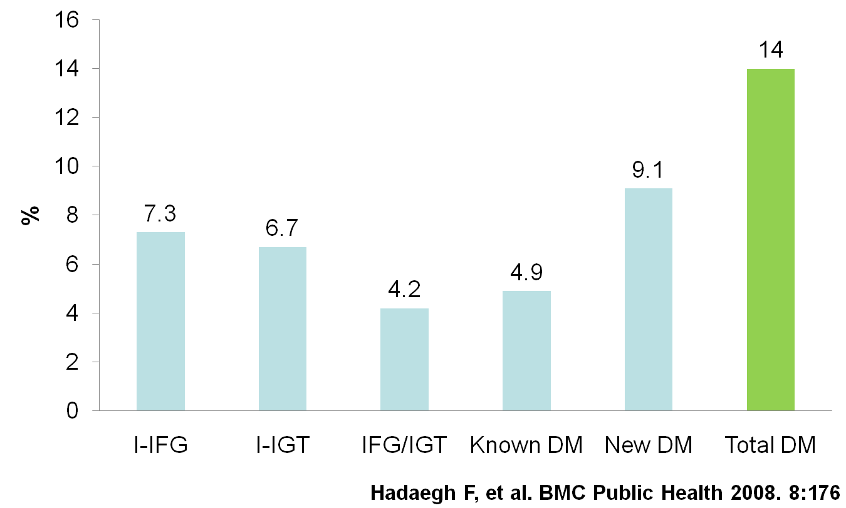
High prevalence of diabetes and abnormal glucose tolerance in adult population (≥20 years) of Tehran

Slide 4
Incidence rate of Type 2 diabetes in the adult population (≥20 years) of Tehran

Slide 5
Hrati et al Population-based incidence of Type 2 diabetes and its associated risk factors: results from a six-year cohort study in Iran , BMC pubic Health 2009
More than 1% of the Iranian urban population older than 20 years develops Type 2 diabetes each year.
If we extrapolate the standardized annual rate of the incident diabetes to the current urban population of IRAN older than 20 years, it is estimated that each year more than 310, 000 individuals develop Type 2 diabetes.
This alarming rate confirms previous estimates that the Middle East region will have the highest increase in number of diabetes cases in the following 20 years

Slide 6
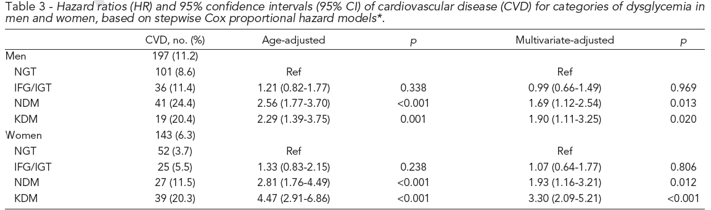
Glucose intolerance and risk of cardiovascular disease in Iranian men and women: Results of the 7.6-year follow-up of the Tehran Lipid and Glucose Study( Hadaegh et alJ. Endocrinol. Invest,32,724-730,2009)

Slide 7
Cardiovascular risk and all cause mortality attributable to diabetes: Tehran Lipid and Glucose Study
Bozorgmanesh et al. j. Endocr. Inves 2011
Outcome | Diabetes status | PAF (%)
CVD | New Diagnosed DM | 6.3 (2.4-11.0)
 | Known DM | 15.2 (9.7-21.1)
 | DM | 21.5 (14.4-28.9)
CHD | New Diagnosed DM | 5.0 (1.0-9.9)
 | Known DM | 15.7 (9.9-22.2)
 | DM | 20.8 (13.1-28.7)
Mortality | New Diagnosed DM | 6.5 (1.5-13.2)
 | Known DM | 17.5 (9.4-26.6)
 | DM | 24.0 (13.8-34.7)

Slide 8
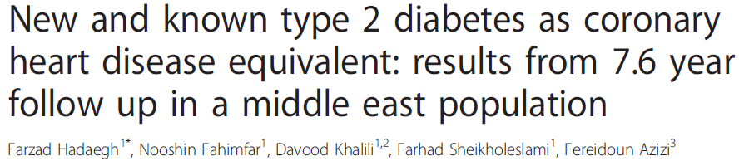
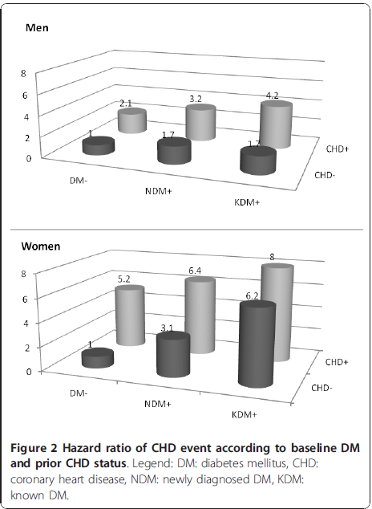

Slide 9
Case study
53 Years old Man with T2DM from 5 years ago
Weight : 78 FBS : 152 mg/dl (120-150-rarely 170 mg/dl)
Height : 168 BS : 254 A1C : 8.1%
Creatinine : 1.14 Cholesterol : 154 Triglyceride : 65
LDL : 88 HDL : 45 , No CAD
Treatment Regimen:
Observing life style modification (Diet, Exercise)
4 Metformin
22 IU Lantus

Slide 10
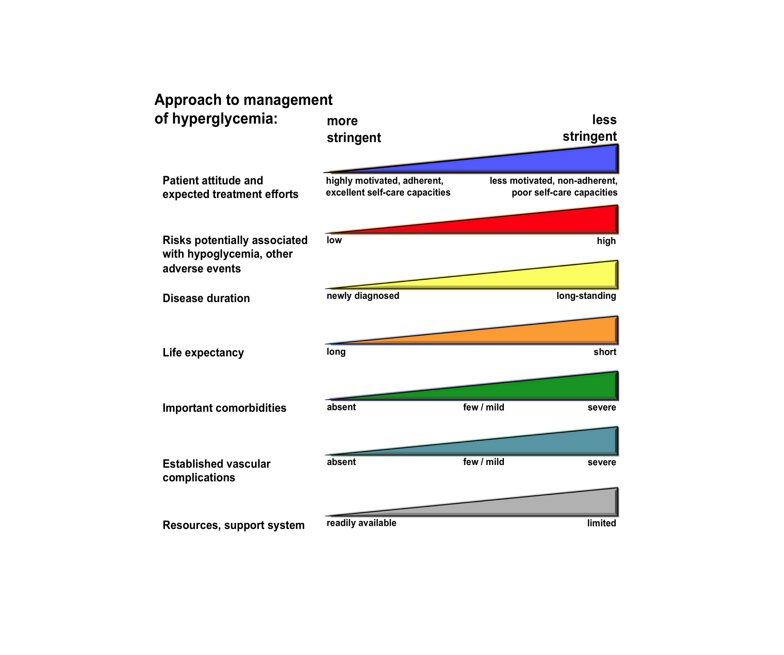
Figure 1
Diabetes Care, Diabetologia. 19 April 2012 [Epub ahead of print]
(Adapted with permission from: Ismail-Beigi F, et al. Ann Intern Med 2011;154:554)
Notes:
Depiction of the elements of decision-making used to determine appropriate efforts to achieve glycaemic targets. Greater concerns about a particular domain are represented by increasing height of the ramp. Thus, characteristics/predicaments towards the left justify more stringent efforts to lower HbA1c, whereas those towards the right are compatible with less stringent efforts. Where possible, such decisions should be made in conjunction with the patient, reflecting his or her preferences, needs and values. This ‘scale’ is not designed to be applied rigidly but to be used as a broad construct to help guide clinical decisions. Adapted with permission from Ismail-Beigi et al [ref 20]

Slide 11
IDEAS AND OPINIONS
Setting Glycemic Targets in Type 2 Diabetes Mellitus
Table 2. Proposed Approximate HbA_{1c}Targets Determined by Clinical Characteristics (in the Absence of Severe Hypoglycemia)
Age | Duration of Diabetes Mellitus | Complications Macrovascular Microvascular |  |  | Treatment Intensity (HbA_{1c}Target )
< 45 y | Any Any | None Established | and and/or | None or early Advanced | Most intensive (≤6.5%) Less intensive (~ 7.0%)
45-65 y | Short Long Any | None None Established | and and and/or | None or early None or early Advanced | Intensive(6.5%-7.0%) Less intensive (~ 7.0%) Not intensive (7.0%-8.0%)
> 65 y | Short Long Any | None None Established | and and and/or | None or early None or early Advanced | Less intensive (~ 7.0%) Not intensive (7.0%-8.0%) Moderated (~ 8.0%)
> 75 y or infirm at any age | Any | Any | and/or | Any | Moderated (~ 8.0%)

Slide 12
ADA 2014
Lowering A1C to below or around 7% has been shown to reduce microvascular complications of diabetes, and if implemented soon after the diagnosis of diabetes is associated with long-term reduction in macrovascular disease.
Therefore, a reasonable A1C goal for many non pregnant adults is ,7%. (B)

Slide 13
ADA 2014
Less stringent A1C goals (such as ,8%) may be appropriate for patients with a history of severe hypoglycemia, limited life expectancy, advanced microvascular or macrovascular complications, and extensive comorbid conditions and for those with longstanding diabetes

Slide 14
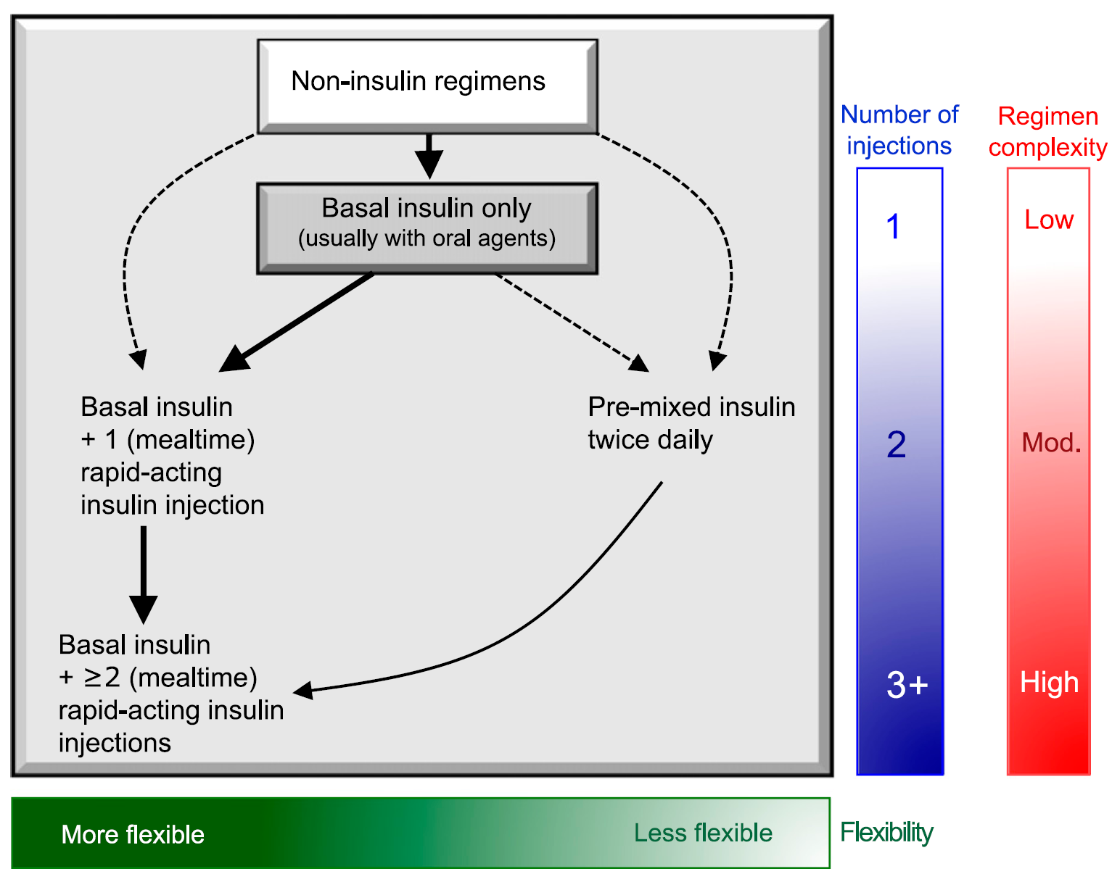

Sequential Insulin Strategies in T₂DM
Basal insulin alone is usually the optimal initial regimen, beginning at 0.1–0.2 units/kg
Usually in conjunction with one to two noninsulin agents

Slide 15
Treating fasting hyperglycaemia lowers the entire 24-hour plasma glucose profile
400
20
300
T2DM
15
200
Hyperglycaemia due to an increase in fasting glucose
Plasma glucose (mmol/l)
Plasma glucose (mg/dl)
10
100
5
Normal
0
Meal
Meal
Meal
0
06.00
10.00
14.00
18.00
22.00
02.00
06.00
Time of day (hours)
Notes:
In patients with T2DM, excess exposure to hyperglycaemia is due to an increase in fasting plasma glucose concentrations.
Specifically targeting fasting hyperglycaemia will therefore lower the entire
24-hour plasma glucose profile and should be a primary aim of therapy.
Hirsch I, et al. Clin Diabetes 2005;23:78–86.

Slide 16
Contribution of Postprandial Hyperglycemia increases as HbA_{1c} nears target
70
60
50
Postprandial
40
Relative contribution
of FBG vs PPBG (%)
Fasting
30
20
10
0
>10.2
9.3–10.2
8.5–9.2
7.3–8.4
<7.3
HbA_{1c} (%)
Adapted from Monnier L, et al. Diabetes Care 2003;26:881–5.
Notes:
This study analysed the diurnal glycaemic profiles of 290 patients with T2DM at different HbA_{1c} levels who were treated with diet or OHAs.¹
Blood-glucose concentrations were determined during fasting and postprandial and post-absorptive periods.
The areas under the curve above FBG concentrations and >6.1 mmol/l (110 mg/dl) were calculated for further evaluation of the relative contributions of postprandial and FBG increments to overall diurnal hyperglycaemia.
The value of 6.1 mmol/l (110 mg/dl) was chosen because this threshold had been defined by the ADA as the upper limit of normal blood glucose at fasting or preprandial times.² The data were compared over quintiles of HbA_{1c}.
The main contributor to overall hyperglycaemia in patients with poorly controlled T2DM was found to be fasting hyperglycaemia. Fasting hyperglycaemia was the dominant factor in patients who were furthest from achieving target HbA_{1c}.
References
Monnier L, et al. Diabetes Care 2003;26:881–5.
ADA. Diabetes Care 2002;25(suppl 1):S5–20.

Slide 17
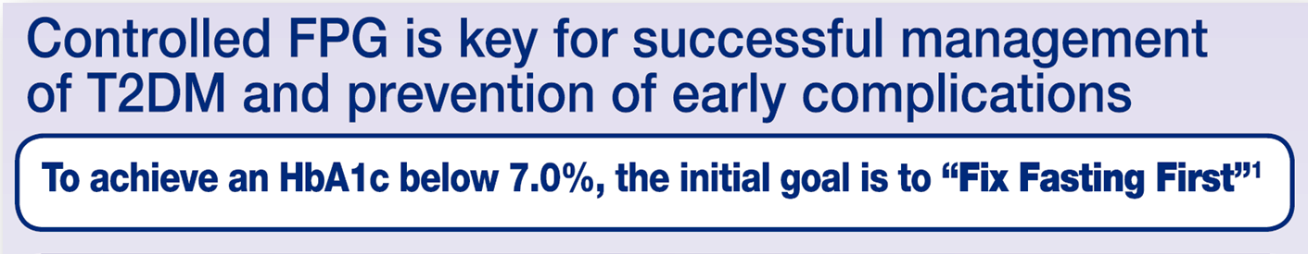


Slide 18
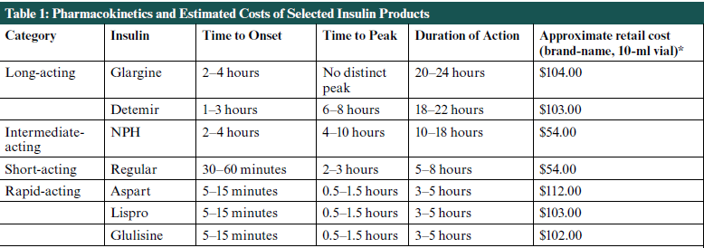

Slide 19
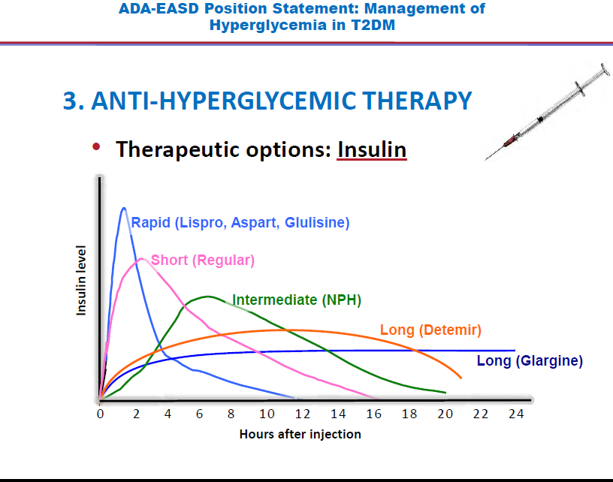

Slide 20
Transitions To and Titrations of Insulin
Downward adjustment is advisable if any hypoglycemia occurs.
During self-titration, frequent contact (telephone, e-mail) with the clinician may be necessary.
After the insulin dose is stabilized, the frequency of monitoring should be reviewed.

Slide 21
Transitions To and Titrations of Insulin
Basal insulin is titrated primarily against FPG, generally irrespective of the total dose.
Be aware that the need for prandial insulin therapy will become likely the more the daily dose exceeds 0.5 U kg/day, especially as it approaches 1 U kg/day.

Slide 22

For most patients basal insulin analogs, the average insulin dose is <50 U/d.
Targeting FBG levels first will solve most glycemic control problems in patients with T2DM
if HbA1c levels are still in excess of 8.5%, reductions in both FBG levels and postprandial glucose levels may be required to achieve the glycemic goal.

Slide 23
Starting Basal Insulin:Fix the Fasting First
“Overbasalization”: Too Much Basal
Insulin, Too Little Effect

Slide 24
Overbasalization occurs when FBG is not controlled with up-titration of basal insulin and HbA1c targets remain elusive.
Providers must understand the concept of overbasalization because it should trigger progression to mealtime insulin intensification in patients.

Slide 25
Maximal amounts of basal insulin can be achieved but should not comprise more than 50% of the total daily insulin calculation.
Violating 50/50 rule may lead to overbasalization.
At this point, administering additional basal insulin may change the pharmacokinetics of the basal insulin from having a profile without pronounced peaks of activity to a profile with an insulin peak

Slide 26
Please consider !
Basal Plus /Basal Bolus (Pre-Mix insulin ?)when HbA1C >8.5%,since these patients need insulin cover for their FPG as well as PPG .

Slide 27
Sequential Insulin Strategies in T₂DM
When basal insulin has been titrated to an acceptable FPG but HbA_{1c} remains above target, consider proceeding to basal plus mealtime insulin.

Slide 28
Transitions To and Titrations of Insulin
Add prandial or mealtime insulin when significant postprandial glucose excursions (>180 mg/dL) occur.
This is suggested when FPG is at target but the HbA1c remains above goal after 3 months of basal insulin titration.
The same would apply if large drops in glucose occur during overnight hours or in between meals, as the basal insulin dose is increased.
  In this scenario, the basal insulin dose would obviously need to be simultaneously decreased as prandial insulin is initiated.

Slide 29
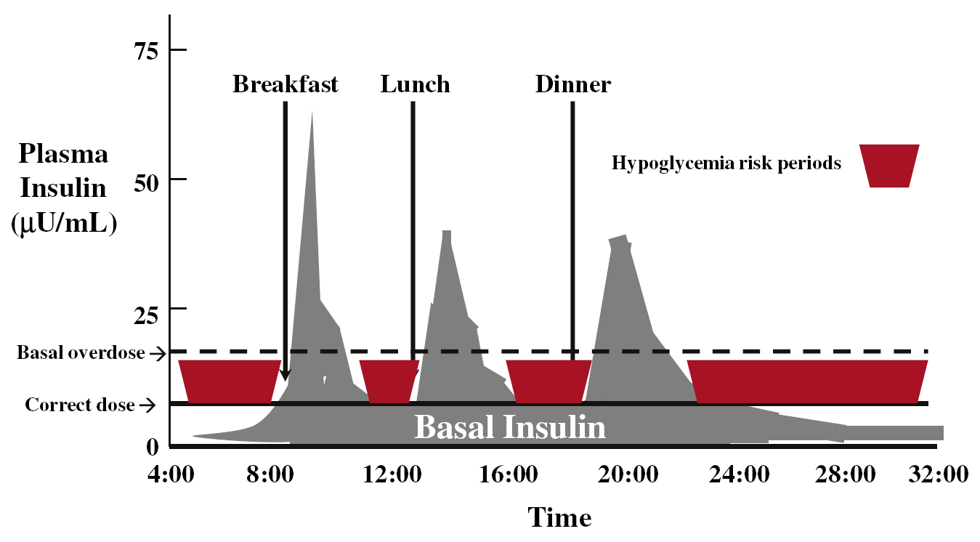
Basal Insulin Overtreatment
Anthony L. McCall. Endocrinol Metab Clin N Am 2012; 41:57–87.

Slide 30
Timing of Largest PPG Excursion Varies Between Individuals
216
12
Breakfast
Evening meal
Meal pattern 1
180
10
Meal pattern 2
8
144
Plasma glucose (mmol/l)
Plasma glucose (mg/dl)
108
6
72
4
08:00
12:00
16:00
20:00
24:00
04:00
08:00
Time of day (hours)
Monnier L, et al. Diabetes Care 2002; 25:737–41.
Notes:
This hypothetical graph shows that postprandial peaks may occur following breakfast or after an evening meal in patients with T2DM. The meal that induces the greatest PPBG excursion varies according to the individual and their meal patterns.¹
This variation may also be due to differences between eating habits in different countries.²
References
1. Monnier L, et al. Diabetes Care 2002;25:737–41.
2. Monnier L, Colette C. Diabetes Metab 2006;32:7–13.

Slide 31
NHANES III: daily meal patterns do not match the recommended 3 well-balanced meals
The National Health and Nutrition Survey
(n=15,978 US adults)
35
B=Breakfast
L=Lunch
D=Dinner
30
25
20
Population (%)
15
10
5
0
B, L, D +
≥2 snacks
B, L, D +
1 snack
B, D +
≥2 snacks
B, L, D
L, D +
≥2 snacks
Meal pattern
Day-to-day meal patterns vary among individuals
Kerver J, et al. J Am Diet Assoc 2006; 106:46–53.
Notes:
This study included data from the NHANES study of 15,978 US adults aged 20 years or older.
Meal patterns were categorised based on the five most common meal and snack combinations.
The highest percentage of individuals (31.6%) reported three meals per day plus two or more snacks.
Meal patterns may also vary depending on the age and ethnicity of the individual. Thus, insulin therapy should be flexible and tailored to individual needs and lifestyle.
Reference
Kerver J, et al. J Am Diet Assoc 2006;106:46–53.

Slide 32
Meal Patterns Vary Among Patients With T₂DM
Few people eat three consistent meals with limited extra snacks.
Many people eat one main meal.
Meal patterns vary from day to day.
Differences in physiology define blood glucose response to meals.
Therefore, the same inflexible insulin regimens applied to all individuals are often ineffective.

Slide 33
OPAL: the 1st study supporting the Basal Plus approach
Addition of 1x insulin glulisine
significantly improves glycaemic control
Baseline
Study end
(Week 26)
Insulin glargine dose (IU)
30
31
FPG (mg/dl)
125
125
Insulin glulisine dose (IU)
−
11
HbA_{1c} (%)
7.4
7.0
*Interim analysis of 158 individuals from all subgroups
Lankisch M, et al. Diabetes 2006; 55(suppl). Abstract 514-P.
Notes:
This study enrolled 158 patients with T2DM who were well titrated with insulin glargine (FBG <6.7 mmol/l [<120 mg/dl]), yet with unsatisfactory HbA_{1c} values (>6.5–≤9.0%).
Patients were stratified according to the predominant meal, as determined by the highest postprandial blood-glucose value, and then randomised to receive insulin glulisine at either breakfast or the predominant meal. OHAs remained unchanged during the study. Interim analysis showed that mean HbA_{1c} was reduced from 7.4% at baseline to 7.0% at 26 weeks, with 26% of patients achieving a mean HbA_{1c} of ≤ 6.5% and FBG remained at target levels.
The mean daily dose of insulin glargine did not change during the study, whereas the mean daily dose of insulin glulisine increased from 5 to 11 IU.
Reference
Lankisch M, et al. Diabetes 2006;55(suppl). Abstract 514-P.

Slide 34
Transitions To and Titrations of Insulin
The most precise and flexible prandial coverage is possible with “basal-plus/bolus” therapy.
Add prandial insulin before the meal responsible for the largest glucose excursion- typically that with the greatest carbohydrate content, often, but not always, the evening meal.
Subsequently, a second injection can be administered before the meal with the next largest excursion (often breakfast).
Ultimately, a third injection may be added before the smallest meal (often lunch).

Slide 35

The most precise and flexible prandial coverage is possible with “basal-plus/bolus” therapy
FPG above target
HbA_{1c} above target
Basal bolus Basal +
3 prandial
Basal plus
Basal +
2 prandial
HbA_{1c} above target
Basal plus
Basal +
1 prandial
Basal insulin
once daily
(treat-to-target)
± 2nd/3rd
Drug
Lifestyle
±
Metformin
HbA_{1c} > target, FBG on target
PPG ≥180 mg/dL
HbA_{1c} > target
Progressive deterioration of β-cell function
Adapted from Raccah et al. Diabetes Metab Res Rev 2007; 23:257.

Slide 36
Types of short and rapid actingInsulin
Insulin Type (trade name) | Onset | Peak | Duration
Bolus (prandial) Insulins
Rapid-acting insulin analogues (clear): Insulin aspart (NovoRapid®) Insulin glulisine (Apidra™) Insulin lispro (Humalog®) | 10 - 15 min 10 - 15 min 10 - 15 min | 1 - 1.5 h 1 - 1.5 h 1 - 2 h | 3 - 5 h 3 - 5 h 3.5 - 4.75 h
Short-acting insulins (clear): Insulin regular (Humulin®-R) ) | 30 min | 2 - 3 h | 6.5 h
Notes:
Insulin preparations are formulated as either structurally identical to human insulin or as modifications of human insulin (insulin analogues) to alter their pharmacokinetics. As shown in this slide, insulin preparations are further classified according to their duration of action, their time of onset and their peak actions.
Basal and bolus insulin protocols attempt to duplicate normal pancreatic insulin secretion. Basal insulin is provided by an intermediate-acting insulin or a long-acting insulin analogue given once- or twice-daily. Intermediate-acting insulin has an onset of action of 1-3 hours, with peak action occurring at 5-8 hours, and a duration of action of up to 18 hours. Long-acting insulin analogues have an onset of action of 90 minutes and duration of action of up to 24 hours.
Insulins available for prandial coverage (bolus insulins) include regular insulin (defined as short-acting) and the rapid-acting insulin analogues (insulin aspart, glulisine, and lispro). The rapid-acting analogues allow for a closer approximation to normal physiological insulin secretion. They are absorbed more rapidly than regular insulin, leading to a more rapid onset of action (10–15 minutes) and peak action (about 1-2 hours), and a shorter duration of action (3–5 hours). Their rapid onset of action allows them to be given just before meals (i.e., within 15 minutes). The dose of bolus insulins should take into account exercise around mealtime as well as the carbohydrate content and glycemic index of the carbohydrates consumed at each meal.
It is important to match these insulin regimens to the individual needs, concerns, and capabilities of each patient.
Reference:
CDA Clinical Practice Guidelines Expert Committee. Canadian Diabetes Association 2008 clinical practice guidelines for the prevention and management of diabetes in Canada. Can J Diabetes 2008;32(Suppl 1):S1-S201.

Slide 37
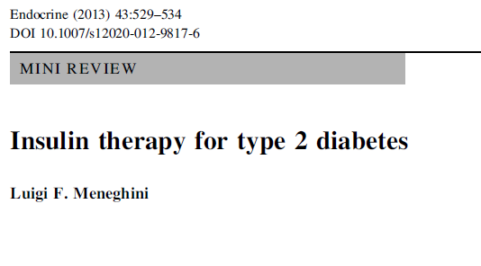
In controlled clinical trial settings, the difference in clinical outcomes between regular insulin and analog preparations is modest at best.

Slide 38
Sequential Insulin Strategies in T2DM
Noninsulin agents may be continued, although insulin secretagogues (sulfonylureas, meglitinides) are typically stopped once more complex regimens beyond basal insulin are utilized.

Slide 39
Sequential Insulin Strategies in T2DM
In patients willing to take > 1 injection and who have higher Hb_{A1c} levels (≥ 9.0%), twice daily premixed insulin or a more advanced basal plus mealtime insulin regimen could also be considered.

Slide 40
Prandial excursions are evident in all patients with T2DM
500
27.8
T2DM with very
elevated blood glucose
400
22.2
300
16.7
Blood glucose (mg/dl)
T2DM with slightly
elevated blood glucose
Blood glucose (mmol/l)
200
11.1
100
5.5
Non-diabetic pattern
0
08:00
10:00
12:00
14:00
16:00
18:00
20:00
22:00
24:00
02:00
04:00
06:00
08:00
Time of day (hours)
Reaven GM, et al. Diabetes 1988;37:1020–24.
Notes:
The curves on the graph show the 24-hour blood glucose profiles for non-diabetic individuals and those with mild and severe T2DM.
The area between the curves highlights the excess glycaemic excursion after meals and an increase in fasting glycaemia.
The aim of treatment for T2DM is to lower the entire 24-hour plasma glucose profile as close as possible to the profile of a healthy individual.
Reference
Reaven GM, et al. Diabetes 1988;37:1020–24.

Slide 41
Sequential Insulin Strategies in T2DM
A less studied alternative-progression from basal insulin to a twice-daily premixed insulin could be also considered

Slide 42
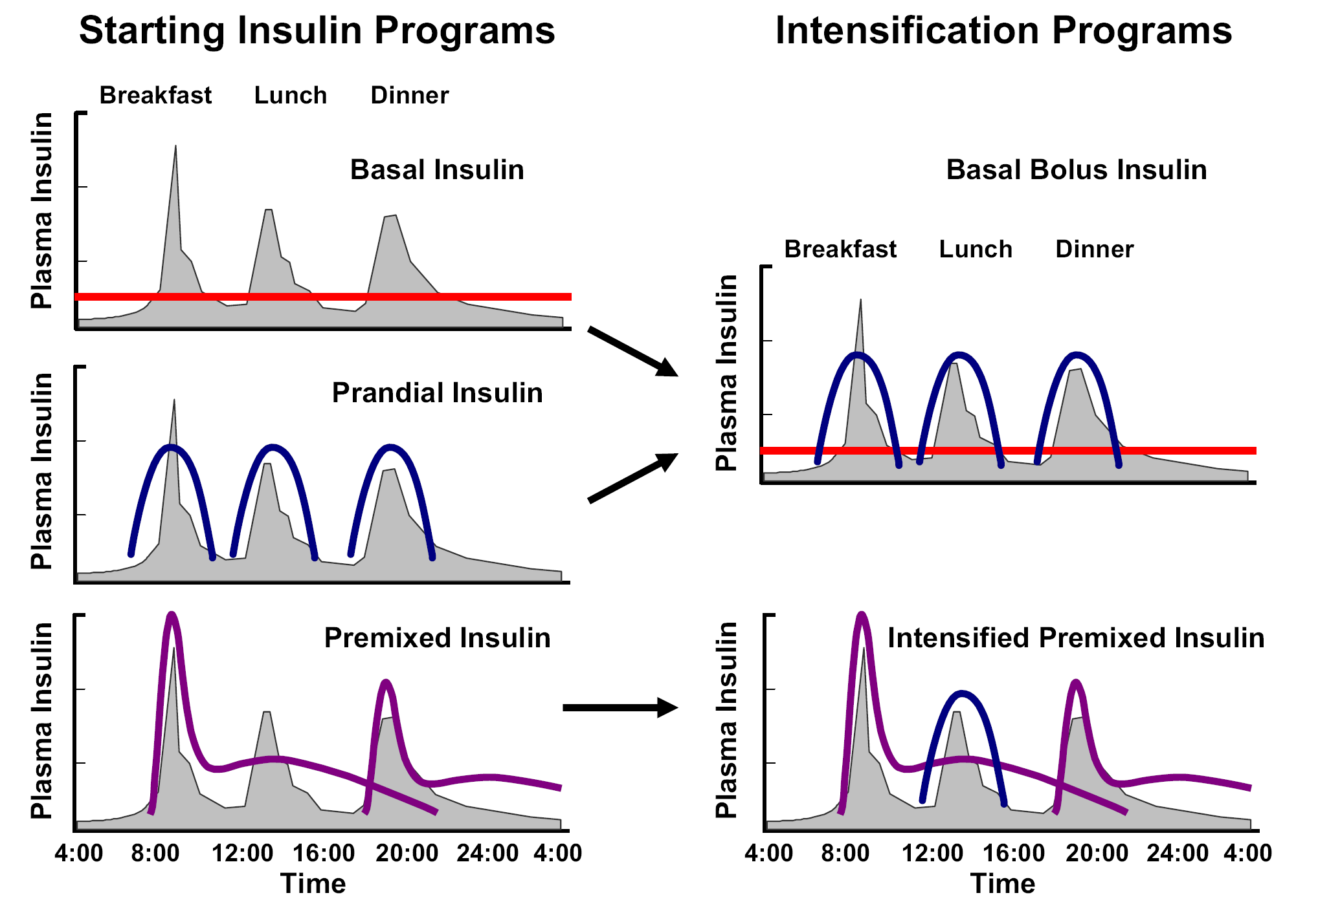
Insulin Intensification Programs for T2DM
Anthony L. McCall. Endocrinol Metab Clin N Am 2012; 41:57–87.

Slide 43
Transitions To and Titrations of Insulin
Perhaps more convenient but less adaptable method involves “premixed” insulin.
Traditionally, administered twice daily, before morning and evening meals
In comparison with basal insulin alone, premixed regimens tend to lower HbA1c to a larger degree, but often at the expense of slightly more hypoglycemia and weight gain.

Slide 44
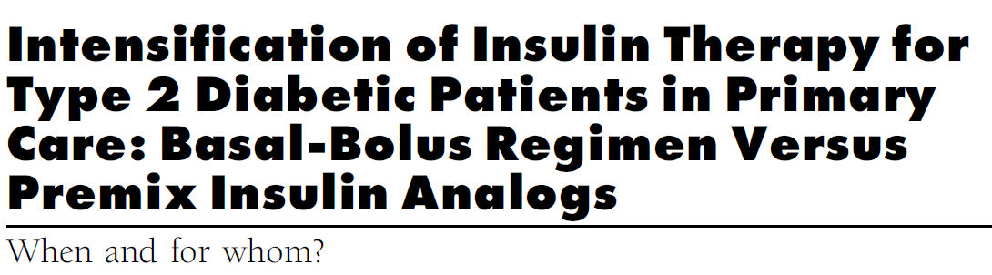
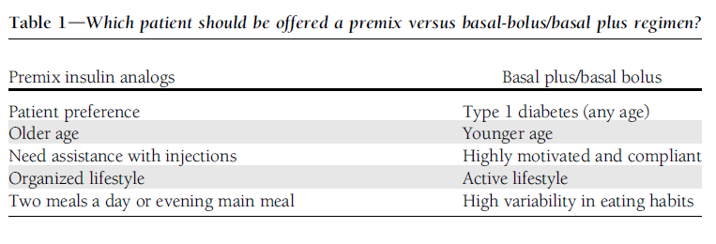
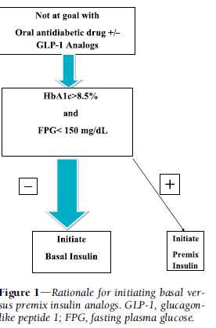

Slide 45
CASE;
A 70-year-old Iranain female. Clinical Presentation: presents to the office, with her daughter, for a follow-up visit after routine blood work 2 weeks earlier showed a progressively increasing HbA1C level.
she doesn’t take her diabetes medication every day, because at times it makes her feel “shaky.” She is trying to follow a low-salt, low-carbohydrate diet, as stated by her daughter.

Slide 46
Case
: Diagnosed 10 years ago, Hypertension: Hyperlipidemia:, Chronic renal insufficiency, Congestive heart failure ,Diabetic retinopathy:
Social History: The patient has been a widow for 10 years and lives with her daughter because her “memory is not as good as it used to be” and she has poor vision due to diabetic retinopathy.. The patient does not eat much during the day while her daughter is at work, because she doesn’t like to cook. However, the daughter states that she eats well at dinner

Slide 47
case
Patient complains of dyspnea with exertion. BMI: 21.6 kg/m2 ,Lungs:
+ Fine crackles in bases bilaterally.
Metoprolol 50 mg daily, Glibenclamide 10 mg daily, Acarbose 100 mg/ daily ,Lisinopril 20 mg daily ,Furosemide 60 mg daily ,Atorvastatin 20 mg daily,Aspirin 81 mg daily,HbA1C:9.5%l, FPG 119mg/dl, Creatinin 2 mg/dl, LFT , Lipid and CBC OK

Slide 48
case
What A1C goal would you recommend for this patient?
1-< 6.0%
2-< 6.5%
3-<7%
4-<8%
5-<9%

Slide 49
case3
Please review the following and indicate which regimen changes you are likely to implement in order to improve this patient’s glycemic control while minimizing her risk of hypoglycemia.
1-Add pioglitazone
2-Add basal insulin at bedtime
3-Add basal-bolus therapy
4-Add biphasic insulin
5-Stop SU therapy
1, and either 2 or 4
1, and either 3 or 4
Either 2 or 4, and 5
Either 3 or 4, and 5

Slide 50
Sequential Insulin Strategies in T2DM
A less studied alternative-progression from basal insulin to a twice-daily premixed insulin could be also considered.
If this is unsuccessful, move to basal plus mealtime insulin

Slide 51
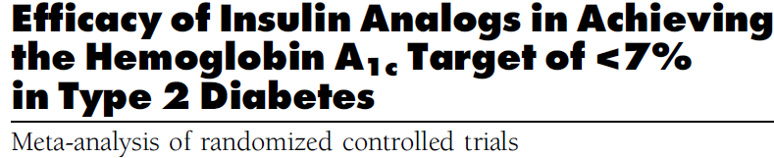
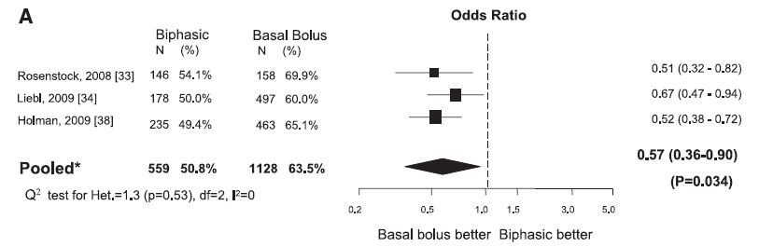

Slide 52
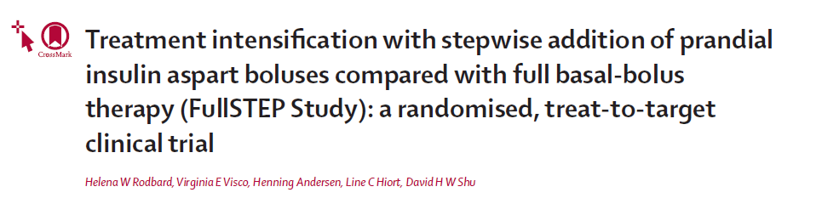
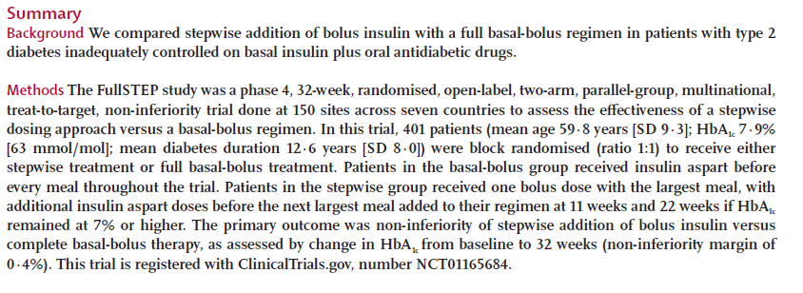
L

Slide 53
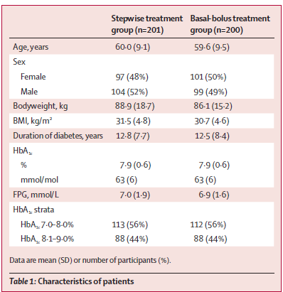
Full STEP LANCET 2014

Slide 54
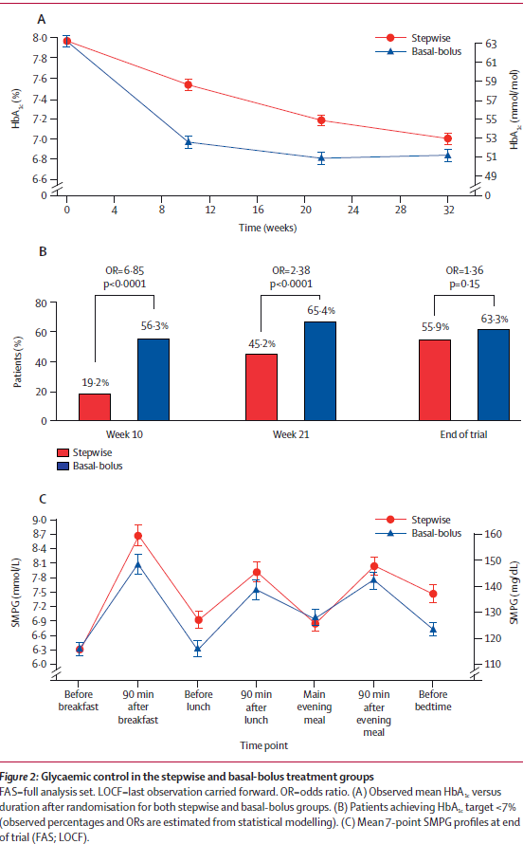

Slide 55
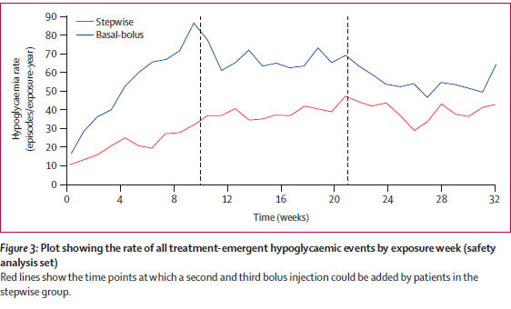

Slide 56
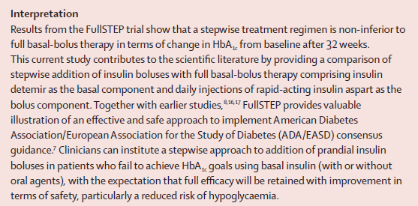

Slide 57
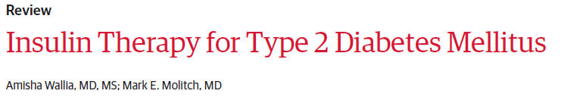

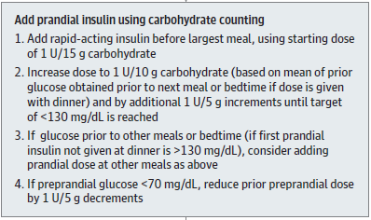

Slide 58

Insulin bolus dose adjustment
Insulin-Carbohydrate ratio (ICR):
It calculates how much bolus units are required for each unit of carbohydrate.
ICR= Total daily dose (TDD) ÷ 30
Example: TDD=60, ICR = 60 ÷ 30 = 2
It means that each unit of carbohydrate requires 2 units of regular insulin

Slide 59
Insulin Sensitivity Factor (ISF)
Calculates how much blood glucose decreases for each unite of bolus insulin
ISF (For human insulin)= 1500 ÷ TDD
ISF (For analogue insulin)= 1800 ÷ TDD
Example: TDD= 50 (human insulin), ISF = 1500 ÷ 50 = 30
It means that each unit of bolus decreases blood glucose by 30 mg/dl By regular insulin and 36mg/dl by Analogue insulin

Slide 60
Bolus dose calculation
Carbohydrate counting of the meal:
Number of units of carbohydrate in the meal × ICR
Example: 10 spoon of rice + 1 apple = 3 units of carbohydrate, ICR = 2.
Bolus dose required for the meal = 3 × 2 = 6 units

Slide 61
Pre-prandial blood glucose
Correction dose = Pre-prandial glucose – desired blood glucose ÷ ISF
Example: Pre-prandial glucose 230, correction dose= 230 – 130 ÷ 50 = 2
It means that 2 units of bolus are required to correct pre-parandial hyperglycemia
Total number of bolus = 6 + 2 = 8 units

Slide 62
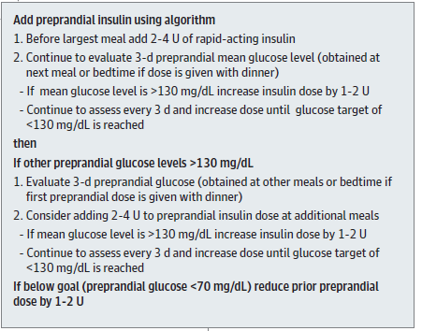

Slide 63
Initiation & titration of prandial insulin
When prandial insulin is started, insulin secretagogues (SU or glinides) should be discontinued
Nathan DM, et al. Diabetes Care 2009;32 193-203.
Notes:
63
Key Point
For the second injection, physicians can begin with approximately 4 units of insulin and adjust by 2 units every 3 days until blood glucose is in range.
Reference:
Nathan DM et al. Management of hyperglycemia in type 2 diabetes: a consensus
algorithm for the initiation and adjustment of therapy. Diabetes Care 2006;29(8):1963-72.

Slide 64
After 2-3 months…
If HbA_{1c} is <7%
  Continue regimen and check HbA_{1c} every 3 months
If HbA_{1c} is ≥7%
  Recheck pre-meal blood glucose
  If premeal blood glucose is out of range, continue to intensify insulin therapy with introduction of a second injection of prandial insulin
Nathan DM, et al. Diabetes Care 2009;32 193-203.
Notes:
64
Key Points
Again, HbA_{1c} should be re-checked within 2 to 3 months.
If it is below 7%, the current regimen should be continued with re-evaluation of HbA_{1c} levels every 3 months.
If it is 7% or higher, physicians should move to next step
Reference:
Nathan DM et al. Management of hyperglycemia in type 2 diabetes: a consensus
algorithm for the initiation and adjustment of therapy. Diabetes Care 2006;29(8):1963-72.

Slide 65
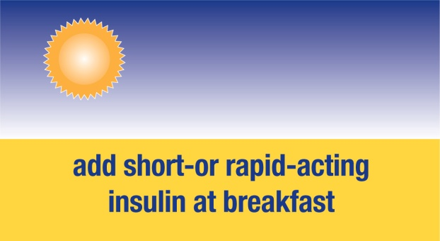
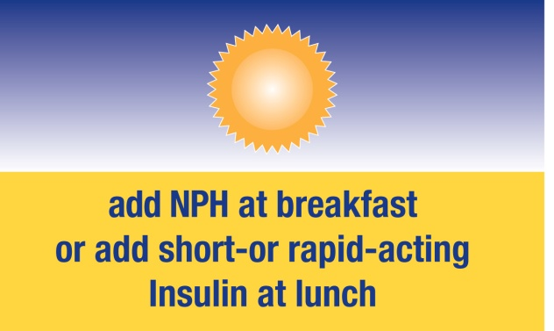
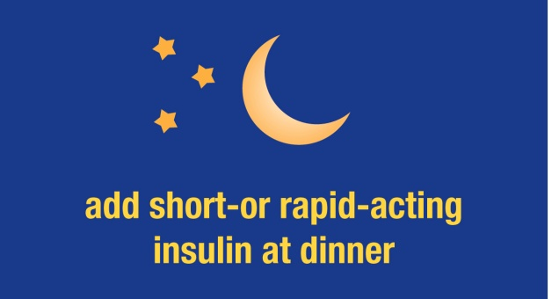
Intensify insulin if HbA_{1c} is still ≥7%
ADA/EASD recommend the stepwise addition of prandial insulin to intensify a basal insulin regimen
If fasting blood glucose (FBG) levels are in target range but HbA_{1c} ≥7%, check blood glucose before lunch, dinner, and bedtime and
add
If pre-lunch blood glucose is out of range...
or
If pre-dinner blood glucose is out of range...
or
If pre-bed blood glucose is out of range...
Nathan DM, et al. Diabetes Care 2009;32 193-203.
Notes:
Insulin therapy should be intensified if HbA_{1c} levels are ≥ 7% after 2–3 months or if the fasting blood glucose level is within target but overall glycemic control is still inadequate. In such cases, prandial insulin may be required and pre-meal blood glucose levels should be checked. If mealtime insulin is required, then it should be added at a dose of approximately 4 units per day and adjusted by 2 units every 3 days until pre-meal blood glucose values are within range. If HbA_{1c} levels are still ≥ 7% after 3 months, then another injection may be required and, ultimately, 2-hour post-prandial glucose levels should be checked and the prandial rapid-acting insulin dose adjusted. HbA_{1c} levels should continue to be checked every 3 months, even when patients are at target levels.

Slide 66
Basal Bolus therapy delivers comparable good efficacy whatever the titration algorithm used
3.1 3502 (CHO) study
Subjects:
273 insulin treated with poorly controlled type 2 diabetes
(HbA_{1c} 7–10%)
Receiving ≥2 insulin injections/day for ≥3 months, about one third were receiving metformin (continued at same dose)
Mean baseline values:
HbA_{1c} (%): 8.2
BMI (kg/m²): 36.0
Diabetes duration (years): 13.0
Insulin glargine + insulin glulisine three times daily; dose adjustments by simple algorithm (n=136)
Insulin glargine + insulin glulisine three times daily; dose adjustments by CHO counting (n=137)
Randomization
24 weeks
Bergenstal RM, et al. Diabetes Care 2008;31:1305–10
Notes:
The aim of the carbohydrate (CHO) counting study was to look at obese T2D subjects receiving once daily glargine and mealtime glulisine and compare the effects of insulin dose adjustment using a simple BG-based method with a more complex dose adjustment algorithm based upon carbohydrate counting.
This open-label, multicenter US trial treated 273 subjects for 24 weeks (simple dose adjustment group n=136, carbohydrate counting group n=137). Subjects had been receiving ≥2 insulin injections/day for ≥3 months (36% 2 injections/day, 64% >2 injections/day (study entry, 37% using glargine and ≥1 injection of a rapid-acting insulin analogue (36% on premixed, with the remainder on other regimens).
All subjects received glargine and mealtime glulisine. The FBG target was 95 mg/dl, and the preprandial FBG target was 130 mg/dl (before lunch and dinner).
All subjects received 50% of their daily insulin as glargine, and 50% as glulisine. The glulisine dose was split over three meals: 50% for the largest (most carbohydrate) meal, 33% for the middle-sized meal, and 17% for the smallest meal.
Bergenstal RM, et al. Diabetes Care 2008;31:1305-10

Slide 67
Basal Bolus therapy delivers comparable good efficacy whatever the titration algorithm used
3.1 3502 (CHO) study
100
8.5
p=NS
8.16
Simple algorithm
CHO counting
80
8.0
8.16
60
73
69
7.5
% achieving HbA_{1c} <7.0
HbA_{1c} (%)
40
7.0
ADA/EASD target
6.70
20
6.5
6.54
0
p=NS
6.0
Simple
algorithm
CHO
counting
Baseline
2
6
12
18
Endpoint
Weeks
Bergenstal RM, et al. Diabetes Care 2008;31:1305–10
Notes:
At study start, glargine dose was calculated to provide 50% of patients’ total daily insulin dose before randomization: glargine was titrated weekly using the mean of the last 3 days’ fasting SMBG (below).
3 day FPG (mg/dl) Dose adjustment
>180 Increase 8 U
140-180 Increase 6 U
120-139 Increase 4 U
95-119 Increase 2 U
70-94 No change
<70 Decrease based upon glulisine dose, or by up to 10% of glargine dose
The remaining 50% of patients’ total daily pre-randomization insulin was given as glulisine, adjusted weekly based on prelunch/dinner and bedtime BG patterns from the previous week as below:
Mealtime dose Mealtime BG <target Mealtime BG >target
≤10 units Decrease by 1 unit Increase by 1 unit
>11–19 units Decrease by 2 units Increase by 2 units
≥20 units Decrease by 3 units Increase by 3 units
Mealtime dose Mealtime BG <target Mealtime BG >target
1 unit/20 g Decrease to 1 unit/25 g Increase to 1 unit/15 g
1 unit/15 g Decrease to 1 unit/20 g Increase to 1 unit/10 g
1 unit/10 g Decrease to 1 unit/15 g Increase to 2 units/15 g
2 units/15 g Decrease to 1 unit/10 g Increase to 3 units/15 g
3 units/15 g Decrease to 2 units/15 g Increase to 4 units/15 g
Dose adjustments in the CHO group were based upon insulin-to-carbohydrate ratio.
Three daily doses of glulisine added to once daily glargine provides good HbA_{1c} control in subjects with late-stage T2D, and efficacy is unaffected by the dose adjustment algorithm used.
Bergenstal RM, et al. Diabetes Care 2008;31:1305-10
Glulisine dosing
CHO group
Glulisine dosing SMBG group

Slide 68
The Basal Bolus strategy is safe and associated with acceptable weight gain
3.1 3502 (CHO) study
p=NS
p=0.02
p=NS
4
8
1.0
8.0
3.6
0.8
0.89
3
6
0.6
0.67
BG <50 mg/dL with symptoms
(event/patient-year)
Severe hypo
(event/patient-year)
Mean body weight change
from baseline (kg)
2.4
4.9
2
4
0.4
1
2
0.2
0
0
0.0
Simple
algorithm
CHO
counting
Simple
algorithm
CHO
counting
Simple
algorithm
CHO
counting
Bergenstal RM, et al. Diabetes Care 2008;31:1305–10
Notes:
There was no significant difference between the simple algorithm group and the carbohydrate counting group in mean body weight change from baseline (3.6kg and 2.4kg, respectively).
The rate of symptomatic hypoglycemia (BG <50 mg/dL) was significantly higher in the carbohydrate counting group than the simple algorithm group (8.0 vs. 4.9 events/patient-year; p=0.02). However, severe hypoglycemia rates were similar (0.89 events/patient-year simple group; 0.67 events/patient-year carbohydrate group).
At baseline, the mean glargine and glulisine doses were 53.9 U each in the simple algorithm and 50.5 U each in the CHO counting group. At week 24, the mean doses of glargine and glulisine in the simple algorithm group were 102.5 and 108.7 U, respectively and 86.4 and 88.9 U, respectively in CHO counting group.
The total insulin dose at week 24 was 1.9 U/kg in the simple algorithm group, and 1.7 U/kg in the CHO counting group.
The Basal Bolus strategy is safe and is associated with an acceptable level of weight gain.
Bergenstal RM, et al. Diabetes Care 2008;31:1305-10

Slide 69
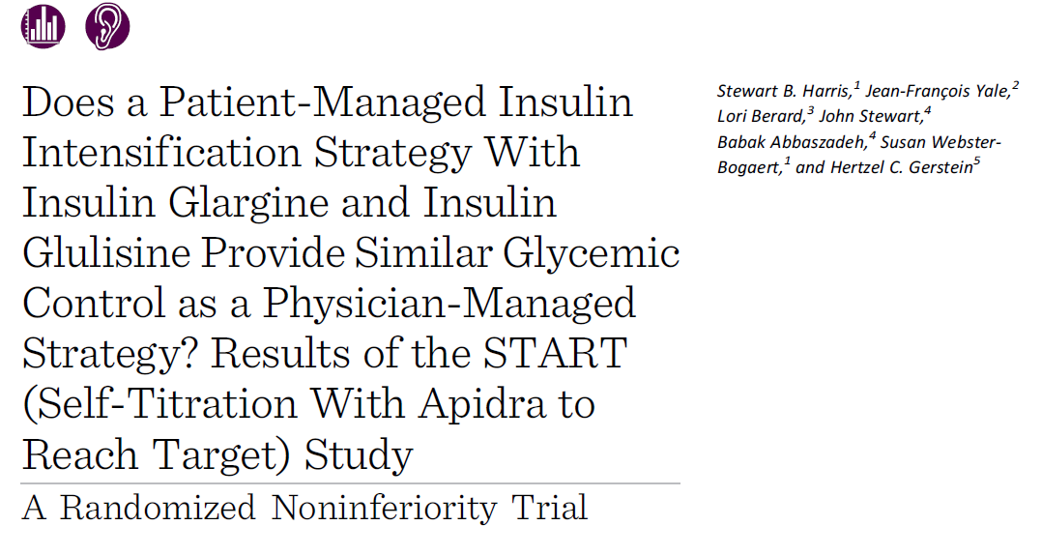

Slide 70
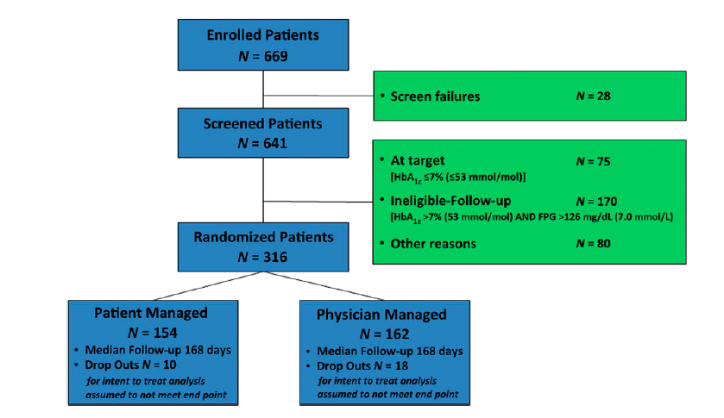

Slide 71

Those randomized to the patient managed arm received a pamphlet explaining the self-titration method.
The starting dose of glulisine was 2 units, and they were instructed to self-titrate 1 unit/day to reach a target 2-h PPG level between 90 and 144 mg/d. The PPG was measured 2 h after the start of breakfast. Once the target was attained, the maintenance dose was based on the monitoring of two or three 2-h PPGs per week.
Those randomized to the physician managed arm had a starting dose of insulin glulisine of 2 units recommended to the physicians, but this dose, and the titration and self-monitoring of blood glucose schedules, were left to the physicians’ discretion.
Patients in this arm were required to contact their physician prior to any dose adjustment

Slide 72
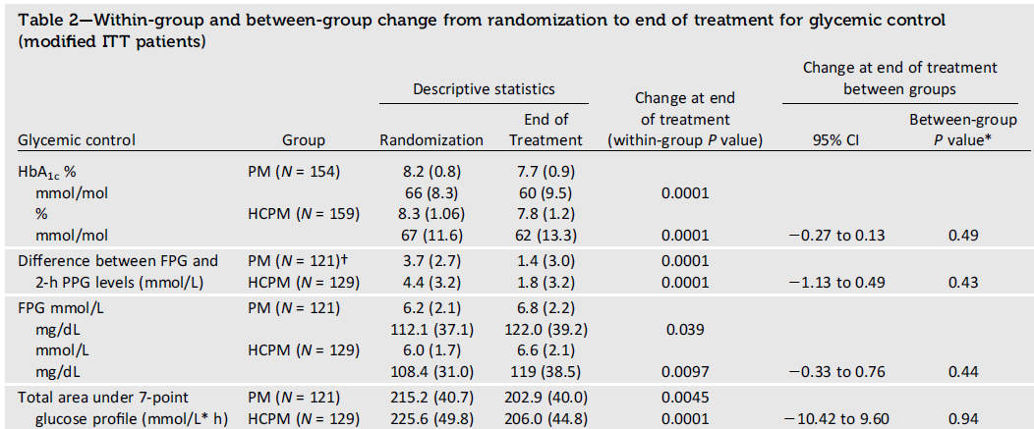

Slide 73
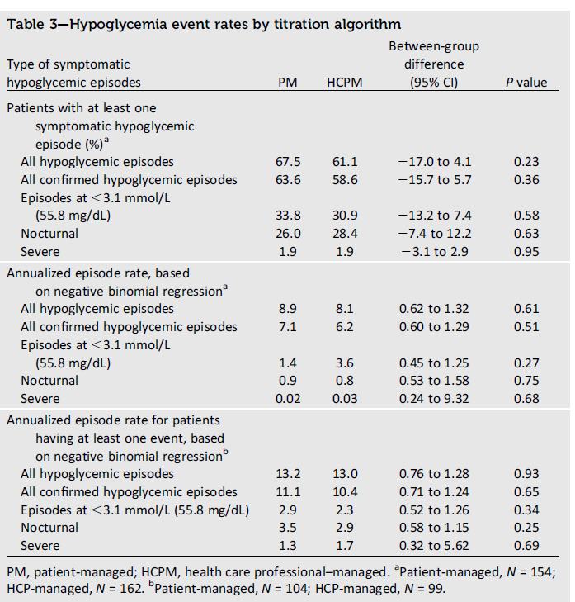

Slide 75
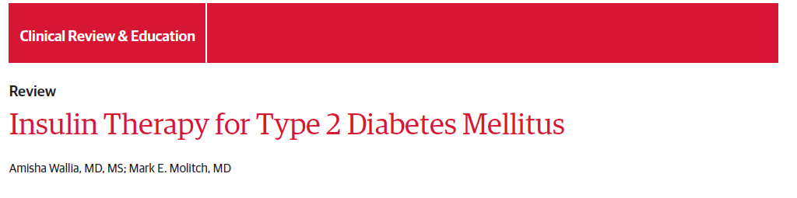
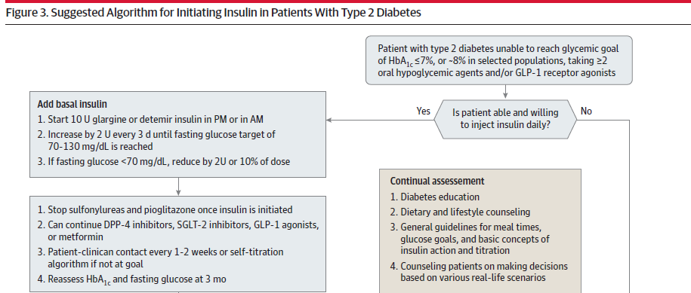

Slide 76
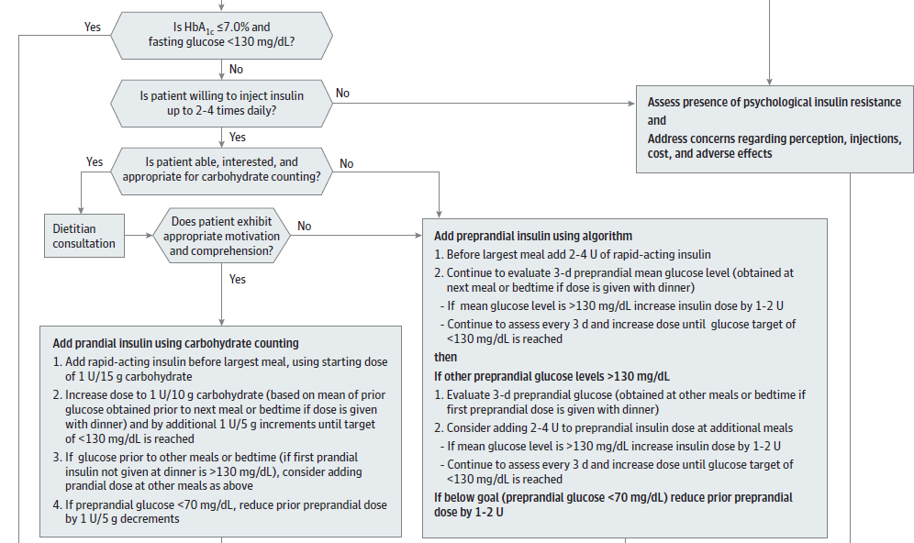

Slide 77
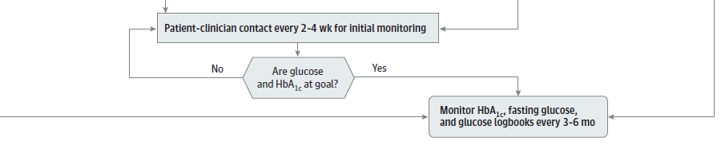

Slide 78
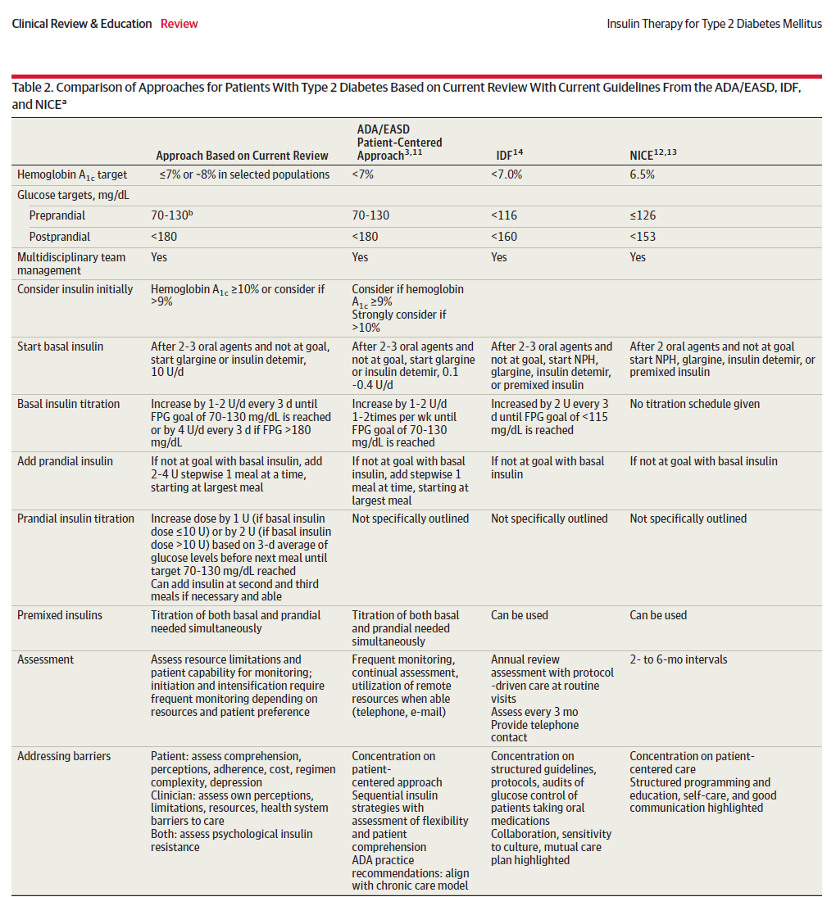

Slide 79
Important Practical Questions
Pitfalls
Education:
  structured program, experienced educators
    Gabric Diabetes Education Association: +98 21 82433
    Iran Diabetes Society: +98 21 8827 5274
  Discuss the fundamental principals in each visit
    Supervise self-adjustments
Importance of SMBG
    Have a contact with the patient to assess SMBG chart
Lantus: how many times daily?
Which prandial insulin: Aspart vs. Regular
  Ease of use, Hypos, Eating habits, SMBG chart review

Slide 80
Key Message
Individualization of therapy is key, incorporating the degree of hyperglycemia needing to be addressed and the overall capacities of the patient.

Slide 81
Conclusion- 1
Any insulin will lower glucose and HbA1c.
No insulin is working by itself alone
All insulins are associated with some weight gain and some risk of hypoglycemia.
Effective dose titration is required to optimise insulin therapy.
  First, Basal insulin and after that, the Prandials.
Long-acting insulin analogs reduce the incidence of overnight hypoglycemia, and rapid-acting insulin analogs reduce postprandial glucose excursions as compared with corresponding human insulins (NPH, Regular).
  They generally do not result in clinically significantly lower HbA1c.

Slide 82
Conclusion- 2
Metformin is often continued when basal insulin is added; less weight gain
Insulin secretagogues do not seem to provide for additional HbA1c reduction or prevention of hypoglycemia or weight gain after insulin is started.
When basal insulin is used, continuing the secretagogue may minimize initial deterioration of glycemic control.
Insulin secretagogues should be avoided once prandial insulin regimens are employed.

Slide 83
Conclusion- 3
TZDs should be reduced in dose (or stopped) to avoid edema and excessive weight gain
Although in certain individuals with large insulin requirements from severe insulin resistance, these insulin sensitizers may be very helpful in lowering HbA1c and minimizing the required insulin dose.

Slide 84
Points to remember: A new sense of urgency
The last not the least:
Early intervention
Patient’s empowerment
  Education, SMBG, treatment adjustment
Shorten delays in treatment changes
Achieve and maintain normal glycemic goals
Add medications, transition to new regimens quickly
  Whenever HbA_{1c} out of target
Nathan DM, et al. Diabetes Care 2009;32 193-203.

Slide 85
So, why not to do!
Start Insulin At The Right Time!
Adjust
&
Follow!

Slide 86

Thanks for your patience,
dear colleagues!

