Slide 1
in the name of god

Slide 2
PI
The patient is a 35 years old women who worked up with hypercalcemia and hypophoaphatemia since 2 years ago and was diagnosed with hyperparathyroidism.

Slide 3
PI continious
She mentioned a history of recurrent nephrolithiasis since 1384 and that time, the serum level of calcium, PTH and 24-hour urine calcium were cheked. Ca and PTH were normal.24-hour urine calcium was elevated.

Slide 4
Ca:9.2mg/dl (8.5-11)
PTH:3.3pg/ml(17.3-73)
24-hr urine:
Cr:1320mg
Ca:362 mg(0-250)
Uric acid:850mg(250-750)
Volume:3500ml
Oxalate:0.65Mmol(0.23-0.63)
Citrate:2.5Mmol(1.4-4.3)

Slide 5
PI continious
After that, she had no symptom,but in serial ultrasonography, kidney stones were always reported.

Slide 6
As long as in 1395, she was nominated for IVF due to her husband s infertility and was found hypercalcemia and hypophosphatemia in pre-pregnancy tests.so, the PTH level was checked, which increased.

Slide 7
94/07/1
Calcium: 9.8mg/dl(8.6-10.3)
P:1.6mg/dl(2.6-5)
Vit D25(OH):30.2nmol/dl(sufficient:75-250)

Slide 8
95/03/9
Calcium:10.6mg/dl(8.6-10.3)
Albumin:4.4g/dl(3.5-5.2)
P:2.3mg/dl(2.6-4.5)
PTH:167pg/ml(4.6-58.1)

Slide 9
Ultrasonography was performed for her and the hypoechoic lesion was reported in the left lobe of the thyroid.
She was under FNA and PTH washout, Which was not diagnostic. A nuclear Scan was done that was negative.

Slide 10
For the patient,cinacalcet tablet was started and the surgery was followed up, but the surgeon did not undergo surgery.

Slide 11
At peresent, gyneocologist has postponed IVF after determining the patient s hyperparathyroid status.

Slide 12
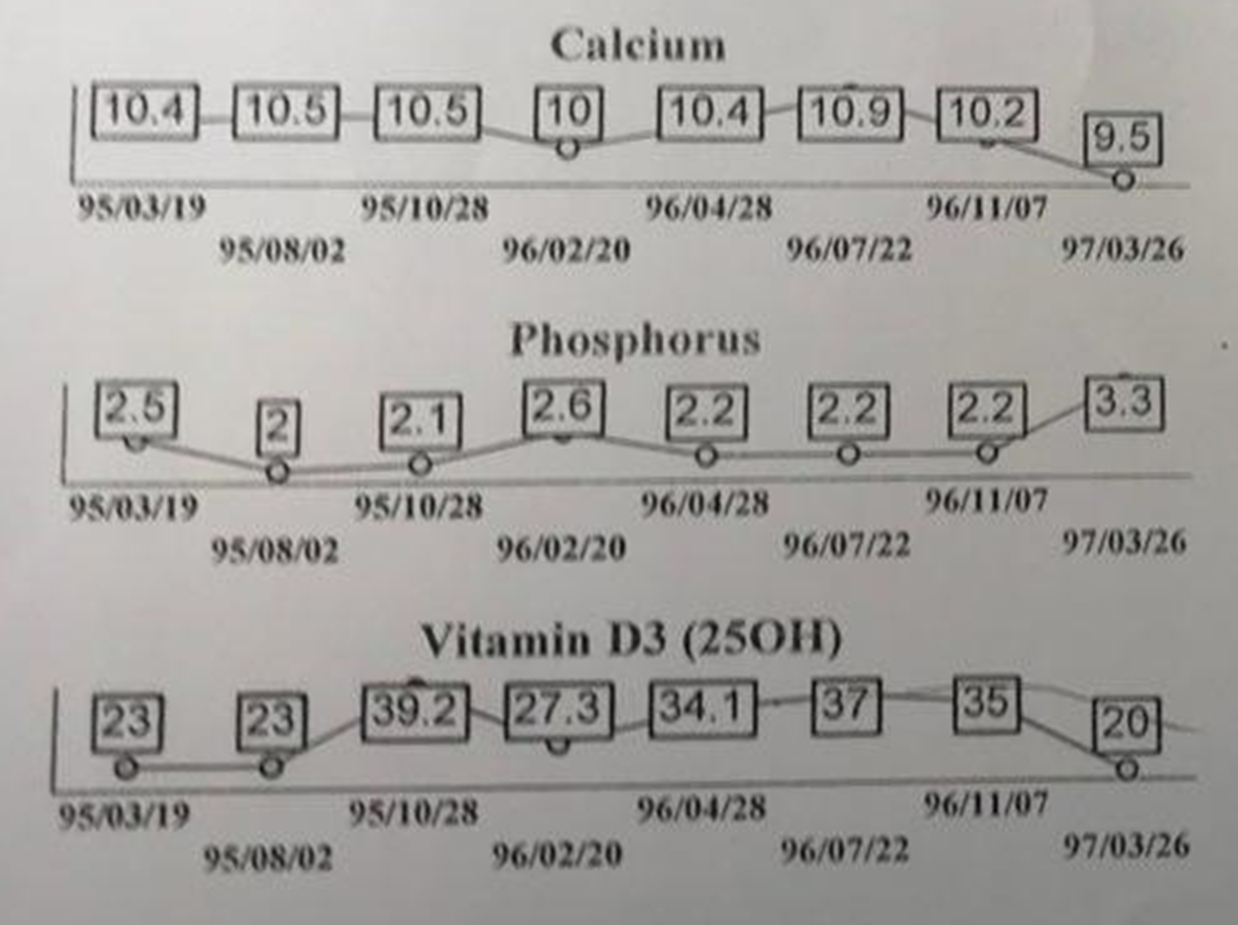

Slide 13
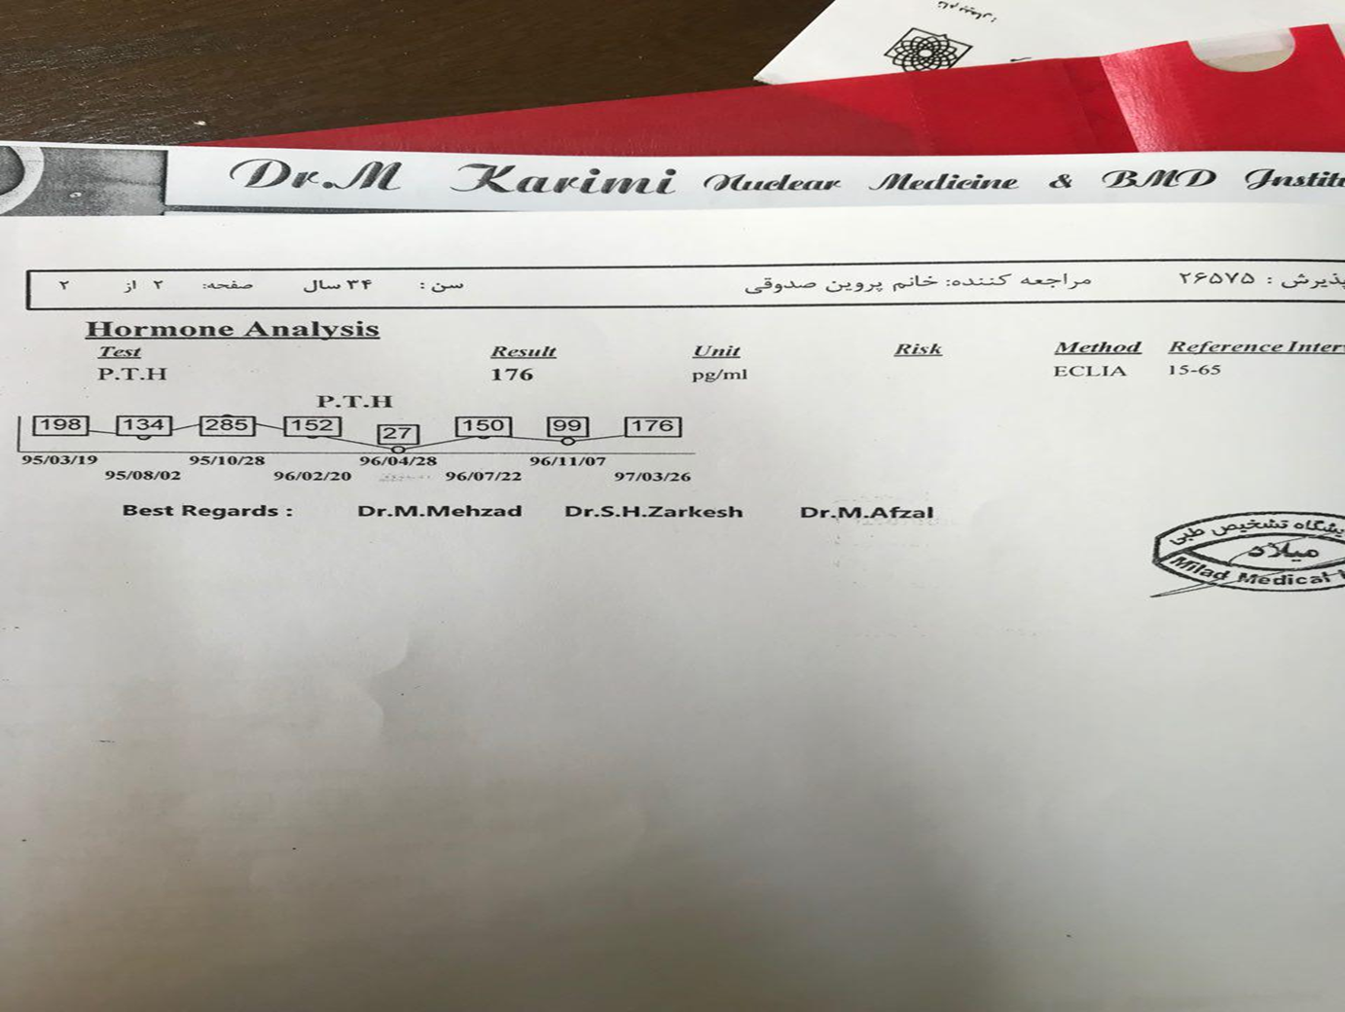

Slide 14
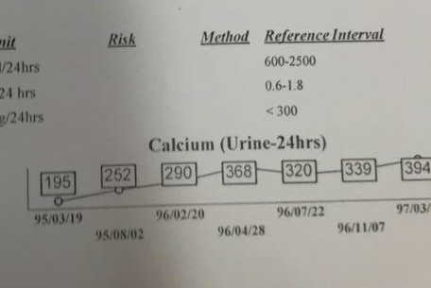

Slide 16
95/4/22

Slide 18
95/5/14

Slide 19
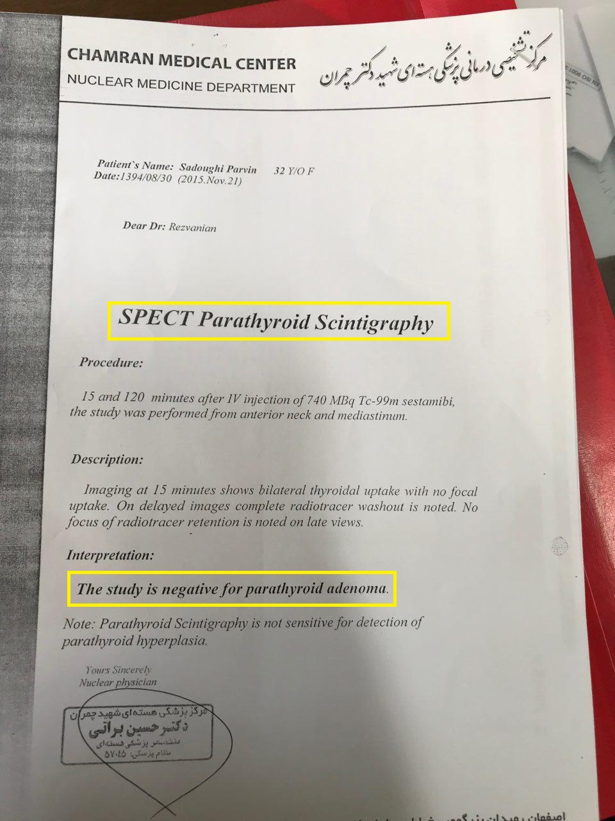

Slide 20
95/11/6

Slide 24
96/5/17

Slide 25
96/5/17

Slide 26
96/5/17

Slide 29
96/5/17

Slide 30
96/5/17

Slide 31
96/5/17

Slide 32
96/5/17

Slide 33
PMH
ESWL(2 times in 1384 & 1385)
PCO(the patiant referred to a gynecologist with a complaint of infertility 5 years ago.she had history of acnea in the adolescent and hirsutism,but her menses were regular.at that time ultrasonography and laboratory tests were performed and pco diagnosis was performed.
Sonography: rt ovary:1 corpous luteum(11mm) and sufficient
small folicule
Lt ovary:1 folicule(2mm) and multiple small folicule.

Slide 37
DH
tablet cinacalcet 30 mg daily from 1.5 years ago and 30mg bid from 9 month ago.
Tablet hydrochlorthiazid from 8 month ago that started with ¼ tablet and after that ½ tablet
Tablet metformin 500mg daily from 2years ago and after that 500mg bid
Pearl vitamin d 50000U from 3 years ago( first weekly until 10 weeks then monthly)

Slide 38
FH:no remarkable family history
HH:negative
AH:negative

Slide 39
PHYSICAL EXAM
W: 58
H:156
BMI:23
Other PH/E: NL

Slide 40
Thanks your attension

