Slide 1
In The Name of God
2013 AHA/ACC/TOS Guideline for the Management of Overweight and Obesity in Adults
Maryam Rezaei.MD

Slide 2
Agenda
Introduction
Classification of recommendation
Statement of the Questions
Gaps in evidence
Recommendations

Slide 3
Introduction
More than 78 million adults in the United States were obese in 2009–2010 . Obesity raises the risk of morbidity from hypertension, dyslipidemia, type 2 diabetes mellitus, CHD, stoke, gallbladder disease, osteoarthritis, sleep apnea and respiratory problems, and some cancers.
Obesity is also associated with increased riskCVD in all-cause andmortality.
overweight is defined as a BMI of 25 kg/m2 to 29.9 kg/m2 and obesity as a BMI of >30 kg/m2. Current estimates are that 69% of adults are either overweight or obese with approximately 35% obese.
the ACC and AHA have collaborated with the National Heart, Lung, and Blood Institute (NHLBI) and stakeholder and professional organizations to develop clinical practice guidelines for assessment of CV risk, lifestyle modifications to reduce CV risk,and management of blood cholesterol, overweight and obesity in adults.

Slide 4
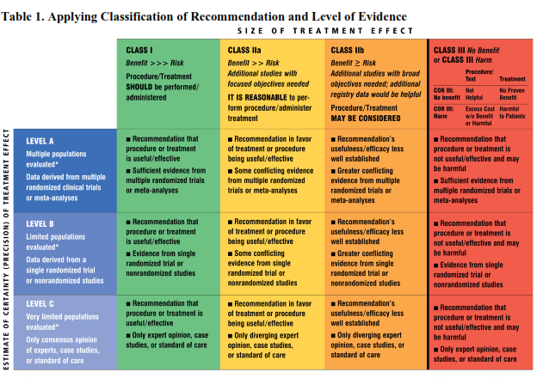

Slide 5
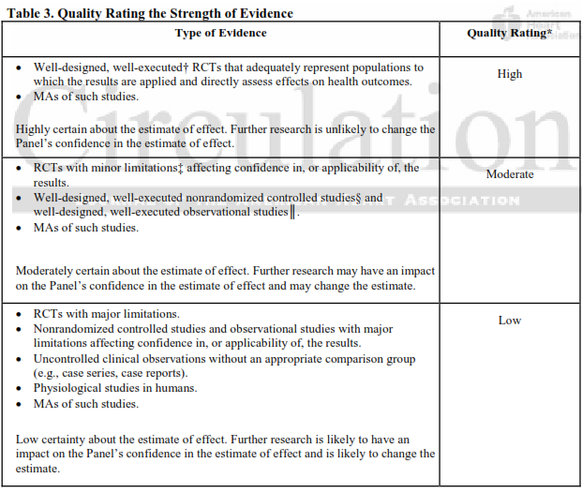

Slide 6
CQ1: addresses the expected health benefits of weight loss
1a. Does this effect vary across population subgroups
1b. What amountof weight loss is necessary to achieve benefit with respect to CVD risk factors, morbidity, and mortality?
• Are there benefits of CVD risk factors, CVD events morbidity, and mortality from weight loss?
• What are the benefits of more significant weight loss?
1c. What is the effect of sustained weight loss for ≥2 years in individuals who are
overweight or obese, on CVD risk factors, CVD events?
• What percent of weight loss needs to be maintained at ≥2 years to be associated with health benefits?

Slide 7
Weight Loss and Risk of Diabetes
In overweight and obese adults at risk for type 2 diabetes, average weight losses of 2.5 kg to 5.5 kg at
=2 years, achieved with lifestyle intervention (with or
without orlistat) reduces the risk of developing type 2
diabetes by 30% to 60%.
Strength of the Evidence: High
In overweight and obese adults with type 2 diabetes, 2% to 5% weight loss achieved with 1 to 4 years
of lifestyle intervention (with or without orlistat) results
in modest reductions in fasting plasma glucose
concentrations and lowering of HbA1c by 0.2% to 0.3%.
Strength of the Evidence: High

Slide 8
In overweight and obese adults with type 2 diabetes, those who achieve greater weight loss at 1 year with lifestyle intervention (with or without orlistat) have greater improvements in HbA1C. Weight loss of 5% to 10% is associated with HbA1C reductions of 0.6% to 1.0% and reduced need for diabetes medications.
Strength of the Evidence: High
In overweight and obese adults with type 2 diabetes treated for 1 year with lifestyle intervention (with or without orlistat), those who lose more weight achieve greater reductions in fasting plasma glucose concentrations. Those who achieve weight losses of 2% to 5% are more likely to have clinically meaningful(>20 mg/dL lowering) reductions in fasting glucose than those who remain weight stable.
Strength of the Evidence: High

Slide 9
As comprehensive lifestyle treatment of overweight and obese adults with type 2 diabetes continues over 4 years, some weight regain will occur on average; partial weight regain is associated with an increase in HbA1C, but HbA1C remains below preintervention levels, and the reduction remains clinically meaningful
Strength of the Evidence: High
In observational cohort studies, overweight and obese adults with type 2
diabetes who intentionally lost 9 kg to 13 kg had a 25% decrease in mortality
ate compared to weight stable controls.
Strength of the Evidence: Low
In overweight and obese adults with type 2 diabetes, orlistat compared to placebo, both with lifestyle intervention, results in 2 kg to 3 kg greater weight loss at 1 and 2 years. The addition of orlistat is associated with greater reductions in fasting blood glucose averaging 11 and 4 mg/dL at 1 and 2 years as well as an average greater reduction in HbA1C of 0.4% at 1 year.
Strength of the Evidence: High

Slide 10
Weight Loss and Impact on Cholesterol/Lipid Profile
In overweight or obese adults with or without elevated CVD risk, there is a dose-response relationship between the amount of weight loss achieved by lifestyle intervention and the improvement in lipid profile. The level of weight loss needed to observe these improvements varies by lipid as follows:
• At a 3 kg weight loss, a weighted mean reduction in triglycerides of at least 15 mg/dL is observed.
• At 5 kg to 8 kg weight loss, low-density lipoprotein cholesterol (LDL–C) reductions of approximately 5 mg/dL and increases in high-density lipoprotein cholesterol (HDL–C) 2 to 3 mg/dL are achieved.
• With <3 kg weight loss, more modest and more variable improvements in triglycerides, HDL–C and LDL–C are observed.
• Strength of the Evidence: High

Slide 11
Among overweight and obese adults with type 2 diabetes,
8.0% weight loss at 1 year and 5.3% weight loss over 4 years compared to usual care control results in greater averag increases (2 mg/dL) in HDl–C and greater average reductions in triglycerides.
Strength of the Evidence: Moderate
A mean 5% weight loss achieved over 4 years by lifestyle intervention in overweight or obese adults with type 2 diabetes is associated with a reduction in newly prescribed lipid lowering medications compared with controls.
Strength of the Evidence: Moderate

Slide 12
Among overweight and obese adults with type 2 diabetes, there is a dose-response relationship between the amount of weight loss and the increase in HDL–C that is most pronounced in those who are the least overweight at baseline.
Strength of the Evidence: Low
Compared to placebo, the addition of orlistat to lifestyle interventiresults in an average 3 kg greater weight loss together with an 8 to 12 mg/dL reduction in LDL–C, a 1mg/dL reduction in HDL and variable changes in triglycerides.
Strength of the Evidence: High

Slide 13
Weight Loss and Hypertension Risk
In overweight or obese adults with elevated CVD risk (including type 2 diabetes and hypertension), there is a dose-response relationship between the amount of weight loss achieved at up to 3 years by lifestyle intervention (alone or combined with orlistat) and the lowering of BP.
At a 5% weight loss, a weighted mean reduction in systolic and diastolic BP of approximately 3 and 2 mm Hg respectively, is observed.
At <5% weight loss, there are more modest and more variable reductions in BP.
Strength of the Evidence: High

Slide 14
A 5% mean weight loss difference achieved over 4 years by intensive lifestyle intervention in overweight or obese adults with type 2 diabetes is associated with a lower prevalence of patients who are prescribed antihypertensive medications compared with controls.
Strength of the Evidence: Moderate

Slide 15
CQ2 :Risks of Overweight and Obesity
Are the current cutpoint values for overweight (BMI 25.0–29.9 kg/mkg/m2) and obesity BMI ≥30 compared with(BMI 18.5–24.9 kg/m2 associated with elevated CVD-related risk?
Are the waist circumference cutpoints of >102 cm (male) and >88 cm (female) associated with elevated CVD-related risk?
How do these cutpoints compare with other cutpoints in terms of elevated CVD-related risk and overall mortality?

Slide 16
Current BMI Cutpoints and CVD-related Risk and All-cause Mortality
Among overweight and obese adults, analyses of continuous BMI show that the greater the BMI, the higher the risk of fatal CHD and combined fatal and nonfatal CHD. The current cutpoints for overweight(BMI ≥25.0 kg/m2) and obesity (BMI ≥30 kg/ m2) compared with normal weight (BMI 18.5 to <25.0 kg/m)are associated with elevated risk of combined fatal and nonfatal CHD.
• Strength of the Evidence: Moderate
Among overweight and obese adults, analyses of continuous BMI show that the greater the BMI, the higher the risk of fatal CHD and combined fatal and nonfatal CHD in both men and women.
The current BMI cutpoints for overweight (BMI ≥25.0 kg/m2) and obesity (BMI ≥30.0 kg/m2) compared with normal weight (BMI 18.5 to <25.0 kg/2) are associated with elevated risk of fatal CHD in both sexes.
• Strength of the Evidence: Moderate
2

Slide 17
Among overweight or obese adults, analyses of continuous BMI show
that the greater the BMI the higher the risk of fatal stroke overall as well
as ischemic and hemorrhagic stroke.
Strength of the Evidence: Moderate
Among overweight and obese adults, analyses of continuous BMI show
that the greater the BMI, the higher the risk of combined fatal and
nonfatal CVD. The current cutpoint for obesity (BMI ≥30 kg/m) compared
with normal weight (BMI 18.5 to <25.0 kg/m2) is associated with an
elevated risk of fatal CVD in men and women.
Strength of the Evidence: Moderate

Slide 18
In men only, the current BMI cutpoint for overweight (BMI 25.0 to 29.9 kg/m2) compared to normal weight (BMI 18.5 to <25.0 kg/m2) is associated with an elevated risk of fatal CVD.
In both men and women, obesity (BMI ≥30.0 kg/m2) compared with normal weight is associated with an elevated risk of fatal CVD.
Strength of the Evidence: Low

Slide 19
Analyses of continuous BMI across the entire BMI range show that the greater the BMI, the higher the risk of type 2 diabetes, without an indication of a threshold effect.
Strength of the Evidence: Moderate

Slide 20
1a. Measure height and weight and calculate BMI at annual visits or more frequently.
E (ExpertOpinion) /I/C
1b. Use the current cutpoints for overweight (BMI >25.0-29.9 kg/m) and obesity (BMI =30 kg/m) to identify adults who may be at elevated riskofCVDand the current cutpoints for obesity (BMI =30) to identify adults who may be at elevated risk of mortality from all causes.
A (Strong)I B

Slide 21
1c. Advise overweight and obese adults that the greater the BMI, the greater the risk of CVD, type 2 diabetes, and all-cause mortality. A (Strong) I B
1d. Measure waist circumference at annual visits or more frequently in overweight and obese adults.
Advise adults that the greater the waist circumference, the greater the riskof CVD, type 2 diabetes, and all-cause mortality.
The cutpoints currently in common use either may continue to be used to identify patients who may be at increased risk until further evidence becomes available.
E (Expert Opinion)/ IIa /B

Slide 22
2. Counsel overweight and obese adults with CV risk factors that lifestyle changes that produce even modest, sustained weight loss of 3%-5%produce clinically meaningful health benefits, and greater weight losses produces greater benefits.
a. Sustained weight loss of 3%-5% is likely to result in clinically meaningful reductions in
triglycerides, blood glucose, HbA1C, and the risk of developing type 2 diabetes;
b. Greater amounts of weight loss will reduce BP, improve LDL–C and HDL–C, and reduce the need for medications to control BP, blood glucose
A (Strong) I A

Slide 23
Among overweight and obese adults, analyses of continuous BMI show that the higher the BMI, the greater the risk of all-cause mortality.
The current category for overweight (BMI 25.0 to 29.9 kg/m) is not associated with elevated risk of all-cause mortality;
but, a BMI at or above the current cutpoint or obesity(BMI≥30kg/m2) is associated with an elevated risk of all-cause mortality, compared with normal weight(18.5 to24.9 kg/m2).
Strength of the Evidence: Moderate

Slide 24
Sex-specific analyses of continuous BMI among
overweight and obese men and women, show that the greater the BMI, the higher the risk of all-cause mortality. The risk of all-cause mortality associated with the current cutpoints of obesity was similar for
men and wmen.
Strength of the Evidence: Moderate

Slide 25
3a. In overweight or obese adults, what is the comparative efficacy/effectiveness of diets of differing forms and structures in achieving or maintaining weight loss?
3b. During weight loss or weight maintenance after weight loss, what are the comparative health
benefits or harms of the above diets and other
dietary weight loss strategies?

Slide 26
Overall Dietary Intervention and Composition—Creating Reduced Dietary Energy Intake
To achieve weight loss, an energy deficit is required The techniques for
reducing dietary energy intake include the following:
• Specification of an energy intake target that is less than that required for
energy balance
usually 1,200 to 1,500 kcal/day for women and 1,500 to 1,800 kcal/day for men (kcal levels are usually adjusted for the individual’s body weight and physical activity levels)
prescription of an energy deficit of 500 kcal/day or 750 kcal/day or 30% energy deficit
Ad libitum approaches where a formal energy deficit target is not prescribed, but lower calorie intake is achieved by restriction or elimination of particular food groups or provision of prescribed foods.
Strength of Evidence: High

Slide 27
A diet from the European Association for the Study of Diabetes Guidelines(food groups)
Higher protein (25% protein)
Higher protein Zone™-type diet (30% protein)
Lacto-ovo-vegetarian-style diet
• Low-calorie diet
• Low-carbohydrate (initially <20 g/day carbohydrate)
• Low-fat (10% to 25% fat)

Slide 28
• Low-fat (20% of total calories from fat)
• Low-glycemic load diet
• Lower fat (≤30% fat), high dairy (4 servings/day) diets with or without increase fiber and/or low-glycemic index/load foods (low-glycemic load) with prescribed energy restriction.
• Macronutrient-targeted diets (15% or 25% of total calories from protein; 20% or 40% oftotal calories from fat; 35%, 45%, 55%, or 65% of total calories from carbohydrate) with prescribed energy restriction.

Slide 29
• Mediterranean-style diet
• Moderate protein (12% protein)
• Provision of high-glycemic load or low-glycemic load
• The AHA-style Step 1 diet (with prescribed energy restriction of 1,500–1,800 kcal/day, <30% of total calories from fat, <10% of total calories from saturated fat).
Strength of Evidence: High

Slide 30
Overall Dietary Intervention and Composition—Pattern of Weight Loss Over Time With Dietary Intervention
With dietary intervention in overweight and obese adults, average weight loss is maximal at 6 months with smaller losses maintained for up to 2 years, while treatment and follow-up tapers.
Weight loss achieved by dietary techniques aimed at reducing daily energy intake ranges from 4 to 12 kg at 6-month follow-up. Thereafter, slow weight regain is observed, with total weight loss at 1 year of 4 kg to 10 kg and at 2 years of 3 kg to 4 kg.
Strength of Evidence: High

Slide 31
Low Fat Approaches
In overweight and obese adults, there is comparable weight loss at 6 to 12 months with instruction to consume a calorie-restricted (500 to 750 kcal deficit/day) lower fat diet (<30%fat) compared to a higher fat (>40% fat) diet.
Strength of Evidence: Moderate

Slide 32
With moderate weight loss, lower fat, higher carbohydrate diets compared to higher fat, lower carbohydrate diets have the following differential effects:
Greater reduction in LDL–C, Lesser reduction in serum triglycerides, and Lesser increases in HDL–C.
Strength of Evidence: Moderate
There is inconsistent evidence regarding BP differences between lower fat, higher carbohydrate diets and higher fat, lower carbohydrate diets.
Strength of Evidence: Low

Slide 33
Higher (25% to 30% of Energy) Protein Approaches
In overweight and obese adults, recommendations to increase dietary protein (25% of total calories) as part of a comprehensive weight loss intervention results in equivalent weight loss as compared with a typical protein diet (15% of total calories) when both diets are calorie-restricted
Strength of Evidence: High
In overweight and obese adults, as compared to typical protein diets (15% of total calories), high protein diets (25% of total calories) do not result in more beneficial effects on CV risk factors, in the presence of weight loss and other macronutrient changes.
Strength of Evidence: Low

Slide 34
Low-Carbohydrate Approaches (<30 g/day)
In overweight and obese adults, there are no differences in weight loss at 6 months with instructions to consume a carbohydrate-restricted diet (20 g/day for up to 3months) in comparison to instruction to consume a calorie-restricted, low-fat diet.
Strength of Evidence: Low
There is insufficient evidence to comment on the CVD risk factor effects of low carbohydrate diets.
St: Low

Slide 35
Complex Versus Simple Carbohydrates
There is insufficient evidence to comment on the value of substituting either simple or complex carbohydrates for dietary fat for overweight or obese adults for the purpose of weight reduction.
Glycemic Load Dietary Approaches
In overweight and obese adults, both high and low glycemic load diets produce a comparable weight loss with a similar rate of loss over 6 months.
Strength of Evidence: Low

Slide 36
Meal Replacement and Adding Foods to Liquid Diets
In overweight and obese women, the use of liquid and bar meal replacements is associated with increased weight loss at up to 6 months, in comparison to a balanced deficit diet utilizing only conventional food.
Strength of Evidence: Low
There is insufficient evidence to comment on the value of adding various types of foods to a low-calorie liquid diet.

Slide 37
3a. Prescribe a diet to achieve reduced calorie intake for obese or overweight individuals who would benefit from weight loss, as part of a comprehensive lifestyle intervention. Any 1 of the following methods can be used to reduce food and calorie intake:
a. Prescribe 1,200–1,500 kcal/day for women and 1,500–1,800 kcal/day for men
b. Prescribe a 500 kcal/day or 750 kcal/day energy
deficit; or
c. Prescribe one of the evidence-based diets that
restricts certain food types (such as high-carbohydrate foods, low-fiber foods, or high-fat foods) in order to create an energy deficit by reduced food intake.( A (Strong)/I /A )

Slide 38
Prescribe a calorie-restricted diet, for obese and overweight individuals who would benefit from weight loss, based on the patient’s preferences and health status and preferably refer to a nutrition professional for counseling. (Strong/ I /A)

Slide 39
CQ4: Lifestyle Interventions for Weight Loss
4a. Among overweight and obese adults, what is the efficacy/effectiveness of a comprehensive
lifestyle intervention program (i.e., comprised of diet, physical activity, and behavior therapy) in
facilitating weight loss or maintenance of lost weight?
4b. What characteristics of delivering comprehensive lifestyl interventions (e.g., frequency and duration of treatment, individual versus group sessions, onsite versus telephone/email contact) are associated with greater weight loss or weight loss maintenance?

Slide 40
Description of the Diet, Physical Activity, and Behavior Therapy Components in High-Intensity, Onsite Lifestyle Interventions
The principal components of an effective high-intensity, on-site comprehensive-lifestyle intervention include:
adherence to diet and activity recommendations.
1) prescription of a moderately-reduced calorie diet;
2) a program of increased physical activity
3) the use of behavioral strategies to facilitate
All 3 components should be included:
• Reduced-calorie diet: In comprehensive lifestyle interventions, overweight/obese individuals typically are prescribed a diet designed to induce an energy deficit >500 kcal/day.
This deficit often is sought by prescribing 1,200 to 1,500kcal/day for women and1,500 to 1,800 kcal/day for men.

Slide 41
• Increased physical activity:
Comprehensive lifestyle intervention programs typically prescribe increased aerobic physical activity (such as brisk walking) for >150 minutes/week .
Higher levels of physical activity, approximately 200 to 300 minutes/week, are recommended to maintain loss weight or minimize weight regain long-term (>1 year).
Behavior therapy: Comprehensive lifestyle interventions usually provide a structured behavior change program that includes regular self-monitoring of food intake, physical activity, and weight.
These same behaviors are recommended to maintain lost weight, with the addition of frequent (i.e., weekly or more often) monitoring of body weight.
Strength of Evidence: High

Slide 42
Comprehensive Interventions Compared with Usual Care, Minimal Care, or No-Treatment ControlES
Short-Term Weight Loss( 6 months )
In overweight and obese individuals in whom weight loss is indicated and who wish to lose weight, comprehensive lifestyle interventions consisting of diet, physical activity, and behavior therapy (all 3 components) produce average weight losses of up to 8 kg in 6 months of frequent (i.e., initially weekly), onsite treatment provided by a trained interventionist in group or individual sessions. Such losses (which can approximate reductions of 5% to 10% of initial weight) are greater than those produced by usual care.
Strength of Evidence: High

Slide 43
Intermediate-Term Weight Loss(1-year)
Longer-term comprehensive lifestyle interventions, which additionally provide weekly to monthly on-site treatment for another 6 months, produce average weight losses of up to 8 kg at 1 year, losses which are greater than those resulting from usual care.
Comparable 1-year weight losses have been observed in treatment comparison studies of comprehensive lifestyle interventions, which did not include a usual care group.
Strength of Evidence: Moderate

Slide 44
Long-Term Weight Loss(>1 year )
Comprehensive lifestyle interventions which, after the first year,continue to provide bimonthly or more frequent intervention contacts, are associated with gradual weight regain of 1 to 2 kg/year (on average), from the weight loss achieved at 6 to 12 months. Long-term (>1 year) weight losses, however, remain larger than those associated with usual care.
Strength of Evidence: High

Slide 45
Efficacy/Effectiveness of Electronically Delivered, Comprehensive Interventions in Achieving Weight Loss
Electronically delivered comprehensive weight loss interventions developed in academic settings,which include frequent self-monitoring of weight, food intake, and physical activity—as well as personalized feedback from a trained interventionist—can produce weight loss of up to 5 kg at 6 to 12months, a loss which is greater than that resulting from no or minimal intervention (i.e.,primarily knowledge based) offered on the internet or print.
Strength of Evidence: Moderate

Slide 46
Efficacy/Effectiveness of Comprehensive, Telephone-Delivered Lifestyle Interventions in Achieving Weight loss
In comprehensive lifestyle interventions that are delivered by telephone or face-to-face counseling,and which also include the use of either commercially-prepared prepackaged meals or an interactive web based program, the telephone delivered and face-to-face delivered interventions produced similar mean net weight losses of approximately 5 kg at 6 months and 24 months, compared with a usual care control group.
Strength of Evidence: Low
Efficacy/Effectiveness of Comprehensive Weight Loss Programs in Patients Within a Primary Care Practice Setting Compared With Usual Care
In studies to date, low to moderate-intensity lifestyle interventions for weight loss provided to overweight or obese adults by primary care practices alone, have not been shown to be effective.
Strength of Evidence: High

Slide 47
Efficacy/Effectiveness of Commercial-Based, Comprehensive
Lifestyle Interventions in Achieving Weight Loss
Commercial-based, comprehensive weight loss interventions that are delivered in person have been shown to induce an average weight loss of 4.8 kg to 6.6 kg at 6 months in 2 trials when conventional foods are consumed and 6.6 kg to 10.1 kg at 12 months in 2 trials with provision of prepared food, losses that are greater than those produced by minimal-treatment control interventions.
Strength of Evidence: Low
Efficacy/Effectiveness of Very Low-Calorie Diets, as Used as Part of a Comprehensive Lifestyle Intervention, in Achieving Weight Loss
Comprehensive, high intensity on-site lifestyle interventions that include a medically supervised very low-calorie diet (often defined as <800 kcal/day), as provided by complete meal replacement products,produce total weight loss of approximately 14.2 kg to 21 kg over 11 to 14 weeks, which is larger than that produced by no intervention or a usual care control group (i.e., advice and education only).
Strength of Evidence: High

Slide 48
Following the cessation of a high intensity lifestyle intervention with a medically supervised very-low calorie diet of 11 to 14 weeks, weight regain of 3.1 kg to 3.7 kg has been observed during the ensuing 21 to 38 weeks of non-intervention follow-up.
Strength of Evidence: High
The prescription of various types (resistance or aerobic training) and doses of moderate intensity exercise training (e.g., brisk walking 135 to 250 minutes/week), delivered in conjunction with weight loss maintenance therapy does not reduce the amount of weight regained after the cessation of the very-low calorie diet, as compared with weight loss maintenance therapy alone.
Strength of Evidence: Low

Slide 49
Efficacy/Effectiveness of Comprehensive Lifestyle Interventions in Maintaining Lost Weight
After initial weight loss, some weight regain can be expected, on average, with greater regain observed over longer periods of time. Continued provision of a comprehensive weight loss maintenance program (onsite or by telephone), for periods of up to 2.5 years following initial weight loss, reduces weight regain, as compared to the provision of minimal intervention (e.g., usual care). The optimal duration of weight loss maintenance programs has not been determined.
Strength of Evidence: Moderate
35% to 60% of overweight/obese adults who participate in a high intensity long-term comprehensive lifestyle intervention maintain a loss of ≥5% of initial body weight at ≥2 year’s follow-up
Strength of Evidence: Moderate

Slide 50
Characteristics of Lifestyle Intervention Delivery That May
Affect Weight Loss: Intervention Intensity
Moderate-Intensity Interventions
Moderate intensity, on-site comprehensive lifestyle interventions, which
provide an average of 1 to 2 treatment sessions per month typically
produce mean weight losses of 2 kg to 4 kg in 6 to 12 months, losses
which generally are greater than those produced by usual care (i.e.,
minimal intervention control group).
Strength of Evidence: High

Slide 51
Low-intensity Interventions
Low intensity, on-site comprehensive lifestyle interventions, which provide fewer than monthly treatment sessions do not consistently produce weight loss when compared to usual care.
Strength of Evidence: Moderate
Effect of intervention intensity
When weight loss with each intervention intensity (i.e.,
low,moderate, and high) is compared to usual care, high-
intensity lifestyle interventions (≥14 sessions in 6
months) typically produce greater net-of-control weight
losses than low-to-moderate intensityinterventions.
Strength of Evidence: Moderate

Slide 52
Characteristics of Lifestyle Intervention Delivery That May Affect Weight Loss or Weight Loss Maintenance:
Individual Versus Group Treatment
There do not appear to be substantial differences in the size of the weight losses produced by individual- and group-based sessions in high-intensity, comprehensive lifestyle intervention delivered on site by a trained interventionist.
Strength of Evidence: Low
Onsite Versus Electronically Delivered Interventions
Weight losses observed in comprehensive lifestyle interventions, which are delivered onsite by a trained interventionist in initially weekly and then biweekly group or individual sessions, are generally greater than weight losses observed in comprehensive interventions that are delivered by Internet or email and which include feedback from a trained interventionist.
Strength of Evidence: Low

Slide 53
4a. Advise overweight and obese individuals who would benefit from weight loss to participate for ≥6 months in a comprehensive lifestyle program that assists participants in adhering to a lower calorie diet and in increasing physical activity through the use of behavioral strategies. (A(Strong)/ I/A)
4b. Prescribe on site, high-intensity (i.e., =14 sessions in6 months) comprehensive weight loss interventions provided in individual or group sessions by a trained interventionist. A (Strong) / I /A

Slide 54
4c. Electronically delivered weight loss programs (including by telephone) that include personalized feedback from a trained interventionist can be prescribed for weight loss but may result in smaller
weight loss than face-to-face interventions
(B /Moderate)/ IIa /A

Slide 55
4e. Use a very low calorie diet (defined as <800 kcal/dayonly in limited circumstances and only when provided by trained practitioners in a medical care setting where medical monitoring and high intensitlifestyle intervention can be provid
A (Strong)/ CQ4 Iia/A

Slide 56
Advise overweight and obese individuals who have lost weight to participate long-term (=1 year) in a comprehensive weight loss maintenance program
A (Strong)/ I/ A
4g. For weight loss maintenance, prescribe face-to-face
or telephone-delivered weight loss maintenance
programs that provide regular contact (monthly or
more frequent) with a trained interventionist who
helps participants engage in high levels of physical
activity (i.e., 200-300 minutes/week), monitor body
weight regularly (i.e., weekly or more frequent), andconsume a reduced-calorie diet
A (Strong)/ I/ A

Slide 57
CQ5 (Surgical Procedures for Weight Loss)
What are the long-term effects of the following surgical procedures on weight loss, weight-loss maintenance, CV risk related comorbidities, and mortality?
What are the long-term effects of these surgical procedures in patients with different BMIs and comorbidities?

Slide 58
What are the predictors associated with long term effects of these surgical procedures in patients with different BMIs and comorbidities?
What are the short-term (>30 days) and long-term (≥3days) complications of the following bariatric surgical procedures?
What are the predictors associated with complications?
What are the complications of these surgical procedures in
patients with different BMIs and comorbidities?

Slide 59
In obese adults, bariatric surgery produces greater weight loss and maintenance of lost weight than that produced by usual care, conventional medical treatment, lifestyle intervention, or medically supervised weight loss, and weight loss efficacy varies depending on the type of procedure and initial body weight.
Weight loss at 2 to 3 years following a variety of surgical
procedures in adults with presurgical BMI≥30 varies from a mean of 20% to 35% of initial weight and mean difference from nonsurgical comparators of 14% to 37% depending on procedure.
Strength of the Evidence: High

Slide 60
In obese adults, bariatric surgery generally results in more favorable impact on obesity-related comorbid conditions than that produced by usual care, conventional medical treatment, lifestyle intervention, or medically supervised weight loss.
At 2 to 3 years following a variety of bariatric surgical procedures in adults with BMI ≥30 who achieve mean weight loss of 20% to 35%,FBS and insulin are reduced and incidence of type 2 diabetes is decreased and there is a greater likelihood of diabetes remission among those with type 2 diabetes at baseline.
Strength of the Evidence: High
At 10 years, incidence and prevalence of type 2 diabetes are lower in those who have undergone surgery. However, among those in whom type 2 diabetes remits after surgery, diabetes may recur over time.
Strength of the Evidence: Low

Slide 61
At 2 to 3 years following a variety of bariatric surgical procedures in adults with BMI ≥30 who achieve mean weight loss of 20% to 35%, BP or use of BP medication is reduced compared with nonsurgical management and at 10 years postsurgery, there is no difference in mean systolic BP or the incidence of new cases of hypertension in those who underwent bariatric surgery compared to those who did not undergo surgery.
Strength of the Evidence: Low
Among obese adults with baseline hypertension, a greater percentage remission at 2 to 3 years and 10 years following bariatric surgery compared with nonsurgical management.
Strength of the Evidence: Low

Slide 62
At 2 to 3 years and 10 years following a variety of bariatric surgical procedures in adults with BMI ≥30 who achieve mean weight loss of 20% to 35%, serum triglyceride levels are lower, HDL–C levels are higher, total cholesterol to HDL–C ratio is lower
Strength of the Evidence: Low
Most measures of health-related quality of life are improved at 2
and 10 years following bariatric surgery.
Strength of the Evidence: Moderate

Slide 63
Total mortality is decreased compared with nonsurgical management at mean follow up of 11 years after undergoing a variety of bariatric surgical procedures in patients with mean BMI >40 who achieve a mean long-term weight loss of 16%.
Strength of the Evidence: Low
There are insufficient data on the efficacy of
bariatric surgical procedures for weight loss and
maintenance or CVD risk factors ≥2 years
postsurgery in patients with a BMI <35.

Slide 64
In direct comparative studies at 2 to 3 years postsurgery:
Weight loss following gastric bypass exceeds LAGB.
Strength of the Evidence: Moderate
• Weight loss following BPD, gastric bypass, and sleeve
gastrectomy are similar.
Strength of the Evidence: Low
In direct comparative studies at 5 to 10 years postsurgery:
Weight loss following gastric bypass exceeds LAGB.
Strength of the Evidence: Low

Slide 65
Type 2 diabetes remission or improved glycemic control
occurs with increasing frequency according to procedure as
follows: LAGB, gastric bypass, BPD.
Strength of the Evidence: Low
Reduction in the prevalence of HTN is more frequent
following gastric bypass than LAGB.
Strength of the Evidence: Low
The prevalence of dyslipidemia is lower following gastric bypass compared to LAGB.
Strength of the Evidence: Low

Slide 66
complications following LAGB
Perioperative complications are infrequent and do not tend to be life-threatening:
major adverse outcomes (1%) such as DVT and reoperations, and minor complications (3%) such as wound infection.
Strength of the Evidence: Moderate

Slide 67
Longer-term complication continue to occur over time and may require operative correction:misplacement of band approximately 3% to 4%, erosion of gastric wall approximately 1%, and portcomplication 5% to 11%.
Strength of the Evidence:Moderate
Longer-term LAGB failure leading to removal of the band with or without conversion to anotherbariatric procedure varies from 2% to 34%.
Strength of the Evidence: Moderate

Slide 68
Roux-en-Y Gastric Bypass
Consist of a major adverse outcome in approximately 4% to 5%, including mortality (0.2%), DVTandPTE (0.4%), and a requirement for reoperation (3% to 5%); any complication, major or minor (2% to 18%).
Strength of the Evidence: Moderate
Are less frequent for the laparoscopic approach than for
open incision.
Strength of the Evidence: Moderate

Slide 69
open gastric bypass:
Consist of a major adverse outcome in approximately 8%, including mortality (2%), deep vein thrombosis/pulmonary embolism (1%), and reoperation (5%).
Strength of the Evidence: Low

Slide 70
Biliopancreatic Diversion
perioperative complications Occur in 2% to 8% of cases and include mortality (<1%); deep vein thrombosis/pulmonary embolism (0.4%). The frequency of anastomotic leak, hemorrhage and wound complication is variable.
Strength of the Evidence: Low
1 to 3 year complications include: anemia (13% to 20%); deficiency of protein (0.3% to 3.0%), iron (17%), zinc (6%), and neuropathy (0.4%). Deficiency of vitamin D and elevated parathyroid hormone may exceed 40%.
When performed by open incision, include ventral hernia as high as 78%.
Strength of the Evidence: Low

Slide 71
Laparoscopic Sleeve Gastrectomy
There is insufficient evidence to establish the incidence of perioperative and longer term complications.

Slide 72
5a. Advise adults with a BMI ≥40 or BMI ≥35 with
obesity-related comorbid conditions who are motivated to lose weight and who have not responded to behavioral treatment with or without pharmacotherapy with sufficient weight loss to achieve targeted health outcome goals that bariatric surgery may be an appropriate option to improve health and offer referral to an experienced bariatric surgeon for consultation and evaluation. A (Strong) / Iia/A
5b. For individuals with a BMI <35, there is insufficient
evidence to recommend for or against undergoing
bariatric surgical procedures. N ( N/A )

Slide 73
CQ1 (Benefits of Weight Loss)
1. Do the observed improvements in CV risk factors, need for medications and improved quality of life associated with weight loss differ by age, sex, race, and BMI/waist circumference?
2. What is the cost-effectiveness of modest weight loss as a preventative strategy for those at risk of developing type 2 diabetes?
3. What is the best approach to identify and engage those who can benefit from weight loss.

Slide 74
CQ2 (Risks of Overweight and Obesity)
Studies are needed that compare current to alternative BMI and waist circumference cutpoints for predicting risk to optimize the specificity of cutpoints.
• Studies should examine the independent and combined effects of BMI and waist circumference to determine if both in combination are better at predicting elevated risk than either alone.

Slide 75
• Such studies should explicate the methods and logical framework that guides the choice of optimal cutpoints.
• Studies comparing the predictive ability of BMI and waist circumference with more objective measures of percent body fat, such as dual-energy x-ray absorptiometry or magnetic resonance imaging, may enhance risk prediction of cutpoints and/or combinations of BMI and waist circumference.

Slide 76
• Similar studies are needed to assess whether overall cutpoints are appropriate for population subgroups
stratified by age, sex, and race/ethnicity.
• Longitudinal studies are needed that assess the risks associated with weight change in normal weight, overweight, and obese adults to determine the role of weight change trajectory in risk assessment.

Slide 77
CQ3 (Dietary Interventions for Weight Loss)
• Because long-term dietary adherence is problematic in weight management, to determine the best dietary approach to sustain weight loss over the long-term, studies are needed:
• testing the impact of tailoring choice of dietary interventions on the individual’s ability to adhere long-term
testing pragmatic approaches to diet intervention delivery in free-living individuals for at least 2 years duration
• evaluating the physiologic and biologic adaptations to weight loss, so as to refine methods of caloric restriction during weight reduction and maintenance.

Slide 78
CQ4 (Lifestyle Interventions for Weight Loss)
Onsite (face-to-face) comprehensive, high-intensity lifestyle interventions (14 or more contacts in first 6 months) represent the standard for behavioral weight loss interventions. Further research can help improve efficiency of these interventions with studies:
evaluating optimal frequency (and duration) of contact
evaluating characteristics of those who lose less weight in response to a standard, comprehensive behavioral intervention and developing alternative approaches for their treatment.

Slide 79
• evaluating effective methods of delivering lifestyle interventions remotely (e.g., internet,mobile phone, text messaging, telephone, DVDs, etc., or some combination of these) to achieve and maintain clinically meaningful weight loss
• Because of changing demographics, there is a need for further research to understand the most appropriate strategies and prescriptions for weight loss for some key populations including older adults and racial/ethnic groups.

Slide 80
• Because the efficacy of on-site (face-to-face) comprehensive, high-intensity lifestyle intervention has been established in academic settings, translational studies are needed evaluating programs that can be delivered in community, work-site, and other settings(including commercial programs)
• identifying the optimal role for PCPs to play in the management of obesity by lifestyle modification
• evaluating head-to-head comparisons of the relative effectiveness and associated costs of delivering interventions on-site (face-to-face), remotely, or by a combination of approaches
(i.e., hybrid delivery).

Slide 81
• determining the personal characteristics, skills, and training required to serve as a lifestyle interventionist;
• Because maintenance of lost weight over the long term has been challenging, studies are needed evaluating strategies to promote additional weight loss beyond the first 6 months, the time at which weight loss plateaus in most individuals; and evaluating novel methods of improving the maintenance of lost weight.
• Further study is needed on the effect of weight loss treatment on health care utilization and cost.

Slide 82
CQ5 (Surgical Procedures for Weight Loss)
Because bariatric surgery offers the potential for prevention or remission of diabetes, better control of CVD risk factors, improvement in quality of life and possibly decreased mortality, there is a need for research to better characterize those patients who are most likely to benefit from and least likely to suffer adverse consequences of bariatric surgical procedures.
Large and well-designed experimental, quasi-experimental and observational studies, with long-term follow-up are needed to determine if the risks and benefits of bariatric surgery are sustained over time.
evaluating which surgical procedures are best applied to different populations, based on factors such as presence and duration of comorbid conditions, age, sex, race/ethnicity, degree and duration of obesity, underlying genetic etiologies, characteristics;
evaluating the implementation of bariatric surgery in nonacademic settings, which may be more reflective of real world clinical practice.

Slide 83
Efficacy/Effectiveness of Very Low-Calorie Diets, as Used as Part of a ComprehensiveLifestyleIntervention, in Achieving Weight Loss
Comprehensive, high intensity on-site lifestyle interventions that include a medically supervised very low-calorie diet (often defined as <800 kcal/day), as provided by complete meal replacement products,produce total weight loss of approximately 14.2 kg to 21 kg over 11 to 14 weeks, which is larger than that produced by no intervention or a usual care control group (i.e., advice and education only)
Strength of Evidence: High

Slide 84
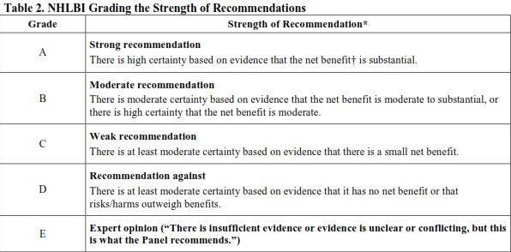

Slide 86
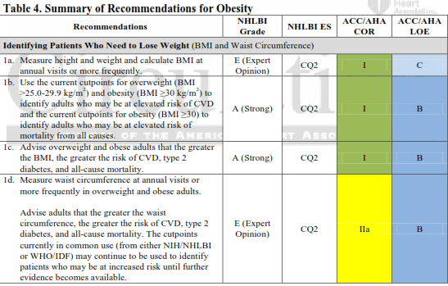

Slide 87
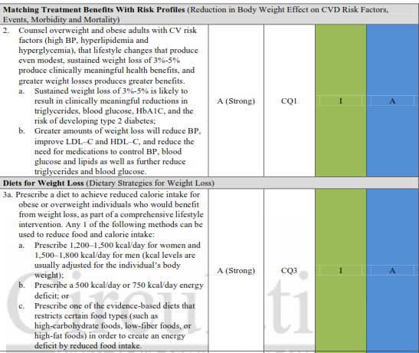

Slide 88
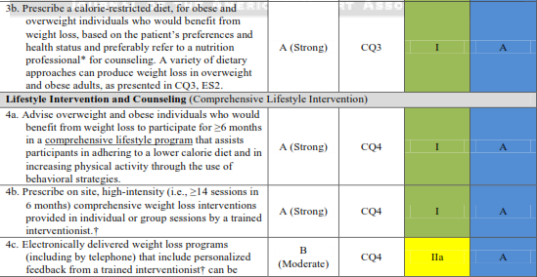

Slide 89
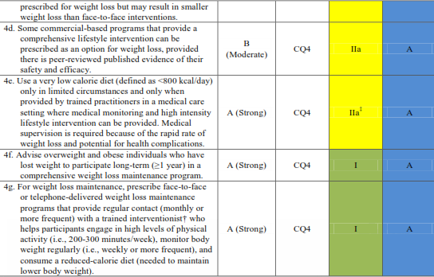

Slide 90
