Slide 1
IN THE NAME OF ALLAH
PROLACTINOMA
Shahin Nosratzehi

Slide 2
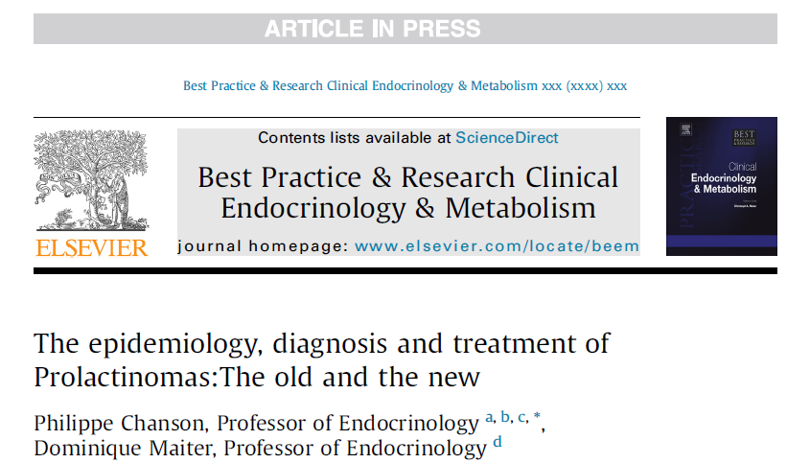
2019

Slide 3
Agenda
Epidemiology
Diagnosis
Clinical consequences of hyperprolactinemia
Biochemical diagnosis
Imaging
Medical treatment
Surgical treatment
Prolactinoma and pregnancy

Slide 4
Epidemiology
Prevalence: 50 per 100,000
incidence 3-5 new cases/100,000/year.
microadenomas are 4-5 fold more frequent than macroadenomas
The ratio between macro- and microprolactinomas is approximately 1:8 in women, whereas it is inverted in men (macroadenomas in 80% of cases)
predominance of PRL-secreting tumors is observed in women aged 25-44 years compared to men ( male to female ratio of 1:5 to 1:10) while this difference disappears after menopause.
peak age of occurrence in women occurs at approximately 30 years, while most men are diagnosed after age 50.

Slide 5
Agenda
Epidemiology
Diagnosis
Clinical consequences of hyperprolactinemia
Biochemical diagnosis
Imaging
Treatment
Medical treatment
Surgical treatment
Prolactinoma and pregnancy

Slide 6
Diagnosis(Clinical consequences of hyperprolactinemia)
Women (Classic symptoms of prolactinomas)
oligo- or amenorrhea :almost all patients (85-90%)
Galactorrhea:84% of patients
infertility
15% of women who experience secondary amenorrhea or oligomenorrhea HPL is found,more than half of those, this is due to a prolactinoma
prevalence of mild HPL in an unselected, asymptomatic population with infertility is approximately 5%

Slide 7
Diagnosis( Clinical consequences of hyperprolactinemia)
Postmenopausal women
They present with mass effects related to large tumors
although prolactinomas may also be discovered incidentally or because of a history of “premature” menopause
Men
approximately 80% are diagnosed with a macroprolactinoma
half of men typically present with symptoms caused by the tumor mass
other half with symptoms of hypogonadism, including a loss of libido, ED, gynecomastia, infertility, and/or osteopenia
Testosterone concentrations are often decreased, these levels may be normal in men with prolactinomas

Slide 8
Diagnosis( Clinical consequences of hyperprolactinemia)
Mass effects
Visual field defects (chiasmal compression depend on the extent of suprasellar extension)
Headaches are a frequent symptom which is often associated with the lateralization of the tumor, and cluster-like headache may also occur as a major manifestation
Hypopituitarism (from direct pituitary compression or more commonly from hypothalamic/stalk dysfunction)
cavernous sinus syndrome is rare and is generally observed in the context of pituitary apoplexy ,which is characterized by headache with a sudden and severe onset that is generally associated with visual disturbances or ocular palsy

Slide 9
Diagnosis( Clinical consequences of hyperprolactinemia
Giant prolactinomas are associated with
endocrine symptoms (75%)
visual symptoms (70%)
headaches (60%)
The extensive invasion of the skull floor with bony destruction ,occurs and may cause spontaneous CSF rhinorrhea, exophthalmos and optic nerve compression at the orbital apex, nasal stuffiness and epistaxis
Extrasellar extension in other directions may cause hydrocephalus, hearing impairments, unilateral hemiparesis, temporal epilepsy or dementia due to frontal lobe extension

Slide 10
Diagnosis( Clinical consequences of hyperprolactinemia
Malignant prolactinomas are rare tumors defined by the presence of distant cerebrospinal,meningeal and/or systemic metastases.
Indeed, a reliable distinction between carcinoma and adenoma is rarely achieved based on standard histological criteria .
Their precise incidence is not precisely known but, overall, they account for only 0.1-0.2% of all pituitary tumors, and prolactinomas correspond to approximately one-third of these tumors

Slide 11
Diagnosis( Clinical consequences of hyperprolactinemia
occur at any age but mostly develop in the fifth or sixth decade of life in patients with a preexisting prolactinoma.
Typically, the primary tumor has been diagnosed many years before metastasis (the latent period between initial diagnosis and detection of metastases may persist for up to 22 years) and has been treated with high-dose DAs, repeated surgery and radiotherapy before the tumor becomes metastases become apparent.
Once metastases are diagnosed,median survival time is 18m
but the outcome of these tumors has improved over the past few years and prolonged

Slide 12
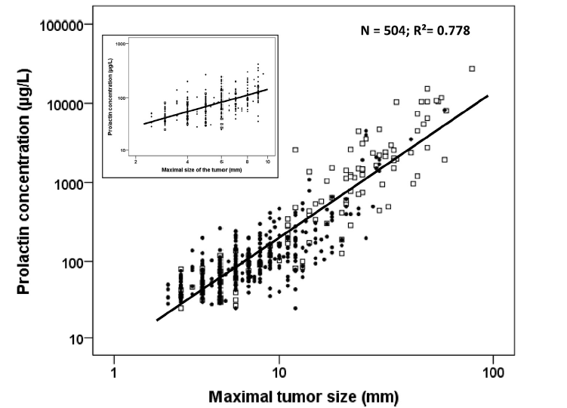
Biochemical diagnosis
Patients with large macroprolactinomas have PRL levels that exceed 250 mg/l, virtually all patients with macroprolactinomas have levels greater than 100 µg/l and most patients with microprolactinomas present levels ranging from 50 to 150 µg/L

Slide 13
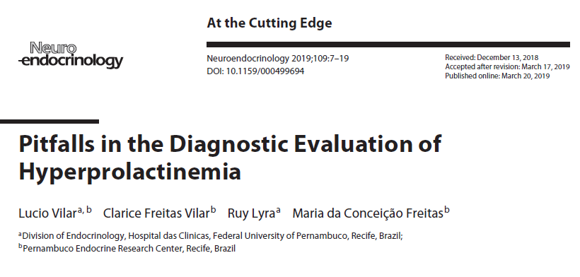

Slide 14
Pitfalls in the PRL assay
Macroprolactinemia is mostly defined as condition where more than 60% of circulating PRL is made up of PRL
In most in vitro studies, macroPRL was shown to display low biological activity most patients with macroPRL are asymptomatic Hyperprolactinemia related to macroPRL
The gold standard for the diagnosis of macroprolactinemia is GFC, but because this method is time-consuming and expensive, PEG serum precipitation has been widely used as a screening method

Slide 15
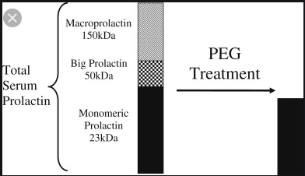
recoveries> 60% point to the diagnosis of monomeric hyperprolactinemia
This test enables the correct diagnosis of macroprolactinemia in at least 80% of cases

Slide 16
Pitfalls in the PRL assay
(PEG) serum precipitation has been widely used as a screening method
Recoveries < 40% are indicative of predominance of macroPRL, whereas recoveries > 60% point to the diagnosis of monomeric hyperprolactinemia.
This test enables the correct diagnosis of macroprolactinemia in at least 80% of cases

Slide 17
Pitfalls in the PRL assay
Clinical Relevance
prevalence of MacroPRL among hyperprolactinemic individuals ranged from 8 - 42% (mean, 19.6%) in 9 European series
the third most common cause of nonphysiological hyperprolactinemia (16%) after prolactinomas and drugs
many patients with MacroPRL can have hypogonadism symptoms or galactorrhea, presumably due to the concomitance of other disorders, such as PCOS, psychogenic erectile dysfunction, idiopathic galactorrhea, nonfunctioning pituitary tumors, or monomeric hyperprolactinemia

Slide 18
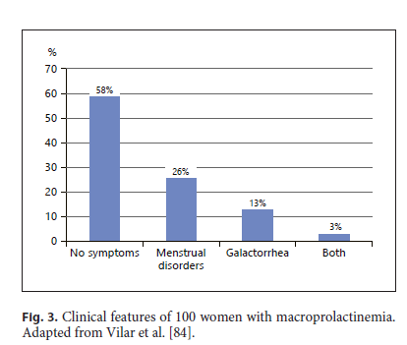

Slide 19
Pitfalls in the PRL assay
the screening for macroprolactin should not be reserved for
asymptomatic patients
atypical clinical picture
for those with an apparent IH,no obvious cause for the hyperPRLmia
delayed decline of serum PRL levels with the usual doses of DA s ,
Conversely, PRL should never be measured in asymptomatic patients in order to avoid the unnecessary detection of macroprolactinemia cases

Slide 20
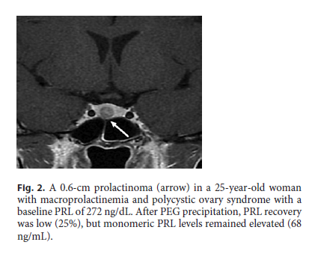

Slide 21
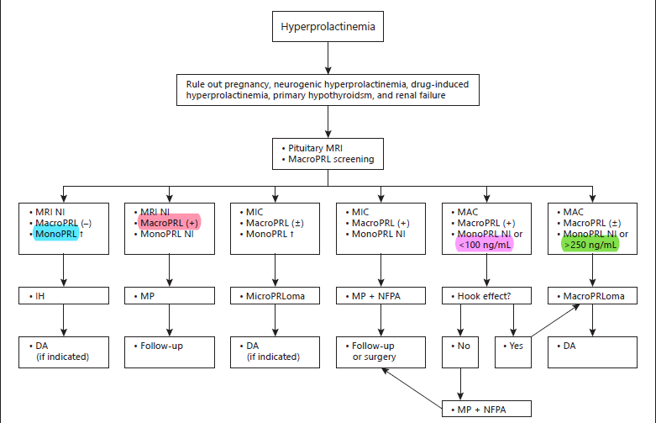

Slide 22
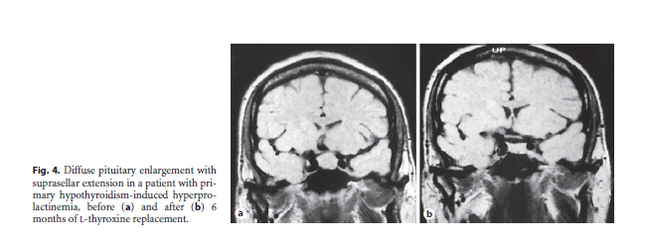
Up to 40% of patients with overt primary hypothyroidism, and up to 22% of those with subclinical hypothyroidism can present with usually mild elevation of PRL levels which normalize by thyroid hormone replacement

Slide 23
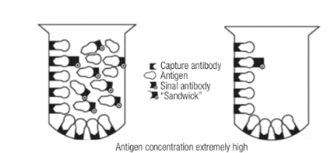
Pitfalls in the PRL assay
Discrepancy between a very large pituitary tumor and mildly elevated prolactine level
Macroprolactinomas are typically associated with prolactin levels greater than 250 µg/l
This confusion can be avoided by repeating the measurements of PRL levels in these patients after diluting the samples 1:100 or using an assay that does not induce this hook effect.

Slide 24
Diagnosis (Imaging)
On T1-weighted MRI, micro- and macroprolactinomas are usually hypointense and occasionally isointense, but are rarely hyperintense (hemorrhagic transformation)
The T2 MRI is more variable: 80% of prolactinomas are hyperintense and approximately half are heterogeneous
Hemorrhagic transformation occurs in approximately 20% of macroprolactinomas, but is usually asymptomatic
Physiological conditions, such as puberty ,the post-pubertal period in girls ,pregnancy or spontaneous intracranial hypotension leading to container-content mismatch may result in misleading images

Slide 25
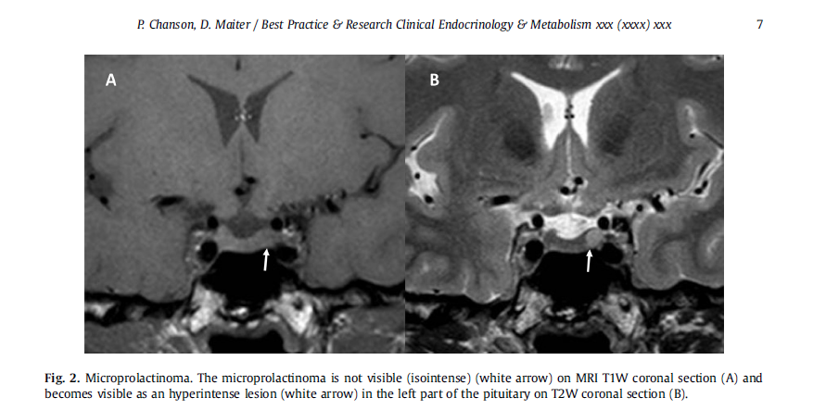

Slide 26
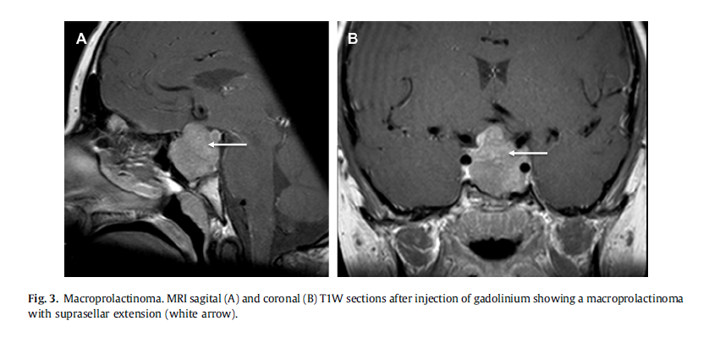

Slide 27
Diagnosis (Imaging)
Visual field testing should be performed in patients whose tumors are adjacent to or abut the optic chiasm, as visualized on an MRI scan.
If a clear distance of >2 mm is seen, this testing is unnecessary.
A CT scan of the pituitary region is useful for detecting skull base bone erosion in patients with large invasive macroprolactinomas particularly in men, which, in combination with subsequent tumor shrinkage following treatment with DAs, may result in spontaneous CSF rhinorrhea

Slide 28
Agenda
Epidemiology
Diagnosis
Clinical consequences of hyperprolactinemia
Biochemical diagnosis
Imaging
Medical treatment
Surgical treatment
Prolactinoma and pregnancy

Slide 29
Medical treatment
DAs represents the primary therapy for almost all prolactinomas, including:
microadenomas, macroprolactinomas and giant prolactinomas.
The three drugs currently that are available for this indication in most countries are bromocriptine, cabergoline and quinagolide

Slide 30
Efficacy of the different DAs
The “old” agent bromocriptine
an ergot derivative that functions as both a D1R and D2R agonist.
Although its use has largely been supplanted by CAB , some patients may continue to use this drug in specific situations :
patients whose symptoms have been well controlled by this drug for many years
young women who are planning a pregnancy and reside in countries where the use of CAB has not been approved for this indication
patients with severe cardiac valve disease

Slide 31
Efficacy of the different DAs
Most patients successfully treated with daily doses of 7.5mg or less. However, doses as high as 20-40 mg/day may be necessary for patients who display DA resistance.
BMC normalizes serum PRL levels in 78% and 72% of patients with microprolactinomas and macroprolactinomas, respectively.
The resumption of ovulatory cycles occurred in approximately 80% of women.
A significant decrease in tumor size is achieved in approximately 77% of patients

Slide 32
Efficacy of the different DAs
A significant decrease in tumor size is achieved in approximately 77% of patients, with a reduction
in tumor size greater than 50% in 40%
between 25 and 50% in 30%
and less than 25%, in the remainder of patients
some patients experience an extremely rapid decrease in tumor size with a significant improvement in visual fields noted within 24-72 hours, and changes are already apparent on images within 2 weeks.

Slide 33
Efficacy of the different DAs
The “new” agent cabergoline
CAB is an ergot derivative that is more (but not strictly) selective for D2R ,long duration of action, once or twice weekly administration.
Most patients are successfully treated with weekly doses of 0.5 or 1 mg, but a few will require doses of 3.5 mg to control their symptoms.
In a compilation of 14 prospective studies of the effects of CAB treatment on patients with hyperprolactinemic disorders, the hormonal response rate was 73-96% and the tumor size was reduced by 50-100%

Slide 34
Efficacy of the different DAs
Approximately 80-90% of patients present a rapid response (within 3 months) to low doses of CAB (less than 2.0 mg/week) and exhibit good tolerability
However, some patients require higher doses, and approximately 10-15% of patients respond to each dose increase with a step-wise reduction in their PRL levels.
Thus CAB is certainly the most effective compound to treat prolactinomas, and provides good patient compliance with long-term treatment regimens.

Slide 35
Efficacy of the different DAs
Quinagolide is a non-ergot dopamine agonist with selective D2R activity.
Therapeutic doses range from 0.075 to 0.600 mg once daily.
Its efficacy in normalizing PRL levels and reducing tumor size is similar to bromocriptine and pergolide
approximately 40% of patients who are resistant to BRC respond to quinagolide and adverse effects occur less frequently than with BRC likely because of the more specific D2R affinity and no intrinsic agonist activity towards 5-HT2B receptors.
drug is currently unavailable in the US, but is approved for use in Europe.

Slide 36
Management of medical treatment
DA is initiated at a low dose (typically 0.25-0.5 mg of CAB 1-2/W), dose is escalated at 1-3 monthly intervals according to PRL levels and the reduction in tumor size.
In patients with macroPRLomas, more intensive treatment with higher doses of CAB and a more rapid increase in the dose has been suggested to achieve a more rapid reduction in PRL levels and tumor volumes
prospective randomized study showed that intensive treatment with CAB was not superior to the conventional recommended dosage schedule with respect to the time needed to normalize PRL levels and to achieve 50% tumor shrinkage.

Slide 37
Management of medical treatment
According to Endocrine Society guidelines, once the PRL level has been normalized and tumor volume has decreased, DA therapy (sometimes at high doses) should be continued for a minimum of two years before attempting treatment withdrawal.
Another strategy is to gradually taper the DA dose to the minimum concentration required to maintain both a normal PRL level and control the tumor volume

Slide 38

March 2017 | Vol. 1, Iss. 3
doi: 10.1210/js.2017-00038 | Journal of the Endocrine Society | 221–230
Downloaded from https://academic.oup.com/jes/article-abstract/1/3/221/3001039 by guest on 23 August 2019

Slide 39
Management of medical treatment
In a large retrospective study of CAB -treated patients with macroprolactinomas, a strategy in which the CAB dose was maintained (fixed-dose group)
a strategy in which the CAB dose was tapered (de-escalation group) until the minimal effective dose required to maintain a normal PRL level was established were compared once the PRL levels were normalized

Slide 40
Management of medical treatment
Results: PRL normalized in 157 patients (60.8%) during CAB treatment.
CAB de-escalation was attempted in 84 (53.5%) of these 157 patients and was successful in 77 (91.7%) cases.
The mean CAB dose reduced from 1.52 ± 1.17 mg/wk to 0.56 ± 0.44 mg/wk at the last visit (P < 0.0001).
CAB de-escalation had no negative long-term effect on tumor size.
De-escalation was also possible in patients requiring high doses of cabergoline (2 mg/week) to normalize PRL levels.

Slide 41
Discontinuation of DA treatment
While the medical treatment of prolactinoma is generally considered a lifelong therapy in most patients
many studies have now shown that withdrawal of DA may be successful under welldefined conditions without recurrence of hyperprolactinemia.
A meta-analysis reported by Dekkers et al. in 2010, which included 19 studies and 743 patients, showed a global remission rate of 21% of all prolactinomas after DA withdrawal

Slide 42
Discontinuation of DA treatment
Slightly better results were observed in
patients with a microprolactinoma
patients who were treated for at least 2 years
patients treated with CAB rather than BRC
absence of cavernous sinus invasion
a longer treatment duration
lower PRL levels ,residual tumor diameter,CAB doses at the time of withdrawal were all associated with a higher likelihood of remission

Slide 43
Discontinuation of DA treatment
Recent studies using strictly defined criteria to eventually stop DA treatment
strict PRL normalization with the lowest dose of the DA (0.25 mg/W of CAB)
no cavernous sinus invasion
at least 2 or 3 years of treatment
tumor disappearance or a greater than 50% reduction in size on MRI
indeed shown a substantial proportion of patients with persistent normoprolactinemia after drug withdrawal In these studies:
remission rates for microprolactinomas range from 23 to 78% (overall: 47%)
remission rates for macroprolactinomas range from 7 to 73% (overall: 41%).

Slide 44
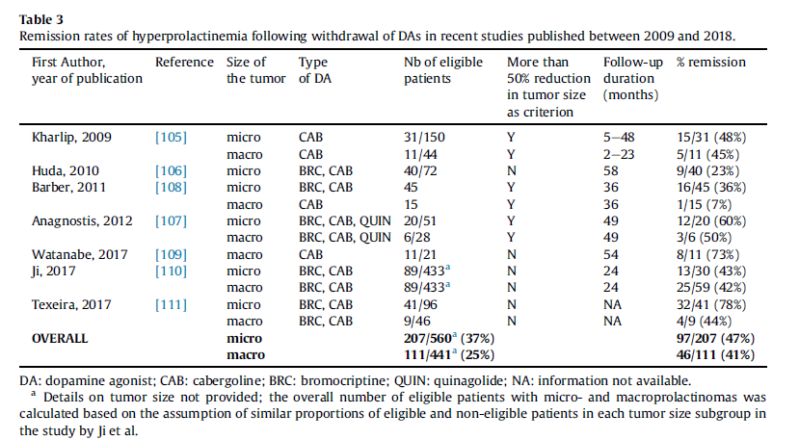
the most effective predictor of long-term remission appeared to be the observation of no visible tumor remnant on MRI at the time of drug withdrawal.

Slide 45
Short-term side effects
Nausea and vomiting, GI symptoms
Postural hypotension, dizziness, headache
Nasal stuffiness and Raynaud's phenomenon
short-term side effects are related to a parallel activation of 5-HT1R and D1R receptors, and are much more common with BMC than with CAB or quinagolide ,likely because less specific D2R agonist activity.
They can be minimized by introducing the drug at a low dose at bedtime, taking it with food, and then escalating the dose very gradually.

Slide 46
Short-term side effects
Nonsurgical CSF rhinorrhea has been reported during treatment of a large invasive macroprolactinoma with BCR or CAB.
due to rapid tumor shrinkage,partially removing the “cork” that was formed by the adenoma to cover the tumor-induced defect in the skull base A reduction in the dose but not discontinuation of the DA is advocated in these patients to achieve mild reexpansion of the adenoma and obturation of the breach

Slide 47
Long-term side effects
constrictive pericarditis
pleuropulmonary fibrosis have been reported in patients who are chronically treated with high doses of bromocriptine or cabergoline for Parkinson's disease but rather exceptionally in patients treated with lower doses for a prolactinoma
cardiac valve disease
fibrotic thickening and stiffening of the leaflets and chordae and a reduction of the valve tenting area (an index of valve closure ability)
involved mainly the tricuspid, mitral and aortic valves
Cabergoline, pergolide > bromocriptine> quinagolide(negligible)
The risk is mainly related to some DAs for the serotoninergic 5-HT2B cardiac receptors present in heart valves

Slide 48
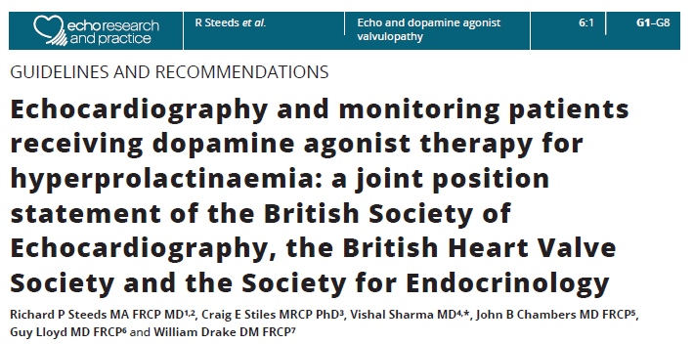
2019 The British Society of Echocardiography, the British Heart Valve Society and the Society for Endocrinology Published by Bioscientifica Ltd

Slide 49
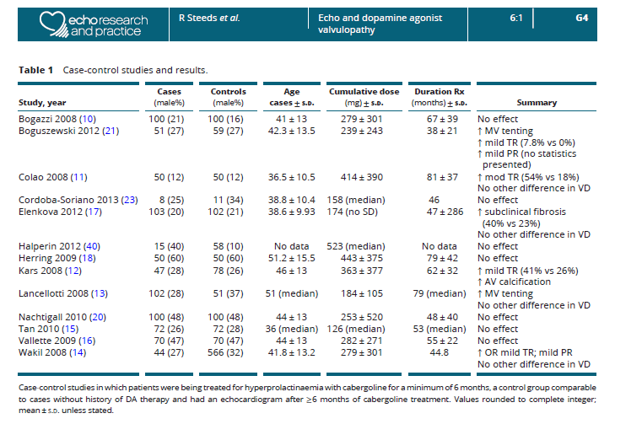

Slide 50
Current evidence
case-control studies investigating DA agonist valvulopathy in hyperprolactinaemia have provided
poor quality data
using different diagnostic criteria
multiple testing in small groups
lack of standardized assessment of valve morphology

Slide 51
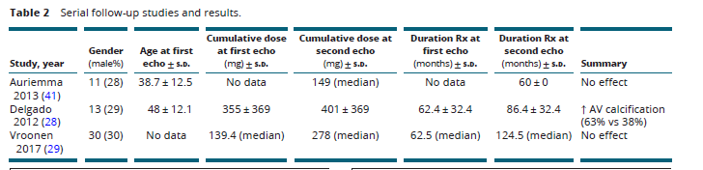

Slide 52
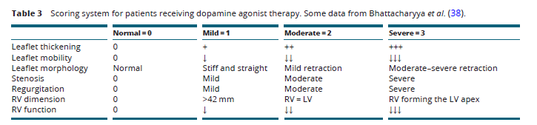
Evidence that DAs cause valvulopathy akin to carcinoid heart disease in patients with hyperprolactinaemia

Slide 53
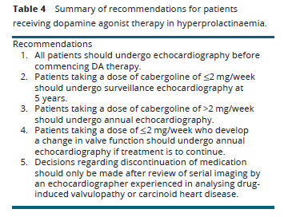

Slide 54
Long-term side effects
It is critical to understand that changes in degree of regurgitation alone, for example from mild to moderate TR, should not on its own be sufficient to alter clinical management, especially without morphological change in leaflet motion, thickness or retraction.

Slide 55
Long-term side effects
neuropsychiatric symptoms such as
psychosis (or exacerbation of preexisting psychosis)
impulse control disorders (ICDs), including pathological gambling, hypersexuality, compulsive shopping or eating, and punding (repetitive performance of tasks)
for the authors recommended that endocrinologists increase their awareness of this potential adverse event to facilitate early detection wand subsequent drug cessation

Slide 56
Agenda
Epidemiology
Diagnosis
Clinical consequences of hyperprolactinemia
Biochemical diagnosis
Imaging
Medical treatment
Surgical treatment
Prolactinoma and pregnancy

Slide 57
Surgical treatment
Indications for surgery
classical indications for neurosurgery have been restricted to a few indications:
(i) acute complications such as pituitary apoplexy or CSF leakage
(ii) resistance or intolerance to DAs
(iii) symptomatic pregnancy related tumor expansion that is refractory to medical therapy
Neurosurgery should be also considered for women with worrisome macroadenomas that are planning a pregnancy.

Slide 58
Surgical treatment
Other indications are now being reconsidered
young patients with a high likelihood of complete tumor resection
who do not wish to undergo prolonged medical treatment
patients with predominantly cystic tumors
Individuals who require higher than standard doses of cabergoline to control PRL levels (the “partially resistant” patients)
although tumor resection is incomplete,Surgical debulking may indeed improve their hormonal control with lower postoperative doses of the DA

Slide 59
Surgical treatment
Other potential indications for surgery
the patients in whom drug withdrawal might become mandatory due to rare cardiac valve complications with chronic DAS
more frequently, unacceptable ICDs

Slide 60
Neurosurgical outcome
Gillam et Al: 50 series published between1980 and 2005
4363 patients
2137 with a microprolactinoma --RR: 75%
2226 with amacroprolactinoma-- RR:34%
Chanson and Maiter :12 series published between 2005 and 2015
1583 patients
741 with a micro--RR:81%
842 with a macroprolactinoma--RR:41%

Slide 61
Neurosurgical outcome
Surgical success rates were highly variable across the series,
depending on surgeon's expertise
The absence of cavernous sinus invasion
remission rate is higher for patients with prolactinomas enclosed by the pituitary gland (87%) than for patients with adenomas located laterally (45%)
the initial magnitude of PRL hypersecretion (less than 200 µg/l)were identified as the two best factors predicting surgical success.

Slide 62
Radiotherapy
high effectiveness of medical treatment to control the symptoms of most patients and of
surgery to rapidly relieve most acute complications,
radiotherapy(RT) has become exceptionally rarely used in patients with prolactinomas.
It should be reserved for the rare large tumors that do not respond to DAs
recur or progress after surgery, and are highly aggressive or malignant

Slide 63
Agenda
Epidemiology
Diagnosis
Clinical consequences of hyperprolactinemia
Biochemical diagnosis
Imaging
Medical treatment
Surgical treatment
Prolactinoma and pregnancy

Slide 64

Endocrinol Metab Clin N Am 48 (2019) 569–581
https://doi.org/10.1016/j.ecl.2019.05.004 endo.theclinics.com
0889-8529/19/ª 2019 Elsevier Inc. All rights reserve

Slide 65
Prolactinoma and pregnancy
When women with prolactinomas get pregnant, 2 important issues arise:
(1) the effects of the DA,s on early fetal development
(2) the effect of pregnancy on prolactinoma size.
DA,s should be stopped on confirmation of pregnancy.
BMC has been shown to cross the placenta in human studies
CAB has been shown to do so in animal studies but such data are lacking in humans

Slide 66
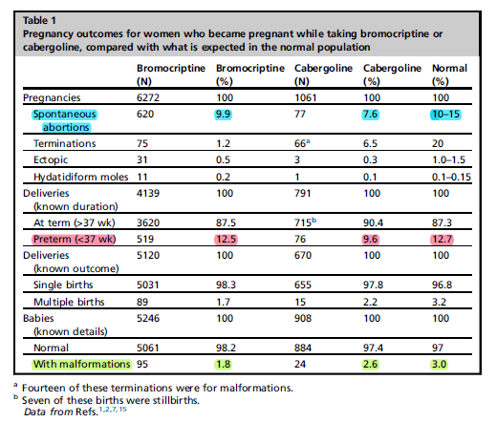
In more than 6000 pregnancies,BRC has not been associated with adverse pregnancy outcomes
no increase in malformations or other adverse pregnancy outcomes, including up to 12 years’ follow-up after exposure

Slide 67
Effects of Dopamine Agonists on the Developing Fetus
BRC has been used throughout gestation in more than 100 women, with no abnormalities noted in the infants except for 1 with an UDT and another with a talipes deformity
A summary of CAB use throughout gestation indicated that healthy infants were delivered at term but 1 had an intrauterine death at 34 weeks when the mother had severe preeclampsia.

Slide 68
Effects of Dopamine Agonists on the Developing Fetus
In a review of 176 pregnancies, quinagolide was associated with
24 spontaneous abortions
1 ectopic pregnancy, 1 stillbirth at 31 weeks of gestation
9 fetal malformations
Thus, quinagolide does not seem to be safe for pregnancy

Slide 69
Effects of Dopamine Agonists on the Developing Fetus
Hurault-Delarue reported some adverse outcomes of DA use.
57,408 mother-baby outcome pairs
183 (0.3%) had received DA at some time during their pregnancies (75% in the first trimester)Compared with a control group:
increased risk of preterm birth
early pregnancy loss and an insignificant increase in fetal malformations
but no difference in psychomotor development at ages 9 and 24 months.
There were no differences between the DA with respect to these outcomes.

Slide 70
Effect of Pregnancy on Prolactinoma Size
PRLomas can enlarge during pregnancy because of high estrogen levels and/or the discontinuation of the DA
The risk of symptomatic (headaches, visual field defects) tumor enlargement in pregnant women
with microPRLomas is : 2.5%,
macroPRLomas with no prior surgery or irradiation:18.1%
macroadenomas with prior surgery/irradiation: 4.7%
In most cases with tumor enlargement, reintroduction of the DA was successful in reversing the problem and surgery was rarely required

Slide 71
Effect of Pregnancy on Prolactinoma Size
In a small proportion of those cases, the tumor enlargement reflected tumor apoplexy; however, the true incidence of apoplexy is unknown
Postpartum PRL levels and tumor sizes often decrease compared with values before pregnancy, but this has not been observed in all series.
Reinstitution of DA has to await the cessation of breastfeeding and is done only in women who remain anovulatory.

Slide 72
Management of Prolactinoma During Pregnancy
Pregnancy can generally be achieved in more than 85% of patients with DA or surgery.
DA,s: the best primary treatment because of their efficacy in restoring ovulation.
Compared with BRC, CAB is better tolerated, more efficacious, and is similarly safe
TSS : a permanent reduction of PRL levels in only 60%-70% of cases and entails morbidity and mortality, albeit at low rates.
Radiotherapy is not warranted for patients with microadenomas because of the risk of long-term sequelae, especially hypopituitarism

Slide 73
Management of Prolactinoma During Pregnancy
Patients with a microadenoma or a small intrasellar macroadenoma
who were treated with a DA and had medication withdrawal after conception need only to be followed clinically throughout gestation.
periodic checking of PRL levels is not recommended
PRL levels do not always increase during pregnancy in women with prolactinomas, even in those with tumor enlargement and PRL levels may rise significantly without any tumor size increase.
visual field testing and MRI scanning are only performed in patients who become symptomatic.
Recently, slight increases in risks of stillbirths, neonatal deaths, and the broad outcome of any rheumatological, inflammatory, or infiltrative skin condition were shown with first-trimester gadolinium exposure. No adverse effects from MRI with or without gadolinium have been shown in the late second or third trimesters.

Slide 74
Management of Prolactinoma During Pregnancy
In patients with a larger macroadenoma
baseline MRI scan just before pregnancy.
The most common approach is to stop the DA after pregnancy is diagnosed,If there was substantial shrinkage of a very large tumor with the DA, then stopping the drug abruptly might cause a sudden enlargement of the tumor. In such a case, the wisest course could be to continue the DA
Another approach is to debulk the tumor via TSS, which reduces the risk of serious tumor enlargement, but cases of tumor expansion during pregnancy after such surgery have been reported.
After surgical debulking, a dopamine agonist is generally required to normalize PRL levels and allow ovulation.

Slide 75
Management of Prolactinoma During Pregnancy
Third approach is to give the DA continuously throughout gestation, but data regarding effects on the fetus are meager
For patients with macroadenomas treated with a DA alone or after surgery, careful follow-up with monthly to 3-monthly formal visual field testing is warranted.
Repeat MRI scanning is reserved for patients with symptoms of tumor enlargement and/or visual field defect

Slide 76
Management of Prolactinoma During Pregnancy
Should symptomatic tumor enlargement occur with any of these approaches,
reinstitution of the DA is probably less harmful to the mother and child than surgery.
Any type of surgery during pregnancy results in a 1.5-fold and 5-fold increase in fetal loss in the first and second trimester respectively, but without risk of congenital malformations.
In addition, pregnant women have significantly increased risks of postoperative complications, including infections and even mortality

Slide 77
Management of Prolactinoma During Pregnancy
Although suckling stimulates PRL secretion in normal women for the first few weeks to months postpartum, there are no data to suggest that breastfeeding can cause tumor growth.
Thus, there seems to be no reason to discourage nursing in women with prolactinomas.

