Slide 3
OBJECTIVE

Slide 4
تفاوت‌هاي روزه‌داري اسلامي و روزه‌‌داري تجربي (FASTING)

Slide 5
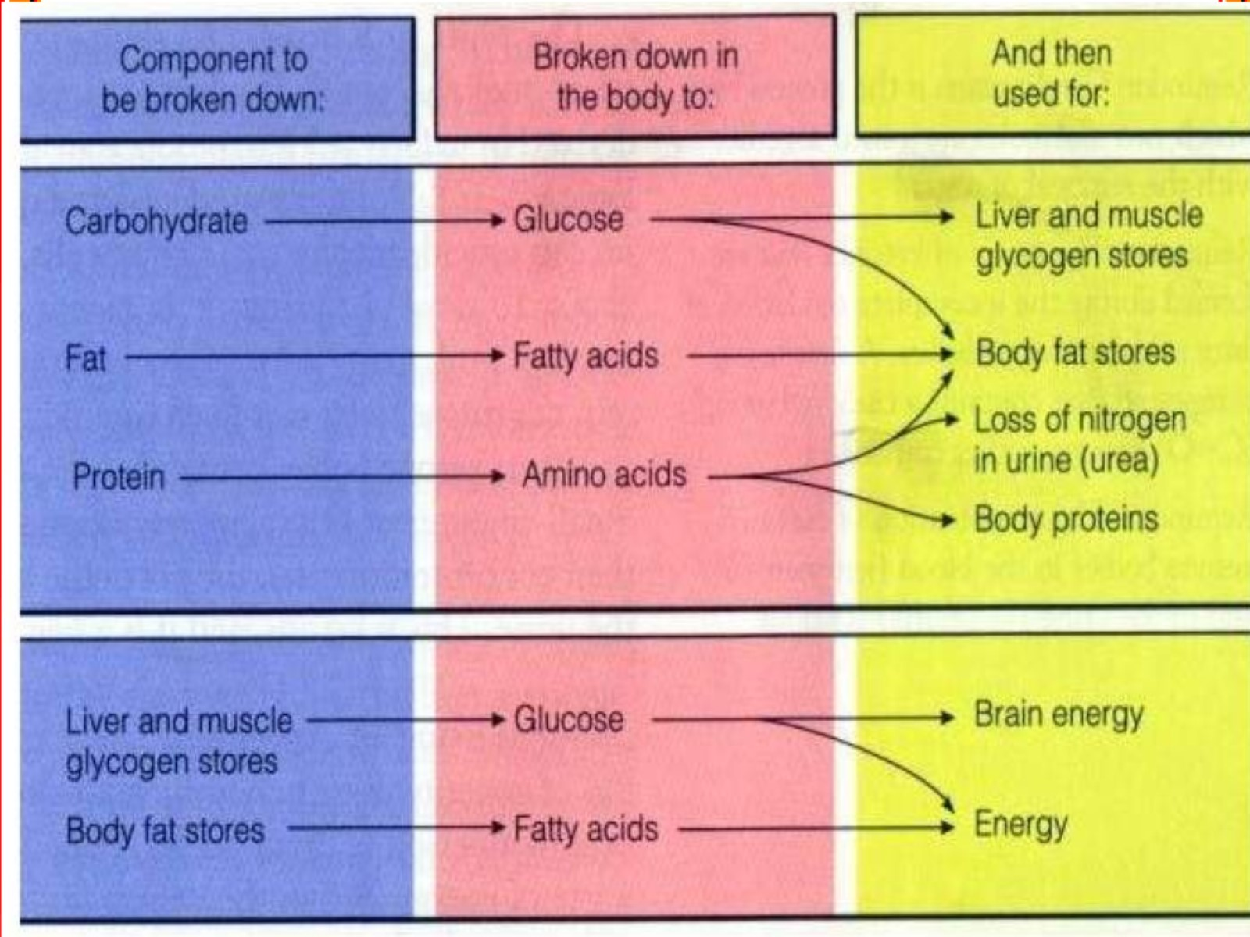

Slide 6
Glucose Turnover

Slide 7
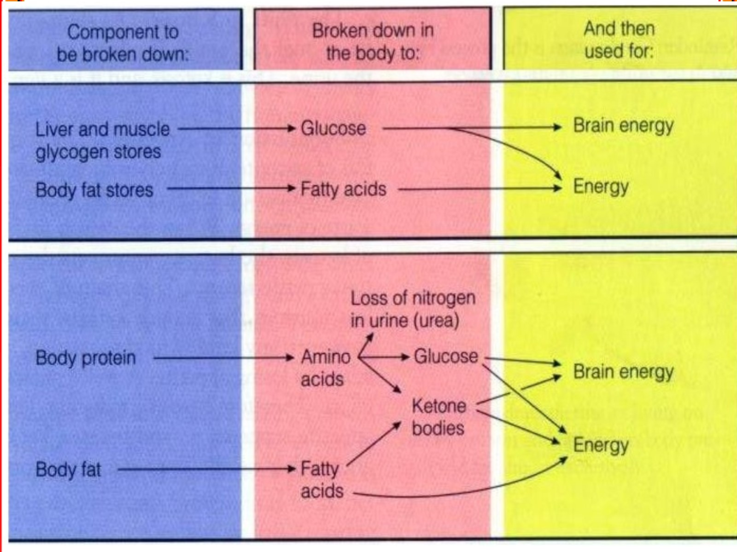

Slide 9
Mean continuous glucose monitoring (CGM) profiles from patients with diabetes before and during Ramadanme A rapid rise in blood glucose is seen at iftar time*

Slide 10
The growing problem of diabetes in Muslim-majority countries

Slide 11
Fasting in type 1 diabetics

Slide 12
Changing in lifestyle during Ramadan

Slide 14
Up to 79% of Muslims with diabetes fast for at least 15 days during Ramadan

Slide 15
Change in physical activity and food intake during Ramadan in patients with diabetes

Slide 16
Change in dosage of insulin and oral hypoglycemic drugs during Ramadan

Slide 17
Management of diabetes during Ramadan _{(continued)}

Slide 18
Key components of a Ramadan-focused educational programme

Slide 19
Factors for risk quantification

Slide 20
Major risks associated with fasting in patients with diabetes

Slide 21
Categories of risks in patients with type 1 or type 2 diabetes who fast during Ramadan

Slide 22
Categories of risks in patients with type 1 or type 2 diabetes who fast during Ramadan

Slide 23
Categories of risks in patients with type 1 or type 2 diabetes who fast during Ramadan

Slide 24
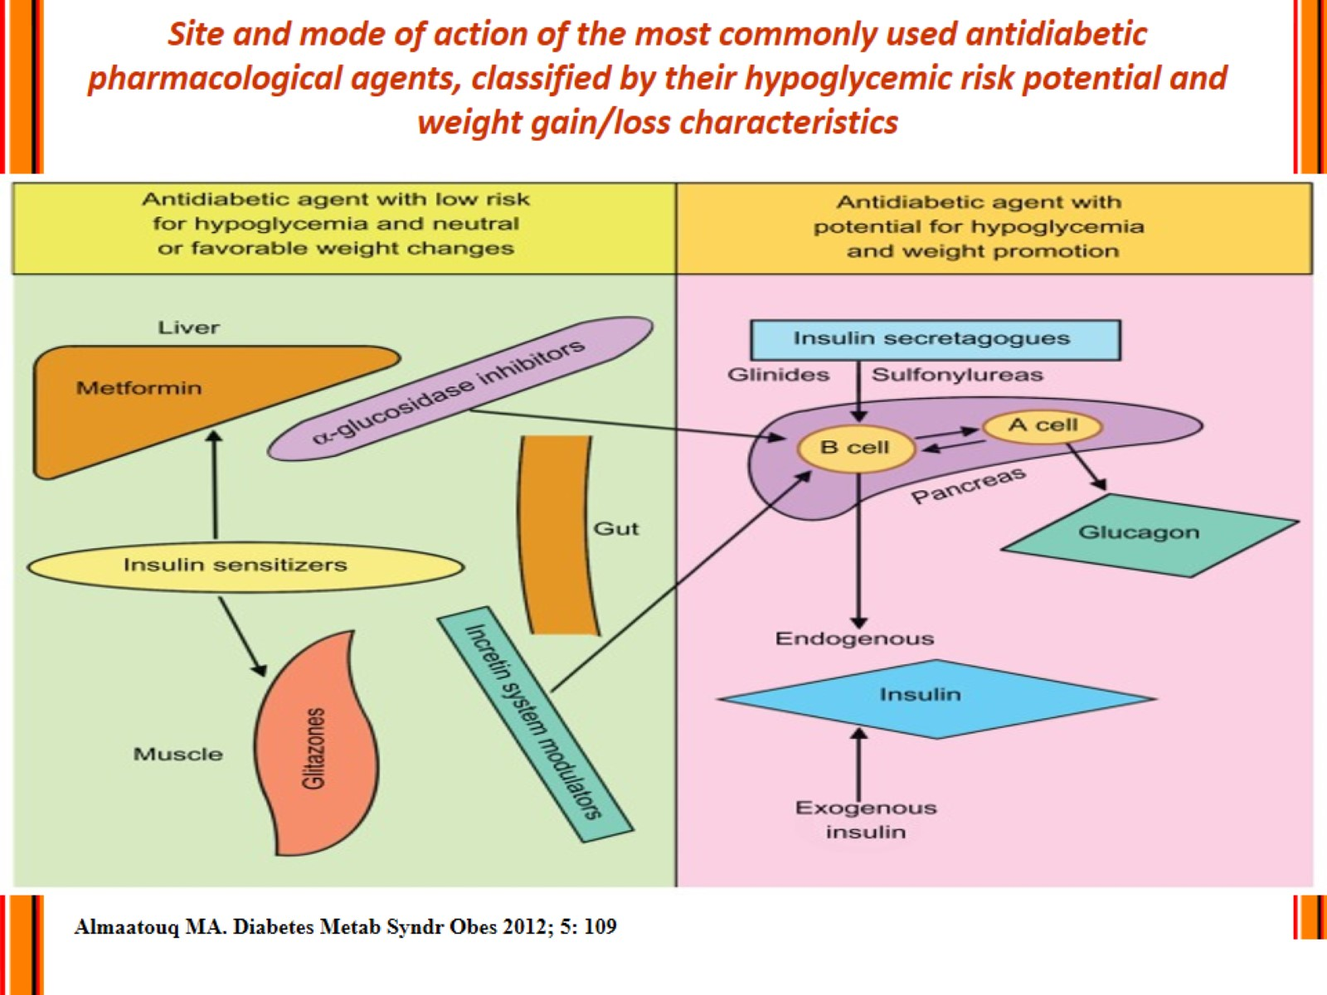
Site and mode of action of the most commonly used antidiabetic pharmacological agents, classified by their hypoglycemic risk potential and weight gain/loss characteristics

Slide 25
Recommended changes of treatment regimen in patients with type 2 diabetes who fast during Ramadan

Slide 26
Recommended changes of treatment regimen in patients with type 2 diabetes who fast during Ramadan

Slide 27
Recommended changes of treatment regimen in patients on insulin therapy who fast during Ramadan

Slide 28
Algrithm for premixed insuling titration during Ramadan

Slide 29
Recommended changes of treatment regimen in patients on insulin therapy who fast during Ramadan

Slide 30
Recommendations for prevention of hypoglycaemia during Ramadan

Slide 31
When to break the fast

Slide 32
Recommended timings to check blood glucose levels during Ramadan fasting

Slide 33
Conclusion (1)

Slide 34
Conclusion (2)

Slide 35
Conclusion (3)

