Slide 1

IN THE NAME OF GOD
IN THE NAME OF GOD

Slide 2
Lipid Management in Patients with Endocrine
Disorders
An Endocrine Society Clinical Practice
Guideline

Slide 3
AGENDA
Screening and cardiovascular disease risk
Assessment
Type 2 diabetes mellitus
Type 1 diabetes mellitus
Obesity
Thyroid disease
Excess glucocorticoids
Disorders of growth hormone secretion
Polycystic ovary syndrome
Menopause and hormonal replacement
Hypogonadism and testosterone replacement
and abuse

Slide 4
Screening and cardiovascular disease risk assessment

Slide 5
In adults with endocrine disorders, we recommend a lipid panel for the assessment of TG levels and for calculating low-density lipoprotein cholesterol (LDL-C). (1⊕⊕⊕O)

Slide 6
Technical Remark
Nonfasting lipid panels are acceptable for initial screening.
If TG levels are elevated or if genetic dyslipidemia is suspected, repeat a fasting lipid panel.
If lipoprotein(a) levels are measured, fasting or nonfasting samples can be obtained.

Slide 7
Cardiovascular risk assessment

Slide 8
In adults with endocrine disorders, we recommend conducting CV risk assessment by evaluating traditional risk factors, including calculation of 10-year ASCVD risk using a tool such as the Pooled Cohort Equations. (1⊕⊕⊕O)

Slide 9
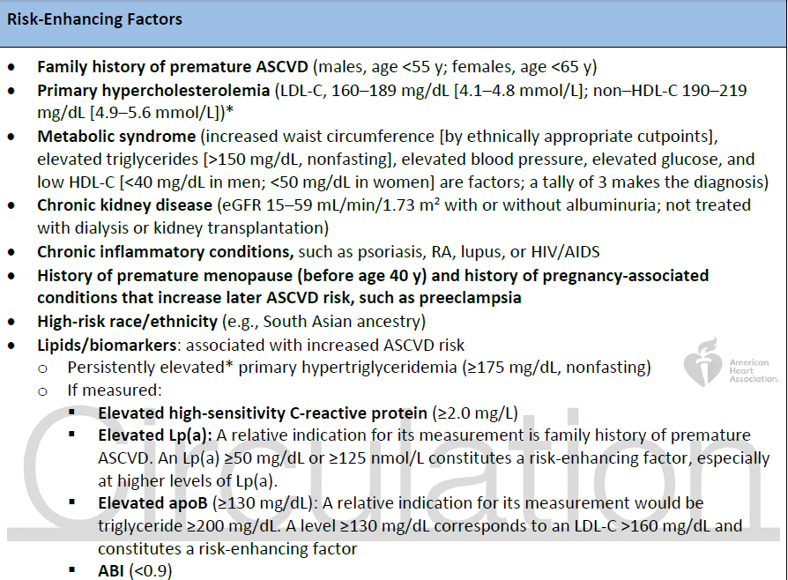
2019 ACC/A HA Guideline on the Primary Prevention of Cardiovascular Disease

Slide 10
In adults with endocrine disorders at borderline or intermediate risk (10-year ASCVD risk 5–19.9%), particularly those with additional risk-enhancing factors, in whom the decision about statin treatment and/or other preventive interventions is uncertain, we suggest measuring coronary artery calcium (CAC) to inform shared decision-making. (2⊕⊕⊕O)

Slide 11
Technical Remark
Borderline and intermediate CV risk are defined as 5% to 7.4% and 7.5% to 19.9% 10-year ASCVD risk using the Pooled Cohort Equations.

Slide 12
Technical Remark
Risk-enhancing factors are additional features, including diseases, that enhance the risk of ASCVD beyond the risk associated with major risk factors and/or the calculated 10-year risk of ASCVD.

Slide 13
Technical Remark
In patients with additional risk-enhancing factors, including elevated Lp(a), risk assessment should consider traditional 10-year ASCVD risk assessment and the presence of risk-enhancing factors. The CAC score should be considered when risk assessment and treatment decisions remain uncertain.

Slide 14
Technical Remark
At present, we suggest measuring CAC as the preferred tool for assessment of subclinical atherosclerosis. Other techniques to assess atherosclerotic burden are being developed.

Slide 15
CAC = 0 marks very low risk of ASCVD.
In patients with baseline CAC = 0, evidence suggests that it is reasonable to repeat a CAC scan :
after 5 to 7 years in low-risk patients
3 to 5 years in borderline-to-intermediate risk
in 3 years for high-risk patients or those with diabetes.

Slide 16
In patients without diabetes and ASCVD
Initiation of statin
with LDL-C >70 mg/dL and 10-year ASCVD risk >7.5%
10 year ASCVD risk 5% to 7.4% plus 1 or more risk-enhancing factors
CAC score over 75th percentile foe age, sex and race
CAC score>100

Slide 17
a family history of premature ASCVD
a personal history of ASCVD
family history of high Lp(a)
we suggest measuring Lp(a) to inform decision-making about short-term and lifetime ASCVD risk and the need to intensify LDL-C–lowering therapy. (2⊕⊕OO)

Slide 18
Technical Remark
Lp(a) ≥50 mg/dL (125 nmol/L) enhances risk of ASCVD.
Lp(a) testing does not need to be repeated if it has previously been measured (ie, in childhood or early adulthood).
It is not yet known whether reducing Lp(a) reduces ASCVD.

Slide 19
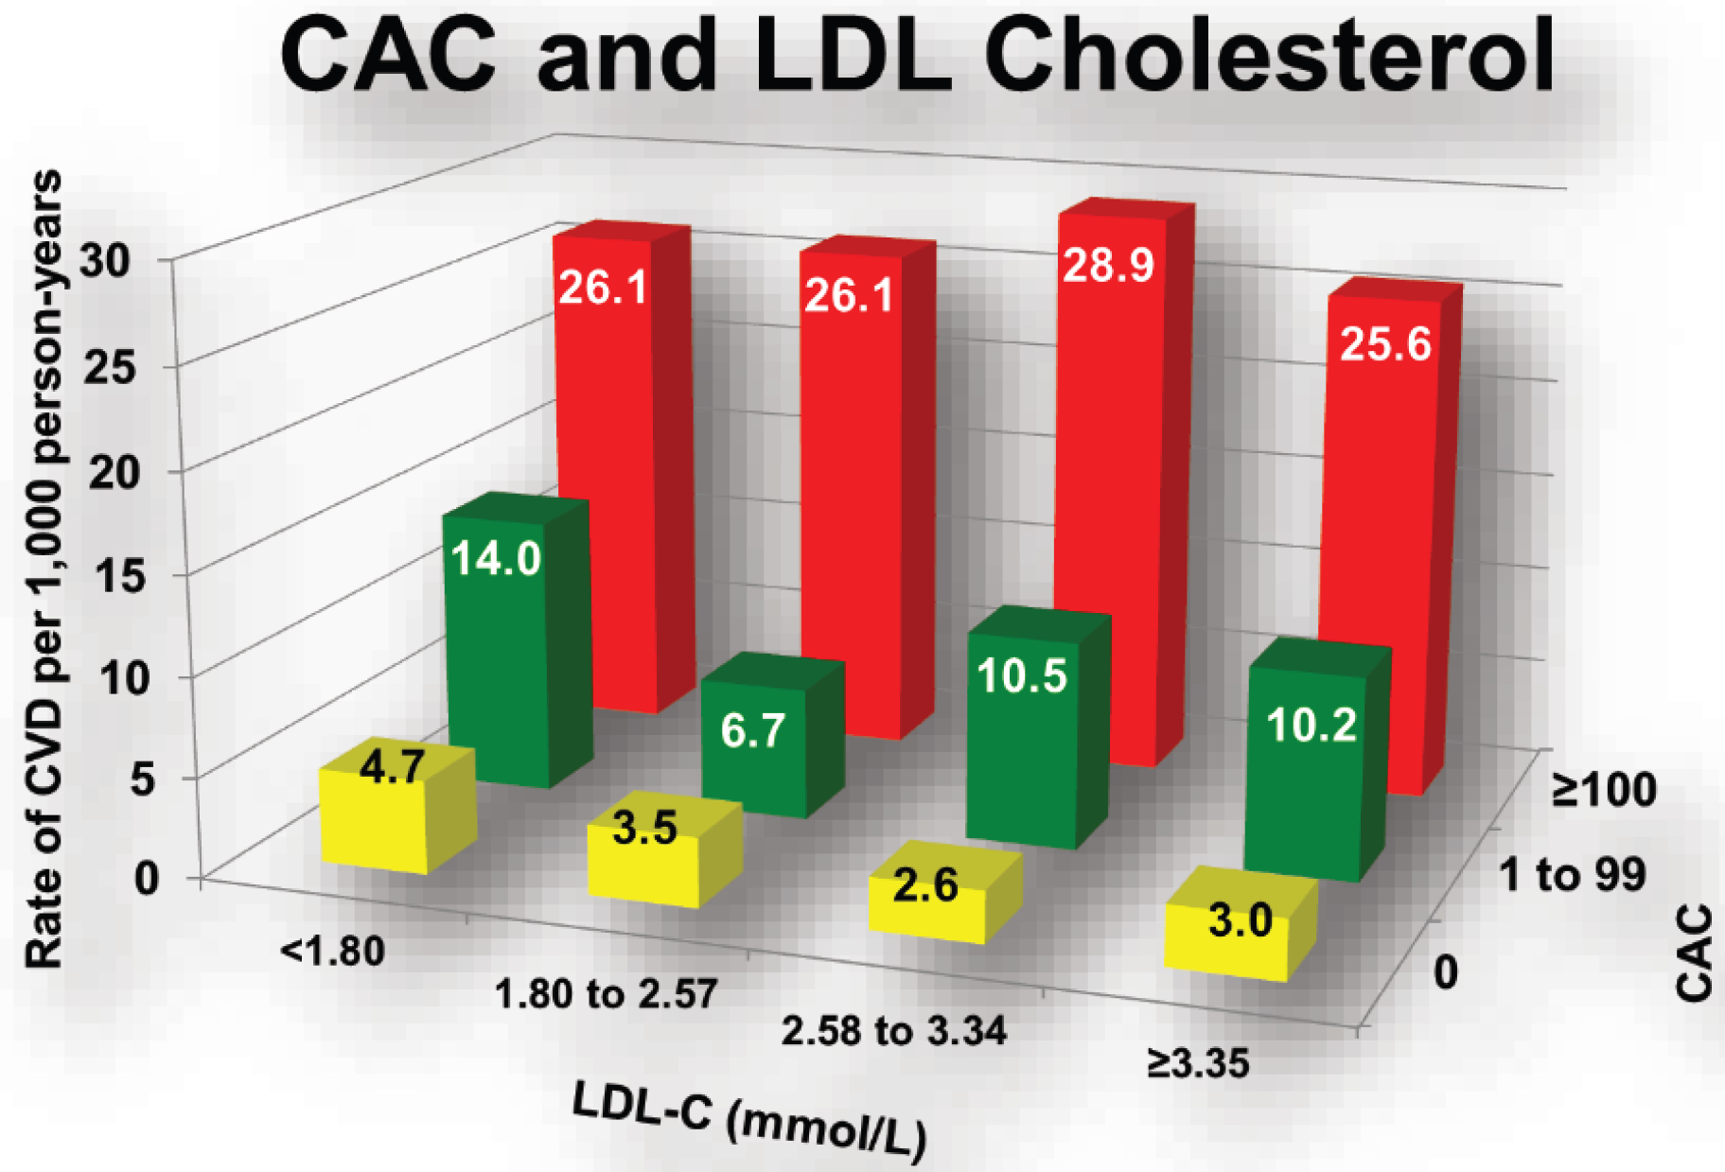
Dyslipidemia, Coronary Artery Calcium, and Incident Atherosclerotic Cardiovascular Disease Circulation. 2014 Jan 7; 129(1): 77–86.

Slide 20
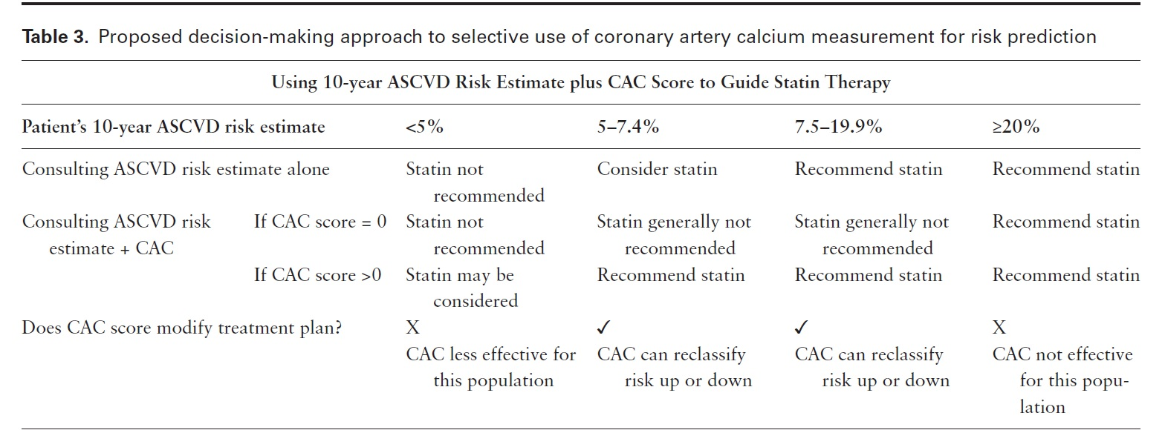
Lipid Management in Patients with Endocrine
Disorders: An Endocrine Society Clinical Practice
Guideline

Slide 21
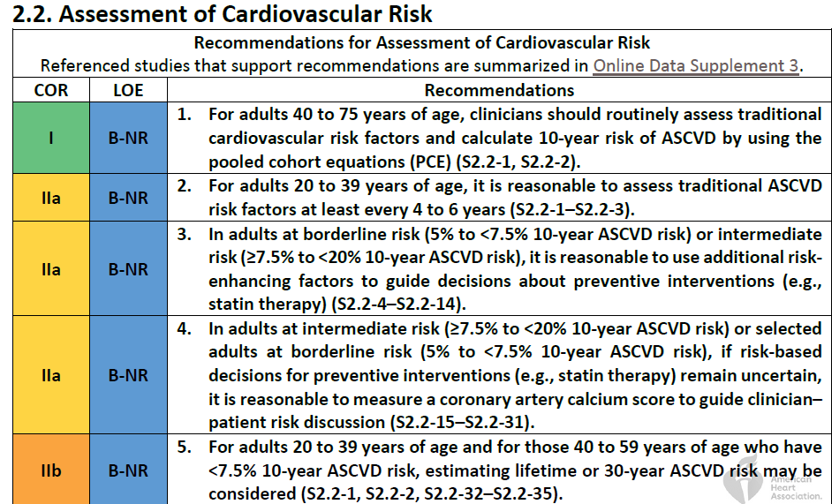
2019 ACC/AHA Guideline on the Primary Prevention of Cardiovascular Disease

Slide 22
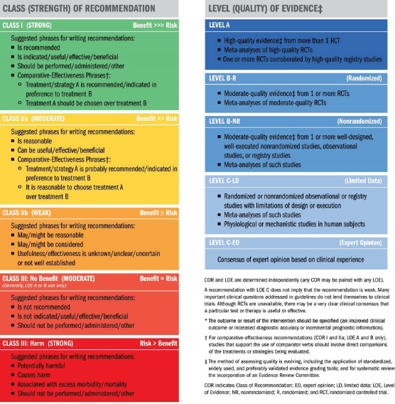

Slide 23
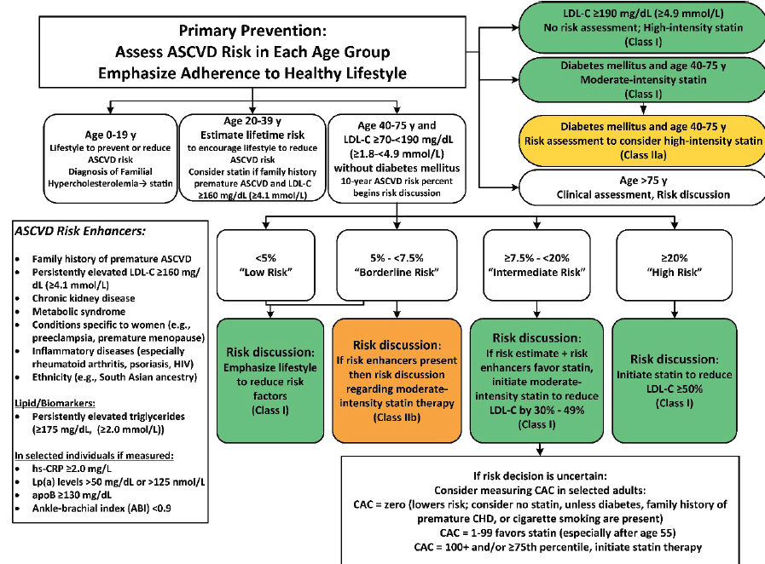
2019 ACC/A HA Guideline on the Primary Prevention of Cardiovascular Disease

Slide 24
Type 2 diabetes mellitus

Slide 25
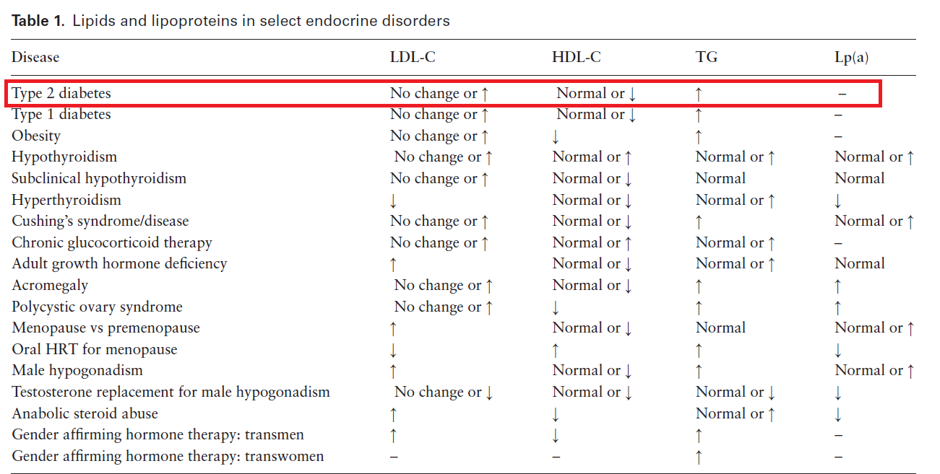

Slide 26
In adults with T2D and other CV risk factors, we recommend statin therapy in addition to lifestyle modification in order to reduce CV risk. (1⊕⊕⊕⊕)

Slide 27
High-intensity statins
1
Patients with ASCVD
2
Those with risk factors for ASCVD
3
Risk enhancing factors

Slide 28
Technical Remark
Statins should not be used in women who are pregnant or trying to become pregnant.

Slide 29
Technical Remark
In patients over the age of 75:
continuation of statin treatment or initiation of statin treatment depends upon:
ASCVD risk
prognosis
potential interacting medications
polypharmacy
mental health
and the wishes of the patient

Slide 30
In adults with T2D and other CV risk factors, we suggest lowering LDL-C to achieve a goal of LDL-C <70 mg/dL in order to reduce CV risk. (2⊕OOO)

Slide 31
Technical Remark
A statin should be added to lifestyle modifications if LDL-C is >70 mg/dL .
LDL-C should be <55 mg/dL in patients with established CVD or multiple risk factors.

Slide 32
Technical Remark
Additional LDL-lowering therapy (ezetimibe, pcsk9 inhibitor) may be needed if the LDL-C goal is not reached with statins.
Risk factors include traditional risk factors and risk enhancing factors.

Slide 33
In adults with T2D on a statin at LDL goal with
residual TG over 150 mg/dL and with
2 additional traditional risk factors or
risk enhancing factors
we suggest adding EPA ethyl ester to reduce CV risk. (2⊕⊕⊕O)

Slide 34
Technical Remark
Consider 4g/day of EPA ethyl ester.
If EPA ethyl ester is not available or accessible, then it is reasonable to consider a fibrate, such as fenofibrate.

Slide 35
In adults with T2D with CKD stages 1–4 and postrenal transplant, we suggest statin therapy, irrespective of the CV risk score, to reduce CV risk. (2⊕OOO)

Slide 36
Technical Remark
When selecting the statin, consider the renal clearance of the statin.
Pitavastatin, pravastatin, and rosuvastatin all have at least partial clearance through the kidney.
whereas atorvastatin, fluvastatin, lovastatin, and simvastatin are cleared via the liver.
All statins require dose adjustments in CKD except for atorvastatin and fluvastatin.

Slide 37
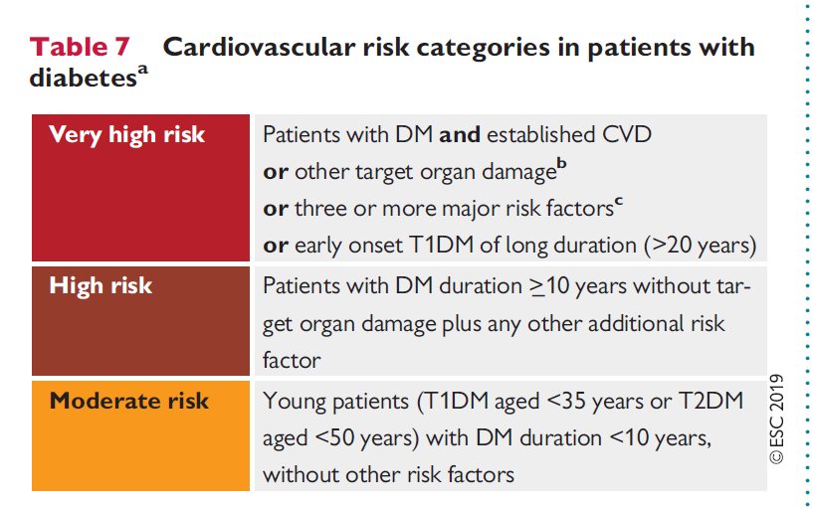
2019 ESC Guidelines on diabetes, pre-diabetes, and cardiovascular diseases developed in collaboration with the EASD

Slide 38
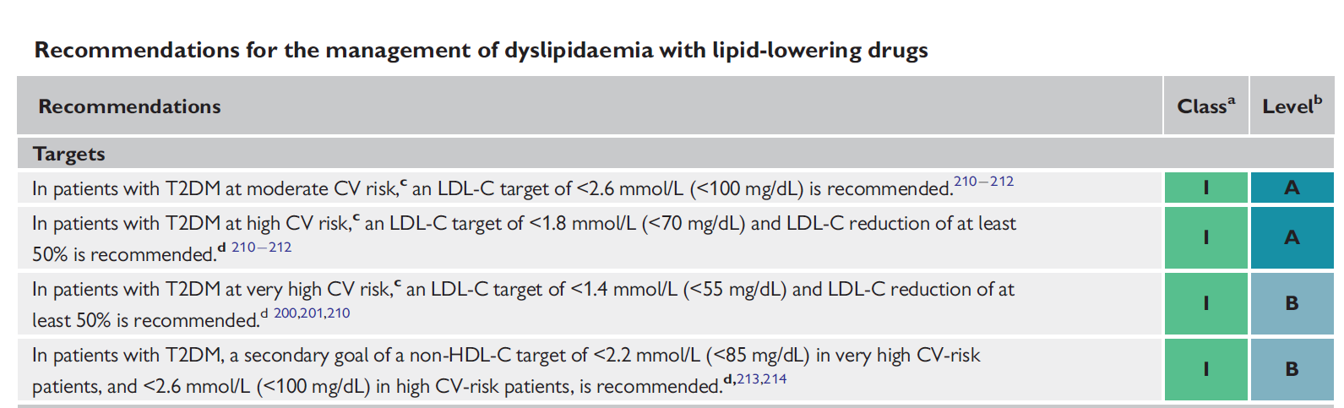
2019 ESC Guidelines on diabetes, pre-diabetes, and cardiovascular diseases developed in collaboration with the EASD

Slide 39
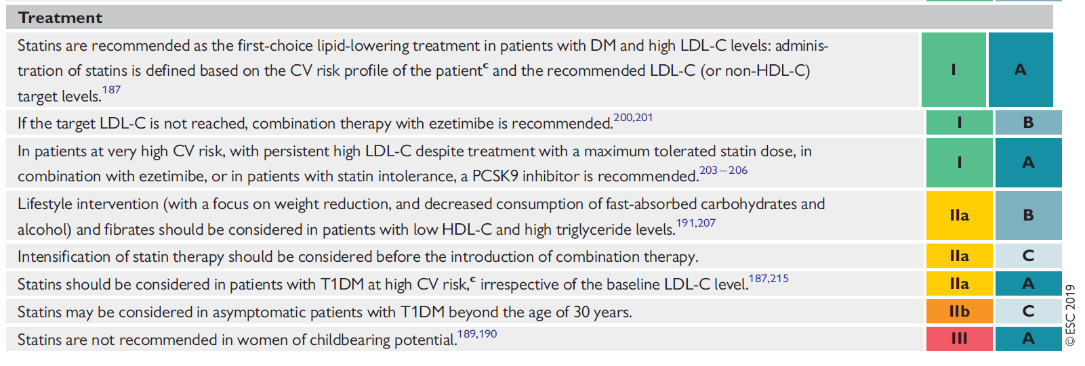
2019 ESC Guidelines on diabetes, pre-diabetes, and cardiovascular diseases developed in collaboration with the EASD

Slide 40
Cardiovascular Disease and Risk Management: Standards of Medical Care in Diabetes—2021
In adults not taking statins or other lipid-lowering therapy:
it is reasonable to obtain a lipid profile at the time of diabetes diagnosis, at an initial medical evaluation, and every 5 years thereafter if under the age of 40 years, or more frequently if indicated. E

Slide 41
Cardiovascular Disease and Risk Management: Standards of Medical Care in Diabetes—2021
Obtain a lipid profile:
at initiation of statins or other lipid-lowering therapy
4–12 weeks after initiation or a change in dose
and annually thereafter
it may help to monitor the response to therapy and inform medication adherence. E

Slide 42
Cardiovascular Disease and Risk Management: Standards of Medical Care in Diabetes—2021
Primary Prevention:
For patients with diabetes aged 40–75 years without atherosclerotic cardiovascular disease
use moderate-intensity statin therapy in addition to lifestyle therapy. A

Slide 43
Cardiovascular Disease and Risk Management: Standards of Medical Care in Diabetes—2021
Primary Prevention:
For patients with diabetes aged 20–39 years with additional atherosclerotic cardiovascular disease risk factors:
it may be reasonable to initiate statin therapy in addition to lifestyle therapy. C

Slide 44
Cardiovascular Disease and Risk Management: Standards of Medical Care in Diabetes—2021
Primary Prevention:
In patients with diabetes at higher risk, especially those with multiple atherosclerotic cardiovascular disease risk factors or aged 50–70 years:
it is reasonable to use high-intensity statin therapy. B

Slide 45
Cardiovascular Disease and Risk Management: Standards of Medical Care in Diabetes—2021
Primary Prevention:
In adults with diabetes and 10-year atherosclerotic cardiovascular disease risk of 20% or higher:
it may be reasonable to add ezetimibe to maximally tolerated statin therapy to reduce LDL cholesterol levels by 50% or more. C

Slide 46
Cardiovascular Disease and Risk Management: Standards of Medical Care in Diabetes—2021
Secondary Prevention:
For patients of all ages with diabetes and atherosclerotic cardiovascular disease:
high-intensity statin therapy should be added to lifestyle therapy. A

Slide 47
Cardiovascular Disease and Risk Management: Standards of Medical Care in Diabetes—2021
Secondary Prevention:
For patients with diabetes and atherosclerotic cardiovascular disease considered very high risk using specific criteria:
if LDL cholesterol is ≥70 mg/dL on maximally tolerated statin dose, consider adding additional LDL-lowering therapy (such as ezetimibe or PCSK9 inhibitor). A
Ezetimibe may be preferred due to lower cost.

Slide 48
Cardiovascular Disease and Risk Management: Standards of Medical Care in Diabetes—2021
Secondary Prevention:
For patients who do not tolerate the intended intensity, the maximally tolerated statin dose should be used. E

Slide 49
Cardiovascular Disease and Risk Management: Standards of Medical Care in Diabetes—2021
Secondary Prevention:
In adults with diabetes aged >75 years already on statin therapy, it is reasonable to continue statin treatment. B

Slide 50
Cardiovascular Disease and Risk Management: Standards of Medical Care in Diabetes—2021
Secondary Prevention:
In adults with diabetes aged >75 years, it may be reasonable to initiate statin therapy after discussion of potential benefits and risks. C

Slide 51
Cardiovascular Disease and Risk Management: Standards of Medical Care in Diabetes—2021
Secondary Prevention:
Statin therapy is contraindicated in pregnancy. B

Slide 52
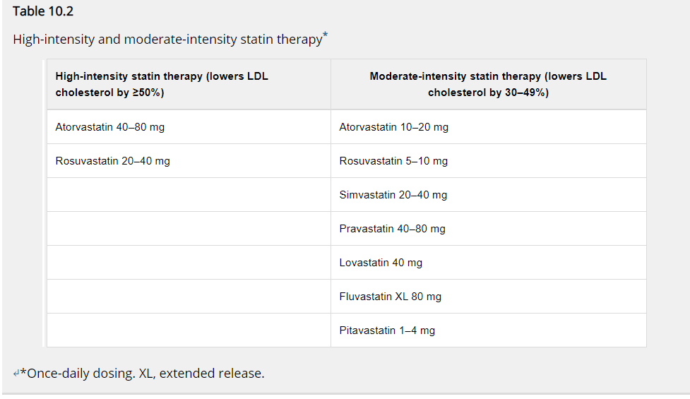
Cardiovascular Disease and Risk Management: Standards of Medical Care in Diabetes—2021

Slide 53
Type 1 diabetes mellitus

Slide 54
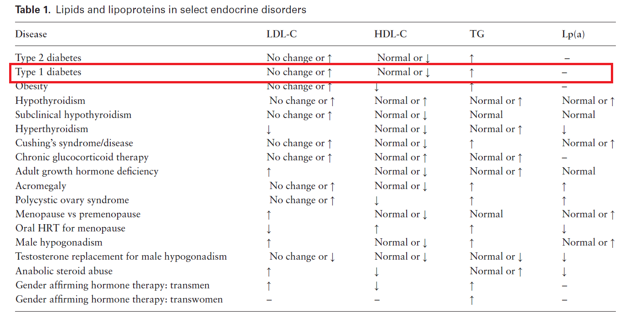

Slide 55
In adults with T1D:
age 40 years and older and/ or
with duration of diabetes > 20 years
and/or microvascular complications
we suggest statin therapy, irrespective of the CV risk score, to reduce CV risk. (2⊕OOO)

Slide 56
Technical Remark
LDL should be the primary target for lipid-lowering therapy.
Consider therapy if LDL is over 70 mg/dl (1.8 mmol/L).
Statins should not be used in women who are pregnant or trying to become pregnant.

Slide 57
In adults with T1D with CKD in stages 1 to 4, we suggest statin therapy, irrespective of the CV risk score, to reduce CV risk. (2⊕OOO)

Slide 58
Technical Remark
LDL should be the primary target for lipid-lowering therapy.
Consider therapy if LDL is over 70 mg/dL

Slide 59
Technical Remark
When selecting the statin, consider the renal clearance of the statin:
pitavastatin, pravastatin, and rosuvastatin all have at least partial clearance through the kidney
whereas atorvastatin, fluvastatin, lovastatin, and simvastatin are cleared via the liver.
All statins require dose adjustments in CKD except for atorvastatin and fluvastatin.

Slide 60
Technical Remark
Ezetimibe can be added to the statin if required to lower LDL-C further. No dose adjustments of ezetimibe are needed in CKD.

Slide 61
In adults with T1D with obesity, or with high TG and low HDL-C, we suggest statin therapy, irrespective of the CV risk score, to reduce CV risk. (2⊕OOO)

Slide 62
Technical Remark
LDL should be the primary target for lipid-lowering therapy.
Consider therapy if LDL-C is over 70 mg/dL

Slide 63
Technical Remark
In adults with T1D and diabetic retinopathy, we suggest statin therapy, irrespective of the CV risk score, to reduce CV risk. (2⊕OOO)

Slide 64
Technical Remark
LDL should be the primary target.
Consider therapy if LDL-C is over 70 mg/dL

Slide 65
Cardiovascular Disease and Risk Management: Standards of Medical Care in Diabetes—2021
Even though the data are not definitive, similar statin treatment approaches should be considered for patients with type 1 or type 2 diabetes, particularly in the presence of other cardiovascular risk factors.

Slide 66
Cardiovascular Disease and Risk Management: Standards of Medical Care in Diabetes—2021
Patients below the age of 40 have lower risk of developing a cardiovascular event over a 10-year horizon; however, their lifetime risk of developing cardiovascular disease and suffering an MI, stroke, or cardiovascular death is high.

Slide 67
Cardiovascular Disease and Risk Management: Standards of Medical Care in Diabetes—2021
For patients who are younger than 40 years of age and/ or have type 1 diabetes with other ASCVD risk factors, it is recommended that the patient and health care provider discuss the relative benefits and risks and consider the use of moderate-intensity statin therapy.

Slide 68
Obesity

Slide 69
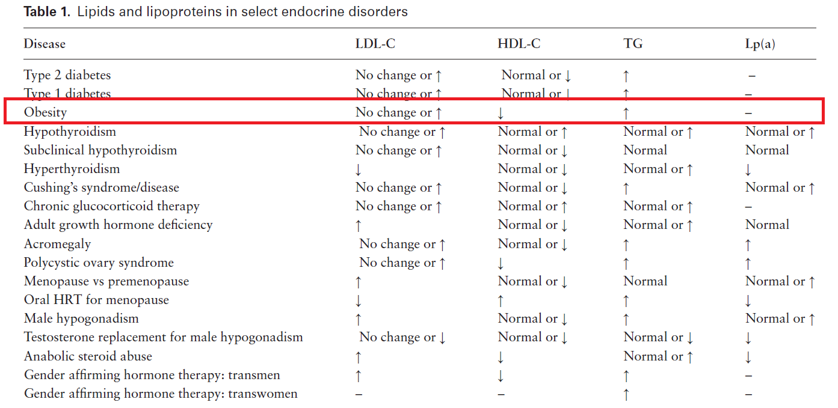

Slide 70
In individuals who have obesity, we suggest lifestyle measures as the first-line treatment to reduce plasma TG to lower CV and pancreatitis risk. (2⊕OOO)

Slide 71
Technical Remark
Reductions in LDL-C and increases in HDL-C are modest compared with the decrease in TG with lifestyle measures that produce weight loss.
Lifestyle therapy–induced changes in the lipid profile in obesity have not been shown to reduce CVD events.

Slide 72
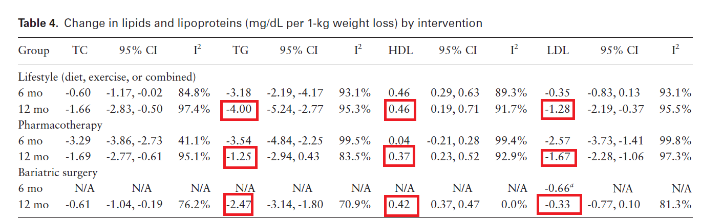

Slide 73
In individuals who have obesity, we recommend the assessment of 10-year risk for ASCVD to guide the use of lipid-lowering therapy. (1⊕⊕⊕O)

Slide 74
Technical Remark
Calculation of 10-year risk for ASCVD may be done using the Pooled Cohort Equations.
Elevated LDL-C is predictive of CV risk

Slide 75
In individuals who have obesity and are on
pharmacological therapy for weight reduction, we suggest reassessment of the lipid profile to evaluate the risk of CVD and pancreatitis. (2⊕OOO)

Slide 76
Technical Remark
As there are no data on the timing of lipid measurements after weight loss, we suggest reassessment of lipids after 5% weight loss and periodically thereafter, when the weight is stable.

Slide 77
In individuals with obesity (BMI >40 or >35 kg/m2 with comorbidities), who undergo bariatric surgery, we suggest measurement of the lipid profile after bariatric surgery to assess CV risk. (2⊕OOO)

Slide 78
Technical Remark
Malabsorptive bariatric surgery procedures (eg, Rouxen- Y gastric bypass [RYGB]) are more effective than restrictive procedures (eg, banding, sleeve gastrectomy [SG]) in decreasing LDL-C levels.

Slide 79
Technical Remark
Both restrictive and malabsorptive procedures decrease TG.
Reassess lipid profile:
1 to 3 months after bariatric surgery and periodically thereafter and when weight is stable.

Slide 80
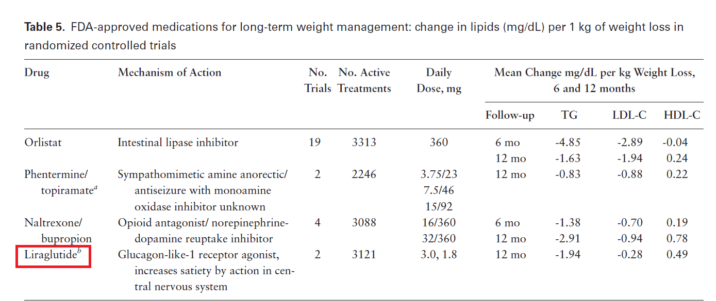

Slide 81
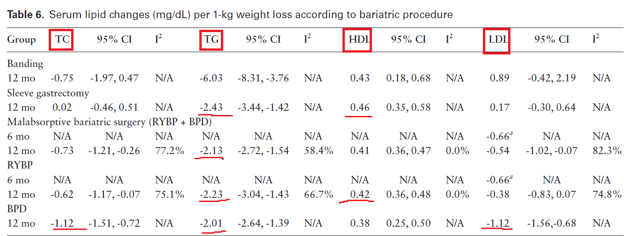

Slide 82
Thyroid disease

Slide 83
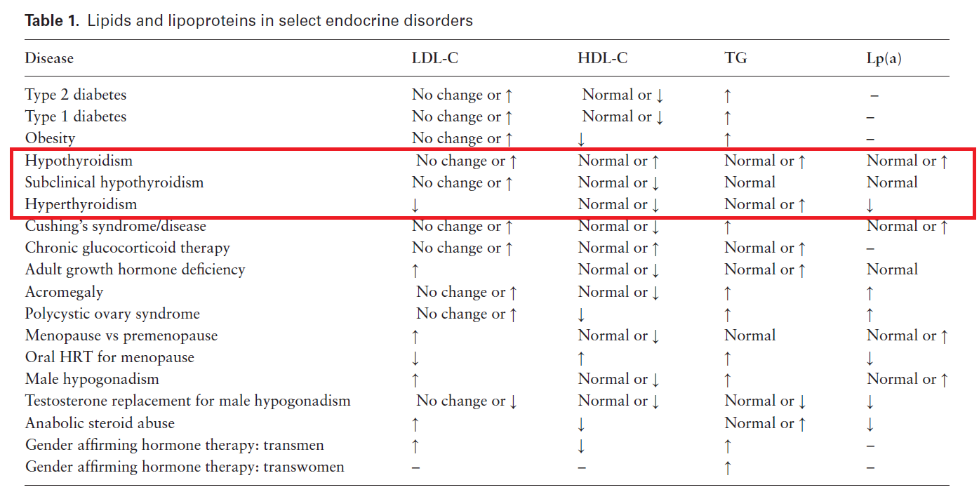

Slide 84
In patients with hyperlipidemia, we recommend ruling out hypothyroidism as the cause of the hyperlipidemia before treatment with lipid lowering medications. (1⊕⊕⊕⊕)

Slide 85
Technical Remark
Hypothyroidism can elevate both cholesterol and TG levels, which improve with treatment.

Slide 86
In patients with hyperthyroidism, we recommend re-evaluating the lipid panel after the patient becomes euthyroid. (1⊕⊕⊕⊕)

Slide 87
Technical Remark
Changes in LDL-C have been observed as early as 3 months after the patient is euthyroid.

Slide 88
In patients with overt hypothyroidism, we suggest against treating hyperlipidemia until the patient becomes euthyroid in order to more accurately assess the lipid profile. (2⊕OOO)

Slide 89
In patients with SCH (TSH <10 mIU/L) with associated hyperlipidemia, we suggest considering thyroxine treatment as a means of reducing LDL levels. (2⊕OOO)

Slide 90
Technical Remark
Take into consideration the patient’s age and general health, the possibility of suppression of TSH, and whether the patient has CVD.

Slide 91
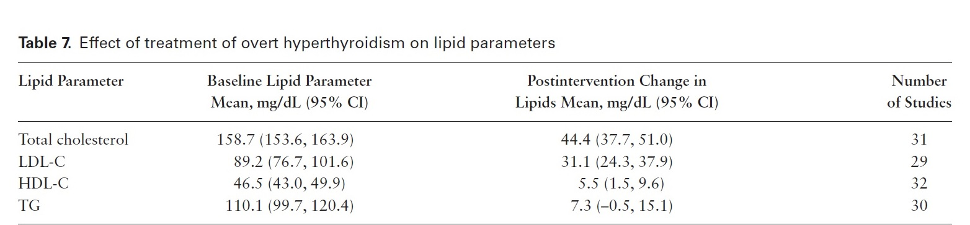

Slide 92
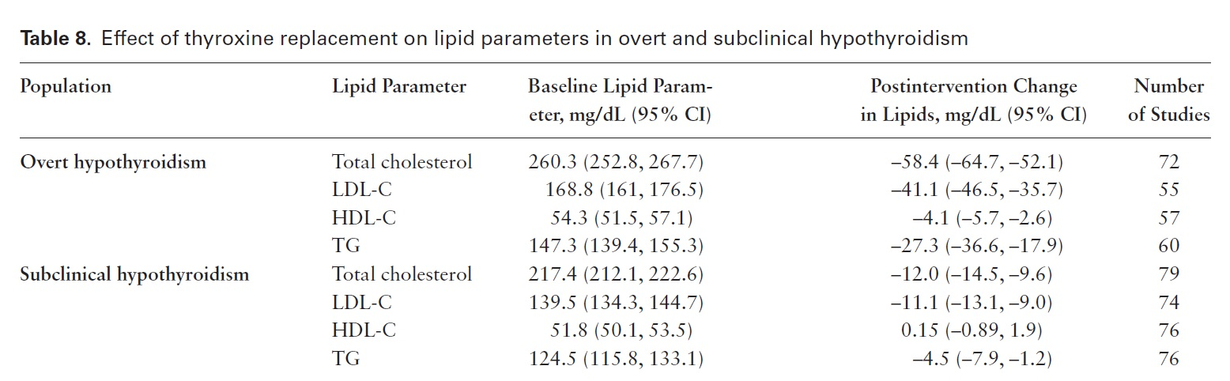

Slide 93
Excess Glucocorticoids

Slide 94
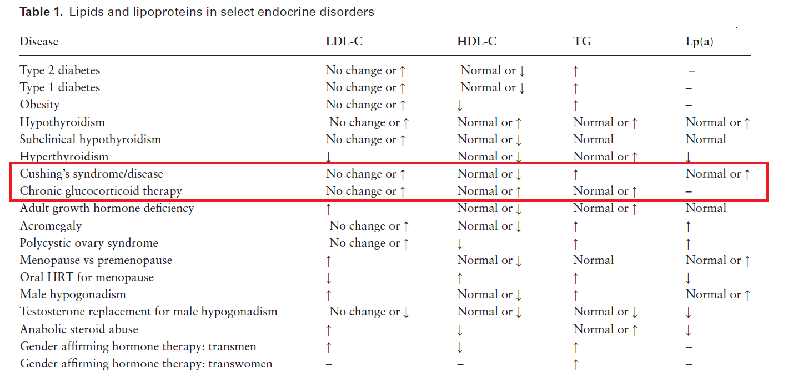

Slide 95
In adult patients with Cushing syndrome, we recommend monitoring the lipid profile in order to identify cases of dyslipidemia. (1⊕⊕OO)

Slide 96
Technical Remark
Monitor lipid profile at the time of diagnosis and periodically afterwards at the discretion of the treating physician.

Slide 97
In adults with persistent endogenous Cushing syndrome, we suggest statin therapy, as adjunct to lifestyle modification, to reduce CV risk irrespective of the CV risk score. (2⊕OOO)

Slide 98
Technical Remark
LDL-C should be the primary target, and therapy should be considered if LDL-C is over 70 mg/dL

Slide 99
Technical Remark
Lipid-lowering therapy may not be appropriate for patients with limited life expectancy, such as those with an underlying malignancy.

Slide 100
In adults with cured Cushing syndrome, we advise the approach to CV risk assessment and treatment be the same as in the general population. (Ungraded Good Practice Statement)

Slide 101
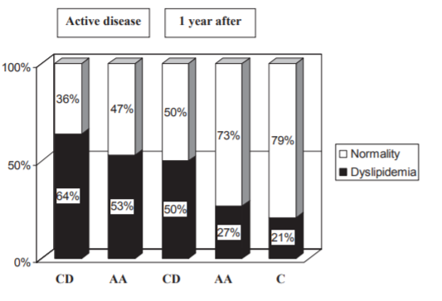
Metabolic and cardiovascular outcomes in patients with Cushing’s syndrome of different aetiologies during active disease and 1 year after remission clinical Endocrinology (2011)

Slide 102
In adults receiving chronic glucocorticoid therapy above replacement levels, we suggest the assessment and treatment of lipids and other CV risk factors because of the increased risk of CVD.(2⊕OOO)

Slide 103
Technical Remarks
Effects of glucocorticoid therapy on lipids and CV risk will vary based on the dose of glucocorticoid, duration of treatment, and underlying disease/indications.

Slide 104
Patients receiving HCeq doses of less than 20 mg/d do not differ in metabolic endpoints from patients with an intact hypothalamic-pituitary-adrenal (HPA) axis. Moreover, with increasing HCeq dose, higher BMI, TC, LDL-C, and triglycerides are observed.
The Impact of Glucocorticoid Replacement Regimens on Metabolic Outcome and Comorbidity in Hypopituitary Patients J Clin Endocrinol Metab, October 2006

Slide 105
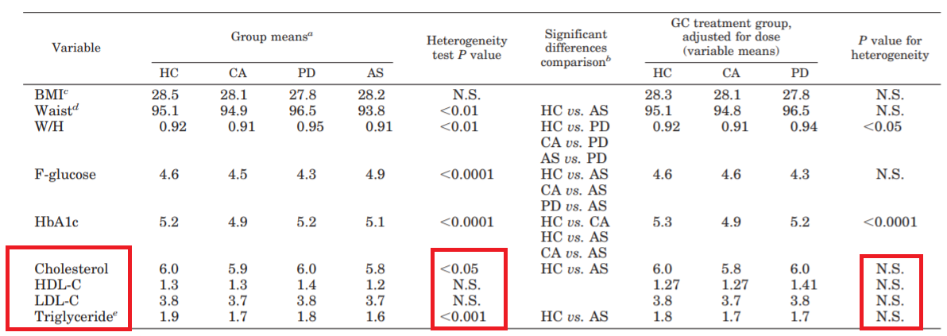
The Impact of Glucocorticoid Replacement Regimens on Metabolic Outcome and Comorbidity in Hypopituitary Patients J Clin Endocrinol Metab, October 2006

Slide 106
Disorders of growth hormone
secretion

Slide 107
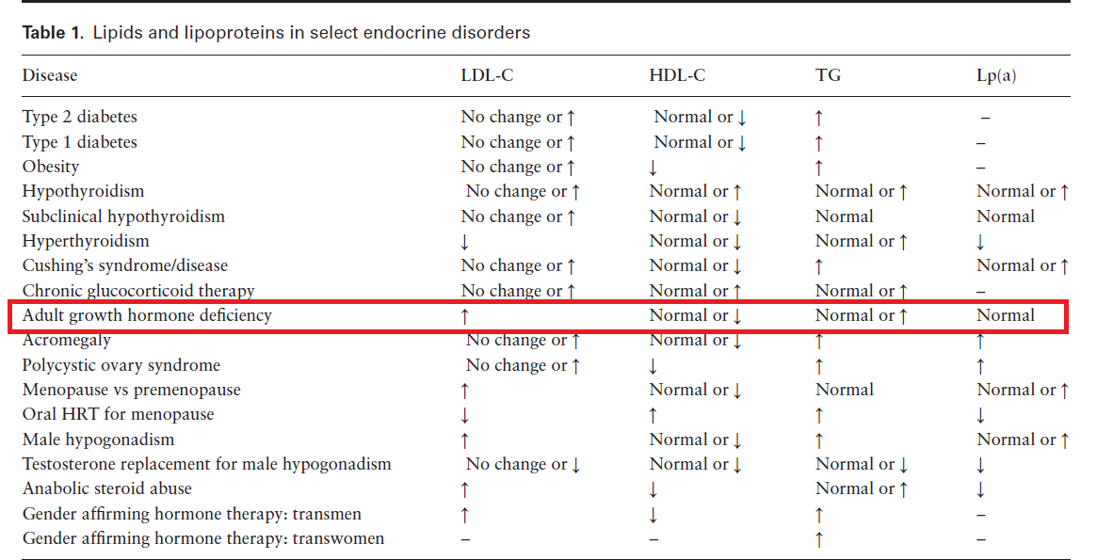

Slide 108
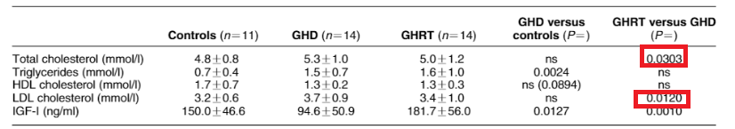
Atherogenic lipoprotein phenotype and low-density lipoproteinsize and subclasses in patients with growth hormone deficiency before and after short-term replacement therapy European Journal of Endocrinology (2007)

Slide 109
In adults with GHD, we recommend obtaining a lipid profile at diagnosis to assess for dyslipidemia. (1⊕⊕⊕O)

Slide 110
In adults with GHD associated with hypopituitarism, we suggest assessment and treatment of lipids and other CV risk factors.(2⊕OOO)

Slide 111
Technical Remarks
LDL-C should be the primary target.
Consider therapy if LDL-C is over 70 mg/dL.

Slide 112
In adult patients with GHD, we recommend against using GH replacement solely to lower LDL-C to reduce CV risk. (1⊕⊕⊕O)

Slide 113
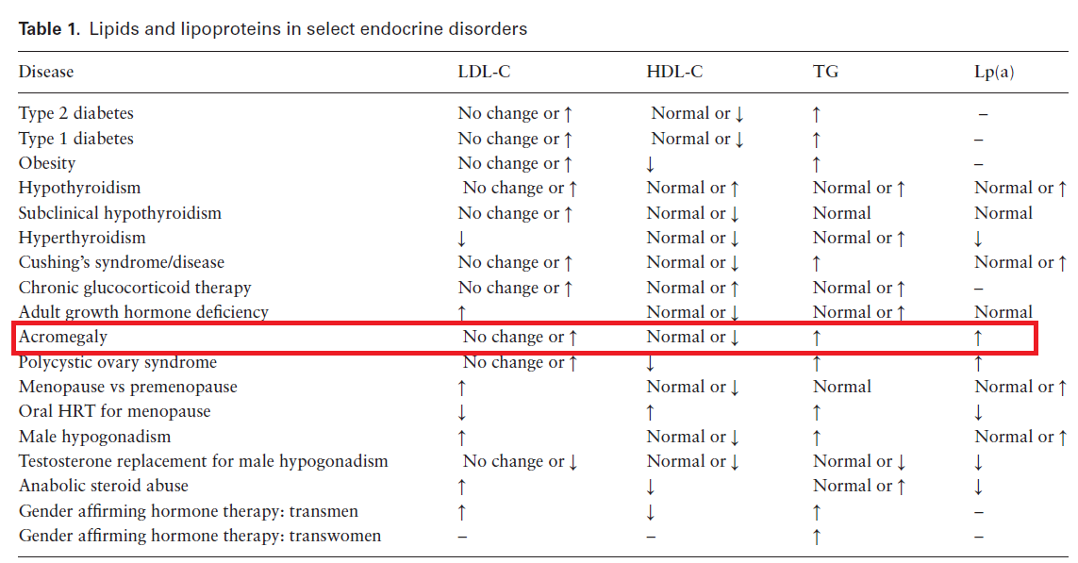

Slide 114
In adults with acromegaly, we suggest measurement of the usual lipid profile before and after treatment of GH excess. (2⊕OOO)

Slide 115
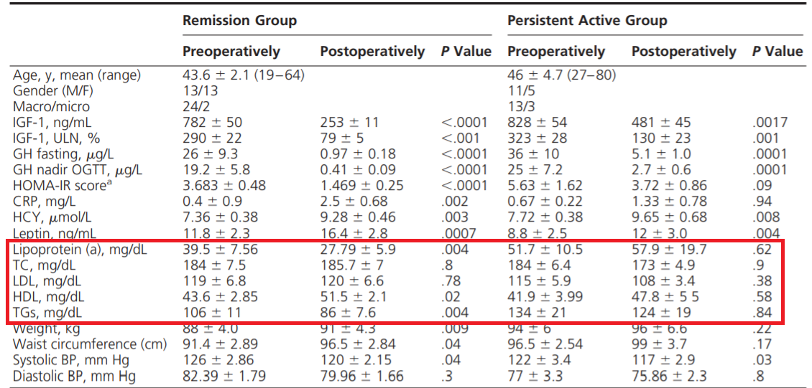
Prospective Study of Surgical Treatment of Acromegaly: Effects on Ghrelin, Weight, Adiposity, and Markers of CV Risk J Clin Endocrinol Metab, November 2014

Slide 116
Polycystic ovary syndrome

Slide 117
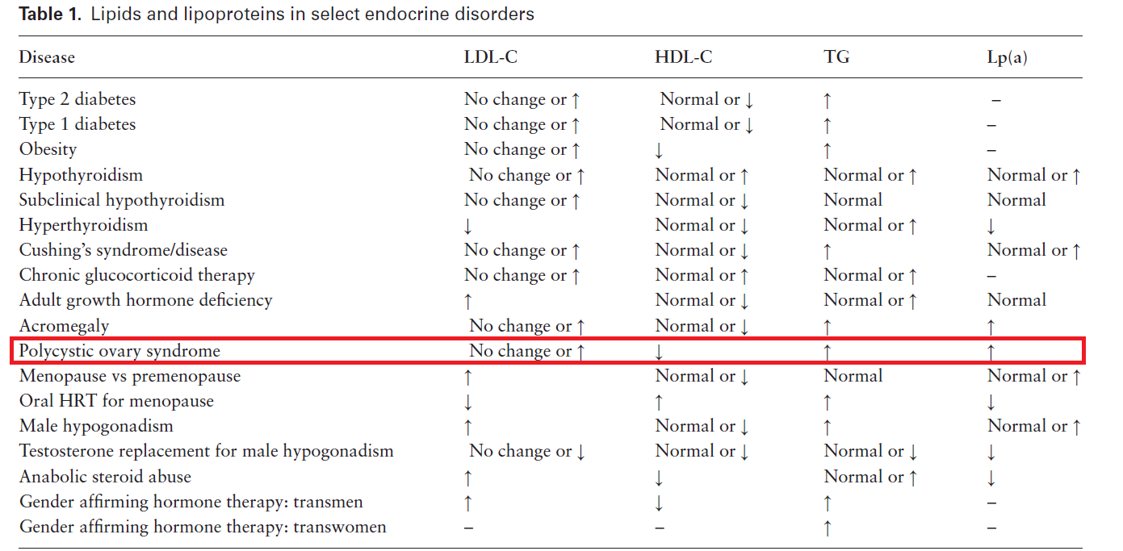

Slide 118
In women with PCOS, we recommend obtaining a fasting screening lipid panel at diagnosis to assess CV risk. (1⊕⊕⊕O)

Slide 119
Technical Remarks
PCOS is associated with CV risk factors.
Conduct a lipid screening both before and intermittently during hormonal therapy.
In PCOS, hypertriglyceridemia is the most common lipid abnormality.

Slide 120
In women with PCOS, we suggest against using lipid-lowering therapies to treat hyperandrogenism or infertility. (2⊕OOO)

Slide 121
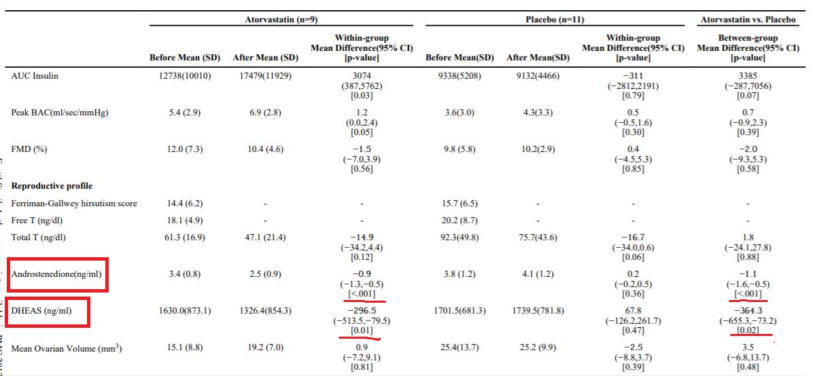
Effects of atorvastatin on vascular function, inflammation, and androgens in women with polycystic ovary syndrome: a doubleblind, randomized placebo-controlled trial
NIH Public Access Author Manuscript 2011

Slide 122
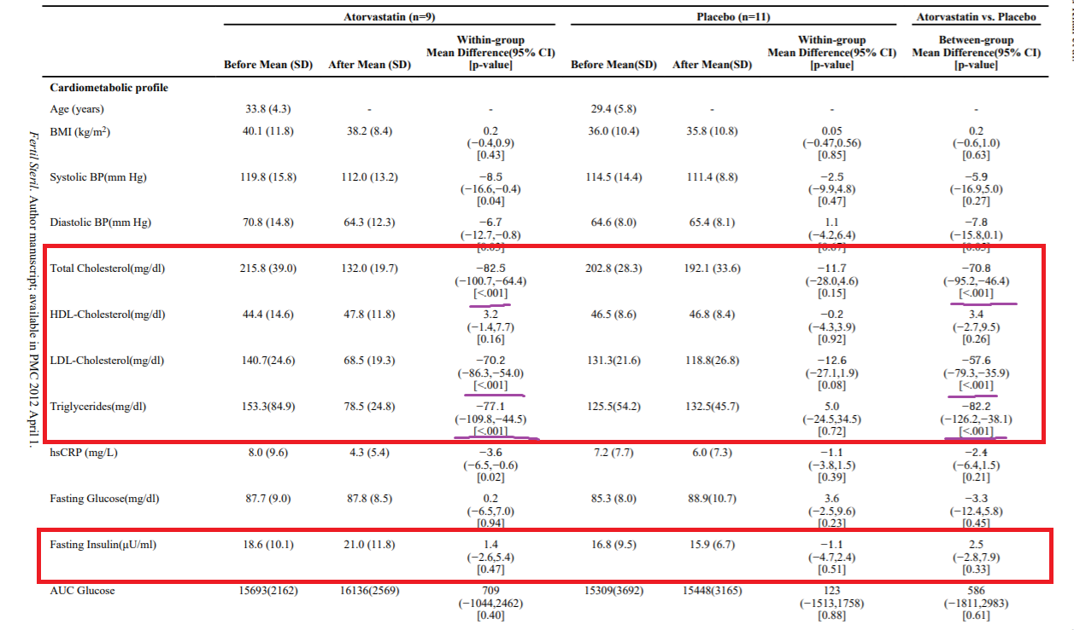
Effects of atorvastatin on vascular function, inflammation, and androgens in women with polycystic ovary syndrome: a doubleblind, randomized placebo-controlled trial
NIH Public Access Author Manuscript 2011

Slide 123
Menopause and hormonal
replacement

Slide 124
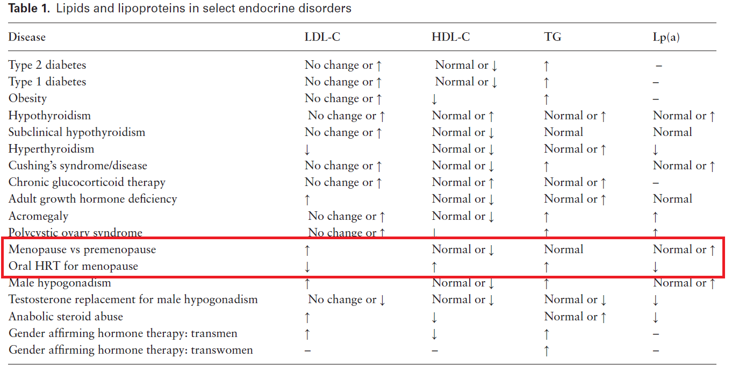

Slide 125
In postmenopausal women, we recommend treating dyslipidemia with statin therapy rather than hormone therapy. (1⊕⊕OO)

Slide 126
Technical Remarks
Hormone therapy is a risk factor for increased CVD.
Hormone therapy is described as estroge progesterone/a progestin.

Slide 127
In postmenopausal women on hormone therapy and with other risk factors for CVD, we recommend statin therapy to reduce CV risk. (1⊕⊕⊕⊕)

Slide 128
Technical Remarks
Menopause may be associated with an increase in LDL-C and a decrease in HDL-C.
Risk factors may be traditional risk factors or risk enhancing factors.

Slide 129
In women who enter menopause early (<40 to 45 years old), we recommend assessment and treatment of lipids and other CV risk factors.(1⊕⊕⊕O)

Slide 130
Technical Remarks
Early menopause enhances CVD risk.
ASCVD risk should be calculated and followed after menopause.

Slide 131
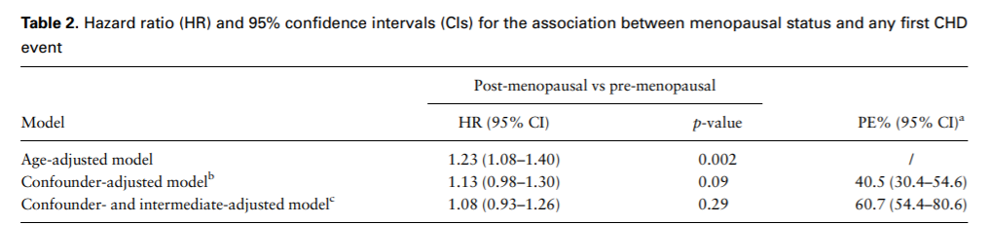
Association of menopausal characteristics and risk of coronary heart disease: a pan-European case–cohort analysis
International Journal of Epidemiology, 2019

Slide 132
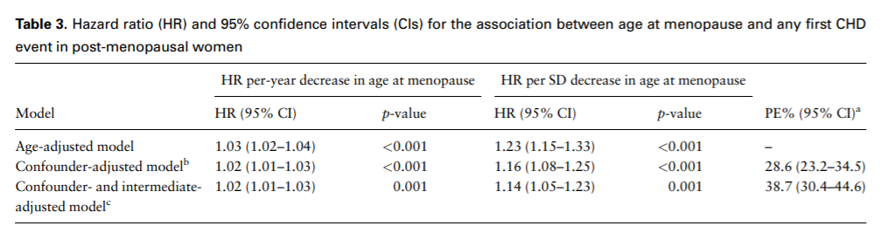
Association of menopausal characteristics and risk of coronary heart disease: a pan-European case–cohort analysis
International Journal of Epidemiology, 2019

Slide 133
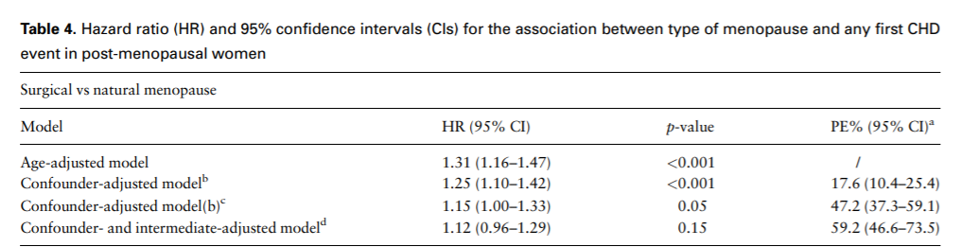
Association of menopausal characteristics and risk of coronary heart disease: a pan-European case–cohort analysis
International Journal of Epidemiology, 2019

Slide 134
Hypogonadism and testosterone replacement and abuse

Slide 135
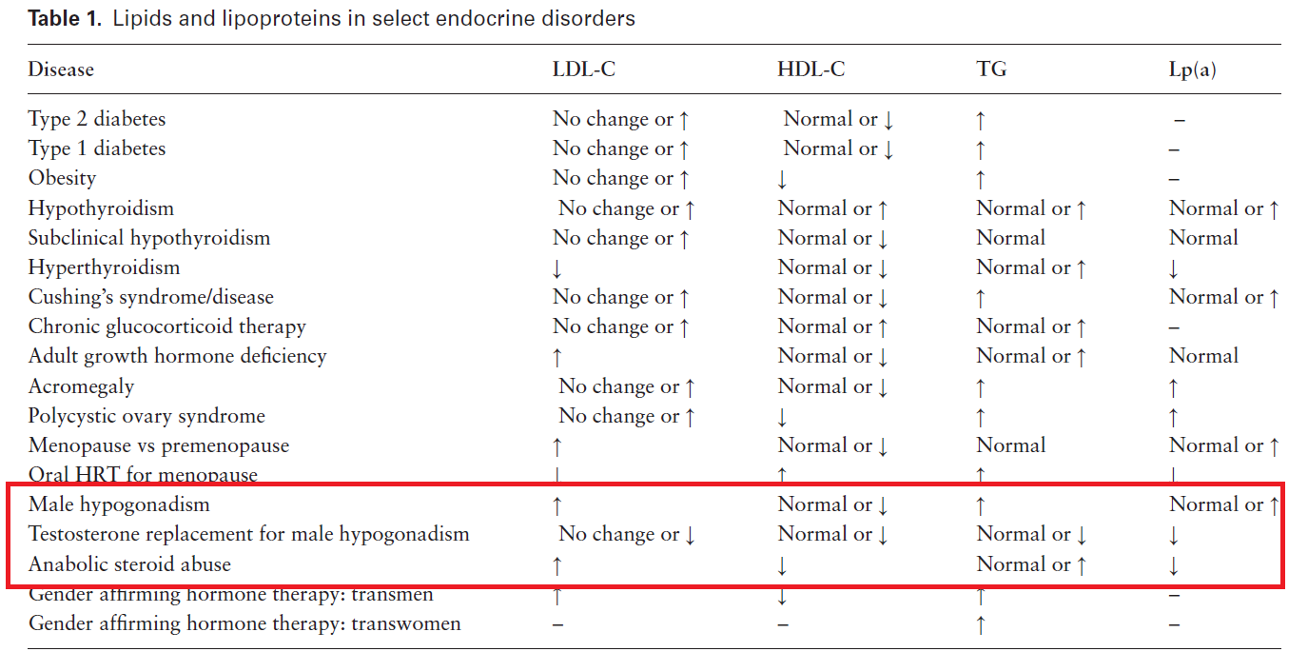

Slide 136
In patients with low testosterone levels, we suggest testosterone therapy as symptomatically indicated, and not as an approach to improve dyslipidemia or CVD risk. (2⊕⊕OO)

Slide 137
In patients with low HDL (<30 mg/dL ), especially in the absence of hypertriglyceridemia, we advise clinical or biochemical investigation of anabolic steroid abuse. (Ungraded Good Practice Statement)

Slide 138
Technical Remarks
Supraphysiological doses of androgens will reduce HDL-C levels.

Slide 139
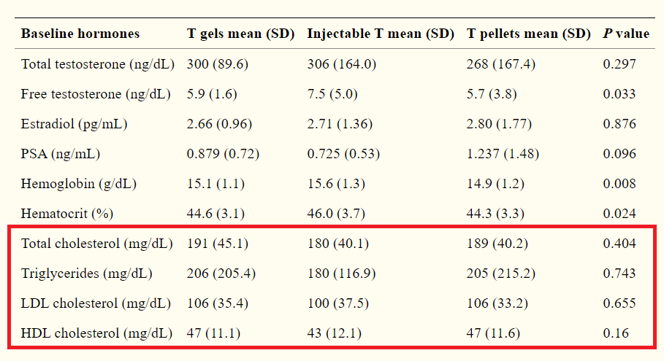
Comparison of the Effects of Testosterone Gels, Injections, and Pellets on Serum Hormones, Erythrocytosis, Lipids, and Prostate-Specific Antigen
Sex Med. 2015

Slide 140
TREATMENT

Slide 141
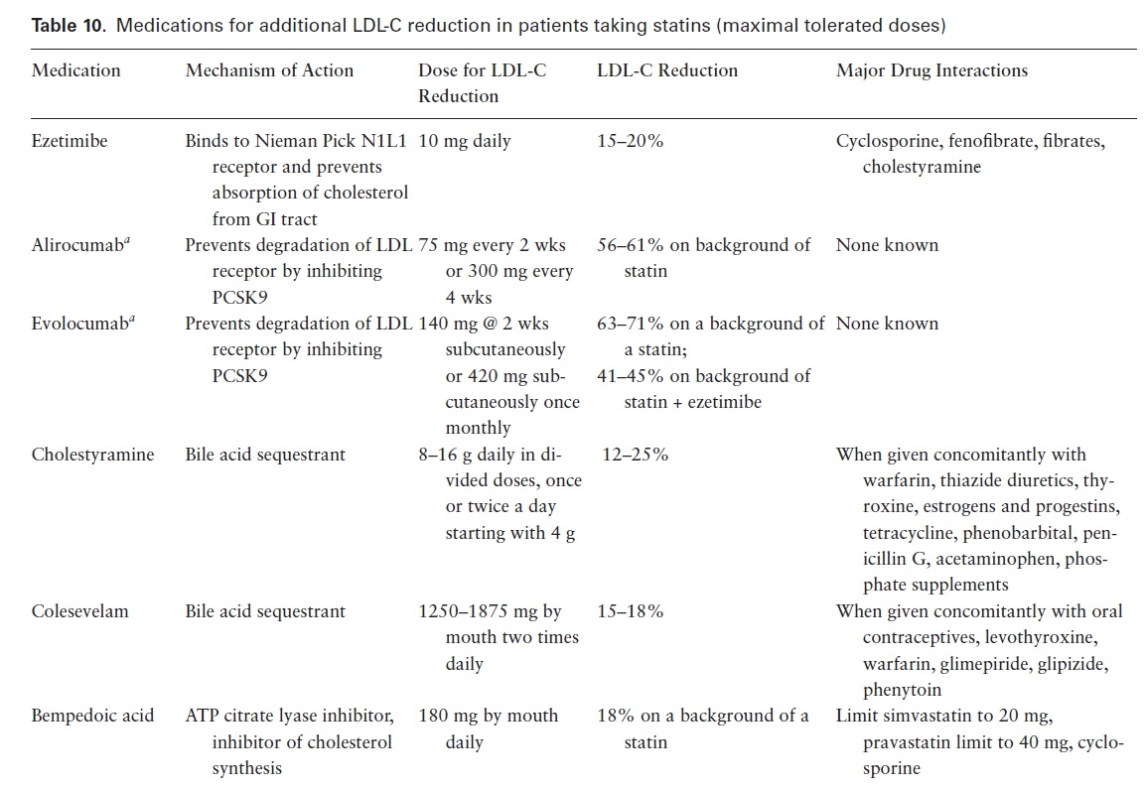

Slide 142
Bempedoic acid
Bempedoic acid was approved by the FDA in 2020, and therefore safety data were limited at the time of writing this guideline.
Drug interactions of bempedoic acid with simvastatin and pravastatin increase concentrations of these statins, which could increase the risk of myopathy
Therefore, concomitant simvastatin should be limited to a dose of 20 mg, and pravastatin to a dose of 40 mg

Slide 143
Bempedoic acid increases uric acid levels, and gout was observed in 1.5% of patients taking bempedoic acid in clinical trials compared with 0.4% of patients on placebo.
The placebo-corrected incidence of other adverse effects in clinical trials were benign prostatic hyperplasia in about 1% of patients and tendon rupture in 0.5% of patients.

Slide 144
An increase in hemoglobin of ≥2 g/dL in 3% of patients,
an increase in platelet counts of 5%
and transient elevations of AST and/or ALT to above 3 times the upper limit of normal n about 1% of patients
usually resolved or improved with continued treatment or after discontinuation of treatment

Slide 145

THANKS FOR YOUR ATTETION

