Slide 1
Lysosomal Storage Disorders
Overview of clinical & Diagnostic Approaches to Inherited Metabolic Disorders
Maryam Banikazemi, MD
Associate Prof of Pediatric and Genetics
New York Medical College
&
Shahid Beheshti University
Notes:
About Fabry Disease: a progressive, debilitating, often life-threatening multisystemic genetic disorder.

Slide 2
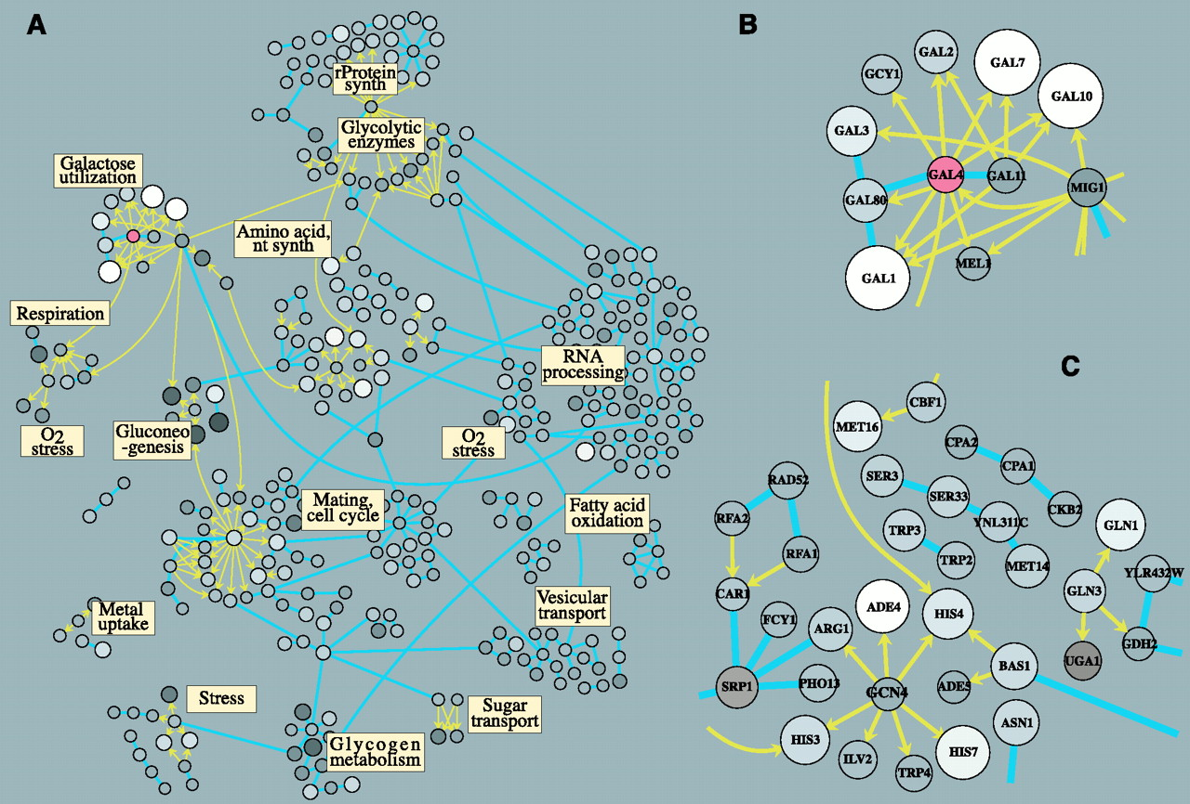
Metabolism
The major metabolic pathways are closely integrated with key molecules via complex mechanism.
A genetic defect in part of the major metabolic pathways is known as INBORN ERRORS of METABOLISM (IEM) when present at birth.

Slide 3
Metabolic Pathways
Molecules specific characteristic
Body physiologic state
Tissue specific: muscle, liver, brain
Tissue-specific response to disruption
Role of endocrine system
Environmental factors
Notes:
3

Slide 4
Inborn Errors of Metabolism (IEM)
A B
X Y
c
D
Result of metabolic block:
Disorders that disrupt the synthesis or catabolism of complex molecules
Disorders that lead to an acute or progressive accumulation of toxic compounds
Disorders due to deficiency of energy production or utilization within different organs

Slide 5
Common Conception
IEM are a large group of hereditary biochemical diseases in which specific gene mutation cause abnormal or missing proteins that lead to alter function.
Biochemical pathway are impossible to remember
  This is true for expert
  Pathways are not the important part of the evaluation
  General approach is more important
It is difficult to conduct diagnostic study
  Should progress from broad to specific

Slide 6
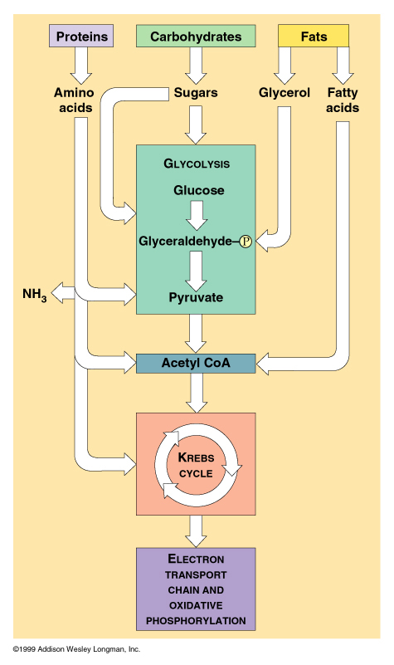
Inborn Errors of Metabolism (IEM)
Can Be Roughly Divided into Two Groups Based on Cellular Localization and Clinical Presentation
Group1
  Predominantly cytoplasmic
    Catabolism of organic acids, amino acids, fatty acids and carbohydrates
    Present acutely after a brief asymptomatic period,
    Presentation may include coma, respiratory distress, hypotonia, seizures, odor
    Impact mostly hemostasis
    Often not causing dysmorphic feature
6
Notes:
6

Slide 7
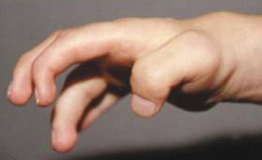
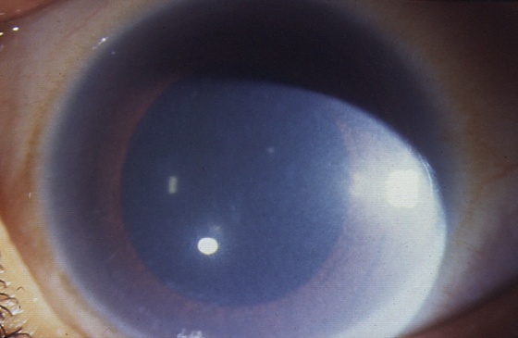
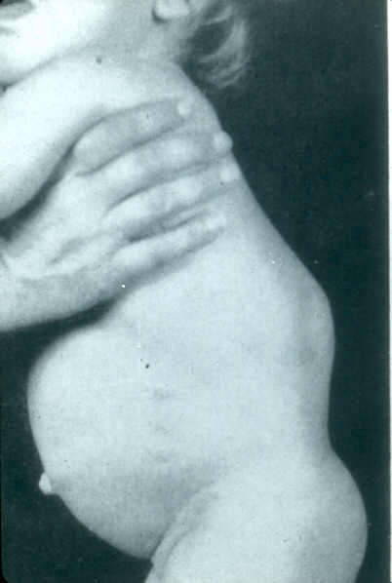
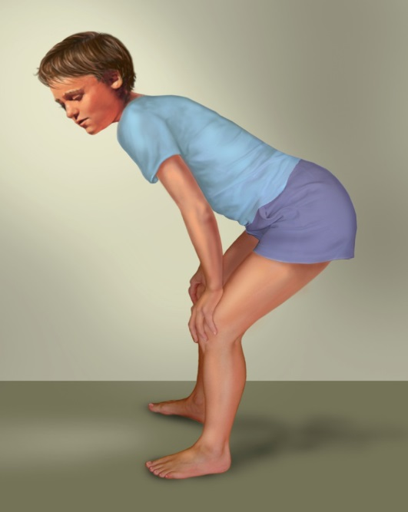
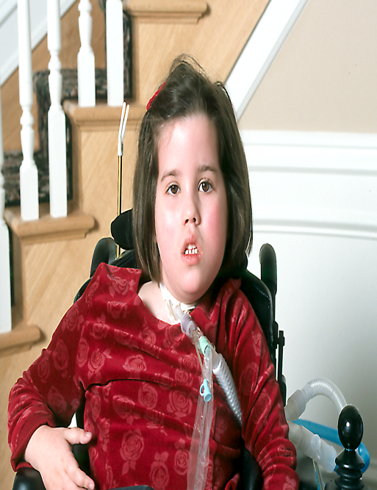
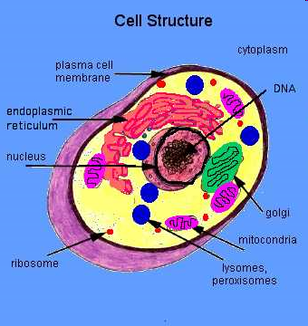
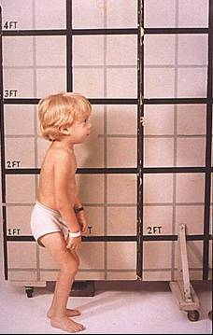
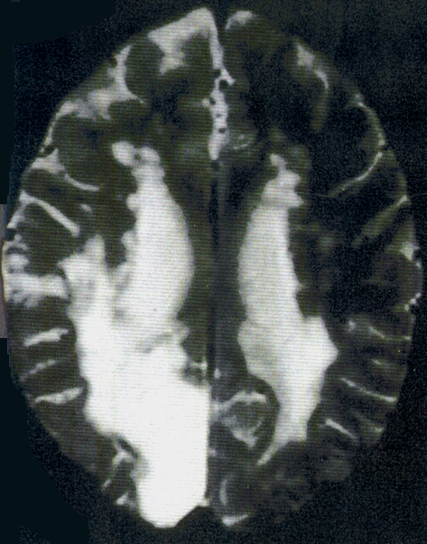
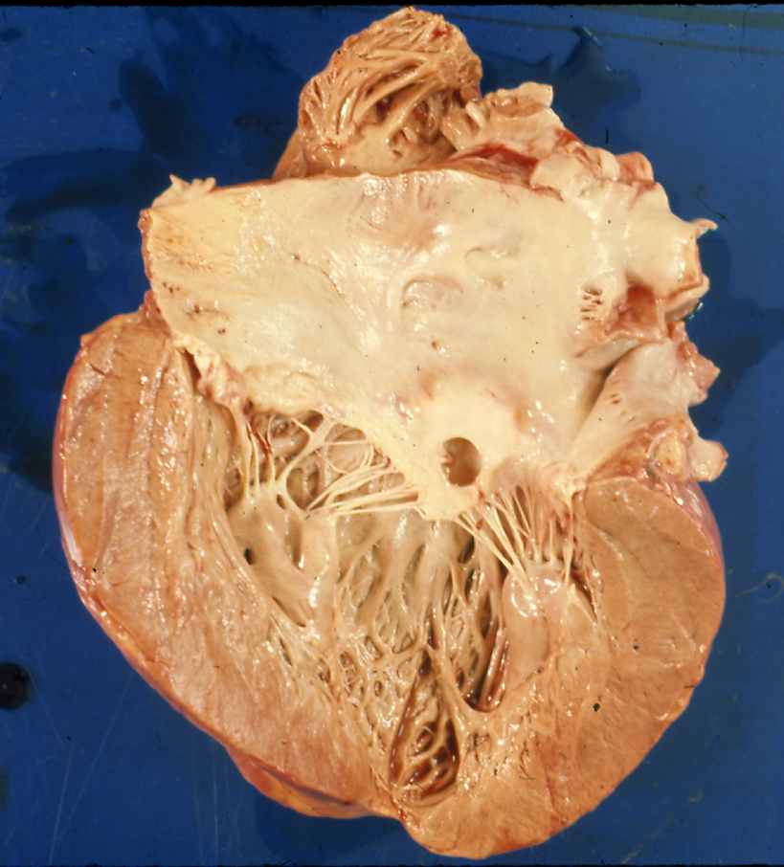
Inborn Errors of Metabolism (IEM)
Group 2
  Predominantly organellar
    Lysosomal storage and Peroxisomal & mitochondrial Disorders
    Have a more chronic course
    Often do not present until late childhood or adulthood
7
Notes:
7

Slide 8
Inborn Errors of Metabolism (IEM)
More than 1400 IMD have been described to date
Mostly are progressive and potentially fetal if not treated in a timely manner
Can present with a variety of signs and symptoms
Easily can mimic non-genetic or non-metabolic disorders
Variable symptom free periods and intervals
Decompensate often precipitate with common illnesses

Slide 9
Inborn Errors of Metabolism (IEM)
Individual metabolic disorders are very rare
All genetic AND mostly autosomal recessive
Many can be treated and/or improved via diet, supplements and/or drug therapy
The outcome is related to underlying metabolic defect as well as timing of the initiation of treatment

Slide 10
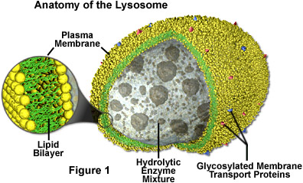
Lysosomal Storage Disorders
Significant or severe CNS involvement
(~ 54%)
No or minimal CNS involvement
(~ 46%)
Mucolipidosis type II / III
2%
GM 1
Gangliosidosis
Sandhoff
Niemann-Pick A
2%
Gaucher type I
2%
2%
Other
13%
Scheie (MPS I)
Niemann-Pick C
2%
1%
4%
Hurler/Scheie (MPS I)
Sanfilippo B
4%
4%
Fabry
Tay-Sachs
7%
4%
Hunter Mild
Krabbe
1%
6%
Pompe
5%
Hunter Severe
5%
Morquio
5%
Sanfilippo A
Sanfilippo D
Cystinosis
7%
Metachromatic
4%
Leukodystophy
1%
a-Mannosidosis
Maroteaux-Lamy
8%
Hurler (MPS I)
3%
4%
1%
Niemann-Pick B
Adapted from Meikle P et al. JAMA. 1
999;281:249-254.
Gaucher type 2 & 3
2%
1%
Notes:
Coded in red are those LSDs that are associated with significant or severe central nervous system involvement. In blue are the disorders that do not affect the CNS or have minimal impact. Roughly half of the disorders affect the CNS.

Slide 11
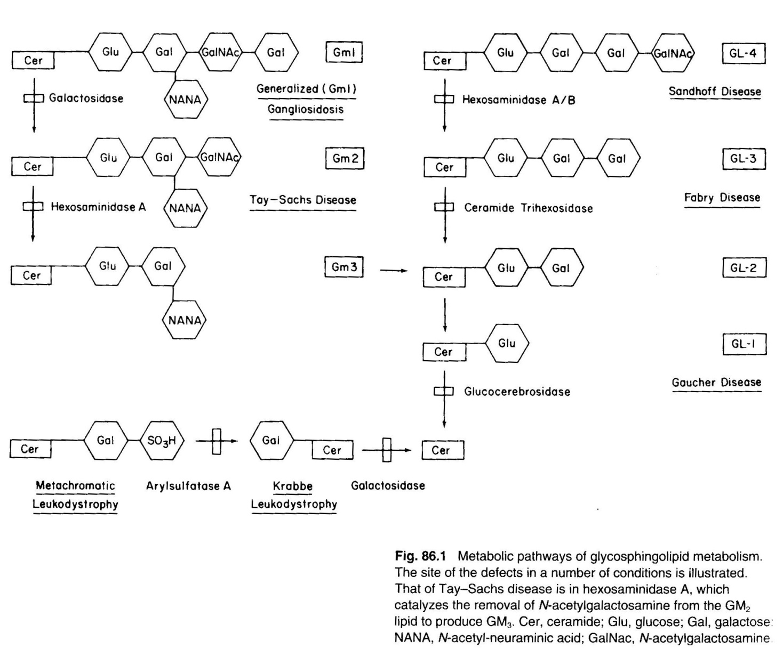
Glycosphingolipid Metabolism
α-galactosidase A
Glucocerbrosidase
Notes:
Friday, March 7, 2008 @ 11am
11
Given the many steps in the synthesis and processing of lysosomal hydrolases, it is not surprising that there are many ways in which they can become dysfunctional.
Since the identification of the first lysosomal enzyme deficiency, for Pompe disease (Hers, 1963), over 40 disorders have been described.

Slide 12
Lysosomal Storage Disorder (LSD)
More than 50 LSDs have been identified
Collectively, LSDs occur in 1 / 6,000 - 7,000 live births
Progressive , often life-threatening
Pathological changes in multiple organs
Wide disease spectrum with variable age of onset
Almost all are inherited as autosomal recessive; except Fabry and Hunter Diseases
Treatments exist for some LSDs
Early diagnosis and intervention may make a significant difference
Important in family planning and reproduction decisions
Notes:
Gaucher disease is a lysosomal storage disorder (LSD). All LSDs are caused by a deficiency of certain lysosomal enzymes necessary to break down carbohydrates. The pathology differs depending on the deficient enzyme. In all LSDs, carbohydrates that are broken down partially or not at all progressively accumulate in the lysosomes of the body’s cells. The result is significant cellular, tissue, and organ dysfunction.

Slide 13
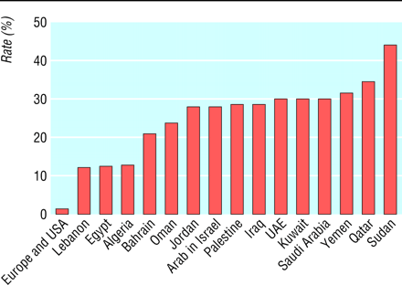
Rate of consanguinity in Middle East
In a study from Shiraz: During a 4-year period, 2,686 couples presented for genetic counseling 85% had consanguineous relationships:
1.5% double first cousin, 74% first cousin, 8% second cousin, 1.5% beyond second cousin

Slide 14
Metabolic-Genetic Research Program
Comprehensive Center for LSDs
Diagnostic Center
Biochemical Testing Lab
Molecular Testing Lab
Comprehensive Patient Care
Disease Registry
Clinical Trials Center

Slide 15
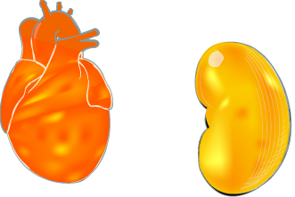
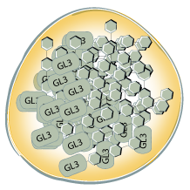
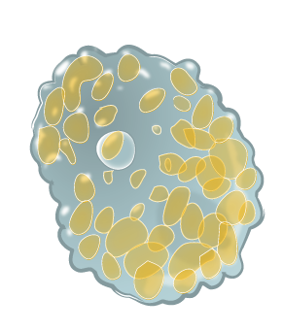






Fabry Disease
Mannose6-P marker guides glycoproteins destined for the lysosome from secretory glycoproteins
α-galactosidase A Deficiency:
X
GL-3
Gal
Gal
Gal
Ceramide
FABRY
lysosomes swelling within cell
over time, cells & tissues harden & may eventually die due to lack of oxygen & blood circulation
lysosome with stored GL-3
Notes:
1/5/2015

Slide 16

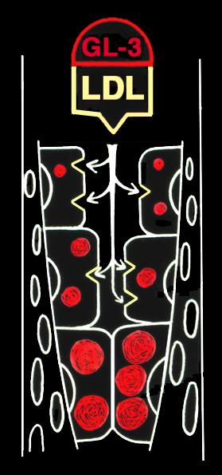
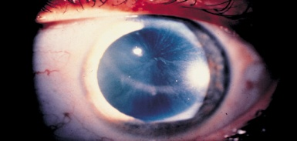
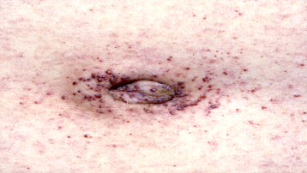
FABRY Disease
Clinical Manifestations
GL-3 Accumulation in Many Cell Types
Early Manifestations
Late Manifestation
Eye Finding
Early Stroke
Enlarged Heart
Irregular Heartbeats
Impaired Sweating
Sensitivity to heat
Time
Chronic Kidney Disease
Diarrhea,
abdominal pain
Reddish purple skin rash (Angiokeratoma)
Acroparesthesia
Pain in the hands & feet.
GL-3 containing Lipids can bind LDL and target the endothelium and accumulate due to enzyme defect

Slide 17

After Diagnosis: Family Screening
X-linked pattern makes it easy to determine who is at risk
When you identify a Fabry patient, you identify a Fabry family
Notes:
Once a patient has been diagnosed, there is the opportunity to identify other family members, and family screening should be conducted. In the extended family shown here, 41 out of 99 members have been diagnosed with Fabry disease.
Since Fabry disease is progressive and can result in irreversible organ damage, early diagnosis of affected family members has the potential to change the course of the disease in that person.

Slide 18
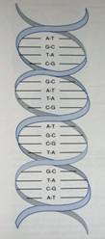
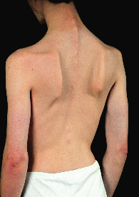

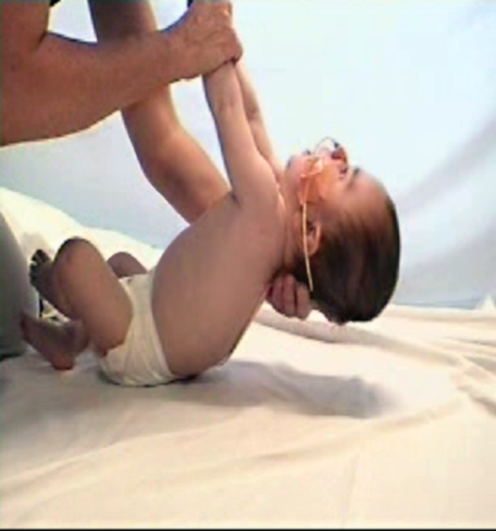
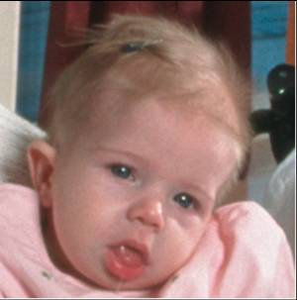
Pompe Disease
Multiple
GAA Genetic Mutations
GAA Deficiency
Total deficiency
to
Partial deficiency
Infantile Pompe Disease
JuvenilePompe Disease
Late Onset Pompe Disease
Notes:
Genetic Heterogeneity = Clinical Variability
Different mutations correlate with different degrees of residual activity of GAA—in other words, depending on the mutation, a patient may have greater or lesser GAA hydrolysis of glycogen, so that accumulation of glycogen in the lysosome will vary.¹⁻³
This variation, in turn, correlates with phenotype, for example²:
Several mutations are known to render a patient ≥98% deficient in lysosomal GAA activity; such patients tend to manifest infantile-onset Pompe disease.
Patients with juvenile and adult forms of the disease have more residual GAA activity, which is linked to genetic mutation.
In 1 extended Dutch family, a grandfather had adult-onset Pompe disease and was identified as a compound heterozygote having the IVS1(-13—>G)/deltaT525 combination of mutations; IVS1(-13—>G) reduces GAA by 60% to 80%. His grandchild with infantile-onset Pompe disease was found to be a homozygote having the deltaT525/deltaT525 mutation, which completely inhibits GAA.³
Correlation is not fully understood and appears to be influenced by other factors.¹
References: 1. Hirschhorn R, Reuser AJJ. Glycogen storage deficiency type II: acid α-glucosidase (acid maltase) deficiency. In: Scriver C, Beaudet A, Sly W, et al, eds. The Molecular and Metabolic Bases of Inherited Diseases. New York, NY: McGraw-Hill; 2001:3389-3420. 2. Hermans MMP, van Leenan D, Kroos M, et al. Twenty-two novel mutations in the lysosomal α-glucosidase gene (GAA) underscore the genotype-phenotype correlation in glycogen storage disease type II. Hum Mutat. 2004;23:47-56.
3. Kroos MA, Van der Kraan M, Van Diggelen OP, Kleijer WJ, Reuser AJJ. Two extremes of the clinical spectrum of glycogen storage disease type II in one family: a matter of genotype. Hum Mutat. 1997;9:17-22.

Slide 19
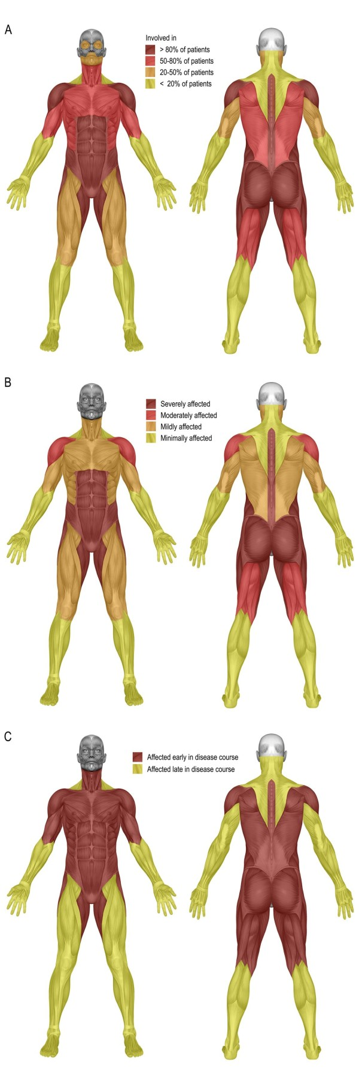
Adult-onset Pompe Disease
Involved
Muscles
Skeletal Muscle Weakness
Severity
Severity of muscle weakness of the individual muscle groups
Early in
Disease
Involvement of the individual muscles over time
Muscle weakness in 94 adults with Pompe disease
Notes:
Muscle weakness in adults with Pompe disease. Distribution of skeletal muscle weakness (A), severity of muscle weakness of the individual muscle groups (B), and involvement of the individual muscles over time (C) in 94 adults with Pompe disease.

Slide 20
Natural History
Late-onset Pompe Disease
Age-specific distribution of events in a Dutch cohort of mean age 48.6 years (n=54)
Black line = mean age for event
First complaints
n=54
Running problems
n=31
Diagnosis
n=54
Problems going up and down staircase
n=46
Problems rising from armchair
n=45
Problems rising from lying position
n=37
Walking problems
n=41
Problems with dressing
n=32
Problems going to toilet
n=18
Start of walking aid use
n=23
Start of wheelchair use
n=26
Start use of artificial ventilation
n=20
0
10
20
30
40
50
60
70
yrs
Brain. 2005;128:671-677.
Notes:
Natural History of Late-Onset Pompe Disease
Late-onset Pompe disease may present at any age.¹
The Pompe disease registry reports a median age of late-onset diagnosis of 31.4 years.²
Unlike the infantile-onset form, the late onset-form typically lacks severe cardiac involvement. In fact, cardiac involvement is usually absent, and the short-term prognosis is less dire than for infantile-onset disease.¹
Usually muscles of the proximal lower limb and paraspinal trunk are affected initially, followed by the diaphragm and accessory muscles of respiration. Some patients, however, may exhibit weakness of the diaphragm before other muscle weakness.¹ Functional impairment follows.³
As the condition progresses, patients begin to experience limitations in mobility and activities of daily living; they often reach a point where they require a wheelchair and ventilatory support. As reported by Hagemens et al, in a cohort of 54 patients (mean age, 48.6 years) with late-onset Pompe disease⁴:
First complaint occurred at a mean age of 28.1 years, diagnosis at a mean age of 35.4 years. As the slide shows, some patients in the range were children when these events occurred.
Wheelchair use began at a mean age of 46.1 years, and at the time of study 48% of patients used a wheelchair. Wheelchair use began as early as 25 years of age.
Ventilator use began at a mean age of 48.6 years, and at the time of study 37% of patients used ventilatory support. Ventilator use began as early as 22 years of age.
References: 1. Kishnani PS, Steiner RD, Bali D, et al, for the ACMG Work Group on Management of Pompe Disease. Pompe disease diagnosis and management guideline. Genet Med. 2006;8:267-288. 2. Topaloglu H, Topalkara K, Merlini L. The Pompe Registry: centralized data collection to outline the natural course of Pompe disease. Neuromusc Disord. 2006;16(suppl):S182. Abstract M-P-12.02. 3. Escolar DM, Wokke JHJ, Pestronk A, et al. Clinical presentation and disease progression in late-onset Pompe disease. Neuromusc Disord. 2006;16:654. Abstract G.P.1 01. 4. Hagemans MLC, Winkel LPF, Van Doorn PA, et al. Clinical manifestations and natural course of late-onset Pompe’s disease in 54 Dutch patients. Brain. 2005;128:671-677.

Slide 21
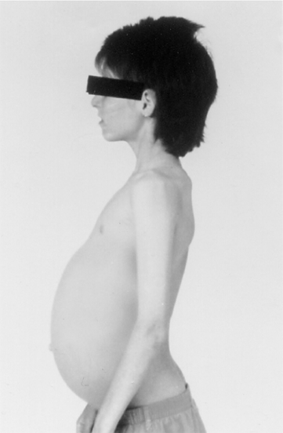
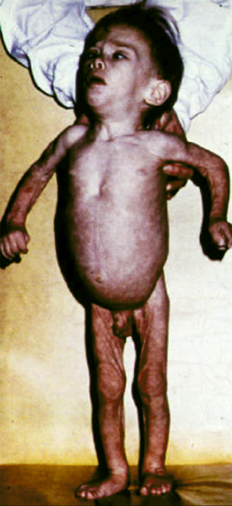
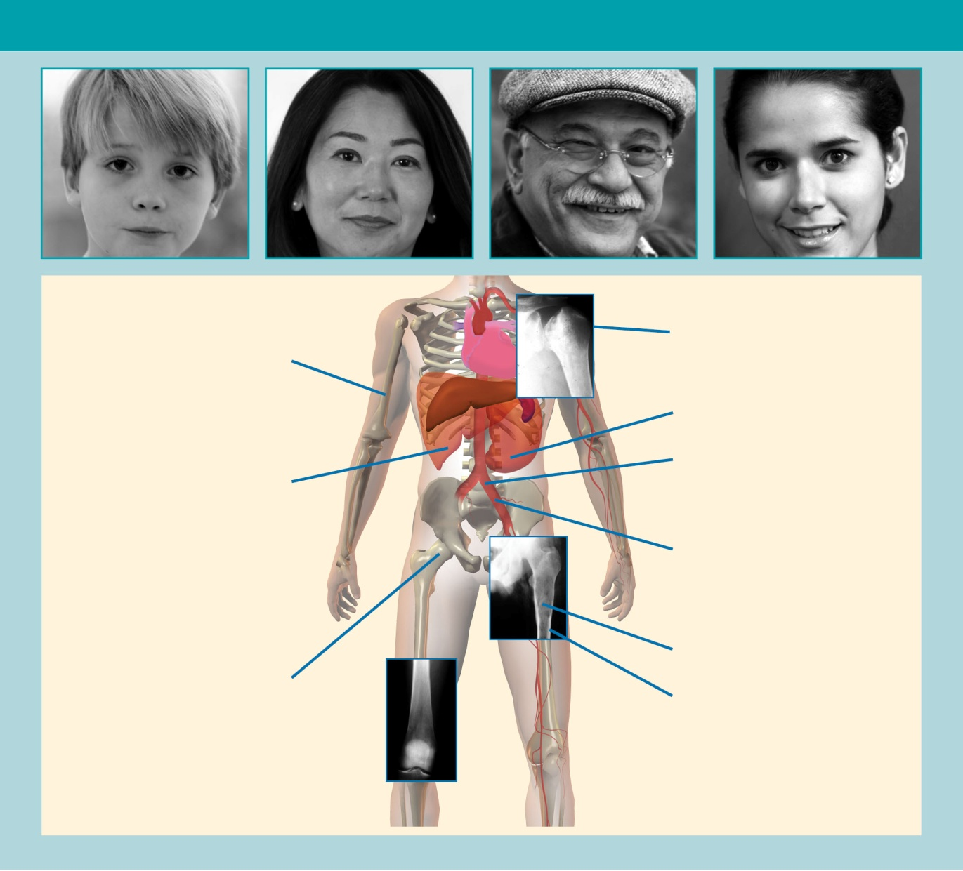
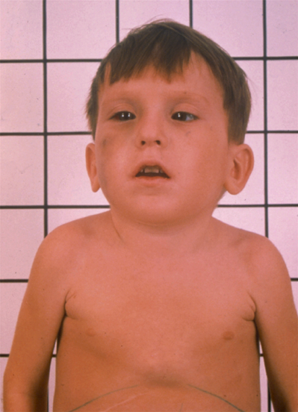
Gaucher Disease
Spectrum
Type I
Pathological
Fracture
Osteonecrosis
Splenomegaly*
Type II
Thrombocytopenia*
Hepatomegaly*
Anemia*
Bone Marrow Infiltration
Bone Pain and Bone Crisis**
Osteopenia
Type II

Slide 22
Gaucher Disease – Type 1
Heterogeneous and Chronic
Multiple organ system involvement
  Primarily skeletal, visceral, and/or blood complications
  Skeletal impact can be devastating yet is often underappreciated
Age of presentation
  Childhood, adolescence, or adulthood
Severity of disorder and rate of progression variable
  Asymptomatic or symptomatic
  Potential for crippling bone disease, fatal bleeding, spleen or
  liver damage
Complex, serious disease
Notes:
Gaucher disease is heterogeneous with respect to organ system involvement, presentation, and rate of progression. In patients with type 1 (nonneuronopathic) Gaucher disease, the clinical course and life expectancy is considerably more variable than in type 2 (acute neuronopathic) or type 3 (chronic or subacute neuronopathic) Gaucher disease. The spectrum encompasses fulminant disease presenting in childhood to an indolent, asymptomatic disorder that may not be discovered until the patient is elderly (although the latter is rare). However, although the clinical onset of type 1 Gaucher disease can occur at any age, a phenotype that manifests in childhood or adolescence is typically more aggressive and severe with a more rapid rate of progression compared with one of later onset. For type 1 Gaucher disease, death can occur at any point from childhood through to old age.
Gaucher disease is progressive, albeit at different rates, and symptomatic patients may die prematurely due to sequelae including bone disease and spleen or liver damage.
Disease progression may be inexorable, or may be slow and erratic, punctuated by periods of rapid exacerbation and clinical crises interspersed with sometimes lengthy periods of quiescence lasting for months or even many years.
References
Beutler E, Grabowski GA. Gaucher disease. In: Scriver C, Beaudet AL, Sly WS, Valle D, eds. The metabolic and molecular bases of inherited disease. 8th ed. New York: McGraw-Hill; 2001:3635-3668.
Cox T, Shofield JP. Gaucher’s disease: clinical features and natural history. Baillieres Clin Haematol. 1997;10:656-689.
Pastores GM, Weinreb NJ, Aerts H, et al. Therapeutic goals in the treatment of Gaucher disease. Semin Hematol. 2004;41(4 suppl 5):4-14.
Slide 6: Type 1 Gaucher Disease – Heterogeneous and Chronic

Slide 23
*
Mucopolysaccharidoses (MPSs)
MPS Type | Name | Deficient Enzyme
MPS I | Hurler syndrome | α-L-iduronidase
MPS II | Hunter syndrome | iduronate sulfatase
MPS III A | Sanfilippo syndrome | heparan N-sulfatase
MPS III B |  | α-N-acetylglucosaminidase
MPS III C |  | acetyl-CoA: α-glucosaminide acetyltransferase
MPS III D |  | N-acetylglucosamine 6-sulfatase
MPS IV A | Morquio syndrome | galactose 6-sulfatase
MPS IV B |  | β-galactosidase
MPS VI | Maroteaux-Lamy syndrome | N-acetylgalactosamine 4-sulfatase
MPS VII | Sly syndrome | β-glucuronidase
MPS IX | Hyaluronidase deficiency (Natowicz) syndrome | hyaluronidase
Notes:
23
Hunter syndrome is one of several types of known mucopolysaccharidoses (MPS).
All mucopolysaccharidoses are rare, and epidemiologic data are scarce. Except for Hunter syndrome, which is an X-linked disease,¹ all mucopolysaccharidoses are autosomal genetic diseases. All MPS diseases are characterized by an inherited enzyme deficiency that prevents proper breakdown of glycosaminoglycans (GAG).¹
Patients with MPS share many clinical features, including the multiorgan involvement and a progressive course of disease. Profound mental retardation is characteristic of MPS IH, of the severe form of MPS II, and of all subtypes of MPS III. Normal intellect may be retained in other MPS types.
These syndromes are named after the physicians who first described them. In this table, the deficient enzyme is listed next to the name of the syndrome. MPS III and MPS IV can be caused by multiple enzyme deficiencies.
MPS II is caused by iduronate-2-sulfatase or I2S (Neufeld & Muenzer use the term iduronate sulfatase¹).
Note that MPS V and VIII are no longer used.
Reference
1. Neufeld EF, Muenzer J. The mucopolysaccharidoses. In: Scriver CR, Beaudet AL, Sly WS, et al (eds). The Metabolic and Molecular Bases of Inherited Disease. 8th ed. New York: McGraw-Hill; 2001:3421-3452.
SHGT Master Deck HU-225-Jan 07

Slide 24
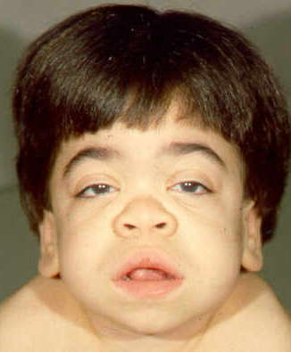
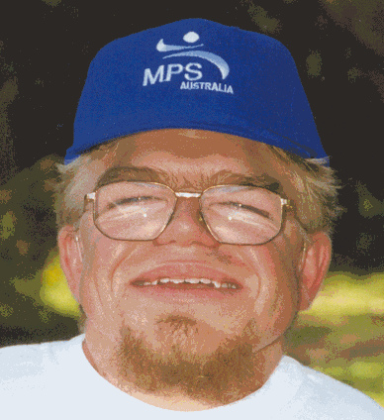

Mucopolysaccharidoses

Slide 25
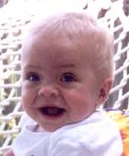

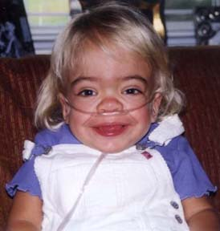

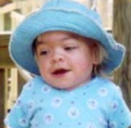
Progressive Disorders
This is Mucopolysaccharidoses type I
10 months
12 months
39 months
22 months
34 months
Notes:
For patients with the more severe form of the disease, the most typical symptoms occur early in life. These symptoms include: coarsened facial features, or facial dysmorphism; progressive physical problems, including hepatosplenomegaly; developmental delay; and progressive, profound mental retardation.
These photos help demonstrate the progressive nature of MPS I.
This patient has the severe form of the disease.

Slide 26
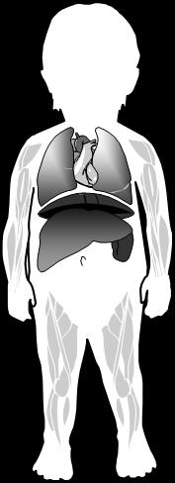
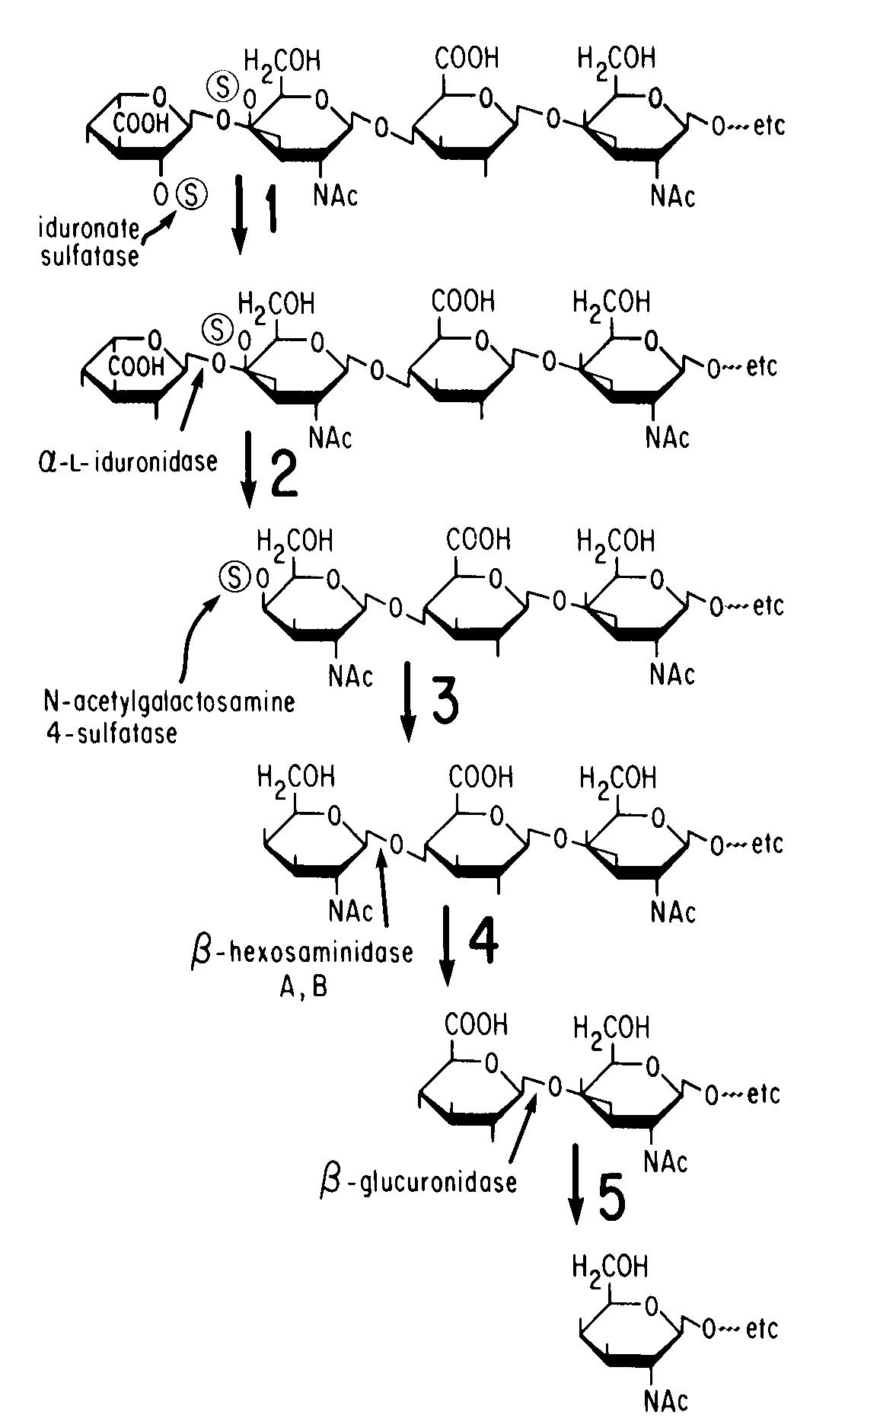
MPS type 1
Iduronidase Deficiency Causes A Block in the Sequential
Breakdown Steps of Glycosaminoglycans (GAG)
Macrosomia
Developmental delay
Chronic Ear Inf
Corneal clouding
Obstructive airway Disease
Hearing loss
Umbilical/inguinal hernia
Enlarged tongue
Skeletal deformities
Cardiovascular disease
Hepatosplenomegaly
Carpal tunnel syndrome
Joint stiffness
Virtually all tissues have some degree of
storage and disease
Notes:
1/5/2015
α-L iduronidase cleaves a terminal iduronic acid residue from dermatan sulfate and heparan sulfate (GAG)
For patients with the more severe form of the disease, the most typical symptoms occur early in life. These symptoms include: coarsened facial features, or facial dysmorphism; progressive physical problems, including hepatosplenomegaly; developmental delay; and progressive, profound mental retardation.
These photos help demonstrate the progressive nature of MPS I.
This patient has the severe form of the disease.

Slide 27
MUCOPOLYSACCHARIDOSIS
Short Stature
Dysostosis Mutiplex (Bone Deformities)
Normal IQ
Macrocephaly (Large Head)
Progressively Coarse Facial Features
Communicating Hydrocephalus
Spinal Cord Compression
Corneal Clouding
Impaired Vision
ENT Problems
Carpal Tunnel Syndrome
Cardiac Valvular Disease
Hepatosplenomegaly
Umbilical & Inguinal Hernias
upper Airway Obstruction
Sleep Apnea
Reduced Pulmonary Function
Reduced Joint Range of Motion
Malaise & Reduced Endurance
27
Notes:
1/5/2015

Slide 28

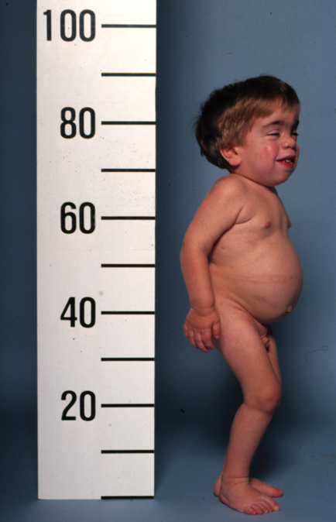
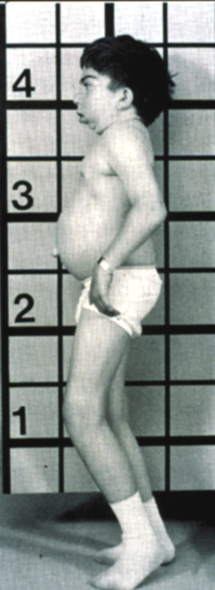
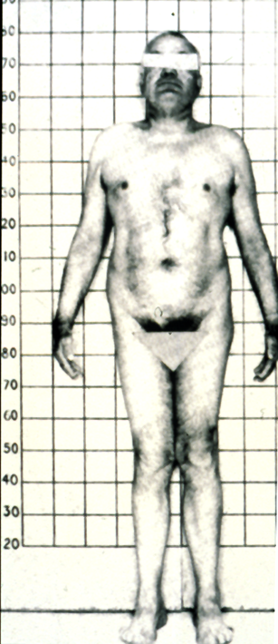
SPECTRUM of DISEASE (MPS I)
Severe
(Hurler)
Intermediate
(Hurler-Scheie)
Attenuated
(Scheie)

Slide 29
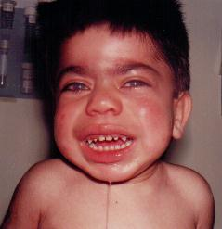
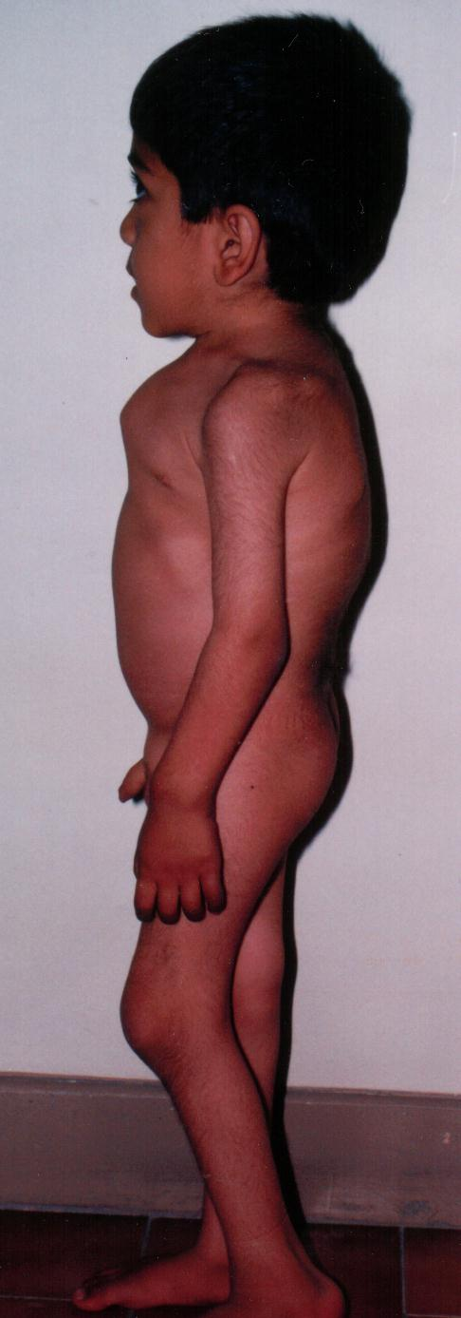
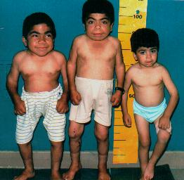
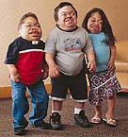
Lysosomal Storage Disorders

Slide 30
Lysosomal Storage Disorders
Summary
Some LSDs are treatable with supportive therapies, but a few are now manageable with disease-specific therapies that address the underlying enzymatic deficiency
Early diagnosis is critical to optimizing outcomes
  LSDs are always progressive, affecting cellular processes on a daily basis
Unusual signs or symptoms and clusters of common signs and symptoms aid diagnosis
  LSDs may mimic the signs and symptoms of other more common diseases
Timely referral to a geneticist, metabolic or neuromuscular specialist can make a difference
Fuller M, et al. J Med Genet. 2011;48(6):422-425.
Notes:
KEY POINT: Currently some LSDs are treatable with disease-specific therapies that can improve outcomes, thus early diagnosis is critical .
Throughout this presentation, it is important to keep in mind that certain LSDs, such as Type 1 Gaucher [GO-SHAY] disease and mucopolysaccharidosis I (MPS I), are treatable. In the past, it was of some comfort for patients and their parents to understand the underlying condition; however, physicians were unable to offer effective treatments. Now physicians can offer hope. This is why early diagnosis is so critical. Without treatment, LSDs may be rapidly progressive and are often life threatening. Primary care providers should look for unusual signs and symptoms, as well as clusters of relatively common signs and symptoms, that could signal the presence of an LSD. Finally, if an LSD is suspected, the child or adult should be immediately referred to a geneticist or a metabolic specialist to confirm or rule out one of these disorders. In some cases, the primary care provider may have to engineer the timeliness of this referral.

Slide 31

Path to Diagnosis
Clinical Suspicion
Urgent
Referral
Definitive Diagnosis
Finding of a unique sign or symptom
Presentation of a cluster of common signs and symptoms
To a geneticist or metabolic specialist
Enzyme assay diagnostic test (“gold standard”)
DNA testing
Notes:
Primary care providers should be aware of the unique signs and symptoms or clusters of common signs and symptoms that are suggestive of an LSD. If there is any clinical suspicion, the individual should be urgently referred to a geneticist or metabolic specialist. Arriving at a definitive diagnosis is relatively simple. The gold standard is an enzyme assay performed on a blood sample. In some cases, DNA testing is performed as well.

Slide 32
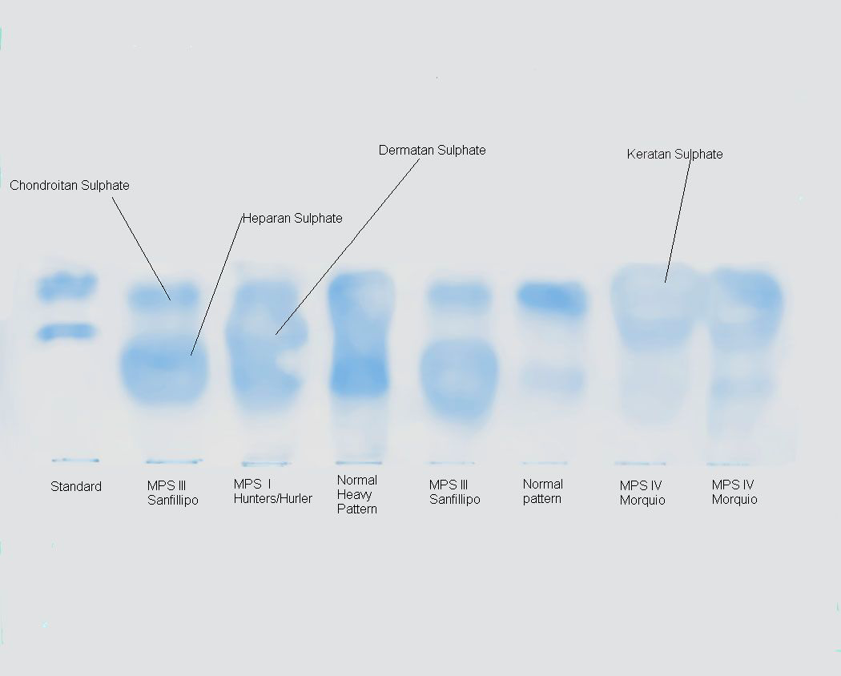
Cellulose Acetate Electrophoresis
Urinary Glycosaminoglycans (GAG)

Slide 33
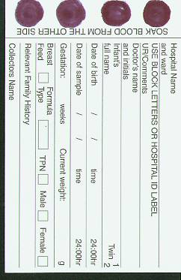
Disease Specific Testing
Enzyme Activity (Definitive Diagnosis)
  Skin Fibroblasts
  Lymphocytes
  Muscle biopsy
  Dried Blood Spot (NEW)
Mutation Analysis
Prenatal Diagnosis
  Amniocentesis
  Chorionic Villus Sampling
Newborn Screening (Dried Blood Spot)
33
Notes:
1/5/2015
Pompe Disease: Diagnostic Tools
A number of tools are available for confirming a clinical diagnosis of Pompe disease, most of which measure GAA enzyme activity in various tissue specimens. Measurement of residual GAA activity in muscle tissue, skin fibroblasts, and blood lymphocytes using glycogen, maltose, or the artificial substrate 4-MUG are the most common diagnostic methods in current clinical practice. Muscle tissue and skin fibroblasts provide the most reliable results, typically showing minimal GAA activity in infantile-onset cases and varying amounts of residual activity in late-onset cases. However, muscle biopsy is an invasive procedure. The skin fibroblast assay is more sensitive and less invasive, but must be cultured for several weeks before assay. Finally, lymphocyte assays have the risk of granulocyte contamination and/or the presence of neutral glucosidases which can lead to false negatives.¹ If the physician has a strong clinical suspicion of Pompe disease but lymphocyte results are negative, follow up testing is warranted.
An immune capture assay for measuring GAA activity in dried blood spots has also been reported, which allows identification of Pompe disease with 100% sensitivity and specificity.² This method is simple, inexpensive, and requires only a small amount of blood. It may be particularly appropriate for newborn screening, although validation of this assay in a large cohort is warranted.
Genotyping is important in genetic counseling and may be of supportive diagnostic value. It provides a way of determining whether children of carrier parents are also carriers. In cases with a family history of disease, prenatal diagnosis may be made by determining GAA in cultured amniotic cells or chorionic villus biopsies.¹
References
Hirschhorn R, Reuser AJJ. Glycogen storage disease type II: acid alpha-glucosidase (acid maltase) deficiency. In: Childs B, et al, eds. The Metabolic and Molecular Bases of Inherited Disease. 8th ed. New York: McGraw-Hill; 2000:3389-3420.
Umapathysivam K, Hopwood JJ, Meikle PJ. Determination of acid α-glucosidase activity in blood spots as a diagnostic test for Pompe disease. Clin Chem. 2001;47:1378-1383.

Slide 34
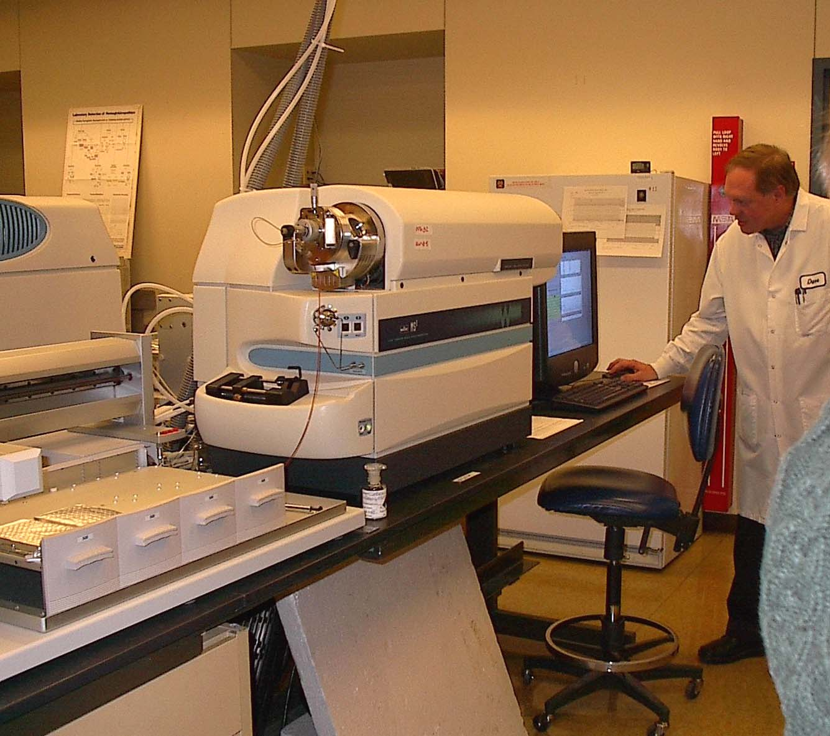
MASS SPECTROMETRY (MS/MS)
Sorts and quantifies molecules on the basis of molecular weight
Electron spray
Mass spec
Collision Cell
Mass spec
Notes:
A tandem mass spectrometer is essentially two mass spectrometers in a series connected by a chamber called the collision cell. This technology has been used for many years to identify and measure carnitine esters in blood and urine of individuals suspected of having a metabolic disorder.
Prior to being sent through the first chamber the sample is subjected to soft ionization either by fast atom bomardment or electrospray. This is why you may sometime see FAB-MS/MS or ES-MS/MS. This produces a charged but not fragmented ion for each organic compound (parent ion) in the sample.
The first chamber separates these parent ions in order of their mass/charge ratio - sending through the mass charge ratio ion into the collision chamber.
The collision cell fragments the parent ions and send these fragments through the second mass spectometer.
The fragmentation pattern from each of the parent ions is analyzed and compared to the spectrum of known internal standards and your spectrograph is obtained.
The entireprocess from ionization to data relay on the computer takes approximately 2 minutes.

Slide 35
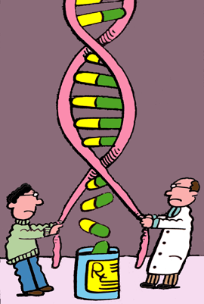
Disease-specific Treatment
To be effective, disease-specific treatment must:
Directly address underlying cause of the disease
Curtail or prevent accumulation of substrate
35
Notes:
1/5/2015
Effective, disease-specific treatment for MPS I must directly address the underlying cause of the disease to stop the progressive accumulation of GAGs. Such a therapy has the potential to forestall progression of the disease.

Slide 36
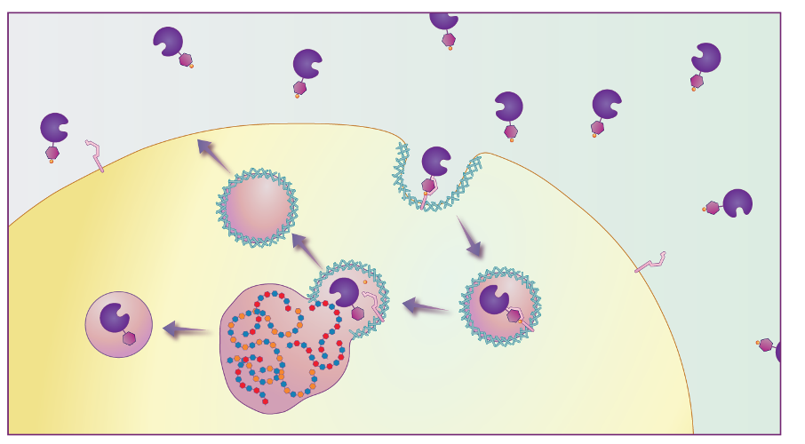
How Enzyme Gets into Cells and Reduces Storage in Lysosomes
M6P residue
Fabrazyme
Phosphorus
Clathrin coated pit
Normal
lysosome
M6P
Receptor
Glycosaminoglycans
GAG filled lysosome
Wennekes et al. Angew Chem Int Ed Engl 2009;48:8848-69
Fabrazyme
Notes:
36
Infused Fabrazyme, like endogenous α-galactosidase A, is taken up from the circulation through mannose-6-phosphate receptors on the cell surface via receptor-mediated endocytosis.
Once inside the cell, the Fabrazyme-M6P receptor complex is transported to the lysosome, where the low pH disassociates the complex, activating Fabrazyme. The activated Fabrazyme can then catalyze the breakdown of GL-3, and the M6P receptor recirculates to the cell surface.
Reference:
Wennekes T, van den Berg RJBHN, Boot RG, van der Marel GA, Overkleeft HS, Aerts JMFG. Glycosphingolipids—Nature, Function, and Pharmacological Modulation. Angew Chem Int Ed Engl 2009;48:8848-69.

Slide 37
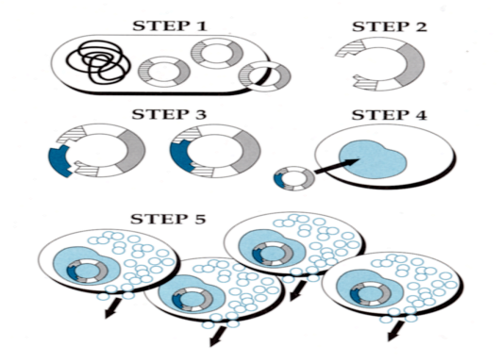
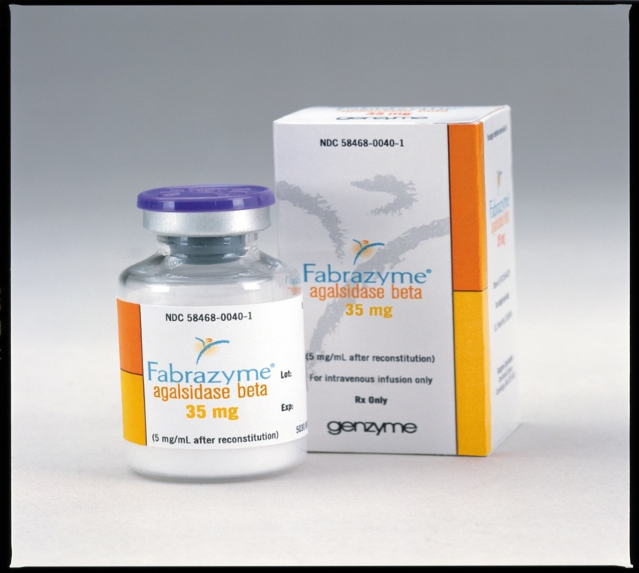

Enzyme Replacement Therapy (ERT) Development
The recombinant enzyme produced by is endocytosed (taken into lysosomes) through the Man-6-P receptor which af the end of the endocytosis process, cycles back to the cell surface.
Enzyme produced by plasmid
Successful Clearance from Lysosomes

Slide 38
Enzyme Replacement Therapy (ERT) for
Fabry Disease
Development of ERT for Fabry Disease
A Phase 1/2 Clinical Trial of Enzyme Replacement in Fabry disease: Pharmacokinetic, Substrate Clearance, and Safety Studies;
Eng CM, Banikazemi M, Gordon R, Goldman M, Phelps R, Kim L, Gass A, Winston J, Dikman S, Fallon JT, Brodie S, Mehta D, Parsons R, Norton K, O’Callaghan M, and Desnick RJ;. Am. J. Hum. Genet. 68:711-722, 2001.
Long-term safety and efficacy of enzyme replacement therapy for Fabry disease
Wilcox R.W.*, Banikazemi M.*, Guffon N, Waldek S, Lee P, Linthorst GE, Desnick RJ, P. Germain DP, for the International Collaborative Fabry Disease Study Group:. Am. J. Hum. Genet., 75(1):65-74, 2004 .
"Agalsidase Beta Therapy for Advanced Fabry Disease: A Randomized Trial“
Banikazemi M, Bultas J, Waldek S, Wilcox W, Whitley C, McDonald M, Finkel R, Packman S, Bichet DG, Warnock DG, Brenner BM, Desnick RJ, for the Fabry Disease Clinical Trial Study Group. Ann Intern Med 2007 Jan 16;146(2):77-86
Notes:
1/5/2015

Slide 39


Primary Endpoint Result Histology:
Capillary Endothelium Clearance
Fabry Disease
Open label extension (12-month data)
  98% of biopsied pts. had a score of 0 for kidney vascular endothelium
  96% of biopsied pts. had a score of 0 for skin vascular endothelium
  75% of biopsied pts. had a score of 0 for heart vascular endothelium
Key point
  Agalsidase β showed significant clearance of GL-3 in kidneys, heart and skin
  Renal function was maintained stable for 30 months
Pre-treatment
30 months Post-treatment
Kidney Histology:
GL3 scores of “zero” maintained over 30 months continued therapy
Proteinuria remained stable over 30 months

Slide 40


Substrate Deprivation Therapy (SDT)
for Gaucher Disease
NB-DNJ
Miglustat is approved drug for Gaucher Disease treatment
(1st generation)
Ceramide
Active & Specific Inhibitor of Glucosylceramide Synthase
T
Prevents Disease Progression by Reduction of Substrate Accumulation
Side Effects: due to the relative promiscuity of drug for other enzymes
Attenuation of Disease Progression.
Glucosylceramide
Complex Glycosphingolipids
Notes:
1/5/2015

Slide 41
Substrate Deprivation Therapy
(SDT)
2nd Generation:
Preliminary Results= Genz-112638 is a molecule designed to mimic the transition state between UDP-glucose & Ceramide and the resulting glucosylceramide:
Preliminary results of a phase II clinical trial of Genz-112638 in patients with type I Gaucher disease
Judith Peterschmitt, Elena Lukina, Nora Watman, Maryam Banikazemi, Marcelo Iastrebner, Hanna Rosenbaum, Ari Zimran, Elsa Avila Arreguin, Fanny O’Brien, Sharon Smith and Ana Cristina Puga
Directed Competitive Inhibition With Higher Degree of Specificity for the Enzyme
Glucosylceramide (Retaining Residual Glucocerebrosidase Activity)
No Measurable Inhibition Of Other enzymes (No SE)
Possibly as good as enzyme replacement.
Notes:
1/5/2015

Slide 42
Enzyme Enhancement Therapy (EET)
(Rescue Of Misfolded LE Molecule = Pharmacologic CHAPERONE)
3’
5’
Messenger RNA
Ribosome
Endoplasmic Reticulum Membrane
Lumen
Wild Type Protein
Misfolded
Mutant Protein
Pharmacologic
Chaperone
Molecular Chaperones
Correct folding
and assembly
Golgi Apparatus
Golgi Apparatus
Degradation
Lysosome
Lysosome
Notes:
1/5/2015

Slide 43
Enzyme Enhancement Therapy (EET)
(PHARMACOLOGIC CHAPERONE)
Rescue catalytically active but unstable, misfolded/mistrafficked enzymes
Started at NYP as part of Multi Center, International, Open label:
“Phase 3 Clinical Trials of Amigal (TM) for Fabry Disease”
Columbia University, Dept of Pediatrics: Maryam Banikazemi
Pharmacologic chaperones are potent small molecule reversible competitive enzyme inhibitors. at sub-inhibitory concentrations (Nanomolar IC₅₀), they bind & induce/enhance conformational stability and enhance proper transit from the ER for processing and trafficking to site of function
Increased enzymatic activity predicts clinical benefit.
Orally administered; biodistribution to sites inaccessible to other therapies, e.g., crosses the blood-brain barrier??!
Notes:
1/5/2015

Slide 44
Diseases-specific Treatment
Development for the LSDs
To be effective, disease-specific treatment must:
Directly address underlying cause of the disease
curtail or prevent accumulation of substrate
Enzyme Replacement Therapy (ERT)
Substrate Deprivation Therapy (SDT)
Enzyme Enhancement Therapy (EET)
Small
Molecule
Therapy

Slide 45



  Supply Enzyme to the Patient
  by Infusion
Human placenta Extracted Enzyme

Slide 46
Diseases-specific Treatment for the LSDs
Enzyme Replacement Therapy (ERT)
    Gaucher Disease Type I in 1991
    Fabry Disease in 2003
    Mucopolysaccharidosis I (MPS I) in 2003
    Mucopolysaccharidosis II (MPS II) in 2005
    Mucopolysaccharidosis VI (MPS VI) in 2005
    Mucopolysaccharidosis IV (MPS VI) in 2014
    Pompe Disease (GSD II) in 2006
    Ongoing Clinical Trial: Niemann-Pick B Disease-Phase II (safety)

Slide 47
Non-specific Treatment for Neuronopathic Lysosomal Storage Diseases-Cell Therapy / Gene Therapy
Recent attempts to treat the neurological forms of LSD include
  Neural stem cell therapy
  Mesenchymal stem cell therapy
  Hematopoietic stem cell therapy and
  Gene therapy

Slide 48
Progression of Fabry Disease to
Major Clinical Events and Premature Death
Premature Death
MORBIDITY
MORTALITY
Major Clinical Events
Early Clinical
Symptoms
Clinical Status
Age (yrs)
0
10
20
30
40
50
60
Progression of clinical disease
Clinical Manifestations
Notes:
During adulthood, the clinical face of Fabry disease is changing. The progression of pathology in kidneys, heart and/or cerebrovascular system becomes clinically symptomatic and patients generally die prematurely^{1,2}.
The progression of Fabry disease in affected males and females appears to follow a unique course within individuals emphasizing the need for the assessment and monitoring of each organ compartment in Fabry patients¹.
References
1. Eng CM, Germain DP, Banikazemi M, et al. Fabry disease: guidelines for the evaluation and management of multi-organ system involvement. Genet Med 2006;8:539-48
2. Wanner C. Fabry disease model: a rational approach to the management of Fabry disease. Clin Ther 2007;29 Suppl A:S2-5

Slide 49
Treatment
Treatments exist for some LSDs
Early diagnosis and intervention may make a significant difference
Important in family planning and reproduction decisions the CNS aspects of these disorders remains a formidable challenge.
Therapy of the central nervous system (CNS) manifestations of lysosomal storage diseases (lsds) has remained a major challenge because of its inability to deliver therapeutic agents efficiently across the intact blood-brain barrier.

Slide 50

Jonah has MPS IIIC

Slide 51
Newborn Screening For Lysosomal Storage Disorders
NBS for LSD relies on measuring enzyme activities, so the most severely affected individuals (usually patients with neuronopathic subtypes) will be detected together with patients with less severe disease
NBS is available for Gaucher, Niemann-Pick A/B, Pompe, Fabry and certain mucopolysaccharidoses
Krabbe disease, in which hematopoietic stem cell transplantation before the onset of symptoms has benefits.

Slide 52
Biochemical Markers
Interpreted in conjunction with clinical assessments
Consistent, serial monitoring of one or more
Gaucher Disease
Chitotriosidase
Angiotensin-converting enzyme (ACE)
Tartrate-resistant acid phosphatase (TRAP)
Pompe Disease
Glucose Tetrasaccharide (GLc4) in Urine
Fabry Disease
Urunery GL-3 or Lyso GL-3
Mucopolysaccharidosis
Urinary GAG
Notes:
Chitotriosidase, an enzyme secreted by activated macrophages, is the most studied biomarker of Gaucher disease burden. Chitotriosidase activity is elevated in the sera of patients with Gaucher disease. Chitotriosidase activity has been shown to decrease with ERT in a dose-dependent manner and to correlate with improvement in hematologic and visceral parameters, but a clear correlation between clinical status and change in chitotriosidase level has not been established.
Values are variable between patients and a small proportion of patients (6%) do not have serum chitotriosidase because of a mutation. Single measurements of chitotriosidase activity are not clinically relevant; only serial measurements have prognostic value. Serial increases in serum chitotriosidase activity may be an early indicator of clinical relapse, including after dosage reduction or treatment interruption. Chitotriosidase levels are interpreted in conjunction with clinical assessments.
Additional or alternative biomarkers that are elevated in Gaucher disease are angiotensin-converting enzyme (ACE) and tartrate-resistance acid phosphatase (TRAP). ACE is a nonspecific indicator of lipid storage. TRAP, distinguished from total acid phosphatase, is often higher in the presence of active bone disease.
Glucose Tetrasaccharide (GLc4) in Urine
Sensitive Though Nonspecific Marker
100% Diagnostic Sensitivity
Can be Elevated in Other GSDs
Correlates with Response to ERT
Validated in Dried Urine on Filter Paper
Easy Collection and Shipment
References
Hollak CE, van Weely S, van Oers MH, Aerts JM. Marked elevation of plasma chitotriosidase activity. A novel hallmark of Gaucher disease. J Clin Invest. 1994;93:1288-1292.
Aerts JM, Hollak CE Plasma and metabolic abnormalities in Gaucher's disease. Baillieres Clin Haematol. 1997;10:691-709.
Hollak CE, Maas M, Aerts JM. Clinically relevant therapeutic endpoints in type I Gaucher disease. J Inherit Metab Dis. 2001;24(Suppl 2):97-105.
Casal JA, Lacerda L, Perez LF, et al. Relationships between serum markers of monocyte/macrophage activation in type 1 Gaucher's disease. Clin Chem Lab Med. 2002;40:
52-55.
Czartoryska B, Tylki-Szymanska A, Lugowska A. Changes in serum chitotriosidase activity with cessation of replacement enzyme (cerebrosidase) administration in Gaucher disease. Clin Biochem. 2000;33:147-149.
Cabrera-Salazar M, O'Rourke E, Henderson N, Wessel H, Barranger J. Correlation of surrogate markers of Gaucher disease. Implications for long-term follow up of enzyme replacement therapy. Clin Chim Acta. 2004;344:101-107.
Giraldo P, Cenarro A, Alfonso P, et al. Chitotriosidase genotype and plasma activity in patients with type 1 Gaucher's disease and their relatives (carriers and non-carriers). Haematologica. 2001;86:977-984.
Slide 37: Biochemical Markers

Slide 53
Notes:
53

Slide 54

Notes:
Schedule of assessments

Slide 55
Genistein Improves Neuropathology and Corrects Behaviour in a Mouse Model of Neurodegenerative Metabolic Disease
Neurodegenerative metabolic disorders such as mucopolysaccharidosis IIIB (MPSIIIB or Sanfilippo disease) accumulate undegraded substrates in the brain and are often unresponsive to enzyme replacement treatments due to the impermeability of the blood brain barrier to enzyme.
Significant reductions of accumulated heparan sulphate substrate in liver of a mouse model of MPSIIIB using the tyrosine kinase inhibitor, genistein.
High doses of genistein aglycone, given continuously over a 9 month period to MPSIIIB mice, significantly reduce lysosomal storage, heparan sulphate substrate and neuroinflammation in the cerebral cortex and hippocampus, resulting in correction of the behavioural defects observed. Improvements in synaptic vesicle protein expression and secondary storage in the cerebral cortex were also observed.
Conclusion: Genistein may prove useful as a substrate reduction agent to delay clinical onset of MPSIIIB and, due to its multimodal action, may provide a treatment adjunct for several other neurodegenerative metabolic diseases.
Professor Grzegorz Wegrzyn

Slide 56




Fabry Disease and Fabrazyme Time Line
1950-Fatty nature of stored material discovered
Fabrazyme approval under exceptional circumstances in EU (2001) and US (2003)
1962-Familial occurrence suggested
1990s-Recombinant α-galactosidase A produced, first pre-clinical studies
EU approval lifted to full approval (2008)
1898-First Fabry patients described
1890 | 1900 | 1910 | 1920 | 1930 | 1940 | 1950 | 1960 | 1970 | 1980 | 1990 | 2000 | 2010
1967-Enzymatic deficiency demonstrated
6 Clinical trials of Fabrazyme conducted
1955-Lysosome discovered by de Duve
Background
Notes:
56
The first cases of Fabry disease were reported more than 110 years ago (in 1898) by two dermatologists, Dr. William Anderson in England and Dr. Johannes Fabry in Germany ^{1,2}.
It was not until 1947 that widespread presence of abnormal vacuoles in blood vessels at post-mortem examination was reported, and the fatty nature of the stored material was discovered in 1950³. The lysosome was discovered in 1955 by Nobel prize winner Christian de Duve, and a familial occurrence of Fabry disease was first suggested by Wise et al in 1962⁴. α-Gal A was recognized as being the specific deficient enzyme in Fabry disease in 1967⁵. This triggered research focusing on the replacement of this deficient enzyme in the 1970s. Eventually, the development of innovative techniques allowed the production of α-Gal A in a Chinese hamster ovary (CHO) host cell line and clinical trials with the recombinant product were started in the late 1990s. These trials led to the approval of Fabrazyme in the European Union in 2001 and in 2003 in the US. In 2008, the EU approval was lifted to full marketing approval.
References:
Fabry, J. A contribution to the understanding of modular hemorrhagic purpura. Arch Dermatol Syphilis 1898;43:187-200
2. Anderson W. A case of "angiokeratoma". Br J Dermatol 1898;10:113-7
3. Scriba K. Zur Diagnostik des Angiokeratoma corporis diffusum Fabry mit cardio-vasorenalem Symptomenkomplex. Verh Dtsch Ges Pathol 1950;34:221
4. Wise D, Wallace H, Jellinek E. Angiokeratoma Corporis Diffusum: A study of eight affected families. Q J Med 1962;31:177-206.
5. Brady RO. Enzymatic abnormalities in diseases of sphingolipid metabolism. Clin Chem 1967;13:565-77.

Slide 57





Gaucher Disease
History
?
Brady: Glucocerebrosidase Deficiency
Beutler; Ginns: Glucocerebroside Gene
Barton; Brady: Placental ERT (Ceredase®)
Grabowski, Barton, Pastores, Brady: Recombinant ERT
(Cerezyme®)
2nd Generation
Substrate Inh
Substrate Inh
Pharmacologic
Chaperone
1882
1965
1985
1991
1994
2004
2006
2013
2013

