Slide 2
چاقي، اپيدمي قرن
دکتر فريدون عزيزي
پژوهشكده علوم غدد درون ريز و متابوليسم
دانشگاه علوم پزشکي شهيد بهشتي
سومين كنگره پيشگيري و درمان چاقي ايران
27-25 آبان ماه 1390

Slide 3
Obesity
Definition & History
Etiology and pathogenesis
Prevalence:
- Global, regional, national
- Childhood and adolescent
- Trends; epidemy
Complications and comorbid conditions
Prevention

Slide 4
تعريف
افزايش وزن و چربي بدن را كه در اثر عوامل محيطي و مساعد بودن ساختمان ژنتيك فرد ايجاد مي‌شود، چاقي مي‌گويند. افزايش وزن و چاقي را مي‌توان با استفاده از جدول‌هاي قد و وزن كه براي گروه‌هاي با جثه‌هاي كوچك، متوسط و بزرگ تهيه شده‌اند، مشخص نمود، ولي معياري كه امروزه به طور وسيع براي تعريف چاقي به كار مي‌رود "نمايه توده بدني“ Body mass index= BMI است. اين معيار از تقسيم وزن (كيلوگرم) به مجذور قد (مترمربع) حاصل مي‌شود.

Slide 5
تاريخچه چاقي
يوناني ها و به ويژه سقراط برخي ويژه گي هاي غذاي سالم را دانسته و به خطرات چاقـــــي و همراهي آن با بيماري اشاره داشته اند (Hippocrates 400 BC)
مصريان قديم نيز به كميت و كيفيت غذا هر دو اهميت مي دادند
(Siculus 90 BC)
موارد بسيار نادري از چاقي و نحوه درمان آن در نوشته هاي قديمي وجود دارد (Galen, 160 AD)
دستورات پيامبر عظيم الشان اسلام و ائمه اطهار در پيشگيري از اضافه وزن و چاقي (Mohammad (PBUH)621 AD)
نوشته هاي پزشكان ايراني و به ويژه ابوعلي سينا (900-1400 AD)
در نوشته هاي پـــزشكان اروپايي از قرن شانزدهم ميلادي به بعد (Cogan, 1584; Eliot, 1539)

Slide 6
زيان چاقي زياد
روي هم رفته چاق بيش از حد كه به سن رشد رسيده باشد براي مرگ نابهنگام آماده تر از غير خودشانند. به ويژه اگر هم از اوايل زندگي چاق پرورده شده باشند و به جواني و سن رشد برسند مرگ در انتظارشان است ... رگهايشان نازك و باريك و زير فشار واقع شده اند. بسا آسان سكته، فلج، خفقان، فساد معده و روده، سوء تنفس، غش كردن و تبهاي بغرنج و شديد مهمان اين بدن چاق مي شوند.
شيخ الرئيس ابوعلي سينا، قانون در طب، كتاب اول، ترجمه عبدالرحمن شرفكندي Medicine Avicenna (980-1037 AD), The Canon of

Slide 7
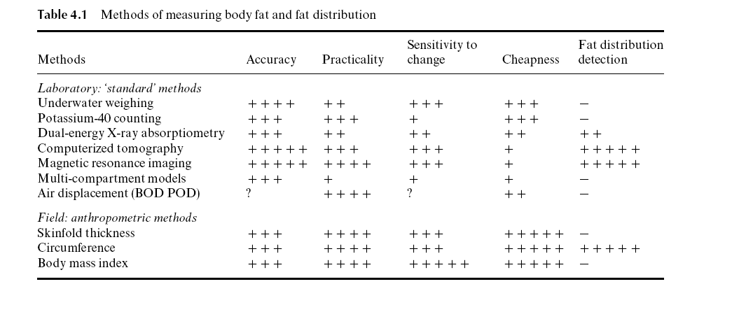

Slide 8
ADVANTAGES OF ANTHROPOMETRY
Objective with high specificity & sensitivity
Readings are numerical & gradable on
standard growth charts
Readings are reproducible.
Non-expensive & need minimal training

Slide 9
Limitations of Anthropometry
Inter-observers errors in measurement
Problems with reference standards, i.e. local versus international standards.
Arbitrary statistical cut-off levels for what considered as abnormal values.

Slide 10
طبقه‌بندي نمايه توده بدني طبيعي و غيرطبيعي
رتبه چاقي | نمايه توده بدني (كيلوگرم بر مترمربع) | وضعيت
 | 18/5< | كم وزن
 | 22/0> | خيلي پير
 | 18/5-24/9 | طبيعي
 | 25-29/9 | وزن اضافي
يك دو | 34/9-30 39/9-35 | چاق
سه | 40≥ | چاقي مفرط

Slide 11
International cut-off points for body mass index for overweight and obesity by sex between 10 and 18 years
Overweight
Obesity
 | Males | Females | Males | Females
10 | 19.84 | 19.86 | 24.00 | 24.11
10.5 | 20.20 | 20.29 | 24.57 | 24.77
11 | 20.55 | 20.74 | 25.10 | 25.42
11.5 | 20.89 | 21.20 | 25.58 | 26.05
12 | 21.22 | 21.68 | 26.02 | 26.67
12.5 | 21.56 | 22.14 | 26.43 | 27.24
13 | 21.91 | 22.58 | 26.84 | 27.76
13.5 | 22.27 | 22.98 | 27.25 | 28.20
14 | 22.62 | 23.34 | 27.63 | 28.57
14.5 | 22.96 | 23.66 | 27.98 | 28.87
15 | 23.29 | 23.94 | 28.30 | 29.11
15.5 | 23.60 | 24.17 | 28.60 | 29.29
16 | 23.90 | 24.37 | 28.88 | 29.43
16.5 | 24.19 | 24.54 | 29.14 | 29.56
17 | 24.46 | 24.70 | 29.41 | 29.69
17.5 | 24.73 | 24.85 | 29.70 | 29.84
18 | 25 | 25 | 30 | 30
Age( years)
Source: Cole et al. BMJ 2000; 320: 1240

Slide 12
Risk factors and influences

Slide 13
Etiology of Obesity
Energy
Expenditure
Sedentary
lifestyle
Energy
Intake
High fat,
high-calorie diet
Genetic Predisposition
Notes:
Etiology of Obesity
Obesity occurs when the body’s energy intake is out of balance with its expenditure over an extended period.
The balance can be upset either by increased intake (eg, through a high-fat, high-calorie diet) or decreased expenditure (eg, through a sedentary lifestyle). A genetic predisposition to obesity accelerates the process.
Treating obesity involves shifting the balance so that expenditure exceeds intake.

Slide 14
Health threat from abdominal obesity is largely due to intra-abdominal obesity
Increased Cardiometabolic Risk
Abdominal
Obesity
Dyslipidemia
Hypertension
Glucose Intolerance
Insulin Resistance
Intra-Abdominal
Adiposity
Adapted from Eckel et al 2005
Notes:
Health threat from abdominal obesity is largely due to intra-abdominal adiposity
This slide summarises the relationships between intra-abdominal adiposity and increased cardiometabolic risk.
Intra-abdominal adiposity drives the progression of multiple risk factors directly, through the secretion of excess free fatty acids and inflammatory adipokines, and decreased secretion of adiponectin. The important contributions of intra-abdominal adiposity to dyslipidaemia and insulin resistance provide an indirect, though clinically important, link to the genesis and progression of atherosclerosis and cardiovascular disease.
Eckel RH, Grundy SM, Zimmet PZ. The metabolic syndrome. Lancet. 2005;365:1415-28.

Slide 15
اندازه دور كمر
وجود چربي در شكم كه با چربي تمام بدن غيرمتناسب باشد، يك پيش‌بيني كننده مستقل براي عوامل خطر و عوارض است.
اندازه دور كمر با ميزان چربي شكم ارتباط مستقيم دارد و شاخص قابل قبولي براي ارزيابي ميزان چربي شكم بيمار قبل و هنگام درمان براي كاهش وزن مي‌باشد.
حدود طبيعي دور كمر در مليت ها متفاوت است.

Slide 16
Various Criteria for Metabolic Syndrome
Population Group Waist Circumference (cm)
Men Women
USA (NCEP ATP III) >102 >88
European >94 >80
South Asian/ >90 >80
Chinese
Japanese >90 >85
Notes:
http://www.idf.org/home/index.cfm?unode=32EF2063-B966-468F-928C-A5682A4E3910 Numbers converted from cm.
South and Central Americans to use South Asian criteria
SubSaharan Africans and Middle Eastern populations use European data
ATP = adult treatment panel

Slide 18
اجلاس كشوري تعيين شاخص هاي چاقي مركزي 1388/7/15
اندازه دور كمر مردان و زنان بالغ 30≤ سال
براي شروع اقدامات پيشگيري (هر دو جنس)
90 سانتيمتر
براي انجام اقدامات جدي (هر دو جنس)
95 سانتيمتر

Slide 19
Global Prevalence of Underweight and Obesity in Adults (by level of development, 2000)
Prevalence (%)
BMI = Body Mass Index
Source: WHO, SDE/NHD, 2000

Slide 20
OBESITY RATES COULD DOUBLE IN 30 YEARS
50
n
USA
n
40
l
England
Australia
30
l
% of population
BMI >30
Mauritius
t
o
u
Brazil
n
20
n
l
u
10
n
n
l
l
n
l
l
u
o
u
l
u
o
0
1960
1970
1980
1990
2000
2010
2020
2030
Year
Adapted from International Obesity Task Force Web site. Available at: http://www.rri.sari.ac.uk/iotf/slides/
graph12.gif.Accessed August 11, 1998.
Notes:
Obesity Rates Could Double in 30 Years¹
This graph (International Obesity Task Force research team projection 1998) provides a crude prediction based on trends since 1980; even these very conservative estimates suggest that close to half the US population will have a BMI of >30 by the year 2025
England could see its obesity rate double again within the next 30 years, while countries as diverse as Mauritius, Australia, and Brazil provide interesting examples of how widespread the growth in obesity levels is around the world

Slide 21
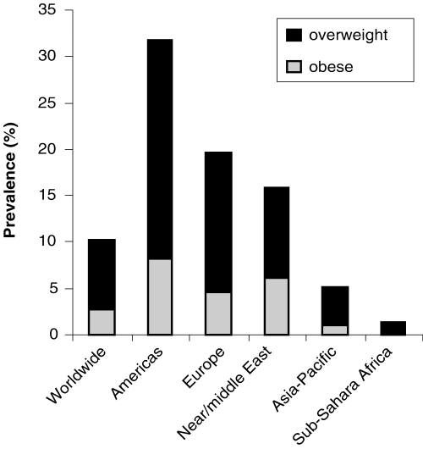
Prevalence of overweight and obesity in children

Slide 22
افزايش وزن و چاقي در برخي از بررسي‌هاي اپيدميولوژي در ايران
درصد نمايه توده بدن |  |  | جنس | جمعيت مورد مطالعه
30 ≥ | 25-29/9 | 25 > | (تعداد)
35 | 47 | 18 | زن (582) | حكيميه
15 | 51 | 34 | مرد (427)
35 | 37 | 27 | زن (1409) | روستاهاي استان تهران
15 | 39 | 49 | مرد (1294)
10 | 34 | 56 | زن (1083) | روستاهاي استان زنجان
11 | 33 | 56 | مرد (605)

Slide 23
Changes in BMI (A) and prevalence of overweight (B) and obesity (C) in Tehranian population during 6.6 years: TLGS, 1999-2011
A
B
C

Slide 24
Changes in WC(A), WHR (B) and prevalence of abdominal obesity (C ) in Tehranian population during 6.6 years: TLGS, 1999-2011
A
B
C

Slide 25
Percent changes in BMI, Overweight and Obesity in various age group of Tehranian adults during 6.6 years: TLGS, 1999-2008
BMI
Overweight
Obesity

Slide 26
Percent changes in WC and abdominal obesity in various age group of Tehranian adults during 6.6 years: TLGS, 1999-2008
WC
Abdominal obesity

Slide 27
Adjusted prevalence and trend of at risk for overweight and overweight in adolescent girls, according to Iranian BMI (body mass index) percentiles and IOTF (International Obesity Task Force) cutoffs in 2 age groups during 4 time periods (1999–2011).
10-14 year
15-19 year
10-14 year
15-19 year
Hosseini-Esfahani F, Mousavi Nasl Khameneh A, Mirmiran P, Ghanbarian A, Azizi F. Trends in Cardiovascular Disease Risk Factors among Adolescents: Tehran Lipid and Glucose Study, 1999-2008. J Epidemiol 2011; 21(5):319-28.

Slide 28
Adjusted prevalence and trend of at risk for overweight and overweight in adolescent boys, according to Iranian BMI (body mass index) percentiles and IOTF (International Obesity Task Force) cutoffs in 2 age groups during 4 time periods (1999–2011).
10-14 year
15-19 year
10-14 year
15-19 year
Hosseini-Esfahani F, Mousavi Nasl Khameneh A, Mirmiran P, Ghanbarian A, Azizi F. Trends in Cardiovascular Disease Risk Factors among Adolescents: Tehran Lipid and Glucose Study, 1999-2008. J Epidemiol 2011; 21(5):319-28.

Slide 29
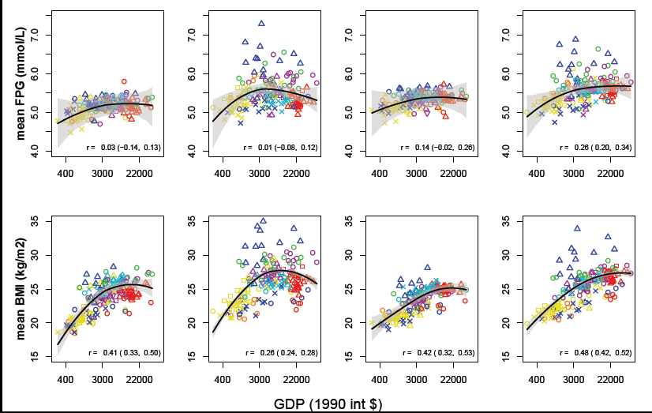
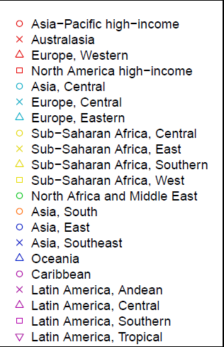
Mean age-standardized levels of metabolic risk factors in relation to per-capita gross domestic product (GDP)
Danaei G, et al. (Global Burden of Metabolic Risk Factors of Chronic Diseases Collaborating Group), In press.

Slide 30
Mean age-standardized SBP, TC, and FPG in relation to mean age-standardized BMI
Danaei G, et al. (Global Burden of Metabolic Risk Factors of Chronic Diseases Collaborating Group), In press.

Slide 31
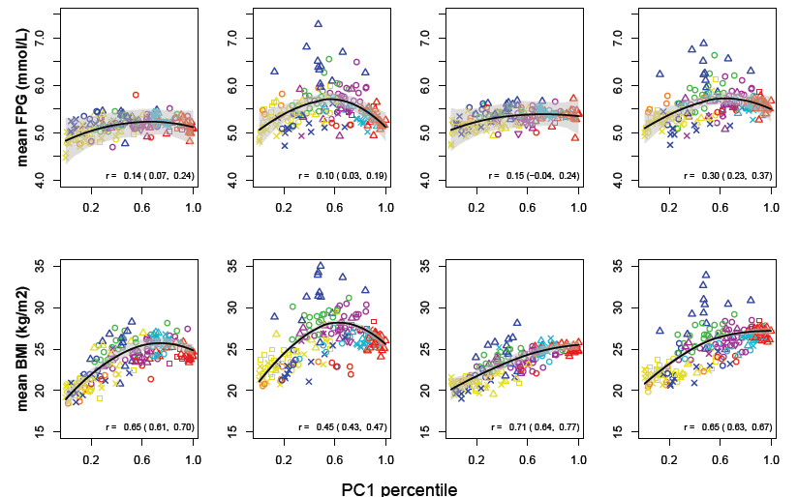
Mean age-standardized levels of metabolic risk factors in relation to western diet. See Methods for how percentiles were calculated
Danaei G, et al. (Global Burden of Metabolic Risk Factors of Chronic Diseases Collaborating Group), In press.

Slide 32
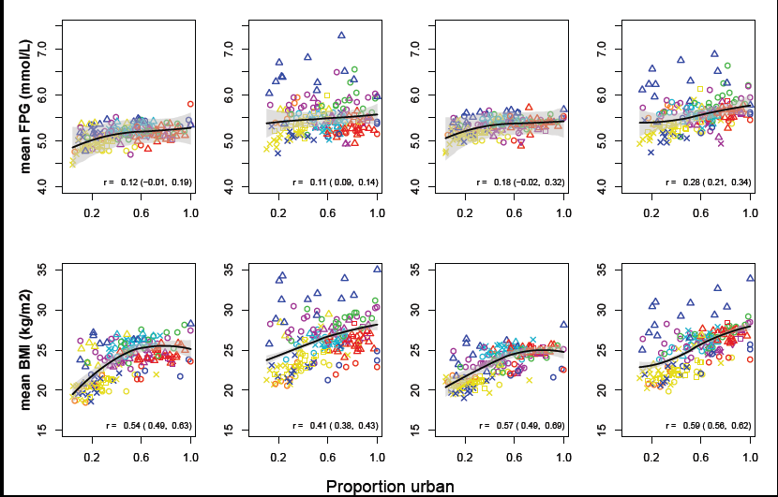
Mean age-standardized levels of metabolic risk factors in relation to the proportion of a country’s population that lived in urban areas
Danaei G, et al. (Global Burden of Metabolic Risk Factors of Chronic Diseases Collaborating Group), In press.

Slide 33
شيوع اضافه وزن و چاقي در ايران ( 20 ≥ سال)
روستا | شهر
35 | 40 | اضافه وزن (BMI 25-29.9 kg/m2)
15 | 21 | چاقي (BMI ≥30 kg/m2)
Notes:
اضافه وزن
(BMI 25-29.9 kg/m2)
چاقي
(BMI >30 kg/m2)

Slide 34
تعداد افراد 20 ≥ ساله با اضافه وزن و چاقي در ايران
كل | روستا | شهر
16/4 | 5/2 | *11/2 | اضافه وزن
8/1 | 2/2 | 5/9 | چاق
24/5 | 7/4 | 17/1 | جمع
* ميليون نفر( کل جمعيت 70 ميليون و 65%، 20 سال و بالاتر

Slide 35
Comorbid Conditions and BMI
Patients With BMI ≥27
No
Comorbidity 35%
Comorbid conditions that increase as BMI increases
Hypertension (56%)
Dyslipidemia (47%)
Type 2 diabetes (70%)
Comorbidity 65%
Notes:
Comorbid Conditions and BMI
As BMI increases, the prevalence of comorbid conditions such as hypertension, dyslipidemia and type 2 diabetes also increases.
Fully 65% of patients age 25 or older with a BMI ≥27 have at least one comorbidity.
56% of patients with hypertension, 47% of patients with dyslipidemia and 70% of patients with type 2 diabetes have a BMI ≥27.
Reference:
Data on file (Reference 038-014). Analysis of data from the National Center for Health
Statistics NHANES III (National Health and Nutrition Examination Survey III),
1988–1994.

Slide 36
Relation Between BMI and Co morbidities
Type 2 diabetes
Cholelithiasis
Hypertension
Coronary heart disease
Women
Men
6
6
5
5
4
4
Relative Risk
3
3
2
2
1
1
0
0
<21
22
23
24
25
26
27
28
29
30
<21
22
23
24
25
26
27
28
29
30
BMI (kg/m2)
BMI (kg/m2)
Notes:
Relation Between BMI and Comorbidities
Two large-scale studies, the Nurses’ Health Study and the Health Professionals Follow-up Study, followed large groups of subjects for several years.
Among these subjects, the risk of various diseases was closely related to BMI.
Cholelithiasis, hypertension and coronary heart disease all increased at comparable rates—a person with a BMI of 30 had approximately 3–4 times the risk of a person with a BMI of 21.
Risk of type 2 diabetes, however, increased much more sharply.
Reference:
Willett WC, Dietz WH, Colditz GA. Guidelines for healthy weight. N Engl J
Med. 1999;341:427–434.

Slide 37
Obesity and Mortality Risk
2.5
2.0
●
■
Mortality Ratio
1.5
●
■
●
●
■
1.0
■
●
■
●
●
■
■
Very Low
Low
Moderate
High
Very High
0
●
Men Women
20
25
30
35
40
■
BMI
Notes:
Obesity and Mortality Risk
Working from a database of 750,000 people, Gray found that mortality and BMI are correlated and that mortality is lowest at BMI 20-25.
Note that, although at any given BMI women tend to have more body fat than men, their risk is virtually identical.
Reference:
Gray DS. Diagnosis and prevalence of obesity. Med Clin North Am. 1989;73(1):1–13.

Slide 38
Annual per-person medical costs, survival adjusted

Slide 39
سير چاقي در جهان
اضافه وزن و چاقي چگونه سلامت جسمي و رواني كودكان و نوجوانان را در دهه هاي بعد مختل مي كند؟
اضافه وزن و چاقي كودكان و نوجوانان چه اثري بر طول عمر خواهد داشت؟
اضافه وزن و چاقي كودكان و نوجوانان چه اثري بر اقتصاد كشورها و مسائل اجتماعي خواهد داشت؟

Slide 41
Complications of Childhood Obesity
Psychosocial | Poor self-esteem Anxiety Depression Eating disorders Social isolation Lower educational attainment
Neurologic | Pseudotumor cerebri
Endocrine | Insulin resistance Type 2 diabetes Precocious puberty Polycystic ovaries (girls) Hypogonadism (boys)
Cardiovascular | Dyslipidemia Hypertension Coagulopathy Chronic inflammation Endothelial dysfunction

Slide 42
Complications of Childhood Obesity
Pulmonary | Sleep apnea Asthma Exercise intolerance
Gastrointestinal | Gastroesophageal reflux Steatohepatitis Gallstones Constipation
Renal | Glomerulosclerosis
Musculoskeletal | Slipped capital femoral epiphysis Blount’s disease* Forearm fracture Back pain Flat feet
* Blount’s disease is a growth disorder of the tibia that causes the lower leg to angle inward (tibia vara).

Slide 43
سير چاقي در جهان
چشم انداز چاقي را مي توان در چهار مرحله خلاصه كرد:
مرحله 1- آغاز از 40 سال پيش: افزايش اضافه وزن و چاقي كودكان و نوجوانان در اكثر نقاط جهان.
مرحله 2- زمان حال: عوارض شديد اضافه وزن و چاقي (افزايش ديابت نوع 2، كبد چرب، عوارض ارتوپديك آپنه خواب، اثرات اجتماعي و رواني و ...)

Slide 44
سير چاقي در جهان
مرحله 3- در آينده نزديك: عوارض شديد منجر به مرگ (افزايش CHD، CRF و ...)
مرحله 4- در آينده اي نه چندان دور: تسريع چاقي از طريق مكانيسم هاي بين نسلي (Transgeneration)- تغييرات در سلولهاي چربي، مغز و هورمون ها به علت چاقي كودكي و اثرات انتقالي آن در فرزندان
Ludwig DS. N Engl J Med 2007; 357: 2325-7
Barker , et al. N Engl J Med 2007; 357: 2329-37

Slide 45
Prevalence of Coronary Heart Disease (CHD) Associated with Three Projections of Future Adult Obesity. High rates of current adolescent overweight are expected to increase the excess prevalence of CHD (Panel A) and to increase the overall population prevalence of CHD (Panel B).
Bibbins-Domingo K, et al. N Engl J Med 2007; 357: 2371

Slide 46
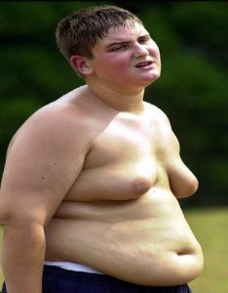
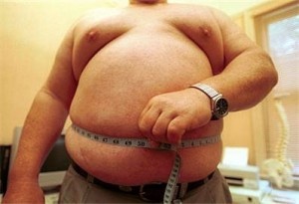
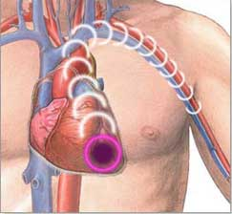
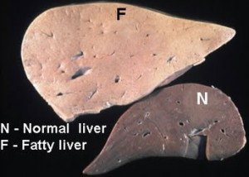
CHD
In
Adolescent
3
A child who has born obese
4
Obese
Adolescent
1
Diabetes
Fatty liver In Adolescent
2

Slide 47
عوامل موثر در اضافه وزن و چاقي كودكان
افزايش وزن بيش از حد در زمان بارداري
وزن كم هنگام تولد
عدم استفاده كافي از شير مادر
كاهش ميزان خواب در دوران كودكي
* اين عوامل احتمالا از طريق هيپوتالاموس، لوزالمعده و تاثير در نسبت چربي بدن اثر مي گذارند.

Slide 48
براي پيشگيري چاقي چه موقع بايد شروع كرد؟
موفقيت هاي مختصر در مداخله هاي تغذيه اي و نگرشي در مدارس
شواهد موجود در كودكان سه ساله
- افزايش غلظت ماركرهاي التهابي مرتبط با بيماري هاي قلبي در كودكان چاق
پيشگيري چاقي بايد قبل از سنين مهد كودك آغاز شود.

Slide 49
Overall summary of meta-analyses results of randomized trials of treatments for pediatric obesity. Plot shows metaanalytic point estimates (f) and 95% CI (horizontal lines). SMD, Standardized mean differences.
McGovern L, et al. J Clin Endocrinol Metab 2008; 93: 4600–4605.

Slide 50
Mean (±SE) Weight Loss at One Year in the Combined-Therapy Group and the Group Treated by Lifestyle Modification Alone among Subjects in the Lowest and Highest Thirds of Adherence for Completing Food-Intake Records during the First 18 Weeks

Slide 51
Change in bodyweight
Astrup A, et al. Lancet 2009; 379: 1606

Slide 52
The main task of country programs must focus on the primary prevention with structured programs of lifestyle modifications. Parents must take responsibility for their children’s health by modifying their own lifestyle and ensuring healthy lifestyles for their children, encouraging more physical activity and less television and computer viewing. These family efforts should be accompanied by the initiation of government and private sectors to provide high -quality food in the market and to curtail ever-increasing manufacturers of fast or junk foods. Without serious and adequate interventions, a catastrophe looms ahead.
Azizi F, et al. AIM 2008; 11: 242-4

Slide 53
يكي از ملوك عجم، طبيبي حاذق به خدمت مصطفي (ص)، فرستاد. سالي در ديار عرب بود و كسي تجربه پيش او نياورد، و معالجه از وي درنخواست. پيش پيغمبر آمد، و گله كرد كه مرين بنده را براي معالجت اصحاب فرستاده اند، و درين مدت كسي التفاتي نكرد. تا خدمتي كه بر بنده معين است به جاي آورد. رسول (ص) گفت: اين طايفه را طريقتي است كه تا اشتها غالب نشود نخورند، و هنوز اشتها باقي بود كه دست از طعام بدارند. حكيم گفت: اين است موجب تندرستي. زمين ببوسيد و برفت.
شرف الدين مصلح (سعدي) شيرازي؛ افصح المتكلمين (شيواترين سخنور) 690-606 هـ.ق (Saedi 1247 AD)

