Slide 1
Case presentation
A.Amouzegar MD
Endocrine Research Center
Research Institute For Endocrine Sciences
Tehran

Slide 3
A 13-year-old girl was seen in the endocrinology clinic because of an enlarging neck mass
8 days earlier, the patient noted swelling of her neck and pain on swallowing
2 days later, her primary care provider noted that the patient had an enlarged thyroid gland
The level of serum TSH was 5.59 μIU /mL
(reference range, 0.28 to 3.89)
FT4 0.88 ng /dL(reference range,0.58 to 1.64)
TT3 159 ng /dL(reference range, 87 to178)

Slide 4
The TPOAb level was 244 IU /mL(reference range, <35), and the antithyroglobulin antibody level was greater than 3000 IU /mL
(reference range, <40
Complete blood count and electrolyte levels were normal
The patient was referred to the endocrinology unit at this hospital, where she was seen 5 days later

Slide 5
The patient reported tightness in her neck and occasional nausea but no difficulty breathing or swallowing
She did not have a sensation of feeling hot or cold; changes in weight, appetite, degree of thirst, energy level, hair, or skin; palpitations;
diarrhea; constipation; abdominal pain;
vomiting; urinary frequency; skin lesions; or
musculoskeletal symptoms

Slide 6
She took over-the counter analgesics as needed for headaches and had no known allergies
She lived with her parents and two younger siblings and did well in school
Her mother, maternal grandmother, maternal aunt, and cousin had hypothyroidism, and a thyroid nodule that had recently developed in her mother was being evaluated

Slide 7
On examination
The patient appeared well
The height was 162 cm (77th percentile for age), the weight 59.4 kg (88th percentile), and the 22.6 (86th percentile)
The BP was 126/66 mm Hg, and the pulse 79 beats /min
There was no exophthalmos, and extraocular movements were normal
The thyroid was firm and possibly had an ill-defined mass on the left

Slide 8
The right lobe measured 4.5 cm and the left lobe 6.5 cm in greatest dimension
There were no enlarged cervical lymph nodes
The administration of levothyroxine (50 μg daily) was begun, and ultrasonography of the thyroid gland was scheduled
15 days after the patient’s initial evaluation, her mother called to report that the thyroid gland was increasing in size

Slide 9
Ultrasonography
Of the thyroid revealed a diffusely enlarged thyroid, with the left lobe (5.9 by 3.6 by 2.7 cm) larger than the right (5.1 by 2.1 by 1.9 )
The parenchyma was heterogeneous
A predominantly cystic lesion in the right isthmus had a hyperechoic component and showed minimal Doppler flow
Multiple punctate, hyperechoic foci were present diffusely in the thyroid gland
Numerous lymph nodes lay on either side of the thyroid gland, lateral to both common carotid arteries and posterior to the left clavicular head
Lateral to the left common carotid artery, there was an enlarged lymph node (1.2 by 1.9 by 0.5 cm), with echotexture resembling that of the thyroid

Slide 10
9 days later, on a repeat examination, the thyroid had increased in greatest dimension to 6 cm on the right and 7 cm on the left and was firm to palpation
Small cervical lymph nodes were palpable
The patient had pain during swallowing but reported no weight change, hoarseness, or difficulty breathing

Slide 11
In brief:
This teenage girl presented with rapid thyroid enlargement (goiter), mild hypothyroidism,
and serologic evidence of autoimmune thyroiditis

Slide 12
Questions:
1-What are the differential diagnosis of the case?
2-What is the next step in this case?

Slide 13
Differential Diagnosis
Goiter
Thyroiditis
Benign thyroid nodule(s)
Thyroid cancers

Slide 14
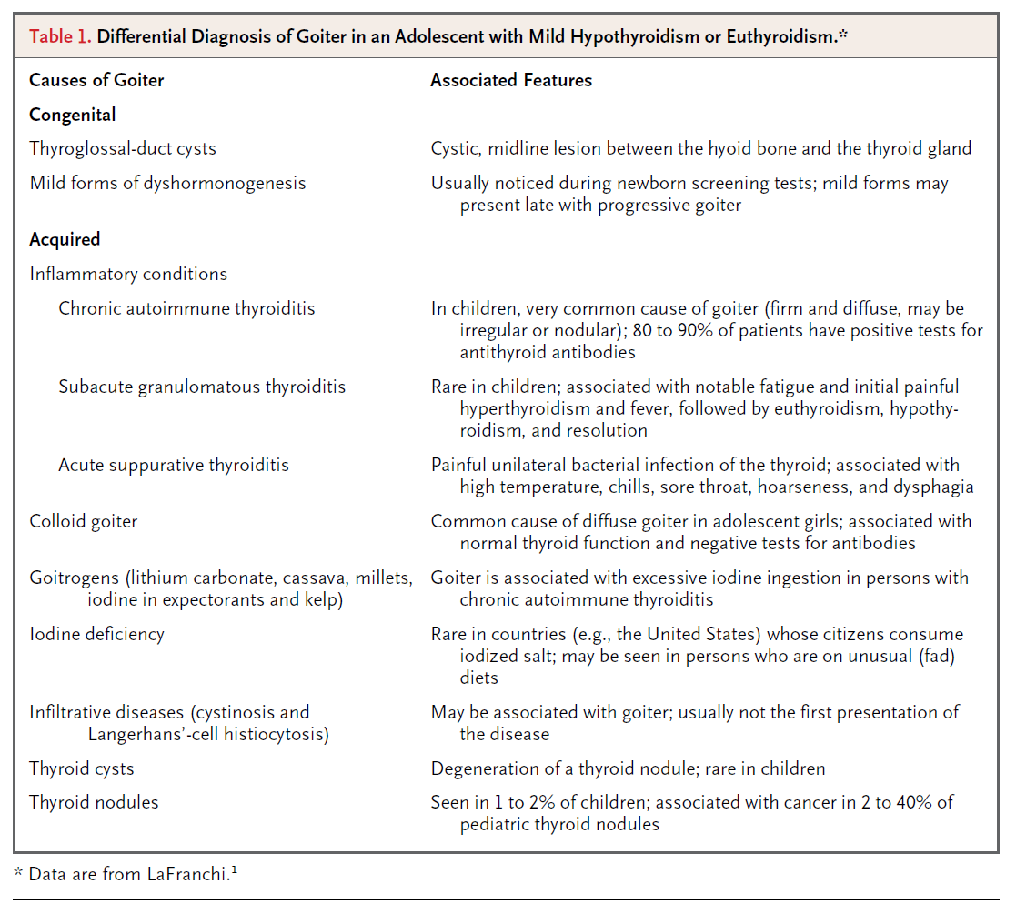
Causes of goiter in a child

Slide 15
When thyroglossal-duct cysts become infected, the patient typically presents with cystic swelling in the midline of the neck
Patients with mild forms of dyshormonogenesis may sometimes present in late childhood with hypothyroidism and goiter
However, rapid enlargement of the thyroid, is not a feature of either condition
Also, neither condition is associated with serologic evidence of autoimmune thyroiditis
This patient had a firm thyroid mass that was enlarging rapidly, and tests for antibodies were strongly positive, making these diagnoses unlikely
This patient had no history of ingestion of goitrogenic substances that would suggest iodine deficiency
Colloid goiters commonly occur in adolescent girls but are not associated with rapid thyroid enlargement or autoantibodies

Slide 16
Thyroiditis:
Among inflammatory conditions, an absence of tenderness, fever, or fatigue made acute suppurative or subacute granulomatous thyroiditis unlikely in this patient
In chronic autoimmune thyroiditis, the goiter is firm and diffuse, although it may sometimes be irregular or even nodular
This patient had a firm goiter, positive antibody tests, and a slightly elevated thyrotropin level, features that are indicative of this condition
However, the dysphagia and rapid enlargement of the thyroid were of concern since neither of these features is typical of chronic autoimmune thyroiditis
The possibility of nodules was also of concern

Slide 17
Thyroid nodules
Chronic autoimmune thyroiditis may have a nodular appearance as a result of thyrotropin-induced hyperplasia of follicular tissue or focal lymphocytic infiltrates, but true nodules may also occur
This patient’s thyroid increased in size after the administration of levothyroxine was begun
Rapid enlargement of the thyroid can occur when there is hemorrhage within a cystic nodule, hemorrhagic degeneration of a nodule, or associated cancer

Slide 18
Cont
Approximately 20% of thyroid nodules in pediatric patients are cancers (reported range, 2 to 40%)
This patient had additional risk factors for cancer, including chronic autoimmune thyroiditis, an elevated thyrotropin level (associated with a 10-fold increase in cancer risk), rapid growth, an abnormal cervical lymph node
On the basis of the history of a rapidly enlarging gland and dysphagia and the continued growth of the thyroid while the patient was being treated with levothyroxine, we were very concerned about the presence of cancer

Slide 19
Thyroid cancers
PTC is the most common type of thyroid cancer in children, followed by follicular and medullary thyroid cancers
Anaplastic cancers, primary thyroid lymphomas, and metastatic cancer are typically seen in older adults and rarely in children
Among papillary cancers, the well-differentiated and follicular variants are most common and are associated with an excellent prognosis (20-year survival, >90%), but they typically present as slow enlargement of a nodule, rather than rapid, diffuse enlargement of the thyroid

Slide 20
However, the diffuse sclerosing variant is associated with larger and more aggressive tumors and higher rates of local and distant metastases than is the common type of papillary cancer
A rapidly enlarging mass is also more common in anaplastic carcinoma and large B-cell lymphoma
than in typical papillary carcinoma
Positive tests for antithyroid antibodies have been reported in up to 75% of pts with the diffuse sclerosing variant of PTC and in 50 to 90% of pts with primary thyroid lymphomas

Slide 21
In view of this patient’s age, the presence of antithyroid antibodies, and the history of rapid enlargement, the most likely diagnosis was the diffuse sclerosing variant of PTC, with primary thyroid lymphoma and anaplastic carcinoma being less likely because of her age

Slide 22
A transverse image of the right lobe of the thyroid gland

Slide 23
sagittal image of the left lobe

Slide 24
sagittal image shows a lymph node

Slide 25
Ultrasound examination of the thyroid
Showed diffuse enlargement of both lobes, with abnormal heterogeneous echotexture and numerous hyperechoic foci, features that were
consistent with microcalcifications
An abnormal-appearing LN with echotexture similar to the thyroid was present lateral to the left lobe of the thyroid
A small complex cystic nodule was present in the isthmus

Slide 26
Most cases of thyroid cancer are manifested as a suspicious nodule, which was not present in this case
The presence of microcalcifications in a diffusely heterogeneous thyroid gland and the presence of a regional lymph node with an appearance similar to that of the thyroid (suggesting involvement by the same process) raise concerns about thyroid cancer
PTC may present with microcalcifications and without an associated mass
A biopsy was recommended

Slide 27
Preoperative fine-needle aspiration (Papanicolaou stain) of a lymph node

Slide 28
Discussion of Management
The initial goal of the endocrine surgeon is to remove the entire primary tumor and affected lymph nodes with minimal complications, reducing the risk for recurrence
Surgical removal of the tumor and any normal surrounding thyroid tissue also allows for radioactive iodine therapy if needed, as well as permitting long-term surveillance

Slide 29
Preoperative evaluation
The management of this patient’s condition began with ultrasonography
Us is used to carefully assess the extent of the tumor and any involved lymph-node basins and has been shown to alter surgical treatment in up to 40% of pts.
In this case, ultrasound examination confirmed the presence of bilateral thyroid enlargement, with microcalcifications throughout the gland; there were multiple enlarged central nodes bilaterally, low in the neck, as well as lymph nodes bilaterally along both internal jugular veins, that raised suspicion.

Slide 30
Operative management
The American Thyroid Association consensus guidelines recommend a total thyroidectomy for patients with papillary cancers that are larger than 1 to 1.5 cm

Slide 31
A low-magnification image of the left lobe of the thyroid (H&E)

Slide 32
At higher magnification (H&E)

Slide 33
The right lobe (H&E )

Slide 34
lymph node (H& E)

Slide 35
Extrathyroid tissue

Slide 36
PTC typically spreads first to the central nodes (closest to the thyroid, also known as level VI), then to the ipsilateral lateral nodes surrounding the internal jugular vein (levels II, III, and IV), and subsequently to the nodes in the contralateral lateral compartments
The ATA consensus statement recommends that the central lymph nodes be considered for removal

Slide 37
The lymph nodes in the central and lateral neck compartments needed to be addressed in this patient, since ultrasound examination showed that both compartments had tumor involvement

Slide 38
The pathological features of this case are characteristic of the diffuse sclerosing variant of papillary thyroid carcinoma.
This cancer often presents in young women, typically involves either the entire thyroid gland or one lobe, without a dominant mass, and produces diffuse fibrosis with scattered foci of tumor.
Extrathyroidal extension and metastasis to lymph nodes are often present at the time of diagnosis

Slide 39
Discussion of Management
Although she had a large tumor, extrathyroidal invasion, focally positive surgical margins, and cervical-node metastases, the cancer is stage I in the TNM staging system, which recognizes age as the dominant prognostic factor

Slide 40
Radioiodine treatment
This patient’s pathological findings indicated the need for radioiodine scanning and ablation of any remaining thyroid tissue to complete the staging and facilitate long-term monitoring
Since young patients with the diffuse sclerosing variant of papillary cancer are at increased risk for pulmonary metastases, a chest CT was obtained without the administration of contrast material

Slide 41
This patient’s CT scan of the chest did not show metastatic disease, but many young patients have pulmonary metastases that are detectable only on radioiodine scans, reflecting a micronodular pattern of metastases below the sensitivity of CT imaging

Slide 42
High levels of serum thyrotropin are desirable before radioiodine treatment
Radioiodine administration is equally efficacious at destroying thyroid tissue after the administration of recombinant human thyrotropin or after the withdrawal of thyroid hormone

Slide 43
Taking into account this patient’s extensive local disease, the focally positive surgical margin, her “adult” stature, and the apparent absence of metastatic disease, she was given 100 mCi of radioiodine to ablate remnants
A post-treatment scan confirmed the absence of
iodine-avid metastases
Although not all thyroid cancer metastases concentrate iodine, iodine-avid pulmonary metastases are reported with the diffuse sclerosing variant of papillary cancer

Slide 44
After the administration of radioiodine, slightly supraphysiologic doses of thyroid hormone are administered to suppress serum TSH levels, since thyrotropin is a growth factor for persistent disease
The suppression of thyrotropin levels is associated with better outcomes in young patients, such as this one, who have tumors that are larger than 4 cm in greatest dimension or who have extrathyroidal extension and in patients with stage II, III, or IV cancer

Slide 45
Follow up
US is the most sensitive imaging technique for detecting the recurrence of thyroid cancer in the anterior neck
It is also the primary imaging technique for long-term f/p
If this patient’s titer of antithyroglobulin Ab falls to negligible levels, measurement of Tg levels after stimulation with rhTSH will also provide critical information on the status of her cancer

Slide 46
Almost 2 y after the operation, the patient is asymptomatic and is being treated with 150 μg of LT4
15 months after the operation, the antithyroglobulin antibody level was 22 IU /mL and the thyroglobulin level was undetectable (<0.2 pg/mL; reference range, 4 to 40)
The patient has no evidence of cancer recurrence on ultrasonography or radioactive iodine scans

Slide 47
Anatomical Diagnosis
PTC, diffuse sclerosing variant (≥12cm), associated with chronic autoimmune thyroiditis

