Slide 2
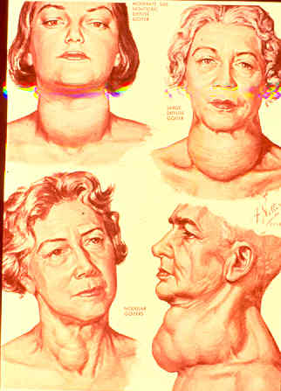

Slide 3
Application of the Risk Based
Management Approach
Fereidoun Azizi
Research Institute for Endocrine Sciences
Shahid Beheshti University of Medical Sciences

Slide 4
روش های تشخیصی
TSH، FT4
سونوگرافی
FNA

Slide 5
Third generation TSH
Free T4
TSH
High
Normal
Low
Thyroid Scan
“Cold” nodule
“Hot” nodule
Workup and treatment of hypothyroidism if there is single dominant nodule
FT4
NL
High
Observe
I ¹³¹ RX
Or
Surgery
FNA

Slide 6
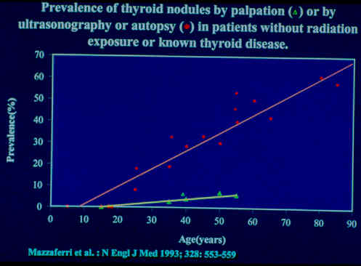

Slide 7
عوامل تاثير گذار در موفقيت FNA
مهارت كافي فرد نمونه گير( + )
پر عروق بودن گره( - )
خيلي كوچك يا خيلي بزرگ بودن گره( - )
سيتولوژيست مجرب( + )

Slide 8
The Problem: Indeterminate FNA Cytology
~9,350 consecutive thyroid nodules evaluated with US and UG-FNA over a 13-year period
FNA Cytology | Proportion Cancer on Histopathology
Suspicious for Papillary Carcinoma | 70%
Follicular Neoplasm (FN/SFN) | 27%
Atypical of an undetermined significance (AUS/FLUS) | 24%
Despite recommendations for surgery, >50% of patients with “abnormal’ cytology prove to have benign disease
Yassa, et al. Cancer Cytopath. 2007

Slide 9
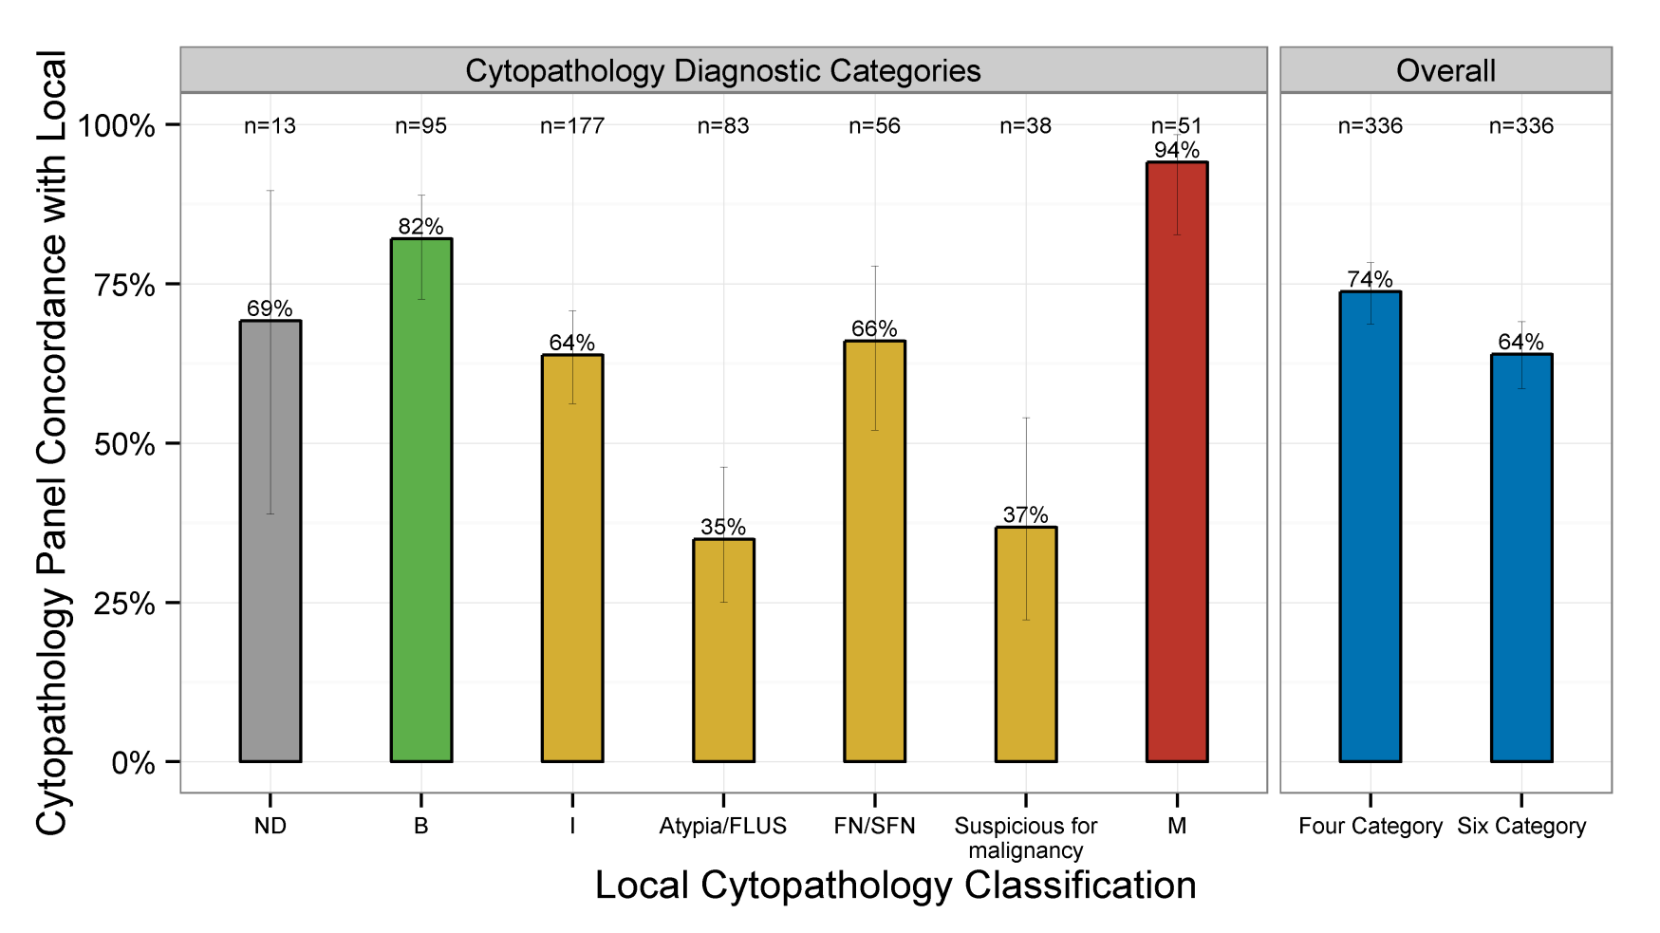
Inter- observer Variability in FNA Cytology:
336 prospectively enrolled patients. Blinded read by experts (EC, ZB, SR)
“Local Cytopathology” report compared to “Bilnded Expert” report
Cibas ES, et al. Annals Int Med 2013

Slide 10
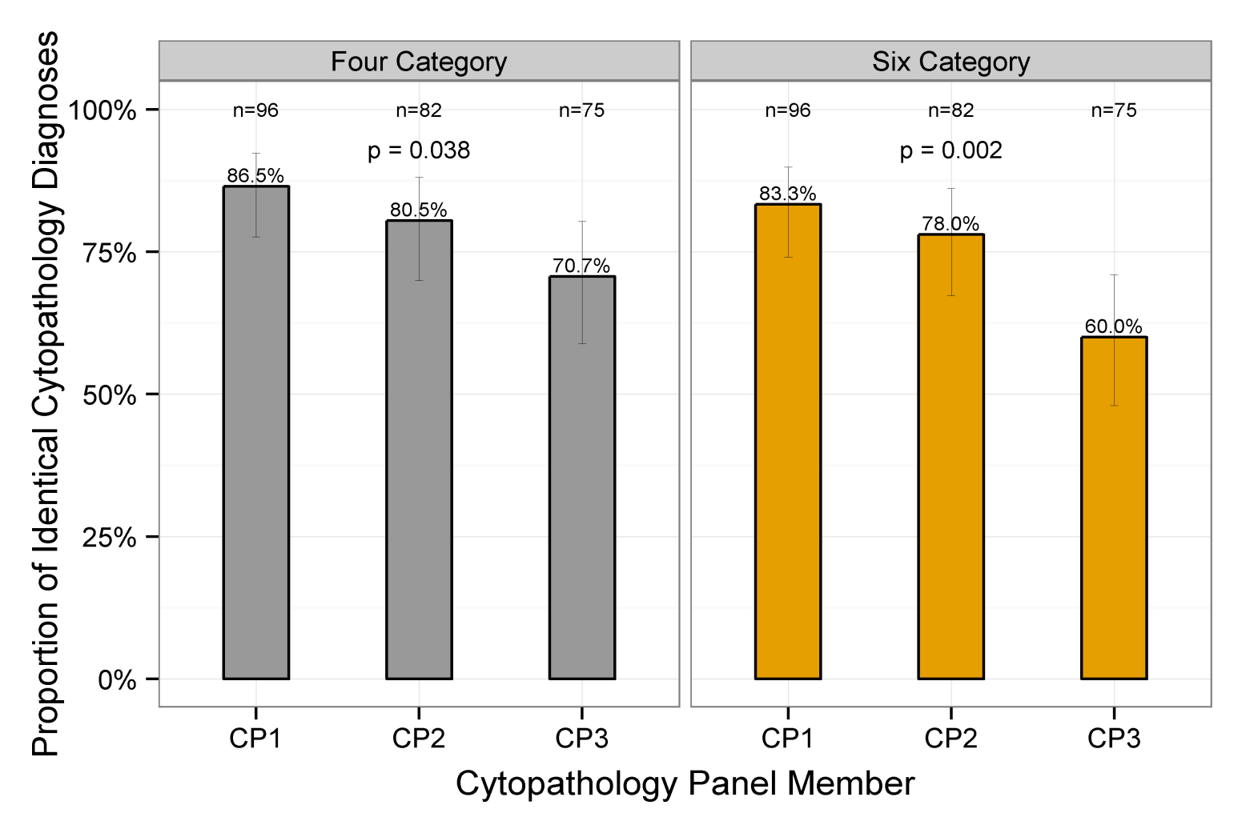
Inter- observer Variability in FNA Cytology:
253 aspirations re-read by same blinded experts (EC, ZB, SR)
Identical slides re-labeled & sent to blinded expert >30 days after 1st read
Cibas ES, et al. Annals Int Med 2013

Slide 11
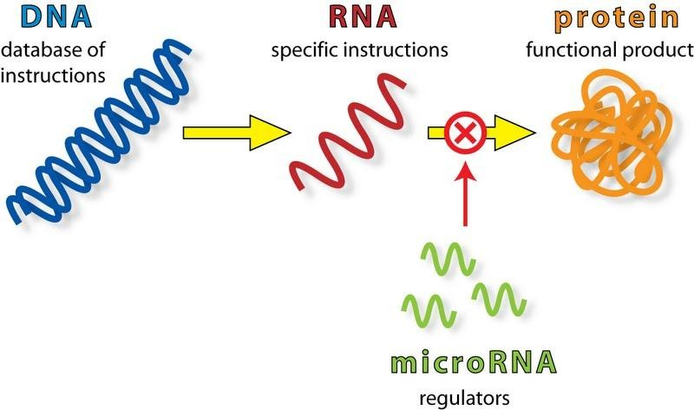
Adressing the need …
Molecular Diagnostic Targets:
Critical Considerations:
• Analytic Validation
• Clinical Validation
• Clinical Utility

Slide 12
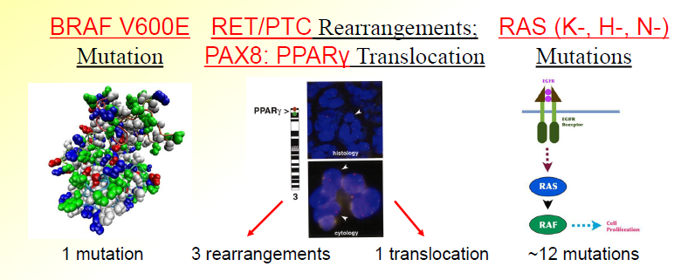
DNA: Single Gene Mutations
• 1 of 4 mutations in majority of thyroid carcinomas.
• Hypothesis: Mutations are likely oncogenic;
if present →cancer. if absent →benign

Slide 13
Translational Studies:
Cantara (Italy): Prospective Study of 174 pts (235 nodules) undergoing thyroid surgery
(Malignancy Prev 56% in cyto indeterminate + cyto Suspicious ).
Nikiforov (U.S.): Retrospective, Non-blinded Study of 479 pts w/ cyto indeterminate nodules
(Malignancy Prev 24% in Bethesda indeterminates).
Moses (U.S.): Prospective, blinded Study of 438 patients ; 110 Cyto indeterminate
(Malignancy Prev 32% in cyto indeterminate + cyto Suspicious).
In cancerous nodules, 34%-78% have genetic mutations.
In cytologically indeterminate nodules, when mutation present, 78-91% predictive of thyroid cancer.
✓
Analytic
Validation:
Analytic
Validation:
Clinical
Utility:
+/-
Into the clinic - high PPV modifies surgical planning
Cantara et al. JCEM 2010;95:1365. Moses et al. World J Surg 2010;34:2589. Nikiforov, et al. JCEM 2011;96:1

Slide 14
Translational Studies:
Afirma Gene Expression Classifier - 164 genes; High NPV.
    Prospective, blinded, 49-center study; >3,700 patients with nodules >1 cm.
    1-2 additional samples after FNA. “Standard of Care Approach”
    Comparison to 2-expert, blinded, gold-standard Histopathology
Performance on all indeterminate: | Cytology AUS/FLUS | Cytology FN/SNF
N=265 | N=129 | N=81
NPV: 93% | NPV: 95% | NPV: 94%
✓
Analytic
Validation:
Analytic
Validation:
Clinical
Utility:
+/-
Into the clinic - high NPV Prevent unnecessary surgery
Alexander, NEJM 2012

Slide 15
Translational Studies:
Galectin-3 immunostaining (>5%) of FNA specimens predicts an increased risk a nodule is cancerous:
Study:
    Prospective, multicenter study of 465 pts. w/ indeterminate cytology.
    Cytology Assessment PLUS immunostaining of cell block
Galectin- 3 Status: | % Nodules Cancer:
Positive (>5%) | 75-85%
Negative (<5%) | ~ 5-7%
✓
Analytic
Validation:
Analytic
Validation:
Clinical
Utility:
+/-
Into the clinic - Usefulf for Histology > Cytology
Bartolazzi, Lancet Onc 2008; 9: 543

Slide 16
Conclusions:
Optimizing the Care of Indeterminate Nodules:
Cytologically Indeterminate nodules are common.
Traditionally, because malignancy cannot be excluded, diagnostic surgery has been recommended.
This approach is suboptimal, as surgery is unnecessary in ~50% of patients, yet carries risk, morbidity & cost.
Molecular analysis of cytologically indeterminate nodules is the new standard – golden era of Discovery & Development.
As we translate into the clinic, results from high-quality, clinical validation studies are critical.
When choosing the ‘best’ diagnostic option, consider:
  1) Test parameters & validation, and 2) patient desires.

Slide 17
Changing Paradigms in the Management of Thyroid Cancer
“Traditional Paradigm”
One Size Fits All
Total thyroidectomy
RAI remnant ablation
All with same follow up
“Risk Adapted Paradigm”
Management recommendations based individualized risk assessment
Increased Emphasis
Risk of death
Risk of recurrence
Risk of persistent disease
Risk of failing initial therapy

Slide 18
Targeted Therapies
What are our options?
Systemic Therapies
Chemotherapy/Novel Therapies
Radioactive Iodine
Surgery
External Beam Radiation
Embolization
Often, multiple “targeted therapies” are used over the life time of a patient with advanced thyroid cancer

Slide 19
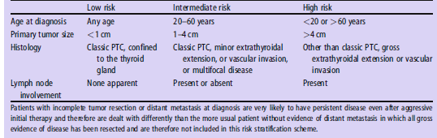
Risk stratification for the likelihood of clinically evident thyroid cancer recurrence following complete resection of primary tumor in patients with no evidence of distant metastases at initial evaluation

Slide 20
ATA risk stratification for the assessment of risk of recurrence
Low | Intermediate | High
T1-2N0M0 | T3 N1 | T4 M1
All macroscopic tumor reacted |  | Incomplete tumor resection
No aggressive histology | Aggressive histology or vascular invasion
No 131-I uptake outside the thyroid bed | N1 and/or M1 AT WBS | Low 131-I uptake of distant metastases

Slide 21
Estimating risk of recurrent in differentiated thyroid cancer after total thyroidectomy and radioactive iodine remnant ablation: using response to therapy variables to modify the initial risk estimates predicted by the new American Thyroid Association Staging System. Tuttle M, et al. Thyroid 2010
588 DTC restaged according to the result of serum Tg (basal and /or stimulated) and imaging 2 yrs after initial treatment
% of cases with persistent or recurrent disease after a mean follow up of 7 years (range 1-15 yrs)
Risk stratification | Low | Intermediate | High
ATA | 3% | 21% | 68%
Excellent T4 withdrawal or rhTSH-Tg <1 ng/ml, no structural disease | 2% | 2% | 14%
Incomplete LT4 Tg >1 ng/ml, T4 withdrawal or rhTSH-Tg >10 ng/ml, Rising Tg values, or structural disease | 13% | 41% | 79%

Slide 22
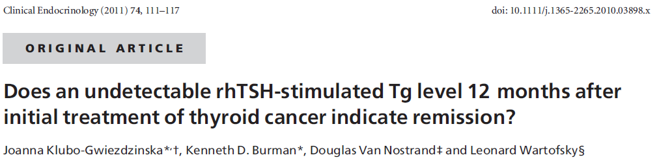
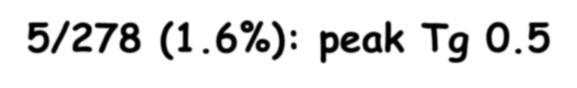
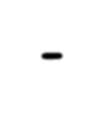
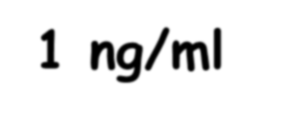

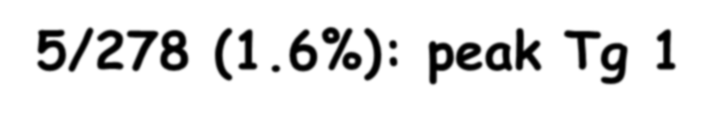
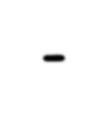
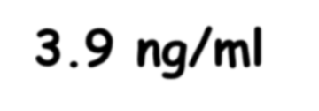

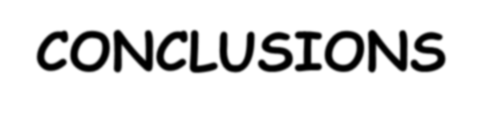

Retrospective study: 278 DTC patients who had a 1st negative rhTSH-Tg test all patients had at least a second (up to seven) rhTSH-Tg test
10/278 (3.6%) had a second positive rhTSH-Tg test

Slide 23
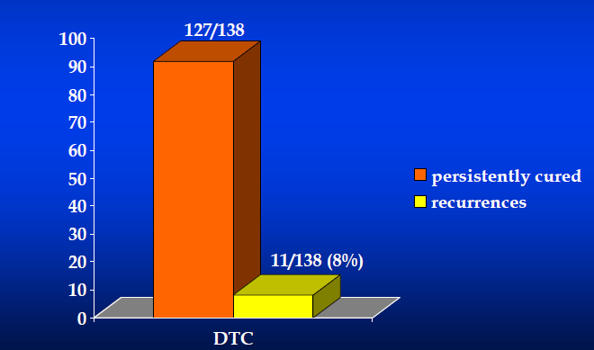
10 years follow up of 138 DTC patients with a negarive rhTSH-Tg test (and negative imaging) at any time of follow up

Slide 24
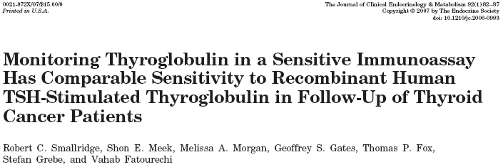
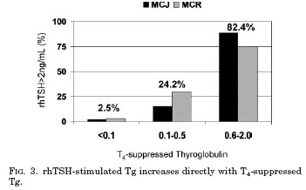

Slide 25
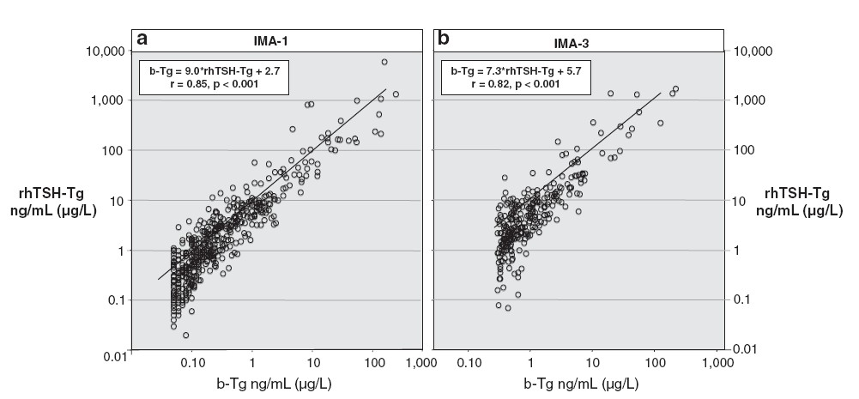
Serum Basal Tg measured by a second –generation assay correlates with the rhTSH stimulated Tg in patients treated for DTC
(Spencer C, et al. Thyroid 2010)

Slide 26
Conclusions and Remarks
The best risk stratification of DTC to predict recurrences should take into account the results of first T4 withdrawal or rhTSH-Tg test, neck US and post ablation WBS
A neative T4 withdrawal or rhTSH-Tg test has a very high negarive predictive values especially when associated with a negative imaging: in our experience the risk of recurrence is 3% when the test is negative after initial treatment and 8% when the negarive test is after multiple treatment of 131-I
The need to repeat the test after a negarive T4 withdrawal or rhTSH-Tg is debated while the test must be repeated every 3-6 years in borderline cases (peak Tg 0.5-2 ng/ml)
An undetectable level of USTg (<0.1 ng/ml) can be considered equivalent to a negarive T4 withdrawal or rhTSH-Tg test although no data at 10 years are yet available.
Borderline USTg values (0.2-1 ng/ml) cannot be used for planning therapy and must be retested with a T4 withdrawal or rhTSH stimulation test or their trend of increase should be considered over the time

Slide 27
Risk of Structural Disease Recurrence
Risk stratification by category
Risk stratification within categories*
High Risk
Gross extrathyroidal extension
incomplete tumor resection,
or distant metastases
FTC, extensive vascular invasion (30-55%)
pT4a gross ETE (23-40%)
PTC, vascular invasion (16-30%)
pN1, any LN > 3 cm (27%)
Intermediate Risk
N1 disease,
minor extrathyroidal extension
vascular invasion,
or aggressive histology
Clinical N1 (22%)
pN1, > 5 LN involved (19%)
pT3 minor ETE (3-8%)
pN1, all LN < 0.2 cm (5%)
pN1, < 5 LN involved (4%)
Intrathyroidal 2-4 cm PTC (5-6%)
Low Risk
Intrathyroidal DTC
Multifocal PMC (4-6%)
Minimally invasive FTC (0-7%)
Unifocal PMC (1-2%)

Slide 28
First Example Patient
32 yr old male
Total thyroidectomy
1.9 cm unifocal
Intrathyroidal PTC
No lymph nodes were sampled
2-3 months post-op: Tg 1 ng/mL
TSH was 1 mIU/mL
Tg Ab negative
Neck US is normal
RAI Ablation
Yes or No?

Slide 29
32 yr old male
Total thyroidectomy, 1.9 cm intrathyroidal PTC
Risk Without RRA
Recurrence 2-4%
Disease Specific Mortality < 1%
Distant Metastases about 1%
Risks of RAI
Permanent dry mouth 1-2%
Blocked tear duct 1%
Second cancer < 1%
Potential Benefits of RAI
Facilitate Staging/Follow-up
+/- Recurrence
No impact on mortality
Tilting the Balance Toward Benefit
Selective Use
Lower administered activities (30 mCi)
rhTSH preparation
Using RAI as salvage therapy

Slide 30
Risk of Structural Disease Recurrence
My personal practice as of Jan 2014
Risk stratification by category
Risk stratification within categories*
High Risk
RAI given
Probably withdrawal
150 mCi
FTC, extensive vascular invasion (30-55%)
pT4a gross ETE (23-40%)
PTC, vascular invasion (16-30%)
pN1, any LN > 3 cm (27%)
Intermediate Risk
Selective use
rhTSH or withdrawal
0 to 30 to 150 mCi depending on risk
Clinical N1 (22%)
pN1, > 5 LN involved (19%)
pT3 minor ETE (3-8%)
pN1, all LN < 0.2 cm (5%)
pN1, < 5 LN involved (4%)
Intrathyroidal 2-4 cm PTC (5-6%)
Low Risk
Usually no RAI
If given, 30 mCi rhTSH
Multifocal PMC (4-6%)
Minimally invasive FTC (0-7%)
Unifocal PMC (1-2%)

Slide 31
RAI ablation is recommended for:
All patients with known distant metastases, gross extrathyroidal extension of the tumor regardless of the rumor regardless of tumor size, or primary tumor size >4 cm even in the absence of other higher risk features.
Selected patients with 1-4 cm thyroid cancers confined to the thyroid, who have documented lymph node metastases, or other higher risk features.
RAI ablation is not recommended for:
For patients with univocal cancer <1 cm without other higher risk features.
The American Thyroid Association Guideline. Thyroid 2009; 19: 1167

Slide 32
Second Example Patient
RAI Ablation
Yes or No?
22 year old female
Total thyroidectomy & left MRN dissection
2.5 cm, multifocal, well differentiated PTC
20/32 lymph nodes positive
No extrathyroidal extension
No vascular invasion

Slide 33
22yr old female
Total thyroidectomy, 2.5 cm intrathyroidal PTC, N1b
Risk Without RRA
Recurrence 25-30%
Disease Specific Mortality < 1%
Distant Metastases about 5-10%
What if her post-operative Tg was <0.2 ng/mL (TSH of 56 mU/L, no Tg antibodies)?
Risks of RAI
Permanent dry mouth 1-2%
Blocked tear duct 1%
Second cancer < 1%
Potential Benefits of RAI
Facilitate Staging/Follow-up
+/- Recurrence
No impact on mortality
Tilting the Balance Toward Benefit
Selective Use
100 mCi
rhTSH?

Slide 34


