Slide 1
Research Center for Social Determinants of Health, Research Institute for Endocrine Sciences, Shahid Beheshti University of Medical Sciences, Tehran, Iran.
The relation of alexithymia and attachment with HbA1C and self-care in adolescents with type1 diabetes: A sex-specific analysis
Parisa Amiri, Mina Moein-Eslam, Zeinab Shayeghian, Elnaz Hajati, Golshan Amirshekari, Mehrdad Karimi

Slide 2
Background
Epidemiology
Worldwide
Iran
Middle East and North Africa: 64000 children
497100 children
Annual incidence: 3.7 per 100,000 people
Peak: 10-14 years of age

Slide 3
Background
Poor metabolic control in adolescence
Spending longer periods with diabetes
Passing responsibility from parents to adolescents
Cognitive and psychological development
High distress in adolescence

Slide 4
Psychological factors and self-care in adolescents
Background
Expectation of positive outcomes
Effective coping
Self-efficacy
Attachment
Family functioning
Alexithymia

Slide 5
Background
Alexithymia
Attachment
difficulty identifying feelings (DIF)
difficulty describing feelings (DDF)
externally oriented thinking (EOT)
secure
insecure
Notes:
تفکر متمرکز بر تجارب بیرونی

Slide 6
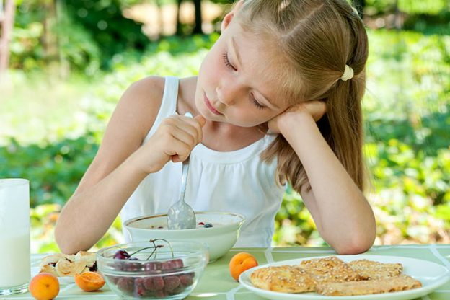
Background
The effect of alexithymia and attachment on self-care in chronic diseases → it seems reasonable that type 1 diabetes can be affected by these two factors
Fewer studies conducted on alexithymia and attachment in type 1 diabetes management
Poorer adherence and metabolic control in girls

Slide 7
Gap of the literature and purpose
Lack of studies (specially gender-specific)
on alexithymia and attachment with type 1 diabetes management
Investigating the gender-specific relationship between alexithymia and attachment with self-care and blood glucose level in a sample of Tehranian adolescents
Lack of studies on clarifying psychological dimensions of the managing of diabetes type 1 in a Eastern-Mediterranean population

Slide 8
Materials and Methods
Adolescents, aged 12-18 years, with type 1 diabetes
From diabetes clinics in Tehran and the Iranian Diabetes Society
Between February 2015 and January 2016

Slide 9
Measures
Alexithymia: the Iranian version of Toronto alexithymia scale (TAS-20)
Attachment: the Iranian version of Inventory of parent and peer attachment (IPPA)
Diabetes management: Farsi version of Summary of Diabetes Self-Care Activities Scale (SDSCA) and Glycated Hemoglobin Measurement (HbA1c)

Slide 10
Conceptual framework
DIF
Alexithymia
DDF
EOT
Self-Care
Trust
HbA1C
Communication
Attachment to mother
Alienation
Trust
Attachment
Communication
Attachment to father
Alienation
Trust
Attachment to peer
Communication
Alienation
Notes:
مدل رگرسیونی

Slide 11
Statistical analysis
Descriptive statistics: the frequencies (%) for categorical data and mean ± SD for continuous variables
Independent samples t-test for comparing the mean between girls and boys
Simple and multiple regression analysis for evaluating the relationship between HbA1c and SCSDA (as dependent variables) with alexithymia and attachment (as independent variables)
Software: IBM SPSS Statistics 23

Slide 12
Results
Table 1. Socio-demographic and clinical characteristics of patients with T1DM (n=150)
Variable | Girl N=86 | Boy N=64 | P-value
Age | 14.99±2.42 | 14.95±2.38 | 0.93
Familial history of diabetes(yes) | 43(51.2) | 32(52.5) | 0.88
Illness(yes) | 18(22) | 12(19) | 0.82
Diabetes duration | 63.41±45.43 | 63.60±51.68 | 0.79
A1C | 8.48±1.94 | 8.09±1.87 | 0.22
SCSDA | 19.82±5.85 | 21.31±5.35 | 0.11
Diet | 3.38±1.24 | 3.65±1.20 | 0.18
Exercise | 2.70±2.02 | 3.68±2.00 | 0.04
Blood Sugar Testing | 4.74±2.57 | 4.57±2.60 | 0.69
Foot Care | 2.76±1.77 | 3.00±1.82 | 0.42
Medications | 6.17±1.63 | 6.39±1.26 | 0.38
Smoking | 0.92±0.40 | 0.93±0.35 | 0.89

Slide 13
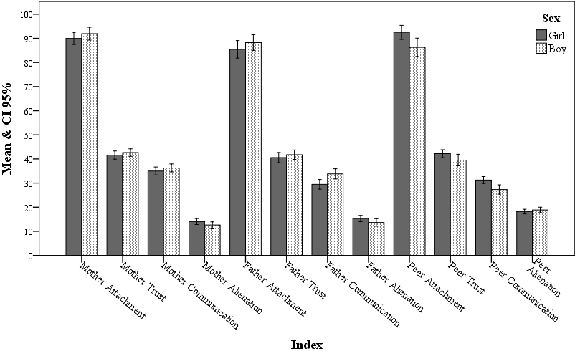
Results
Attachment to mother
Attachment to father
Attachment to peer
**
*
**
P<0.01, ** p<0.05
Figure1. comparison of two genders on attachment (mother, father and peer)

Slide 14
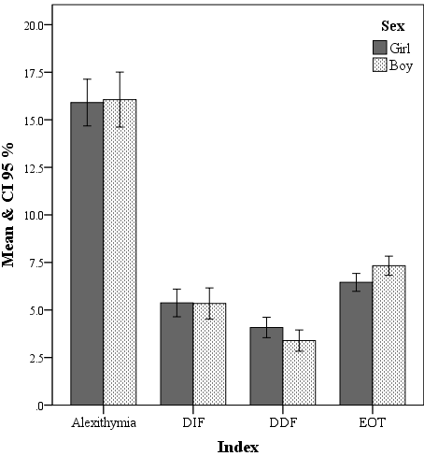
Results
Figure2. Comparison of two genders on alexithymia

Slide 15
Results
Table 1. Simple and multiple linear regression results (β (SE)) for predicting of HbA1C by attachment (mother, father and peer).
 | girl |  |  |  |  | boy
 | unadjusted |  | adjusted |  |  | unadjusted |  | adjusted
Predictors | β (SE) | P | β (SE) | P |  | β (SE) | P | β (SE) | P
Mother Attachment
Mother-Trust | -0.02 (0.03) | 0.60 | -0.03 (0.03) | 0.31 |  | -0.01 (0.04) | 0.81 | -0.04 (0.05) | 0.36
Mother-Communication | -0.07 (0.03) | 0.03 | -0.08 (0.04) | 0.03 |  | -0.03 (0.04) | 0.49 | -0.02 (0.05) | 0.69
Mother-Alienation | 0.05 (0.04) | 0.19 | 0.07 (0.05) | 0.17 |  | -0.02 (0.05) | 0.65 | 0.01 (0.07) | 0.86
total | -0.03 (0.02) | 0.28 | -0.03 (0.02) | 0.22 |  | 0.001 (0.03) | 0.98 | 0.001 (0.04) | 0.99
Father Attachment
Father-trust | -0.02 (0.02) | 0.40 | -0.02 (0.03) | 0.44 |  | -0.02 (0.03) | 0.65 | -0.04 (0.04) | 0.35
Father-communication | -0.03 (0.02) | 0.21 | -0.04 (0.03) | 0.21 |  | -0.05 (0.03) | 0.11 | -0.04 (0.04) | 0.23
Father-Alienation | 0.06 (0.04) | 0.13 | 0.07 (0.05) | 0.17 |  | 0.002 (0.04) | 0.97 | 0.03 (0.06) | 0.62
total | -0.01 (0.02) | 0.43 | -0.02 (0.02) | 0.30 |  | -0.03 (0.02) | 0.24 | -0.02 (0.02) | 0.37
Peer attachment
Peer-Trust | -0.05 (0.03) | 0.12 | -0.01 (0.04) | 0.69 |  | 0.004 (0.03) | 0.89 | 0.01 (0.04) | 0.69
Peer-communication | -0.05 (0.03) | 0.12 | -0.03 (0.03) | 0.49 |  | -0.03 (0.04) | 0.42 | -0.01 (0.04) | 0.90
Peer – Alienation | -0.06 (0.05) | 0.21 | -0.10 (0.06) | 0.10 |  | 0.02 (0.06) | 0.74 | 0.05 (0.09) | 0.55
total | -0.04 (0.02) | 0.03 | -0.04 (0.03) | 0.15 |  | 0.001 (0.02) | 0.97 | 0.01 (0.03) | 0.57
* P<0.01, ** p<0.05, adjustment was conducted by age, BMI and parent history of diabetes.

Slide 16
Results
Table 2. Simple and multiple regression results (β (SE)) for predicting of SCSDA by attachment (mother, father and peer)
 | girl |  |  |  |  | boy
 | unadjusted |  | adjusted |  |  | unadjusted |  | adjusted
Predictors | β (SE) | P | β (SE) | P |  | β (SE) | P | β (SE) | P
Mother Attachment
Mother-Trust | 0.02 (0.01) | 0.27 | 0.001 (0.02) | 0.99 |  | 0.04 (0.02) | 0.04 | 0.04 (0.02) | 0.07
Mother-Communication | 0.03 (0.02) | 0.06 | 0.01 (0.02) | 0.45 |  | 0.05 (0.02) | 0.02 | 0.04 (0.02) | 0.04
Mother-Alienation | -0.04 (0.02) | 0.03 | -0.03 (0.02) | 0.13 |  | -0.04 (0.02) | 0.12 | -0.06 (0.03) | 0.03
total | 0.002 (0.01) | 0.83 | -0.01 (0.01) | 0.49 |  | 0.02 (0.01) | 0.06 | 0.01 (0.02) | 0.44
Father Attachment
Father-trust | 0.03 (0.01) | 0.004 | 0.02 (0.01) | 0.08 |  | 0.03 (0.02) | 0.05 | 0.02 (0.02) | 0.25
Father-communication | 0.04 (0.01) | 0.002 | 0.02 (0.02) | 0.19 |  | 0.03 (0.01) | 0.03 | 0.02 (0.02) | 0.15
Father-Alienation | -0.04 (0.02) | 0.04 | -0.04 (0.03) | 0.20 |  | -0.05 (0.02) | 0.01 | -0.06 (0.02) | 0.01
total | 0.02 (0.01) | 0.003 | 0.01 (0.01) | 0.17 |  | 0.02 (0.01) | 0.01 | 0.01 (0.01) | 0.60
Peer attachment
Peer-Trust | 0.03 (0.02) | 0.04 | 0.01 (0.02) | 0.50 |  | 0.01 (0.01) | 0.32 | 0.01 (0.02) | 0.61
Peer-communication | 0.04 (0.02) | 0.02 | 0.02 (0.02) | 0.30 |  | 0.002 (0.02) | 0.88 | -0.004 (0.02) | 0.84
Peer – Alienation | -0.004 (0.03) | 0.86 | -0.02 (0.03) | 0.53 |  | -0.04 (0.03) | 0.21 | -0.09 (0.04) | 0.03
total | 0.03 (0.01) | 0.005 | 0.01 (0.01) | 0.29 |  | -0.01 (0.01) | 0.58 | -0.01 (0.01) | 0.39
* P<0.01, ** p<0.05, adjustment was conducted by age, BMI and parent history of diabetes.

Slide 17
Results
Table 3. Simple and multiple linear regression results (β (SE)) for predicting of HbA1C by alexithymia
 | girl |  |  |  |  | boy
 | unadjusted |  | adjusted |  |  | unadjusted |  | adjusted
Predictors | β (SE) | P | β (SE) | P |  | β (SE) | P | β (SE) | P
Alexithymia
DIF | 0.16 (0.06) | 0.01 | 0.15 (0.07) | 0.03 |  | -0.07 (0.07) | 0.37 | -0.07 (0.10) | 0.48
DDF | 0.17 (0.08) | 0.04 | 0.10 (0.09) | 0.26 |  | -0.10 (0.11) | 0.35 | -0.10 (0.14) | 0.48
EOT | 0.20 (0.10) | 0.03 | 0.19 (0.11) | 0.07 |  | 0.22 (0.12) | 0.06 | 0.22 (0.13) | 0.10
total | 0.12 (0.04) | 0.001 | 0.10 (0.04) | 0.01 |  | -0.01 (0.04) | 0.83 | 0.001 (0.06) | 0.99
* P<0.01, ** p<0.05, adjustment was conducted by age, BMI and parent history of diabetes.

Slide 18
Results
Table 4. Simple and multiple regression results (β (SE)) for predicting of SCSDA by alexithymia
 | girl |  |  |  |  | boy
 | unadjusted |  | adjusted |  |  | unadjusted |  | adjusted
Predictors | β (SE) | P | β (SE) | P |  | β (SE) | P | β (SE) | P
Alexithymia
DIF | -0.07 (0.03) | 0.02 | -0.06 (0.03) | 0.04 |  | -0.03 (0.03) | 0.40 | -0.11 (0.04) | 0.01
DDF | -0.09 (0.04) | 0.30 | -0.07 (0.04) | 0.13 |  | -0.02 (0.05) | 0.66 | -0.16 (0.06) | 0.02
EOT | -0.08 (0.05) | 0.11 | -0.08 (0.05) | 0.11 |  | -0.03 (0.06) | 0.61 | -0.02 (0.06) | 0.63
total | -0.05 (0.02) | 0.003 | -0.04 (0.02) | 0.02 |  | -0.02 (0.02) | 0.40 | -0.07 (0.02) | 0.006
* P<0.01, ** p<0.05, adjustment was conducted by age, BMI and parent history of diabetes.

Slide 19
Conclusions
Blood glucose levels in girls are associated with their psychological status; this association in boys was just indirect via their self-care.
The key role of mothers in predicting metabolic control and predicting role of alexithymia in self-care of adolescents of both genders are consistent with those documented in existing literature.
Boys need more support resources and girls are more independent in their responsibilities to control diabetes.
Alexithymia may interfere with self-care and blood glucose levels in adolescents with type 1 diabetes via a gender-specific pattern.
Providing a gender-tailored relationship with parents and friends may result in better management of diabetes in this age group and could be useful for designing future health promotion strategies and programs.

Slide 20
Thanks for your attention

