Slide 1
In The Name Of GOD

Slide 2
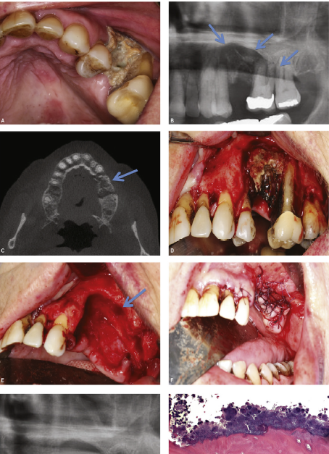
Medication-related osteonecrosis of the jaw
meysam orangi

Slide 3
agenda
Definition and pathophysiology
Incidence and risk factors
risk assessment
drug holiday?
staging and treatment

Slide 4
Introduction:
Medication related osteonecrosis of the jaw(MRONJ) is an uncommon condition that can occur aftere xposure to agents used to prevent bone complications,such as bisphosphonates or denosumab,or treatment with other agents , such as angiogenesisin hibitors. In the majority of cases,MRONJ manifests as exposed bone in the maxillofacial region, although non-exposed MRONJ has also been recognized

Slide 5
Bisphosphonates are small molecules that dock in hydroxyapatite-binding sites on bone surfaces. When osteoclasts begin to resorb bisphosphonate-impregnated bone, the liberated bisphosphonates bind to farnesil pyrophosphate synthase inside the osteoclasts, ultimately leading to apoptosis.
Denosumab is a fully human monoclonal antibody, which has a different mode of action from that of bisphosphonates. It targets and binds to the receptot activator of nuclear factor k-B (RANK) ligand (RANKL); in doing so it prevents the activation of RANK on the surface of osteoclasts and osteoclast precursors. Inhibition of the RANKL–RANK interaction impedes osteoclast formation, function, and survival, thereby decreasing bone resorption.

Slide 6
The first cases of MRONJ were reported in 2003; in patients receiving the bisphosphonates pamidronic acid or zoledronic acid.
MRONJ is also associated with anticancer agents including classic chemotherapy agents,angiogenesis inhibitors,TKIs,and immunotherapeutic agents.

Slide 7
Rationale for treatment with bisphosphonates or denosumab
Osteoporosis
Cancer treatment–induced bone loss(denosumab has more effective)
Skeletal-related events(SRE) in patients with malignancies involving bone
Giant cell tumor of bone
Hypercalcemia of malignancy
Paget disease of bone

Slide 8
risks associated with bisphosphonates or denosumab agents
AEs/MRONJ
Bisphosphonates are nephrotoxic and are associated with upper gastrointestinal irritation (when used orally), acute-phase responses, and an increased risk of atrial fibrillation.
hypocalcemia

Slide 9
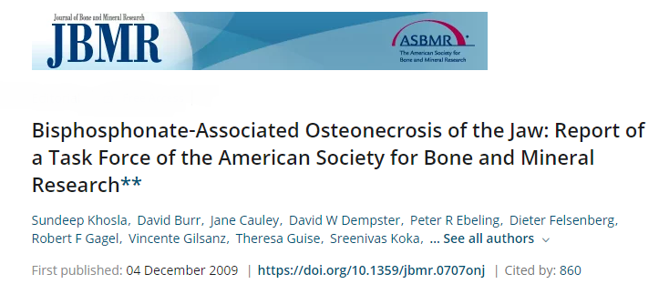

Slide 10
MRONJ Definition 1:
presence of exposed bone in the maxillofacial region that did not heal within 8 wk after identification by a health care provider

Slide 12
MRONJ Definition2:
Current or previous treatmentwith antiresorptive or antiangiogenic agent
Exposed bone or bone that can be probed through an intraoral or extraoral fistula in the maxillofacial region that has persisted for longer than 8 weeks
No history of radiation therapy to the jaws or obvious metastatic disease to the jaws

Slide 13
Pathophysiology:
Although the first MRONJ case was reported over a decade ago (in 2002 and first publication by Max in 2003 in the Journal of Oral and Maxillofacial Surgery(JOMS) with 36 case associated with IV bisphosphonates(pamidronate or zoledronic acid) , the
pathophysiology of the disease has not been fully elucidated Proposed
hypotheses that attempt to explain the unique localization of MRONJ
exclusively to the jaws include altered bone remodeling or
oversuppression of bone resorption, angiogenesis inhibition, constant
microtrauma, suppression of innate or acquired immunity, vitamin D
deficiency, soft tissue BP toxicity, and inflammation or infection

Slide 14
INHIBITION OF OSTEOCLASTIC BONE RESORPTION AND REMODELING:
BPs and other antiresorptive drugs, such as denosumab, inhibit osteoclast differentiation and
function and increase apoptosis, all leading to decreased bone resorption and remodeling.
Osteoclast differentiation and function play a vital role in bone healing and remodeling in all skeletal
sites, but ONJ occurs only primarily within the alveolar bone of the maxilla and mandible. An
increased remodeling rate in the jaws and prone to traum and exposure may explain the
differential predisposition to ONJ to occur
in the jaws compared with other bones in the axial or appendicular skeleton. Long-term studies in
a large animal model have shown decreased intracortical bone turnover with dynamic
histomorphometry.The central role of bone Remodeling inhibition has been further corroborated
by a similar incidence of ONJ observed with other antiresorptive

Slide 15
INFLAMMATION AND INFECTION:
Systemic and local oral risk factors have been implicated in ONJ pathogenesis, in which several human studies have implicated dental disease or bacterial Infection Early studies identified bacteria, especially Actinomyces species, in biopsied specimens of necrotic bone removed from patients with ONJ. more studies have identified bacteria in combination with fungi and viruses
A study in patients with MRONJ has shown that even after treatment with doxycycline and metronidazole ,total bacterial level at the site of the jaw lesion was higher than that observed in a control population of orally healthy individuals

Slide 16
INHIBITION OF ANGIOGENESIS
Osteonecrosis is classically considered an interruption in vascular
supply or avascular necrosis.
In vitro experiments have consistently shown a decrease in
angiogenesis in response to zoledronic acid. Studies in patients with
cancer treated with zoledronic acid have supported these data by
reporting decreased circulating VEGF levels.
inhibition of angiogenesis has not been reported with denosumab.

Slide 17
OTHER HYPOTHESES:
soft tissue toxicity with BPs
Immune Dysfunction
Many studies have shown mucosal ulceration, delayed healing, exposed bone, and histologic necrosis and inflammation when BPs and chemotherapy or steroids are administered in rodents undergoing extractions

Slide 18
Risk Factors for MRONJ:
Medication related risk factor:
therapeutic indications types of medication
osteoporosis /osteopenia malignancy BP non-BP

Slide 19
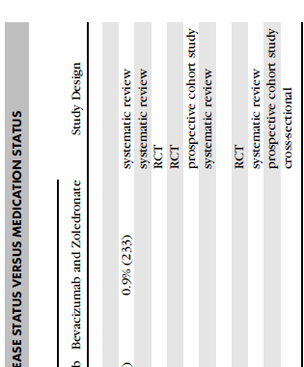

Slide 21
DEMOGRAPHIC, SYSTEMIC, AND OTHER MEDICATION FACTORS
Age and gender are variably reported as risk factors for MRONJ
higher prevalence of this complication in the female population is likely areflection of the underlying disease for which the agents are being prescribed (ie, osteoporosis, breast cancer).
Corticosteroids use/Antiangiogenic agents, when given in addition to antiresorptive medications
Comorbid conditions(hemoglobin <10 g/dL) and diabetes melitus
Tobacco use

Slide 22
Anatomic Factors: more likely to appear in the mandible (73%) than in the maxilla (22.5), but can appear in the 2 jaws (4.5%)
Denture use
Genetic facrors: single nucleotide polymorphisms (SNPs) that were associated with the development MRONJ
other: poor oral hygiene, smoking, diabetes mellitus, concomitant glucocorticoid and/or chemotherapy use, and invasive dental procedures, such as dental extractions or implants

Slide 23
Data from the eosteoporosis setting showed that the effects of
bisphosphonates on bone cancontinue for up to 3 years after the last
administration because of accumulation in the bonematrix.
Incontrast,denosumab does not accumulate in bone and exerts a
more transient effect on the inhibition of bone resorption

Slide 24
This is reflected in the elimination half-life of denosumab and may rationalize the numerically shorter time to MRONJ resolution among patients with bone metastases from solid tumors or bone lesions caused by MM observed for denosumab compared with zoledronic acid in threephase III trials (median 8.0 vs 8.7months)
The mean denosumab elimination half life was 28 days for doses of 120mg every 4weeks (highdose) and 26days for a dose approximating to 60mg every 6months (lowdose)

Slide 27
Incidence of MRONJ with bisphosphonates or denosumab therapy
Low-dose therapy :
In the HORIZON (Health Outcomes and Reduced Incidence with ZoledronicAcid Once Yearly)(N Engl j 2007 on 3889 patients) pivotal fracture trial ,there were no reports of spontaneous MRONJ after 3years of treatment with zoledronicacid (5mg,annually).

Slide 29
Thirteen cases of MRONJ were reported in an open label extension of the phaseIII FREEDOM(FractureReduction Evaluation of Denosumab in Osteoporosis Every 6 Months) study, which included 4550 postmenopausal women with osteoporosis receiving treatment with low dose denosumab (60mg every 6months) for up to 10 years. The risk of MRONJ increased with duration of exposure to denosumab (0.04% at 3years, 0.06% at 5years,and 0.44% at 10 years)

Slide 30
High-dosetherapy:
Greater than 90% of cases of MRONJ occur in patients with cancer receiving high doses of IV bisphosphonates or SC denosumab (120mgevery4weeks).

Slide 31
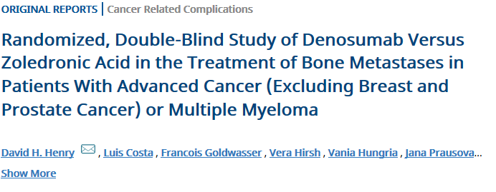
JClinOncol.2011;29:1125-1132.

Slide 32
A phase III study compared the use of zoledronic acid (4 mg every 4 weeks) with that of denosumab (120 mg every 4 weeks) for the treatment of bone metastases in 1776 patients with advanced cancers (other than prostate or breast cancers). Treatment was received for a median duration of 7 months. Results showed that positively adjudicated MRONJ occurred at rates of 1.3% in patients treated with zoledronic acid and 1.1% in those treated with denosumab (high dose). The authors noted that among those who experienced ONJ, 81% were exposed to ONJ risk factors during the study

Slide 33
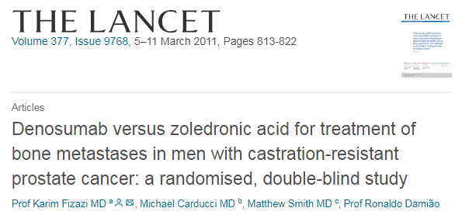
The incidences of MRONJ in patients with metastatic castration-resistant prostate cancer in year 1 and year 2 were 1% and 1% in the zoledronic acid group (median duration on study 11.2 months), and 1% and 2% in the denosumab group (median duration on study 12.2 months)

Slide 34
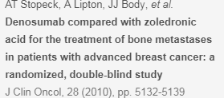
Among patients with advanced breast cancer, the incidence of MRONJ
at years 1, 2, and 3, were 0.5%, 1.2%, and 1.4%, respectively, in the
zoledronic acid group and 0.8%, 1.9%, and 2.0%, respectively, in the
denosumab group

Slide 36
In an observational chart review of 327 patients with cancer who were deemed to have MRONJ, 97% had received bisphosphonates and/or denosumab, 92% had received medication to treat the condition, and 31% had undergone surgery. Resolution of MRONJ during the study (as judged by the AAOMS criteria) was observed in 43% of evaluable patients, and improvement in MRONJ was reported in 19% of patients. The median time to MRONJ resolution was 7.3 months. Of note, almost half (47%) the patients in the study had undergone a tooth extraction during the study.

Slide 37
In patients receiving BP therapy for osteoporosis, current estimates of the incidence of ONJ range from approximately 1/10,000 to 1/100,000 patient treatment years.

Slide 38
Drug holidays
The increased risk of SREs during drug holidays must be balanced with the reduced risk of development of MRONJ on a case-by-case basis and should be discussed by a multiprofessional team.
Evidence to support the benefit of drug holidays is lacking; however, a recent Japanese study found that treatment holidays before dental extraction did not reduce the risk of MRONJ in patients receiving oral bisphosphonates. An American Association of Oral and Maxillofacial surgeons(AAOMS) position paper on MRONJ stated that a 2-month drug holiday before and after dental surgery in patients receiving oral bisphosphonates may be prudent, and an international ONJ task force recommended that treatment should be withheld after invasive dental surgery in patients receiving high-dose bisphosphonates or denosumab. Of note, the authors of both sets of guidelines acknowledged that there is little evidence to support their recommendations, and the concept of drug holidays, thus, remains a contentious issue.

Slide 39
Drug Holiday
Less protection on long term use
Long term residency time in bone after discontinuance
Serious concern regarding long term safety

Slide 40
Postponing initiation of bisphosphonates until after completion of invasive dental treatments.
If already on a bisphosphonate, a drug holiday of 2 months before the procedure is recommended for patients who have been on bisphosphonates for longer than 4 years regardless of other risk factors.
If patients are at high risk (concomitant corticosteroid or antiangiogenic cancer treatment medications) then consider a drug holiday even if bisphosphonate use is less than 4 years.
In most cases the bisphosphonate should not be restarted until osseous healing has occurred

Slide 41
To assess MRONJ risk accurately, the dentist should ascertain the following information during
initial discussions with the physician:
Indication of bisphosphonate or denosumab therapy (osteoporosis or malignancy)
Prior exposure to bisphosphonates or denosumab
Time frame for initiating bisphosphonate or denosumab (Is there a window of opportunity for
the dentist to perform dental procedures or is there a need to start therapy immediately?)
Patient's prognosis (months or years) and general health status
If any other agents with potential oral side effects are being used (e.g.,chemotherapy,
angiogenesis inhibitors, mammalian target of rapamycin inhibitors, TKIs, or corticosteroids)
Who will discuss the risks of developing MRONJ with the patient
Who will coordinate the follow-up of oral care

Slide 42
Prophylactic dental care before in itiation of bisphosphonate or denosumab treatment
Prophylactic dental treatment should be carried out on all high-risk patients to minimize the probability of its development. Treatment should include extraction of partially embedded teeth; conservative endodontic and prosthodontic therapies of teeth with good prognosis; periodontal stabilization splints for teeth with grade 1 or 2 mobility in patients with good dental hygiene, and extraction of such teeth in patients whose dental hygiene is poor; and the identification and treatment of occult pockets of infection All necessary oral surgery should be completed before initiation of treatment with bisphosphonates or denosumab.

Slide 44
During bisphosphonate or denosumab treatment
Invasive dental procedures should be avoided in high-risk patients unless dental infections are present that cannot be controlled using standard therapies. Elective dentoalveolar surgery , however, is not contraindicated in low-risk patients. Simple extractions and surgeries that do not involve osteotomy can be carried out on low-risk patients in the primary care setting
If invasive dental procedures are unavoidable use of an antimicrobial mouthwash should be recommended, and the use of systemic antibiotics before and/or after the procedure should be considered.

Slide 45
The choice of an antibiotic capable of penetrating bone is prudent, and penicillin, amoxicillin (with or without clavulanic acid), and metronidazole are the commonly used agents

Slide 46
Diagnosis of MRONJ
Key signs and symptoms:
Jaw Pain and signs of infection are the most frequent symptoms reported by patients/tooth mobility,bone enlargement,gingival swelling,erythema and ulceration/ but MRONJ can be asymptomatic.
DDx:
alveolar osteitis, sinusitis, gingivitis and periodontitis, periapical pathology, odontalgia, atypical neuralgias, sarcoma, and chronic sclerosing osteomyelitis, nonexposed forms of osteonecrosis

Slide 47
In most cases, a diagnosis of MRONJ requires the following:
Current or previous treatment with bisphosphonates, denosumab, or antiangiogenic therapy
An area of exposed bone, or bone that can be probed through an intraoral or extraoral fistula and has persisted for greater than 8 weeks
No history of radiation therapy to the jaw or obvious metastatic disease of the jaw

Slide 48
The AAOMS has defined the stages of MRONJ to describe disease presentation and to facilitate the appropriate stratification of patients
Stage 0—no clinical evidence of necrotic bone, but nonspecific clinical findings, radiographic changes, and symptoms
Stage 1—exposed and necrotic bone/fistulae that can be probed to bone, asymptomatic, no evidence of infection
Stage 2—exposed and necrotic bone/fistulae that can be probed to bone, associated with infection
Stage 3—exposed and necrotic bone/fistulae that can be probed to bone, associated with infection and additional complications

Slide 49
Treatment of MRONJ
The goal of MRONJ management should be control of infection, progression of bone necrosis, and pain
Conservative management:
Conservative management approaches include maintaining optimal oral hygiene, eliminating active dental and periodontal diseases, and application of topical antibacterial mouth rinses and systemic antibiotic therapy, as indicated by local guidelines. Such strategies may be used in cases where there is no obvious disease progression, uncontrolled pain, or discontinuation of bisphosphonate or denosumab therapy as a result of MRONJ.

Slide 50
Surgical management:
indicated for patients with MRONJ whose disease does not respond to or is deemed unlikely to respond to conservative approaches. The following surgical principles have been proposed for the removal of necrotic bone in this patient group: “A full-thickness mucoperiosteal flap should be high and extended to reveal the entire area of exposed bone and beyond to disease-free margins; resection of the affected bone should be extended horizontally and inferiorly to reach healthy-appearing, bleeding bone; sharp edges should be smoothed; and primary soft tissue closure achieved” through appropriate mobilization and suturing to facilitate tension-free mucosal healing

Slide 51
STAGE-SPECIFIC TREATMENT STRATEGIES:
At Risk
These patients are at risk of developing MRONJ owing to an exposure
history with an antiresorptive or an antiangiogenic drug. They do not
have exposed bone and they do not require any treatment. However,
these patients should be informed of the risks of developing
MRONJ and of the signs and symptoms of this
disease process

Slide 52
Stage 0
These patients should receive symptomatic treatment and conservative
management of other local factors, such as caries and periodontal disease
Systemic management can include the use of medication for chronic pain and
control of infection with antibiotics, when indicated. These patients will require
close monitoring given the potential for progression to a higher stage of disease.
In patients with radiographic signs alone suggesting close monitoring
stage 0 (see above), the committee recommends for progression
to a higher stage of disease. Other diagnoses (eg, fibro-osseous disease, chronic
sclerosing osteomyelitis) also should be considered.

Slide 53
Stage 1
These patients benefit from medical management,
including the use of oral antimicrobial rinses, such as
chlorhexidine 0.12%. No immediate operative treatment
is required.

Slide 54
Stage 2
These patients benefit from the use of oral antimicrobial rinses in combination with antibiotic therapy. Although local bone and soft tissue infection is not considered the primary etiology for this process, the colonization of the exposed bone is a very common occurrence. Most isolated microbes have been sensitive to the penicillin group of antibiotics. Quinolones, metronidazole, clindamycin, doxycycline, and erythromycin have been used with success in those patientswho are allergic to penicillin. Microbial cultures also should be analyzed and the antibiotic regimen should be adjusted accordingly. Biofilm Formation on the surface of the exposed bone has been reported in several reports and may be responsible for the failure of systemic antibiotic therapies that are described in some refractory cases. In such cases, operative therapy directed at reducing the volume of colonized necrotic bone may serve as a beneficial adjunct to antibiotic therapy.

Slide 55
Stage 3
These patients benefit from debridement, including resection, in combination with
antibiotic therapy, which can offer long-term palliation with resolution
of acute infection and pain. Symptomatic patients with stage 3 disease may require
resection and immediate reconstruction with a reconstruction plate or an
obturator. The potential for failure of the reconstruction plate because of the
generalized effects of the BP exposure needs to be recognized by the clinician
and the patient. Case reports with small samples have described successful
immediate reconstruction with vascularized bone.
Regardless of the disease stage, mobile bony sequestra should be removed to
facilitate soft tissue healing. The extraction of symptomatic teeth with in exposed
necrotic bone should be considered because it is unlikely that the extraction will
exacerbate the established necrotic process. A thorough histologic analysis is
indicated for all resected bone specimens (especially for patients with a history a
malignant disease)because metastatic cancer has been reported in such specimens

Slide 56
Adjuvant treatment options:
In addition to the established conservative and suegical treatment options, several adjuvant treatment for MRONJ have been investigated, including laser-assisted surgical debridement/low-level laser therapy and the application of ozone oil or platelet-rich plasma/platelet-derived growth factor to the surgical wound.However, it should be noted that these techniques have yielded conflicting results and have not yet been assessed in prospective RCT.

Slide 57
Conclusion:
MRONJ is uncommon & occurs more in cancer Pts treated with high potency BP OR denosumab
Patophysiology and risk factors: multifactorial/impaired bone repaie,suppression of osteoclast, impaired angiogenesis,poor dental hygine and infections
ONJ incidence is slightly higher with denosumab rather than BP in cancer PTs
Denoalveolar surgery is a major risk factor for MRONJ and patiens being consider for antiresoptive therapy should be examined by dentist befor treatment

Slide 58
Drug holiday: no recommendation but it is reasonable to withhold ARs agent for 2 months before and after invasive procedure and restart after mucosal healing.
MRONJ treatment: conservative with limited debridment , topical mouth rinses, antibiotic therapy, surgical resection of necrotic bone, stage-specific management
Discontinuation ARs agent is controversial but temporary D/C is reasonable

