Slide 2
EVIDENCE AND POTENTIAL MECHANISMS FOR MINDFULNESS PRACTICES AND ENERGY
PSYCHOLOGY FOR OBESITY

Slide 3
Obesity is a growing epidemic.Chronic stress produces endocrine an immune factors that are contributors to .obesity’s .etiology
The inadequacies of standard care and the problem of patient noncompliance have inspired a search for alternative treatments.

Slide 4
We propose that mind-body therapies, and specifically the approaches of energy psychology and mindfulness, may substantially improve our success in the prevention and treatment of obesity by addressing three of the psychological and behavioral contributors to obesity : stress, anxiety, and binge-eating disorder (BED).

Slide 5
CONVENTIONAL APPROCHES TO OBESITY
The National Institutes of Health clinical guidelines for obesity
recommend the modification of diet, physical exercise, and drug
therapies, often combined with cognitive behavioral therapy
(CBT), to bring behavioral change.
“Diets Don’t Work” has been a mantra repeated over and over in the media.
The authors of a more recent study found that the benefits of exercise in inducing weight loss may come through psychological pathways rather than through actual energy expenditure.

Slide 6
Mechanick and Apovian argue that “multiple pathways to weight gain certainly require multiple targets to block this eons-old survival instinct to eat when food is plentiful.”
Common treatments
Psychological interventions, particularly behavioral therapy and CBT, have been shown to be effective, especially when combined with diet and exercise.
Bariatric surgery has succeeded in producing significant weight loss, but the procedure is costly and associated with risks that may not be justifiable.
Pharmacotherapy has not demonstrated dramatic efficacy and produces limited results, often at the expense of cardio metabolic health risks.

Slide 7
FOUNDATIONS OF OVEREATING AND EMOTIONAL EATING.
Overweight and obesity is merely caused by an imbalance in the homeostatic processes controlling food intake.
Another perspective is that people participate in “mindless eating” as a way of becoming disconnected from their internal experience.
overweight and obesity come about both through direct physiological pathways, as well as through changes in health-related behaviors such as food choice and intake quantity.

Slide 8
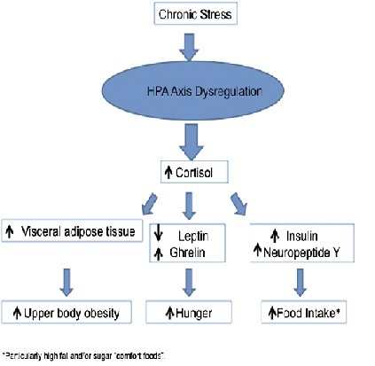
THE BIOCHEMICAL MECHANISM OF THE STRESS CONNECTION.

Slide 9
The Role of Mind-Body Therapies
Energy Psychology
Emotional Freedom Techniques (EFT).
Eye Movement Desensitization and Reprocessing.
Tapas Acupressure Technique (TAT).
MINDFULNESS MEDITATION
Mindfulness-Based Stress Reduction(MBSR)
Mindfulness-Based Cognitive Therapy(MBCT)

Slide 10
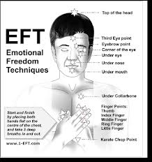
A disruption in the body’s energy system is the root cause of all negative emotions. EFT works by bringing about a “reversal of polarity”
EFT
EXPOSURE THERAPY
noninvasive somatic intervention

Slide 11
CONCLUSION
Despite increasing public awareness of obesity’s detrimental effects on health, the conventional approaches to managing this condition have not been effective.
Behavioral therapy and CBT may have some effect but are costly and difficult to implement.
This article has provided a brief review of energy psychology and mindfulness meditation and interventions involving mindfulness practices, which show great potential in treatment of patients with obesity and/or BED. The principles behind these therapies make them ideal for addressing the behavioral components of overeating.
There is evidence that MBSR and MBCT are effective in reducing stress, anxiety, depression, and other psychological factors associated with obesity and binge eating.

