Slide 1
A 66 years old woman with
Malaise
Weight loss
Hypoglycemia
acute hyponatremia

Slide 2
hyponatremia?
Hypoglycemia?
Pancytopenia?

Slide 3
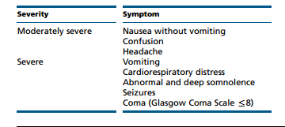

Slide 4
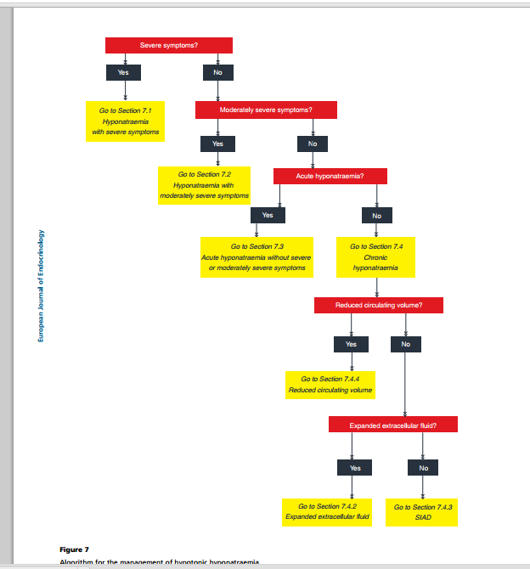

Slide 5
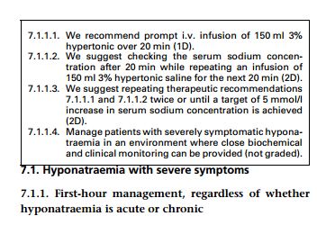

Slide 6
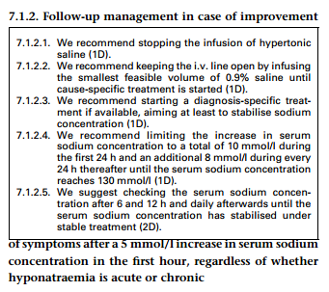

Slide 7
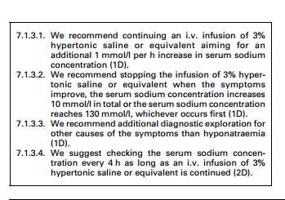

Slide 8
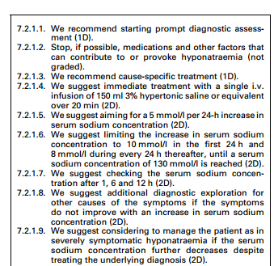

Slide 9
