Slide 1
با نام و یاد خدا

Slide 2
Case presentation
Prepared by Dr Fatemeh Kokabeh
8/9/1400

Slide 3
ID
67 year old woman
Born and live in tehran
Housewife
source of history :family *reliable ☆with a lot of missing data
CC: referred to clinic for treatment decisions

Slide 4
pI
A 67-year-old woman with a history of thyroid disease
She noticed thyroid disease during a routine check-up two years ago. hypo or hyperthyroidism???!!!
Evaluations conducted two years ago:
sono
FNA

Slide 5
2 year's ago
signs and symptoms :no problem ,Only slight weight loss due to tooth extraction
TSH | ??
T4 T3 | ??
⊙
sono
•
FNA:benign

Slide 6
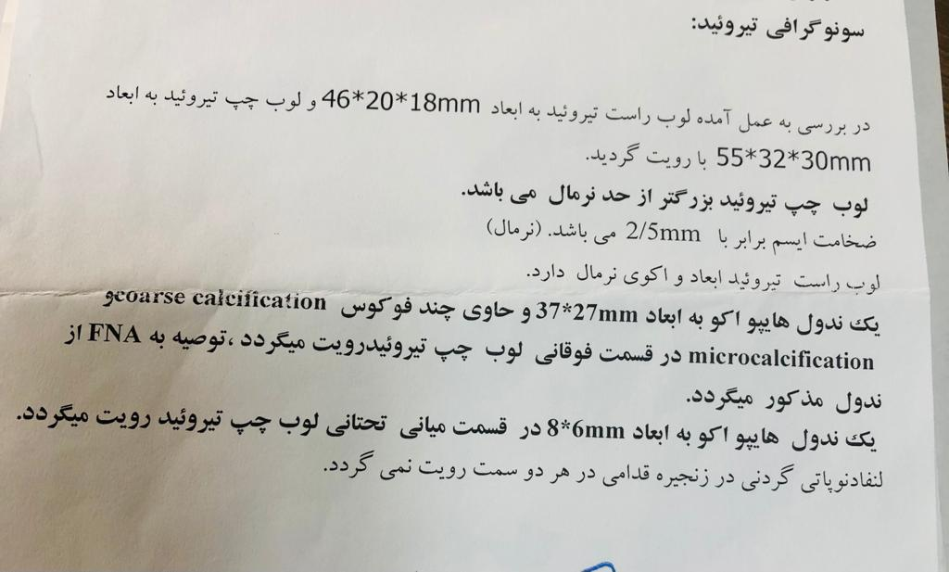
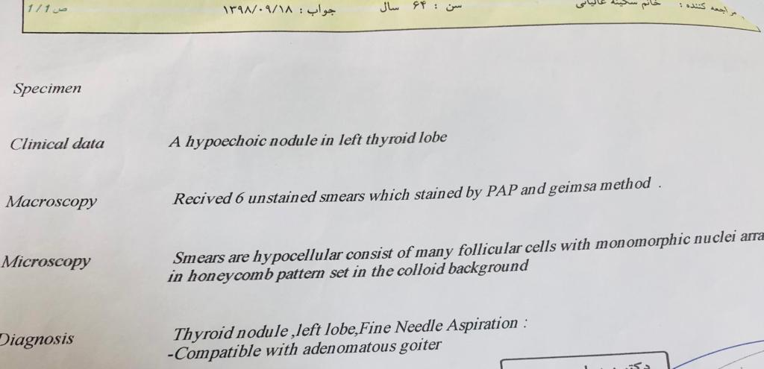

Slide 7
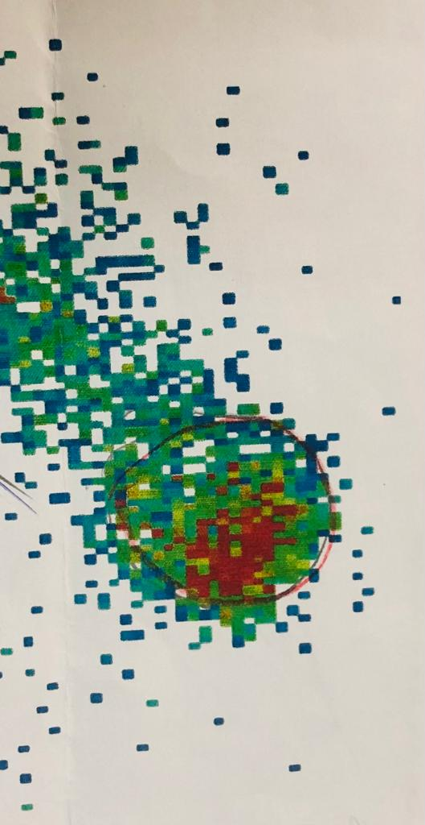
PI
The patient is then treated with levothyroxine and loses weight up to 15 kg and is weak within 5 months of treatment.
The treatment is stopped by the doctor and the patient goes to the second doctor two months later to continue the treatment.
scan Tc99
Evaluations by the second clinician:
TSH | 0/1
T4 | 10/7
T3 | 193

Slide 8
pI
toxic adenoma
Diagnosis based on scan and lab tests?
The patient was treated with methimazole and receives iodine two months later (dosage??)
Methimazole continues in low doses for up to 8 months later
The patient was admitted to the hospital with aggravation of shortness of breath, bone pain and weakness

Slide 9
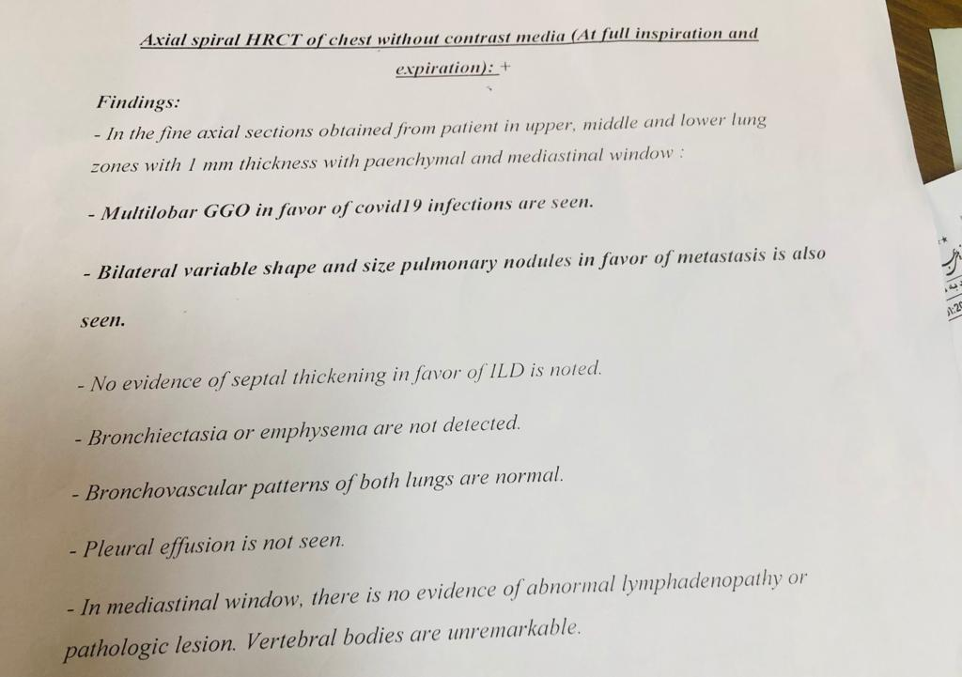
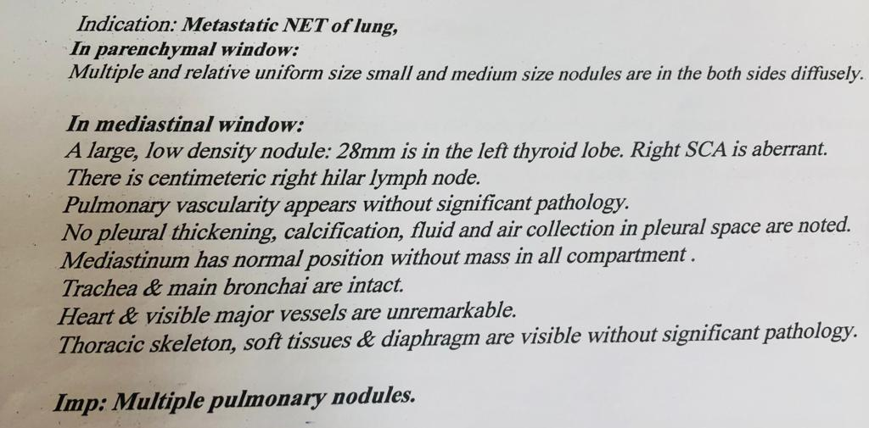
Inpatient evaluation
lung CT scan :R/o covid 19:

Slide 10
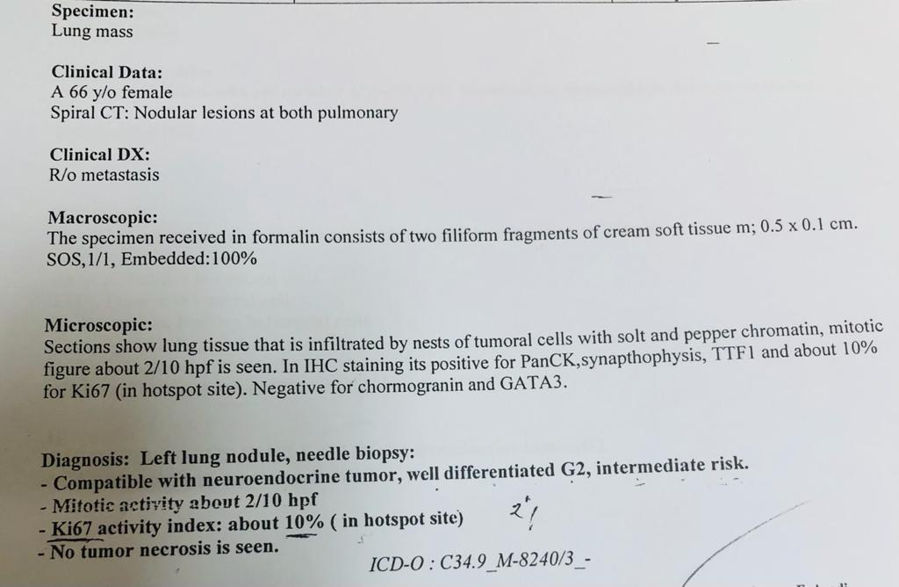
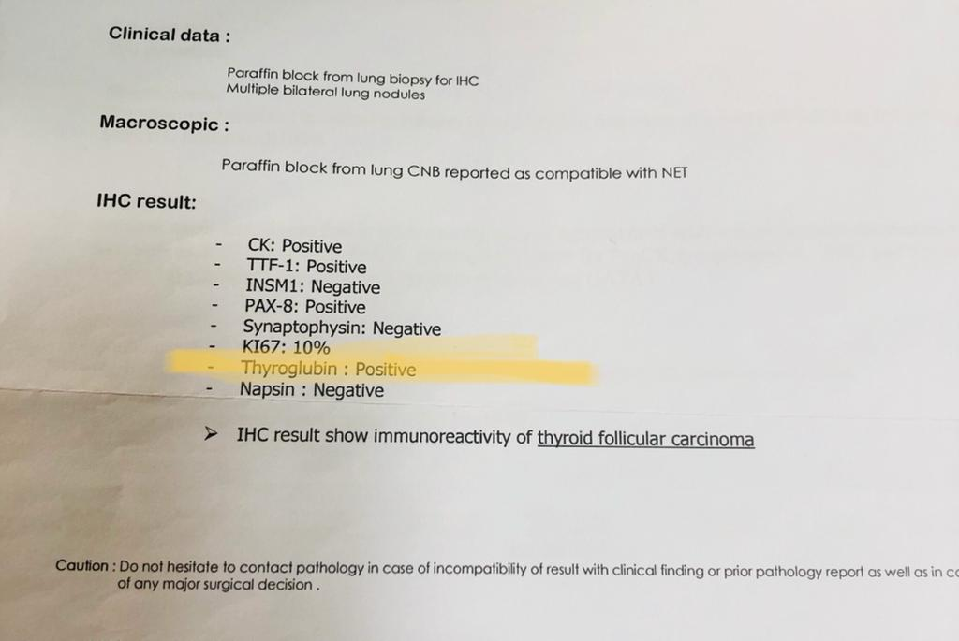
2- CT-guided Biopsy of lung nodules:
Reread

Slide 11
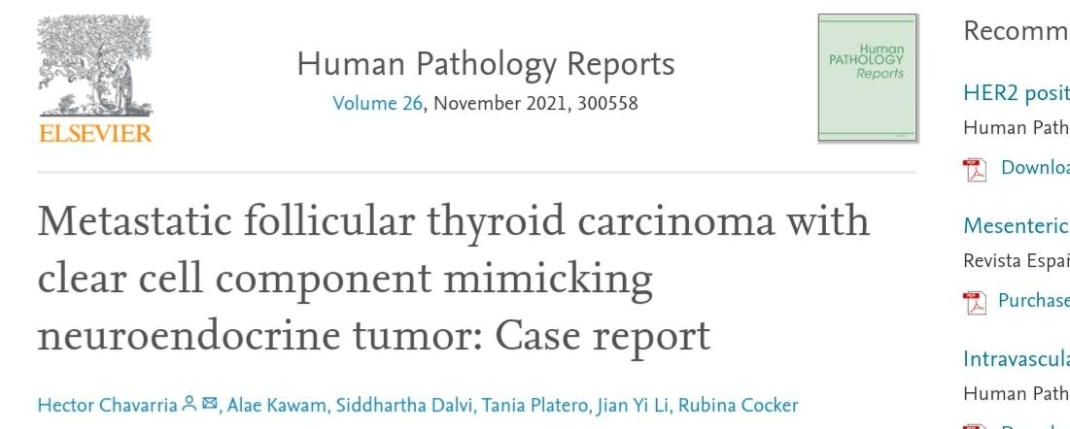
https://doi.org/10.1016/j.hpr.2021.300558Get

Slide 12
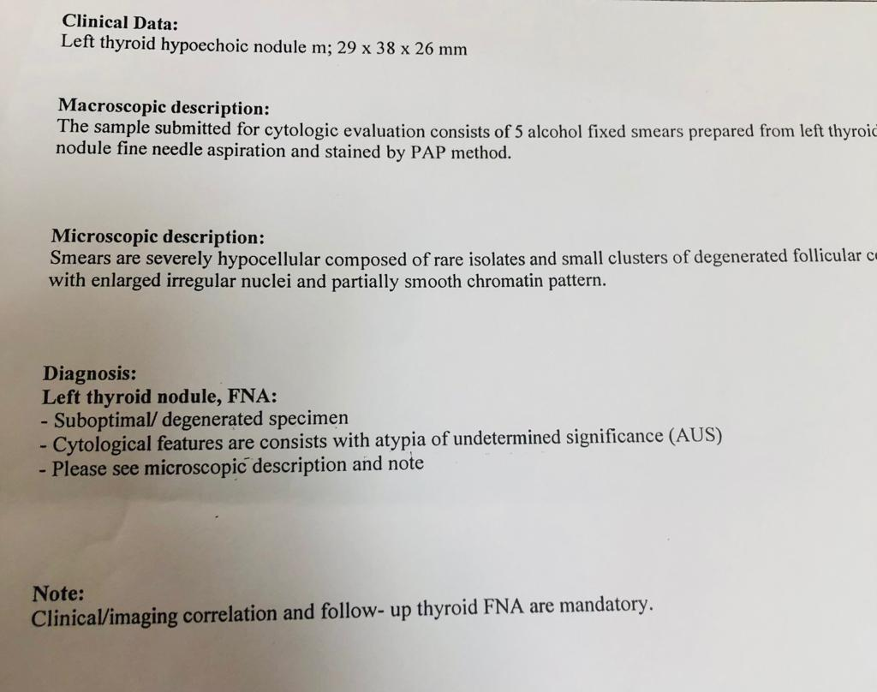
3-thyroid FNA: AUS
Dx:metastatic FTC

Slide 13
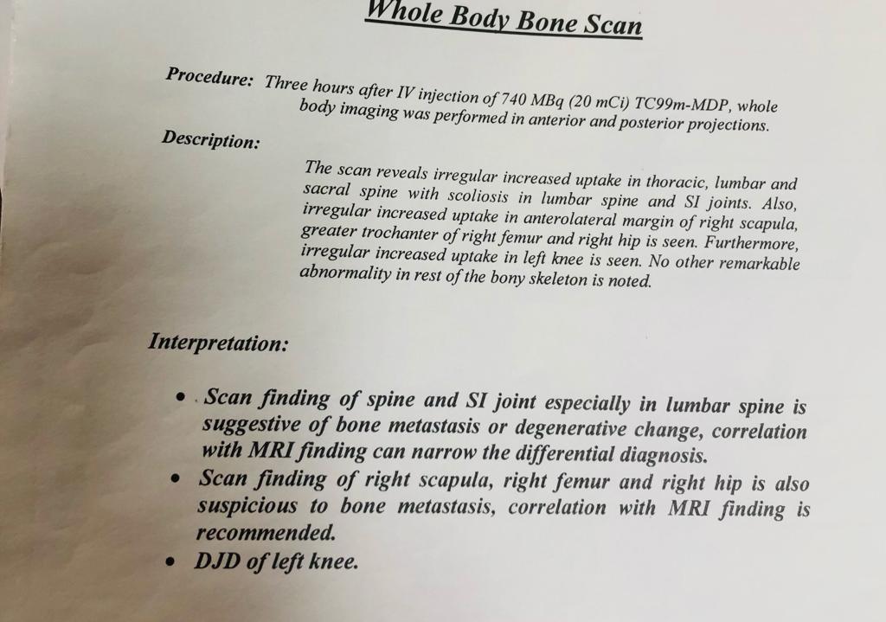
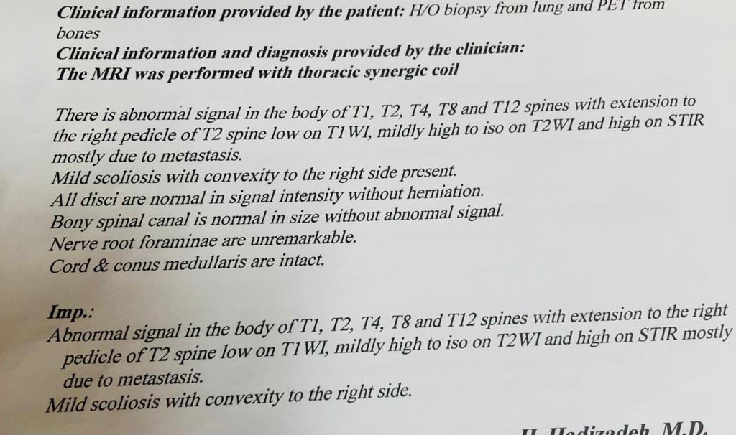
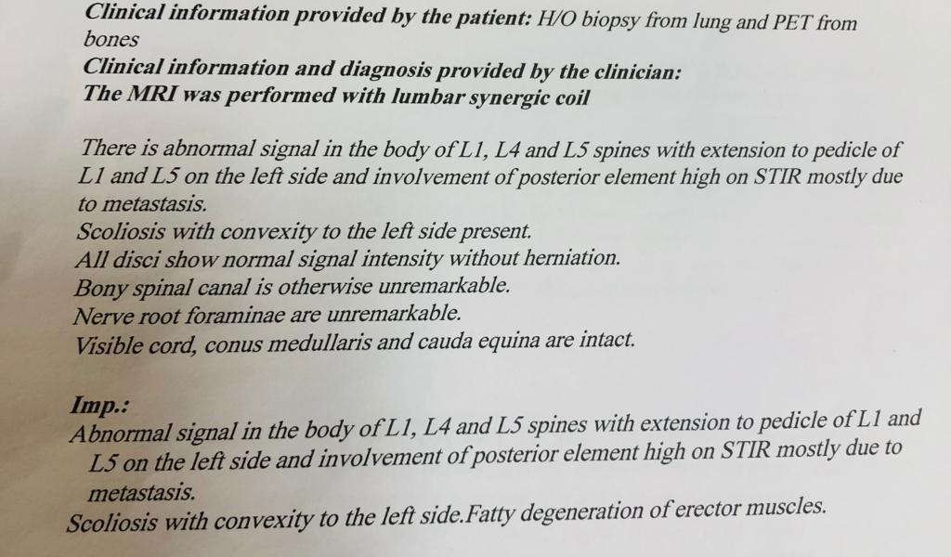
Subsequent related evaluation :
WBS
MRI

Slide 14
Subsequent related evaluation :
Abdominopelvis CT scan : unremarkable
Brain CT scan : Was not done
DX: metastatic FTC to lung and bone

Slide 15
PMH and pSH :NEG Except for thyroid disease described above
History of radiation :NEG
History of weight loss described above
DH:vitamins and methimazole described above
FH:A history of hyperthyroidism in the patient's brother
ROS : weight loss + general weakness + bone pain + sweat 😓
P/E:It was not performed due to the general weakness of the patient and the dissatisfaction of the patient’s family

Slide 16
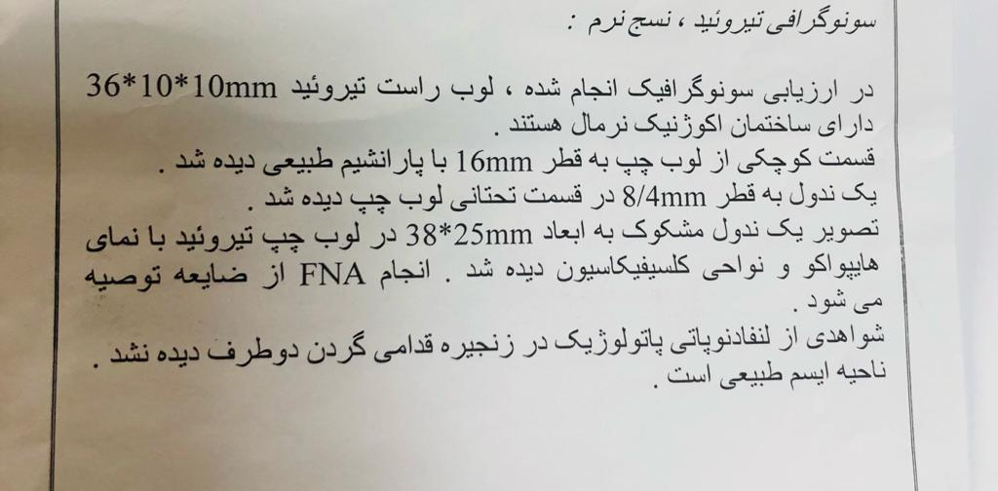
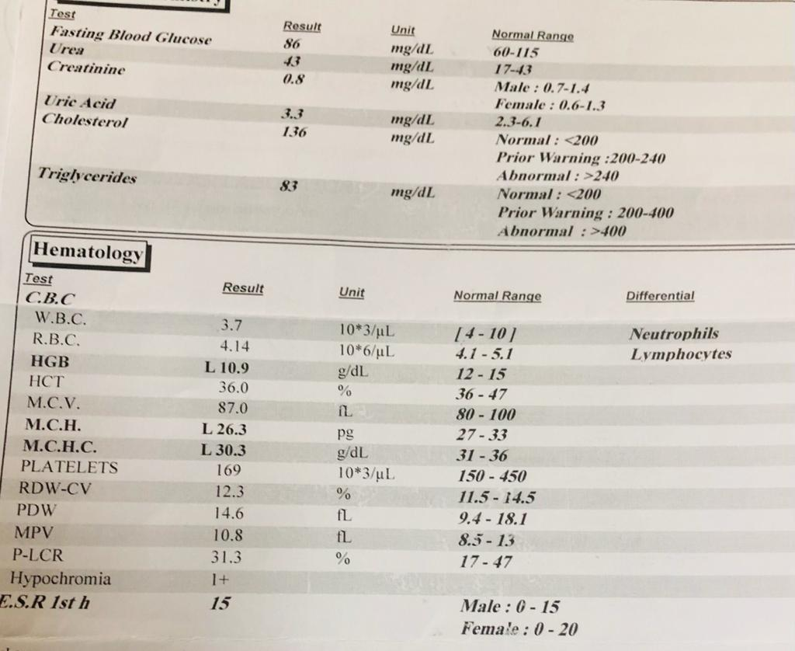
plan:surgery
Preoperative ultrasound
Preoperative lab

Slide 17
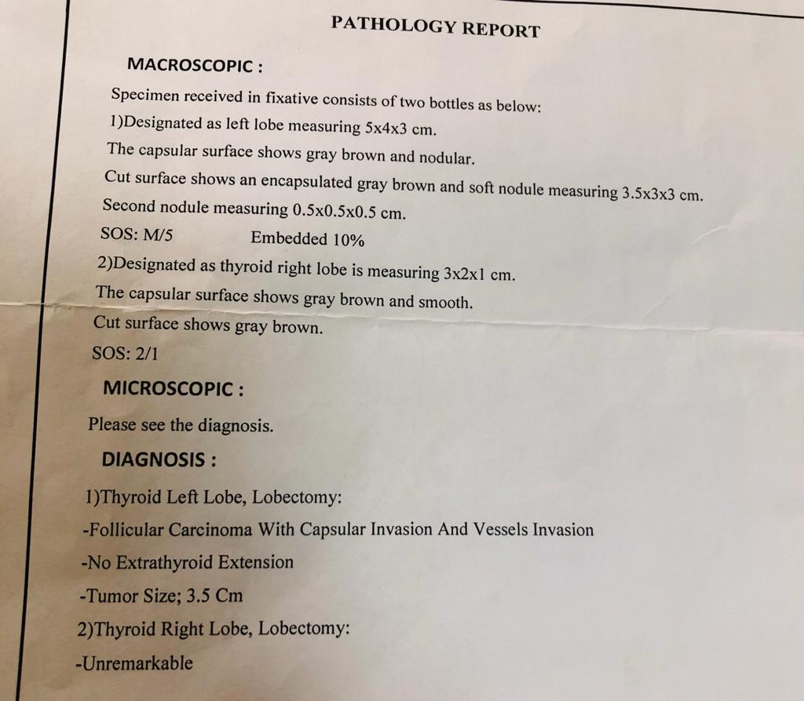
postsurgery pathology
Became a candidate ‌for iodine therapy

Slide 18
Lab tests one day before receiving iodine:
TSH | <0/004
Tg | >300《0/7-84》
Anti Tg | 20/4(up to40)
levothyroxine off
functional metastases
The patient received 150 mCi of iodine

Slide 19
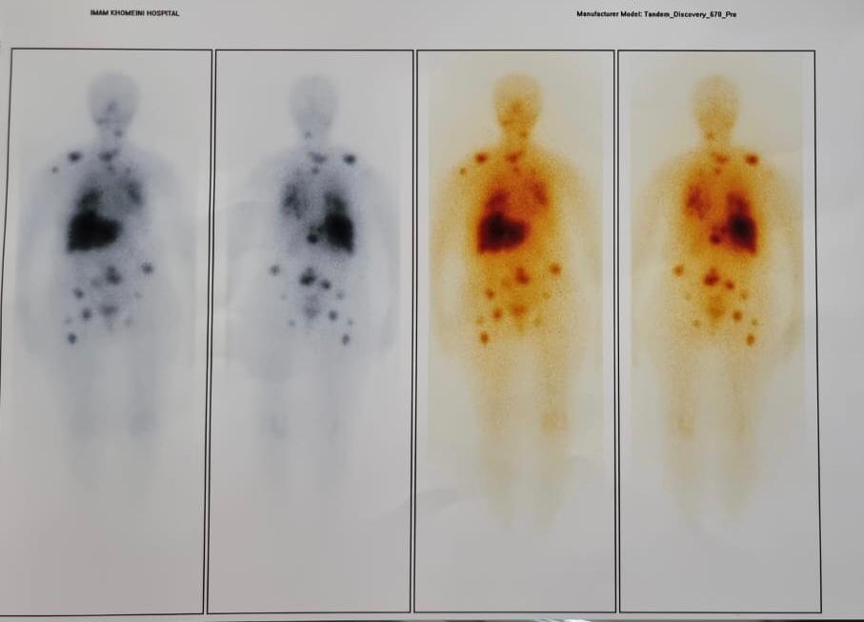
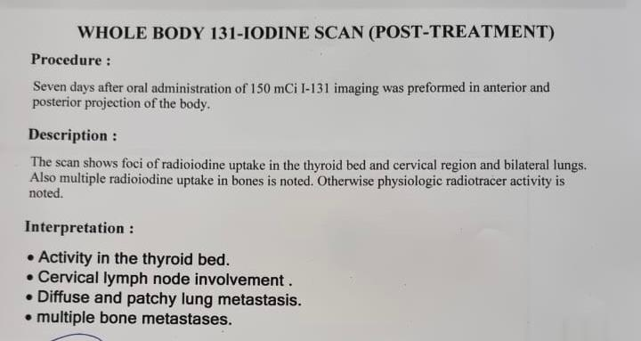
Postablation scan:

Slide 20
Toxic adenoma (?)
prevalence:nearly 5%, third, less common form of hyperthyroidism
pathogenesis:Toxic adenomas are true follicular adenomas . The basic pathogenesis of many
toxic adenomas (up to 70%) is one of several somatic point mutations.in the TSHR gene, commonly in the third transmembrane

Slide 21
Clinical Presentation
TSH suppressed
sono:hypoecho nodule
scan:a localized area of
increased radioiodine
age:< toxic MNG~30-40y
thyrotoxicosis is rare except over 3 cm
Possibility of spontaneous necrosis
Macroscopic and irregular calcifications

Slide 22
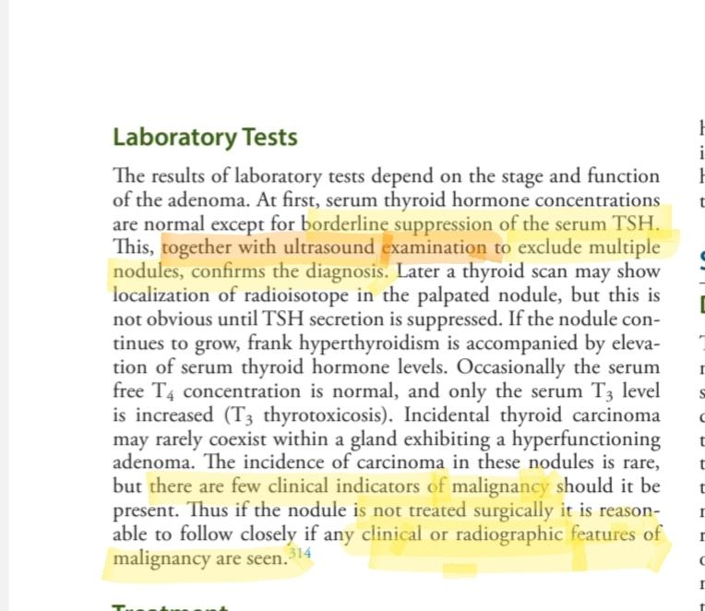

Slide 23
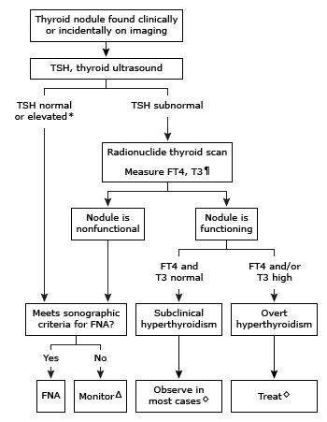

Slide 24
Treatment based on Williams
Annual follow-up if the patient is euthyroid
2. if TSH<0/1
Over 18 years and under five cm, 8-10 ml of iodine.TSHrh not recommended
Otherwise surgery is preferred

Slide 25
treatment base on ATA and up to date
INDICATIONS FOR TREATMENT
●All patients with overt hyperthyroidism (low TSH with elevated free thyroxine [T4] and/or triiodothyronine [T3]) due to toxic adenoma require treatment.
●The decision to treat when thyroid tests show subclinical hyperthyroidism (low serum TSH concentrations [<0.4 mU/mL] but normal serum free T4 and T3 concentrations) is based upon the risk for developing complications from subclinical hyperthyroidism (skeletal, cardiovascular) and the degree of TSH suppression

Slide 26
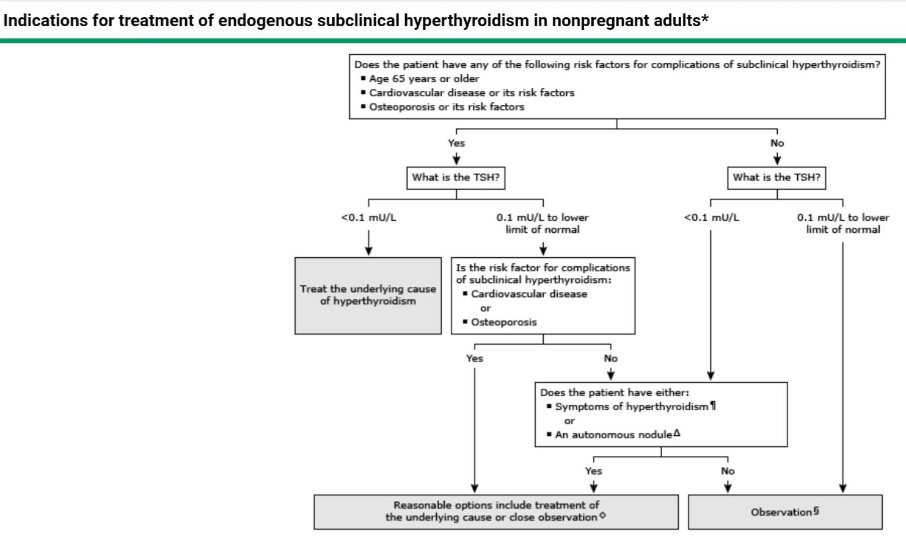

Slide 27
THERAPEUTIC APPROACH — Treatment of hyperthyroidism due to toxic adenoma consists of both symptomatic relief with beta blockers and decreasing the production of thyroid hormone with radioiodine ablation or surgery . Prolonged (probably lifelong) thionamide therapy is an increasingly popular option for patients who would like to avoid both radioiodine and surgery.
Patient preference

Slide 28
surgry Indications — Surgery is used more commonly for the treatment of patients with a toxic adenoma . It is indicated for patients with:
●Obstructive goiters or very large goiters (>80 g)
●Coexisting malignancy or primary hyperparathyroidism
Or patients who:
●coexisting a cold and..in the other side

Slide 29
Total or near-total thyroidectomy results in correction of goiter in almost all patients, whereas radioiodine reduces thyroid volume by approximately 38 to 45 percent.
Preoperative preparation:
Preoperative euthyroidism with mmi
2-We typically avoid iodine in the preoperative preparation of patients with toxic adenoma

Slide 30
Complications — Potential complications following near-total or total thyroidectomy include permanent hypoparathyroidism and recurrent laryngeal nerve injury, each reported in approximately 2 percent of patients
Radioiodine therapy — We typically suggest radioiodine to patients who do not meet the surgical indications described above . Radioiodine can be given as primary therapy to patients with mild, well-tolerated hyperthyroidism. In comparison, patients who are more symptomatic, older, or have underlying heart disease are usually pretreated with a thionamide before radioiodine

Slide 31
Radioiodine therapy
old age
comorbidity and cardiovascular, pulmonary diseases
Previous surgical history
Smaller size
Lack of access to a thyroid surgeon

Slide 32
Radioiodine contraindications:
Pregnancy and breastfeeding are absolute contraindications to radioiodine therapy. In addition, radioiodine should not be administered for the treatment of toxic adenoma or MNG to women planning a pregnancy within four to six months, patients with coexisting thyroid cancer, or patients who are unable to comply with radiation safety guidelines

Slide 33
Other therapies
●Ethanol injection – Ethanol injection of toxic adenomas under ultrasound guidance is a nonsurgical method of destroying the adenomas . Ethanol is injected percutaneously using ultrasound guidance at weekly intervals for five to eight weeks. This form of therapy is not widely used in the United States. However, where available, it can be used when I-131 or surgery is not desirable and when the nodule is not too large (<5 mL in volume).

Slide 34
Other therapies
Radiofrequency ablation and laser therapy – Ultrasound-guided interstitial laser photocoagulation has been used to destroy autonomous nodules.

Slide 35
approach thyroid nodules

Slide 38
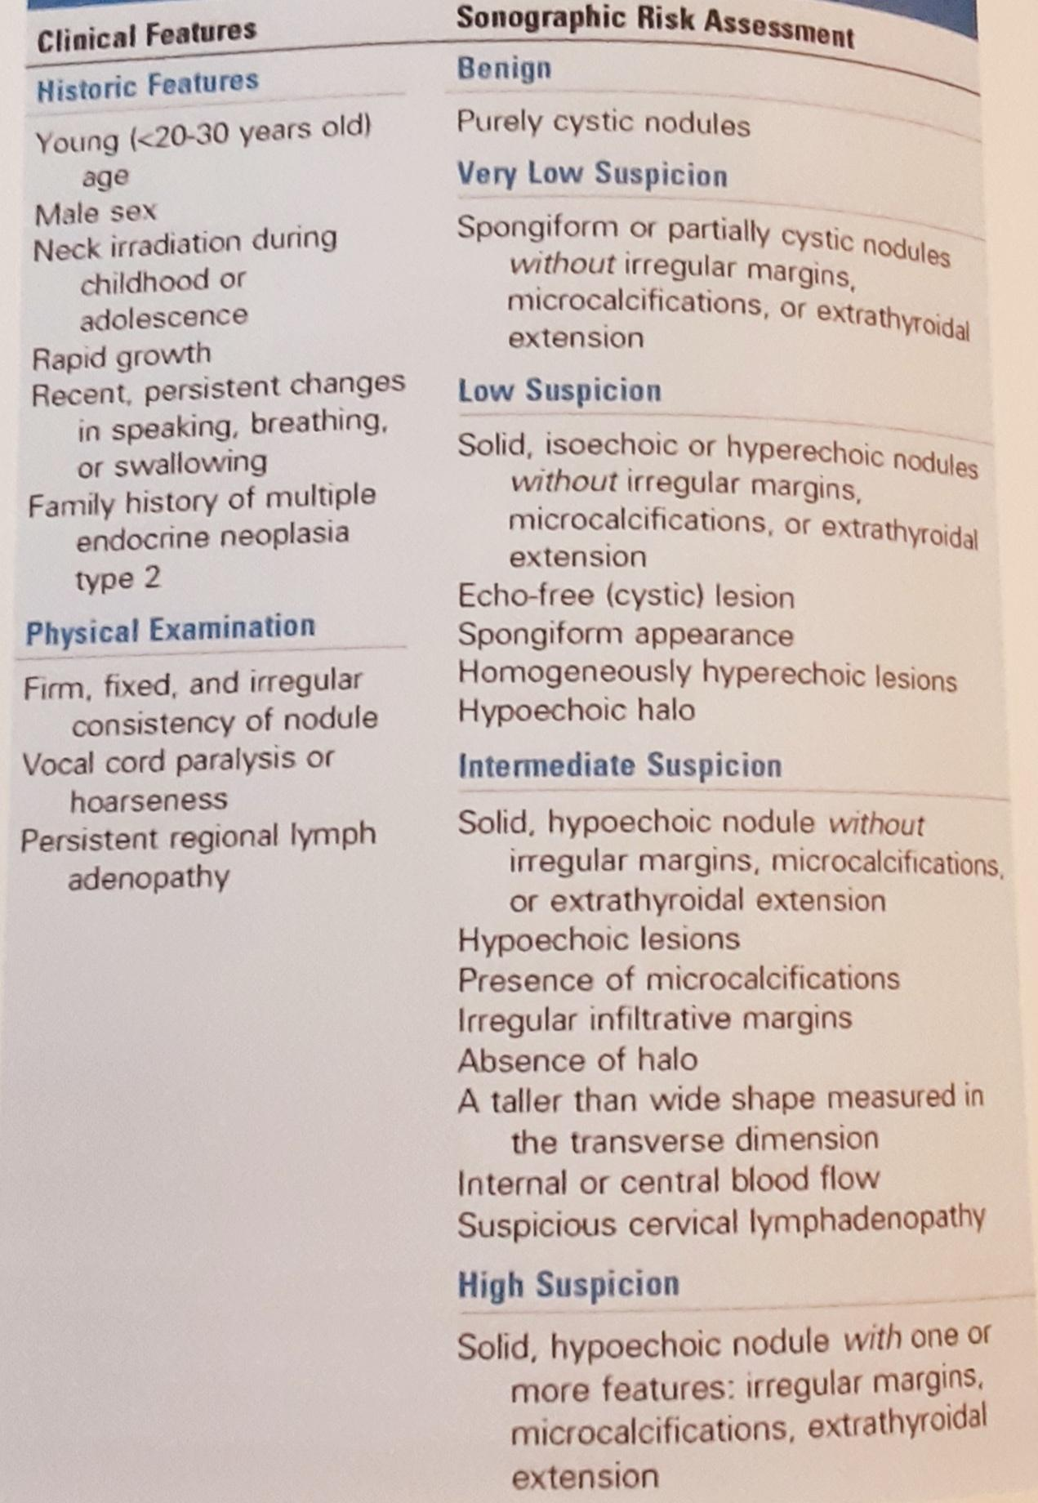

Slide 39
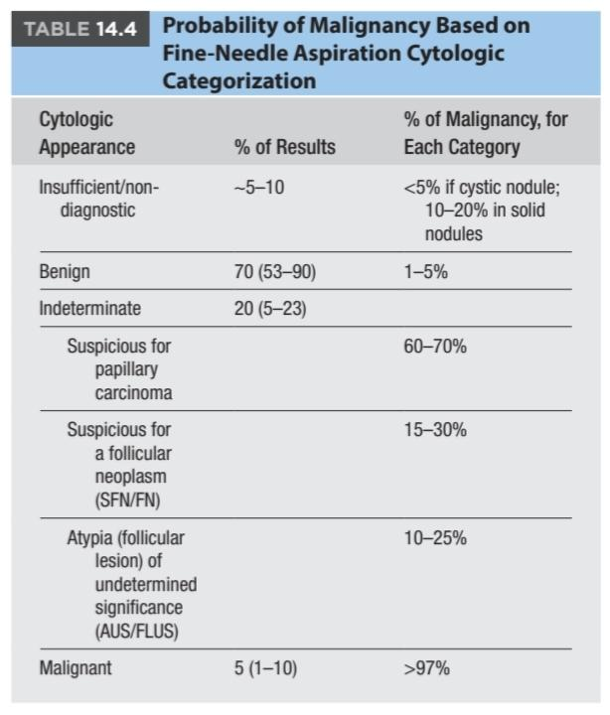

Slide 41
Challenge the possibility of malignancy in the hot nodules
Prevalence of cancer based on surgical nodules? was 3/1%
To decide on nodules, we calculate the pre-test probability
But on what basis?
Sono Findings
clinical features
FNA
Now how to calculate this pre-test probability for hot nodules? 🔥

Slide 42
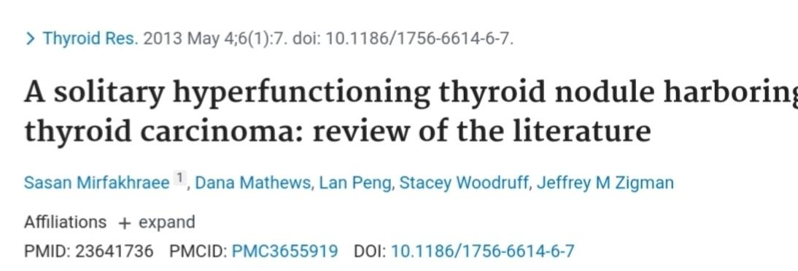
Mirfakhraee S, Mathews D, Peng L, Woodruff S, Zigman JM. A solitary hyperfunctioning thyroid nodule harboring thyroid carcinoma: review of the literature. Thyroid Res. 2013 May 4;6(1):7. doi: 10.1186/1756-6614-6-7. PMID: 23641736; PMCID: PMC3655919.
Nelson RL, Wahner HW, Gorman CA. Rectilinear thyroid scanning as a predictor of malignancy. Ann Intern Med. 1978 Jan;88(1):41-4. doi: 10.7326/0003-4819-88-1-41. PMID: 619756.

Slide 43
Based on review of literature:
Demographic features

Slide 44
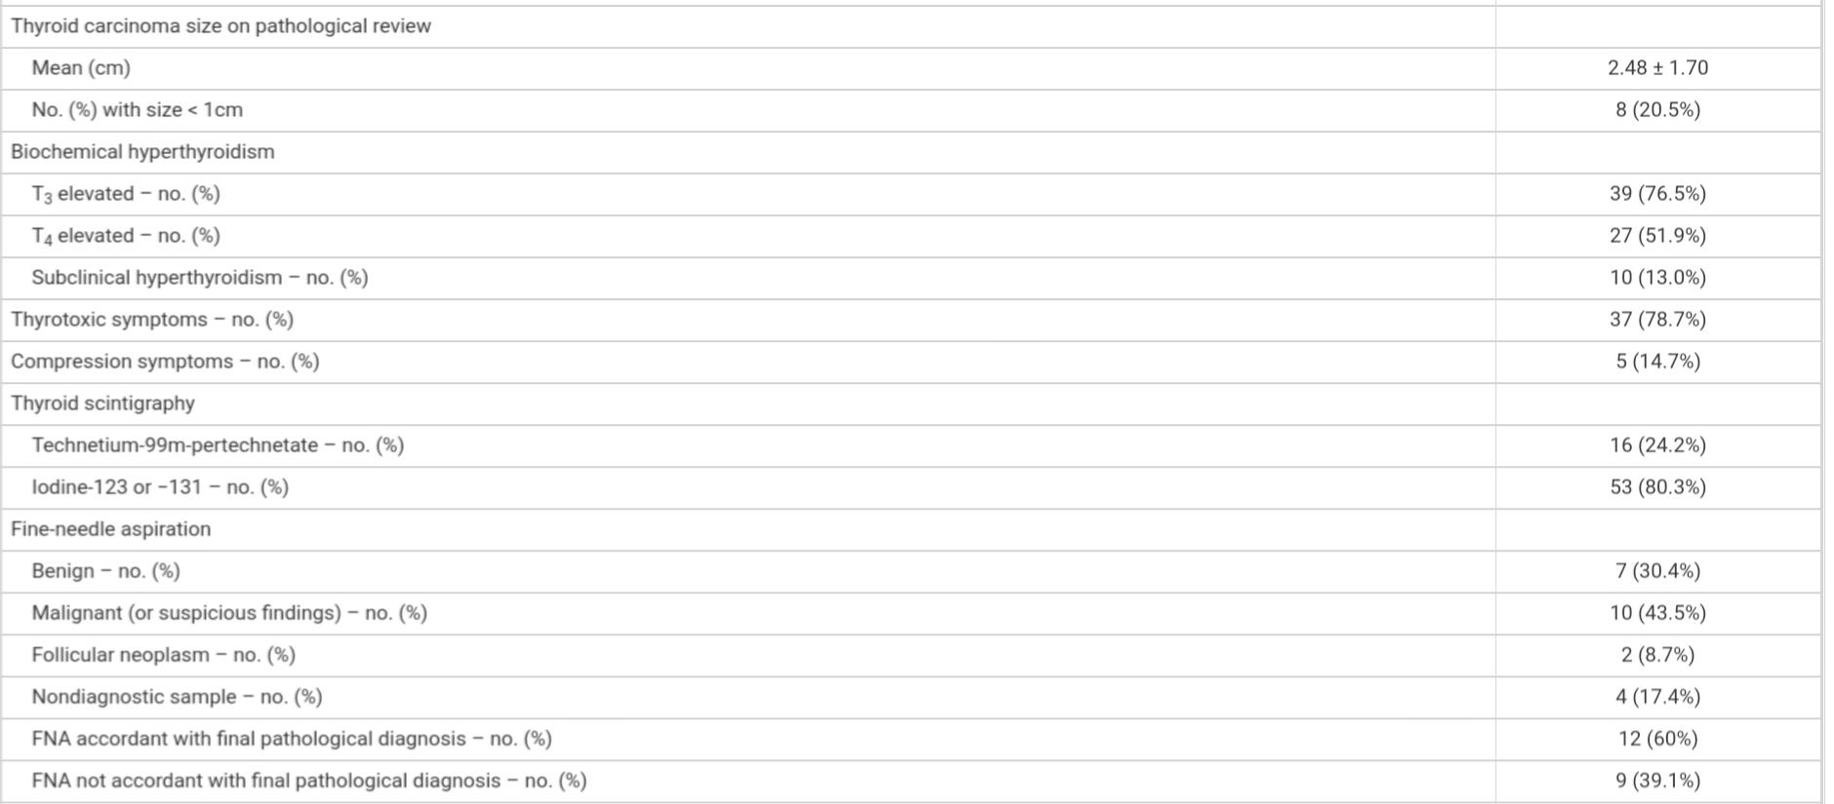
Based on review of literature:

Slide 45
Based on review of literature:

Slide 46
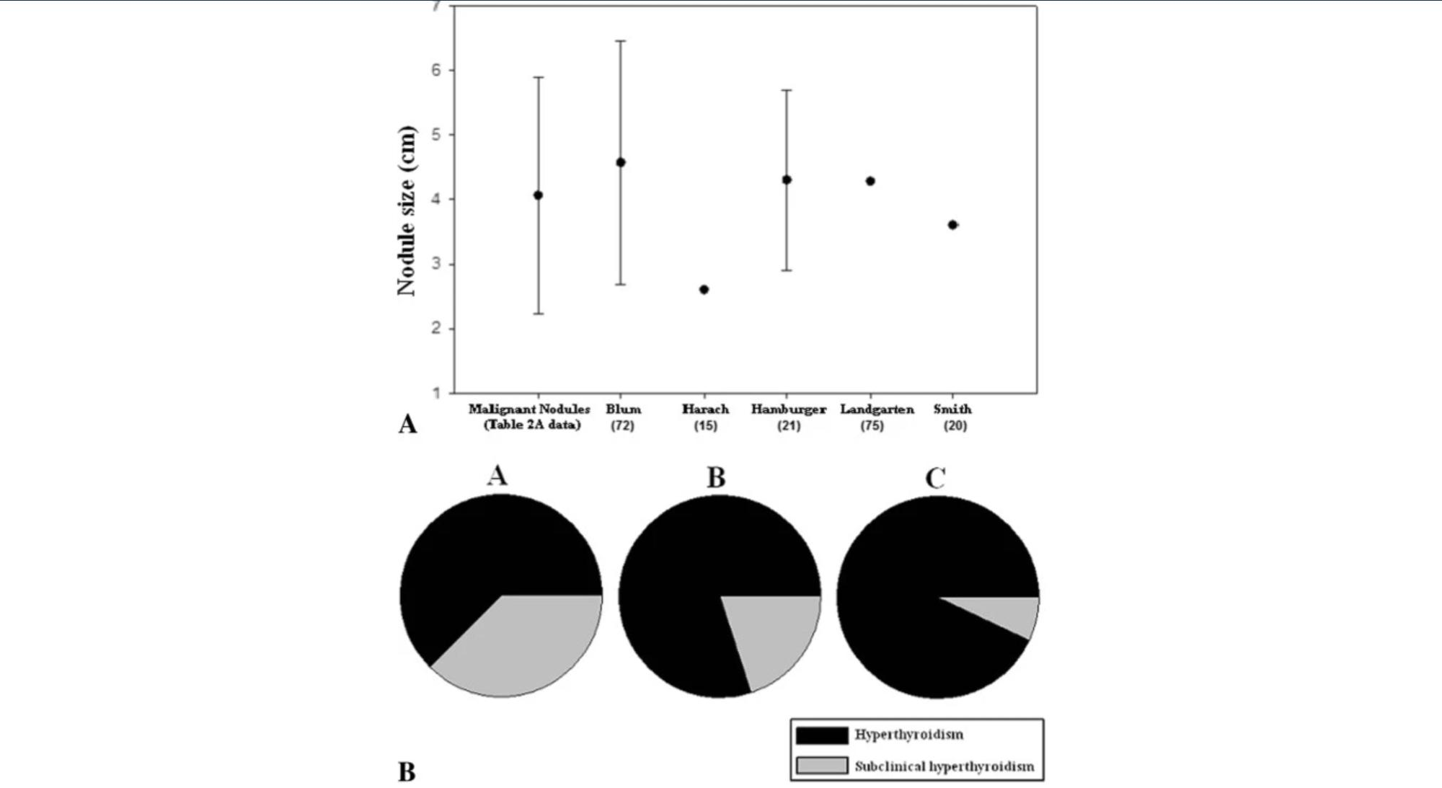
In most studies, the size malignant was more than 2.5 and t3 was more than 2.5 in part A of up to 4.5 in part c and B between these.

Slide 47
57/1% with 18/2% FVPTC
PTC in hot nodules
pTC in total nodules
85%
FTC in hot nodules
4/36
5o%
FTC in total nodules
10%
7/8
hurtel in hot nodules
hurtel in total nodules
3%

Slide 48
The prevalence of carcinoma in hyperthyroidism is 3/1%versus the prevalence of 5-15% in all nodules which is a high figure.
So in cases that do not undergo surgery, care must be taken, but what possibilities should we pay more attention to?

Slide 49
High risk??
age | up to 60 y
sex | female
size | up to 2/5cm
T3>T4 | UP
FNA | FTC ,hurtel
sonographic features | high and ...base on ATA~TIRAD
notice to scan TC99 vs I 123-131

Slide 50
How to calculate pre-test probability for malignancy risk in hot nodules?
notice to :
demographic features:age and sex
Sono increase the risk up to 40%
sonographic features specially size
biochemical values
And make an individual decision based on pre-test probability

Slide 51
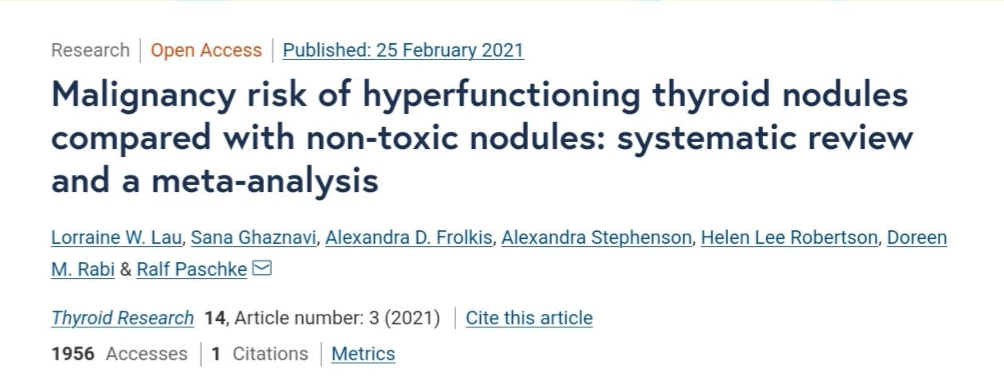
Lau, L.W., Ghaznavi, S., Frolkis, A.D. et al. Malignancy risk of hyperfunctioning thyroid nodules compared with non-toxic nodules: systematic review and a meta-analysis. Thyroid Res 14, 3 (2021). https://doi.org/10.1186/s13044-021-00094-1

Slide 52
HOT Nodules and malignancy
recent studies have challenged the presumed low-risk of malignancy in hot nodules, suggesting that the incidence of cancer has been underestimated . In 22 patients who underwent thyroid surgery irrespective of functional nodule status, Ashcraft and Van Herle reported a malignancy risk of 4% in hot nodules. A recent study demonstrated higher than expected malignancy rates in hot nodules with an overall malignancy rate of 8.5% . The reported malignancy rates of hot nodules ranges broadly from 0.34 to 44% among patients undergoing thyroid surgery In comparison, the reported malignancy rate of non-toxic nodules ranges from 8 to 16% .
Lau, L.W., Ghaznavi, S., Frolkis, A.D. et al. Malignancy risk of hyperfunctioning thyroid nodules compared with non-toxic nodules: systematic review and a meta-analysis. Thyroid Res 14, 3 (2021). https://doi.org/10.1186/s13044-021-00094-1

Slide 53
But what is the purpose?
this systematic review aims to address the question: among those individuals undergoing thyroidectomy for benign indication, are hot nodules diagnosed by scintigraphy associated with a lower risk of thyroid malignancy compared with non-toxic thyroid nodules? Secondary objectives include comparison of malignancy risk in single compared with multiple hot nodules, assessment of reported carcinomas within compared to outside the hot nodule, association of hyperfunctioning on scintigraphy compared with biochemical hyperfunctioning (as determined by TSH levels) and its impact on malignancy, and the impact of inclusion of microcarcinomas on malignancy rates of hot nodules.

Slide 54
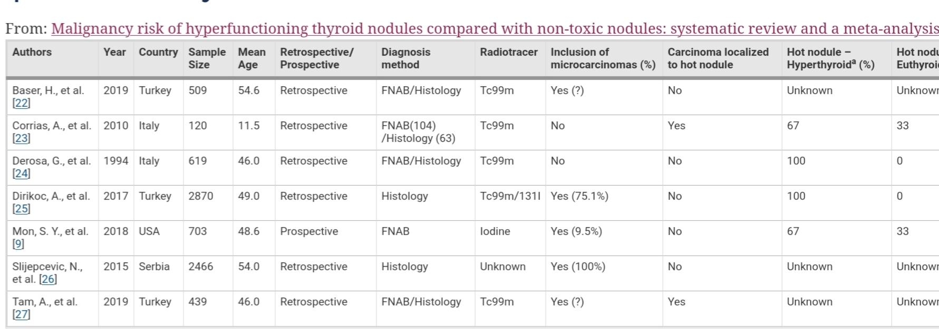

Slide 56
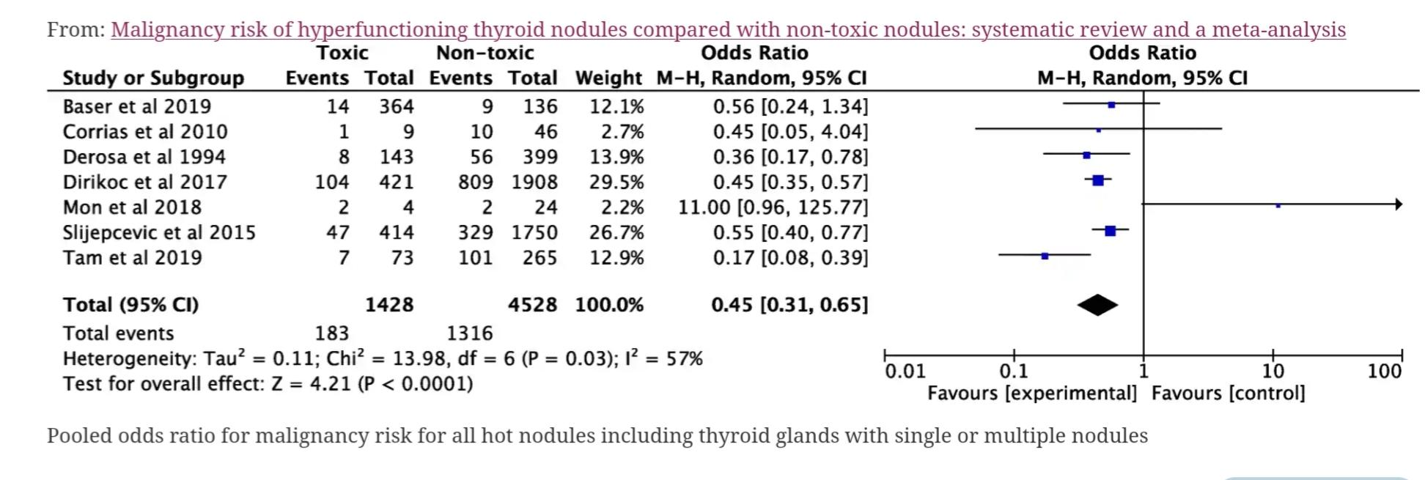

Slide 57
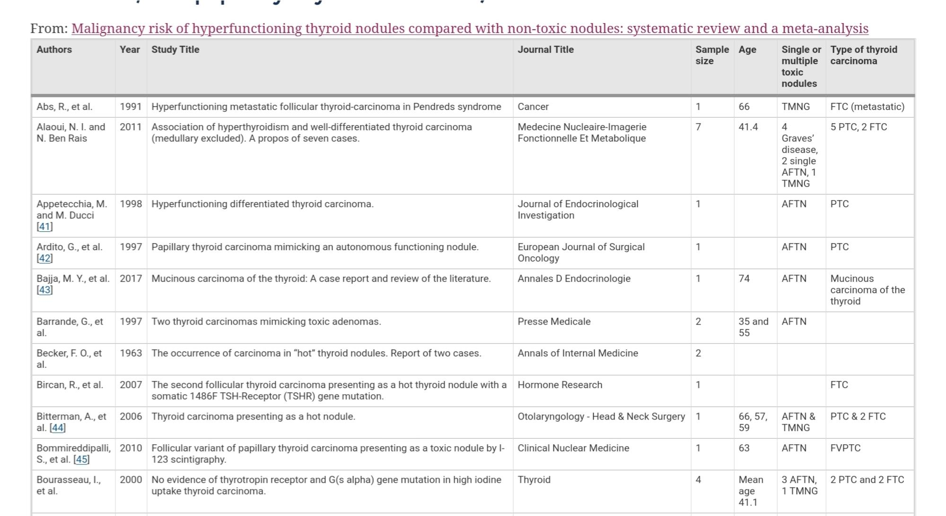

Slide 58
In summary, this systematic review highlights the need for further research into the malignancy risk assessment of hot nodules. There is sufficient evidence to question the notion that hot nodules rarely harbour thyroid cancer. To adequately address this question, a study of adult patients would need to incorporate both scintigraphically hot and non-toxic nodules, resected for any indication, with histologic correlation of the location of the nodule by pre-operative imaging (ultrasound and scintigraphy) and histologic examination, and exclusion of low-risk papillary microcarcinomas. Furthermore, if hot nodules were to be subjected to further assessment, the ultrasonographic malignancy risk stratification would need to be assessed for this specific population.

Slide 59
Of 138 patients, 22% (31/138) were found to have malignancy on final pathology. The breakdown of malignancy by hyperthyroid condition was as follows: 16% in Graves’ disease, 24% in toxic multinodular goiter patients, and 50% in toxic solitary nodule patients.
Alexandra L. Alvarez, Michelle Mulder, Rachel S. Handelsman, John I. Lew, Josefina C. Farra,
High Rates of Underlying Thyroid Cancer in Patients Undergoing Thyroidectomy for Hyperthyroidism,
Journal of Surgical Research,
Volume 245,
2020,
Pages 523-528,
ISSN 0022-4804,
https://doi.org/10.1016/j.jss.2019.07.048.
(https://www.sciencedirect.com/science/article/pii/S0022480419305426)

Slide 60
Serum TSH is an independent risk factor for predicting malignancy in a thyroid nodule. In a study of 1500 patients presenting to a thyroid practice, the prevalence of malignancy was 2.8, 3.7, 8.3, 12.3, and 29.7 percent for patients with serum TSH concentrations <0.4 mU/L, 0.4 to 0.9 mU/L, 1 to 1.7 mU/L, 1.8 to 5.5 mU/L, and >5.5 mU/L, respectively Other studies have shown that when cancer was diagnosed, a higher TSH was associated with a more advanced stage of cancer .
Author:
Douglas S Ross, MD
Section Editor:
David S Cooper, MD
Deputy Editor:
Jean E Mulder, MD
Boelaert K, Horacek J, Holder RL, Watkinson JC, Sheppard MC, Franklyn JA. Serum thyrotropin concentration as a novel predictor of malignancy in thyroid nodules investigated by fine-needle aspiration. J Clin Endocrinol Metab. 2006 Nov;91(11):4295-301. doi: 10.1210/jc.2006-0527. Epub 2006 Jul 25.

