Slide 2
Bariatric surgery
KHALAJ A.R. M.D
Obesity Clinic
Mostafa Khomini Hospital
Shahed University
Tehran
www.totc.ir

Slide 3
We should answer these questions
Why Surgery ?
Evidences about obesity surgery and diabetes?
What is Indication of Surgery?
What is ContraIndication of surgery?
What is aproved operations?
What is benefit of laparoscopy verses open surgery ?
Which procedure is better for your patient ?
What is Complication of obesity surgery ?

Slide 4
EFFECTIVENESS OF BARIATRICSURGERY
Reduction of comorbidities
Reduction in mortality
Surgery compared to medical treatment
Treatment for type 2 diabetes

Slide 5
Reduction of comorbidities
Meta-analysis: surgical treatment of obesity.
Ann Intern Med 2005 Apr 5;142(7):547-59.
Maggard MA; et al
147 studies
Bariatric surgery: a systematic review and meta-analysis.
AU Buchwald H; Avidor Y; Braunwald E; Jensen MD; Pories W; Fahrbach K; Schoelles K
SO JAMA 2004 Oct 13;292(14):1724-37
136 fully extracted studies,

Slide 6
• Diabetes completely resolved in 77 percent and resolved or improved in 86 percent.
• Hyperlipidemia improved in 70 percent or more of patients.
• Hypertension resolved in 62 percent and resolved or improved in 79 percent.

Slide 7
• Obstructive sleep apnea resolved in 86 percent and resolved or improved in 84 percent.
• Gastroesophageal reflux symptoms improve and complete or partial regression of Barrett's esophagus has been demonstrated.
Urinary stress incontinence episodes decreased by 47 percent in women who achieved 8 percent weight loss

Slide 8
Reduction in mortality
Long-term mortality after gastric bypass surgery.
Adams TD; et al
N Engl J Med. 2007 Aug 23;357(8):753-61.
cohort study
from 1984 to 2002
9949 patients who had undergone gastric bypass surgery
9628 severely obese in control group

Slide 9
Effects of bariatric surgery on mortality in Swedish obese subjects.
AU Sjostrom L; Narbro K; Sjostrom CD; Karason K; Larsson B; Wedel H; Lystig T; Sullivan M; Bouchard C; Carlsson B; Bengtsson C; Dahlgren S; Gummesson A; Jacobson P; Karlsson J; Lindroos AK; Lonroth H; Naslund I; Olbers T; Stenlof K; Torgerson J; Agren G; Carlsson LM
SO N Engl J Med. 2007 Aug 23;357(8):741-52.

Slide 10
. Deaths from all causes were reduced by 40 percent,
from diabetes by 92 percent,
from coronary disease by 56 percent,
and from cancers by 60 percent.
Although the majority of mortality data for bariatric surgery comes from patients under age 65, a retrospective cohort analysis suggests that survival is improved, even in patients over age 65

Slide 11
CONCLUSIONS:
Bariatric surgery for severe obesity is associated with long-term weight loss and decreased overall mortality.

Slide 12
Surgery compared to medical treatment
The Swedish Obese Subjects (SOS) study--rationale and results.
Swedish obese subjects (SOS)--an intervention study of obesity. Two-year follow-up of health-related quality of life (HRQL) and eating behavior after gastric surgery for severe obesity.
Effects of bariatric surgery on mortality in Swedish obese subjects.

Slide 13
Weight decreased by 23 percent after two years in the surgery group while it increased in the control group by 0.1 percent [35].
After 10 years, weight had decreased by 16 percent in the surgery group and increased in the control group by 1.6 percent
The surgery group had better two and 10-year incidence rates of diabetes, hypertriglyceridemia, lowered HDL levels, improved hypertension and hyperuricemia rates.

Slide 14
Surgically treated patients were significantly less likely to require medications for cardiovascular disease or diabetes at two and six years
• Surgically treated patients had dramatic improvement in scores on validated measures of quality of life and psychiatric dysfunction

Slide 15
After 10 years of follow-up, the improvements in quality of life diminished somewhat in the surgery group due to weight regain, but overall outcome was still significantly better in the surgical than the medically treated group

Slide 16
Treatment for type 2 diabetes
Adjustable gastric banding and conventional therapy for type 2 diabetes: a randomized controlled trial.
Improvement in glucose metabolism after bariatric surgery: comparison of laparoscopic Roux-en-Y gastric bypass and laparoscopic sleeve gastrectomy: a prospective randomized trial.
Cost-efficacy of surgically induced weight loss for the management of type 2 diabetes: a randomized controlled trial.

Slide 17
Participants randomized to surgical therapy were more likely to achieve remission of type 2 diabetes through greater weight loss.
Both procedures markedly improved glucose homeostasis.
Surgical therapy appears to be a cost-effective option for managing type 2 diabetes in class I and II obese patients.

Slide 18
Bariatric Surgery versus conventional Medical Therapy for Type 2 Diabetes Geltrude Mingrone, M.D., Simona Panunzi, Ph.D., Andrea De Gaetano, M.D., Ph.D. N Engl J Med 2012;366:1577-85.

Slide 19
Study characteristics
2009- 2011, 72 patients at the Day Hospital of Metabolic Diseases and Diabetology of the Catholic University in Rome.

Slide 20
Study characteristics
Exclusion criteria:
history of type 1 diabetes
diabetes secondary to a specific disease or glucocorticoid therapy
previous bariatric surgery
Pregnancy
other medical conditions requiring short-term hospitalization
severe diabetes complications
other severe medical conditions
geographic inaccessibility

Slide 21
Study characteristics
primary end point was the difference in the rate of remission of type 2 diabetes among patients undergoing either gastric bypass or biliopancreatic diversion, as compared with medical therapy
Secondary end points were changes from baseline in levels of fasting plasma glucose and glycated hemoglobin, the average glycated hemoglobin level, body weight, waist circumference, arterial blood pressure, and levels of plasma cholesterol, HDL cholesterol, and triglycerides at 2 years

Slide 24
Bariatric Surgery versus Intensive Medical Therapy in obese patients with diabetes
Philip R. Schauer, M.D., Sangeeta R. Kashyap, M.D., Kathy Wolski, M.P.H., Stacy
N Engl J Med 2012;366:1567-76.

Slide 25
Study characteristics
2007 – 2011
screened 218 patients at the Cleveland Clinic
150 eligible patients
Eligible criteria:
20 – 60 years
DM Type 2 (Hb A1C > 7%)
BMI: 27 – 43
Exclusion criteria:
previous bariatric surgery
other complex abdominal surgery
poorly controlled medical
Psychiatric disorders

Slide 26
Study characteristics
primary end point :
Hb A1C ≤ 6% (with or without diabetes medications) 12 months after randomization
Secondary end point :
FPG
fasting insulin
Lipids
high-sensitivity CRP
the homeostasis model assessment of insulin resistance (HOMA-IR)
weight loss; blood pressure; adverse events; coexisting illnesses; and changes in medications.

Slide 28
Key message
Limitations:
short duration of follow-up (12months)
single-center
open-label nature of the study
Cardiovascular risk factors improved
Reductions in lipid-lowering and antihypertensive therapies
Theoretically, such improvements have the potential to reduce cardiovascular morbidity and mortality

Slide 30
Study characteristics
Objective : To compare Roux-en-Y gastric bypass with lifestyle and intensive medical Management to achieve control of comorbid risk factors.
2008-2011
theUniversity of Minnesota (starting in2008), Columbia University Medical Center (starting in 2009), 2 academic clinics in Taiwan (National Taiwan University Hospital and Min Sheng General Hospital, together called Taiwan,starting in 2009), and the Mayo Clinic in Rochester, Minnesota (starting in 2010)

Slide 31
Study characteristics
Inclusion criteria:
30-67 years
Hba1c≥8%
under a physician’s care for type 2 diabetes for at least 6 months befor recruitment
BMI: 30-39.9
serum C-peptide level higher than 1.0 ng/mL (to convert C-peptide to nanomoles per liter, multiply by 0.331) 90 minutes after a liquid mixed meal (250 calories, 6 g fat, 40 g carbohydrate, and 9 g protein).
Absence of conditions that would contraindicate surgery, such as serious cardiovascular disease, previous gastrointestinal surgery, psychological concerns, or history of malignancy.

Slide 32
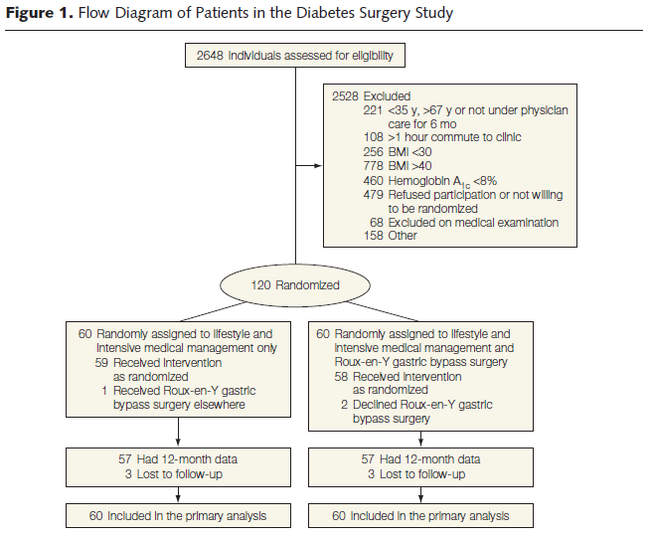

Slide 33
Outcomes
The primary outcome was considered successful if patients achieved the composite of the triple end point:
HbA1c of less than 7.0%
LDL cholesterol level of less than 100 mg/dL
Systolic blood pressure less than 130 mm Hg, at the 12-month visit.

Slide 34
Secondary outcome measures included:
weight loss
adverse events
fasting glucose
HbA1c levels less than 6.0%
high-density lipoprotein (HDL) cholesterol and triglycerides levels,
diastolic blood pressure
waist circumference
medications.

Slide 36
Stacy A. Brethauer, MD, Ali Aminian, MD, H´ector Romero-Talam´as, MD,∗ Esam Batayyah, MD,∗

Slide 37
Study characteristics
Inclusion criteria:
30 -60 years
BMI ≥ 35
history of type 2 diabetes of at least 5 years
Hb A1c ≥ 7%

Slide 38
Study characteristics
Exclusion criteria:
reoperative bariatric surgery
International patients who were not expected to follow-up
Patients who had not continued long-term follow up

Slide 40
Key message
This study that 24% of all patients and 31% of gastric bypass patients achieved long-term complete remission with an A1C less than 6.0% and that 27% of the gastric bypass patients sustained that level of glycemic control off medication continuously for more than 5 years.
Predictors of relapse after remission were poor preoperative glycemic control, longer duration of diabetes, and insulin use
poor preoperative glycemic control and insulin use did not predict remission or recurrence of T2DM

Slide 41
Role of Bariatric Surgery as reatment for Type 2 Diabetes in Patients Who Do Not Meet Current NIH Criteria: A Systematic Review and Meta-nalysis
Manish Parikh, MD, FACS, Reda Issa, BA, Dorice Vieira, MLS, Michelle McMacken, MD
2013 by the American College of Surgeons

Slide 42
Study characteristics
The search was conducted in January 2012 and was limited to articles published in English after 1990
A total of 953 articles were originally identified and 736 articles remained after duplicates were removed

Slide 43
Study characteristics
Inclusion criteria:
patients with T2DM and BMI <35 kg/m²
Exclusion criteria:
Animal studies
review articles
articles not on the topic of T2DM and surgery
Overlapping data

Slide 50
Limitations :
short term with durations of 3 months to 36 months
small number of patients
inadequate diabetes outcomes data at 24months
not a randomized group of patients
mainly retrospective reports

Slide 51
Key message
surgery is safe and effective in diabetes remission, mirroring the existing bariatric surgery literature about diabetes remission in patients with BMI >35 kg/m²
Remission rate: 55% at 12 months
improvement rate: 95%
Remission rate LAGB : 33%
MGB : 49%
LsG : 54%
RYGB: 64%
BPD: 71%
Ileal transposition : 81%

Slide 52
ADA GUIDELINE 2013
Bariatric surgery may be considered for adults with BMI ≥35 kg/m2 and type 2 diabetes, especially if the diabetes or associated comorbidities are difficult to control with lifestyle and pharmacological therapy. (B)

Slide 53
Conclusion
Bariatricsurgery, specifically gastric bypass and biliopancreatic diversion, may be more effective than conventional medical therapy in controlling hyperglycemia in severely obese patients with type 2 diabetes.
There is trial provides data about efficacy and safety for the first year of treatment.
The benefits of applying bariatric surgery must be weighed against the risk of serious adverse events.
Bariatric surgery is safe and effective in diabetes remission in patients with t2dm and BMI <35 kg/m2

Slide 55
Indications of bariatric surgery
Be well-informed and motivated
Have a BMI >40
Have acceptable risk for surgery
Have failed previous non-surgical weight loss
The NIH also suggested that adults with a BMI >35 who have serious comorbidities such as diabetes, sleep apnea, obesity-related cardiomyopathy, or severe joint disease may also be candidates
In 2011, the FDA approved the laparoscopic adjustable gastric band for use in patients with BMI greater than 30 with one or more weight related comorbid conditions

Slide 56
Contraindications to bariatric surgery
untreated major depression or psychosis,
binge eating disorders,
current drug and alcohol abuse,
severe cardiac disease with prohibitive anesthetic risks
severe coagulopathy
inability to comply with nutritional requirements including life-long vitamin replacement
Bariatric surgery in advanced (above 65) or very young age (under 18) is controversial.

Slide 58
RATIONALE FOR MINIMALLY INVASIVE BARIATRIC SURGERY
Wound infection
Rates of wound infection are significantly greater with open (10 to 15 percent) than laparoscopic (3 to 4 percent) gastric bypass procedures .
SO - Ann Surg 2000 Oct;232(4):515-29
Ventral incisional hernia
Ventral incisional hernias occur with a frequency of 0 to 1.8 percent in laparoscopic series and as high as 24 percent in open series, underscoring a clear advantage of the laparoscopic approach in this regard
SO - Ann Surg 2001 Sep;234(3):279-89; discussion 289-91
Reduction in postoperative pain, shorter length of hospital
stay, and faster recovery

Slide 59
OUTCOMES OF LAPAROSCOPIC VERSUS OPEN GASTRIC BYPASS
Postoperative Pulmonary Function
FEV1 was 38% higher on the first postoperative day after laparoscopic than after open GBP
lower rate of segmental atelectasis after laparoscopic GBP
Nguyen NT, Lee SL, Goldman C, et al.: Comparison of pulmonary
function and postoperative pain after laparoscopic versus open
gastric bypass: A randomized trial. J Am Coll Surg 192:469–476,
2001.

Slide 60
Postoperative Pain
Despite utilizing greater dosages of narcotics,
open GBP patients still reported higher visual analog pain score
Weight Loss
6 months after surgery L>O
Long term L=O
Ann Surg 239:433–437, 2004
Obes Surg 13:341–346, 2003.
Obes Surg 10:233–239, 2000

Slide 61
learning curve
Mastering the technique of laparoscopic GBP often requires between 75 and 100 cases.

Slide 62
Operation of choice for a patient :
Patients dietary and psychology history
Medical and surgical history
Surgeon experience
Patient comfort and expectation
Ability of medical facility to handle most known complications

Slide 63
Buchwald algorithm for patient selection
There is no gold standard operation .
A surgeon should be able to perform more than one operation.
Patient can be matched to a specific procedure

Slide 64
Types of bariatric procedures
Restrictive
Vertical banded gastroplasty
Laparoscopic adjustable gastric band
Sleeve gastrectomy
Gastric plication
Malabsorptive
Jejunoileal bypass
Biliopancreatic diversion
Biliopancreatic diversion with duodenal switch
Combination of restrictive and malabsorptive
Roux-en-Y gastric bypass

Slide 65
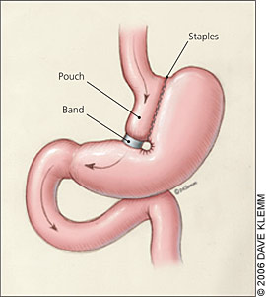
VERTICAL BANDING

Slide 66
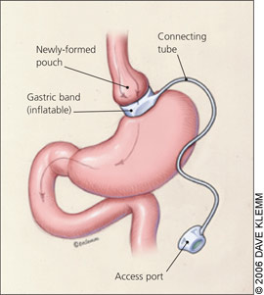
LAP ADJUSTABLE BANDING

Slide 67
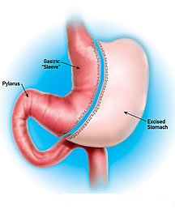
Sleeve gastrectomy

Slide 68
Jejunoileal Bypass
Payne and Dewind, Archives of Surgery, 1973
Notes:
First series in 1969 of 80 patients; now a series of 153 JI bypasses reported 1973
Jejunum to ileum [note that this is end-to-side]
80 patients, with 5 deaths - one was from liver failure, 2 had PE, 2 had MI
“14-4”; this was to replace the IC bypass; 16 year follow up; 153 JI bypasses done;
9% total mortality[6% blamed on bypass]
noted that there was significant fatty change of the liver at the initial operation - this worsened w/ rapid weight loss. . .
This was modified by Scott et al. in 1974; Note that the anastomosis is now end to end and the defunctionalized limb of distal ileum is drained into the transverse colon; note that the proximal jejunum sutured to the mesentery

Slide 69
BPD & BPD w/ DUODENAL SWITCH

Slide 70
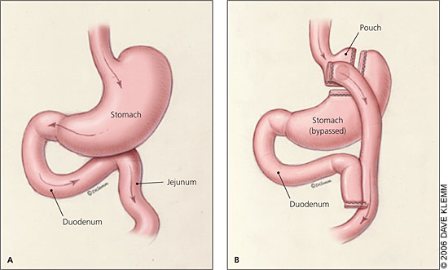
ROUX-EN-Y GASTRIC BYPASS

Slide 72
MORTALITY
Overall mortality was estimated to be less than 1 percent Meta-analysis: surgical treatment of obesity.
AU - Maggard MA; Shugarman LR; Suttorp M; Maglione M; Sugarman HJ; Livingston EH; Nguyen NT; Li Z; Mojica WA; Hilton L; Rhodes S; Morton SC; Shekelle PG
SO - Ann Intern Med 2005 Apr 5;142(7):547-59
increasing mortality was associated with advancing age, male sex, and lower surgeon volume of bariatric procedures Surgical volume impacts bariatric surgery mortality: a case for centers of excellence.
AU - Hollenbeak CS; Rogers AM; Barrus B; Wadiwala I; Cooney RN
SO - Surgery. 2008 Nov;144(5):736-43. Epub 2008 Jul 21

Slide 73
COMPLICATIONS OF MALABSORPTIVE PROCEDURES
Jejunoileal bypass
JIB resulted in high rates of diarrhea, arthritis, hepatic failure, cirrhosis, nephrolithiasis, protein malnutritio and vitamin deficiencies - Am J Med 1978 Mar;64(3):461-75.n,
Surg Clin North Am 1979; 59:1071.

Slide 74
COMPLICATIONS OF MALABSORPTIVE PROCEDURES
Biliopancreatic diversion and duodenal switch complications
significant protein calorie malnutrition, anemia, metabolic bone disease, deficiencies of fat-soluble vitamins and vitamin B12
- Gastroenterology 2001 Feb;120(3):669-81.

Slide 75
Vertical banded gastroplasty
staple line disruption 27-48%, stomal stenosis 20-33%, band erosion 1-7%, GERD, nausea/vomiting, marginal ulcers, and weight regain TI - Bariatric surgery. Surgery for weight control in patients with morbid obesity.
AU - Balsiger BM; Murr MM; Poggio JL; Sarr MG
SO - Med Clin North Am 2000 Mar;84(2):477-89.

Slide 76
Laparoscopic adjustable gastric band
Early complications include acute stomal obstruction 6%, band infection 0.3-9%, gastric perforation, hemorrhage, bronchopneumonia, and delayed gastric emptying.
Gastrointest Surg 2003; 7:429.

Slide 77
Laparoscopic adjustable gastric band
Late complications include band erosion 7%, band slippage 2-14% or prolapse, port or tubing malfunction, leakage at the port site tubing or band, pouch or esophageal dilatation and esophagitis .
SO - Obes Surg 2002 Apr;12(2):254-60

Slide 78
Roux-en-Y gastric bypass
Pulmonary embolus up to 3.3%
Leaks 2 and 3 percent
Gastric remnant distension
Marginal ulcers 0.6 to 16%
Cholelithiasis
Wound infection
Stomal stenosis 6 to 20 percent

Slide 79
Bleeding
Ventral incisional hernia
Failure to lose weight and weight regain
Metabolic and nutritional derangements
Internal hernias
Notes:
Failure to lPostoperative hypoglycemia and
Dumping
ose weight and weight regain

Slide 80
SLEEVE GASTRECTOMY
COMPLICATIONS
Difficulty eating
Vomiting
Leak
Reflux

Slide 81
با سپاس از توجه شما

