Slide 1
Problem list
Medullary thyroid carcinoma
Acth dependent Cushing syndrome due to medullary thyroid carcinoma
Family history of medullary thyroid carcinoma
Bilateral adrenal hyperplasia and hypodense lesion in right adrenal
post operation Calcitonin>150, suspicious lymphadenopathy

Slide 2
Hereditary MTC
MTC accounts for approximately 5% of all thyroid cancers and occurs either sporadically (75% of cases) or in a hereditary pattern(25%)
hereditary MTC is multicentric and occupies the upper and middle portions of each thyroid lobe. The tumor remains confined to the thyroid gland for a variable period of time before spreading to the regional lymph nodes and subsequently to the liver, lung, bone, and brain.
There should be two MEN2 syndromes: MEN2A and MEN2B.

Slide 3
MEN2A
accounts for 95% of MEN2 cases, there should be four variants:
classical MEN2A (represented by the uniform presence of MTC and the less frequent occurrence of PHEO, or HPTH, or both),
MEN2Awith CLA(Cutaneous lichen amyloidosis)
MEN2A with HD (Hirschsprung’s disease)
FMTC (families or individuals with RET germline mutations who have MTC but neither PHEOs nor HPTH).

Slide 4
Classic MEN2a
Classical MEN2A is the most common MEN2A variant
in 95% of patients RET germline mutations occur in codons 609, 611, 618, or 620 of exon 10 or codon 634 of exon 11
Virtually all patients develop MTC and lower numbers(50%) develop PHEOs or(30%) HPTH, the frequency of each depending on the specific RET
The mean age of PHEOCHROMOCYTOMA presentation is 36 years and it is made after MTC in 50% of cases, concurrently with MTC in 40% of cases, and before MTC in 10% of cases. The tumors are almost always benign and confined to the adrenal gland.
In 65% of cases, they are multicentric and bilateral. Patients with unilateral pheochromocytomas usually develop a contralateral pheochromocytoma within10 years

Slide 5
MEN2A and CLA
is characterized by dermatological lesions that are particularly evident in the scapular region of the back corresponding to dermatomes T2–T6
The classic symptom of CLA is intense pruritus that improves with sun exposure and worsens during periods of stress. Hyperpigmented lesions develop later, apparently secondary to scratching.
The inciting lesion appears to be a sensory neuropathy involving the dorsal spinal nerves.
The CLA may be present at a young age and prior to the onset of clinically evident MTC, thus serving as a precursor for the syndrome

Slide 6
MEN2A and HD
HD is almost always apparent shortly after birth;
however, it is important to exclude HD in older patients with MEN2A and exon 10 RET mutations who have colon symptoms suggestive of HD

Slide 7
MEN type 2B
MEN2B accounts for 5% of hereditary MTCs.
Patients with MEN2B also develop pheochromocytomas
a definitive phenotype characterized by typical facies, a marfanoid habitus, ocular abnormalities (enlarged corneal nerves, conjunctivitis sicca, and the inability to cry tears), musculoskeletal manifestations (bowing of the extremities and slipped capital femoral epiphysis), and generalized ganglioneuromatosis.
Over 90% of patients have gastrointestinal symptoms characterized by abdominal pain, constipation, and alternatively diarrhea, bloating, and megacolon. The gastrointestinal symptoms are particularly evident in children and young adults and may require a surgicall procedure to relieve symptoms

Slide 8
Familial MTC
FMTC accounts for 15% of hereditary MTCs.
This entity is characterized by the presence of only MTC, which has a late age of onset and a less aggressive clinical course compared with MEN2A and MEN2B.
diagnosis of FMTC would apply to kindreds with more than 10 carriers, multiple carriers, or affected members over the age of 50 and an adequate medical history to exclude the presence of pheochromocytoma and hyperparathyroidism, especially in older subjects .{Guidelines for Diagnosis and Therapy of MEN Type 1and Type 2}
the International RET Mutation Consortium Analysis, which defined FMTC as a kindred with a minimum of 4 family members with MTC and no objective evidence of pheochromocytoma or hyperparathyroidism

Slide 9
Genotype-Phenotype Correlations in
MEN2A, MEN2B, and FMTC
in 95% of patients with MEN2A, RET mutations occur in codons 609, 611, 618, and 620 in exon 10 or in codon 634 in exon11.
The presence of any germline mutation at codon 634 is highly associated with the development of hyperparathyroidism and also pheochromocytoma
the frequency of the pheochromocytoma depending on the RET codon mutation: 609 (4%), 611 (0%), 618 (22%), 620 (9%), and 634 (50%). And increased with age, being 25% by age 30 years, 52% by age 50 years, and 88% by age 77 years
The large majority of patients with MEN2B have mutations in exon 16 (M918T) and less often exon 15(A883F).
The clinical behavior of the MTC appears to be less aggressive in patients with the A883F mutation, compared with those with a M918T mutation, and despite the generally poor prognosis, rare long-term cures after early thyroidectomy have been reported

Slide 11
The most common FMTC mutations affect extracellular cysteine codons in RET exon 10, or intracellular RET codons other than A883 and M918
Codon Mutations:
Exon 10: (C611F), Exon 13: (E768D), and Exon 16 (R912P)

Slide 12
initial testing for MEN2A
The recommended method of initial testing for MEN2A is either a single or multi-tiered analysis to detect RET mutations in exon 10 (codons 609, 611, 618, and 620), exon 11 (codons 630 and 634), and exons 8, 13, 14, 15, and 16.(Grade B Recommendation)
Sequencing of the entire coding region should be reserved for situations in which no RET mutation is identified or there is a discrepancy between the MEN2 phenotype and the expected genotype. (Grade B Recommendation)

Slide 13
Cushing’s syndrome (CS) in medullary thyroid carcinoma (MTC)
is rare. Only 50 cases have been reported
The prognosis is poor because of frequency of metastasis at diagnosis.
Frequency of EAS in MTC is than 10 in 1637 or 0.6%, and at most 0.7% (13/1640).

Slide 14
Ectopic Adrenocorticotropic Hormone-Syndrome in Medullary Carcinoma of the Thyroid: A Retrospective Analysis and Review of the Literature. THYROID 2005
Among 1640 MTC, a diagnosis of ectopic ACTH Cushing syndrome (EAS)was reported in 13 cases.
Of these 13 patients, 10 had EAS unequivocally related to MTC (explorations did not reveal any additional cancer).
In 2 patients with multiple endocrine neoplasia (MEN) 2a, ACTH secretion could not be accurately attributed to MEN, because pheochromocytoma could be involved as well.
Missing data led to exclusion of one case
It revealed MTC in 3 cases and followed diagnosis by an average of 34.5 months in the others.
Metastases were often present at diagnosis

Slide 18
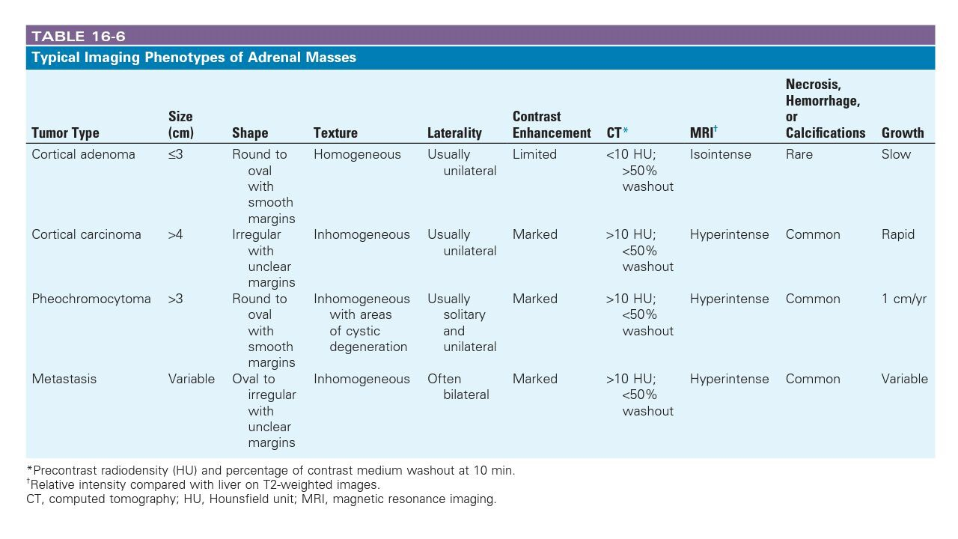

Slide 19
Biochemical diagnosis, localization and management of pheochromocytoma: focus on multiple endocrine neoplasia type 2 in relation to other hereditary syndromes and sporadic forms of the tumour Journal of Internal Medicine 2005;
These particularities of pheochromocytomas in MEN 2 patients entail the expression of an adrenergic phenotype, which is characterized more by paroxysmal than sustained hypertension.
Amongst patients with pheochromocytoma, those with MEN 2A have more subtle symptoms compared to those with sporadic disease or with MEN 2B
The sensitivity of measurements of plasma metanephrines for the detection of pheochromocytoma in patients with MEN 2 is very high (100%) and better than that of any other biochemical test .
In patients with exclusively normetanephrine producing pheochromocytomas, MEN 2 can be practically excluded

Slide 21
10/53 patients (19%) had at least one adrenal nodule that was 10 mm or greater in diameter .

Slide 22
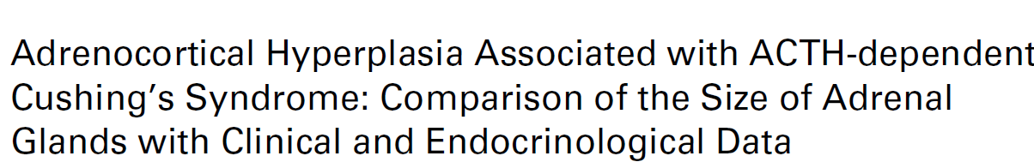
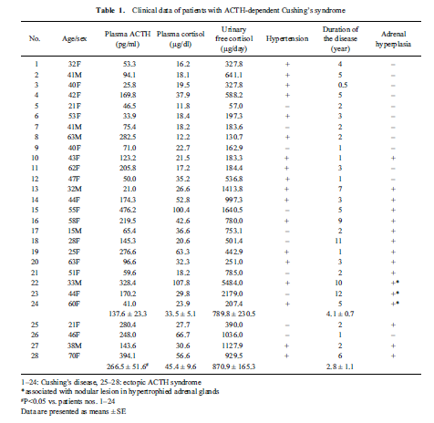

Slide 23
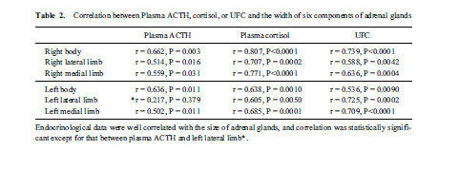
Of the 28 patients,16(57%)showed diffuse adrenal hyperplasia while only 3 patients had focal adrenal nodules in the hypertrophied adrenal

Slide 24
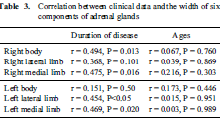
The reported macronodular adrenal hyperplasia was between 8-40% in different study and it was only1 out of 28 (3.6%).the tumor mass was stable and slightly decrease 6 years after pituitary surgery when it was in clinical and Para clinical remission.

Slide 25
If the adrenal mass is indeterminate on noncontrast CT and the results of the hormonal work-up do not indicate significant hormone excess, there are three options that should be considered by a multidisciplinary team acknowledging the patient’s clinical context:
immediate additional imaging with another modality
interval imaging in 6–12 months (noncontrast CT or MRI)
or surgery without further delay

Slide 26
FDG-PET/CT has the advantage that the risk of false negative results is quite low, and this refers mainly to a few subtypes of extra-adrenal malignancies with low uptake (lymphoma ,renal carcinoma)
This procedure is, however, more expensive, not always easily available, and has the disadvantage that several benign adrenal tumors (e.g. functional adenomas or benign pheochromocytoma) may be FDG-positive
While with [123I]-MIBG it has 83–100% sensitivity and95–100% specificity for pheochromocytoma but has false positive results for carcinoma and metasteses
Alternatively, in patients without a strong suspicion of malignancy and older patients, follow-up imaging 6–12 months after the initial scan could be undertaken. The rationale for a follow-up scan at 6–12 months is based on the principle that either primary adrenal malignancies or adrenal metastases are likely to increase in size over this time period; lack of growth may be taken as an indicator of benign disease in radiologically indeterminate lesions.
the expert panel agreed that an increase in >20% of the largest tumor diameter together with an at least 5 mm increase in this diameter should be considered as suspicious.

Slide 27
Ultrasound examination of the neck should be performed in all patients with MTC.
Contrast-enhancedCTof the neck and chest, three-phase contrast-enhanced multi-detector liver CT, or contrast-enhanced MRI of the liver, and axial MRI and bone scintigraphy are recommended in patients with extensive neck disease and signs or symptoms of regional or distant metastases, and in all patients with a serum Ctn level greater than 500 pg/mL. Grade C Recommendation

Slide 28
If the postoperative serum Ctn level exceeds 150 pg/Ml patients should be evaluated by imaging procedures, including:
neck US,
chest CT,
contrast-enhanced MRI or three-phase contrast-enhanced CT of the liver, and
bone scintigraphy and
MRI of the pelvis and axial skeleton.

Slide 29
Preoperative alpha blockade for normotensive pheochromocytoma: is it necessary? Journal of Hypertension 2011
Methods From January 2003 to July 2011, patients with adrenal incidentaloma, 430 cases of adrenal incidentalomas that were defined as lesions discovered serendipitously on a radiological examination Of the patients, 66 cases with elevated plasma catecholamine level (any of norepinephrine, epinephrine, and dopamine)or 24-h urinary metanephrine excretion as well as normal blood pressure which was highly suspected as normotensive pheochromocytoma, were divided into two groups. Group 1 recieved a1-blockade doxazosin before adrenalectomy. Group 2 received no a-adrenoceptor, preoperatively.

Slide 31
Anesthetic Management of Clinically Silent Familial Pheochromocytoma with MEN 2A: A Report of Four Cases Indian J Surg October 2016
A family of 19 members, of which 12 were positive for MEN 2A syndrome, presented to our hospital. Seven of the 12 patients had pheochromocytoma and medullary thyroid carcinoma (MTC), while the other 5 had only raised plasma calcitonin levels. Two of the 7 patients presented with bilateral pheochromocytoma and underwent an open adrenalectomy. The other 5 patients had a left-sided adrenal tumor and underwent left laparoscopic adrenalectomy under combined general and epidural anesthesia. We present our experience with four of these five cases

Slide 34
Although there is paucity of literature regarding preoperative optimization of biochemically silent pheochromocytomas,
we recommend that all such patients be optimized preoperatively with adrenergic blockers and intraoperative precautions taken, including hemodynamic monitoring, to ensure a stable perioperative course. This is especially important in patients where screening for plasma and urinary metanephrines is either not available or not feasible

