Slide 1
ICC Shahroud
Shahrivar 1395
Reza Malekzadeh M.D

Slide 2
Life expectancy at birth in Iran in 2013 (1394)
In 2013 (1394), life expectancy at birth in Iran was 76.3 years for males and 80.7 years for females.

Slide 3
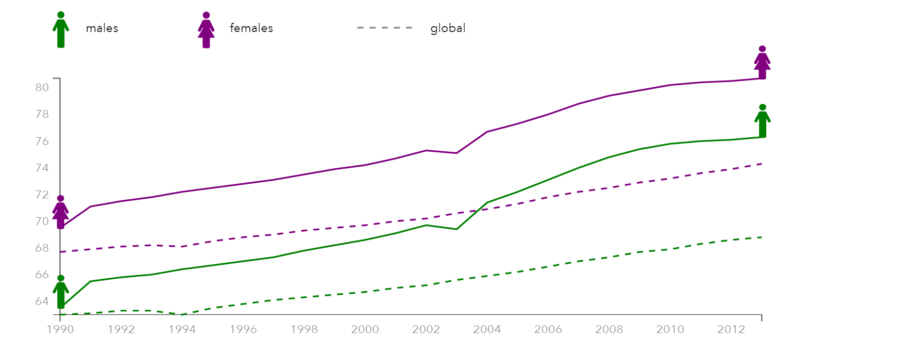
Trend of life expectancy at birth in Iran in 1990-2013

Slide 4
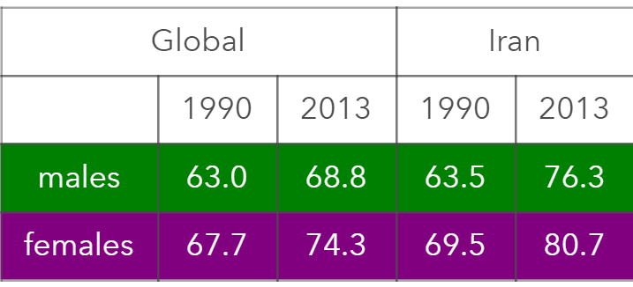

LIFE EXPECTANCY GLOBALLY AND IN IRAN, 1990-2013

Slide 5
Premature Death
An important indicator of health status
Substantial reductions are achievable everywhere
Appropriate national and regional risk-reduction priorities follow
Targeting premature death could establish a political precedent whose effects will continue after 2030.

Slide 6
Number of papers and citations in selected countries/regions in 2015, reported by SCOPUS
Country | No. of Papers | No. of Citations | Citation per paper
Iran | 40088 | 17080 | 0.4
Turkey | 38226 | 12178 | 0.3
Israel | 17883 | 12004 | 0.7
Saudi Arabia | 17424 | 12582 | 0.7
Middle East | 127731 | 56838 | 0.4
The World | 2436341 | 1060734 | 0.4

Slide 7
Number of scientists with h-index≥ 15, reported by SCIVAL
Country | No. of Population (in Million) | No. of Researchers with h-index ≥15 | Rate (in Million)
Egypt | 84 | 54 | 0.64
Iran | 78 | 620 | 6.92
Pakistan | 186 | 73 | 0.39
Israel | 7.7 | 97 | 12.60
Saudi Arabia | 27 | 82 | 3.04
Turkey | 75 | 90 | 1.2

Slide 8
Iran Quantity of Publication in Scopus
In 2015, Iran has published more than 40,500 papers in Scopus
By publishing this number of papers, Iran ranked as the 1st in the Middles East
& also 16th in the World.

Slide 9
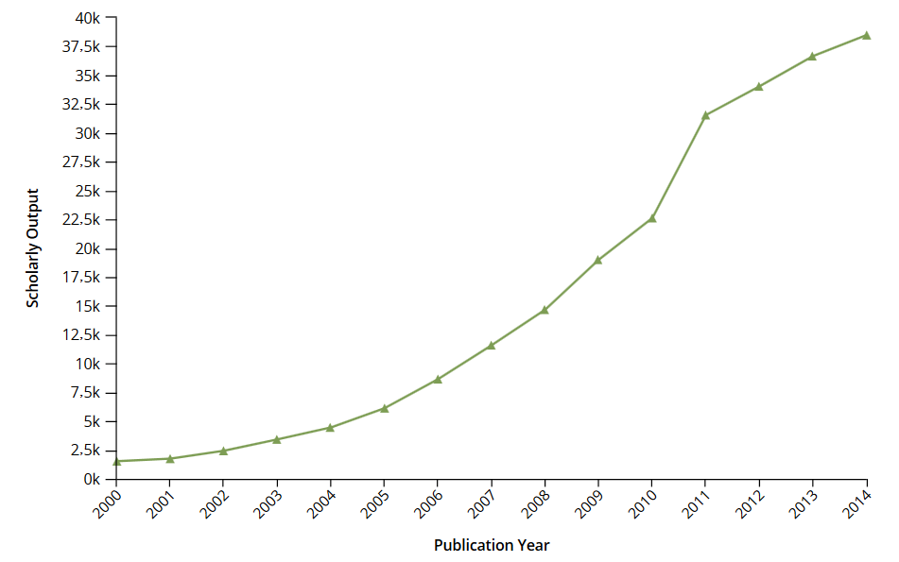
Iran Number of Publication in Scopus

Slide 10
Iran Quality of Publications in Scopus
In 2014, Iran has achieved more than 103,480 citations in Scopus
By achieving this number of citations, Iran ranked as the 1st in the Middles East
Turkey with 74,850 citations is the 2nd & Israel is the 3rd.

Slide 11
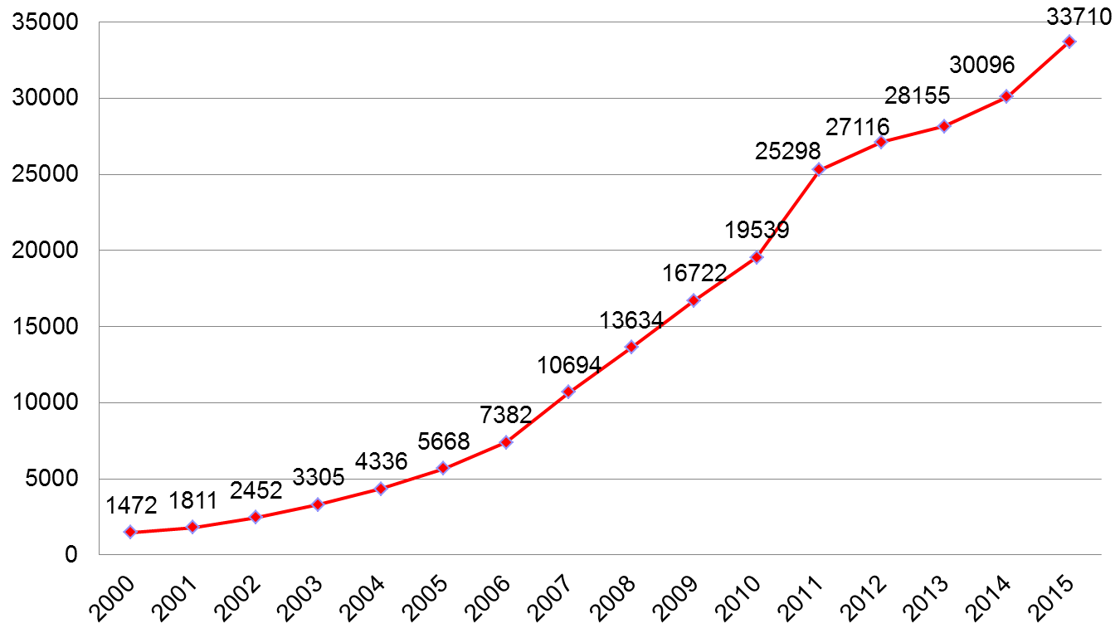
Iran Number of
All Publications in ISI

Slide 12
Iran Number of Biomedical Publications in ISI

Slide 13
Research Obstacles & Barriers
This ranks has been achieved while the country was on the sanction of reaching to international currencies, laboratory research tools & materials, budget restriction & loss, electronic journal & papers, & denial of international collaborations.

Slide 14
Ministry Research Promotion Plan & Action
Changing the Research Evaluation Protocol & Indices to comply with International Ranking Systems & to improve the qualitative research.
Promoting papers publishing in reputable highly ranked journals.

Slide 15
Ministry Research Promotion Plan & Action
Encouraging International Collaboration in Research projects.
Establishing the Clinician Scientists program to save the human resources & avoid brain drains.

Slide 16
Ministry Research Promotion Plan & Action
Supporting the Post-Docs courses.
Setting up special support & grants for young productive faculty members.
Providing Research Infra-structure in universities by establishing 10 Big Research Laboratory

Slide 17
Ministry Research Promotion Plan & Action
Establishing NIMAD as a research granting body.
Setting up 10 Big National Cohort study.
Preparing disease registry programs.

Slide 18

National Institute for Medical Research Development (NIMAD)
IR of Iran Governmental Grant Awarding Research institute

Slide 19
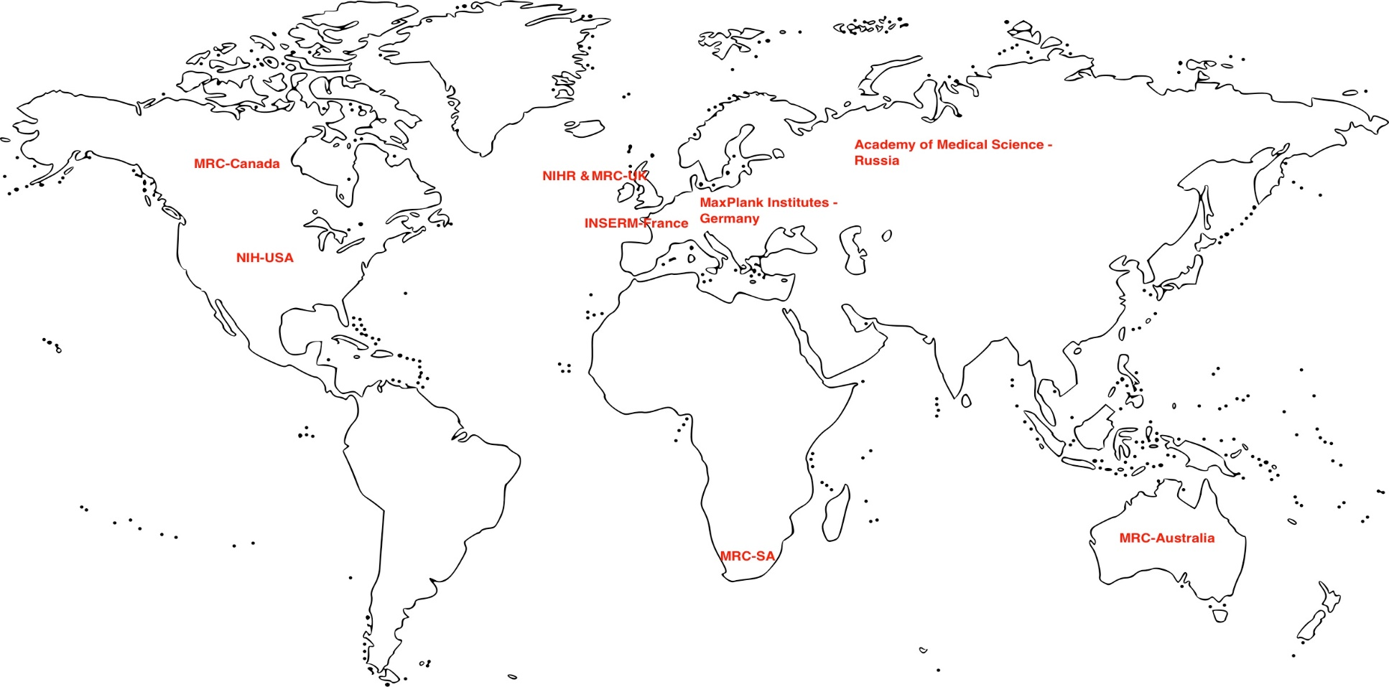
Governmental Grant Awarding Bodies

Slide 20


Slide 21
Clinician Scientist program
www.hbi.ir/rcd

Slide 22
Research Career Development
for Clinical and Non-clinical Medical Scientists
Entry
MDPhD training
آموزش دکترا
MD training
آموزش دکترای حرفه‌ای پزشکی
PhD training
آموزش دکترا
3-4y
MD + 3y
intermediate
نخبگان
نخبگان
Postdoc پسادکترا
1-3y
Clinician-scientist
پزشک پژوهشگر
Non-clinical scientist
پژوهشگر
3-5y
3y +
clinical training
Senior
Senior Non-clinical Scientist
پژهشگر ارشد
5y
5y
Senior Clinician-scientist
پزشک پژوهشگر ارشد
Clinical Path
Non-clinical Path

Slide 23
Adoption of large-scale collaborative research
With a strong replication culture has been successful in several biomedical fields: in particular, in genetic and molecular epidemiology.
These techniques have helped transform genetic epidemiology from a spurious field to a highly credible one .
Recently applied to other observational research like GBD 2010

Slide 24
Registration
Registration of randomized trials and their results has enhanced transparency in clinical trials research and has allowed probing of selective reporting biases even if not fully remedying them.
It may show redundancy and allow better visualizing of the evolution of the total corpus of research in a given field.
Registration is currently proposed for many other types of research, including both human observational studies and nonhuman studies

Slide 25
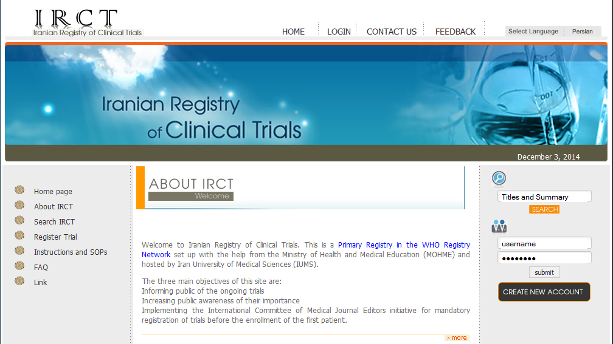
4th of December 2008 (IRCT became a primary register)
7th of April 2009 (IRCT became a data provider to ICTRP
IRCT was the 9th registry to join the WHO network and the only registry in EMRO
Over 10,000 trials has now been registered in IRCT

Slide 26

Accreditation of Research Ethics Committee in Medical Universities
ا

Slide 27
دستاوردهای نظام سلامت
دکتر رضا ملک زاده
خرداد ۱۳۹۵

Slide 28
معیارهای اندازه گیری سلامت
شیوع
بروز
ناتوانی
مرگ: مهمترین شاخص اندازه گیری سلامت در سطح ملی و فروملی است

Slide 29
Premature Death :Death at age <70
Death at age <60
Death at age <55
Death at age<50

Slide 30
Premature Death
An important indicator of health status
Substantial reductions are achievable everywhere
Appropriate national and regional risk-reduction priorities follow
Targeting premature death could establish a political precedent whose effects will continue after 2030.

Slide 31
اهداف توسعه پایدار (۲۰۱۶ تا ۲۰۳۰)
کاهش مرگ مادری به کمتر از ۷۰ مرگ به ازای هر تولد زنده
ریشه کنی مرگ های قابل پیشگیری در میان نوزادان و کودکان زیر ۵ سال
اتمام اپیدمی HIV، سل، مالاریا، NTD، و سایر عفونت ها
کاهش یک سوم از مرگ های زودرس ناشی از بیماری های مزمن
کاهش مرگ و ناتوانی ناشی از حوادث جاده ای به نصف
تقویت پیشگیری و درمان سوء مصرف مواد مخدر
دسترسی همگانی به خدمات سلامت بارداری

Slide 32
اهداف توسعه پایدار (۲۰۱۶ تا ۲۰۳۰)
کاهش قابل ملاحظه در مرگ و ناتوانی ناشی از آلودگی آب، هوا، و خاک
تقویت پیشگیری از مصرف سیگار و ظرفیت سازی برای مقابله با عوامل خطر سلامت
حمایت از پژوهش و توسعه در حیطه سلامت
حمایت مالی از کارکنان در حیطه سلامت
دسترسی به پوشش همگانی سلامت

Slide 33
در ایران
ایران تقریبا به تمامی اهداف توسعه پایدار دست یافته است از جمله:
کاهش بیش از یک سوم از مرگ های زودرس ناشی از بیماری های مزمن

Slide 34
در ایران
امید به زندگی در ایران از 1369 تا 1392:
در مردان از 63 سال به 76 سال
در زنان از 69 سال به 80 سال
تعداد مرگ در ایران از ۳۷۰ هزار در سال ۱۳۶۹ به ۲۹۲ هزار در ۱۳۹2 کاهش پیدا کرده است
درصد مرگ های زودرس از 81% به 50% کاهش پیدا کرده است

Slide 35
تعداد مرگ های زودرس در ایران
از 1369 تا 1392:
از 300 هزار به 145 هزار کاهش پیدا کرده است
در بیماری های عفونی از 93 هزار به 21 هزار (77% کاهش)
در بیماری های مزمن غیرواگیر: از 128 هزار به 98 هزار (23% کاهش)
در حوادث: از 78 هزار به 26 هزار (67% کاهش)

Slide 36
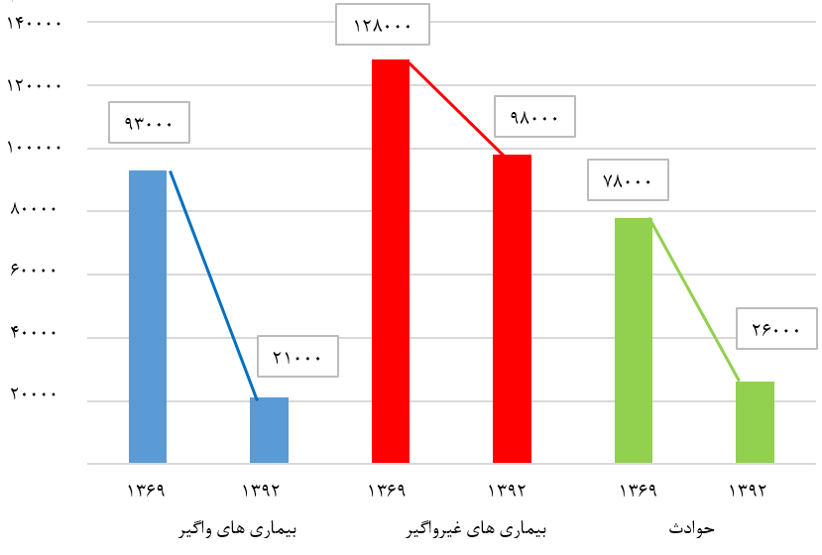
تعداد مرگ های زودرس در ایران

Slide 37
مرگ زودرس در بیماری های مزمن غیرواگیر در 1392
کل مرگ های زودرس غیرواگیر زیر 55 سال در سال 1392: 47 هزار
بیماری ایسکمیک قلبی: 11 هزار
سکته مغزی: 3800
سایر بیماری های عروقی: 4100
سرطان: 10400
بیماری مزمن ریوی: 2400
بیماری مزمن کلیوی: 950
بیماری مزمن کبدی: 870
سایر علل: 13 هزار

Slide 38
ضرورت عمل
با توجه به بار بالای ناشی از مرگ زودرس در جمعیت جوان و بهره ور در کشور، اتخاذ سیاستهای لازم برای پیشگیری از مرگ زودرس در ایران ضرورت دارد.

Slide 39
4 عامل خطر رفتاری
مصرف دخانیات
مصرف الکل
تغذیه نا سالم
تحرک بدنی ناکافی

Slide 40
4 عامل خطر بیولوژیکی
کلسترول
اختلال قند خون
فشار خون بالا
چاقی

Slide 46
اصلاح وضعیت تغذیه ای مردم:
کاهش استاندارد نمک مصرفی:
  نان از 2/3% به 1%
    متوسط مصرف سرانه نان در کشورمان در روز 310 گرم است،تا حال میزان متوسط دریافت نمک از این مقدار نان 5/58 تا 7 گرم است
  اسنک از 2/5% به 1/5%
  رب گوجه از 3% به 2%
  سس خردل از 5% به 3%
  کنسرو ماهی تن از 2% به 1/5%
  پنیر از 4% به 3%
کاهش استاندارد محتوی شکرنوشابه های غیر الکلی: تا حد 10 درصد
پیگیری اجرای ماده 37 بند الف و ج در خصوص مالیات و منع تبلیغات فراورده ها و رفتارهای آسیب رسان از برنامه پنجم توسعه جمهوری اسلامی ایران
(افزایش مالیات بر ارزش افزوده در کالاهای آسیب رسان در دستور کار دولت )
به‌كارگيري كارشناسان تغذيه در طرح تحول نظام سلامت، به منظور اجراي مراقبت‌هاي تغذيه‌اي در بيماري‌هاي غيرواگير
همكاري در اجراي پايلوت طرح ايراپن در چهار شهرستان و گسترش آن بر اساس پروتکل ایراپن

Slide 47
توسعه فعاليت بدنی
کاهش کم تحرکی تا 20درصد
تدوین سند ملی فعالیت بدنی و تصویب آن در شورای عالی سلامت
شناسائی و ارجاع افراد كم تحرك توسط مراقب سلامت بر اساس پروتكل ایراپن
تمهیدات لازم برای جلب مشارکت وزارت ورزش و جوانان

Slide 48
Cohort study
Maximizing the Value of Iranian Population
Cohorts:

Slide 49
UK Medical Research Council (MRC)
The MRC has a 50-year history of supporting population cohort studies, including :
1946 Birth Cohort,2 the world’s longest continuously running birth cohort,
UK Biobank,3 which tracks half a million participants.
Million Women Study: the largest longitudinal study of women’s health

Slide 50
Public Support for Research
It is noteworthy that 2·2 million people in the UK are currently taking part in these large population cohort studies—one in 30 of the general population
Population cohort studies are a major long-term commitment for participants, study teams, and funders,

Slide 51
UK population cohort portfolio
Has wide coverage: from before conception to old age, both sexes, and all major ethnic groups.
Multi-generations cohort such as Avon Longitudinal Study of Parents and Children (ALSPAC), include data from several generations that enable investigators to study familial clustering of risk and disease and the underlying mechanisms.

Slide 52
34 largest UK population cohort studies.
Almost £30 million is spent per year on the 34 largest UK population cohort studies,.
50% of these cohort have been followed for more than 20 years.
92% of cohort participants are aged 45 years or older
62% are female

Slide 53
Why should we spent on Cohort?
What are the strength of Cohort study?
Ability to identify multiple risk factors over time.
Assessment of exposures that cannot be randomized (smoking, alcohol ,opium…)
Collection of serial measurements and samples that enables measurement of changes in exposure and their effect on health outcomes over time.
Identifying the effect of one risk factor on multiple outcomes.
Cohorts are generally more inclusive than randomised trials which are usually highly selective.
Findings from cohort studies can, therefore, be more generalisable to the population as a whole.

Slide 54
Another important strength is :
Cross-cohort collaborations
Are an effective way to increase statistical power.
The Healthy Ageing Across the Life Course (HALCyon) collaboration merged data from nine cohorts to undertake studies of ageing that would not have been feasible using any single cohort.
Cohort and Longitudinal Studies Enhancement Resources (CLOSER) initiative, funded by the MRC and Economic and Social Research Council, brings together nine cohorts with the aim of combining variables across these studies.

Slide 55
Generalizability of Finding
Further laboratory and genetic study
Some cohorts might not be representative of the general population in terms of demographics and lifestyle, but the results may nonetheless be generalizable.
Broad and enduring consent could be obtained from the participants of all cohorts to obtain additional information through linkage to routine data and further laboratory and genetic study

Slide 56
Research use of personal data
Trustworthy research use of personal data using robust governance processes in secure environments with safeguards that protect
confidentiality is fundamental to understanding the causes of disease and improving public health.

Slide 57
Cross-cohort comparisons
Cohorts be included in online directories and appropriate meta-data provided.
Also, cohorts should use standardized and validated approaches, where possible, to facilitate cross-cohort comparisons.
The findings from the cohorts are of great value in informing policy and practice in the UK, as well as further afield.

Slide 58
UK RCT participation rate
One in seven newly diagnosed cancer patients in UK would be participating in a clinical trial.
This figure rising to over 80% among childhood cancer patients.
The potential impact of these activities on the improvement of clinical care is tremendous.

Slide 59
Examples of Important Cohort Study Results
Long-term follow-up in the European Prospective Investigation of Cancer (EPIC) Norfolk study showed that exercise, a healthy diet, and not smoking increased life expectancy by 14 years.
The Million Women Study has measured the effects of hormone-replacement therapy on fracture incidence, cancers, and other conditions.

Slide 60
Convergence across scientific fields
Over time, scientific research has invited the use of larger teams.
In recent years research teams have become increasingly internationalized.
There is convergence in the size distribution: team sizes that are the least international are becoming international at a faster rate.
There is convergence across scientific fields: the least international of fields are becoming more international at a faster rate.

Slide 62
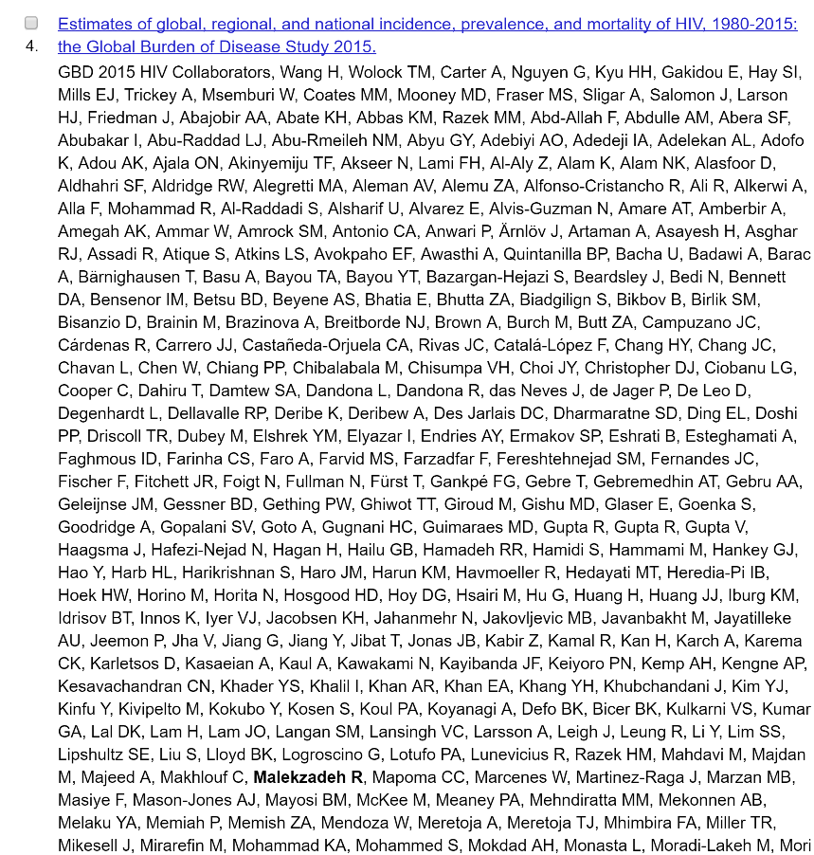

Slide 63
430 authors 5 from Iran

Slide 64
720 Authors per this paper,21 from Iran

Slide 65
Why is this happening?
Is it because of an increasing range of complementary skills and equipment needed to do the research, coupled with rising specialization?
Or is it due to a decline of the cost of research conducted at a distance?
Or to the rise of scientific research outside any single country?
Probably it is the last two explanations that are the most compelling, given the speed of the change that we observe.

Slide 66
Research on cancer
International
Cancer Genome Consortium

Slide 67
ICGC Goal
To obtain a comprehensive description of genomic, transcriptomic and epigenomic changes in 50 different tumor types and/or subtypes which are of clinical and societal importance across the globe.

Slide 68
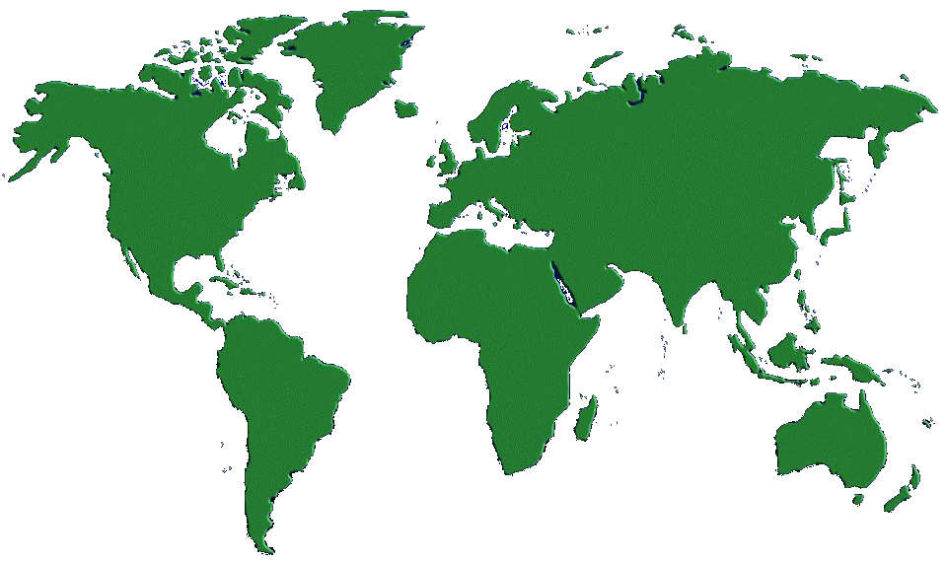





International Cancer Genomics
Strategy Meeting

Slide 69
International Cancer Genomics
Strategy Meeting
October 1–2, 2007 Toronto (Canada)
22 countries represented
120 participants
34 Genome or Cancer Center Directors
24 Representatives from funding agencies
62 Scientists selected to represent
ethics, technologies, statistics,
informatics, pathology, clinical
oncology and cancer biology

Slide 70
Rationale for an international consortium
The scope is huge, such that no country can do it all
Independent cancer genome initiatives could lead to relative duplication of effort for common and easy to acquire tumor samples, and incomplete studies for many forms of cancer
Lack of standardization, and different quality measures across studies could decrease the opportunities to merge datasets, increase power, and detect additional targets
The spectrum of many cancers is known to vary across the world for many tumor types, because of environmental, genetic and other causes
An international consortium will accelerate the dissemination of genomic and analytical methods across participating sites, and into the user community

Slide 71
Data Releases
ICGC Open Access Datasets | ICGC Controlled Access Datasets
Cancer Pathology Histologic type or subtype Histologic nuclear grade Patient/Person Gender Age range Gene Expression (normalized) DNA methylation Genotype frequencies Computed Copy Number and Loss of Heterozygosity Newly discovered somatic variants | Detailed Phenotype and Outcome Data Patient demography Risk factors Examination Surgery/Drugs/Radiation Sample/Slide Specific histological features Protocol Analyte/Aliquot Gene Expression (probe-level data) Raw genotype calls Gene-sample identifier links Genome sequence files

Slide 72
ICGC Database Model

Slide 73
Genome projects enable research into the complex nature of human disease
Human Genome Project
The HapMap Project
The Cancer Genome Atlas
ICGC Cancer Genome Projects
The most important contribution to science of these large-scale projects is the generation and transfer of resources, databases and technologies to the scientific community

Slide 74
ICGC will be an enduring legacy
A comprehensive catalog of somatic changes in the major cancers will be a powerful driver for cancer research and clinical practice for decades
Early clinical benefits will be stratification of tumors to allow better prediction of prognosis and response to therapy
Longer term benefits will be development of new and more effective targeted therapies

Slide 75
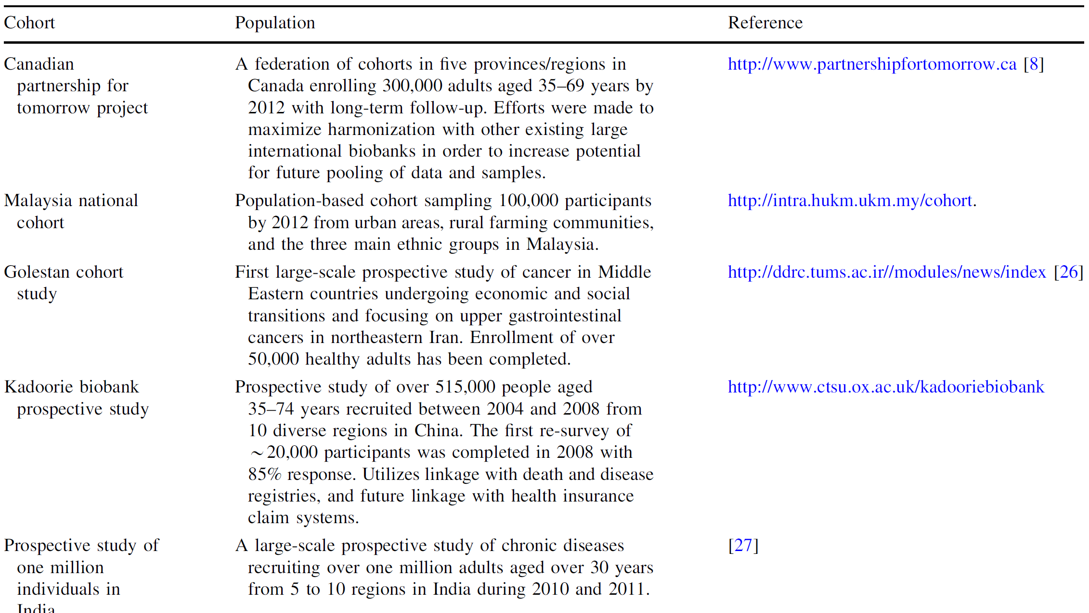
Description of selected newly established cohort studies

Slide 76
The NCI C C includes investigators responsible for more than 50 high-quality cohorts involving more than 7 million people
The cohorts are international in scope and cover large, rich, and diverse populations.
Extensive risk factor data are available on each cohort, and biospecimens including germline DNA collected at baseline, are available on approximately 2 million individuals.
Investigators team up to use common protocols and methods, and to conduct coordinated parallel and pooled analyses.

Slide 77
Policies Regarding Quality Standards of Samples
A committee of clinical and pathology experts (with representation from different institutions) will be needed to draft and oversee the specific guidelines that will apply for every tumor type or sub-type.
Tumor types should be defined using the existing international standards of the WHO (including ICD-10 and ICD-O). If novel molecular subtypes are studied, these should be defined with sufficient detail.
All samples will have to be reviewed by two or more reference pathologists.
Patient-matched control samples, representative for the germline genome, are mandatory to discern “somatic” from “inherited” mutations.

Slide 78
Policy Regarding Study Design and Statistical Issues
Every cancer genome project should state a clear rationale for its choice of sample size, in terms of the desired sensitivity to detect mutations. The target number of 500 samples per tumor type/subtype is set as a minimum, pending further information to be provided by ICGC members proposing to tackle specific cancer types/subtypes.

Slide 79

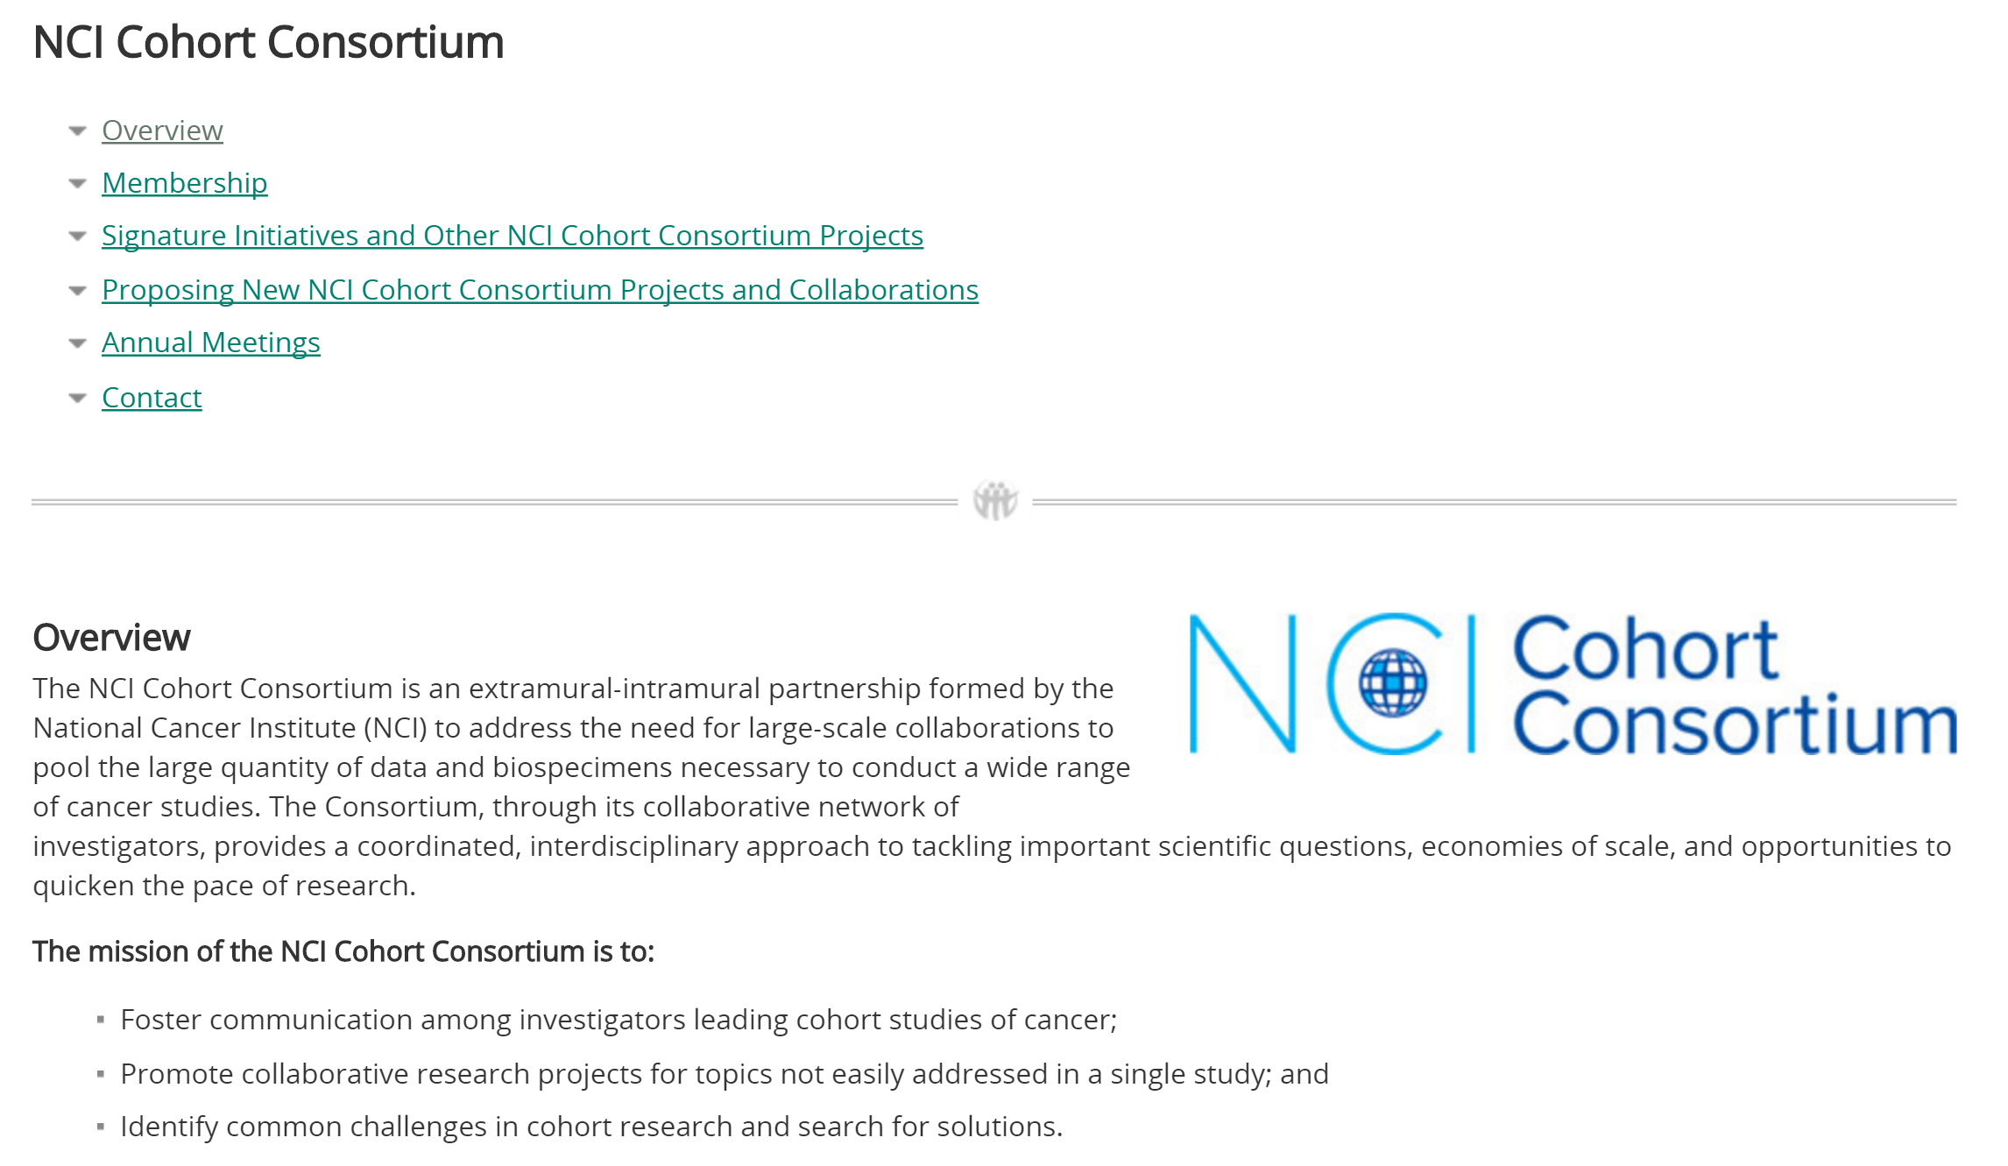
NCI Cohort Consortium

Slide 80
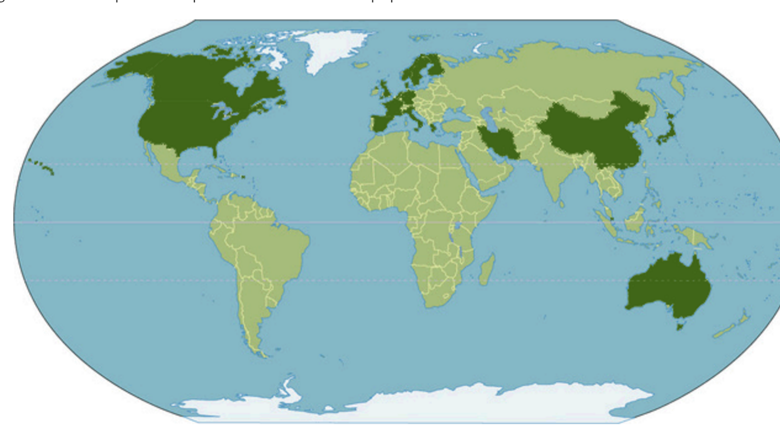
Current Members of NCI Cohort Consortium

Slide 81
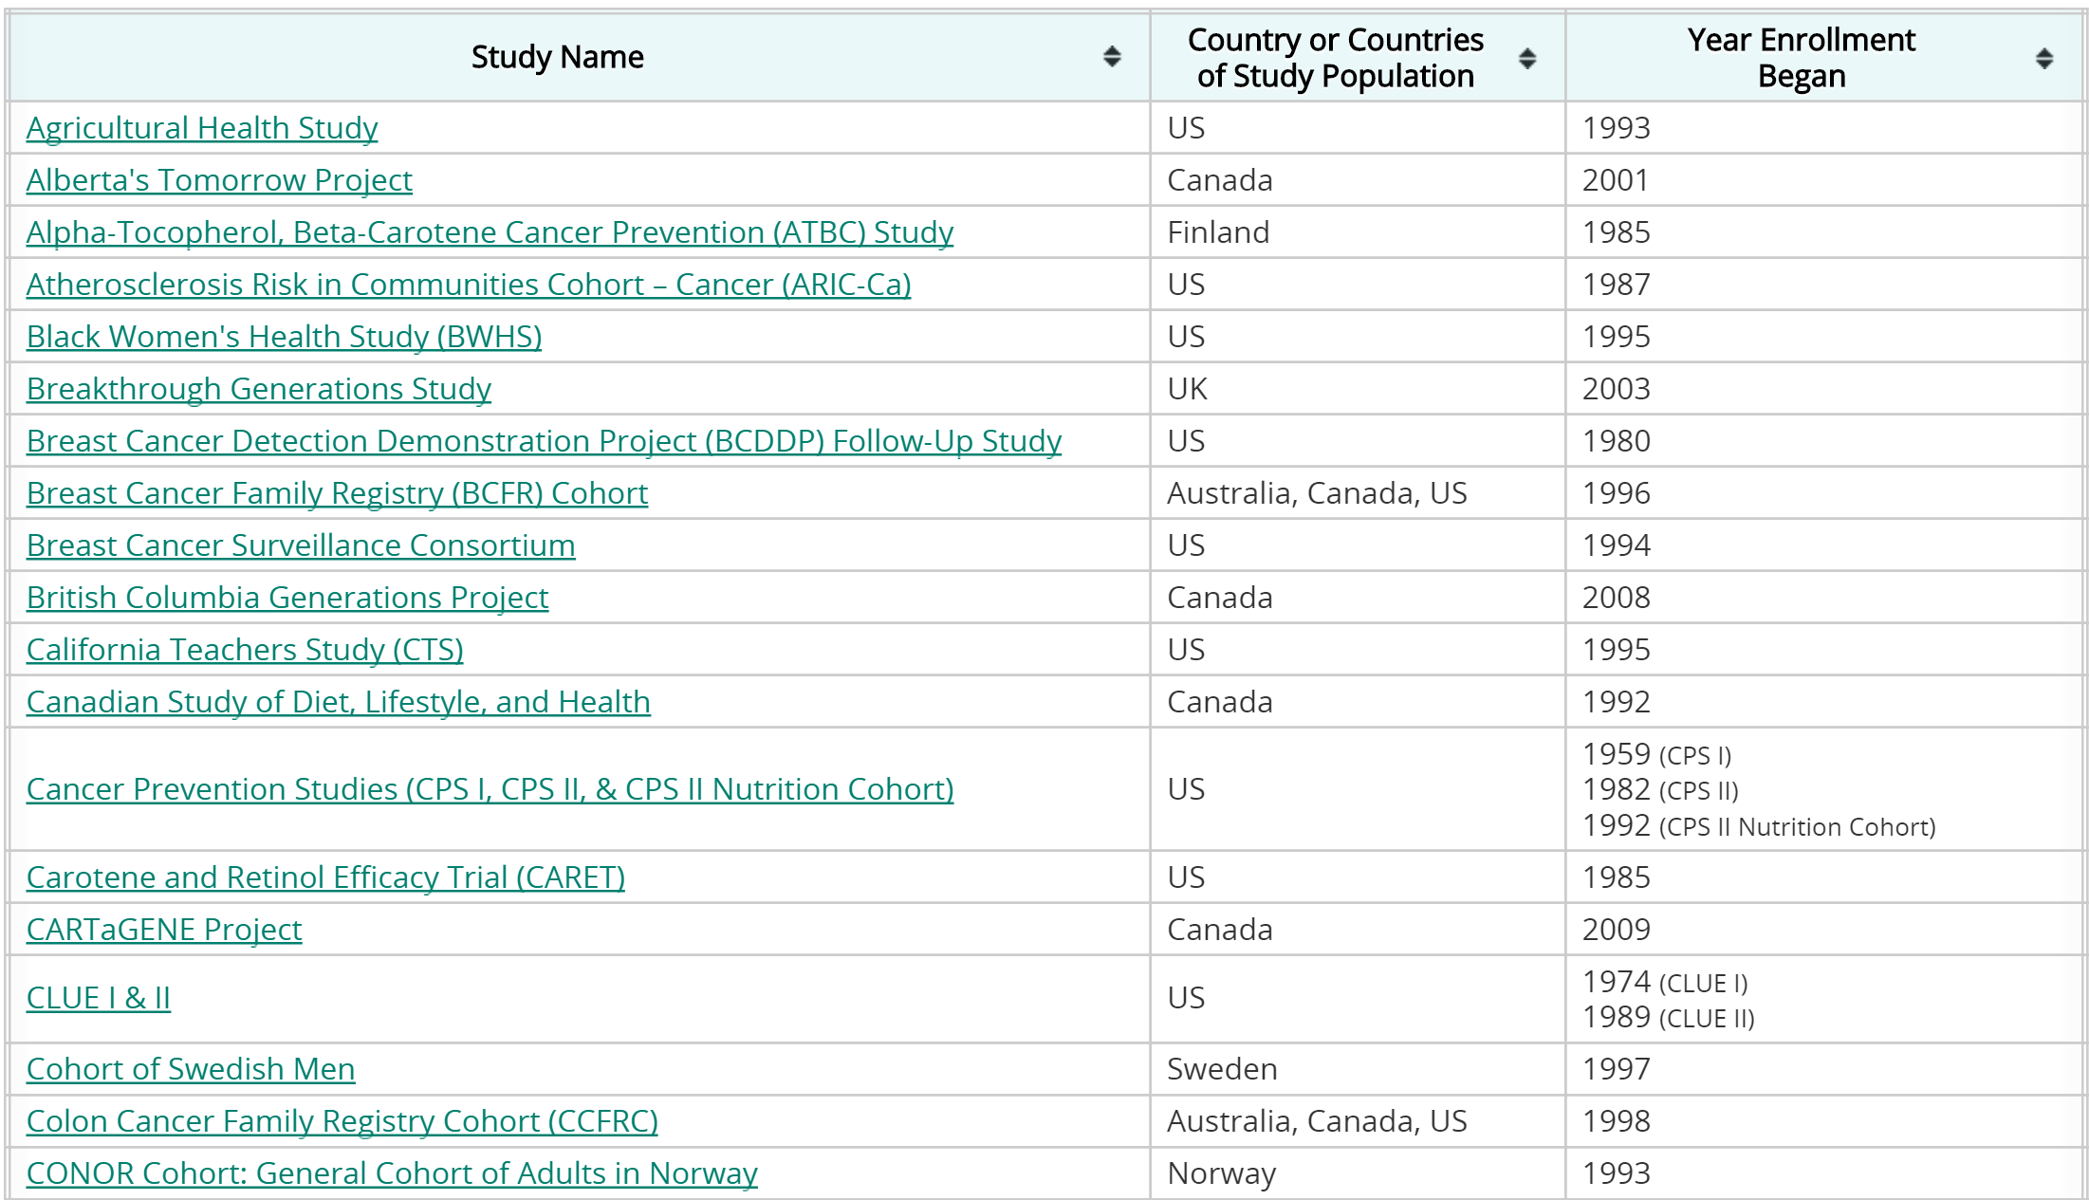
Current Members of NCI Cohort Consortium

Slide 82
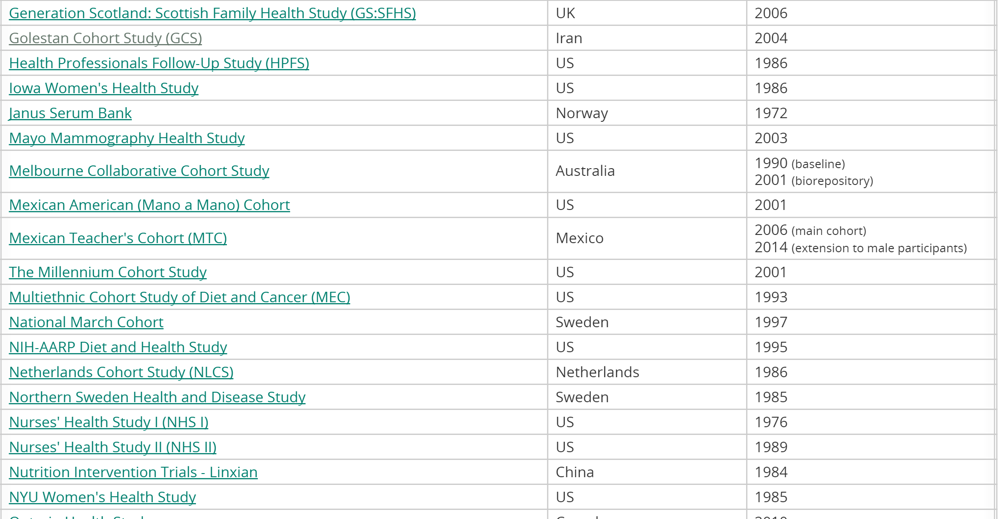
Current Members of NCI Cohort Consortium cont..

Slide 83
Golestan Cohort Study
Lead Contacts and/or Principal Investigators (PIs):
Reza Malekzadeh, M.D:Digestive Disease Research Center (DDRC), Tehran University of Medical Sciences
Paolo Boffetta, M.D.: Mount Sinai School of Medicine and ,International Prevention Research Institute (IPRI), Lyon, France
Christian Abnet, Ph.D.:Division of Cancer Epidemiology and Genetics (DCEG), National Cancer Institute (NCI)
Paul Brennan, Ph.D.International Agency for Research on Cancer (IARC), Lyon, France Funded Since: 2004
Funding Source: Digestive Disease Research Center, Tehran University of Medical Sciences; NCI Intramural Program (DCEG); Cancer Research UK
Year(s) of Enrollment: 2004-2008
Study Website: http://www.ddri.ir/en/modules/fmcontent/content.php?topic=gastro-intestinal-and-liver-cancers&id=249&page=golestan-cohort-study-of-esophageal-cancerExternal Web Site Policy

Slide 84
Golestan Cohort Study
The earliest reports of high incidence of esophageal cancer in the northern parts of Iran date back to the early 1970s. A population-based cancer registry established in 1969 confirmed the high incidence of the cancer in the eastern portion of the Caspian Sea littoral, in the area which is now known as Golestan Province. The highest incidence rates were reported from the semi-desert plain settled mainly by people of Turkmen ethnicity in Gonbad and Kalaleh counties. A series of studies was conducted in the region in the 1970s, but was not conclusive in explaining the very high rates.
Etiological hypotheses related to diet and lifestyle can be best addressed in prospective cohort studies, in which measurement error can be reduced and recall bias is minimal. From 2002 to 2003, a pilot study of 1,057 subjects was conducted by the Digestive Disease Research Center (DDRC), Tehran University of Medical Sciences, in collaboration with the Mount Sinai School of Medicine, National Cancer Institute (NCI), International Prevention Research Institute (IPRI), and International Agency for Research on Cancer (IARC), to evaluate the logistical aspects of establishing a prospective study in Golestan. Subsequently, the Golestan Cohort Study (GCS) was launched in January 2004. The study protocol and the informed consent used for this study were approved by the relevant ethical review committees. In June 2008, the accrual goal of 50,000 subjects was reached and enrollment was closed. Yearly follow-up is ongoing; a repeated exposure assessment is planned for ten percent of the cohort in 2010.
The primary aims of the GCS are to:
Identify risk factors for esophageal cancer by a comprehensive assessment of ethnicity; occupational history; socioeconomic status; past medical history; family history of cancers; gastrointestinal symptoms and signs; tobacco, opium and alcohol use; oral health; anthropometric characteristics; physical activity; and tea drinking habits, including tea temperature.
Establish biospecimen banks for blood, urine, hair, and nail samples to be used in molecular and genetic studies of cross-sectional or nested case-control design.
Investigate prospectively risk factors of cancers other than esophageal cancer and other chronic diseases prevalent in this population.
Provide a model for population-based studies in a country in economic and social transition based on collaboration between local health workers, local health authorities, national research centers, the national government, and international research institutions.

Slide 85
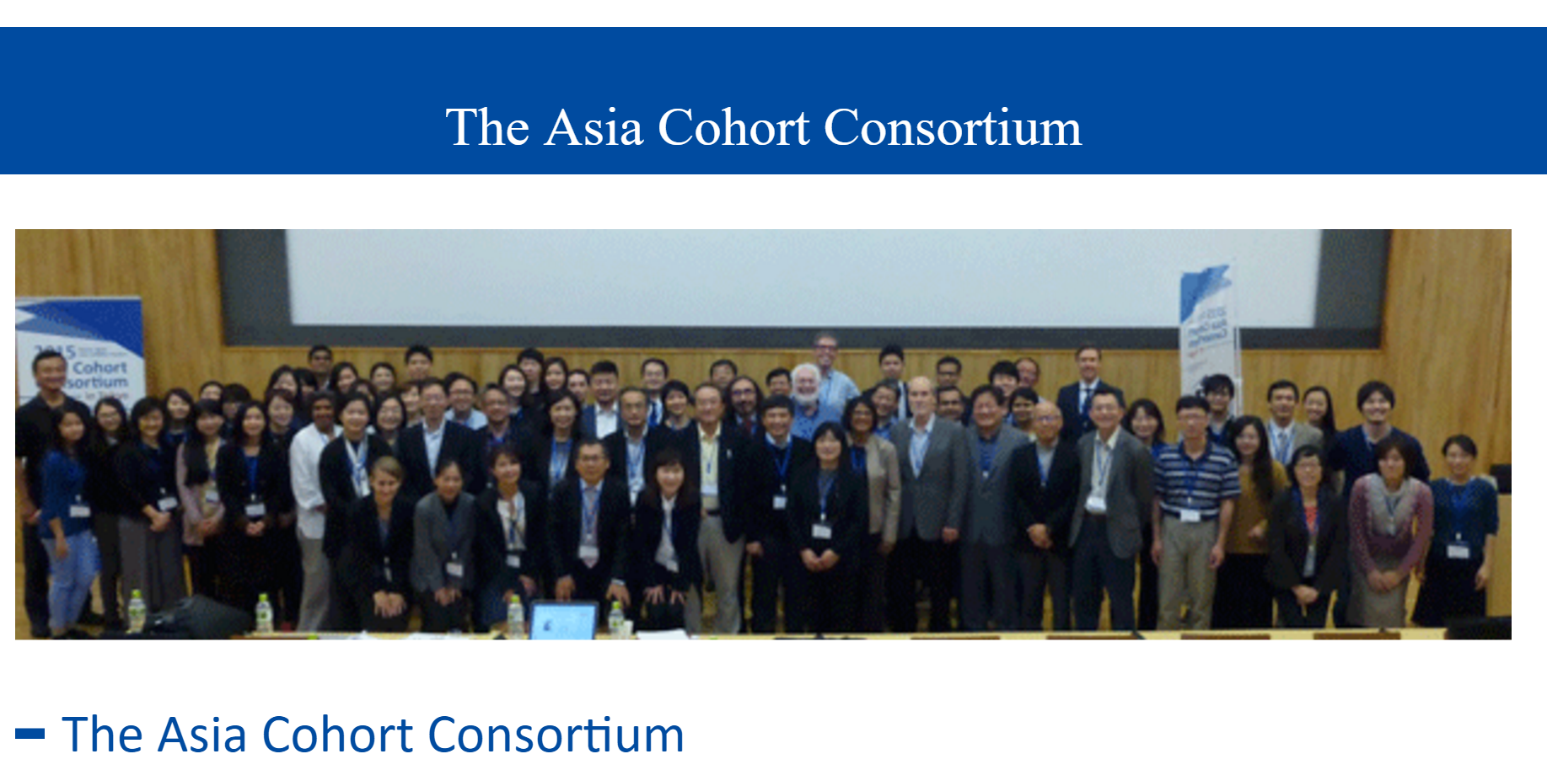

Slide 86
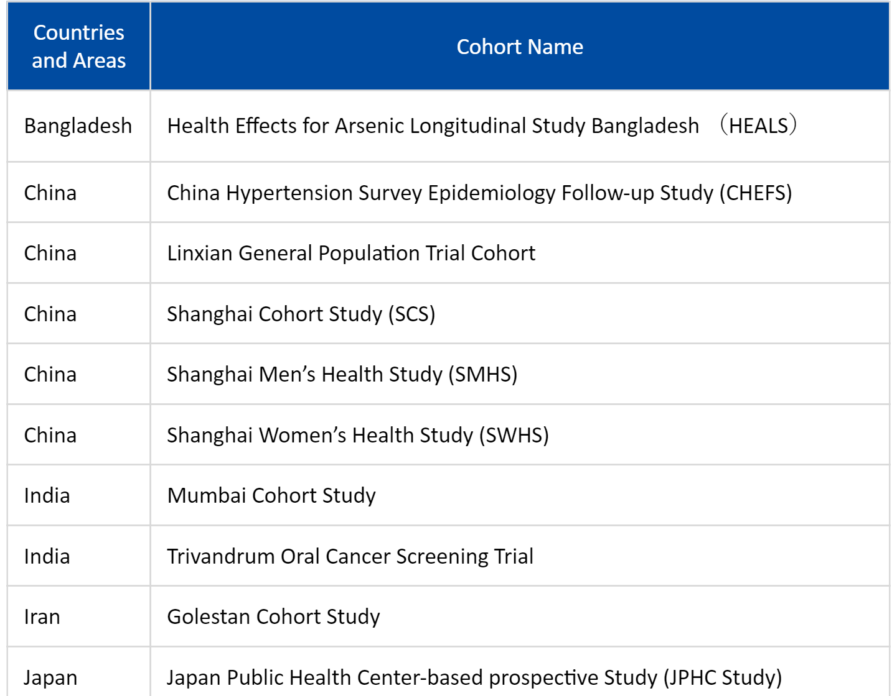
List of participating cohorts

Slide 87
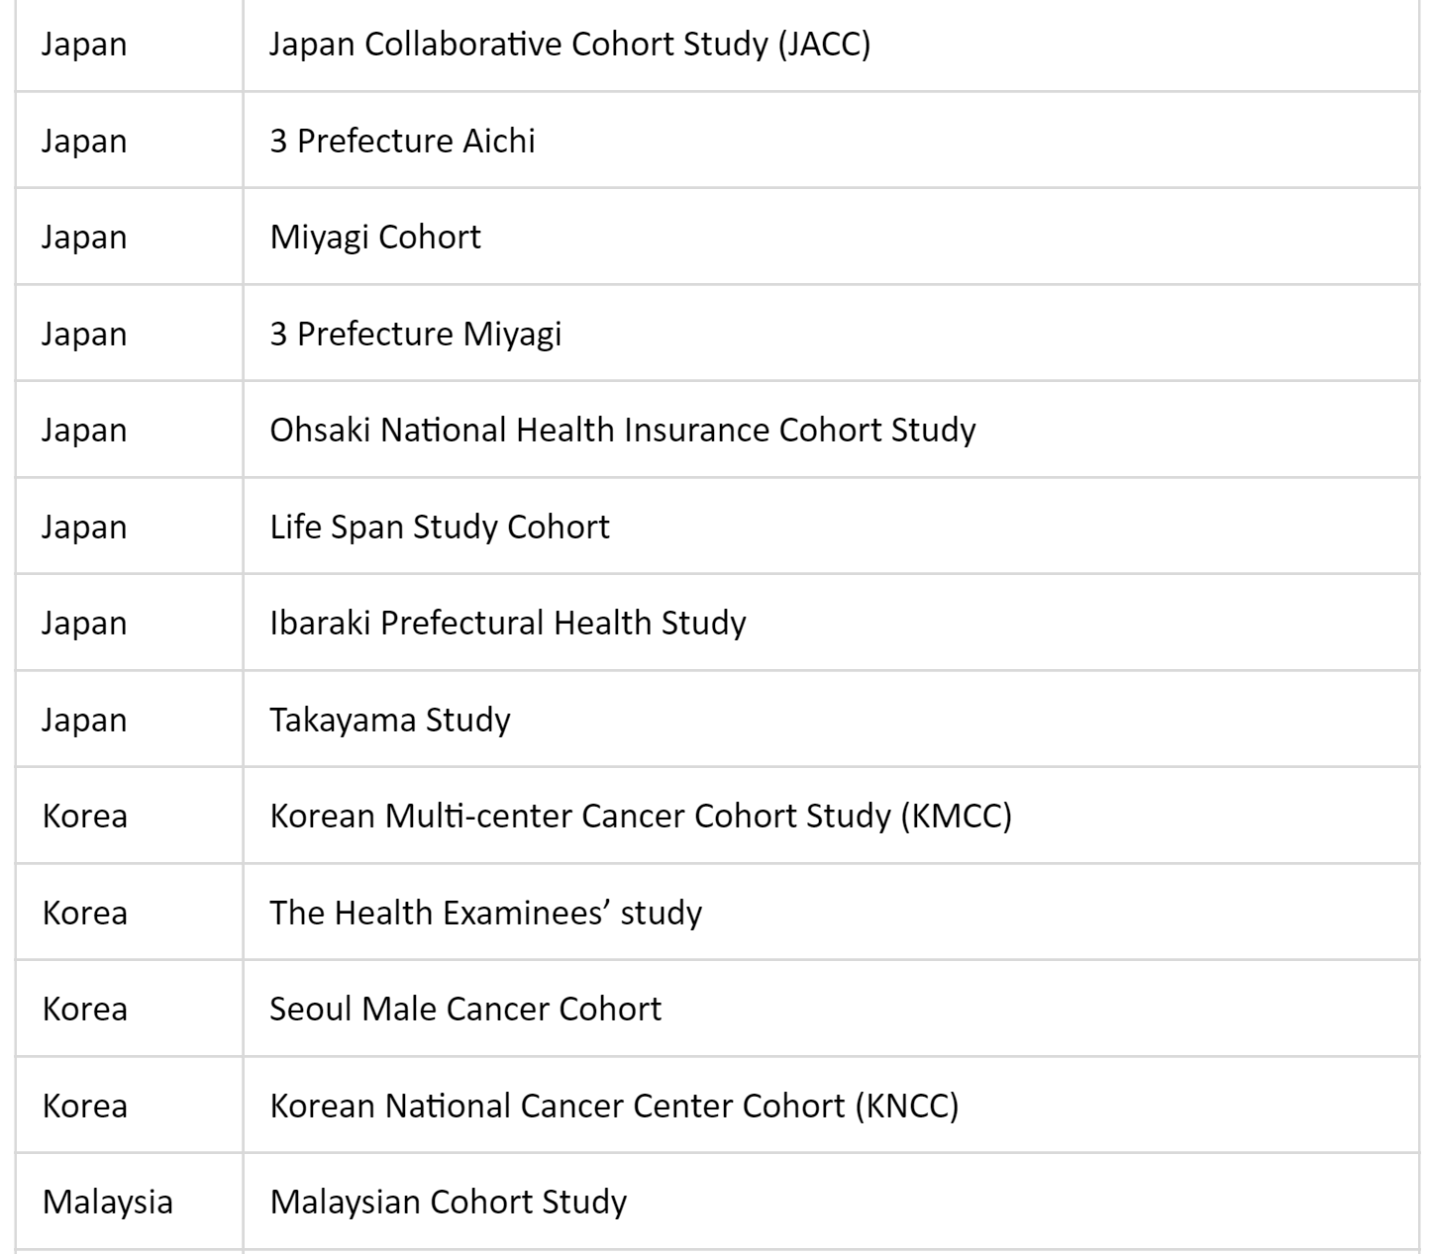
List of participating cohorts continued

Slide 88
The Asia Cohort Consortium
The Asia Cohort Consortium (ACC) is a collaborative effort seeking to understand the relationship between genetics, environmental exposures, and the etiology of disease through the establishment of a cohort of at least one million healthy people around the world.
These participants will be followed over time to various disease endpoints, including cancer.
The collaboration also involves seeking partners among existing cohorts across Asia to facilitate the exploration of specific research questions that need more immediate answers.

Slide 89
About The Asia Cohort Consortium
The Asia Cohort Consortium is led by co-chairs John Potter MD PhD, Member and Senior Advisor, Fred Hutchinson Cancer Research Center, USA and Daehee Kang MD PhD, Chair, Department of Preventive Medicine, Seoul National University College of Medicine, Korea.
The ACC Coordinating Center has been established at the Fred Hutchinson Cancer Research Center to provide support for scientific collaboration, coordination and communication, data operations, and statistical consultation.
Investigators from China, India, Japan, Korea, Malaysia, Singapore, Taiwan, Iran ,the United States, and other countries meet on a biannual basis to report on the progress of each country's cohort, to discuss issues relevant to the development of common protocol guidelines, and to prepare for collaborative projects.
Working groups, each consisting of representatives from the different member countries, have been established to examine specifically the issues of: diet; obesity and physical activity; occupation and environment; alcohol and tobacco; medical and reproductive history; family history; follow-up and endpoint ascertainment; biospecimens and sample collection; data collection and management; and previously established cohorts

Slide 90
PERSIAN Cohort
The Prospective Epidemiological Research Studies in IrAN
  Includes 150,000 individuals from 15 different centers in Iran
  Males and females 35-70 years of age

Slide 91
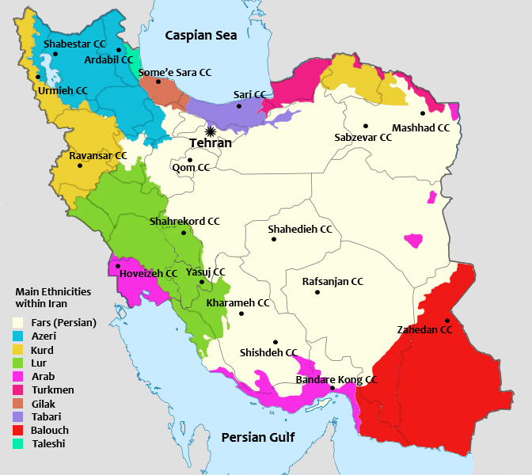
Ethnicities Included in the PERSIAN Cohort

Slide 92
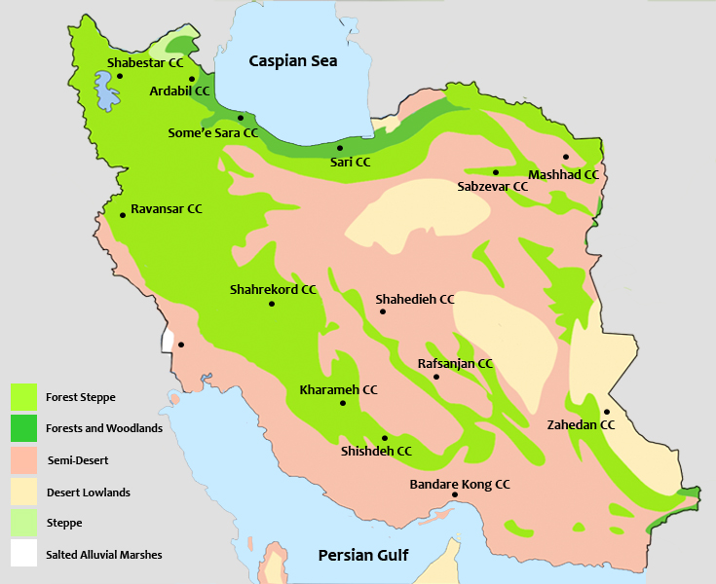
Geographical Areas Included in the PERSIAN Cohort

Slide 93
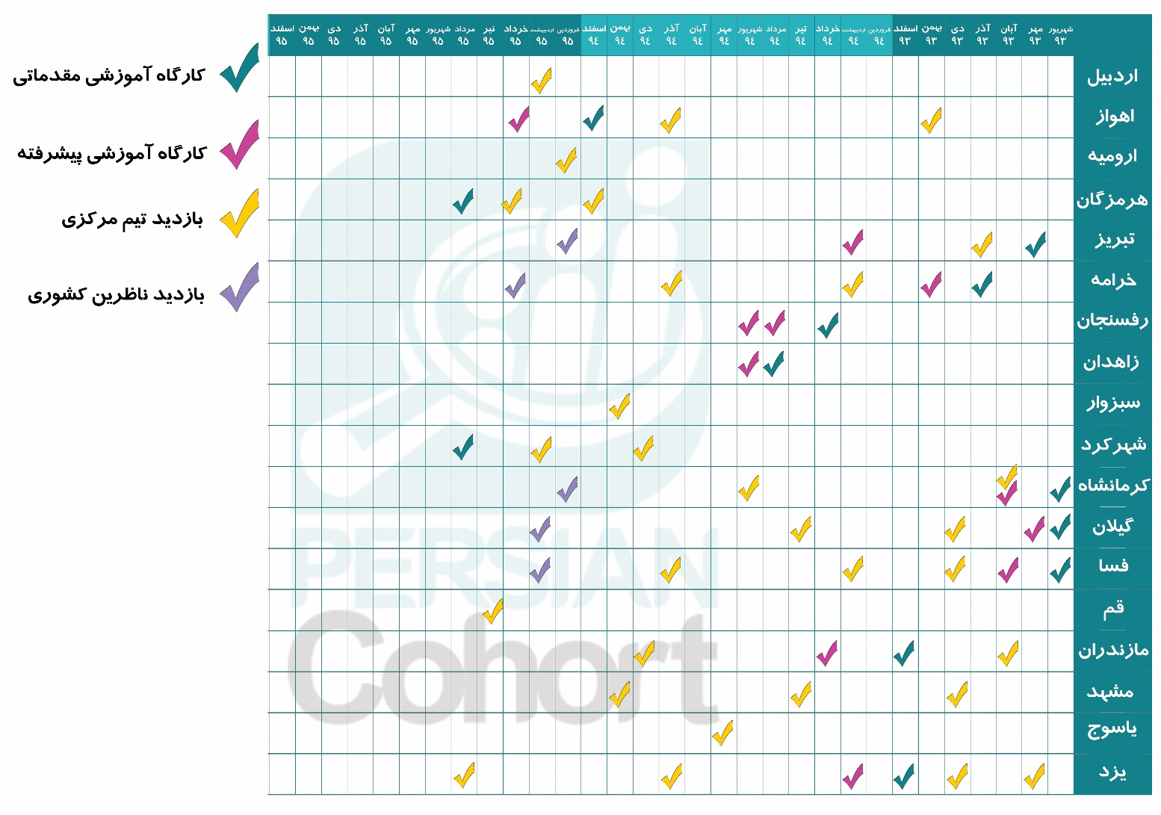
Launch of Cohorts and Site Visits
Over 50 trips made to the different cohort sites by the Central Committee

Slide 94
Cohort Site Status as of 95/6/1
Center | Enrolled | % Completed | # Remaining | Estimated Date to Finish Enrollment
Tabriz | 11,334 | 100% | Finished
Fasa | 10,000 | 100% | Finished
Guilan | 8,324 | 83.24% | 1,676 | Azar 95
Kermanshah | 7,847 | 78.47% | 2,153 | Dey 95
Kharameh | 7,459 | 74.59% | 2,541 | Bahman 95
Yazd | 5,328 | 53.28% | 4,672 | Mordad 96
Rafsanjan | 4,379 | 43.79% | 5,621 | Mehr 96
Mazandaran | 3,885 | 38.85% | 6,117 | Dey 96
Zahedan | 1,892 | 18.92% | 8,108 | Tir 97
Ahwaz | 542 | 5.42% | 9,458 | Aban 97
Total | 60,958 | -

Slide 95

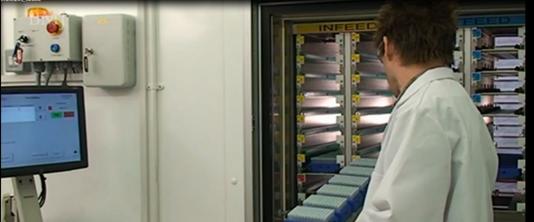


Modern Biobanks Around the World

Slide 96


New Addition to the PERSIAN Biobank
Compatible to Modern Biobanks
2D tubes—used in the best biobanks in the world
Workshop held in Bahman to demonstrate and teach its use
Plane to have two separated Bio-bank

Slide 97
Parallel Studies in the PERSIAN Cohort
Adult Cohort
Birth Cohort
Youth Cohort
Elderly Cohort

Slide 98
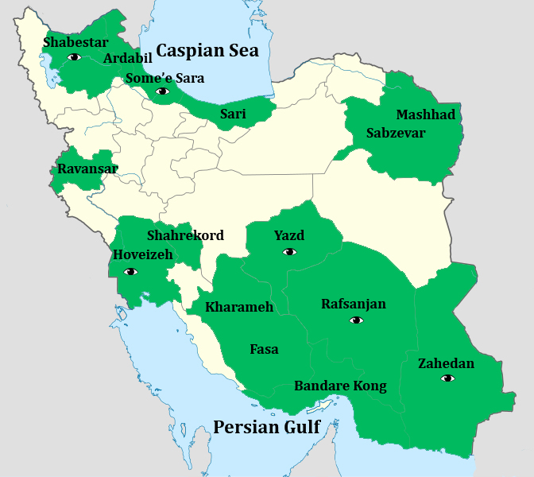
Adult Cohort Sites

Slide 99
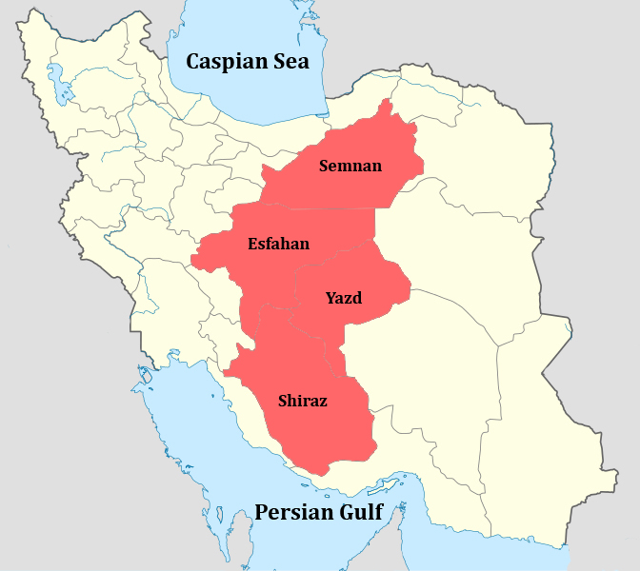
Birth Cohort Sites

Slide 100
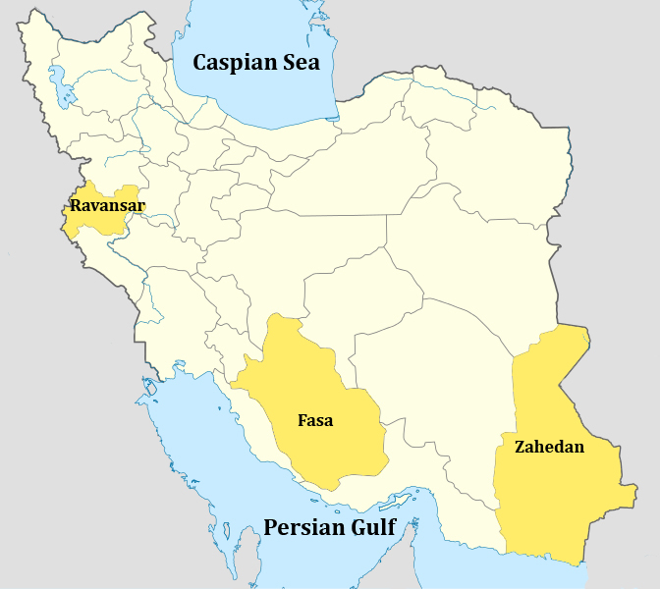
Youth Cohort Sites

Slide 101
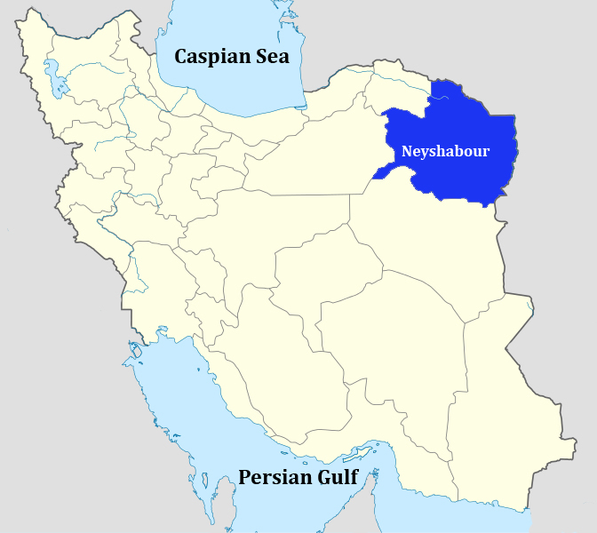
Elderly Cohort Sites

Slide 102
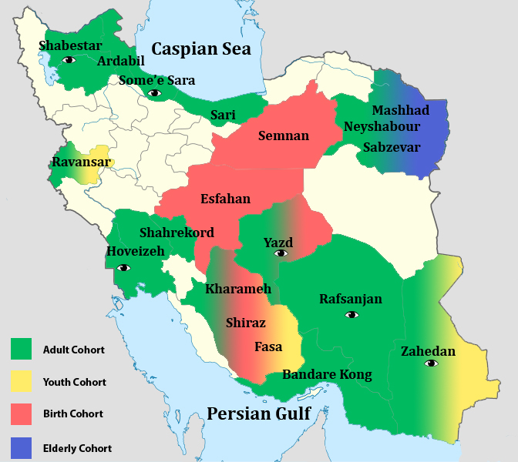
All PERSIAN Cohort Sites

