Slide 1
Is there any association between Obesity & Panhypopituitarism?
A.H. Ghanooni M.D.
Fellow of Endocrinology in SBMU
May 2017

Slide 2
Panhypopituitarism Obesity
?

Slide 3
obesity in children and adolescents
DEFINITIONS
The body mass index (BMI) is the accepted standard measure of overweight and obesity for children two years of age and older.
weight-for-height (which is particularly useful for the child younger than two years), measures of regional fat distribution (eg, waist circumference and waist-to-hip ratio),

Slide 4
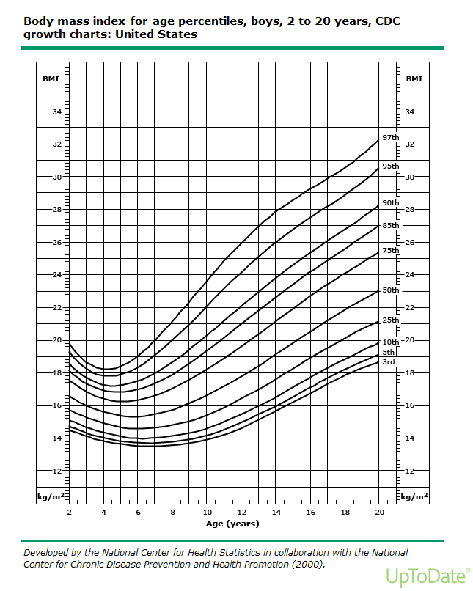

Slide 5
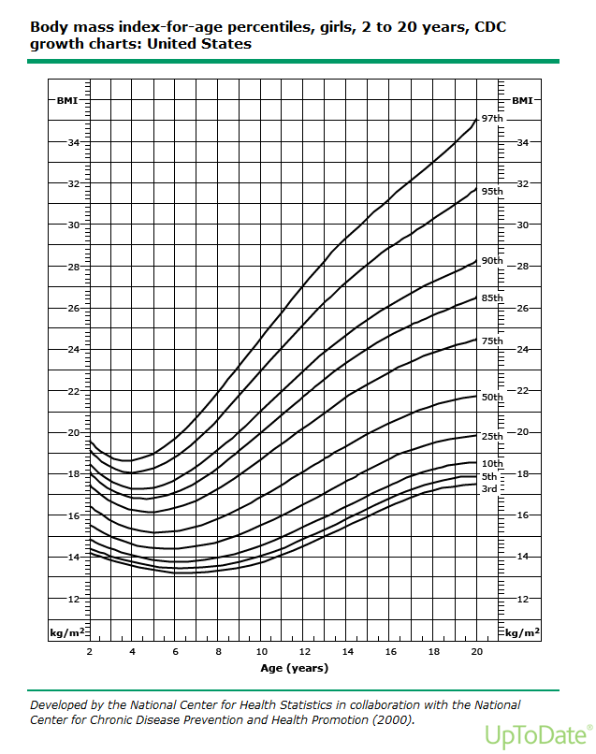

Slide 6
obesity in children and adolescents
●Underweight – BMI <5th percentile for age and sex
●Normal weight – BMI between the 5th and <85th percentile for age and sex
●Overweight – BMI between >85th and 95th percentile for age and sex
●Obese – BMI ≥95th percentile for age and sex
●Severe obesity – BMI ≥120 percent of the 95th percentile values, or a BMI ≥35 kg/m²
Some authors distinguish an additional subgroup with more severe obesity with BMI ≥140 percent of the 95th percentile values or a BMI ≥40 kg/m², which corresponds to class III obesity in adults.

Slide 7
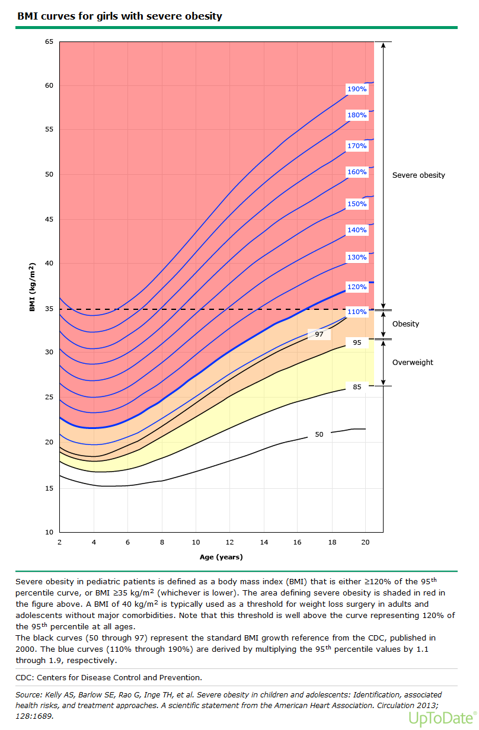

Slide 8
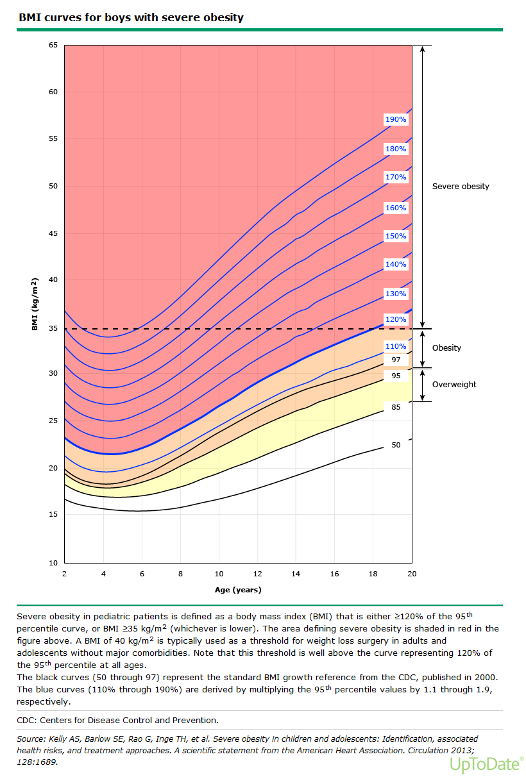

Slide 9
Importance of obesity in children and adolescents
severe obesity represent approximately 5 percent of children and adolescents in the United States,
with the highest prevalence in Black and Mexican-American youth.
This group has significantly more cardiovascular risk factors and a greater risk for having obesity in adulthood.
Adolescents with this severe degree of obesity should be treated within a tertiary care program
  such as medications, very-low-calorie diets, meal replacements, and weight loss surgery.

Slide 10
Etiology of obesity in children and adolescents
Environmental factors
  - Sugar-sweetened beverages
  - Television
  - Video games
  - Exergames
  - Sleep
  - Medications
Genetic factors
Endocrine disorders
Hypothalamic obesity

Slide 11
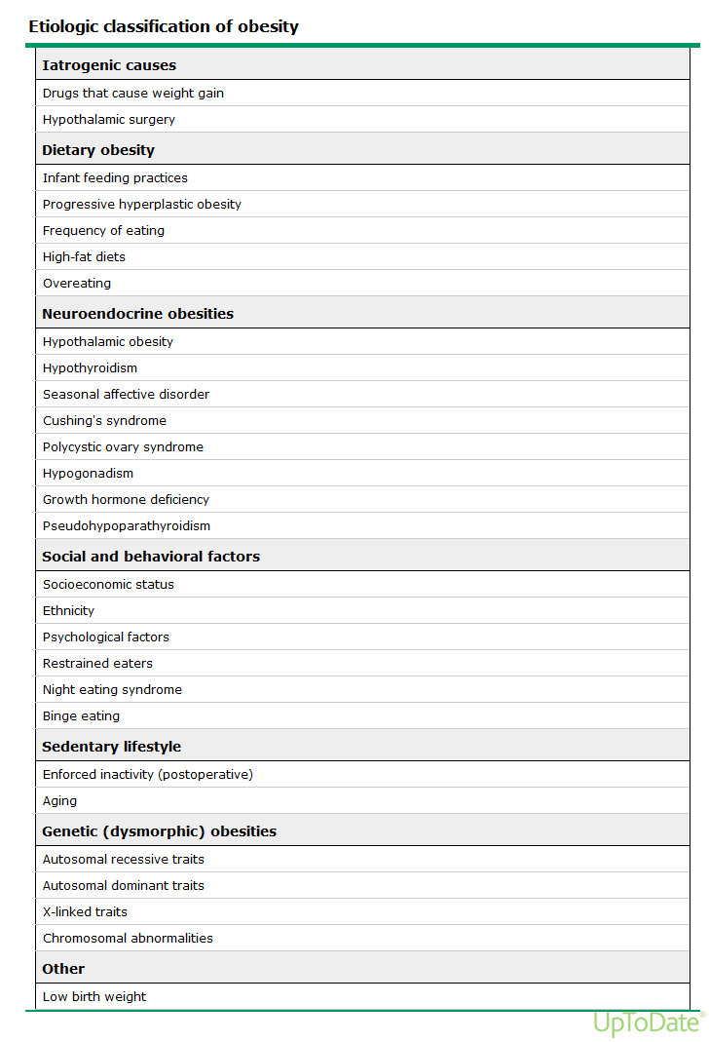

Slide 12
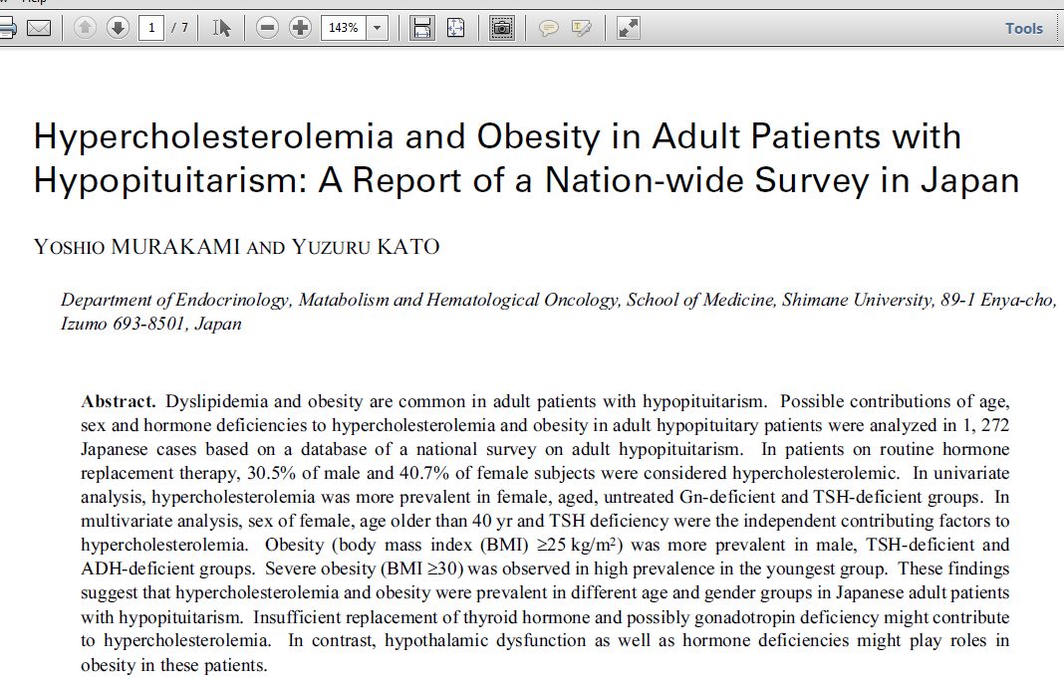


Slide 13
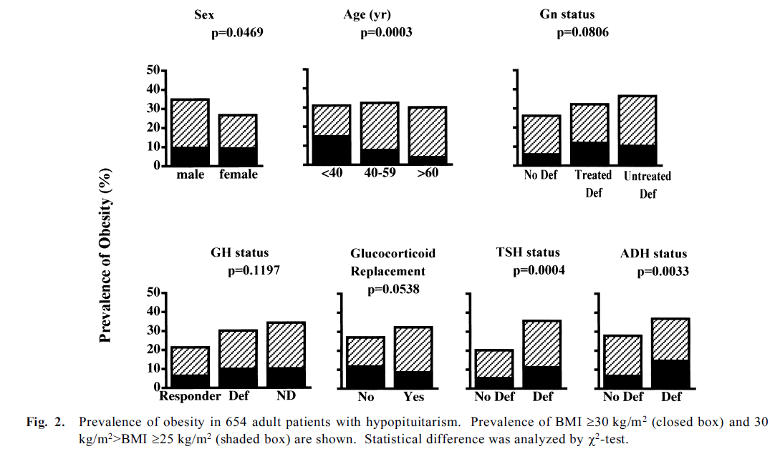

Slide 14
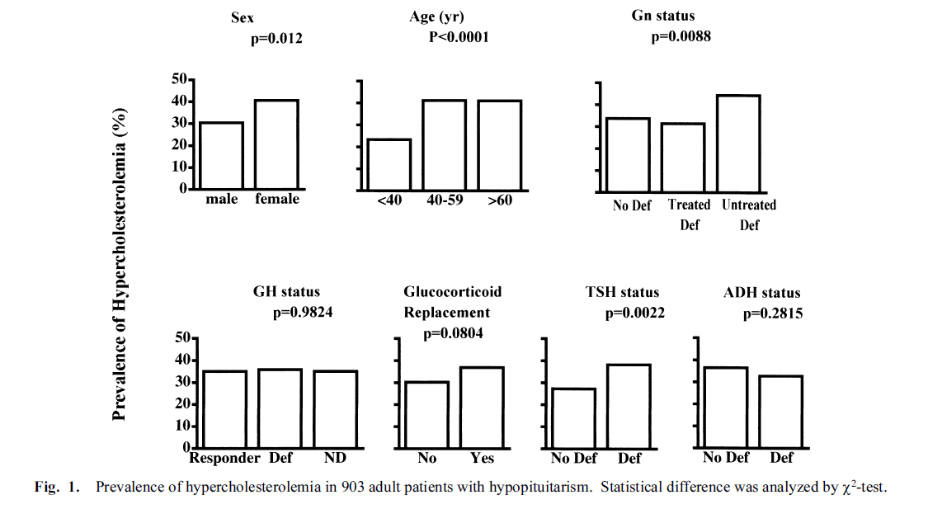

Slide 15
Panhypopituitarism Obesity

Slide 16
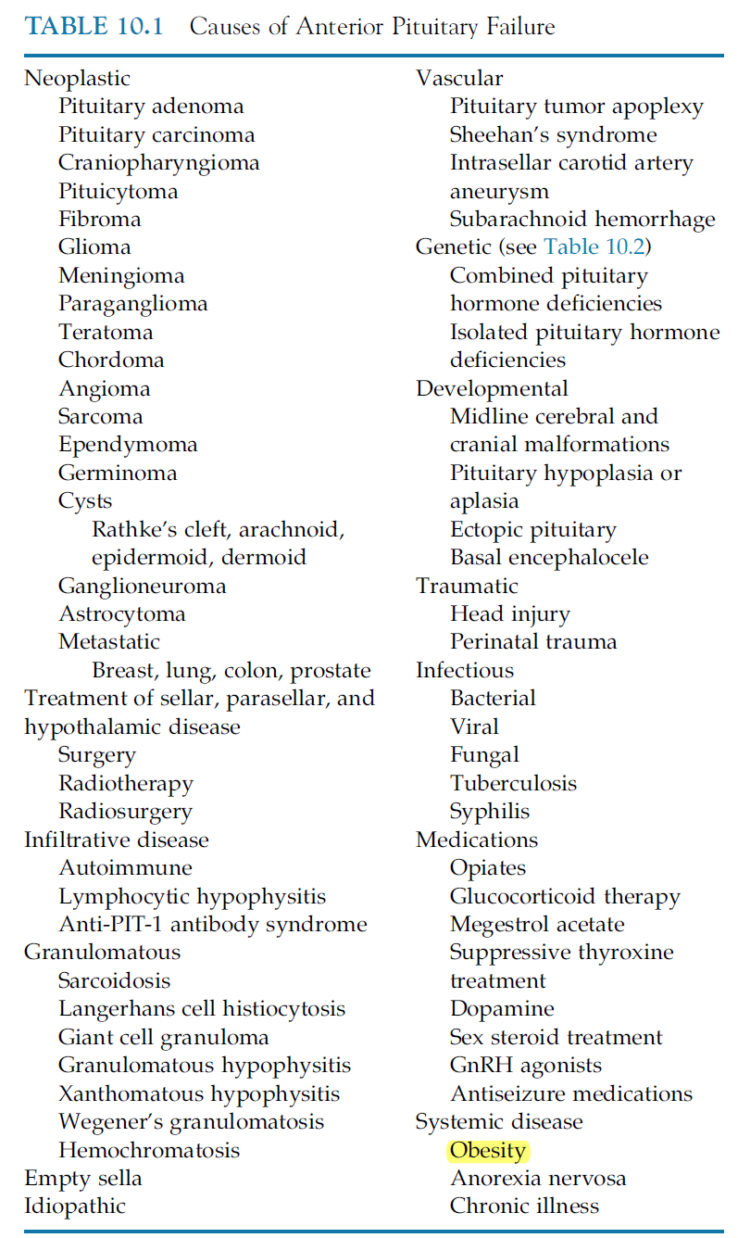
The pituitary 4th edition 2017

Slide 17
‘Functional’ hormonal imbalance associated with obesity
impaired growth hormone axis,
  circulating GH is low in obesity
  somatotrophic responses are impaired
  are reversible with significant weight loss.22
  There has been no clear evidence for the efficacy of GH use in achieving weight loss in obese subjects, as similar fat reductions may be achieved by diet or exercise interventions.23

Slide 18
‘Functional’ hormonal imbalance associated with obesity
gonadal dysfunction
  is common in male obese
  affects GnRH and gonadotrophin hormone release,
  there are decreased testosterone and sex hormone binding globulin levels.

Slide 19
‘Functional’ hormonal imbalance associated with obesity
thyroid dysfunction
  is no more common than in the nonobese population and is unlikely to be the cause of obesity.
  Thyroid function should be tested and treated as appropriate, but rarely results in significant weight loss.

Slide 20
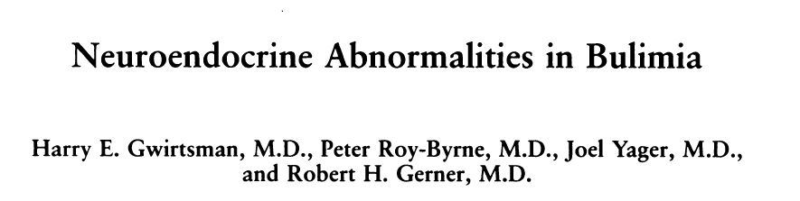
18 bulimic patients
Twelve of 18 patients (67%) showed abnormalities of cortisol suppression,
8 of 10 (80%) showed blunted thyrotropin-releasing hormone (TRH) tests.
These findings suggest that neuroendocrine abnormalities identified previously in anorexia nervosa are not solely an artifact of low weight and, further, that eating disorders and affective disorders may share neurochemical similarities.

Slide 21
hypopituitarism Obesity

Slide 22
hypopituitarism Obesity
?

Slide 23
neuroendocrine disorders associated with childhood obesity
less than 1 percent of children and adolescents with obesity
usually are associated with overweight or mild obesity rather than severe obesity
Most children with these problems have short stature and/or hypogonadism

Slide 24
Hypothalamic Disorders
Congenital syndromes
  Prader-Willi Syndrome
  Ciliopathies :
    Bardet-Biedl syndrome
    Laurence-Moon syndrome
    Biemond syndrome
    Alstrom-Hallgren syndrome
Impairment of hypothalamic functions without any evident structural abnormality
characterized by defects that involve appetite control, hypogonadotrophic hypogonadism, mental retardation with personality anomalies and, less frequently, sleepwake cycle and temperature regulation problems.

Slide 25
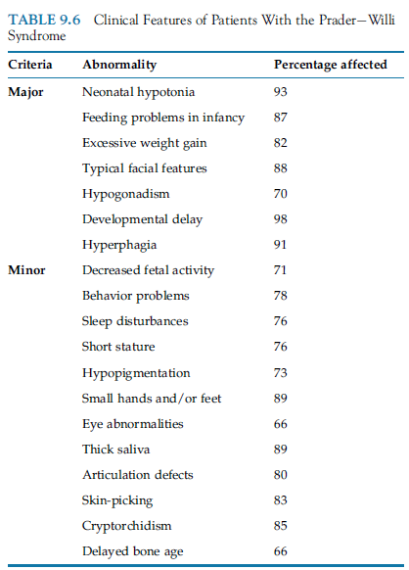
  Prader-Willi Syndrome

Slide 26
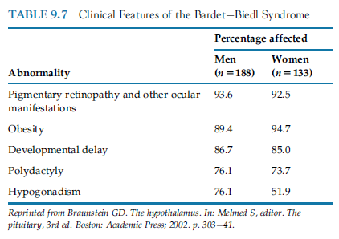
  Bardet-Biedl syndrome

Slide 27
Hypothalamic Disorders
Acquired lesions
rapidly progressive severe obesity,
difficult to treat
In the pediatric age group, most often arises after surgical treatment for craniopharyngioma, and usually is associated with panhypopituitarism.
Similar patterns may be caused by trauma, tumor, or inflammatory disease affecting the hypothalamus.

Slide 28
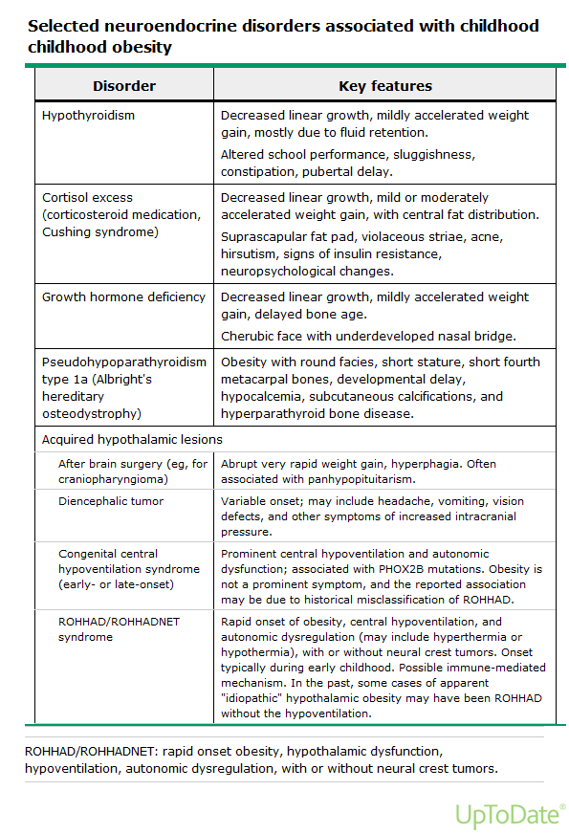

Slide 29
ROHHAD/ROHHADNET syndrome
A rare cause of hypothalamic obesity
Rapid onset Obesity, Hypothalamic dysfunction, Hypoventilation, and Autonomic Dysregulation (ROHHAD),
may be associated with neuroendocrine tumors, (ROHHADNET).

Slide 30
ROHHAD/ROHHADNET syndrome
in infancy or early childhood with central hypoventilation (resembling congenital central hypoventilation syndrome)
and a variety of abnormalities in the hypothalamic-pituitary axis, with autonomic dysregulation including episodes of hyperthermia or hypothermia
Although there is no diagnostic test for ROHHAD available at present, a few case reports suggest an immune-mediated central nervous system (CNS) disorder.

Slide 31
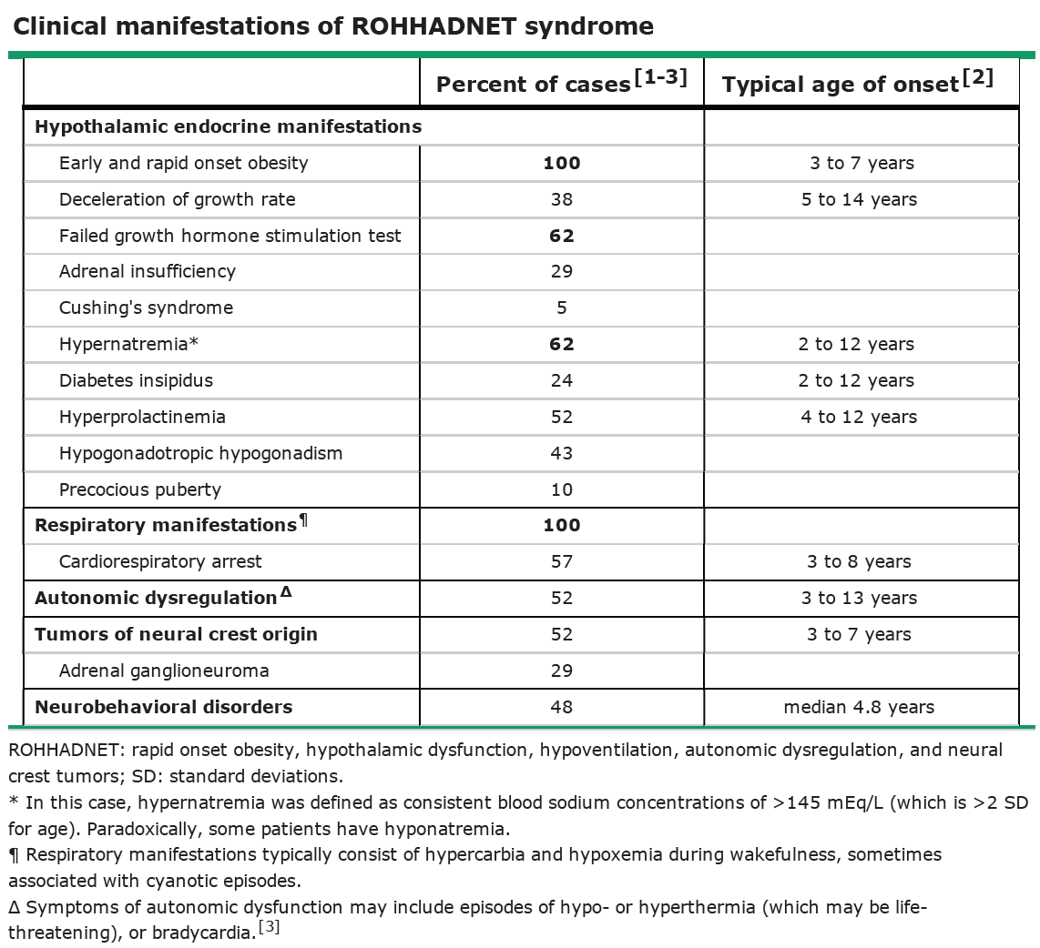

Slide 32
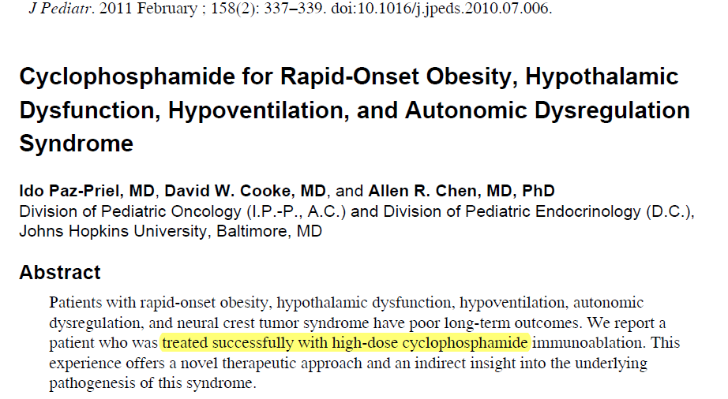

Slide 33
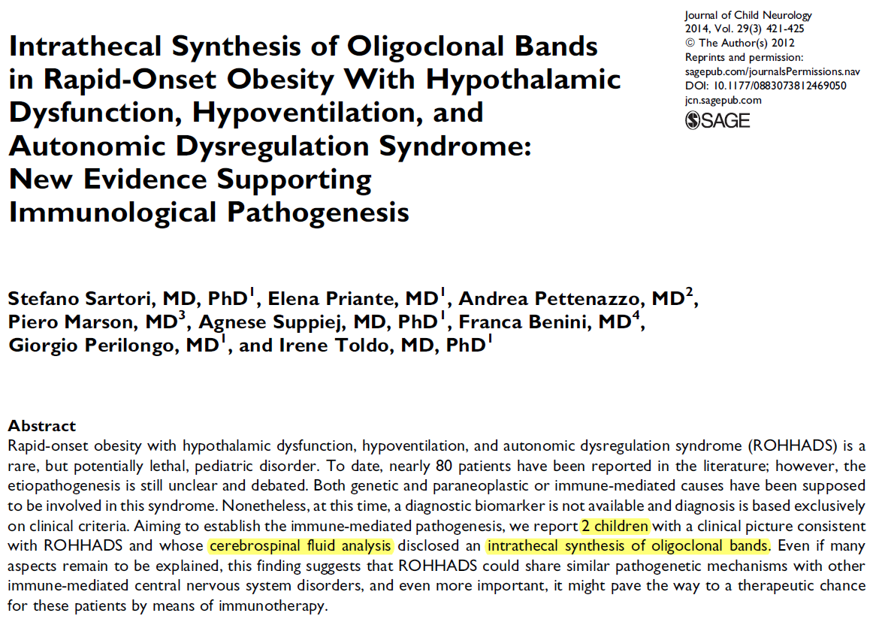

Slide 34
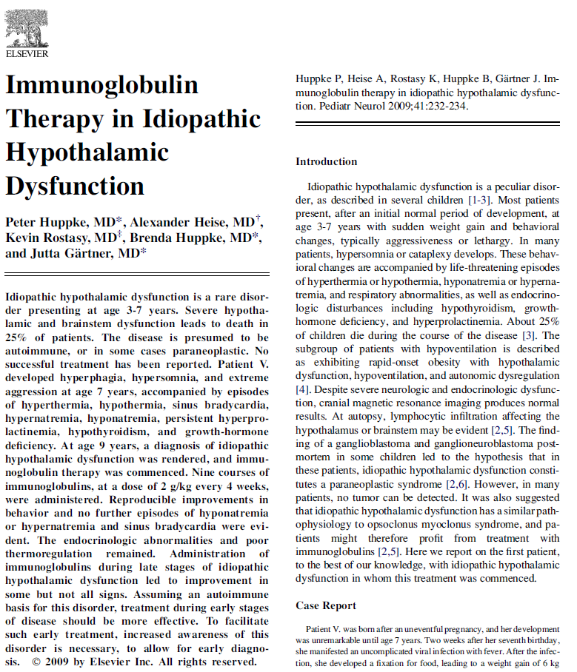

Slide 35
hypopituitarism Obesity
?
Hypothalamic Disorders
Congenital
Acqueired

