Slide 1
Primary amenorrhea
Omid gharooi Ahangar

Slide 2
Diagnostic clue in this patient
Primary amenorrhea
Normal Thelarche and Pubarche
Normal IQ
Growth retardation
Normal FSH
Absence of uterine or hypoplastic
Karyotype XX

Slide 3
agenda
What is DDx of primary amenorrhea in presence of normal secondary sexual characteristics?
How approach to primary amenorrhea?
Is there relationship between primary amenorrhea and growth failure in this patient ?
What is next plan and management?

Slide 4
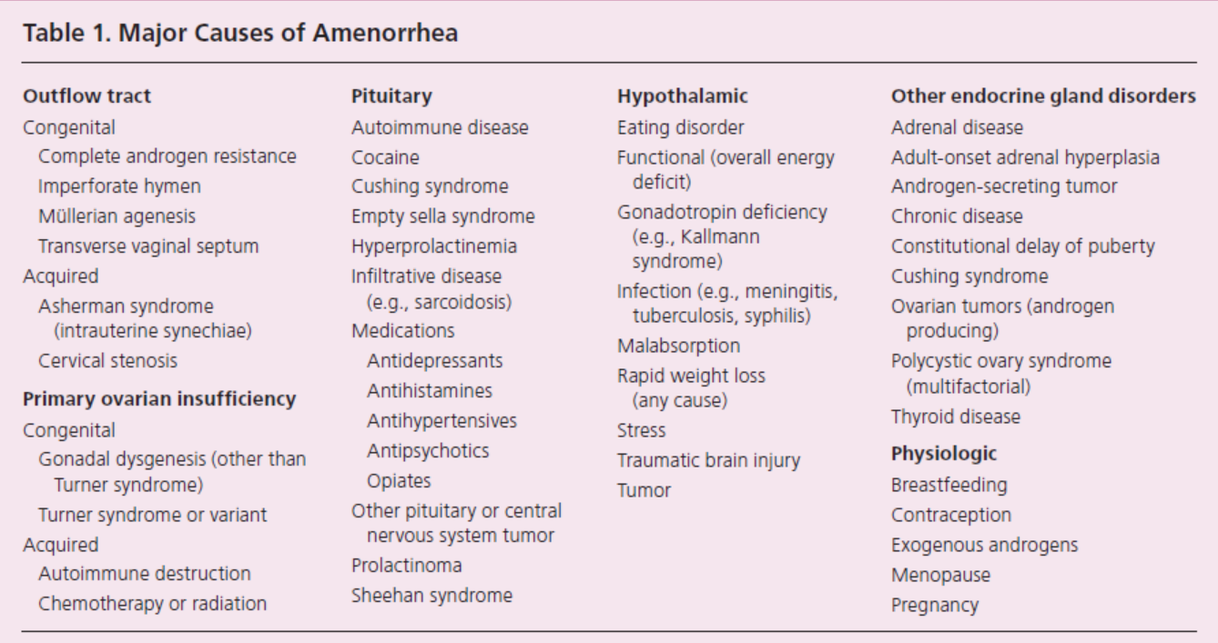

Slide 5
Primary Amenorrhea: Etiology
Pregnancy
Thyroid disease
Hyperprolactinemia
Prolactinoma
Hypergonadotropic hypogonadism
Gonadal dysgenesis (i.e. Turner syndrome)
Premature ovarian failure
Hypogonadotropic hypogonadism
Constitutional delay of puberty
Congenital GnRH deficiency (Kallman syndrome)
Functional hypothalamic amenorrhea (i.e. Anorexia or Bulimia nervosa)
CNS tumor (i.e. Craniopharyngioma)
Normogonadotropic
Congenital (i.e. Mullerian agenesis, Androgen Insensitivity syndrome)
Outflow tract obstruction (i.e. Imperforate hymen, Transverse vaginal septum)
Hyperandrogenic anovulation (i.e. PCOS, Cushing’s disease)

Slide 6
Etiology prevalence
Chromosomal abnormalities causing gonadal dysgenesis (ovarian failure due to the premature depletion of all oocytes and follicles) — 50 percent
Hypothalamic hypogonadism including functional hypothalamic amenorrhea — 20 percent
Absence of the uterus, cervix and/or vagina, müllerian agenesis — 15 percent
Transverse vaginal septum or imperforate hymen — 5 percent
Pituitary disease — 5 percent
The remaining 5 percent of cases are due to a combination of disorders including androgen insensitivity due to mutations in the androgen receptor, congenital adrenal hyperplasia, and polycystic ovary syndrome

Slide 7
DIAGNOSTIC EVALUATION
Primary amenorrhea is evaluated most efficiently by focusing on:
the presence or absence of breast development (a marker of estrogen action and therefore function of the ovary),
the presence or absence of the uterus (as determined by ultrasound, or in more complex cases by magnetic resonance imaging)
and the FSH level.

Slide 8
scenario
If there is no breast development and the FSH level is elevated, the probable diagnosis is gonadal dysgenesis, and a karyotype should be obtained
If the ultrasound indicates that the uterus is absent and FSH is normal, the probable diagnosis is müllerian agenesis or androgen insensitivity syndrome. In the case of müllerian agenesis, the circulating testosterone is in the normal range for women and in the case of androgen insensitivity, the circulating testosterone is in the male range.
If the FSH is normal, and both breast development and the uterus are present, then the work-up should focus on the common causes of secondary amenorrhea, where the initial work up includes measurement of height and weight, serum FSH, prolactin and TSH.

Slide 9
Primary Amenorrhea
Is there normal development of secondary sexual characteristcs?
NO
Think hypogonadism or hypogonadotropism

Slide 10
Primary Amenorrhea
Is there normal development of secondary sexual characteristics?
YES
Think
Pregnancy beta HCG elevated
Mullerian anomaly normal androgen level
Androgen insensitivity elevated testosterone level
Notes:
With androgen insensitivity, there will typically be more breast development than pubic hair development.

Slide 11
Primary Amenorrhea: Evaluation
Secondary sexual characteristics present?
No
Yes
Measure FSH
Perform ultrasound of uterus
FSH < 5
FSH > 20
Uterus absent or abnormal
Uterus present or normal
Hypogonadotropic
hypogonadism
Hypergonadotropic
hypogonadism
Karyotype analysis
Outflow obstruction
Hypothalamic amenorrhea
Constitutional delay of puberty
Kallman syndrome
CNS tumor
Karyotype analysis
46,XY
46,XX
No
Yes
46,XX
45,XO
Androgen insensitivity syndrome
Müllerian agenesis
Evaluate for
2° amenorrhea
Imperforate hymen
Transverse vaginal septum
Premature
ovarian failure
Turner’s
syndrome
PCOS
Cushing’s

Slide 12
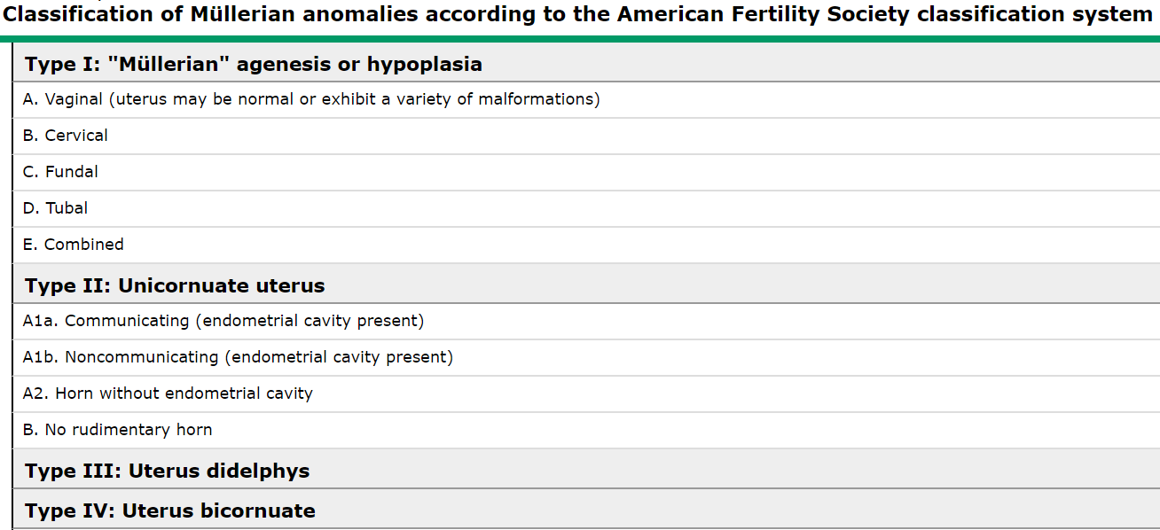
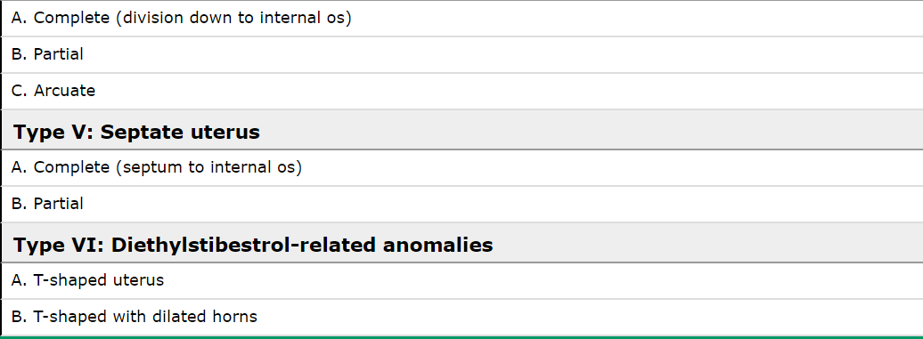

Slide 13
Frequency of specific anomalies
A review including a combined population of infertile and fertile women, the frequency of anomalies by type was:
septate (35 percent),
bicornuate (26 percent),
arcuate (18 percent),
unicornuate (10 percent),
didelphys (8 percent),
and agenesis (3 percent)

Slide 14
There are three common developmental defects of the müllerian system to consider:
Agenesis
Lateral fusion defects
Vertical fusion defects

Slide 15
Agenesis
The Mayer-Rokitansky-Küster-Hauser (MRKH) syndrome refers to congenital absence of the vagina with variable uterine development; it is the result of müllerian agenesis. Variable uterine development may result in lateral hemi-uteri or uterine horns, a midline uterus without a cervix, or no uterine structures at all.

Slide 16
Is there any association between MRKH and growth failure?

Slide 17
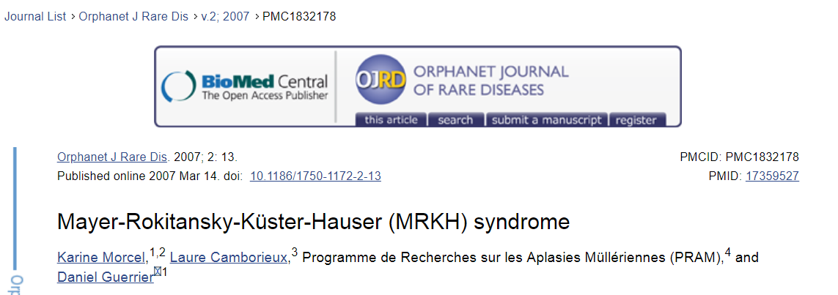

Slide 18
Isolated utero-vaginal aplasia is referred to as Rokitansky sequence or to type I (isolated) MRKH syndrome. Incomplete aplasia and/or associated with other malformations, is generally referred to as MURCS association (or type II MRKH syndrome). In this case, the term GRES (Genital Renal Ear Syndrome) can also be used.

Slide 19
Associated malformations in MRKH syndrome type II
upper urinary tract malformations
hearing impairment
heart malformations
skeletal abnormalities
These anomalies mainly involve the spine (30 to 40%) and, less frequently, the face and the limb extremities. Rachidial malformations encountered in MURCS association are scoliosis (20%), isolated vertebral anomalies (asymmetric, fused or wedged vertebrae), Klippel-Feil association (fusion of at least two cervical segments, short neck, low hair line, restriction of neck motion) and/or Sprengel's deformity, rib malformation or agenesis, and spina bifida. Face and limb malformations are mainly brachymesophalangy, ectrodactyly, duplicated thumb, absent radius, atrio-digital dysplasia (Holt-Oram like syndrome) and facial asymmetry.

Slide 20
Primary vaginal elongation by dilation is the appropriate first-line approach in most patients because it is safer, patient-controlled, and more cost effective than surgery
Evaluation for associated congenital anomalies is essential because up to 53% of patients with müllerian agenesis have concomitant congenital malformations, especially of the urinary tract and skeleton
Although vulvar and vaginal intraepithelial neoplasia are possible, routine cytology testing is not regularly recommended because of the lack of a cervix.
Patients should be given a written medical summary of their condition, including a summary of concomitant malformations. This information may be useful if the patient requires urgent medical care or emergency surgery by a health care provider unfamiliar with müllerian agenesis.

