Slide 2
Bariatric surgery
KHALAJ A.R. M.D
Obesity Clinic
Mostafa Khomini Hospital
Shahed University
Tehran
WWW.IRANOBESITY.COM

Slide 3
We should answer these questions
Why Surgery ?
What is Indication of Surgery?
What is ContraIndication of surgery?
What is benefit of laparoscopy verses open surgery ?
Which procedure is better for your patient ?
What is Complication of obesity surgery ?

Slide 4
EFFECTIVENESS OF BARIATRICSURGERY
Reduction of comorbidities
Reduction in mortality
Surgery compared to medical treatment
Treatment for type 2 diabetes

Slide 5
Reduction of comorbidities
Meta-analysis: surgical treatment of obesity.
Ann Intern Med 2005 Apr 5;142(7):547-59.
Maggard MA; et al
147 studies
Bariatric surgery: a systematic review and meta-analysis.
AU Buchwald H; Avidor Y; Braunwald E; Jensen MD; Pories W; Fahrbach K; Schoelles K
SO JAMA 2004 Oct 13;292(14):1724-37
136 fully extracted studies,

Slide 6
• Diabetes completely resolved in 77 percent and resolved or improved in 86 percent.
• Hyperlipidemia improved in 70 percent or more of patients.
• Hypertension resolved in 62 percent and resolved or improved in 79 percent.

Slide 7
• Obstructive sleep apnea resolved in 86 percent and resolved or improved in 84 percent.
• Gastroesophageal reflux symptoms improve and complete or partial regression of Barrett's esophagus has been demonstrated.

Slide 8
Reduction in mortality
Long-term mortality after gastric bypass surgery.
Adams TD; et al
N Engl J Med. 2007 Aug 23;357(8):753-61.
cohort study
from 1984 to 2002
9949 patients who had undergone gastric bypass surgery
9628 severely obese in control group

Slide 9
Effects of bariatric surgery on mortality in Swedish obese subjects.
AU Sjostrom L; Narbro K; Sjostrom CD; Karason K; Larsson B; Wedel H; Lystig T; Sullivan M; Bouchard C; Carlsson B; Bengtsson C; Dahlgren S; Gummesson A; Jacobson P; Karlsson J; Lindroos AK; Lonroth H; Naslund I; Olbers T; Stenlof K; Torgerson J; Agren G; Carlsson LM
SO N Engl J Med. 2007 Aug 23;357(8):741-52.

Slide 10
. Deaths from all causes were reduced by 40 percent,
from diabetes by 92 percent,
from coronary disease by 56 percent,
and from cancers by 60 percent.
Although the majority of mortality data for bariatric surgery comes from patients under age 65, a retrospective cohort analysis suggests that survival is improved, even in patients over age 65

Slide 11
CONCLUSIONS:
Bariatric surgery for severe obesity is associated with long-term weight loss and decreased overall mortality.

Slide 12
Surgery compared to medical treatment
The Swedish Obese Subjects (SOS) study--rationale and results.
Swedish obese subjects (SOS)--an intervention study of obesity. Two-year follow-up of health-related quality of life (HRQL) and eating behavior after gastric surgery for severe obesity.
Effects of bariatric surgery on mortality in Swedish obese subjects.

Slide 13
Weight decreased by 23 percent after two years in the surgery group while it increased in the control group by 0.1 percent [35].
After 10 years, weight had decreased by 16 percent in the surgery group and increased in the control group by 1.6 percent
The surgery group had better two and 10-year incidence rates of diabetes, hypertriglyceridemia, lowered HDL levels, improved hypertension and hyperuricemia rates.

Slide 14
Surgically treated patients were significantly less likely to require medications for cardiovascular disease or diabetes at two and six years
• Surgically treated patients had dramatic improvement in scores on validated measures of quality of life and psychiatric dysfunction

Slide 15
After 10 years of follow-up, the improvements in quality of life diminished somewhat in the surgery group due to weight regain, but overall outcome was still significantly better in the surgical than the medically treated group

Slide 16
Treatment for type 2 diabetes
Adjustable gastric banding and conventional therapy for type 2 diabetes: a randomized controlled trial.
Improvement in glucose metabolism after bariatric surgery: comparison of laparoscopic Roux-en-Y gastric bypass and laparoscopic sleeve gastrectomy: a prospective randomized trial.
Cost-efficacy of surgically induced weight loss for the management of type 2 diabetes: a randomized controlled trial.

Slide 17
Participants randomized to surgical therapy were more likely to achieve remission of type 2 diabetes through greater weight loss.
Both procedures markedly improved glucose homeostasis.
Surgical therapy appears to be a cost-effective option for managing type 2 diabetes in class I and II obese patients.

Slide 19
Indications of bariatric surgery
Be well-informed and motivated
Have a BMI >40
Have acceptable risk for surgery
Have failed previous non-surgical weight loss
The NIH also suggested that adults with a BMI >35 who have serious comorbidities such as diabetes, sleep apnea, obesity-related cardiomyopathy, or severe joint disease may also be candidates

Slide 20
Contraindications to bariatric surgery
untreated major depression or psychosis,
binge eating disorders,
current drug and alcohol abuse,
severe cardiac disease with prohibitive anesthetic risks
severe coagulopathy
inability to comply with nutritional requirements including life-long vitamin replacement
Bariatric surgery in advanced (above 65) or very young age (under 18) is controversial.

Slide 22
RATIONALE FOR MINIMALLY INVASIVE BARIATRIC SURGERY
Wound infection
Rates of wound infection are significantly greater with open (10 to 15 percent) than laparoscopic (3 to 4 percent) gastric bypass procedures .
SO - Ann Surg 2000 Oct;232(4):515-29
Ventral incisional hernia
Ventral incisional hernias occur with a frequency of 0 to 1.8 percent in laparoscopic series and as high as 24 percent in open series, underscoring a clear advantage of the laparoscopic approach in this regard
SO - Ann Surg 2001 Sep;234(3):279-89; discussion 289-91
Reduction in postoperative pain, shorter length of hospital
stay, and faster recovery

Slide 23
OUTCOMES OF LAPAROSCOPIC VERSUS OPEN GASTRIC BYPASS
Postoperative Pulmonary Function
FEV1 was 38% higher on the first postoperative day after laparoscopic than after open GBP
lower rate of segmental atelectasis after laparoscopic GBP
Nguyen NT, Lee SL, Goldman C, et al.: Comparison of pulmonary
function and postoperative pain after laparoscopic versus open
gastric bypass: A randomized trial. J Am Coll Surg 192:469–476,
2001.

Slide 24
Postoperative Pain
Despite utilizing greater dosages of narcotics,
open GBP patients still reported higher visual analog pain score
Weight Loss
6 months after surgery L>O
Long term L=O
Ann Surg 239:433–437, 2004
Obes Surg 13:341–346, 2003.
Obes Surg 10:233–239, 2000

Slide 25
learning curve
Mastering the technique of laparoscopic GBP often requires between 75 and 100 cases.

Slide 26
Operation of choice for a patient :
Patients dietary and psychology history
Medical and surgical history
Surgeon experience
Patient comfort and expectation
Ability of medical facility to handle most known complications

Slide 27
Buchwald algorithm for patient selection
There is no gold standard operation .
A surgeon should be able to perform more than one operation.
Patient can be matched to a specific procedure

Slide 28
Types of bariatric procedures
Restrictive
Vertical banded gastroplasty
Laparoscopic adjustable gastric band
Sleeve gastrectomy
Malabsorptive
Jejunoileal bypass
Biliopancreatic diversion
Biliopancreatic diversion with duodenal switch
Combination of restrictive and malabsorptive
Roux-en-Y gastric bypass

Slide 29
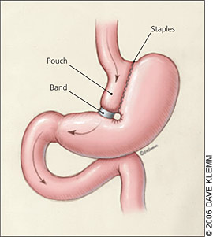
VERTICAL BANDING

Slide 30
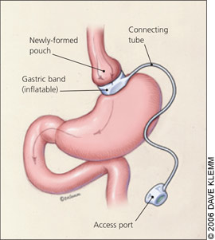
LAP ADJUSTABLE BANDING

Slide 31
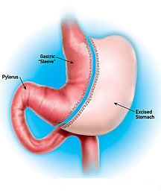
Sleeve gastrectomy

Slide 32
Jejunoileal Bypass
Payne and Dewind, Archives of Surgery, 1973
Notes:
First series in 1969 of 80 patients; now a series of 153 JI bypasses reported 1973
Jejunum to ileum [note that this is end-to-side]
80 patients, with 5 deaths - one was from liver failure, 2 had PE, 2 had MI
“14-4”; this was to replace the IC bypass; 16 year follow up; 153 JI bypasses done;
9% total mortality[6% blamed on bypass]
noted that there was significant fatty change of the liver at the initial operation - this worsened w/ rapid weight loss. . .
This was modified by Scott et al. in 1974; Note that the anastomosis is now end to end and the defunctionalized limb of distal ileum is drained into the transverse colon; note that the proximal jejunum sutured to the mesentery

Slide 33
BPD & BPD w/ DUODENAL SWITCH

Slide 34
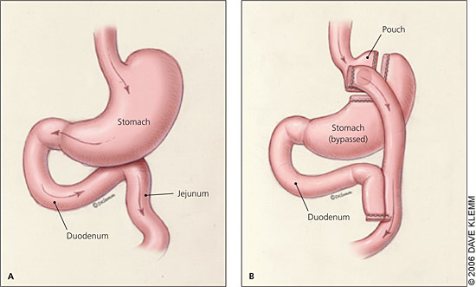
ROUX-EN-Y GASTRIC BYPASS

Slide 35
INTRAGASTRIC BALLOON

Slide 37
MORTALITY
Overall mortality was estimated to be less than 1 percent Meta-analysis: surgical treatment of obesity.
AU - Maggard MA; Shugarman LR; Suttorp M; Maglione M; Sugarman HJ; Livingston EH; Nguyen NT; Li Z; Mojica WA; Hilton L; Rhodes S; Morton SC; Shekelle PG
SO - Ann Intern Med 2005 Apr 5;142(7):547-59
increasing mortality was associated with advancing age, male sex, and lower surgeon volume of bariatric procedures Surgical volume impacts bariatric surgery mortality: a case for centers of excellence.
AU - Hollenbeak CS; Rogers AM; Barrus B; Wadiwala I; Cooney RN
SO - Surgery. 2008 Nov;144(5):736-43. Epub 2008 Jul 21

Slide 38
COMPLICATIONS OF MALABSORPTIVE PROCEDURES
Jejunoileal bypass
JIB resulted in high rates of diarrhea, arthritis, hepatic failure, cirrhosis, nephrolithiasis, protein malnutritio and vitamin deficiencies - Am J Med 1978 Mar;64(3):461-75.n,
Surg Clin North Am 1979; 59:1071.

Slide 39
COMPLICATIONS OF MALABSORPTIVE PROCEDURES
Biliopancreatic diversion and duodenal switch complications
significant protein calorie malnutrition, anemia, metabolic bone disease, deficiencies of fat-soluble vitamins and vitamin B12
- Gastroenterology 2001 Feb;120(3):669-81.

Slide 40
Vertical banded gastroplasty
staple line disruption 27-48%, stomal stenosis 20-33%, band erosion 1-7%, GERD, nausea/vomiting, marginal ulcers, and weight regain TI - Bariatric surgery. Surgery for weight control in patients with morbid obesity.
AU - Balsiger BM; Murr MM; Poggio JL; Sarr MG
SO - Med Clin North Am 2000 Mar;84(2):477-89.

Slide 41
Laparoscopic adjustable gastric band
Early complications include acute stomal obstruction 6%, band infection 0.3-9%, gastric perforation, hemorrhage, bronchopneumonia, and delayed gastric emptying.
Gastrointest Surg 2003; 7:429.

Slide 42
Laparoscopic adjustable gastric band
Late complications include band erosion 7%, band slippage 2-14% or prolapse, port or tubing malfunction, leakage at the port site tubing or band, pouch or esophageal dilatation and esophagitis .
SO - Obes Surg 2002 Apr;12(2):254-60

Slide 43
Roux-en-Y gastric bypass
Pulmonary embolus up to 3.3%
Leaks 2 and 3 percent
Gastric remnant distension
Marginal ulcers 0.6 to 16%
Cholelithiasis
Wound infection
Stomal stenosis 6 to 20 percent

Slide 44
Bleeding
Ventral incisional hernia
Failure to lose weight and weight regain
Metabolic and nutritional derangements
Internal hernias
Notes:
Failure to lPostoperative hypoglycemia and
Dumping
ose weight and weight regain

Slide 45
SLEEVE GASTRECTOMY
COMPLICATIONS
Difficulty eating
Vomiting
Leak
Reflux

Slide 46
با سپاس از توجه شما

