Slide 1
In the Name of God
Case Presentation
By:A.Soleimani.MD
B.Rezvankhah.MD

Slide 2
ID: A 45 y-o ♀,
Married,
Student of PHD
Born & Living in Tabriz

Slide 3
CC:Hypoglycemia
PI: The patient came to our clinic with CC of a hypoglycemic attack occurred in 3/96 during she was on the exam, she claimed it happened 4 hours after lunch. The symptoms included lightheadedness ,palpitation ,tremor and drowsiness.
They called emergency & they detected a low BS level:35 mg/dl, she was admitted in emergency department for 12 hours and her symptoms were relieved by administration of D/W serum and then discharged.

Slide 4
Till then she eats snacks several time a day & during night fearing of hypoglycemia and she gained weight.
She had sign & symptoms of Hypoglycemia in both fasting & post prandial conditions but she did not check
There are no other concomitant sign & symptoms like hypotension ,abdominal pain,irregular menstruation,…
She stated she experienced an other hypoglycemic attack 4 years ago.It happened in fasting condition & BS was 28 mg/dl with glucometer.
She couldn't has kept fasting in Ramadan for 4-5 years.

Slide 5
She did a fasting test in Tabriz and in the third day (hour:60-65) the test was terminated
BS: 53 mg/dl | BS:50
Insulin: 1.1 mcIU/ml | Insulin: 1.2
C-peptide: 0.3 ng/ml | C-peptide: 0.64
Cortisol: 7.5 mcg/dl | Cortisol: 8.67

Slide 6
Because of the unexpected results, the patient was admitted and the fasting test was performed again.
In the 3rd night the BS level reached below 50 mg/dl attending palpitation,pallor,drowsiness,headache

Slide 7
And the results of the test were as following:
طالقانی | مرکزی | طالقانی
BS: 44 mg/dl | BS: 43 mg/dl | BS: 36 mg/dl
Insulin: 2 mcIU/ml | Insulin: 1.1 | Insulin:1.9
C-peptide: 0.6 | C-peptide: 0.6 ng/ml | C-peptide: 0.5
Cortisol: 15 mcg/dl |  | Cortisol: 11.4 mcg/dl

Slide 8
According to cortisol level a cosyntropin test was done:
Cortisol 0’ | -------
Cortisol 30’ | 21 mcg/dl
Cortisol 60’ | 24 mcg/dl

Slide 9
PMH: Idiopathic DVT ( 2 times ), C/S, Appendectomy
DH: _
FH: (DM in her uncles)
She has two children ( 12 & 8 y-o) & had breast feeding & regular menstruation after delivery

Slide 10
Menstrual irregularity: neg
Sexual dysfunction: neg
Weight gain: 5kg in 6months
Hypotension: (-)
Headaches: (-)
Malaise & weakness: (+)

Slide 11
Ph/E: The patient is a thin well being young woman,she is oriented & cooperator.
Vital sign: BP: 100/60 (no orthostatic changes)
PR: 78 BMI: 23

Slide 12
H&N: No hyperpigmentation, No features in favor of acromegaly,
Thyroid was NL
Chest: breast examination was NL
Abdomen: Organomegaly (-), mass (-)
Extremities: flexion contracture (-) muscle atrophy(-)

Slide 13
LAB DATA:
HB: 12.5 MCV: 82
Na:141 K: 4.5 Cr: 0.9
TSH: 0.6 T4 : 8.2
IGF1: ?

Slide 14
SPIRAL CT SCAN OF ABDOMEN without & with contrast: 96/04/19
A 11 mm cyst is noted at spleen
Chest spiral CT without & with contrast: normal

Slide 15
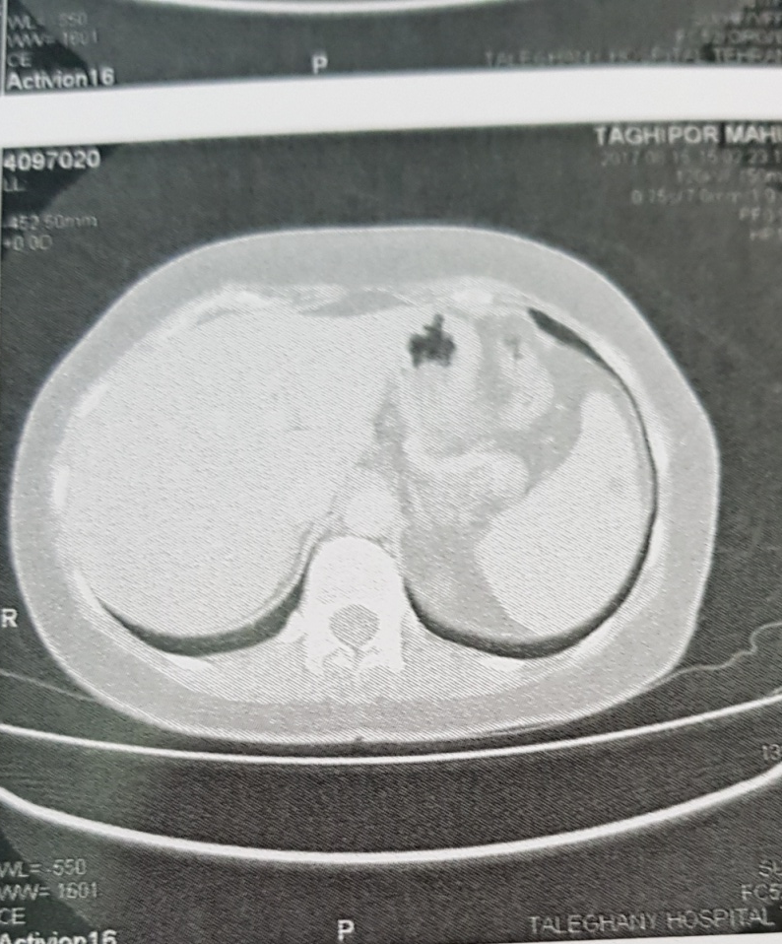
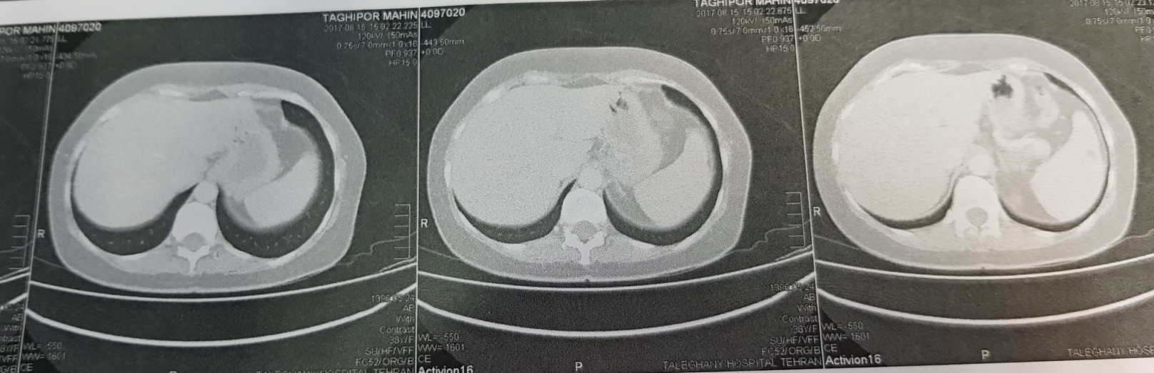
Spiral CT of abdomino pelvic without & with contrast
2 simple cyst at spleen( 3 & 7 mm)

Slide 16
Problem list
A 45 y-o woman with several attacks of hypoglycemia
In fasting test low insulin & C-peptide were detected
WEIGHT GAIN
A SPLEEN SIMPLE CYST IN IMAGING

