Slide 1
Osteoporosis case study
F. Hosseinpanah, M.D. Endocrinologist
Research Institute for Endocrine sciences
Shahid Beheshti University
of Medical Sciences
July 14, 2016
Tehran

Slide 2
Scenario
A 58 year old woman with a parental history of hip fracture was noted to have lumbar spine T-score of -1.9, mean total hip T-score was -2.2 on her first DXA scan 8 year after menopause
Soon after the initial BMD, an L3 compression fracture with 50% loss of height was discovered
Treatment with ALN 70 mg weekly was initiated and continued for 8 years

Slide 3
Scenario..
ALN was then discontinued due to patient concern for ONJ and AFF
A follow up DXA at the end of treatment scan showed the lumbar spine T score remained at -1.9; the mean total hip T-score was -2.5. No new clinical fractures occurred since her original treatment
She has a BMI of 22 kg/m2, and her 10 year FRAX would be estimated at 20.3% for MOF and 4.4% for hip fracture, if she was drug naive

Slide 4
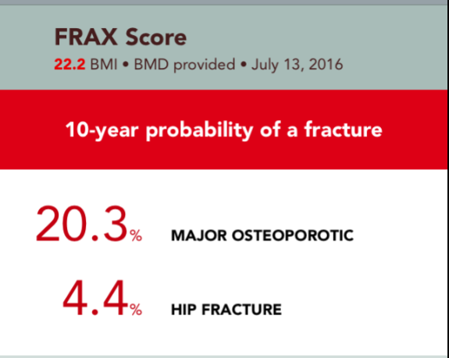
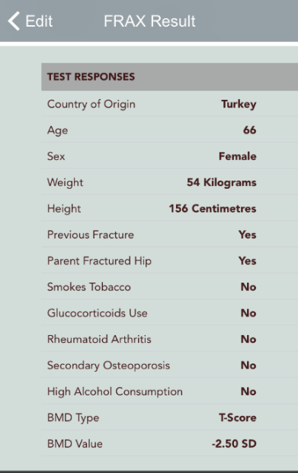

Slide 5
What would you recommend ?
Drug holiday
Reassurance and retreatment with ALN
Switching to Denosumab
Switching to Teriparatide

Slide 6
What would you recommend ?
Drug holiday
Reassurance and retreatment with ALN
Switching to Denosumab
Switching to Teriparatide

Slide 7
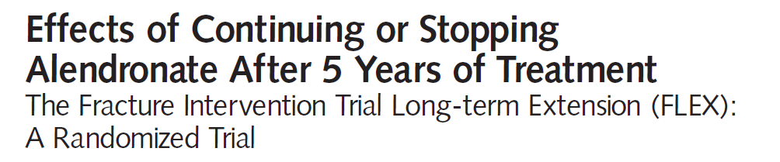
Methods: Randomized, placebo-controlled ,double-blind trial, extension trial to FIT.
Participants : 1099 women 60–86 year of age who had been randomized to ALN in FIT.
Intervention : Randomization to ALN , 5 mg/d (n=329) or 10 mg/d (n=333), or placebo (n=437) for 5 years (1998-2003).
primary outcome : measure was total hip bone mineral density (BMD)
secondary outcome : measures were BMD at other sites and biochemical markers of bone remodeling. An exploratory outcome measure was fracture incidence.

Slide 8
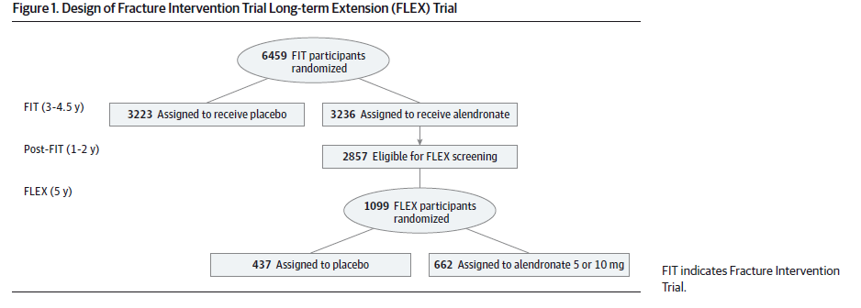

Slide 9
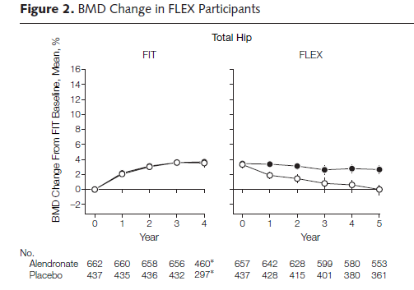


Slide 10
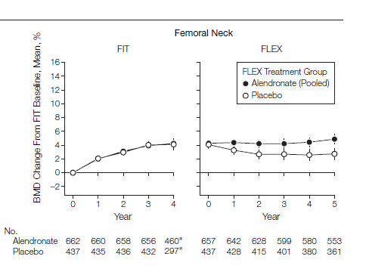

Slide 11
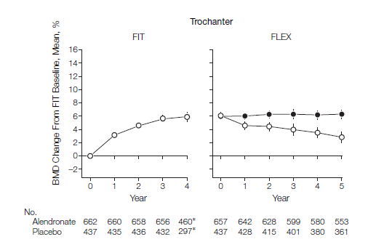

Slide 12
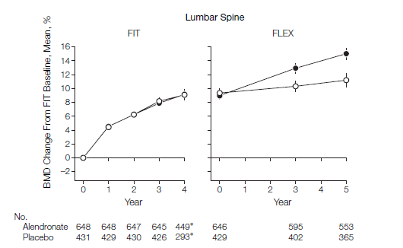

Slide 13
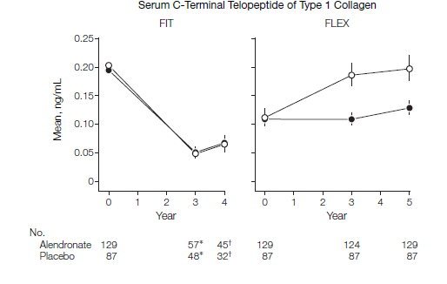

Slide 14
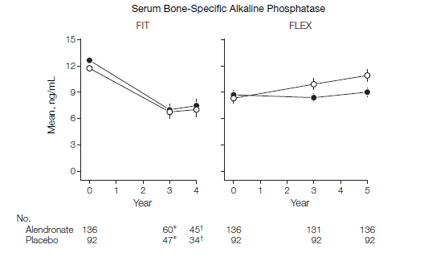

Slide 15
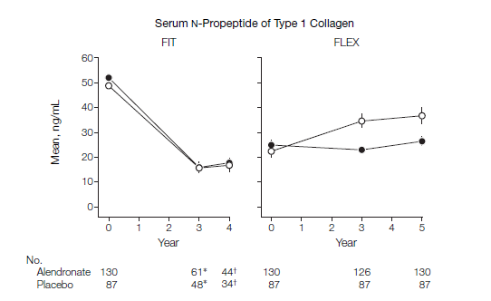

Slide 16
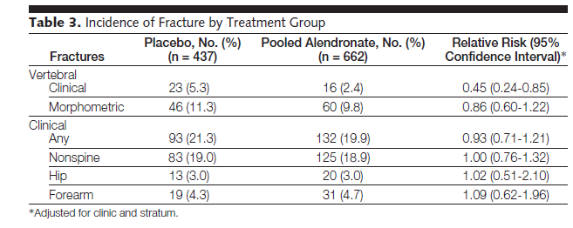

Slide 17
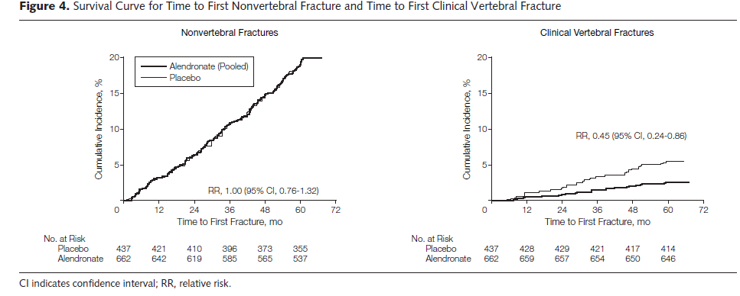

Slide 18
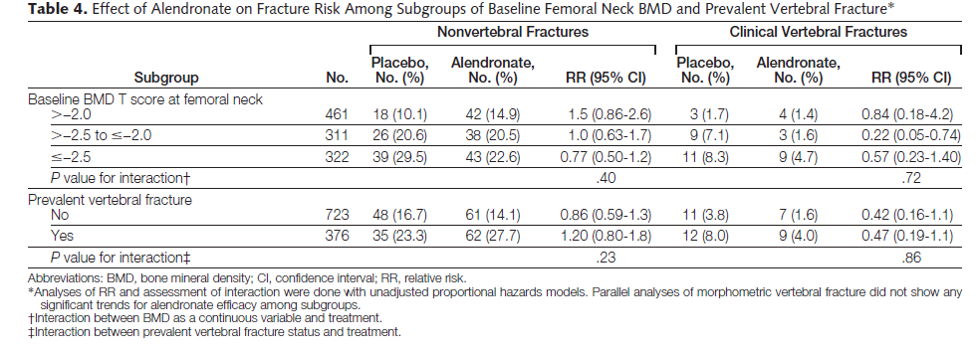

Slide 19
Key messages
Women who discontinued alendronate after 5 years showed a moderate decline in BMD and a gradual rise in biochemical markers but no higher fracture risk other than for clinical vertebral fractures compared with those who continued alendronate.
These results suggest that for many women, discontinuation of alendronate for up to 5 years does not appear to significantly increase fracture risk. However, women at very high risk of clinical vertebral fractures may benefit by continuing beyond 5 years.

Slide 20
Methods: multicenter, double-blind, placebo controlled , extension trial.
participants: 1233 postmenopausal women who received ZOL for 3 years in the core study were randomized to 3 additional years of ZOL (Z6, n=616) or placebo (Z3P3, n=617).
primary outcome: femoral neck (FN) BMD percentage change.
Secondary outcome: other BMD sites, fractures, biochemical bone turnover markers and safety.

Slide 21
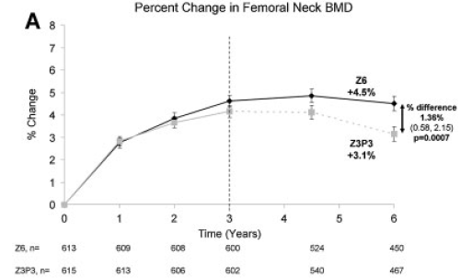
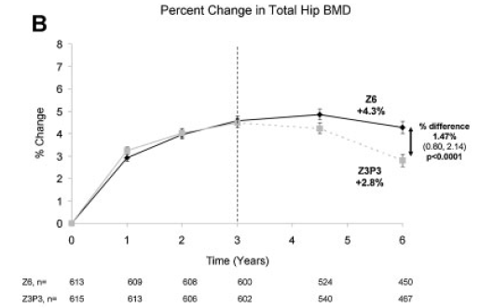

Slide 22
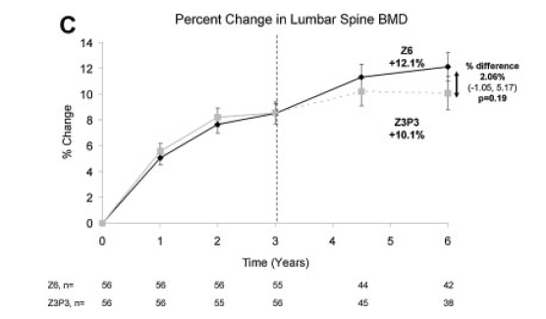

Slide 23
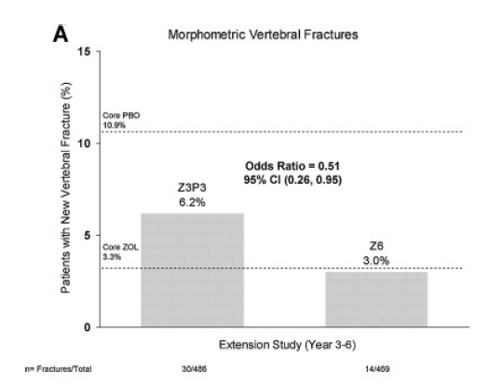

Slide 24
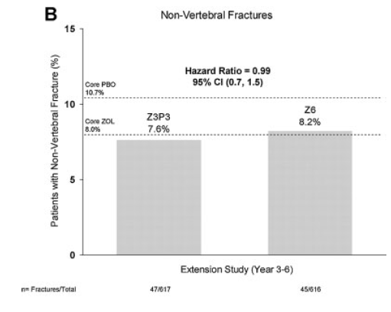

Slide 25
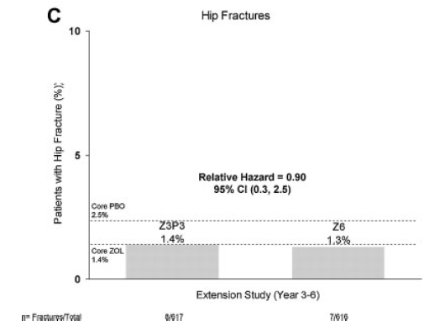

Slide 26
Key messages
Small differences in BMD in those who continued versus those who stopped treatment suggest residual effects after 3 years of annual ZOL, many patients may discontinue therapy up to 3 years.
However, vertebral fracture reductions suggest that those at high fracture risk, particularly vertebral fracture, may benefit by continued treatment.

Slide 27
Osteonecrosis of the jaw (ONJ)
ONJ was first associated with BP therapy in a report in 2003, in patients with metastatic cancer receiving high dose intravenous BP therapy
ONJ is characterized by
exposed necrotic bone in the maxillofacial region that has been present for at least 8 weeks of appropriate therapy
exposure to potent antiresorptive agents (BPs or denosumab) or anti-angiogenic agents
no history of radiation therapy to the jaw.
The pathogenesis of ONJ remains unclear , but several potential mechanisms have been proposed. These include over suppression of bone remodeling, infection, inhibition of angiogenesis, soft tissue toxicity, and immune dysfunction.
In patients receiving BP therapy for osteoporosis, current estimates of the incidence of ONJ range from approximately 1/10,000 to1/100,000 patient treatment years.

Slide 28
ONJ
Potential factors increasing the risk for BP-treated patients to develop ONJ include poor oral hygiene, smoking, diabetes mellitus, concomitant glucocorticoid and/or chemotherapy use, and invasive dental procedures, such as dental extractions or implants.
The incidence may be higher in Asian populations.
Preventive practices that may reduce the incidence of ONJ include prophylactic dental care and avoidance of invasive dental procedures.

Slide 29
Postponing initiation of bisphosphonates until after completion of invasive dental treatments.
If already on a bisphosphonate, a drug holiday of 2 months before the procedure is recommended for patients who have been on bisphosphonates for longer than 4 years regardless of other risk factors.
If patients are at high risk (concomitant corticosteroid or antiangiogenic cancer treatment medications) then consider a drug holiday even if bisphosphonate use is less than 4 years.
In most cases the bisphosphonate should not be restarted until osseous healing has occurred
J Oral Maxillofac Surg 72:1938-1956, 2014

Slide 30
Atypical femur fractures (AFFs)
The relationship between AFFs and BPs was first reported in 2005 in patients receiving oral BPs for osteoporosis.
Incidence rates from 1.8/100,000 per year with a 2- year exposure to 113/100,000 per year with exposure from 8 to 9.9 years.

Slide 31
N Engl J Med 2010; 362: 1761-71.

Slide 32
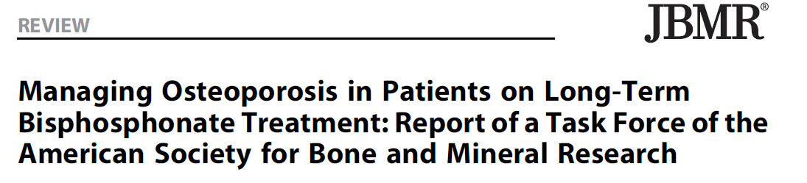

Slide 33
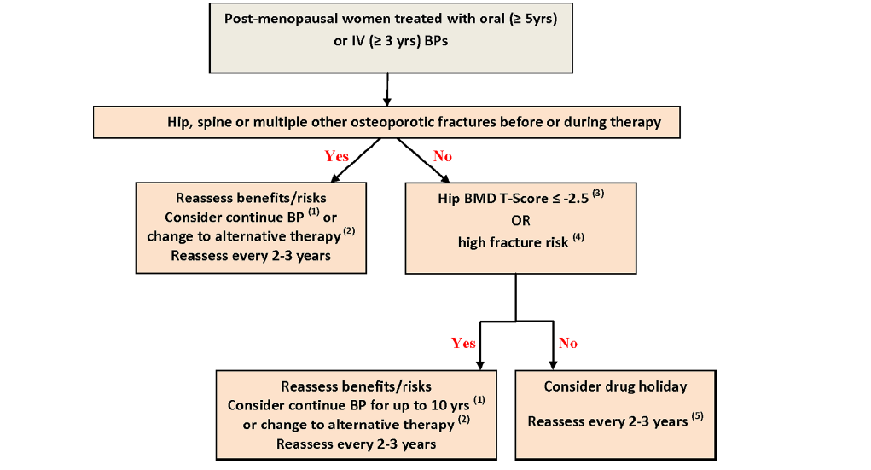

Slide 34
Definition of high risk
Older age (70–75 years)
other strong risk factors for fracture (low BMI, weight loss, fall history, or the intake of drugs that have adverse effects on bone)
FRAX fracture risk score that is above country specific thresholds

Slide 35
Evaluation and Treatment of Osteoporosis
Medical Clinics of North America, Volume 100, Issue 4, Pages 807-826
Kim M. O’Connor

Slide 36
Evaluation and Treatment of Osteoporosis
Medical Clinics of North America, Volume 100, Issue 4, Pages 807-826
Kim M. O’Connor

Slide 37
FRAX
As a treatment goal at the end of original treatment
Reassessment tool at the end of drug Holiday

Slide 38
FRAX as at target?
FRAX can already be used to predict fracture risk, but to attain the status of a treatment goal, it would need to be responsive to changes in risk factors and osteoporosis treatments
Ideally, change in FRAX score would also independently predict the risk of incident fractures

Slide 39
Evidence for usefulness of FRAX in treated patients is limited

Slide 40
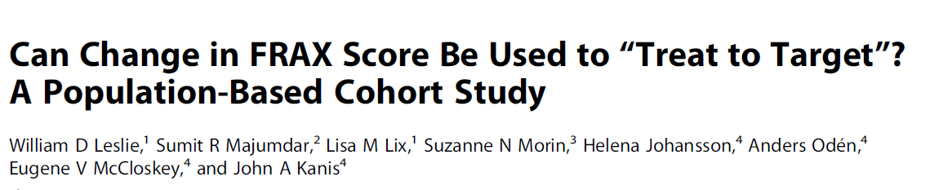
Objective: To confirm (or refute) the clinical utility of using change in FRAX scores over time as a surrogate measure that could be used to inform goal‐directed therapy and thus guide decisions around initiation and duration of osteoporosis treatment
Journal of Bone and Mineral Research, Vol. 29, No. 5, May 2014, pp 1074–1080

Slide 41
Methods
11,049 untreated women aged 50 years undergoing baseline and follow‐up DXA examinations in Manitoba, Canada were evaluated
Median interval between two DXA was 4 years and for median of 4 years were followed for incident fracture
A total of 6534 (59%) of them initiated treatment
FRAX scores for major osteoporotic and hip fractures were computed for each scan using the most current (updated) FRAX inputs were calculated

Slide 42
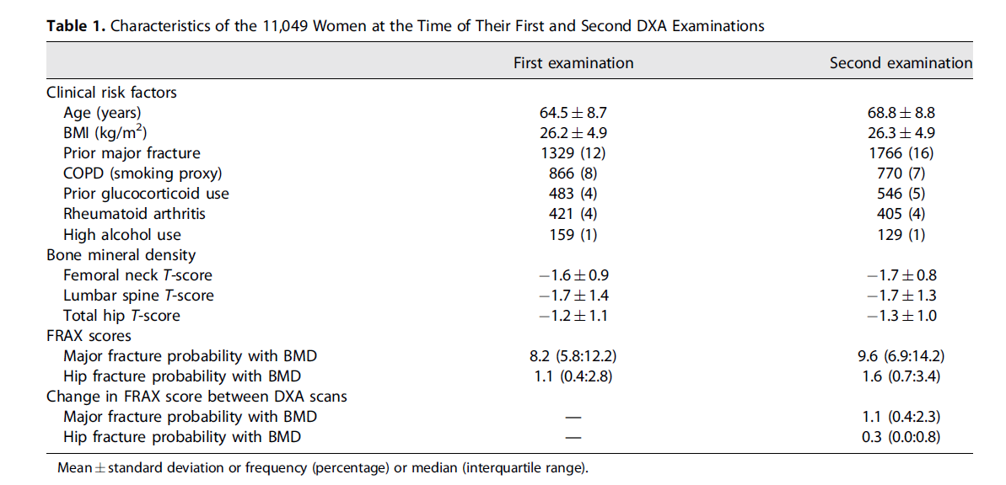

Slide 43
In the subgroup of women highly adherent to osteoporosis treatment, a negligible clinically important reclassification of fracture risk: 98% of these women had the same or greater risk of major fracture according to FRAX as they did before therapy

Slide 44
Results
FRAX scores were strongly predictive of incident major fractures (adjusted hazard ratios [aHR] per SD increase in FRAX 1.8, 95% CI 1.7–1.9) and hip fractures (aHR per SD 4.5, 95% CI 3.7–5.7)
However, change in FRAX score was not independently associated with major fracture (p=0.8) or hip fracture (p=0.3)

Slide 45
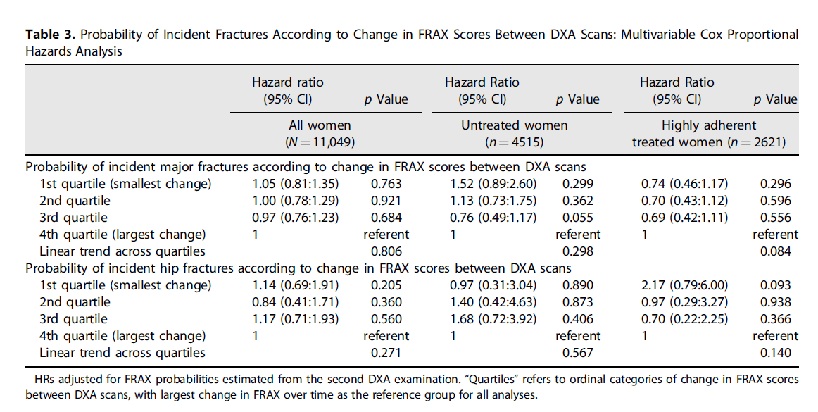

Slide 46
Key messages
FRAX tended to increase over time and were not particularly responsive to changes in risk factors, BMD, or osteoporosis treatments
Thus, changes in FRAX score are a poor surrogate measure for treatment response and cannot be recommended as a target for goal‐directed therapy.

Slide 47
What would you recommend ?
Drug holiday
Reassurance and retreatment with ALN
Switching to Denosumab
Switching to Teriparatide

Slide 48
The present study was conducted in postmenopausal women previously treated with alendronate to evaluate the effects of transitioning to denosumab on safety, BMD, and bone remodeling in comparison with continued branded alendronate therapy.
J Bone Miner Res,2010 Jan;25(1):72-81

Slide 51
Median serum CTX levels remained near baseline in the alendronate group and were
significantly decreased versus alendronate (p<.0001)

Slide 52
Key message
Transition to denosumab produced greater increases in BMD at all measured skeletal sites and a greater reduction in bone turnover than did continued alendronate with a similar safety profile in both groups.

Slide 53
What would you recommend ?
Drug holiday
Reassurance and retreatment with ALN
Switching to Denosumab
Switching to Teriparatide

Slide 54

A part of results of EUROFORS study:
Comparison of BMD gain after 24 m teriparatide therapy. between 3 groups of participants based on their prior antiresorptive(AR) treatment:
1-Treatment-naïve (n=84)
2-Pretreated with AR with adequate treatment response (n=134)
3- Pretreated with AR showing an inadequate response to AR treatment (n=285)
JOURNAL OF BONE AND MINERAL RESEARCH 2008 :1591-1600
Notes:
women55 yr of age who
were at least 2 yr postmenopausal, had a T-score of −2.5 or
less for BMD at the lumbar spine, total hip, or femoral
neck, and at least one documented vertebral or nonverte-bral fragility fracture in the 3 yr before study entry

Slide 55
Definition of inadequate AR responders
Sustained at least one new vertebral or nonvertebral fragility fracture despite prior prescription of an AR therapy for at least 12 month
Had a lumbar spine, total hip, or femoral neck BMD T-score of −3.0 or less after documented prior AR treatment for at least 24 month
Experienced a decrease of >3.5% in BMD in 2 yr at any one of the skeletal sites measured, despite documented continuous prescription of an AR agent in the preceding 24 month

Slide 57
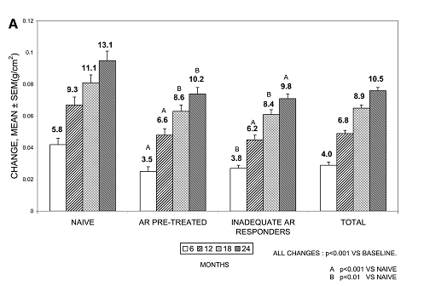
BMD changes of lumbar spine from baseline in the three pretreatment subgroups and the total population
Notes:
. No statistically significant differences between the AR pretreated and the inad-equate A

Slide 58
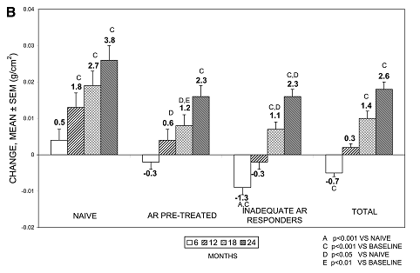
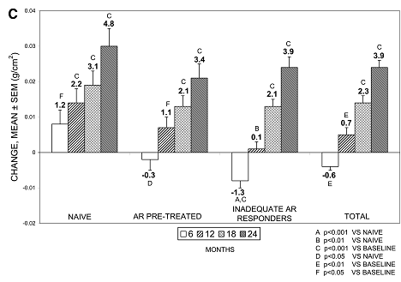
Total hip
Femoral neck

Slide 59
Key messages
Teriparatide treatment for 24 month is associated with a significant increase in BMD in patients with and without previous AR use.
Prior AR treatment modestly blunted the BMD response to teriparatide.

Slide 60
Scenario resolution

Slide 61
Management Approach and Rationale
Although, the evidence for fracture reduction is only available for vertebral fracture reduction with oral ALN for up to 10 years and IV ZOL for up to 6 years, and there is no evidence for non-vertebral fracture risk reductionit is reasonable to extend treatment beyond the 10 years , in view of the patient’s presumed high risk based on low BMI, positive family history, and calculated FRAX.
However, the use of FRAX in patients on therapy has not been well validated

Slide 62
Validated Risk Factors
Advanced age
Previous fracture
Long-term glucocorticoid therapy
Low body weight (less than 58 kg [127 lb])
Family history of hip fracture
Cigarette smoking
Excess alcohol intake

Slide 63
What happened…..
While the spine T-score was unchanged over 8 years of BP therapy and no fracture had occurred, switching to anti-fracture therapy using a non-BP was recommended, after discussing the limited evidence and pros and cons of such an approach with the patient.
She was begun on teriparatide 20 mcg SC daily, which increased her lumbar spine BMD by 13.4% and total hip BMD by 6.8% by 24 months.
To preserve the increases in spine and hip BMDs, she received a series of three ZOL infusions 5.0 mg IV every 12 months. One year after the third infusion, her spine BMD had increased by 3.1% while her total hip BMD was stable. No new clinical fractures occurred since her original treatment.

Slide 64
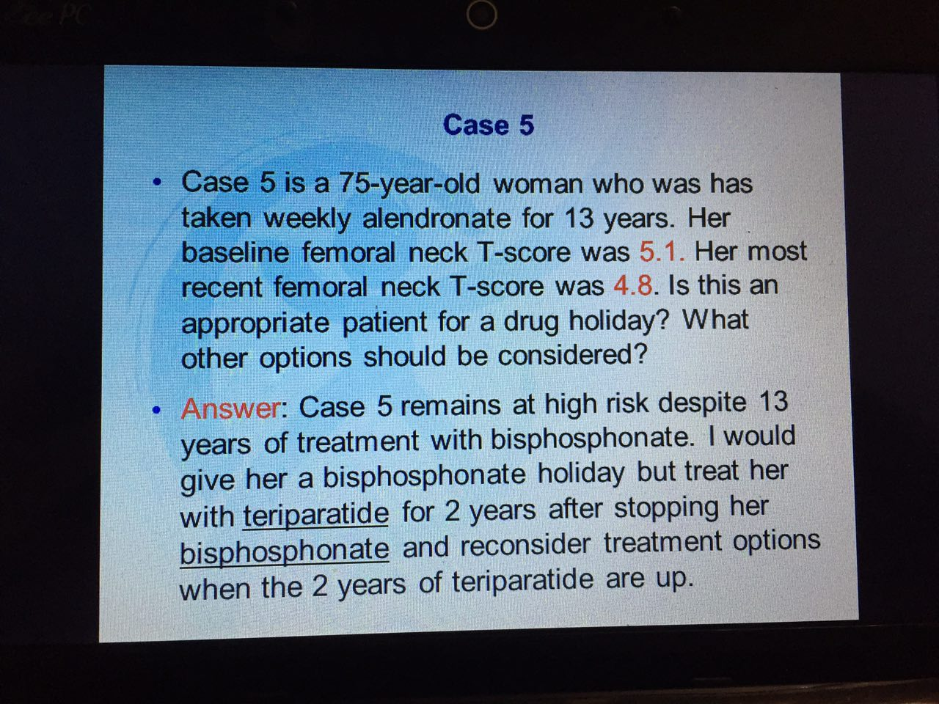

Slide 66
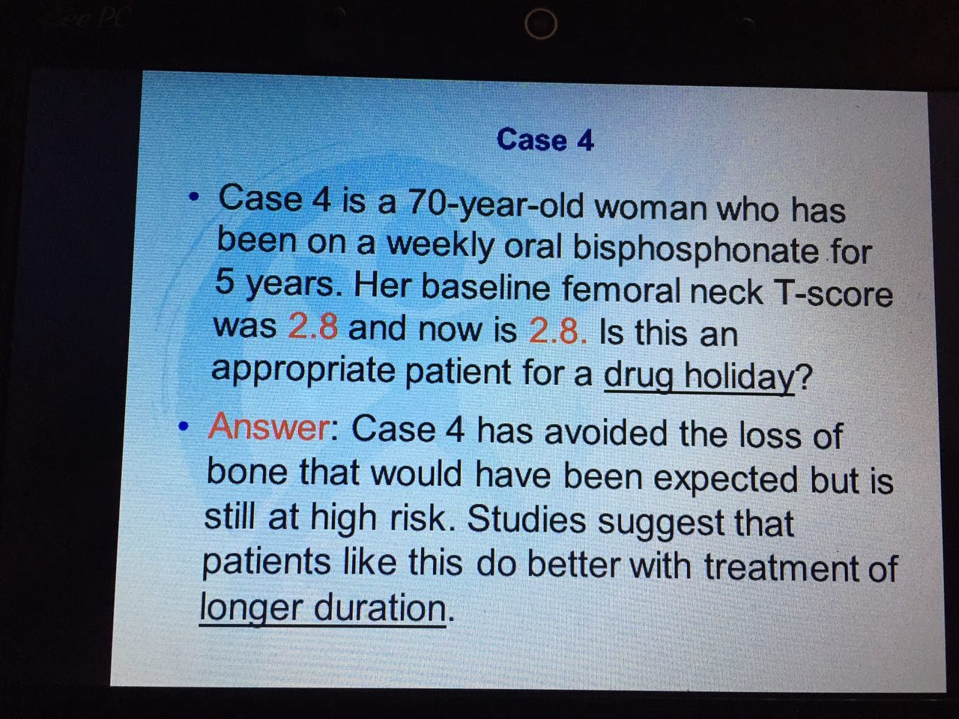

Slide 69
