Slide 1
Diabetes and Bone Disease
Omid Gharooi Ahangar

Slide 2
65-year-old female with T2D, body mass index 30.5 kg/m2, prior fractures distal radius and humerus, one recent fall, hip T-score -2.1, TBS at the 10th percentile 1.160.
FRAX= Osteoporotic Fracture 10 y (%) 15
Hip Fracture 10 y (%) 2.5

Slide 3
Clinical question
What is the significance of DM or Hx of falling in this patient?
What is the effect of TBS in FRAX calculation?
Is that correct Fx risk assessment for this patient in real life?
Treatment or f/u?

Slide 4
Agenda
Risk of fracture in DM 1 & 2
Risk factors of fracture in DM
pathophysiology of the increased fracture risk in DM 1 & 2
DXA derived parameters for evaluating fracture risk in DM 1 & 2
fracture prediction tools and their pitfall
How can modify our calculation score?
Management of osteoporosis in DM

Slide 5
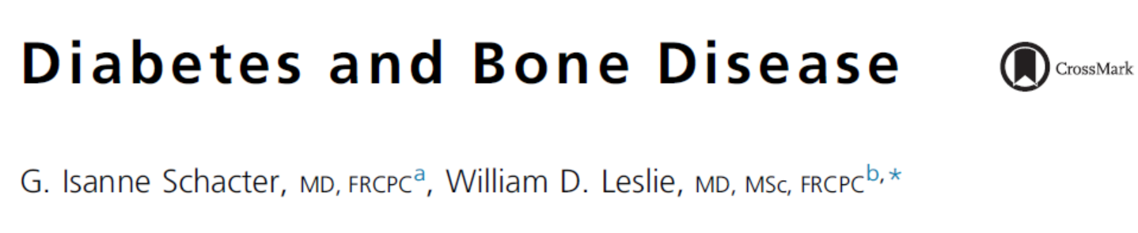

Slide 6
Agenda
Risk of fracture in DM 1 & 2
Risk factors of fracture in DM
pathophysiology of the increased fracture risk in DM 1 & 2
DXA derived parameters for evaluating fracture risk in DM 1 & 2
fracture prediction tools and their pitfall
How can modify our calculation score?
Management of osteoporosis in DM

Slide 7
Prevalence
The World Health Organization estimated that diabetes mellitus occurs in more than 415 million people worldwide, and that this number could double by 2040.
Nine percent of adults aged 50 and over have osteoporosis, as defined by a low bone mineral density (BMD) at either the femoral neck or the lumbar spine.
The total number of hip fractures in 1990 was estimated to be 1.26 million, and is projected to double twice, to 2.6 million hip fractures annually by 2025 and 4.5 million by 2050.

Slide 8
Epidemiology
In a study of more than 33,000 Swedish adults (ages 25–60 years old), the strongest risk factor for hip fracture in both women and men was diabetes (RR 3.89 for women; RR 6.13 for men).
The increase in fracture risk, which is particularly marked at the hip, is much greater than what would be expected on the basis of the BMD decrement, implying that there are other factors independent of BMD that contribute to this increased fracture risk.
Vestergaard P. Discrepancies in bone mineral density and fracture risk in patients with type 1 and type 2 diabetes–a meta-analysis. Osteoporos Int 2007; 18(4):427–44.
Holmberg AH, Johnell O, Nilsson PM, et al. Risk factors for hip fractures in a middle-aged population: a study of 33,000 men and women. Osteoporos Int 2005;16(12):2185–94.
Zhukouskaya VV, Eller-Vainicher C, Vadzianava VV, et al. Prevalence of morphometric vertebral fractures in patients with type 1 diabetes. Diabetes care 2013; 36(6):1635–40.

Slide 9
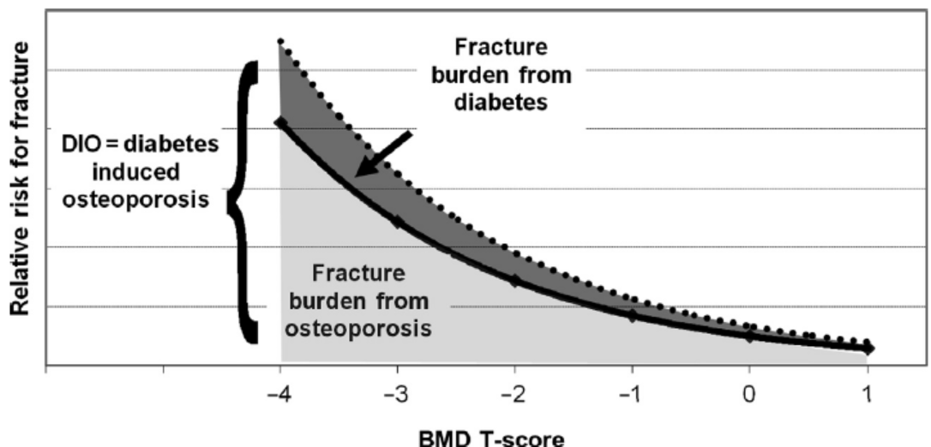

Slide 10
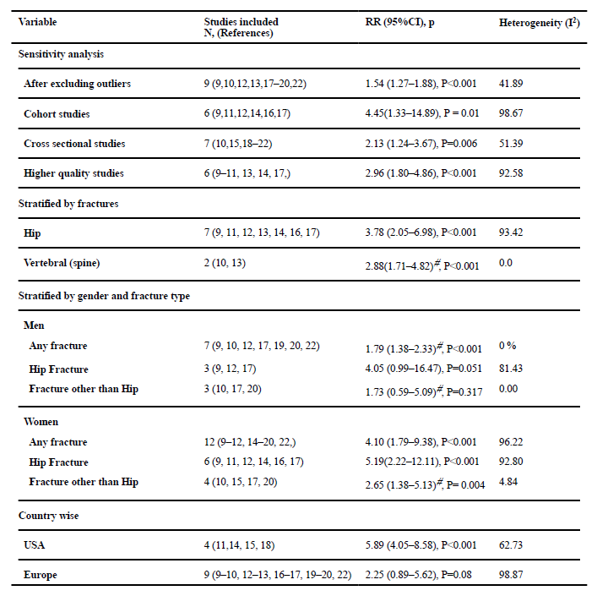
Increased Fractures are at Multiple Sites in T1D
Starup-Linde J, Frost M, Vestergaard P, Abrahamsen B. Epidemiology of Fractures in Diabetes.Calcif Tissue Int. 2017 Feb;100(2):109-121.

Slide 11
Increased Fractures are at Multiple Sites in T2D
WHI (n=93,676; 7 years follow-up)
RR for fracture in T2D:
Hip 1.41
Foot 1.44
Upper arm 1.30
Ankle 1.34
Spine 1.28
Forearm 0.98
Bonds DE, Larson JC, Schwartz AV, Strotmeyer ES, Robbins J, Rodriguez BL, Johnson KC, Margolis KL. Risk of fracture in women with type 2 diabetes: the Women's Health Initiative Observational Study. J Clin Endocrinol Metab. 2006 Sep;91(9):3404-10
Notes:
Not only hip fx
Overall risk of fx was higher in women
W DM at baseline
Women w T2D had a 20% incr
Risd of Any fx (RR 1.20, 1.11-1.30)
Hip 1.41= 41%
All except forearm have increased risk
DID HAVE MORE FALLS, BUT RISK REMAINED
AFTER ADJUSTING FOR FALLS
11

Slide 12
Agenda
Risk of fracture in DM 1 & 2
Risk factors of fracture in DM
pathophysiology of the increased fracture risk in DM 1 & 2
DXA derived parameters for evaluating fracture risk in DM 1 & 2
fracture prediction tools and their pitfall
How can modify our calculation score?
Management of osteoporosis in DM

Slide 13
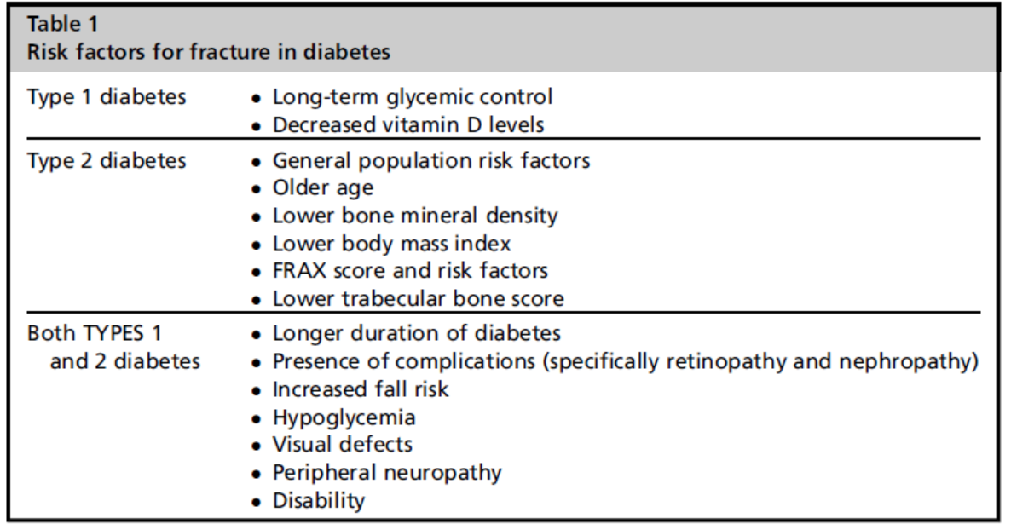
RISK FACTORS

Slide 14
Table 1: Effect of anti-diabetic agents on BMD and fragility fractures in humans
 |  | BMD | Fractures
Thiazolidinediones
 | Rosiglitazone | ▼ | ▲ / = (= in men in some studies)
 | Pioglitazone | = | ▲ / = (= in men in some studies)
 | Metformin | ▲/ = | ▼/ =
 | Sulfonylureas | ▬ | ▼ /=
Incretin therapies
 | GLP-1 analogs | ▲/ = | =
 | DPP-4 inhibitors | ▬ | ▼ / =
 | Insulin | = | ▲/ =
SGLT2 inhibitors
 | Canagliflozin | ▼(Total Hip) | ▲
 | Dapagliflozin | = | ▲ / =
 | Pramlintide | =

Slide 15
Agenda
Risk of fracture in DM 1 & 2
Risk factors of fracture in DM
pathophysiology of the increased fracture risk in DM 1 & 2
DXA derived parameters for evaluating fracture risk in DM 1 & 2
fracture prediction tools and their pitfall
How can modify our calculation score?
Management of osteoporosis in DM

Slide 16
PATHOPHYSIOLOGY
Although patients with T1D and T2D are at increased risk for fractures, the pathophysiology differs.
the pathophysiology of diabetes-induced osteoporosis is likely multifactorial in nature.

Slide 17
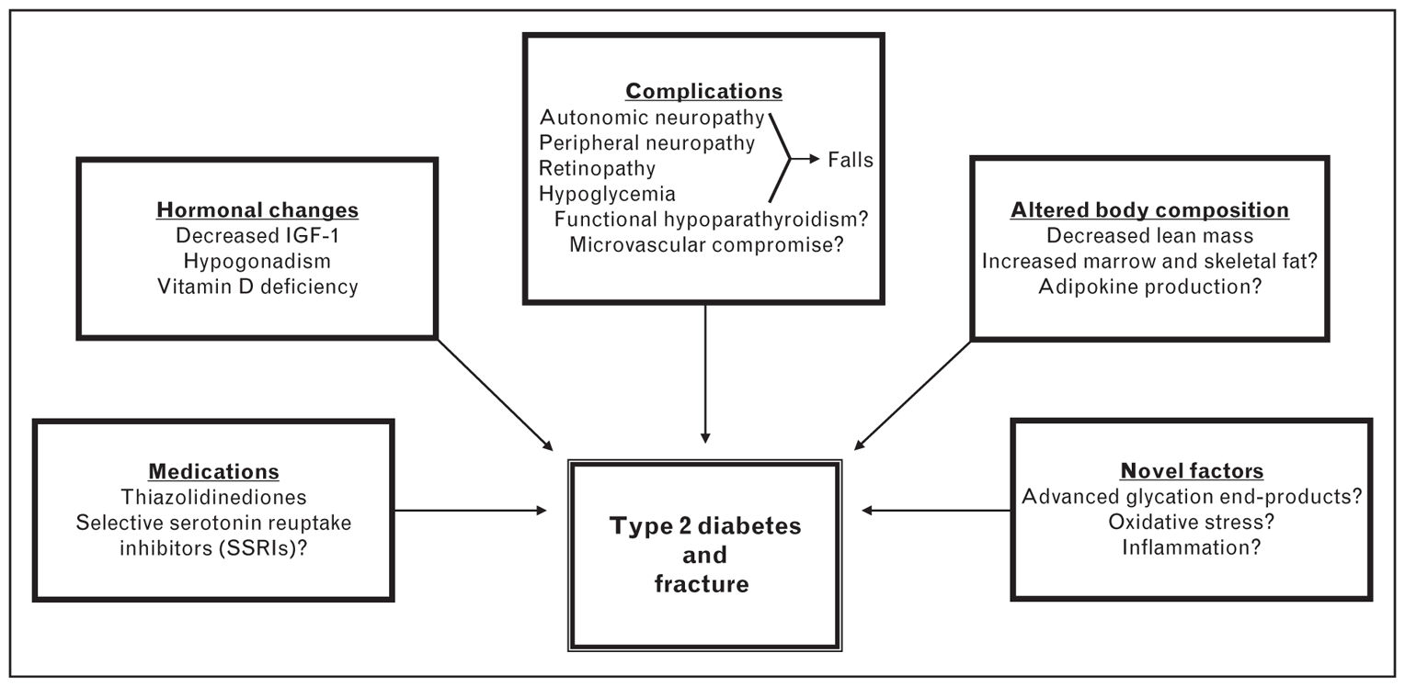

Slide 18
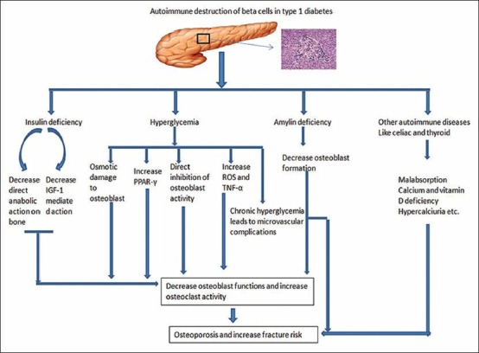

Slide 19
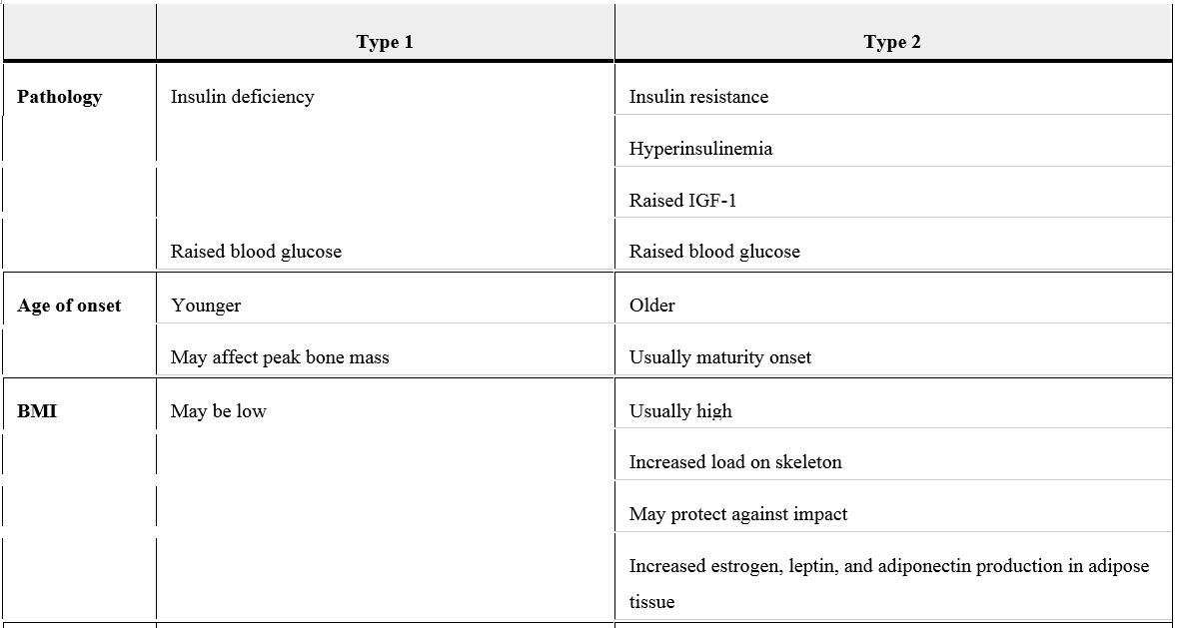
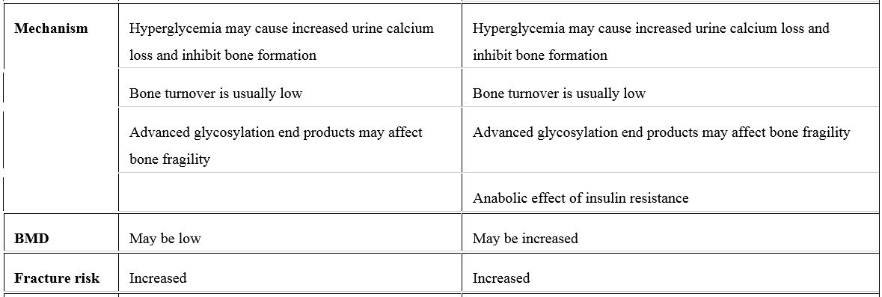

Slide 20
Agenda
Risk of fracture in DM 1 & 2
Risk factors of fracture in DM
pathophysiology of the increased fracture risk in DM 1 & 2
DXA derived parameters for evaluating fracture risk in DM 1 & 2
fracture prediction tools and their pitfall
How can modify our calculation score?
Management of osteoporosis in DM

Slide 21
DXA
Although BMD is the most commonly reported measurement from DXA, other DXA derived parameters for evaluating fracture risk are available.
These include skeletal geometry, trabecular bone score (TBS), vertebral fracture assessment (VFA), and body composition.

Slide 22
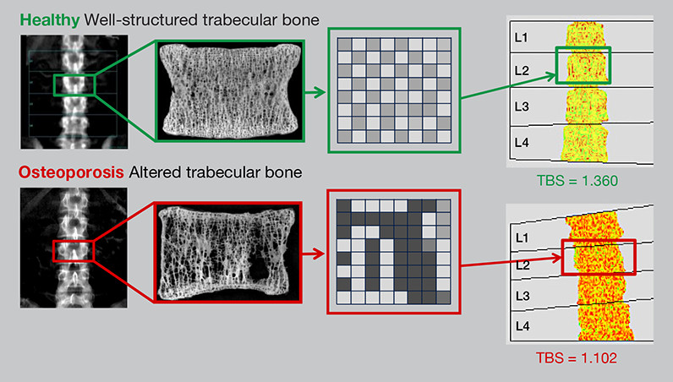
What is TBS ?
TBS, a texture parameter derived from pixel–gray level variations in the spine DXA image, can be used to enhance fracture risk predictions independent of BMD.

Slide 23
DXA parameters In DM 1

Slide 24
BMD
Reduced bone density in patients with T1D as compared with normal controls has been demonstrated in a meta analysis, where a significant reduction in BMD Z-score was seen at both the hip (mean, 0.37) and lumbar spine (mean, 0.22).
the decrease in BMD reported in subjects with T1D only partially explains the observed 6.4-6.9 fold higher hip fracture risk (expected approximately 1.42) compared with individuals without diabetes.

Slide 25
Trabecular bone score
A TBS cutoff of less than 1.42 captured prevalent fractures with 91.7% sensitivity and 43.2% specificity.
Only TBS and total hip BMD discriminated between diabetic patients with and without fractures (area under the curve [AUC], 0.63 and AUC, 0.64, respectively).
The combination of lumbar spine TBS and total hip BMD increased the AUC to 0.68, suggesting potential additive value of TBS and BMD.

Slide 26
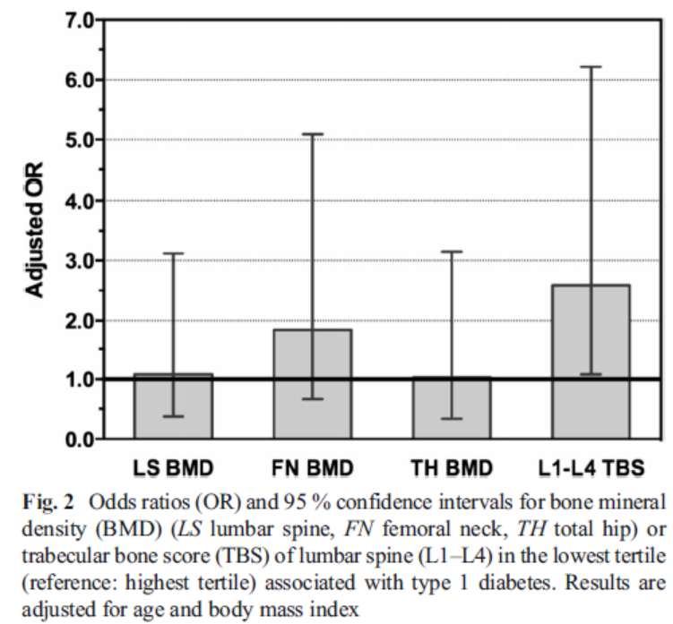
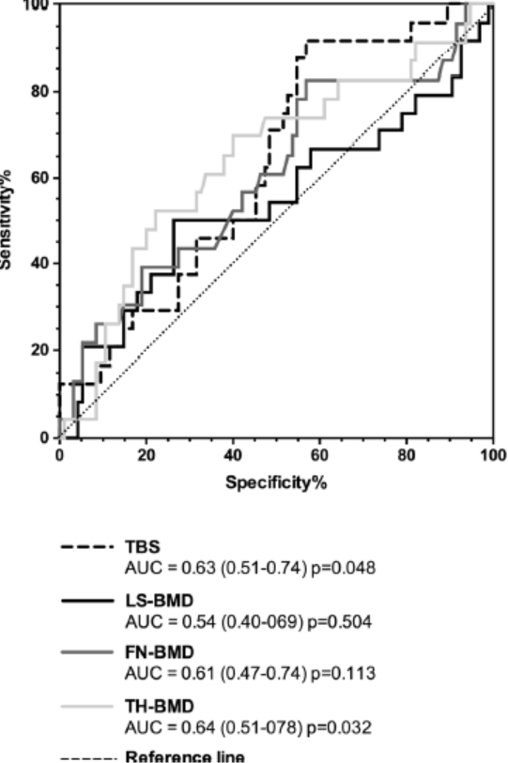

Slide 27
Vertebral fracture assessment: Evidence for the use of VFA for fracture risk prediction in T1D is limited.
Body composition: There are no adult studies that examine the role of body composition in fracture risk in T1D.

Slide 28
DXA parameters In DM 2

Slide 29
BMD
Meta analyses provide robust evidence for normal or even high BMD at both the hip and the spine in T2D, although there is paradoxically increased fracture risk.
Pooled results from 3 large prospective observational studies found that the fracture risk for any given femoral neck BMD T-score and age was increased in patients with T2D when compared with normal controls.
a lower BMD is strongly predictive of fractures in T2D, similar to the general population. However, the excess fracture risk in T2D is not captured by BMD, which is paradoxically higher, even after adjustment for greater BMI.

Slide 30
Skeletal geometry: There are few studies evaluating hip structure in T2D and no studies have evaluated fracture as an outcome. The clinical usefulness of skeletal strength measurements derived from DXA for fracture prediction in T2D is unproven.
Vertebral fracture assessment: There are no published studies assessing VFA in T2D and as such its ability to predict incident fractures and capture excess fracture risk is untested.

Slide 31
Trabecular bone score: Combining lumbar spine TBS with BMD may incrementally improve fracture prediction in those with diabetes, as it has for the general population.
Body composition: there are no studies available that examined whether either body composition or VAT is a predictor of fracture in T2D or whether sarcopenic obesity can identify bone fragility and fracture risk in T2D.

Slide 32
Agenda
Risk of fracture in DM 1 & 2
Risk factors of fracture in DM
pathophysiology of the increased fracture risk in DM 1 & 2
DXA derived parameters for evaluating fracture risk in DM 1 & 2
fracture prediction tools and their pitfall
How can modify our calculation score?
Management of osteoporosis in DM

Slide 33
RISK ASSESSMENT
fracture prediction tools such as the World Health Organization fracture risk assessment tool (FRAX; www.shef.ac.uk/FRAX/ index.aspx), the Garvan fracture risk calculator (www.garvan.org.au/bonefracture- risk), and the QFracture score (www.qfracture.org ) have all been derived to aid with fracture risk prediction in the general population.
although only the QFracture score has specific inputs for T1D and T2D.

Slide 34
Can the FRAX Score, as currently constituted, be used reliably in DM?
BMD (femoral neck T-score)
Age
Gender
Race
BMI
Fracture history
Parental history of hip fracture
Current smoker
Recent corticosteroid use
Rheumatoid arthritis
3+ alcohol drinks/day
Secondary osteoporosis?
* Diabetes is not listed as a clinical risk factor!
Notes:
Includes BMD and other variables; not T2D
Is FRAX useful in a diabetic population?
34

Slide 35

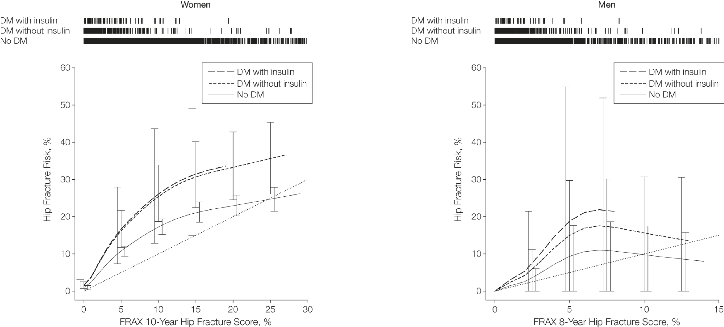
From: Association of BMD and FRAX Score With Risk of Fracture in Older Adults With Type 2 Diabetes
JAMA. 2011;305(21):2184-2192. doi:10.1001/jama.2011.715
For a given FRAX score, fracture risk is higher than predicted in T2D

Slide 36
Agenda
Risk of fracture in DM 1 & 2
Risk factors of fracture in DM
pathophysiology of the increased fracture risk in DM 1 & 2
DXA derived parameters for evaluating fracture risk in DM 1 & 2
fracture prediction tools and their pitfall
How can modify our calculation score?
Management of osteoporosis in DM

Slide 37
Fracture prediction tools modification
the individual FRAX risk factors (including BMD) remain important in patients with T2D, and FRAX provides fracture discrimination in the diabetes population similar to that seen in the general population.
However, the absolute fracture risk is underestimated, possibly owing to alterations in material strength and greater risk for falls.
Several methods have been proposed to capture the effect of T2D despite its absence as an input variable in FRAX. One such method is to use rheumatoid arthritis in the calculation as a proxy for T2D, because the effect seems to be very similar to that of T2D, whereas other options are to use the recently validated TBS adjustment for FRAX or lower the femoral neck T-score by 0.5 SD.

Slide 38
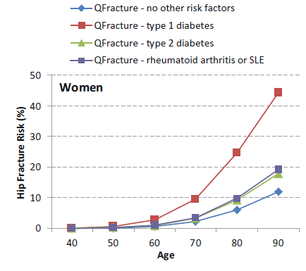
use rheumatoid arthritis in the calculation as a proxy for T2D
Schacter GI, Leslie WD. DXA-based measurements in diabetes: can they predict fracture risk? Calcif Tissue Int 2017;100:150e64.

Slide 39
TBS
TBS has now been implemented as an adjustment to the FRAX score, and was validated in a multi cohort meta analysis.

Slide 40
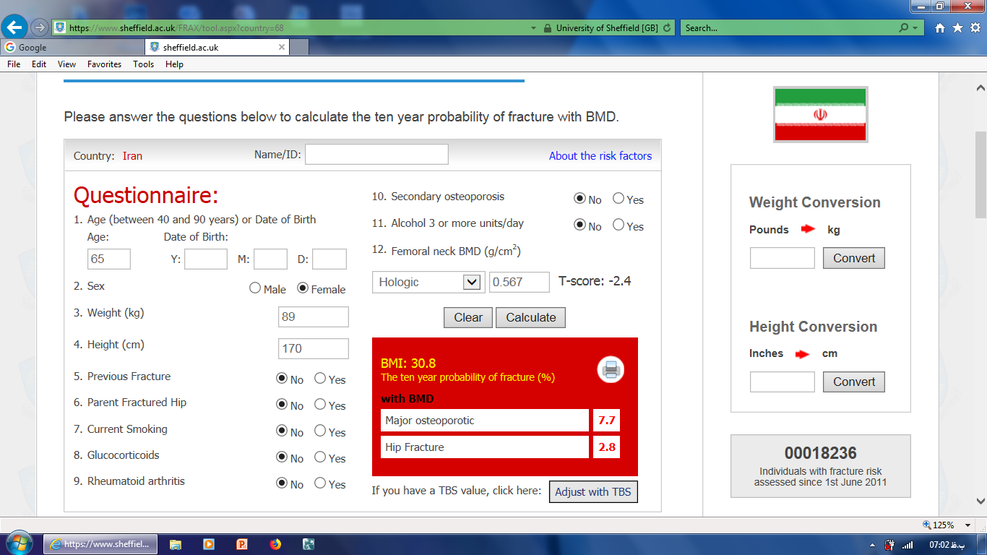
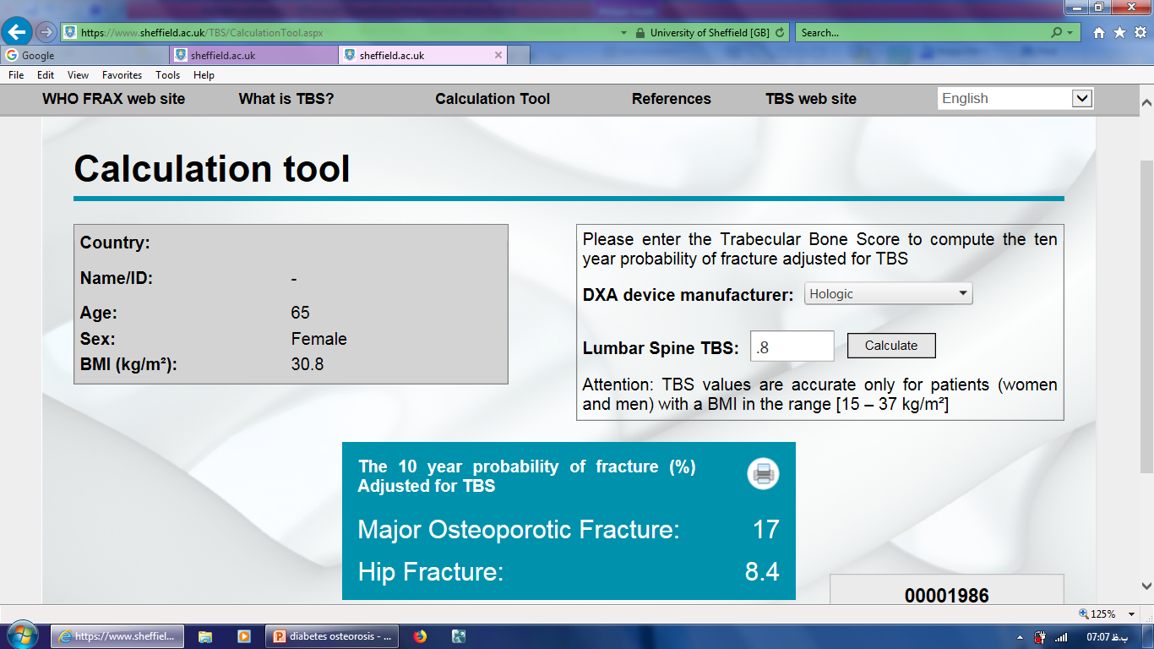

Slide 41
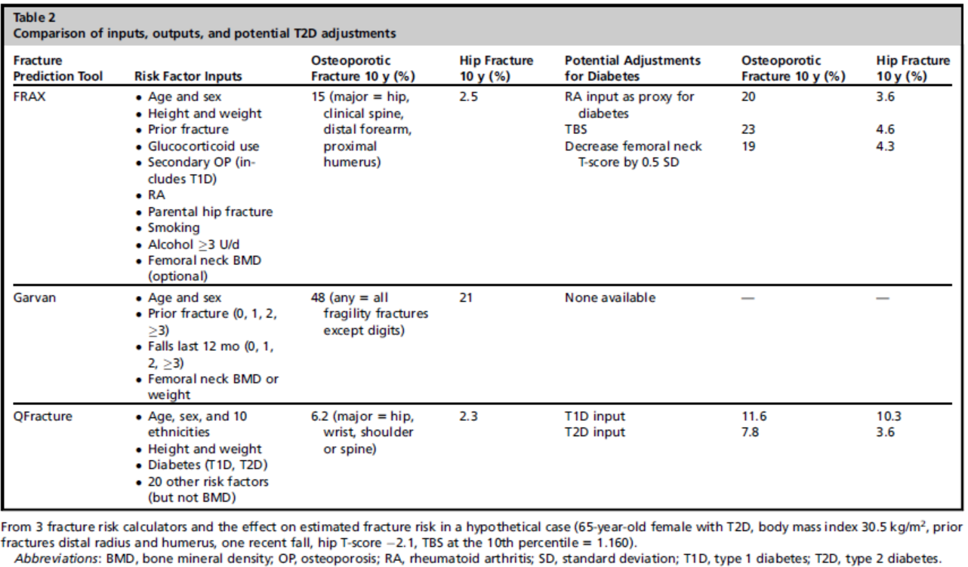

Slide 42
Agenda
Risk of fracture in DM 1 & 2
Risk factors of fracture in DM
pathophysiology of the increased fracture risk in DM 1 & 2
DXA derived parameters for evaluating fracture risk in DM 1 & 2
fracture prediction tools and their pitfall
How can modify our calculation score?
Management of osteoporosis in DM

Slide 43
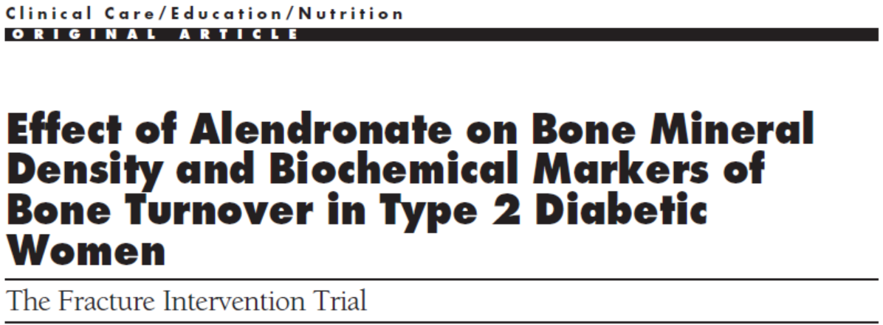


Slide 44
FIT (Fracture Intervention Trial)
involving 6450 women aged 54 to 81 years with low femoral neck BMD who were randomly assigned to either placebo or alendronate for 7 years.
In the patients with diabetes, after 3 years of treatment with alendronate, there was an increase in BMD at all sites, including 6.6% at the lumbar spine and 2.4% at the hip.

Slide 45
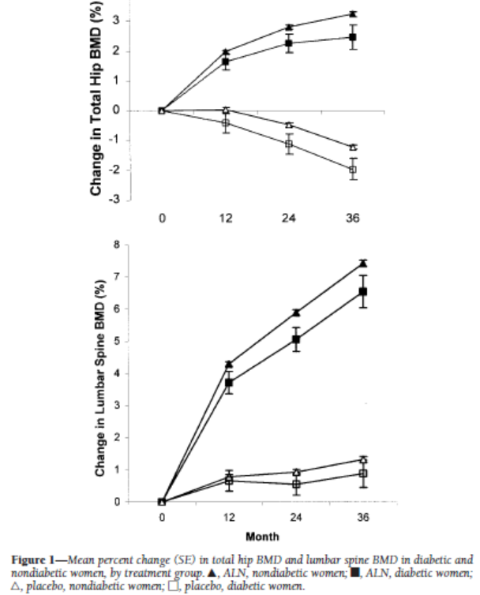

Slide 46
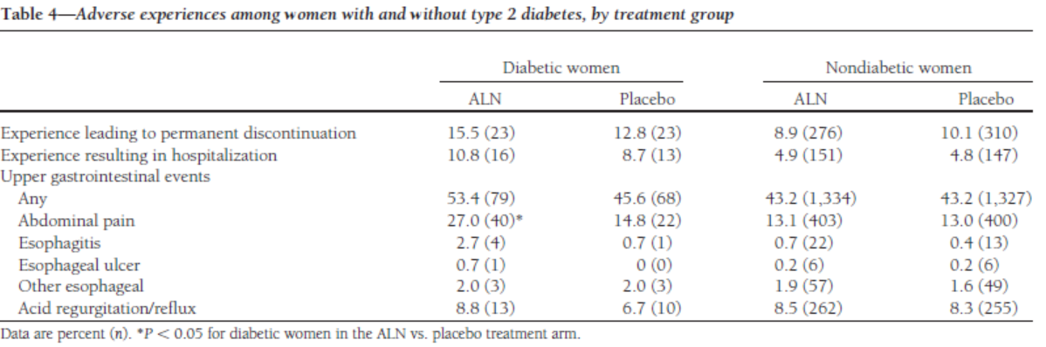

Slide 47
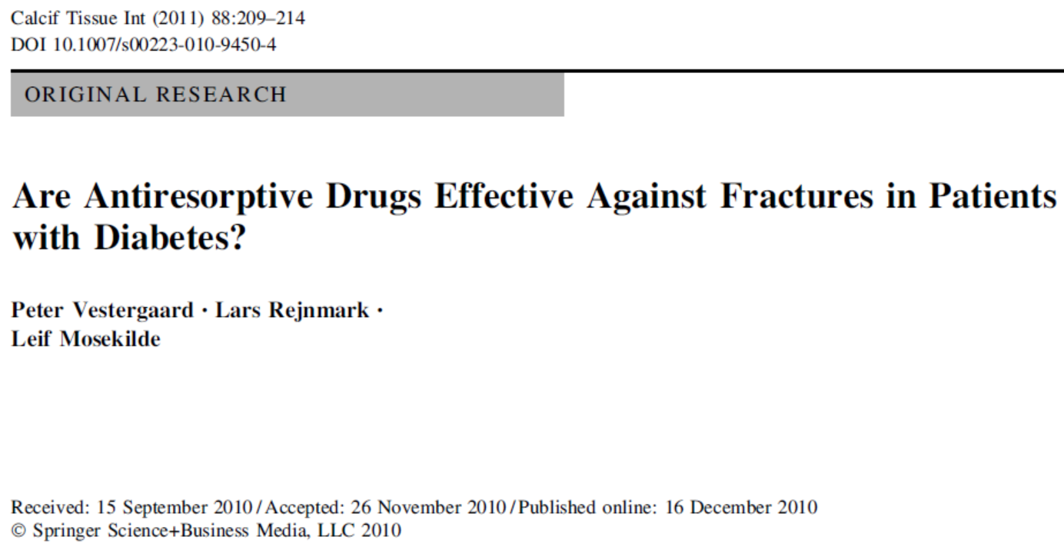

Slide 48
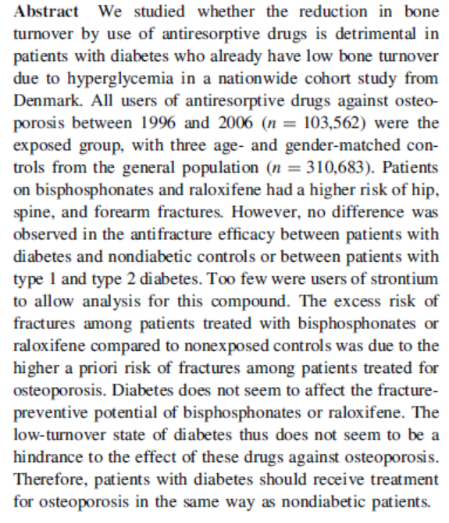

Slide 49
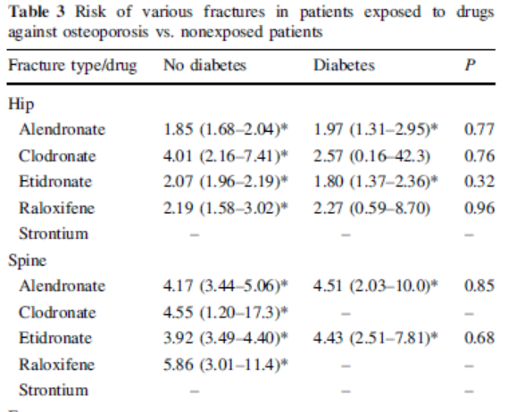
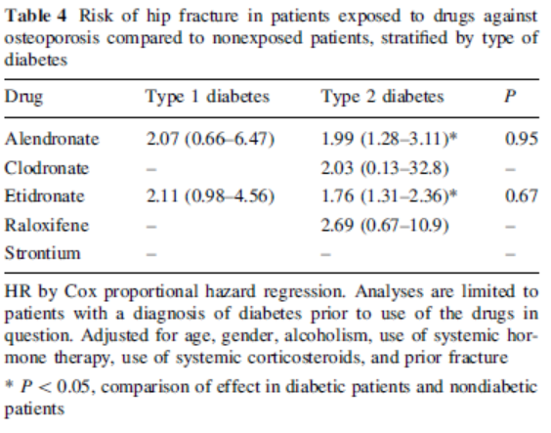
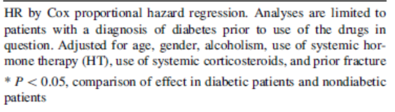

Slide 50
MANAGEMENT
The Institute of Medicine recommends 700 to 1300 mg/d of calcium intake (preferably from food sources) and 600 IU/d of vitamin D for those aged 1 to 70 years of age, and 800 IU/d for ages 71 and older.
There is very little information available from comparative studies on the effectiveness of traditional osteoporosis treatment in diabetes-induced osteoporosis in general, and in T1D specifically.
there was no difference observed in anti fracture efficacy between subjects with and without diabetes, nor between those with T1D and T2D.
Serious adverse events from bisphosphonate treatment do not seem to be increased in patients with diabetes.
the absence of studies specifically targeting osteoporosis in individuals with diabetes, treatment recommendations should follow other guidelines, such as those for postmenopausal women and men

Slide 51
Summary and recommendation
Fracture risk is increased in both DM 1 & 2, possibly related to factors in addition to BMD.
For a given FRAX score, fracture risk is higher than predicted in DM
Several methods have been proposed to capture the effect of T2D despite its absence as an input variable in FRAX.
use rheumatoid arthritis in the calculation as a proxy for T2D
TBS adjustment for FRAX
lower the femoral neck T-score by 0.5 SD.
In the absence of studies specifically targeting osteoporosis in individuals with diabetes, treatment recommendations should follow other guidelines, such as those for postmenopausal women and men.

