Slide 1
IN THE NAME OF ALLAH

Slide 2
Whats the diagnosis of this patient?
Cushing disease or Ectopic ACTH syndrome?

Slide 4
HDDST
dexamethasone suppression test have less than optimal sensitivity and specificity for diagnosing CD, ranging from 50% to 70%.

Slide 5
IMAGING(MRI)
with up to 40% of MRI studies reported as normal
Sellar imaging fails to detect small adenomas in 50% of the patients with CD
The use of dynamic MRI (with iv gad) with spoiled gradient sequences may increase the sensitivity
pituitary incidentaloma can be found in 10–30% of the general population
pituitary imaging is often insufficient to confirm the diagnosis

Slide 6
non-invasive CRH test
CRH in a dose of 1 μg/ kg or a single dose of 100 μg inject
After basal sampling, CRH is administered and blood samples for
ACTH and cortisol are then taken every 15 minutes for 1 to 2
normal subjects:rise in ACTH and cortisol of 15% to 20%.
Cushing disease, ACTH >50% and a cortisol >20% over baseline values are seen.

Slide 7
IPSS
early studies with IPSS reported a diagnostic sensitivity and specificity approaching 100%
IPSS is now considered to be a gold standard in the preoperative diagnosis of CD with a diagnostic sensitivity of 95% and specificity of 90%-95%.
When performed in conjunction with corticotropic-releasing hormone (CRH) stimulation, the diagnostic accuracy of BIPSS exceeds 97%.
additional experience has revealed These false negatives results (rates of 1–10%)

Slide 8
a recent shortage of CRH led to the use of desmopressin (DDAVP), a synthetic form of vasopressin which can also stimulate pituitary ACTH secretion
The results show similar diagnostic accuracy and complication rates, suggesting that DDAVP is a safe and effective alternative to CRH with a sensitivity of approximately 94.4%.

Slide 11
We also selected 16 patients who underwent BIPSS with CRH who had centralizing and lateralizing results in the consecutive months preceding the shift to using DDAVP.
Two-way ANOVA showed no significant difference between DDAVP and CRH stimulation in the ACTH ratios of the lateralized side (F=0.04; p=0.85).

Slide 12
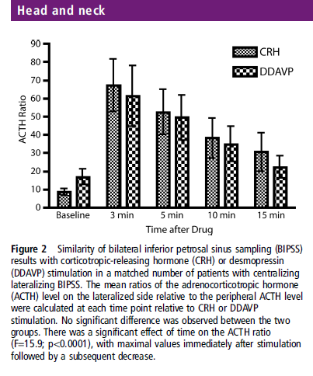

Slide 13
collecting baseline samples from a peripheral line and from both sinuses
peripheral intravenous infusion of 10 mg DDAVP in normal saline, samples are collected at -5,0,3, 5 and 10.
The diagnostic criteria for CD by BIPSS with DDAVP include
(IPS/P) ACTH ratios of ≥2 at Baseline or ≥3 after stimulation).
Lateralization is defined as an ACTH intersinus gradient of ≥1.4 at any time point after stimulation.

Slide 15
ACTH (pg/ml) | -5 min | 0 | 3 min | 5 min | 10 min
R | 225 | 254 | 113 | 151 | 236
L | 1044 | 899 | 226 | 493 | 735
F | 122 | 112 | 105 | 99 | 94
Left IPS/P | 8.5 | 8 | 2.1 | 4.9 | 7.8
Right IPS/P | 1.8 | 2.2 | 1 | 1.5 | 2.4

Slide 17
false positive
identification of Cushing’s disease can occur in patients with
pseudo-Cushing’s states (Yanovski et al., 1993)
in patients with intermittent ectopic ACTH syndrome in whom the procedure is
performed during the eucortisolaemic phase (described in two patients by Yoshihiro et al., 1995)
and in the rare patients with neuroendocrine tumours secreting both ACTH and CRH (described in one patient by Young et al., 1998).

Slide 18
case 1
This 33-year-old woman developed skin pigmentation and significant weight gain during the year prior to presentation to her local physician.
Laboratory studies
morning cortisol level of 18.7 m g/dl
a 24-hour UFC of 221 m g (normal 24–108).
an ACTH level of 89 pg/ml (normal 0–60)
HDDST was nonsuppressive (plasma cortisol 13 m g/dl).
A computerized tomography (CT) scan of the head showed a possible microadenoma on the left side of the pituitary gland.

Slide 20
UFC measurements 7 and 8 days after the IPSS study were 39 and 41 mg per 24 hours, respectively (normal 50 mg/24hours).
The repeated morning cortisol level was 31 mg/dl (normal 25)
with an evening cortisol level of 19 mg/dl(normal 14).
24-hour UFC was 200 mg/24 hours
DST showed a 24-hour UFC level of 61 mg/24 hours with LDDST, and 50 mg/24 hours with HDDST.
Repeat CT scan

Slide 21
CT scan of the chest showed a 1-cm indeterminate nodule in the right mid lung
The patient underwent a complete right hemi hypophysectomy and subtotal left hemi hypophysectomy, but no adenoma was found on biopsy.
the patient’s 24-hour UFC level remained high, at 225 mg/24 hours.
A right thoracotomy and right middle lobectomy were performed 2 months after TSS and a 1-cm carcinoid tumor was found in the surgical specimen.

Slide 23
Case 2
This 38-year-old woman with a 2-year history of HTN, significant weight gain, acne, and hirsutism.
Evaluation at another institution showed a markedly elevated 24-hour UFC of 2265 mg
Plasma ACTH levels of 35 and 159 pg/ml (normal 0–60).
HDDST showed suppression consistent with pituitary disease (plasma cortisol 17 mg/dl at baseline and suppressed to 4.2 mg/dl).

Slide 24
Evaluation at the Mayo Clinic revealed
a morning cortisol level of 20 mg/dl
and a 24-hour UFC level of 96 mg /24
Inferior petrosal sinus sampling showed no baseline IPS/P gradient, but significant gradient (12:1) was found with oCRH in the left IPS
Both CT scans and MRI images failed to show evidence of a pituitary lesion.
A chest CT showed a 1-cm nodule in the right mid lung posteriorly,

Slide 25
TSS did not reveal pituitary adenoma, and a neartotal anterior hypophysectomy was performed.
After surgery, the morning plasma cortisol level was 5.5 m g/dl.
Two months later, however, the morning plasma cortisol was 56 mg/dl and the 24-hour UFC was 8852.
The patient’s postoperative course was complicated by a compression fracture of L-4 and T-12 from severe osteoporosis.

Slide 26
The patient subsequently developed necrotizing Aspergillus bronchopneumonia and died 3 months after surgery.
The postmortem study revealed a 1-cm bronchial carcinoid tumor in the posterior segment of the right upper lung

Slide 28
False negative
either technical problems because of unsuccessful catheterization
a corticotroph adenoma not responsive to CRH
atrophic inferior petrosal sinuses
or anomalous venous drainage (such as filling defects of the vertebral venous plexuses

Slide 29
We analysed the retrospectively collated data on all patients who had undergone IPSS over a 5-year period at St. Thomas’ Hospital between 2005 and 2010 (n = 83).

Slide 30
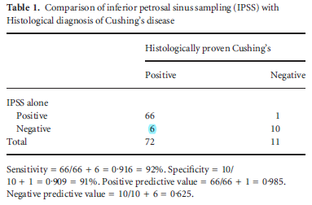

Slide 31
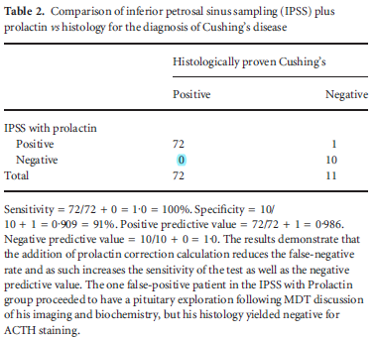

Slide 33
RESULTS
Diagnosis of Cushing’s disease by IPSS
Among the 91 patients included:
82 (90.1%) had basal petrosal/peripheral gradients ≥2
and 9 (9.9%) had basal petrosal/peripheral ACTH gradients <2.
After desmopressin administration, 7 (77.8%) of the 9 patients had the ACTH gradient amplified to >3.0.
.

Slide 34
RESULTS
Among all 90 patients who had CD, 89 (98.9%) had positive IPSS findings, therefore the sensitivity of IPSS in the diagnosis of CD was 98.9%.
The patient who did not have CD also had negative IPSS findings, therefore the specificity of IPSS in the diagnosis of CD was 100%

Slide 35
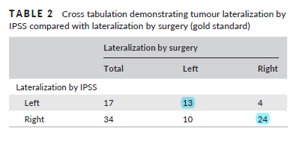
RESULTS
Tumour lateralization accuracy
In total, 37 (72.5%) had IPSS lateralization in concordance with that of surgery, hence the concordance rate was 72.5%.

Slide 37
RESULTS
The considerable variations of accuracy among different studies might be attributed to several reasons.
First, taking into consideration the heterogeneity of surgical interventions and judgements of lateralization by surgeons,
Besides, the selection criteria of cases into the assessment of lateralization accuracy were not standardized among studies.

Slide 38
RESULTS
Deipolyi et al calculated the accuracy from patients who had lateralizations from both IPSS and from surgery, 66.7% (10 of 15).
Castinetti et al calculated the accuracy from patients in whom the surgical lateralization of tumours was either left or right, regardless whether the lateralization by IPSS was conclusive or inconclusive, 54% (15 of 28).

Slide 40
conclusion
Our study has shown that higher lateralization accuracy was related with right lateralization by surgery
It might be explained by asymmetrical venous drainage caused by anatomical variations
Asymmetric venous drainage of bipss is not a rare phenomenon)
previous studies have shown that selecting patients with symmetrical venous drainage could enhance the
lateralization accuracy

Slide 41
Desmopressin test
Response is assessed by measuring ACTH serum cortisol and possibly salivary cortisol 30 minute before ,basally,15,30,45 and 60minutes after iv administration of 10 ug of Desmopressin with serial blood samples obtained from an indwelling catheter inserted in a forearm vein.
Increase of more than 35-50%in ACTH
Increase of more than20-36% in cortisol
Desmopressin test induce a positive ACTH response in 85%of patient with CD

