Slide 1
Thiazolidendiones SGLT2 inhibitors
A Amouzegar MD
Endocrine Research Center, Research Institute For Endocrine Sciences, Shahid Beheshti University

Slide 2
Outlines:
Mechanism of action of TZDs
Efficacy of TZDs
Safety of TZDs
CVDs
Osteoporosis
Cancers
SGLT2 inhibitors

Slide 3
Thiazolidinediones, which are selective ligands of the nuclear transcription factor peroxisome-proliferator–activated receptor(PPAR-gamma)
PPAR-gamma is expressed most abundantly in adipose tissue but is also found in pancreatic beta cells, vascular endothelium, and macrophages, muscles, liver

Slide 4
enhancement of insulin sensitivity
Thiazolidinediones consistently lower fasting and postprandial glucose concentrations as well as free fatty acid concentrations in clinical studies
These indicate that thiazolidinediones act as insulin sensitizers, increases insulin-stimulated glucose uptake in peripheral tissues

Slide 5
Thiazolidinediones increase hepatic insulin sensitivity (the ability of insulin to suppress endogenous glucose production) and insulin sensitivity in adipose tissue (measured from the ability of insulin to suppress free fatty acid concentrations)

Slide 7
Yki-Järvinen H. N Engl J Med 2004;351:1106-1118.
Comparative Effects of Maximal Doses of Rosiglitazone (8 mg) and Pioglitazone (30 to 45 mg) on Glycemic Control as Measured by Absolute Change in Glycosylated Hemoglobin as Compared with Placebo or Control Group (Metformin, Sulfonylurea, or Insulin Alone or in Combination).

Slide 8
Both pioglitazone and metformin reduced HbA1c by 1.5% from baseline
J Clin Endocrinol Metab, December 2004, 89(12):6068–6076

Slide 9
Within the first 6 months, levels of fasting plasma glucose and glycated hemoglobin decreased in all treatment groups, with glyburide showing the greatest effect. After 6 months, the rates of increase in these glycemic measures were greatest in the glyburide group
N Engl J Med. 2006 Dec 7;355(23):2427-43.

Slide 11
In addition to providing sustained glycemic control in T2DM patients, pioglitazone resulted in a 70% reduction in the risk of developing T2DM in the Actos Now for the prevention of diabetes (ACT NOW) study

Slide 12
DeFronzo RA et al. N Engl J Med 2011;364:1104-1115.
Kaplan–Meier Plot of Hazard Ratios for Time to Development of Diabetes.
Notes:
Figure 2. Kaplan–Meier Plot of Hazard Ratios for Time to Development of Diabetes.

Slide 13
CARDIOVASCULAR EFFECTS
Although thiazolidinediones have been shown to improve a number of cardiovascular risk factors and surrogate cardiovascular endpoints, including :
Dyslipidemia, markers of inflammation
vascular smooth muscle proliferation
vascular reactivity, endothelial function
carotid intima media thickness, and
progression of atherosclerosis

Slide 14
Pioglitazone has been shown to increase HDL cholesterol, decrease fasting triglycerides, and decrease fasting plasma free fatty acids
Rosiglitazone was found to improve only HDL cholesterol
In addition, total cholesterol and LDL cholesterol levels were unaffected with pioglitazone but were significantly increased with rosiglitazone
Diabetes Care 2007;30: 2458–2464

Slide 15
Yki-Järvinen H. N Engl J Med 2004;351:1106-1118.
Comparative Effects of Maximal Doses of Rosiglitazone (8 mg) and Pioglitazone (30 to 45 mg) on Serum Lipids and Lipoproteins in Randomized, Controlled Trials.
Notes:
Figure 4. Comparative Effects of Maximal Doses of Rosiglitazone (8 mg) and Pioglitazone (30 to 45 mg) on Serum Lipids and Lipoproteins in Randomized, Controlled Trials. All changes are shown as percent changes relative to the change in the placebo group (i.e., percent change from baseline with pioglitazone or rosiglitazone minus percent change with placebo from baseline). Asterisks indicate P≤0.05. LDL denotes low-density lipoprotein, HDL high-density lipoprotein, and ND no data. Yellow bars indicate monotherapy, red bars combination therapy with metformin, green bars combination therapy with sulfonylurea, and purple bars combination therapy with insulin.

Slide 16
Data demonstrating their ability to decrease cardiovascular events are unimpressive and concerns about side effects (weight gain, fluid retention, heart failure, myocardial infarction, and fractures) persist

Slide 18
PRO Active Study www.thelancet.com Vol 366 October 8, 2005

Slide 19
Nissen SE, Wolski K. N Engl J Med 2007;356:2457-2471.
Rates of Myocardial Infarction and Death from Cardiovascular Causes.
Relatively small number of events

Slide 20
A report of Nationwide, observational, retrospective, inception cohort from the U.S. Food and Drug Administration (FDA) analyzing the risk of CV events in 227,571 patients aged>65 years who were treated with TZDs
JAMA, July 28, 2010—Vol 304, No. 4

Slide 22
RECORD study www.thelancet.com Vol 373 June 20, 2009

Slide 24
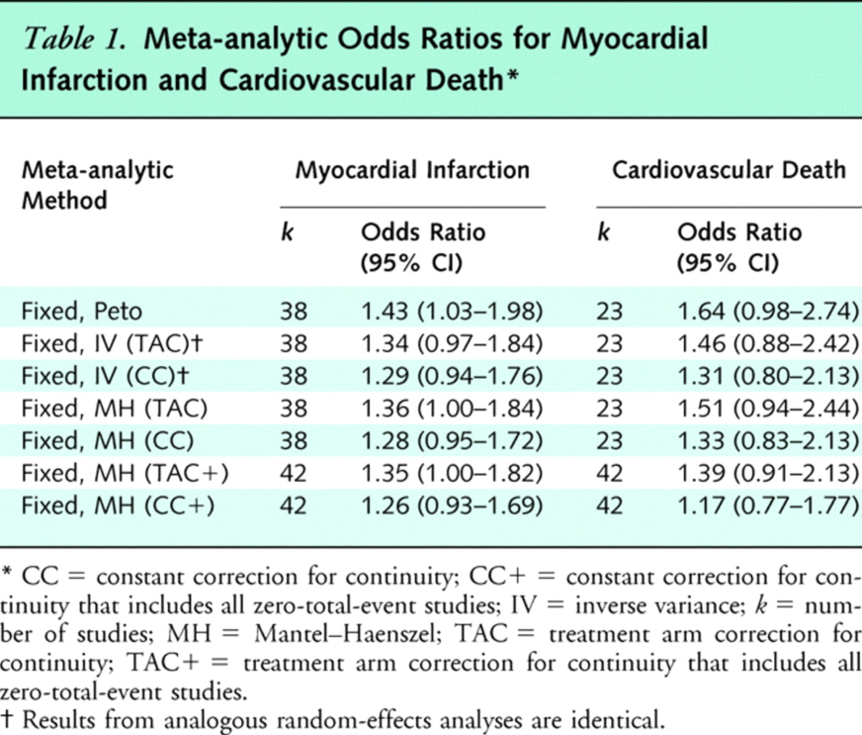
From: Uncertain Effects of Rosiglitazone on the Risk for Myocardial Infarction and Cardiovascular Death
Ann Intern Med. 2007;147(8):578-581. doi:10.7326/0003-4819-147-8-200710160-00182
Table Title:
Meta-analytic Odds Ratios for Myocardial Infarction and Cardiovascular Death
Date of download: 2/24/2015
Copyright © American College of Physicians. All rights reserved.

Slide 25
The mechanism for the apparent increase in myocardial infarction and death from cardiovascular causes associated with rosiglitazone remains uncertain
One potential contributing factor may be the adverse effect of the drug on serum lipids, although the rapidity and magnitude of the apparent hazard was not consistent with an effect produced by lipid changes alone

Slide 26
SAFETY
Hypoglycemia :
The thiazolidinediones improve blood glucose primarily by increasing insulin sensitivity Therefore, thiazolidinedione monotherapy is less likely to cause hypoglycemia than sulfonylureas or insulin
However, mild to moderate hypoglycemic events can occur when thiazolidinediones are given in conjunction with sulfonylureas or insulin
Diabetes Care 2000; 23:1605

Slide 27
Weight gain:
All of the thiazolidinediones cause weight gain
The weight gain is caused in part by fluid retention
Weight gain may also result from the proliferation of new adipocytes
CNS PPAR-gamma activation mediates weight gain by promoting increased feeding. This finding accounts, in part, for the weight gain associated with thiazolidinedione treatment
Nat Med. 2011;17(5):618.

Slide 28
Fluid retention/heart failure:
Fluid retention, which is more prominent with concomitant insulin therapy, can occur with all the thiazolidinediones
Edema occurs in ~5% of patients treated with pioglitazone in monotherapy or in oral combination therapy and in ~10% of patients treated with TZDs in combination with insulin
This fluid retention may lead to the precipitation or worsening of HF

Slide 29
Along the nephron, PPAR-gamma is most abundant in the collecting tubules, and the fluid retention with thiazolidinediones appears to result from PPAR-gamma stimulation of sodium reabsorption by sodium channels in the luminal membrane of the collecting tubule cells
Nat Med 2005; 11:861

Slide 30
Skeletal :
In the Health, Aging and Body Composition Study (Health ABC), a 4-year observational study, 666 diabetic patients, aged 70 to 79 years at baseline, had bone density assessment every two years
Although baseline bone density was similar, the subset of women (not men) taking thiazolidinediones (n = 69) had greater bone loss at the whole body, lumbar spine, and trochanter compared with those not taking the drug

Slide 31
ADOPT Study www.nejm.org December 7, 2006

Slide 32
In the RECORD trial described above, the incidence of fractures was higher in the rosiglitazone group (185 versus 118 in the control group, RR 1.57, 95% CI 1.26-1.97).

Slide 33
In addition, in a large population-based study using the UK-based General Practice Research Database, both pioglitazone (OR 2.59, 95% CI 0.96-7.01) and rosiglitazone (OR 2.38, 95% CI 1.39-4.09) were associated with low-trauma fracture in men and women

Slide 34
CMAJ • JANUARY 6, 2009 • 180(1)

Slide 37
Sites of fractures in women with Type 2 diabetes treated with rosiglitazone, RECORD study

Slide 38
Bladder cancer

Slide 40
Pioglitazone should not be used in patients with active bladder cancer
In patients with a history of bladder cancer, the benefits of glycemic control versus the unknown risk for cancer recurrence with pioglitazone should be considered

Slide 41
W. Harper et al / Can J Diabetes 37 (2013)

Slide 42
Sodium–Glucose Cotransporter 2 Inhibitors
The major change in treatment options since the publication of the 2012 position statement has been the availability of a new class of glucose-lowering drugs, the sodium–glucose cotransporter 2(SGLT2) inhibitors
These agents reduce HbA1c by 0.5–1.0% versus placebo
When compared with most standard oral agents in head-to-head trials, they appear to be roughly similarly efficacious with regard to initial HbA1c lowering

Slide 43
Their mechanism of action
It involves inhibiting the SGLT2 in the proximal nephron, thereby reducing glucose reabsorption and increasing urinary glucose excretion by up to 80 g/day
Because this action is independent of insulin, SGLT2 inhibitors may be used at any stage of type 2 diabetes, even after insulin secretion has waned significantly

Slide 44
Side effects of SGLT2 inhibitor therapy include genital mycotic infections, at rates of about 11% higher in women and about 4% higher in men compared with placebo
In some studies, a slight increase in urinary tract infections was shown
They also possess a diuretic effect, and so symptoms related to volume depletion may occur

Slide 45
Consequently, these agents should be used cautiously in the elderly, in any patient already on a diuretic, and in anyone with a tenuous intravascular volume status
Reversible small increases in serum creatinine occur
Increased urine calcium excretion has been observed , and the U.S. FDA mandated a follow-up of upper limb fractures of patients on canagliflozin after an adverse imbalance in cases was reported in short-term trials

Slide 46
Small increases in LDL cholesterol (5%) have been noted in some trials, the implications of which are unknown
Due to their mechanism of action, SGLT2 inhibitors are less effective when the estimated GFR (eGFR) is,45– 60 mL/min/1.73 $m^{2}$
Currently available agents have variable label restrictions for values below this threshold

Slide 47
Data on microvascular outcomes with SGLT2 inhibitors are lacking (as with most agents other than sulfonylureas and insulin)
Effects on macrovascular disease are also unknown; cardiovascular safety trials are currently in progress

Slide 48
Drugs
Canagliflozin
Dapagliflozin
Empagliflozin

Slide 49
Summary
pioglitazone monotherapy can be considered an alternative to metformin monotherapy if metformin cannot be used (not tolerated or is contraindicated), as a combination therapy if monotherapy with metformin alone does not achieve/ maintain an HbA1c target, or a triple combination therapy
Pioglitazone appeared to have a modest benefit on CV events as a secondary outcome in one large trial involving patients with overt macrovascular disease

Slide 50
The risk for myocardial infarction and death from cardiovascular disease for diabetic patients taking rosiglitazone is uncertain
Pioglitazone should not be used in patients with active bladder cancer

Slide 51
Thus, pioglitazone remains an effective and useful antidiabetes drug with a unique insulin-sensitizing action

