Slide 1
Approach to sellar mass and pituitary stalk lesions
Majid Valizadeh
Research institute for endocrine sciences

Slide 2
Outline:
Sellar and parasellar mass
different pathology
Presentation
Approach to Sellar mass
Stalk lesions
different pathology
Presentation
Approach to Stalk lesions
Take home message

Slide 4
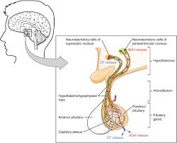
Introduction:
the pituitary gland, (hypophysis ) is an endocrine gland about the size of a pea and weighing 0.5 grams in humans.
Anterior
Intermediate
Posterior

Slide 5
Introduction:

Slide 6
Importance:
The prevalence of pituitary adenomas per 100,000 was fourfold higher than previous estimates :
●All adenomas – 77.6
●Lactotroph adenomas – 44.4
●Nonfunctioning adenomas – 22.2
●Somatotroph adenomas – 8.6
●Corticotroph adenomas – 1.2

Slide 7
Classification:
Size:
Microadenoma
Macroadenoma
Cell of origin:
Gonadotroph adenomas
Thyrotroph adenomas
Corticotroph adenomas
Lactotroph adenomas
Somatotroph adenomas
plurihormonal adenomas: // Lactotroph/somatotroph adenoma combinations
Location:
Intrasellar
Extrasellar
Mixed

Slide 8
Presentations of sellar and parasellar mass
● Neurologic symptoms, such as visual impairment or headache
● Incidental finding on MRI performed for some other reason
● Hormonal abnormalities (under- or oversecretion of pituitary hormones)

Slide 9
Causes:
Pituitary adenomas are the most common cause of sellar masses (about 90%)
Other disorders, which are often difficult to distinguish from pituitary adenomas by imaging, include physiologic enlargement of the pituitary and benign and malignant tumors
Pituitary hyperplasia :
Lactotroph hyperplasia
Thyrotroph and gonadotroph hyperplasia
Somatotroph hyperplasia
Other benign tumors
Craniopharyngiomas, meningiomas, and, less commonly, pituicytomas

Slide 10
Causes:
Malignant tumors :
Primary: germ cell tumors (ectopic pinealomas), sarcomas, chordomas, lymphomas and rarely Pituitary carcinomas.
Metastatic disease — Metastases to the hypothalamus and pituitary gland account for 1 to 2% of sellar masses (most commonly: breast cancer in women / lung cancer in men)
Cysts — Several types of cysts can occur in the sellar and/or suprasellar area, including Rathke's cleft , arachnoid, and dermoid cysts
Abscess: only one third have features suggestive of infection (fever, leukocytosis, meningismus)
Arteriovenous fistula of the cavernous sinus
Hypophysitis: usually occurs in late pregnancy or the postpartum period

Slide 13
How distinguish
Why: Correct preoperative diagnosis is clinically important because the treatment of choice for many of these nonpituitary sellar masses differs from that of a pituitary tumor. (Germ cell tumors, Sarcoidosis, LCH, Lymphoma )
In some cases, there are no features that clearly distinguish the unusual etiologies from the clinically nonfunctioning pituitary adenoma.
In others, certain endocrine, neurologic, and radiographic findings that are more characteristic of patients with a nonpituitary sellar mass may be present and can help in their differentiation.

Slide 14
Evaluation of sellar mass:
Should be evaluated both radiologically and hormonally. (Clinically- Visual field)
Certain MRI findings: suggest a greater likelihood of some kinds of sellar masses
As an example, a mass that is separate from the pituitary gland generally indicates that the mass is not a pituitary adenoma.
However, no finding is usually pathognomonic of any one kind of mass

Slide 15
SIGNS AND SYMPTOMS OF NONPITUITARY SELLAR LESIONS
Clinical DI at presentation is highly suggestive of a nonpituitary etiology of a sellar or parasellar mass. Sarcoidosis and metastatic disease to the sellar region are especially likely to lead to diabetes insipidus.
The (SIADH) syndrome of inappropriate antidiuretic hormone secretion leading to
potentially severe hyponatremia may also occur in patients with nonpituitary
sellar and parasellar lesions.

Slide 16
SIGNS AND SYMPTOMS OF NONPITUITARY SELLAR LESIONS
Hypothalamic tumors in children may produce the diencephalic syndrome manifest as wasting, poor development, and sexual immaturity.
Hypothalamic dysfunction in adults may lead to disruption of the control of appetite and cause syndromes of polyphagia and massive obesity or severe starvation.

Slide 17
MRI:
Unenhanced image The normal anterior pituitary gland demonstrates a signal intensity similar to or slightly greater than white matter, whereas the posterior pituitary gland appears bright in most patients owing to the presence of phospholipid within the neurosecretory granules. This bright spot may not be seen in 10% to 20% of normal individual.
Pituitary adenomas, by contrast, are most often hypointense relative to the normal gland on T1-weighted images, and approximately one third to one half are hyperintense on T2- weighted images.
n delayed images, this pattern may be reversed.
Pituitary adenomas may be confined to the sella, extend suprasellarly toward the optic the lack of sellar enlargement is helpful in diagnosis, which is suggestive for a nonpituitary lesion.

Slide 18
Gadolinium-enhanced image
Normal pituitary tissue takes up gadolinium to a greater degree than CNS tissue and therefore has a higher-intensity signal than the surrounding CNS. Both micro- and macroadenomas of the pituitary (as well as other sellar masses such as craniopharyngiomas and meningiomas) usually take up gadolinium to a lesser degree than the normal pituitary but more than the CNS.
Therefore, the degree of gadolinium enhancement does not distinguish one kind of sellar mass from another. The postcontrast enhancement of meningiomas is usually homogeneous.
If a sellar lesion can be seen as separate from the normal pituitary, whether on unenhanced or, more commonly, enhanced images, the lesion is not a pituitary adenoma

Slide 19
Some lesions:
Cystic lesions, such as Rathke's cleft cysts:
On T1-weighted images low-intensity signal; however, craniopharyngiomas and even pituitary adenomas may be partially cystic and, therefore, have low-intensity signals. Furthermore, the signal intensity on T1-weighted images will be high if the protein or lipid concentration of the cyst fluid is high.
On T2-weighted images, cystic lesions may have a high-intensity signal .
Hemorrhage into the pituitary gland results in a high-intensity signal on both T1- and T2-weighted images.
Meningiomas typically have a brighter and more homogeneous signal than pituitary adenomas. They also have a suprasellar rather than a sellar epicenter and a dural-based attachment best seen after contrast enhancement

Slide 20
CT scan :
Calcification in a craniopharyngioma or meningioma is seen better by CT scan than by MRI.

Slide 21
Visual loss
The particular visual field loss may provide some clue as to the nature of the lesion.
Unilateral visual loss: Lesions anterior to the chiasm, such as meningiomas of the optic nerve sheath
homonymous hemianopsias: lesions compressing the visual system more posteriorly along the optic tract, such as meningiomas or aneurysms.
bitemporal field cuts of the classic superior chiasmal compression variety.
more unusual visual deficits: Lesions involving the chiasm, such as gliomas
Cranial neuropathy: nonpituitary masses more commonly originate from or infiltrate parasellar structures

Slide 22
Visual loss pattern:
Unilateral visual loss
homonymous hemianopsias
bitemporal field cuts
more unusual visual deficits

Slide 23
Hormonal evaluation
Hormonal hyposecretion — Usually has no value in the differential diagnosis of a sellar mass.
Can be caused by any hypothalamic or pituitary lesion
One exception to this statement is that the spontaneous development of central DI indicates that the lesion affects the hypothalamus or the stalk and is therefore not a pituitary lesion.
The possibility of hormonal hyposecretion should be evaluated in all patients who have a sellar mass in order to identify and replace hormone deficiencies.

Slide 24
hypersecretion
Acromegaly
Hyperprolactinemia
Cushing and Subclinical Cushing

Slide 25
Stalk lesions

Slide 27
Anatomy
The normal pituitary stalk is widest superiorly and tapers inferiorly.
near the median eminence:3.5 mm,
at its midpoint: 2.88 mm,
at its insertion at the pituitary: 1.9mm
Enlargement of the pituitary stalk greater than 2–3 mm in MRI is pathologic
On MRI:
T1-weighted images, the signal intensity of the stalk is less than that of the optic chiasm and neurohypophysis.
Deviation or tilt of the pituitary stalk can be seen without any underlying abnormality

Slide 28
Pituitary stalk:

Slide 29
Pituitary stalk:
Within the pituitary stalk are the axons carrying vasopressin and oxytocin
within the stalk are the pituitary portal vessels that transport the various releasing and inhibiting factors collected in the venous plexus of the median eminence to the pituitary sinusoids
As a consequence of this critical position of the pituitary stalk, patients who develop
pathology involving the stalk commonly present with varying degrees of hypopituitarism, diabetes insipidus, and hyperprolactinemia.

Slide 30
Pituitary stalk lesions
Discovered on MRI:
incidentally
to investigate symptoms such as DI
Classification:
Congenital and developmental
Inflammatory and infectious
Neoplastic

Slide 31
Congenital lesions
pituitary hypoplasia:
Clinically, patients present with short stature because of GH deficiency
On MRI, these patients can
have a hypoplasic, absent, or a short, thickened stalk and an ectopic posterior pituitary

Slide 32
septooptic dysplasia
midline forebrain abnormalities, optic nerve hypoplasia, and hypopituitarism.
On an MRI of a patient with septo-optic dysplasia, one may see lack of
an infundibulum, anterior pituitary hypoplasia, and an ectopic or undescended posterior pituitary.
Clinically, GH deficiency is seen first,
mutation in the pituitary transcription
factor HESX1

Slide 33
Duplication of the pituitary
These cases are often associated with midline facial abnormalities and many of these patients die in infancy

Slide 34
Inflammatory and infectious lesions
Infundibuloneurohypophysitis (LINH)
the inflammation is limited to the infundibulum and posterior lobe, the term lymphocytic infundibuloneurohypophysitis (LINH)
the most common inflammatory cause of pituitary stalk abnormalities
MRI: thickening of the pituitary stalk, loss of the tapering at the pituitary insertion, and marked enhancement with gadolinium, the normal enhancement of the neurohypophysis is absent on MRI, and clinically DI is present

Slide 35
infundibuloneurohypophysitis (LINH):
If the adenohypophsis (infundibulopanhypophysitis) is also involved, anterior pituitary deficiencies can occur.
Corticotropin (ACTH) is the most common anterior pituitary hormone affected, followed by thyrotropin, gonadotropins, and prolactin.
Pathology: Lymphocytic Infiltration
In LINH, the inflammation can be self limited and regression of the lesion can be seen on follow up imaging. / DI, however, tends to be permanent.
In contrast to lymphocytic hypophysitis: a male predominance and the mean age of occurrence is 47 years.
The diagnosis of LINH is made based upon clinical, laboratory, and imaging findings; however, a definitive diagnosis can only be made with biopsy.

Slide 36
LINH treatment:
Glucocorticoids can be used to treat LINH.
the response to glucocorticoids was more pronounced in those with disease duration < 6 months.
Improvement in MRI findings occurred in the majority of patients within 6 weeks to 6 months of treatment.

Slide 37
Langerhans cell histiocytosis (LCH)
Involves the skin, bones, orbit, lungs, and CNS
Granulomas are formed from a proliferation of histiocytes
MRI: asymmetrically thickened pituitary stalk or a hypothalamic
Mass that is isointense on T1 images, hyperintense on T2 images, and enhances with gadolinium
Loss of posterior pituitary enhancement

Slide 38
Diagnosis and Treatment
Search for extracranial manifestations of LCH with a radiographic skeletal survey, skull series, chest radiograph, and bone scan so that these lesions can be Biopsied.
Local radiotherapy (1000–2500 cGy) alone or with chemotherapy (etoposide, vinblastine, and/or cyclosporine).

Slide 39
sarcoidosis
Neurosarcoidosis 5-15% - Usually in context of widespread disease
DI occurs in 25% of patients with CNS sarcoid.
MRI: pituitary stalk thickening and enhancement as well as pituitary enlargement. Periventricular lesions and leptomeningeal enhancement can be seen in sarcoidosis and this can help distinguish it from lymphocytic hypophysitis.
A chest radiograph, (CSF) angiotensin converting enzyme (ACE),

Slide 40
Wegener’s granulomatosis
Systemic vasculitis that causes necrotizing granulomas in the upper and lower respiratory tracts and kidneys.
mean age of onset is 40 and there is a 2 : 1 male to female.
Involvement of the pituitary can occur:
via direct extension from nasal, paranasal, or orbital disease,
from remote granulomatous involvement
from vasculitis of the hypothalamus
Clinically, patients most frequently have DI but hyperprolactinemia and panhypopituitarism have also been reported.

Slide 41
Wegener’s granulomatosis
MRI: an enlarged pituitary with homogenous enhancement as well as thickening and enhancement of the pituitary stalk, and enhancement of
the optic chiasm
Wegener’s granulomatosis can be treated with glucocorticoids and/or cyclophosphamide.

Slide 42
Craniopharyngioma
have a bimodal peak of incidence:
occurring predominantly in children between the ages of 5 and 10 years,
second smaller peak in incidence occurs in the sixth decade.
There is a female preponderance.
Most craniopharyngiomas present as a calcific, cystic suprasellar mass.

Slide 43
Craniopharyngioma
The solid portions typically appear isointense or hypointense on T1-weighted images and hyperintense on T2-weighted imagesa1 but can also have a mottled appearance owing to calcific regions on MR imaging.
Cystic components demonstrate a high signal on T1- weighted images owing to their high protein content or hemorrhagic components.
Tumoral calcification, which may be best appreciated on CT scan,
Dl is particularly common and is seen in 70% to 90% of childhood craniopharyngiomas
and 40% to 60% of adulthood tumors.

Slide 44
Neoplasms
Germinomas typically present as a hypothalamic or pineal mass, however, they can also manifest as isolated pituitary stalk thickening.
first two decades of life and both sexes are affected equally.
(hCG) or alpha-fetoprotein (aFP)
The clinical manifestations of suprasellar germinomas: include DI, hypopituitarism, and vision changes

Slide 45
Germinomas
germinomas progress within 1.3 years of the discovery of pituitary stalk thickening, and within 2.5 years of the diagnosis of DI.
PET scan can be used to assist in making the diagnosis. The PET scan
will be positive if the patient has a germ cell tumor, and can help distinguish from processes such as histiocytosis.
germinomas are highly radiosensitive
Adjuvant chemotherapy can be given to reduce the radiotherapy doses

Slide 46
Metastases to the infundibulum
The most common malignancies that
result in pituitary metastases are breast and lung cancers
typically occur in older patients and
are often locally invasive and have rapid growth.

Slide 47
Primary tumors
that can involve the pituitary stalk include gliomas such as:
astrocytomas, ependymomas, and pleomorphic xanthoastrocytomas
Pituicytomas (also called infundibulomas)

Slide 48
Investigating a pituitary stalk lesion
Preliminary investigations:
• Anterior pituitary hormones (FSH , LH, testosterone (men), oestradiol (women), ACTH, cortisol, TSH, fT4, prolactin, GH, IGF-1)
• Full blood examination, blood film, biochemistry, calcium and phosphate, renal and liver function
• Markers of cell turnover (LDH, B2M) and inflammation
CRP (C-reactive protein), ESR (erythrocyte sedimentation rate)
Serum ACE, 1,25 dihydroxyvitamin D
• Serum AFP (alpha-fetoprotein) and hCG (human chorionic
gonadotropin)
• c-ANCA (cytoplasmic antineutrophil cytoplasmic antibody)
Quantiferon Gold in the presence of risk factors for tuberculosis, such as travel within an endemic area and immunocompromised states.
Urinalysis
• Urine microscopy and culture
• 24 h urine calcium excretion
Imaging
• CT neck, chest, abdomen and pelvis with contrast

Slide 49
Incidental pituitary stalk lesion
Symptomatic pituitary stalk lesion
clinical review and repeat pituitary hormone testing in 3 months, and MRI pituitary in 6 months, and thereafter every 6–12 months during the first 2– 3 years.
If the PS lesion increases significantly in size (>6.5 mm in width) or new lesions develop, or if pituitary hormone deficiency arises or the patient’s clinical status changes, then we suggest proceeding to more invasive investigations including consideration of PS biopsy.
Tumour markers of solid organ malignancy
• For selected patients in whom metastatic malignancy is suspected. • e.g. CEA, Ca125, Ca199, PSA.
Serum IgG4
• For patients with features suggestive of IgG4-related hypophysitis, such as autoimmune pancreatitis and chronic sinusitis.
CSF analysis
• CSF analysis for cytology, flow cytometry, immunohistochemistry and polymerase chain reaction (PCR) may be diagnostic in suspected CNS lymphoma and obviate the need for intracranial tissue biopsy.

Slide 50
Symptomatic pituitary stalk lesion
• CSF analysis for microscopy and culture is indicated in patients with risk factors, or clinical or radiographic features suggestive of CNS tuberculosis.
• CSF analysis for AFP and hCG should be performed in patients with radiographic features of GCT in whom serum AFP and hCG are negative.
Testicular ultrasongraphy
• Should be performed in men with features of CNS lymphoma
to exclude occult testicular lymphoma.
Other imaging modalities
• In suspected cases of LCH, radiographic skeletal survey,
chest X-ray and whole body bone scan are indicated to assess
for extracranial granulomas amenable to biopsy.
Bone marrow aspirate and trephine (BMAT)
• For patients with suspected CNS lymphoma as a confirmatory
and staging investigation.
Tissue biopsy
• Histopathology is required for a diagnosis of metastatic disease
from solid organ malignancy, neurosarcoidosis, CNS lymphoma,
GCT and LCH.
• If peripheral tissue is not available, then PS biopsy should
be considered.

Slide 51
Pituitary stalk biopsy
1. Isolated PS lesion (especially if width >6.5 mm) with or
without associated pituitary pathology on imaging.
2. CDI and/or hypopituitarism, or progressive disease on imaging.
3. Diagnosis unclear from extensive investigations.
4. Alternate tissue sites for biopsy not available or accessible.
5. Pituitary neurosurgical expertise available.

Slide 55
Take home message
Clinical back ground and history (DH, PMH)
Imaging characteristics (No specific finding- Separate from pituiter- lack of sellar enlagement)
Hormonal evaluation (Clinical DI)
Visual field defect
Extracranial manifestations

Slide 56
Thanks for your attention

Slide 58
ITE 2018 Question 35
A 31-year-old woman first presented 4 years earlier with amenorrhea and galactorrhea. An 11-mm prolactinoma was identified, and she has since been treated with cabergoline. Her current dosage is 0.5 mg twice weekly. She has regular menses and no galactorrhea. She has recently married and wishes to become pregnant as soon as possible; she is using no contraception.
On physical examination, she appears well. Her height is 64 in (162.6 cm), and weight is 140 lb (63.6 kg) (BMI = 24 kg/m2). Her blood pressure is 105/68 mm Hg. No abnormalities are noted.
Laboratory test results:
Prolactin = 26 ng/mL (4-30 ng/mL) (SI: 1.13 nmol/L [0.17-1.30 nmol/L])
β-hCG = 2.1 mIU/mL (<3.0 mIU/mL) (SI: 2.1 mIU/mL [<3.0 IU/L])

Slide 59
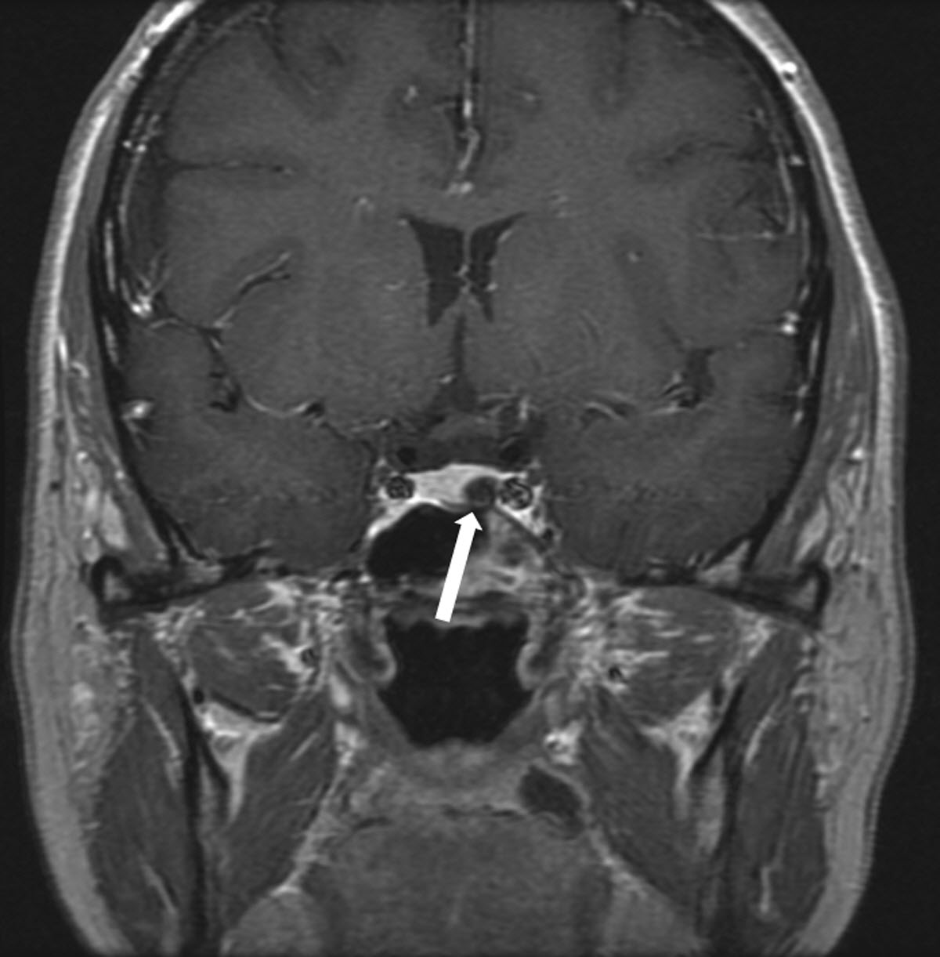
ITE 2018 Question 35
Pituitary MRI shows a 5-mm left-sided microadenoma (see image, arrow).

Slide 60
Which of the following is the best advice for this patient?
Stop cabergoline now
Stop cabergoline once pregnant
Switch from cabergoline to bromocriptine once pregnant
Reduce the cabergoline dosage to 0.25 mg once weekly
Continue cabergoline indefinitely
Correct Answer: B
Learning objective:
Guide the management of microprolactinoma in a woman seeking to become pregnant.

Slide 61
Rationale:
This patient has had an excellent clinical, biochemical, and radiologic response to cabergoline (a dopamine agonist) used to treat her prolactinoma. The main question relates to the safety of dopamine agonists during pregnancy and when or if they should be discontinued in women who wish to become pregnant.
The main aims of prolactin-lowering therapy in this patient were to restore pituitary-gonadal function and allow spontaneous ovulation, as well as to shrink her macroadenoma to minimize the consequence of pituitary expansion during pregnancy. Stopping therapy suddenly now (Answer A) would put her at risk for relapse given her visible adenoma on MRI and the fact that her serum prolactin remains at the high end of the normal range on her current cabergoline dosage. While the Endocrine Society clinical practice guideline for the management of prolactinoma suggests that therapy can be withdrawn after 2 years if there has been a response to treatment, this should be done gradually with dosage tapering and monitoring of serum prolactin. This may be an option if the patient accepts that there is a risk of recurrence of hyperprolactinemia. However, even if this were embarked upon, the cabergoline dosage should be gradually reduced to 0.25 mg twice weekly (thus, Answer D is incorrect).

Slide 62
Rationale Continued:
Both cabergoline and bromocriptine effectively manage hyperprolactinemia. However, cabergoline is often the drug of first choice because it is more effective than bromocriptine and is better tolerated. While there is more accumulated experience with bromocriptine in pregnancy, both drugs are considered safe. The incidence of miscarriage and congenital malformations associated with each drug is no higher than in the general population. As a result of greater experience, some clinicians may favor the use of bromocriptine to treat prolactin excess when pregnancy is desired, although many would use cabergoline. Regardless, in the setting of a microprolactinoma, there is no requirement to continue dopamine agonist therapy once the patient is pregnant (thus, Answer C is incorrect).

Slide 63
Rationale Continued:
It is unusual for dopamine agonist therapy to be continued throughout pregnancy (Answer E) and it is not warranted in this case. Very rarely, treatment may be resumed during pregnancy if an adenoma expands sufficiently to result in visual field impairment. The chance that an increase in the size of a lactotroph adenoma will be clinically important depends on the size of the adenoma before pregnancy. For a microadenoma such as the one described in this vignette, the risk is very low. One review of 12 studies involving 658 patients with microprolactinomas showed that only 2.7% exhibited a symptomatic increase in adenoma size during pregnancy. The only other circumstance in which continuation of dopamine agonist therapy in pregnancy may be prudent is in women who have macroadenomas that are invasive or abutting the optic chiasm and who have not had prepregnancy debulking surgery or radiotherapy.
Therefore, the best course of action is to advise the patient to stop her cabergoline once pregnant (Answer B). Continuation of therapy until that time ensures ongoing fertility, but the small size and position of her microadenoma (away from the optic chiasm) indicate that ongoing treatment during pregnancy is not justified.

Slide 64
Reference(s):
Melmed S, Casanueva FF, Hoffman AR, et al; Endocrine Society. Diagnosis and treatment of hyperprolactinemia: an Endocrine Society clinical practice guideline. J Clin Endocrinol Metab. 2011;96(2):273-288. PMID: 21296991
Molitch ME. Prolactinoma in pregnancy. Best Pract Res Clin Endocrinol Metab. 2011;25(6):885-896. PMID: 22115164

Slide 65
Tuberculosis:
more frequently in women
MRI: can reveal involvement of the paranasal sinuses or pititary fossa,
thickening of the pituitary stalk, and adjacent meningeal enhancement.
Tuberculomas are isointense-to-hypointense on T1-weighted images
and hyperintense on T2-weighted images.

Slide 66
Pituicytomas (also called infundibulomas) are benign tumors that typically arise from the infundibulum.
in men in the third to fifth decades of life. Clinically, patients present with panhypopituitarism and fatigue.
On MRI, pituicytomas have the same isodensity as normal brain tissue, they enhance
homogenously with contrast, and there is absence of the normal T1 hyperintensity of the posterior lobe
Treatment for pituicytomas is surgical resection

Slide 67
Leukemia (chronic myelogenous leukemia and acute myelogenous leukemia) and lymphoma

Slide 68
Pituitary stalk interruption syndrome
an ectopic posterior pituitary,
a hypoplastic anterior pituitary,
and lack of or significant thinning of the pituitary stalk

