Slide 1
In the name of GOD
Meysam orangi
98.2.2

Slide 2
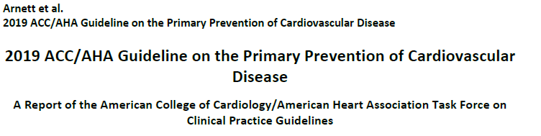

Slide 3
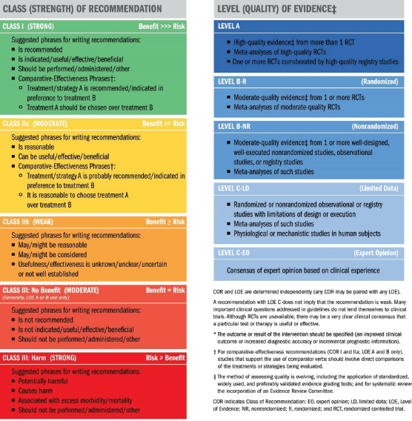

Slide 4
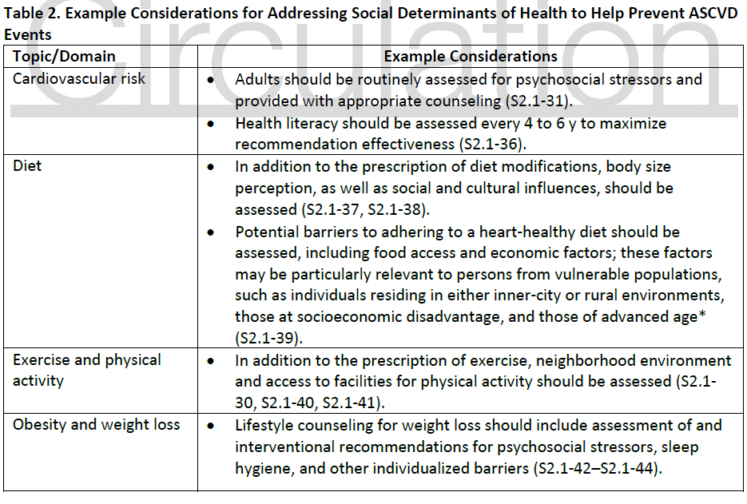

Slide 5
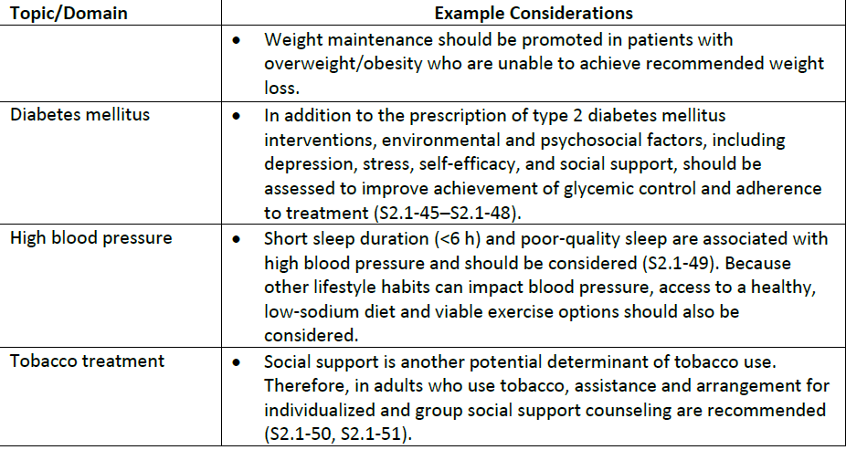

Slide 6
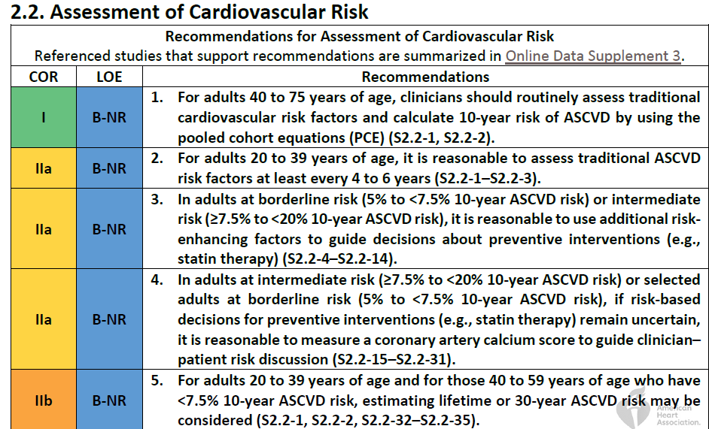

Slide 7
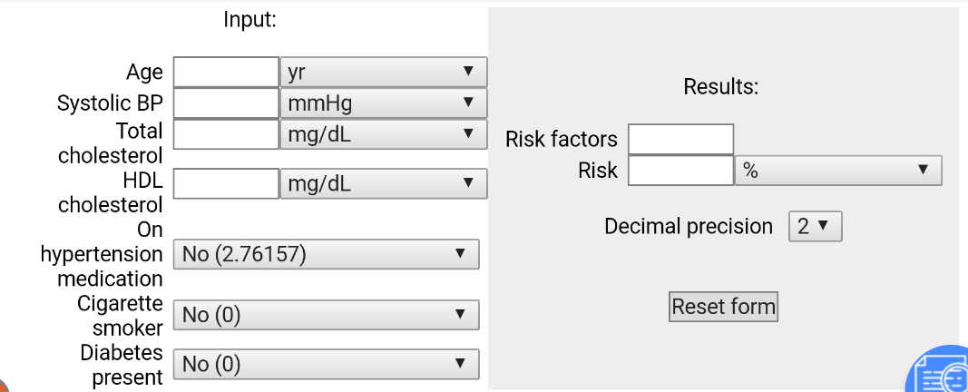

Slide 8
Patients with familial hypercholesterolemia are at significant risk of having an early ASCVD event, and the use of risk calculators is not applicable to these patients.

Slide 9
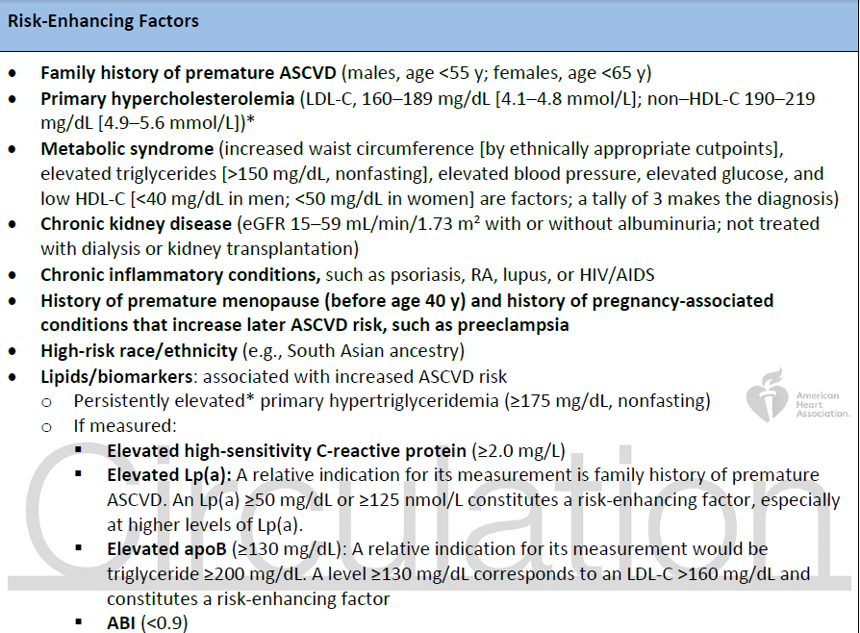

Slide 10
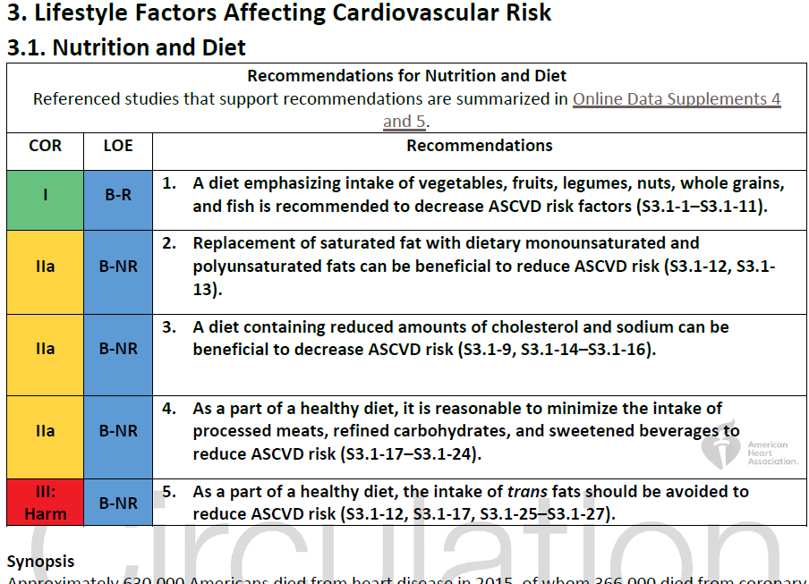

Slide 11
using meat for protein was associated with a 61% increase in mortality rate, whereas replacing meat with nuts and seeds was associated with a 40% reduction in mortality rate.
The evidence is mixed with regard to the effectiveness of dairy intake to reduce ASCVD risk, Although the DASH diet, which includes low-fat dairy products, was shown to reduce BP ,and the PURE (Prospective Urban Rural Epidemiology) study indicated that dairy intake was associated with a 23% lower mortality rate.
Song et al. indicated an 11% increase in cardiovascular mortality rate with dairy consumption as compared with vegetable protein

Slide 12
high consumption of sodium (>2,000 mg daily), red meat (>14 g/d), and sugar-sweetened beverages and processed red meat consumption were associated with cardiovascular death.
poultry and fish were associated with a 6% higher mortality rate, dairy with an 8% higher mortality rate, unprocessed red meat with a 12% higher mortality rate, eggs with a 19% higher mortality rate, and processed red meat with a 34% higher mortality rate. Overall, plant protein was associated with a reduction in mortality rate of 10%

Slide 13
Sugar-sweetened and artificially sweetened beverages have been correlated with increasing the development of T2DM and with ASCVD risk, with a 20% increase in the frequency of diabetes mellitus with 1 daily serving of these sweetened beverages.
In large cohort studies, consumption of added sugar at >10% of daily calories has been associated with increased mortality rate

Slide 14
Consuming a diet with juices and sweetened beverages, refined grains, potatoes/fries, and sweets resulted in a greater increase in coronary events than the increase seen with consumption of animal products.
Low carbohydrate diets were associated with a 31% higher risk of all-cause death, with increased cardiac mortality rate.
A 23% increase in mortality rate associated with high-carbohydrate diets, with the optimal carbohydrate intake observed to be 50% to 55%.

Slide 15
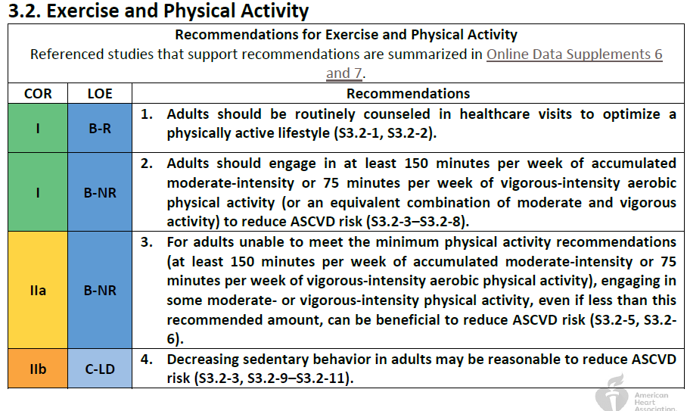

Slide 16
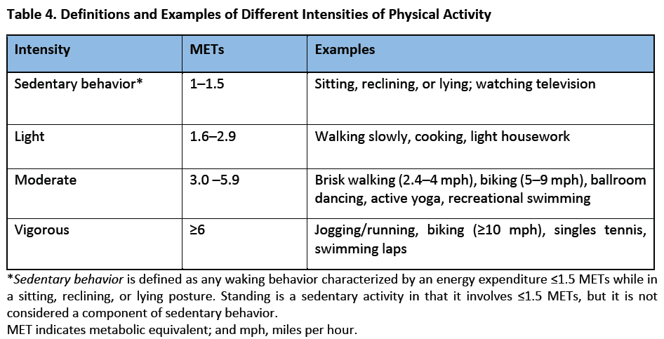

Slide 17
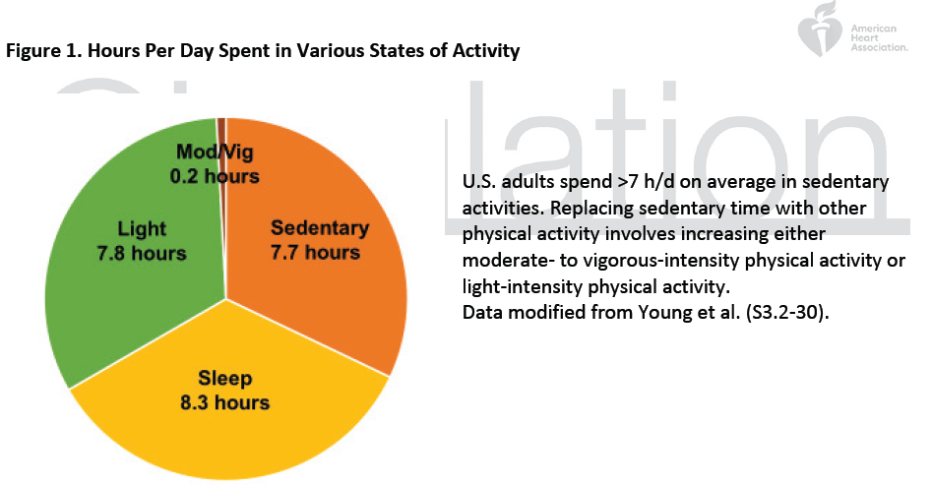

Slide 18
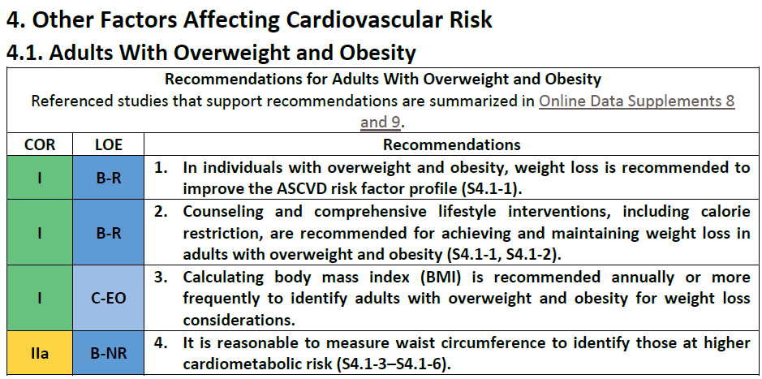

Slide 19
weight loss (≥5% initial weight) is associated with moderate improvement in BP, LDL-C, triglyceride, and glucose levels among individuals with overweight/obesity .
Weight loss reduces or delays the development of T2DM in persons with obesity.
Increased physical activity, preferably aerobic physical activity (e.g., brisk walking) for ≥150 minutes/week (equal to ≥30 minutes/day on most days of the week), is recommended for initial weight loss.
Higher levels of physical activity, approximately 200 to 300 minutes/week, are recommended to maintain weight loss or minimize weight regain after 1 year.

Slide 20
Adults with obesity are also typically prescribed a diet designed to reduce caloric intake by ≥500 kcal/day from baseline, which often can be attained by limiting women to 1,200 to 1,500 kcal/day and men to 1,500 to 1,800 kcal/day.
weight loss (5% to 10% of initial body weight) in the short term (≤6 months) and intermediate term (6 to 12 months)

Slide 21
Waist circumference may be more useful than BMI in persons with abdominal obesity (central adiposity). Definitions of elevated waist circumference as ≥40 inches (≥102 cm) in men and ≥35 inches (≥88 cm) in women.

Slide 22
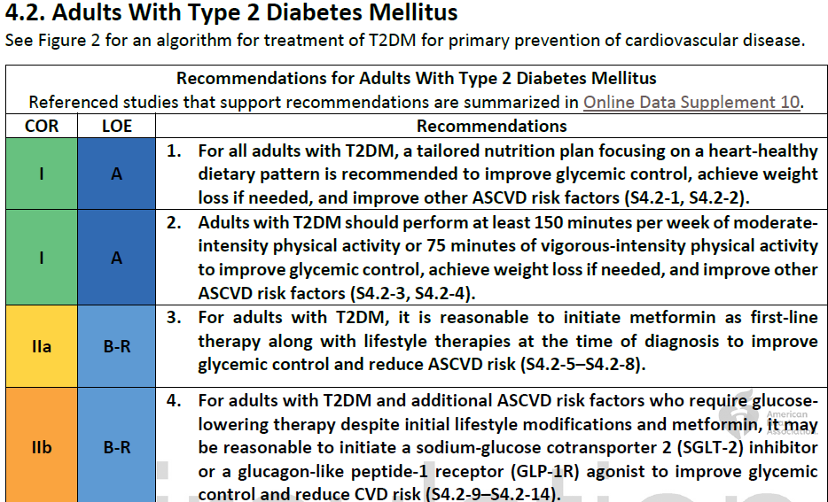

Slide 23
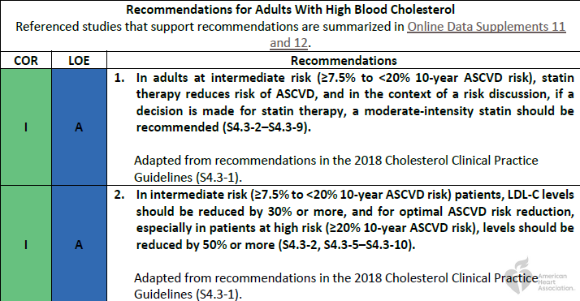

Slide 24
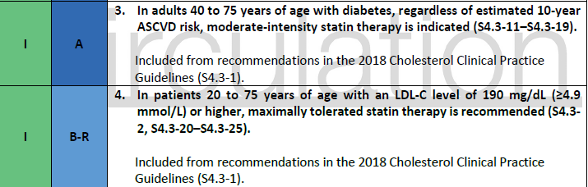

Slide 25
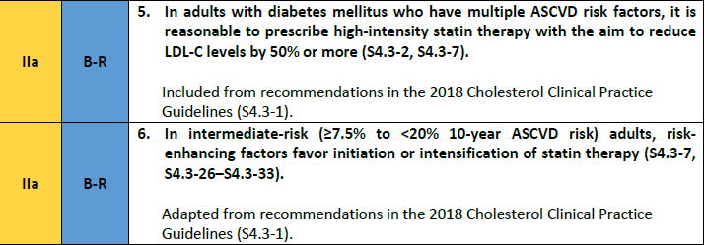

Slide 26
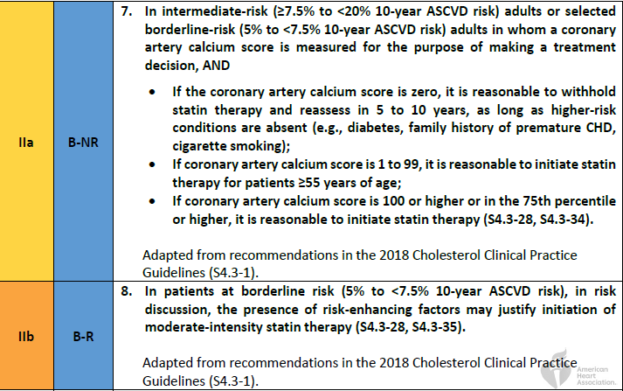

Slide 27
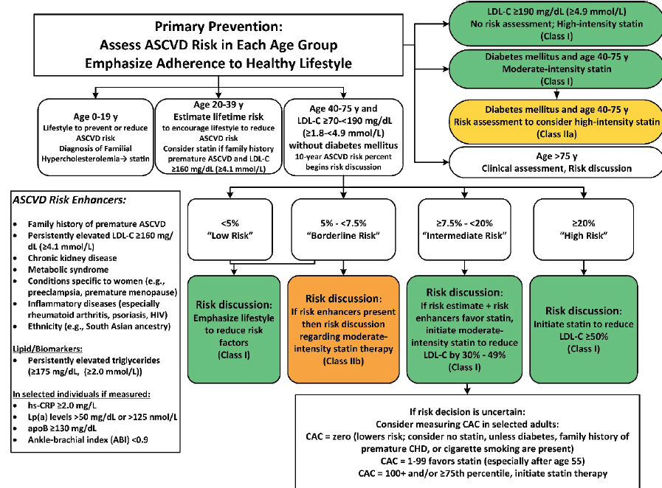

Slide 28
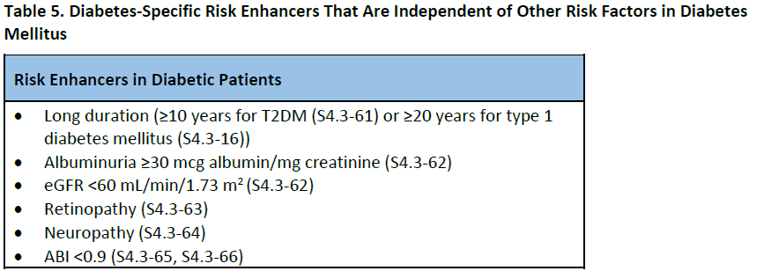
In adults 20 to 39 years of age with diabetes mellitus that have risk enhancers ,it may be reasonable to initiate statin therapy

Slide 29
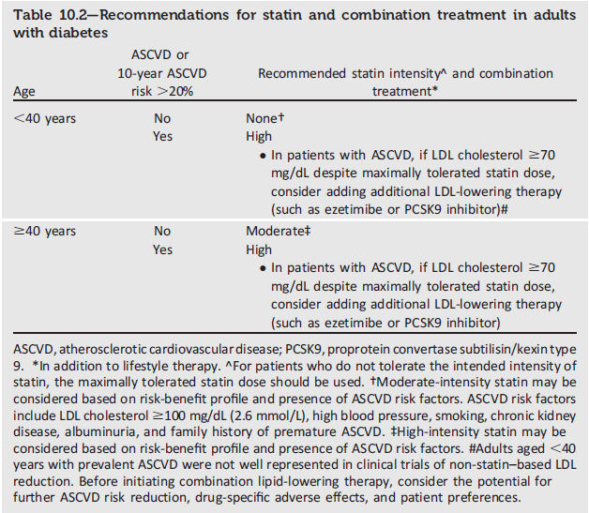
ADA 2019

Slide 30
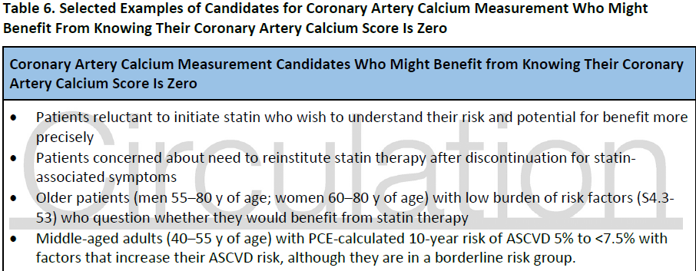

Slide 31
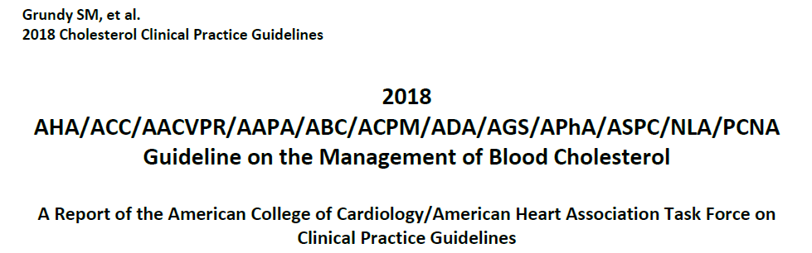

Slide 32
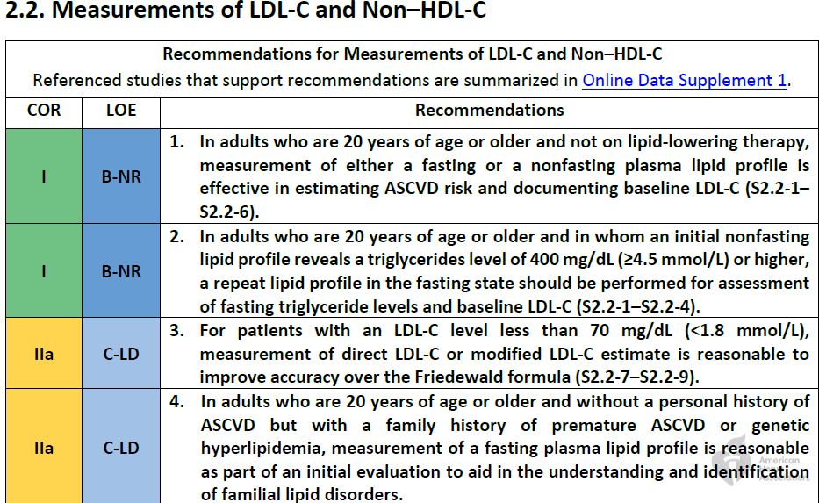

Slide 33
A relative indication for measurement of apo B would be triglyceride ≥200 mg/dL.
A apo B level >130 mg/dL corresponds to an LDL-C level ≥160 mg/dL and constitutes a risk-enhancing factor. A persistent elevation of apoB can be considered a risk-enhancing factor

Slide 34
a lowering of LDL-C levels of 1% gives an approximate 1% reduction in the risk of ASCVD— somewhat more at higher baseline LDL-C levels and somewhat less at lower baseline levels

Slide 35
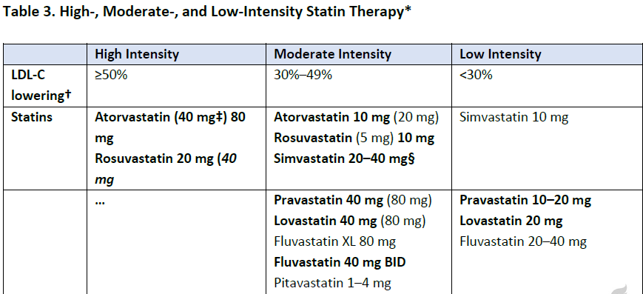

Slide 36
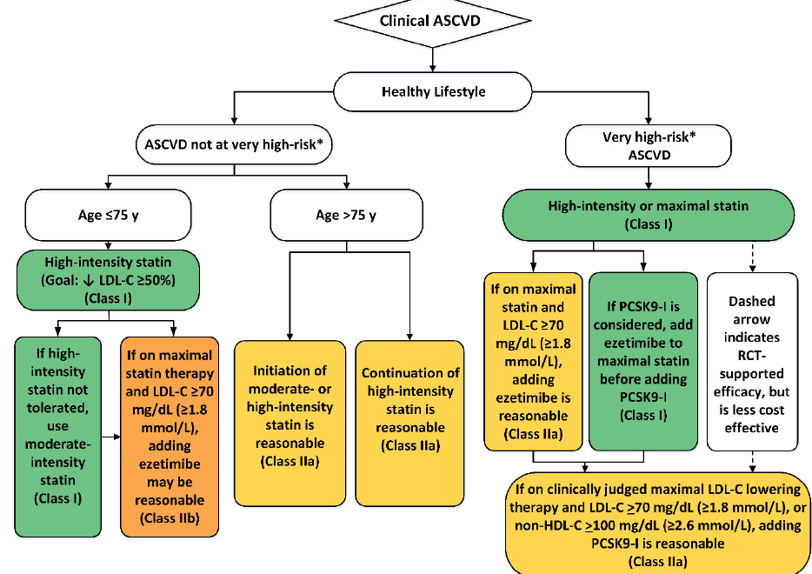

Slide 37
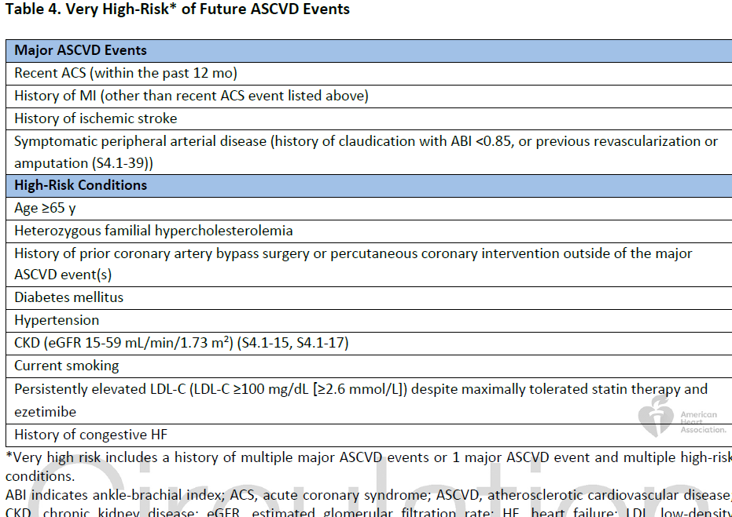

Slide 38
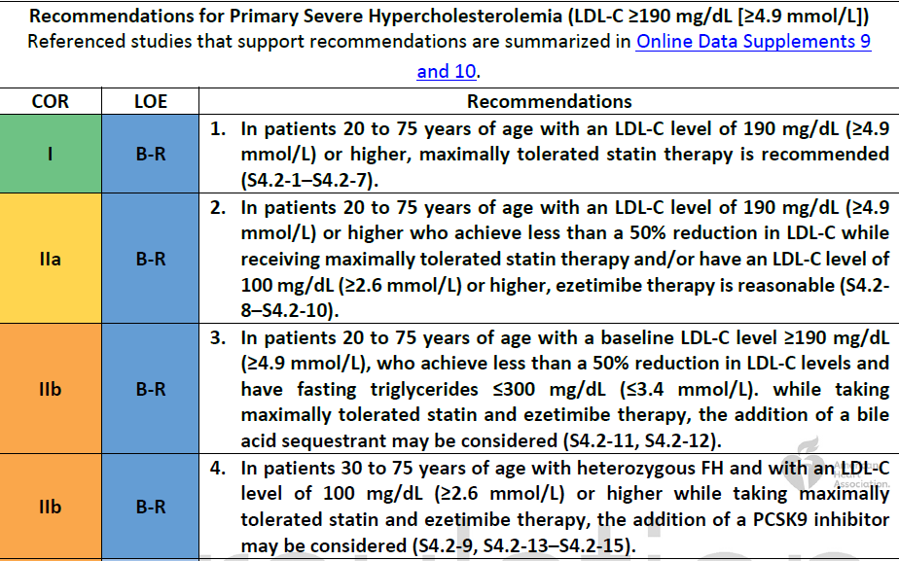

Slide 39
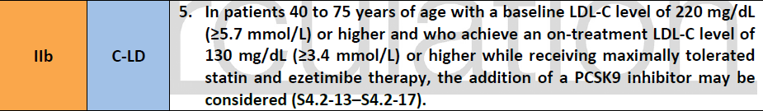

Slide 40
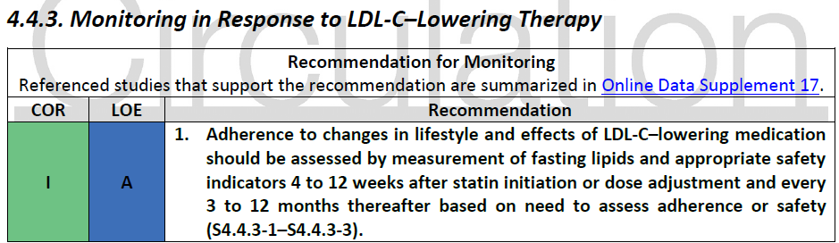

Slide 41
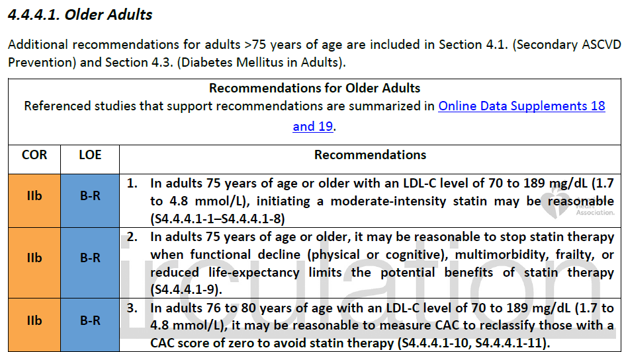

Slide 42
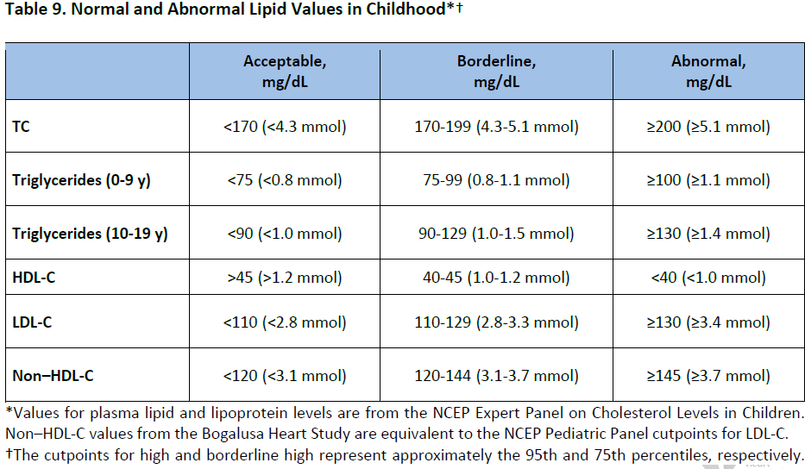

Slide 43
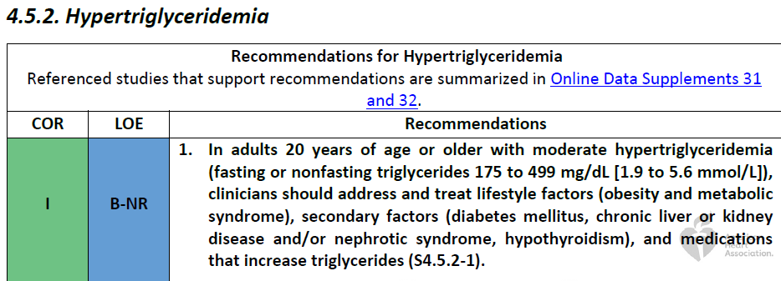

Slide 44
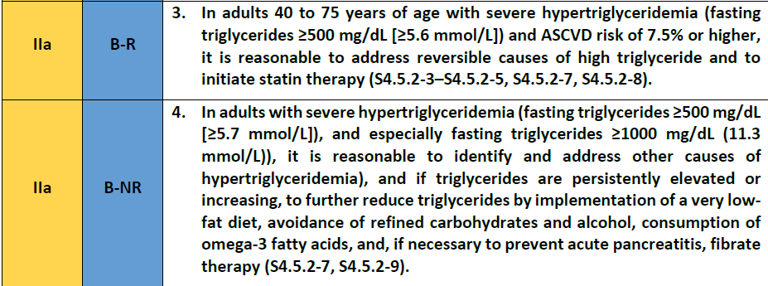

Slide 45

4.5.3. Issues Specific to Women

Slide 46
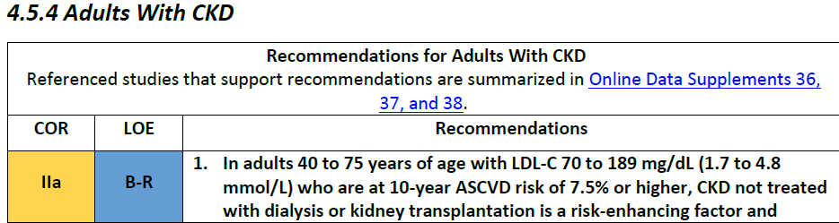

Slide 47
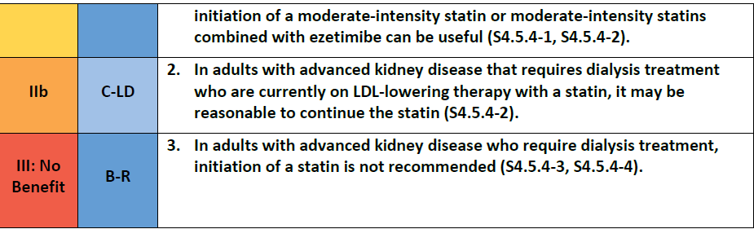

Slide 48
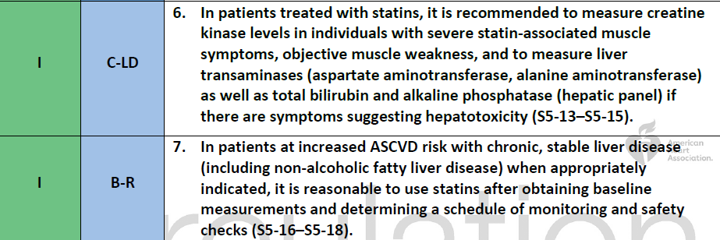
5. Statin Safety and Statin-Associated Side Effects

Slide 49
indications of direct LDL use( not accuracy in friedwald formula):
LDL-c < 70 TG > 400
if TG > 200…..check apo B
Apo B >130 = LDL>160 { risk enhancer factor)

Slide 50
Indication of statin therapy
non diabetic:
Familial hyperchlosterolemia( LDL>325 + premature ASCVD “ men<55 yr &
women<65 yr in first family” ) :
Age > 10 yr ..high intensity statin…Ezetimab….PSK9 i( if age >30 yr)
D/C 3 month before pregnancy…….only colesevelam/colestyramine
LDL goal <100
LDL >=190 : Age 20 – 75 yr…high intensity statin…Ezetimab…colestyramin(if TG< 300)
PCSK9 i( if age >40 yr and baseline LDL>220, LDL not reach to < 130 or multiple risk)
D/C 1-2 month before pregnancy…….only colesevelam/colestyramine
LDL goal <100

Slide 51
Indication of statin therapy
non diabetic:
LDL>160 + premature ASCVD in family) in age 20- 39… moderate intensity statin
Age 40-75 yr with LDL 70 - <190:
ASCVD risk 5-20% + risk enhancers….moderate statin( L DL 30-50%)
If CKD patient( no dialysis & no kidney transplant) + risk >7.5%...moderate
statin
Risk > 20%.....high statin( LDL > 50%)
Age > 75 yr…..clinical assessment/risk discussion

Slide 52
Indication of statin therapy
diabetic:
Diabetic 20-39 yr + diabetic risk enhancer…..moderate statin
( ADA: age<40 yr + ASCVD risk factors…..moderate statin)
ASCVD >20%....high statin
Diabetic 40-75 yr…moderate statin
(ADA: age > 40 yr + ASCVD risk factors….high statin)
ASCVD >20%....high statin

Slide 53
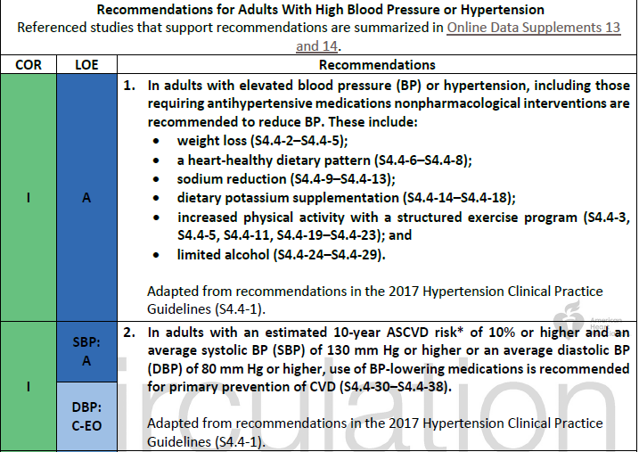

Slide 54
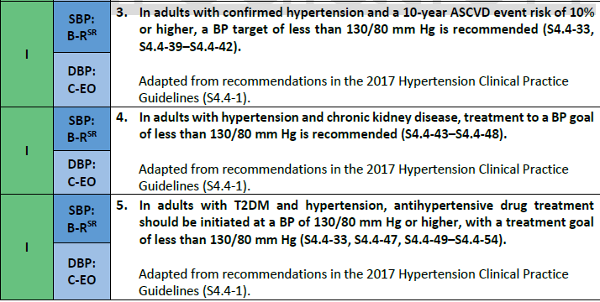

Slide 55
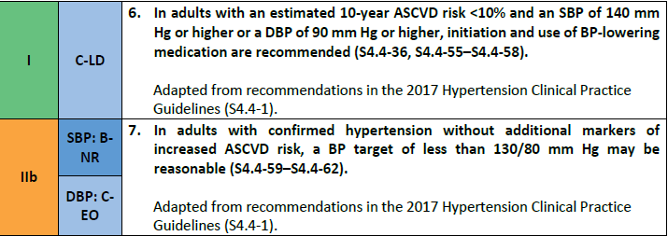

Slide 56
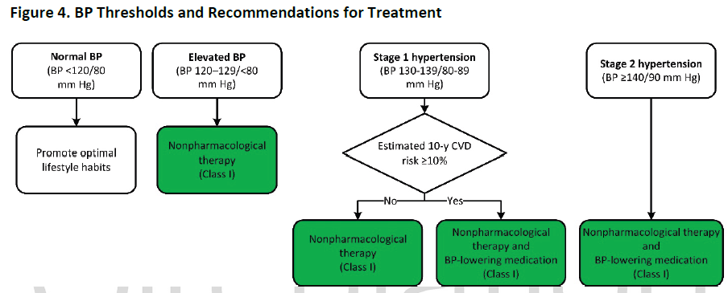

Slide 57
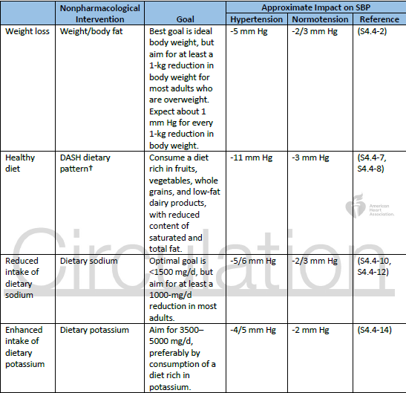

Slide 58
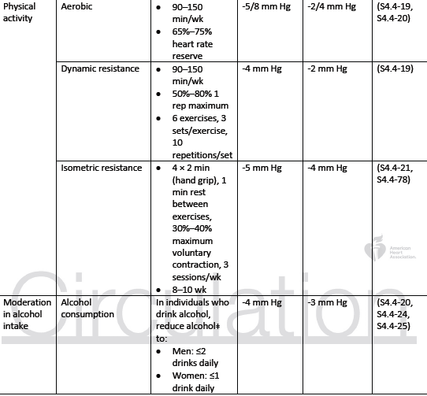

Slide 59
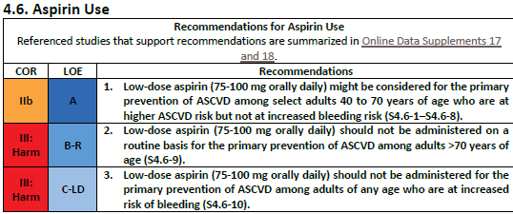

Slide 60
Thanks for your attention

