Slide 1
Persistent CD after TSS
Dr.rahim zahedi M.D

Slide 2
Problem list
Before TSS :
After TSS :
weight gain
Weakness
menstrual abnormality
easy bruising
hirsutism
depression
weight gain
Weakness
menstrual abnormality
easy bruising
hirsutism
Depression
DI

Slide 3
آیا برای بیمار persistent cushing مطرح میباشد؟
Failure در سانترهای مختلف تا چه حد قابل انتظار است؟
اگر persistent cushing مطرح باشد مشکل کجاست؟
آیا لوکالیزاسیون اشتباه بوده ؟ ( IPSS مثبت کاذب)
آیا آدنوم قابل exploration نبوده؟
شیوع عوارض TSS ؟
PLAN ؟

Slide 4
Postoperative initial remission
There is no consensus on the criteria for remission after resecting an ACTH-producing tumor
Normal corticotropes are suppressed by sustained hypercortisolism; therefore, ACTH and cortisol levels are low after resecting the ACTH-producing tumor
Remission is generally defined as morning serum cortisol values>5 mcg/dL(>138nmol/L) or UFC> 28–56 nmol/d (>10–20 mcg/d) within 7 days of selective tumor resection

Slide 5
Adult series report a remission rate of 73–76% for selectively resected microadenomas, but a lower remission rate for macroadenomas (43%)
The study also associated long term remission with younger age, smaller adenoma, and morning serum cortisol of <1 mcg /dL
Patients with mild or cyclic CS and those rendered eucortisolemic by medical treatment before surgery may not have suppressed corticotropes
Their postoperative UFC and morning cortisol may be normal
In these patients, clinicians must measure late-night serum or salivary cortisol

Slide 6
Patients who are eucortisolemic after resection, especially those with moderate preoperative hypercortisolism, may have residual tumors and are more prone to recurrence than patients with prolonged postoperative hypocortisolism
Early recovery (within 6 mo) of HPA axis function may indicate an increased risk of recurrence

Slide 7
Monitoring and treating Cushing’s features and comorbidities
Clinicians should tell patients that they may feel unwell for 6–9 months, that their mood will gradually improve, and that improvement may continue for more than 1year. Generally, weight, bruising, and the physical appearance of the face change first.
Patients should receive recommendations for physical therapy and nutrition to optimize the recovery of muscle strength and the normalization of weight.

Slide 8
Comparing of Remission VS Failure
Remission
Failure
Salivary cortisol test
Overnight suppression test
NL rang UFC
clinical condition was unchanged
morning serum cortisol values>5 mcg/dL
UFC > 20 mcg/d
Not compatible of pathological result

Slide 9
Between 1986 and 2002 179 patients underwent 185 IPSS procedures as part of their evaluation for Cushing’s syndrome. Six patients underwent two procedures

Slide 10
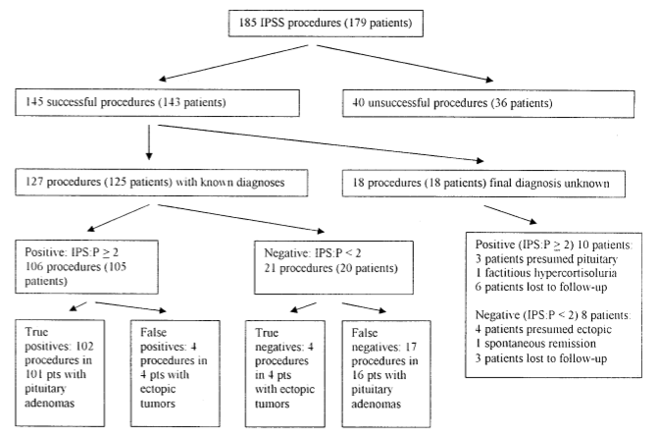

Slide 11
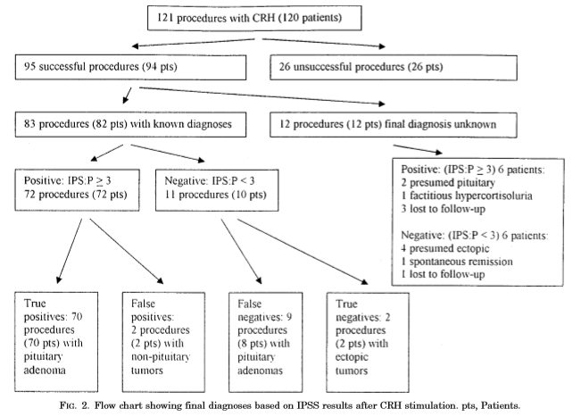

Slide 12
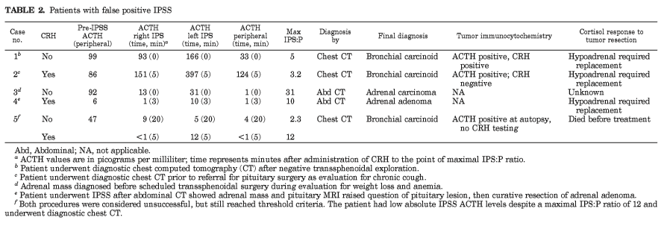

Slide 13
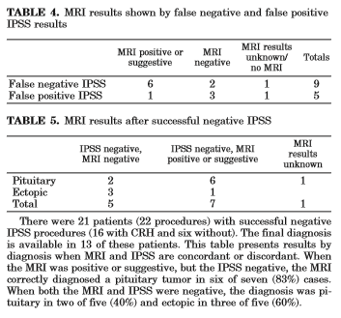

Slide 14
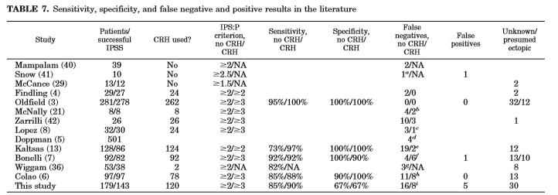

Slide 15
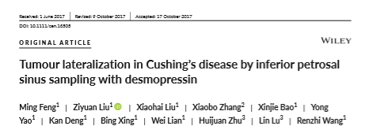
IPSS is now considered to be a gold standard in the preoperative diagnosis of CD, with a diagnostic sensitivity of 95% and specificity of 90%- 95%
However, the high cost and limited availability of CRH had limited its use
Since the 1990s, desmopressin (DDAVP) has been used as a substitute for CRH to stimulate adrenocorticotropic hormone (ACTH) secretion during IPSS

Slide 16
Procedure of IPSS
First, bilateral femoral veins were cannulated and catheters were guided into bilateral petrosal sinuses without anticoagulation
Next, peripheral venous blood from peripheral veins and the internal jugular veins as well as blood samples from left and right petrosal sinuses were collected and transferred to laboratory for ACTH assay
Then, 10 μg of desmopressin in saline solution was given intravenously. Peripheral blood samples and blood samples from bilateralpetrosal sinuses were collected 3, 5 and 10 minutes after the administration of desmopressin

Slide 17
Sensitivity and specificity
Among all 90 patients who had CD, 89 (98.9%) had positive IPSS findings, therefore the sensitivity of IPSS in the diagnosis of CD was 98.9%
The patient who did not have CD also had negative IPSS findings, therefore the specificity of IPSS in the diagnosis of CD was 100%.

Slide 18
Tumour lateralization accuracy In total, 37 (72.5%) had IPSS lateralization in concordance with that of surgery, hence the concordance rate was 72.5%.

Slide 19
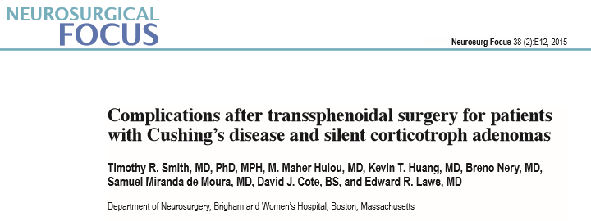
Of the 681 patients who had undergone transsphenoidal resection at Brigham and Women’s Hospital from April 2008 through April 2014, medical records were reviewed for 82 who had either CD or SCA.

Slide 20
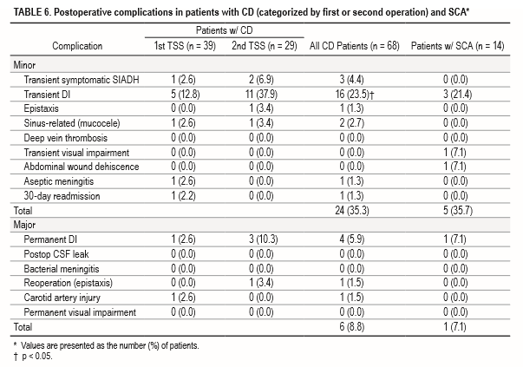

Slide 21
Second-line therapeutic options
6.1 In patients with ACTH-dependent Cushing’s syndrome who underwent a non curative surgery or for whom surgery was not possible, we suggest a shared decision making approach because there are several available second-line therapies (eg, repeat trans sphenoidal surgery, radiotherapy, medical therapy, or bilateral adrenalectomy). (2++)
6.1a We suggest bilateral adrenalectomy for occult or metastatic EAS or as a life-preserving emergency treatment in patients with very severe ACTH dependent disease who can not be promptly controlled by medical therapy. (2 +++)
6.2Wesuggest repeat trans sphenoidal surgery, particularly in patients with evidence of incomplete resection, or a pituitary lesion on imaging. (2++)

Slide 22
6.3aWe suggest RT/radiosurgery in patients who have failed TSS or have recurrent CD. (2++)
6.3b We recommend using RT where there are concerns about the mass effects or invasion associated with corticotroph adenomas. (1+++)
Although pituitary radiation may serve as a primary treatment for CD inindividuals who cannot undergosurgery or when the tumor is invasive or unresectable

Slide 23
Medical treatment

Slide 24
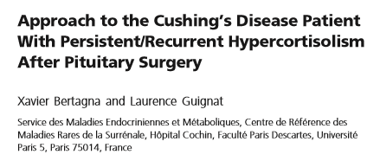
30-year old female was referred to a specialized center for persistent hypercortisolism after pituitary surgery
One year ago she was diagnosed with Cushing’s disease after she had developed weight gain ,high bloodpressure, mood change, fatigability, hirsutism, and amenorrhea.
The left part of the pituitary was preferentially removed, and pathological examination showed only normal intermingled pituitary cells that stained for all pituitary hormones.

Slide 25
One week and 2 months after surgery, UC was essentially the same and was 2 to 3 times the upper limit of normal. The patient’s clinical condition was unchanged.
The BIPSS showed a clear central/peripheral gradient
Repeat MRI at 3months, just before surgery, did not identify a clear image of adenoma.
Cautious surgery avoided bleeding such that adenomatous tissue was successfully visualized in the left part of the gland, allowing an apparently “complete removal.” Pathology confirmed the corticotroph adenoma
Two weeks after surgery, both serum cortisol(less than 10 ng/ml) and ACTH (less than 5 pg/ml) were undetectable, with no response to desmopressin.

Slide 26
The patient had apparently jumped from track2 . . . To track 5

Slide 27
After 3 years she presented with evidence of clinical recurrence (amenorrhea, weight gain), and unequivocal biological hypercortisolism.
The comparison of her pituitary MRI with that 3 months after the last surgery revealed evidence of new tissue growth in the left part of the sella,highly suggestive of an invasive adenomatous tissue remnant.

Slide 28
How to Choose? How to Evaluate? The Impossible Algorithm!

Slide 29
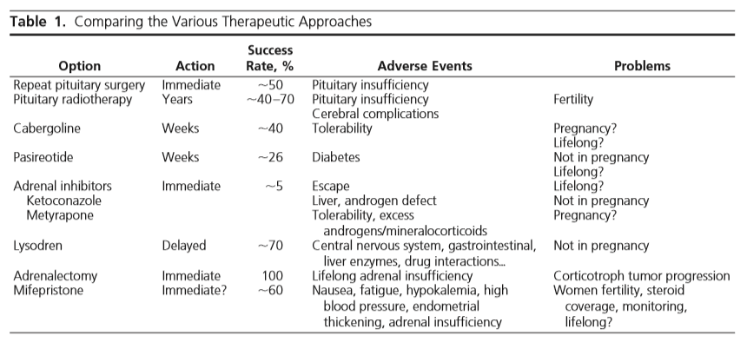

Slide 30
PLAN
wait and follow up
Medical treatment ( ketoconazole)

Slide 31
Thank you for your attention

