Slide 1
thyroid Imaging
Pooneh Dehghan, MD
Associate Professor of Radiology
Taleghani Hospital, Shahid Beheshti University of Medical Sciences

Slide 2
Imaging modalities
Scintigraphy and ultrasound are the mainstay of diagnostic imaging
CT and MRI
New modalities:
PET & SPECT
Elastography

Slide 3
CT & MRI
Adjuvant role mainly in staging
Fusion PET-CT/MRI
DWI: Benign nodules have higher ADC values
MRS: Choline peak in almost all carcinomas (Ch/Cr=1.6 in well differentiated CA and 9.4 in anaplastic carcinomas)
Benign lesions generally demonstrate no choline peak

Slide 4
PET in thyroid cancer
The radioactive tracer used is Fluorodeoxyglucose (FDG), which combines the natural body compound glucose with the radioisotope Fluorine-18.
FDG has a short half-life and will disappear from the body within hours. Therefore, PET scan for thyroid glands is safe and the patient should free themselves of any worry about the radiation content of this procedure.
PET imaging traces the absorption rate of FDG by cells and can determine whether cancerous cells are present in the thyroid, as glucose (which FDG shares a similar structure) is absorbed at a faster rate by cancerous cells compared to healthy cells.

Slide 5
PET
Greatest utility in thyroid imaging:
Dedifferentiated thyroid cancers (Iodine scintigraphy negative but high serum Tg)
Malignant nodule (high FDG avidity) from benign nodule (low FDG avidity)
Also superior in localizing cervical and mediastinal LN involvement
PET/CT & PET/MRI are very promising

Slide 6
Major Drawback
FDG-PET :
Poor specificity (inflammation vs neoplasm)
Poor sensitivity to detect micrometastases
Poor sensitivity to detect tumor sites in well-differentiated cancers that concentrate iodine.

Slide 7
The procedure
FDG-PET imaging requires patient preparation prior to examination and requires fasting for at least 4 hours prior to examination.
Patients should be well hydrated to promote rapid excretion of tracer so as to decrease the radiation dose and improve image quality
Serum glucose level is measured prior to FDG administration and ideally should be less than 150 mg/dL for oncologic applications, whereas for the assessment of infection and noninfectious inflammation hyperglycemia, up to 200 mg/dL does not seem to have a significant effect on the sensitivity of FDGPET.
PET/CT acquisition can take place from 30 minutes to 4 hours after injection.

Slide 8
Acquisition of PET is carried out immediately following acquisition of CT, without changing the patient’s positioning.
There are different options regarding the acquisition protocol of CT:
full-dose CT;
reduced-dose CT limited to a selected body region according to the clinical issue or PET findings; or
CT of a larger field of view.
PET can also be acquired without any CT

Slide 9
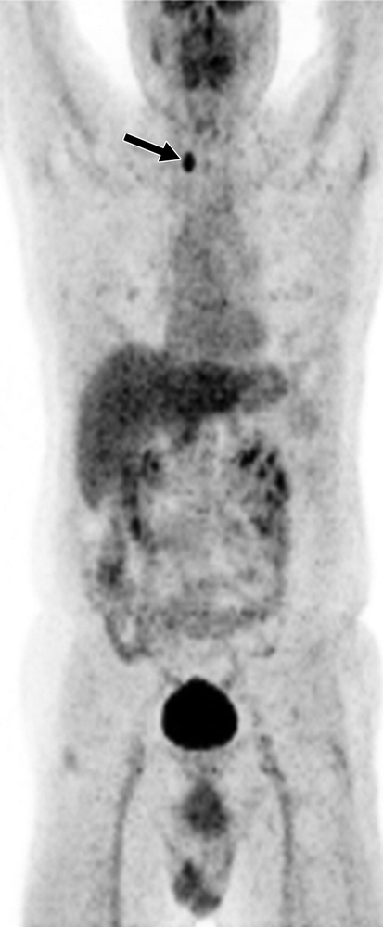
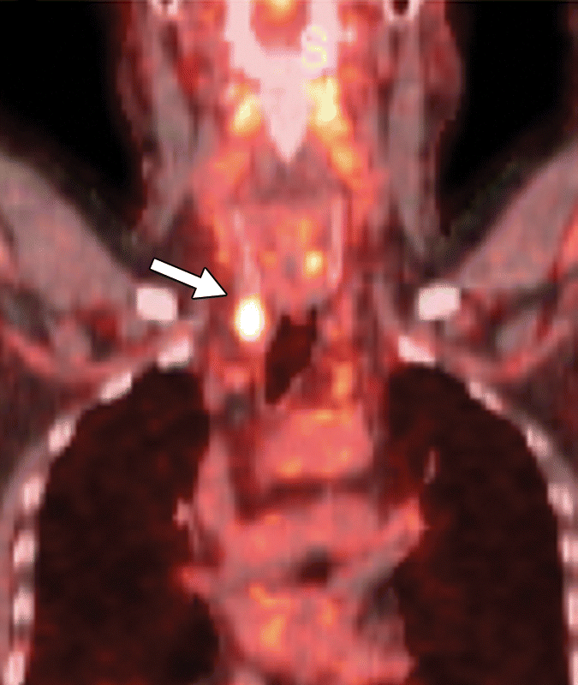
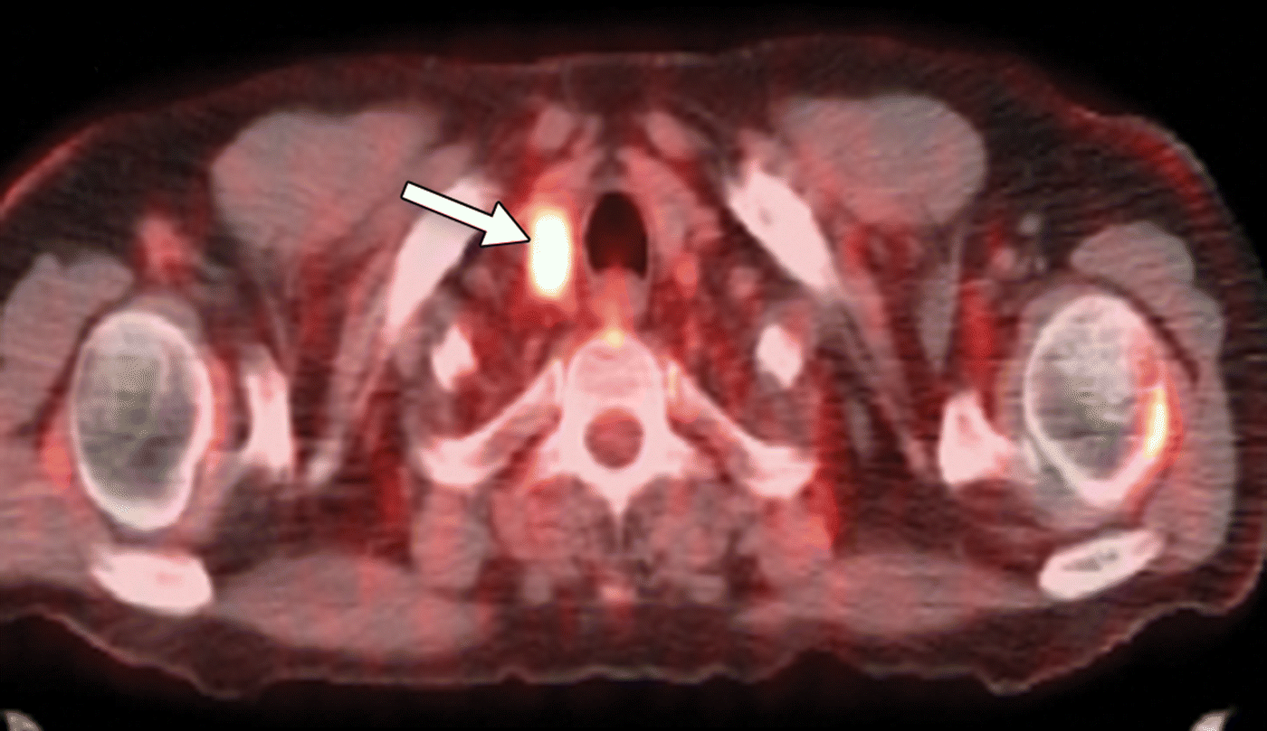
57-year-old man with bronchioalveolar carcinoma. FNA cytology of lesion showed papillary thyroid carcinoma.

Slide 10
A, In staging PET/CT study, anterior maximum intensity projection (A) and coronal (B) and axial (C) fused PET/CT images show incidental focal right thyroid FDG uptake (maximum standardized uptake value, 7.22). Fine-needle aspiration cytology of lesion (arrows) showed papillary thyroid carcinoma. Patient underwent total thyroidectomy followed by radioiodine ablation and is on regular follow-up.

Slide 11
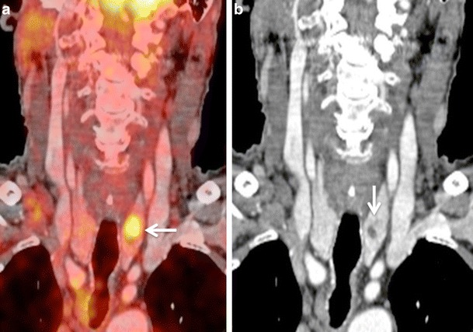
Coronal PET/CT image illustrates a focal nodular area of high FDG uptake within the left thyroid lobe (white arrow). b Corresponding coronal CECT image shows a small hypodense nodule within the left thyroid lobe (white arrow), corresponding to the focus of high FDG uptake on PET/CT.
Subsequent US FNAC of the left thyroid nodule and follow-up over a period of 2 years yielded benign thyroid nodule, thereby indicating that the PET/CT result was false-positive for malignancy

Slide 12
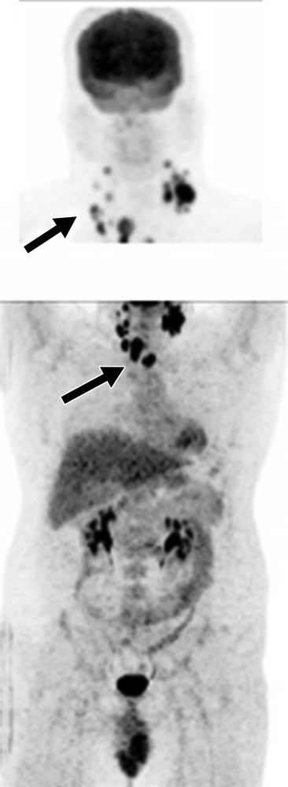
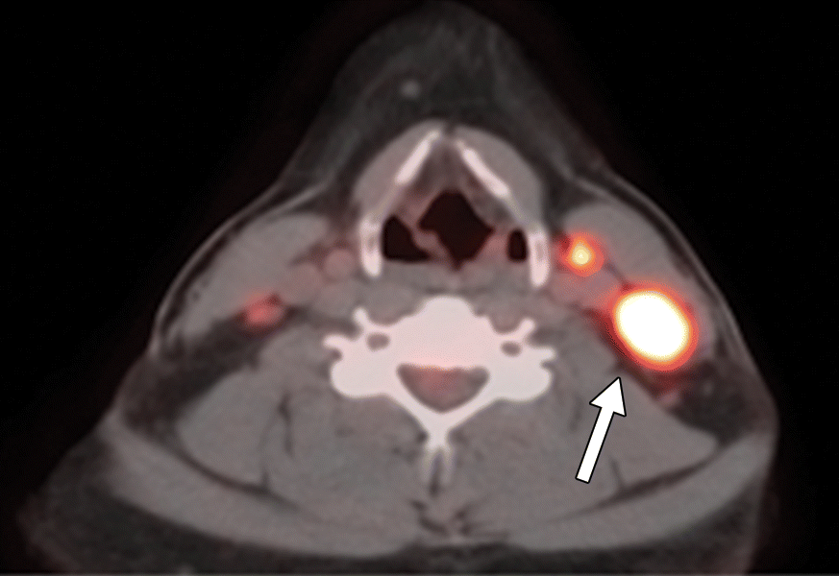
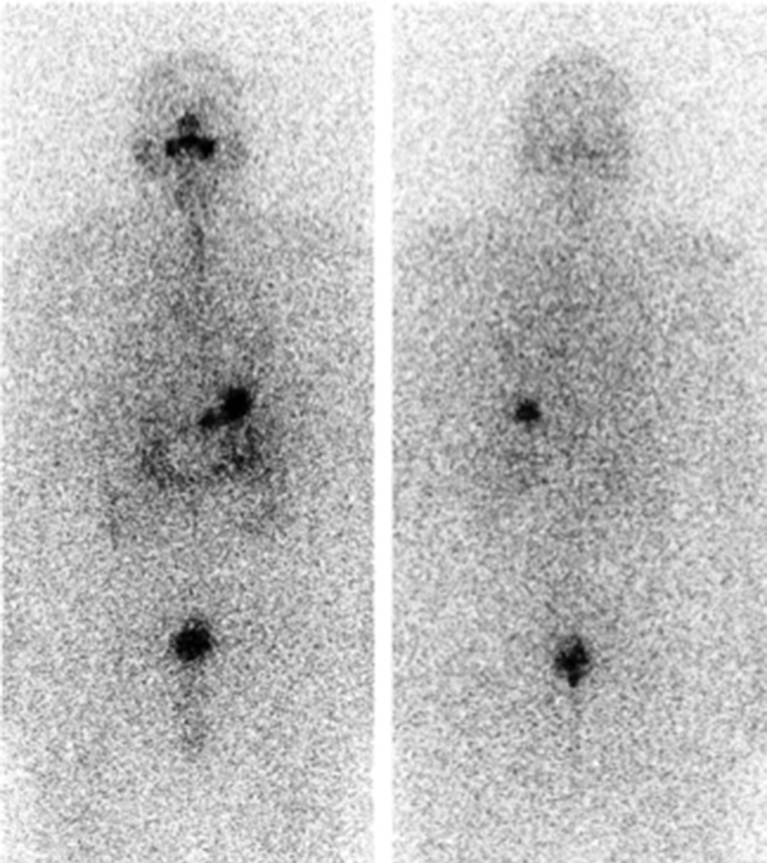
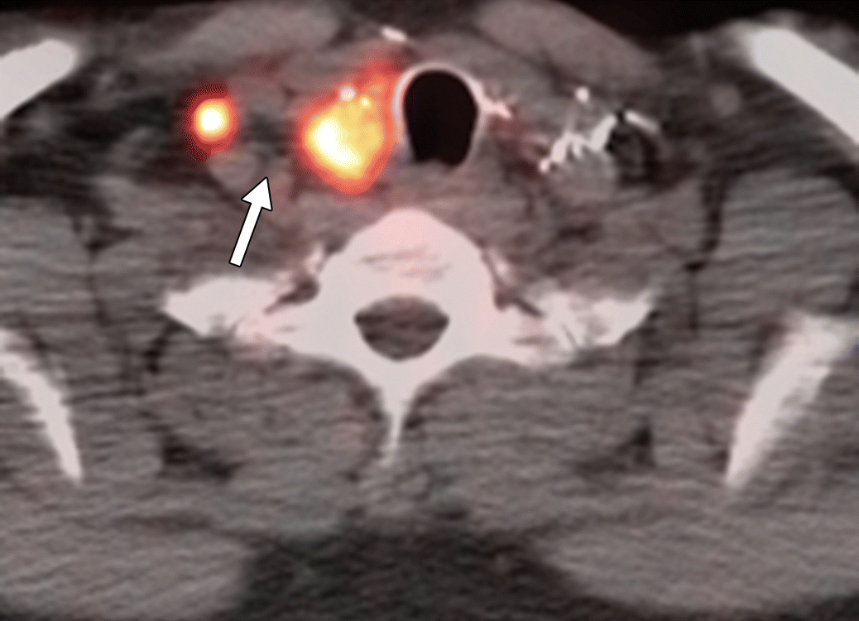
37-yo man with papillary thyroid carcinoma who underwent FDG PET/CT study after thyroidectomy and radioiodine ablation. Whole-body scans were negative. Patient was found to have persistently elevated thyroglobulin level (27.2 ng/mL)

Slide 13
A, Radioiodine anterior (left) and posterior (right) whole-body scans were negative. Patient was found to have persistently elevated thyroglobulin level. His thyroglobulin level at time of study was 27.2 ng/mL.
B, Anterior maximum intensity projections of head and neck (top, B) and body (bottom, B) in two acquisitions and axial fused PET/CT images of body (C) and head and neck (D) show recurrent thyroid papillary cancer (arrows, B–D) with numerous foci of increased FDG activity consistent with recurrent disease in thyroid bed and nodal metastases in neck bilaterally. Fine-needle aspiration cytology of lesions confirmed diagnosis.

Slide 14
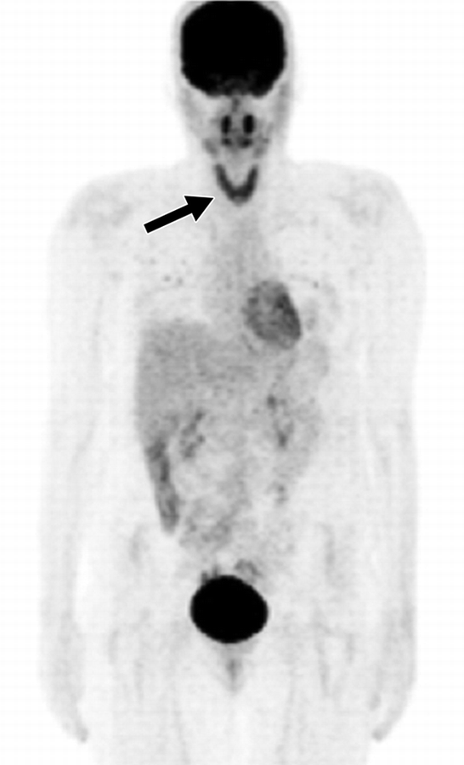
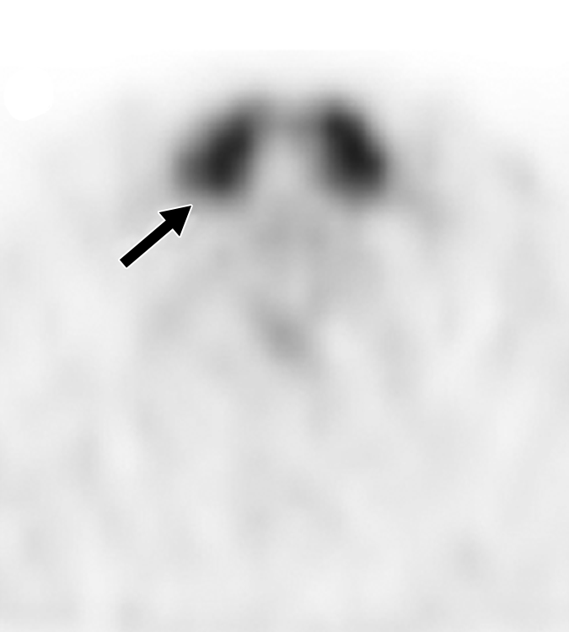
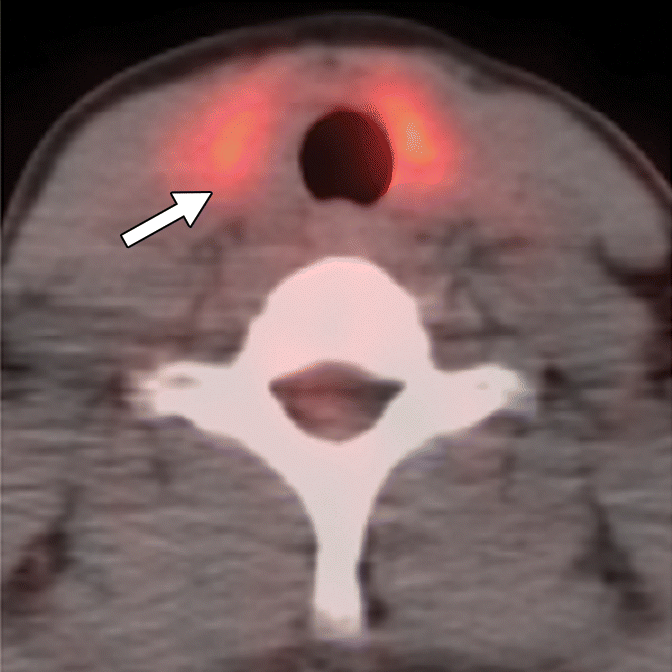
23-year-old woman with melanoma of right shoulder who underwent restaging FDG PET/CT study after resection and adjuvant chemotherapy.

Slide 15
Pet thyroiditis
A, Anterior maximum intensity projection (A), axial PET (B), and axial fused PET/CT (C) images show diffusely increased FDG uptake (maximum standardized uptake value, 5.58) in thyroid gland (arrows), which was incidentally noticed. Radioactive iodine uptake and scan of thyroid showed increased radiotracer uptake in normal-sized thyroid gland. Uptake of ¹²³I in thyroid was 8.1% at 4 hours and 9.6% at 25 hours (normal range, 12–34% at 24 hours). Antibody testing showed significantly elevated anti– thyroid peroxidase antibody level of 1633 ng/mL and antithyroglobulin level of 1740 ng/mL. Features are consistent with subacute thyroiditis.

Slide 16
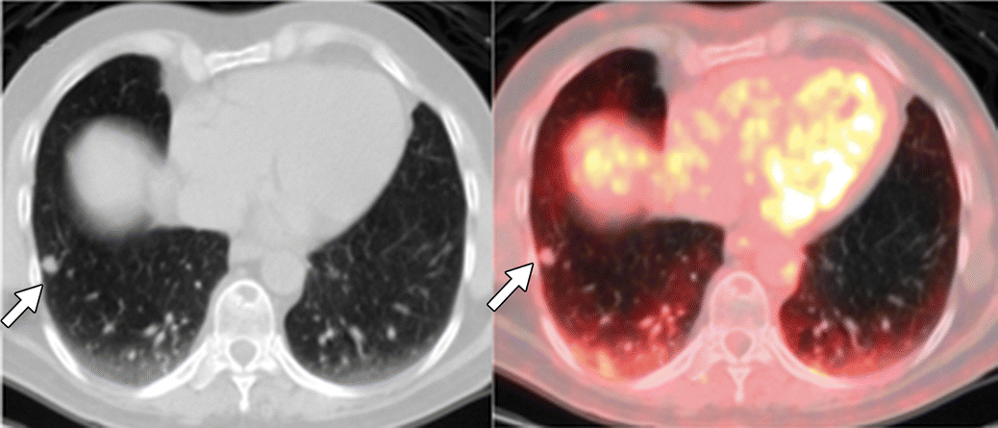
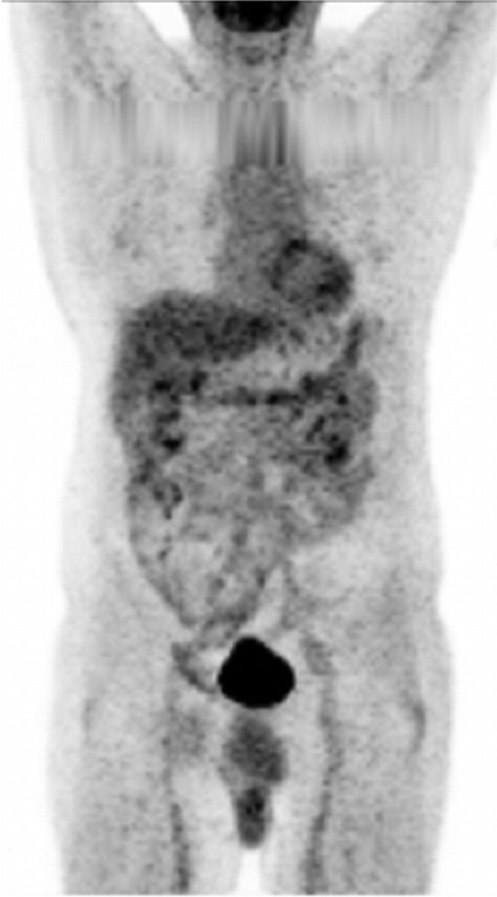
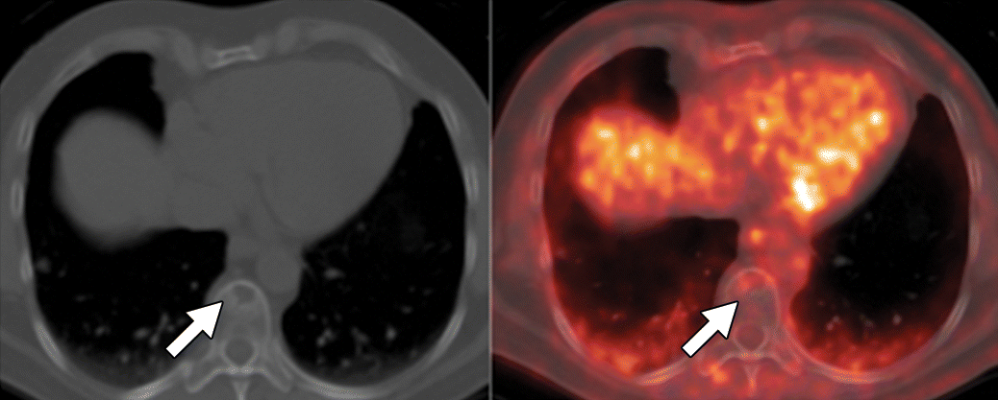
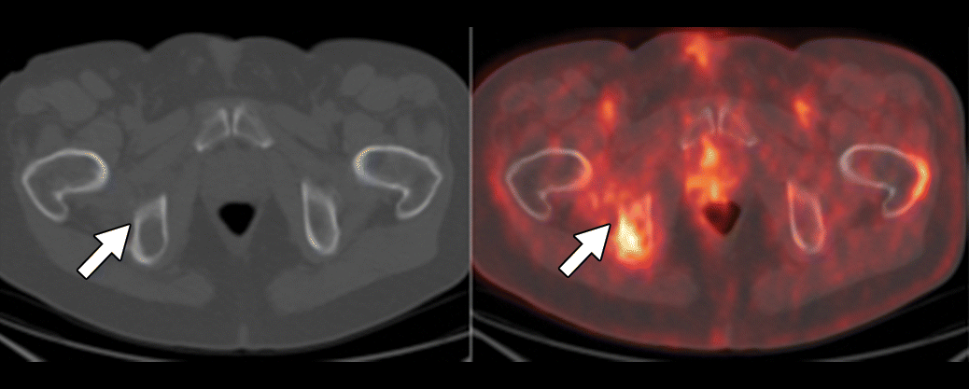
62-yo man with metastatic follicular carcinoma of thyroid who underwent FDG PET/CT study after thyroidectomy, multiple radioiodine ablations, and chemoradiation. His thyroglobulin level at time of study was 478.4 ng/mL.

Slide 17
4
62-year-old man with metastatic follicular carcinoma of thyroid who underwent FDG PET/CT study after thyroidectomy, multiple radioiodine ablations, and chemoradiation. His thyroglobulin level at time of study was 478.4 ng/mL.
A, Anterior maximum intensity projection (A), axial contrast-enhanced CT (left, B–D), and fused PET/CT (right, B–D) images show FDG-avid metastatic lesions (arrows, B–D) in right lung (B), right acetabulum (C), and T10 vertebra (D). After study, patient underwent chemoradiation.

Slide 18
Elastography
Two main techniques: Strain and Shear Wave
Benign nodules are softer whereas malignant ones are harder
Cysts and nodules with calcification are excluded from exam
High predictive value in indeterminate nodules as malignant with effectiveness almost comparable to FNA cytology
Limitation in lesions that are not surrounded by adequate normal tissue

Slide 19
Elastogtaphy
Strain (or static) elastography requires an external palpation with a probe or endogenous stress such as cardiovascular movements, resulting in an axial displacement of the tissue by mechanical stress .
The former uses focused ultrasonic beams that propagate through the entire imaging area.
The elastic image is superimposed on the B-mode image, and tissue stiffness is displayed in a continuum of colors from red (soft tissue) to blue (hard tissue). According to the chosen machine, color scales are applied inversely

Slide 20
Two kinds of elasticity assessments can be obtained:
First, visual scoring of colors within and around the nodules can be assessed, using 4-5-scale scoring systems.
Second, two regions of interest (ROIs) are drawn over the target region and the adjacent reference region, respectively. Then, a strain ratio is automatically calculated through the machine. The likelihood of malignancy increases with an increase in the strain ratio

Slide 21
A tumor whose stiffness is greater than 65 kPa or for which the stiffness ratio is greater than 3.7 compared to surrounding healthy tissue is highly suspicious.
Lymph node metastasis of papillary thyroid cancer can also be detected by elastography due to its increased stiffness.

Slide 22
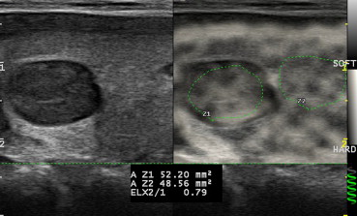
Strain elastography. 2D colour map of stiffness. Right upper third nodule. Nodule is softer than the parenchyma.

Slide 23
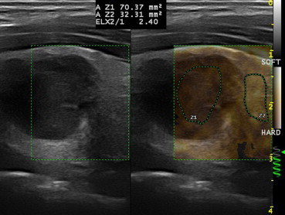
Semi-quantitative strain technique: thyroid cancer: high stiffness ratio between the nodule and the healthy tissue.

Slide 24
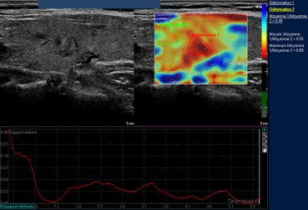
Strain elastography. Semi-quantitative technique. Nodule twice as hard as the parenchyma (Philips).

Slide 25
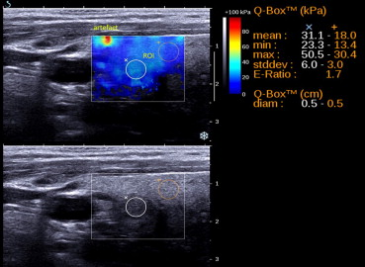
Shear wave elastography. Benign nodule. Two regions of interest placed on the nodule and the healthy tissue. 2D colour map of stiffness. Q-box: quantitative analysis between the two regions of interest (x for the nodule and + for the healthy tissue)

Slide 26
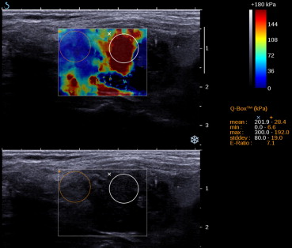
Shear wave elastography. Undifferentiated cancer: very stiff lesion, with a high ratio and “min” values at 0 due to the presence of necrotic areas.

Slide 27
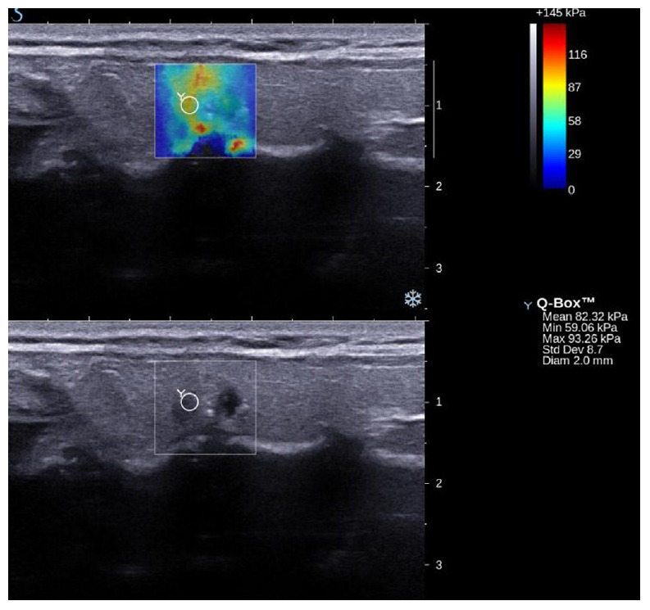

Slide 28
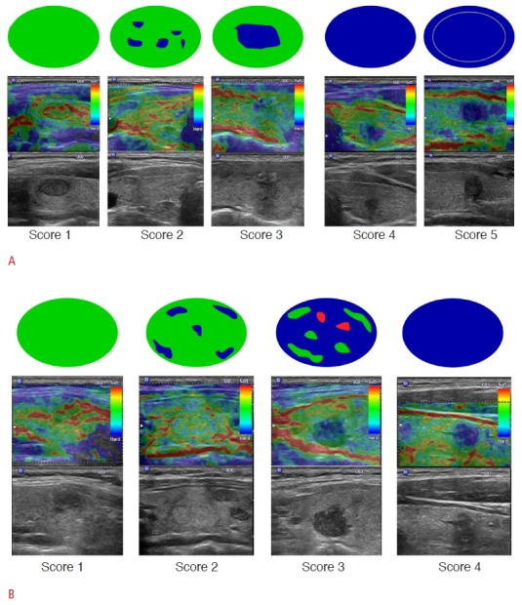

Slide 29
References
American Journal of Roentgenology. “PET/CT in the Management of Thyroid Cancers”; 2014;202: 1316-1329. 10.2214/AJR.13.11673
Read More: http://www.ajronline.org/doi/full/10.2214/ajr.13.11673
Indian Journal of Endocrinology and Metabolism. “Imaging of the thyroid: Recent advances”; 2012 May-June; 16(3):371-376
Ultrasonography. “Ultrasound elastography for thyroid nodules: recent advances”; 2014 Apr; 33(2): 75–82.
Diagnostic and interventional imaging. “Elastography of the thyroid”; 2013 (94): 535-544
Diagnostic Ultrasound (Rumack-2017)
Diagnostic Radiology (Grainger-Allison-2015)

