Slide 1
IN THE NAME OF GOD

Slide 2
AGENDA
What is the differential diagnosis?
What is the reason of amenorrhea and low AMH?
What is the diagnosis?
What are the symptoms and signs of the disease?
How can we treat the disease?

Slide 3
DDX
Sheehan syndrome
Functional hypothalamic amenorrhea
PCOS

Slide 4
Amenorrhoea with PMH Regular menses
Post partum beeliding and pack cell transfusion
low Androgens
Normal SHBG

Slide 5
Sheehan's syndrome
Sheehan's syndrome (SS) is postpartum hypopituitarism caused by necrosis of the pituitary gland.
It is usually the result of severe hypotension or shock caused by massive hemorrhage during or after delivery.
Patients with SS have varying degrees of anterior pituitary hormone deficiency.
Sheehan's syndrome: Newer advances Indian J Endocrinol Metab. 2011

Slide 6
The hormones that are manufactured in the anterior pituitary gland are the gonadotropins such as FSH and LH, GH, prolactin (PRL), ACTH, and TSH.
They are affected primarily in a certain order when necrosis occurs, GH first, followed by PRL, FSH, LH, ACTH and then TSH last.
Sheehan's syndrome: Newer advances Indian J Endocrinol Metab. 2011

Slide 7
3 | 97/4/2 پارس | 98/7/24 خاتم | 98/11/23 خاتم | 99/6/2 خاتم | 99/7/17خاتم | 99/7/24پارس | 1400/1/18پارس | 1400/2/6 پارس
LH | 3.1(2.4-12.6) (IU/l) | 1(mIU/ml)(0.5-10.5) | 1.87 (2.4-12.6 Fullicular phase mIU/ml) | 4.68 (2.4-12.6 Fullicular phase mIU/ml) | 7.11 (2.4-12.6 Fullicular phase mIU/ml) | 16 (2.4-12.6 Fullicular phase IU/l) | 6 (1.8-11.78 Fullicular phase IU/l) | 5.9 ((1.8-11.78 Fullicular phase IU/l)
FSH | 5.7(3.5-12.5) (IU/l) | 1.9(mIU/ml)(3-12) | 3.48 (3.5-12.5 Fullicular phase mIU/ml) | 7.99 (3.5-12.5 Fullicular phase mIU/ml) | 8.7 (3.5-12.5 Fullicular phase mIU/ml) | 8.5 (3.5-12.5 Fullicular phase IU/l)) | 8.40 (3.03-8.08 Fullicular phase IU/l) | 5.5 (3.03-8.08 Fullicular phase IU/l)
ESTRADIOL | 6.62 (12.5-166 pg/ml) | 220 pg/ml) (9-175) | 95 (12.4-233 Fullicular phase pg/ml) | 91.6 (12.4-233 Fullicular phase pg/ml) |  | 522 (21-251 Fullicular phase pg/ml) | 133 (21-251 Fullicular phase pg/ml) | 222 (21-251 Fullicular phase pg/ml)
PROGESTERONE |  | 0.18 ng/ml) (0.12-1.7) | 0.4 (0.12-1.7 Fullicular phase mIU/ml) | 0.36 (0.05-0.89 Fullicular phase Ng/ml) |  | 0.39 (0.2-1.5 Fullicular phase Ng/ml) | <0.1 (<0.1-0.3 Fullicular phase Ng/ml) | <0.1 (<0.1-0.3 Fullicular phase Ng/ml)

Slide 8
 | 97/4/2 پارس | 98/7/24 خاتم | 98/11/23 خاتم | 99/6/2 خاتم | 99/7/17خاتم | 99/7/24پارس | 1400/1/18پارس | 1400/2/6 پارس
CORTISOL |  |  |  |  |  | 6.95 (6.2-20 micg/dl) | 6.71 (6.2-20 micg/dl) | 10.2 (6.2-20 micg/dl)
ACTH |  |  |  |  |  | 23 (7.2-64pg/ml) | 11.1 (7.2-64pg/ml) | 14.6 (7.2-64pg/ml)
DHEA-S |  |  |  |  | 67 (60-337) |  | 68 (macrog/dl25-460) | 56 (macrog/dl25-460)
IGF 1 |  |  |  |  |  | 183 (61-204 ng/ml) |  | 187 (61-204 ng/ml)
AMH |  |  | 0.4(0.14-10.4) |  |  |  | 0.05 (0.06-4.4)
TOTAL TESTOSTERONE |  |  |  |  | 0.09 Ng/ml (<0.2-0.95) |  | 0.2 (up to 0.59 in female ng/ml)
PROLACTIN |  |  |  |  | 4.89 (1.2-28.5 ng/ml) | 7.4 ng/ml (2.8-26)
Free TESTOSTERONE |  |  |  |  | 1.25 (0.3-4.4 pg/ml)
17 OH PROGESTERONE |  |  |  |  | 0.38 ng/ml (0.2-1.3 Follicular phase)
ANDROSTENDION |  |  |  |  | 1.2 ng/ml (0.75-3.1)Follicular phase)

Slide 9
 | 95/12/7 خاتم | 96/2/19 خاتم | 97/1/30 ابن سینا | 97/3/22 ابن سینا | 97/4/2 پارس | 97/6/15 ابن سینا | 98/7/24 خاتم | 98/11/23 خاتم | 99/6/2 خاتم | 99/7/17 خاتم | 99/7/24 پارس | 1400/1/18 پارس | 1400/2/6 پارس
T4 | 6.8 (5.1-14.1) | 5.35 (4.6-12) | 4.21 (5.5-12.6micg/dl) | 3.39 (5.5-12.6micg/dl) |  | 3.73 (5.5-12.6micg/dl) | 8.5 (5.4-12.6 micg/dl) | 3.88 (4.8-12.7micg/dl) | 4.81 (4.8-12.7micg/dl) | 4.82 (4.8-12.7micg/dl) | 5.52 5.1-14.1µg/dl) | 3.9 5.1-14.1µg/dl) | 4.69 (5.1-14.1µg/dl)
T Uptake | 0.7 (0.8-1.3) | 1.13 (0.8-1.3) |  |  |  | 1 )0.8-1.3) | 30 (25-35) | 0.8 (0.8-1.3) | 1 (0.8-1.3) |  | 0.95 (0.8-1.3) | 0.6 (0.8-1.3) | 0.6 (0.8-1.3)
Free T4 Index `(FTI) | 9.7 (4.8-12.7) | 4.7 (4.8-12.7) |  |  |  |  | 2.56 (1.35-4.4) |  |  |  |  | 6.5 (4.8-12.7) | 7.6 (4.8-12.7)
TSH | 1.48 (0.3-4.2) | 2.22 (0.27-4.2) | 2.72 (0.27-4.2miciU/ml) | 0.97 (0.27-4.2miciU/ml) |  | 4.72 (0.27-4.2miciU/ml) | 2.6 (0.3-5.5miU/ml) | 2.51 (0.27-4.2 miU/l) | 3.5 (0.27-4.2 miU/l) | 2.45 (0.27-4.2 miU/l) | 3.14 (0.3-4.2 miU\ml) | 2.41 (0.3-4.2 miU\ml) | 3.47 (0.3-4.2 miU\ml)
Free T4 | 13.9 (10.3-26) | 0.97 (0.97-1.71ng/dl) | 13.42 (12-22pmo/l) |  |  |  | 1.2 (0.7-1.8ng/dl) |  | 1.2 (0.97-1.71 ng/dl) |  | 13.8 (10.3-26 pmol/l) | 15.2 (10.3-26 pmol/l) | 13.2 (10.3-26 pmol/l)
T3 | 1.1 (0.7-2) | 1.24 (0.8-2) | 79.8 (84-201 ng/dl) | 51 (84-201 ng/dl) |  | 69 (84-201 ng/dl) | 0.6 (0.52-1.85ng/ml) | 0.56 (0.8-2ng/ml) | 0.85 (0.8-2ng/ml) |  |  | 0.81(0.7-2ng/ml) | 0.72(0.7-2ng/ml)

Slide 10
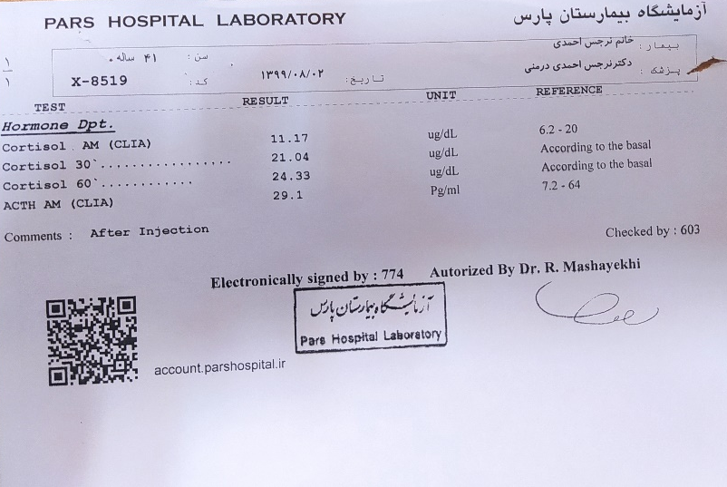

Slide 11
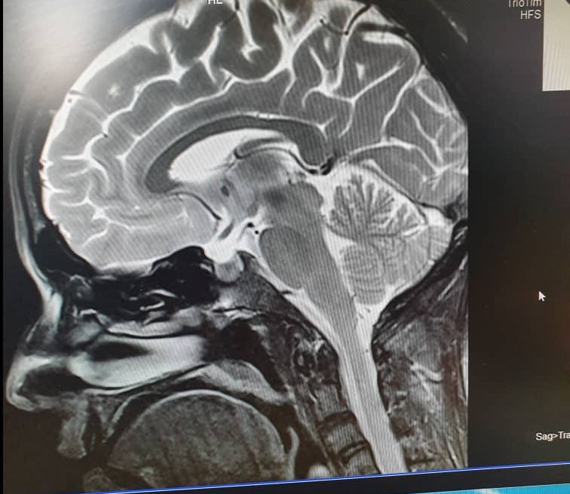

Slide 12
Sheehan syndrome
Functional hypothalamic amenorrhea
PCOS

Slide 13
FHA
FHA is a form of amenorrhea and chronic anovulation and is one of the most common types of secondary amenorrhea. It is classified as hypogonadotropic hypogonadism. FHA has multiple risk factors, with links to stress-related, weight-related, and exercise-related factors. FHA is caused by stress-induced suppression of the hypothalamic-pituitary-ovarian (HPO) axis, which results in inhibition of GnRH secretion, and FSH and LH.

Slide 14

RE VI EW A R T ICL E
Clinical and biochemical discriminants between functional
hypothalamic amenorrhoea (FHA) and polycystic ovary
syndrome (PCOS) Clinical Endocrinology. 2021;00:1–14. ﻿wileyonlinelibrary

Slide 15
Sheehan syndrome
Functional hypothalamic amenorrhea
PCOS

Slide 16
Amenorrhoea
Endometrial Thickness
positive Progesteron challenge test
overweight
High estradiol

Slide 17
PCO
presence of two or more of the following features:
oligo/amenorrhea
clinical or biochemical hyperandrogenism
PCO morphology on ultrasound.
A major feature of the diagnosis of PCOS is the presence of PCO morphology on ultrasound.

Slide 18
AGENDA
What is the differential diagnosis?
What is the reason of amenorrhea and low AMH?
What is the diagnosis?
What are the symptoms and signs of the disease?
How can we treat the disease?

Slide 19
Diminished ovarian reserve
DOR is defined as a decreased capacity of ovary to produce oocytes. It is used to describe women of reproductive age with regular cycles mostly ovulatory, whose response to stimulation is reduced compared to women of comparable age.
Fertility with early reduction of ovarian reserve Npj (nature partner journals) 2017

Slide 20
Three tests consisting of bloodwork and ultrasound imaging are performed on the third day of a woman's menstrual cycle. A transvaginal ultrasound and hormone evaluations for
FSH
estradiol
AMH
Recognizing diminished ovarian reserve study book medicine 2012

Slide 21
Causes of DOR:
Chemotherapy
Radiotherapy
Genetic mutations
Smoking
Ovarian surgeries
Autoimmune
Mumps
Galactosemia
Tubal surgery
Idiopathic
Fertility with early reduction of ovarian reserve Npj (nature partner journals) 2017

Slide 22
AMH is a member of the transforming growth factor-β superfamily that is produced by growing ovarian antral follicles.
Serum Anti-Müllerian hormone (AMH) correlates with the total number of antral follicles over both ovaries.
AMH expression is restricted to one cell type: the granulosa cells of the ovary.
Anti-Müllerian hormone (AMH) in the Diagnosis of Menstrual Disturbance Due to Polycystic Ovarian SyndromeFront Endocrinol (Lausanne). 2019

Slide 23
It starts around the 25th week of gestation continuing until menopause . AMH is expressed at all steps of folliculogenesis. It is initiated as soon as primordial follicles are recruited to grow into small preantral follicles and its highest expression is observed in pre antral and small antral follicles.
Anti-Müllerian hormone (AMH) in the Diagnosis of Menstrual Disturbance Due to Polycystic Ovarian SyndromeFront Endocrinol (Lausanne). 2019

Slide 24
AMH expression then decreases with the selection of follicles for dominance and is no longer expressed during the FSH dependent stages of follicular growth.
Anti-Müllerian hormone (AMH) in the Diagnosis of Menstrual Disturbance Due to Polycystic Ovarian SyndromeFront Endocrinol (Lausanne).2019

Slide 25
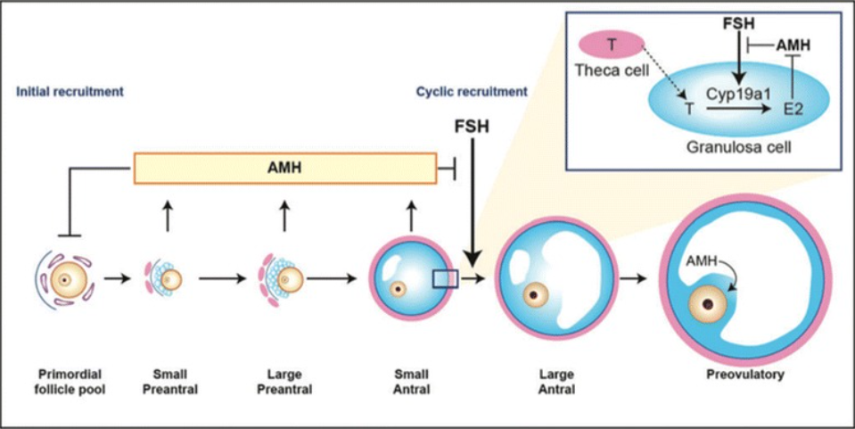

Slide 26
Low AMH results generally coincide with high FSH results, and both of these together are an indicator of low ovarian reserve.
FSH stands for ‘follicle stimulating hormone’, and is a hormone released by the pituitary which stimulates the growth and development of follicles within the ovaries. Developing follicles release estrogen which inhibits FSH, indicating that there are enough viable follicles being ‘recruited’.
Fertility with early reduction of ovarian reserve Npj (nature partner journals) 2017

Slide 27
When ovarian reserve is low there will not be many follicles recruited, and the levels of estrogen released will be low. This gives the brain a signal that not enough follicles are developing, and it will subsequently release more FSH. This is why women with a diminished ovarian reserve will have high FSH levels when this is tested on day 3 of the cycle. FSH used to be the most common blood test used to assess ovarian reserve.
Fertility with early reduction of ovarian reserve Npj (nature partner journals) 2017

Slide 28
AMH may not be an accurate marker of ovarian reserve in patients with deficient endogenous gonadotropin production. Our data supports the hypothesis that a proportion of circulating AMH comes from gonadotropin-dependent follicles.
Clinical pregnancy in a woman with idiopathic hypogonadotropic hypogonadism and low AMHJ Assist Reprod Genet. 2014 Oc

Slide 29
Ovarian reserve testing in patients with IHH can be challenging due to deficient FSH production. In these patients, AMH levels may underestimate ovarian reserve due to the lack of FSH-dependent growing follicles. When treated with a long course of hMG, these patients may exhibit increased AMH levels and demonstrate adequate follicular development.
Clinical pregnancy in a woman with idiopathi hypogonadotropic hypogonadism and low AMH J Assist Reprod Genet. 2014 Oc

Slide 30
AGENDA
What is the differential diagnosis?
What is the reason of amenorrhea and low AMH?
What is the diagnosis?
What are the symptoms and signs of the disease?
How can we treat the disease?

Slide 31
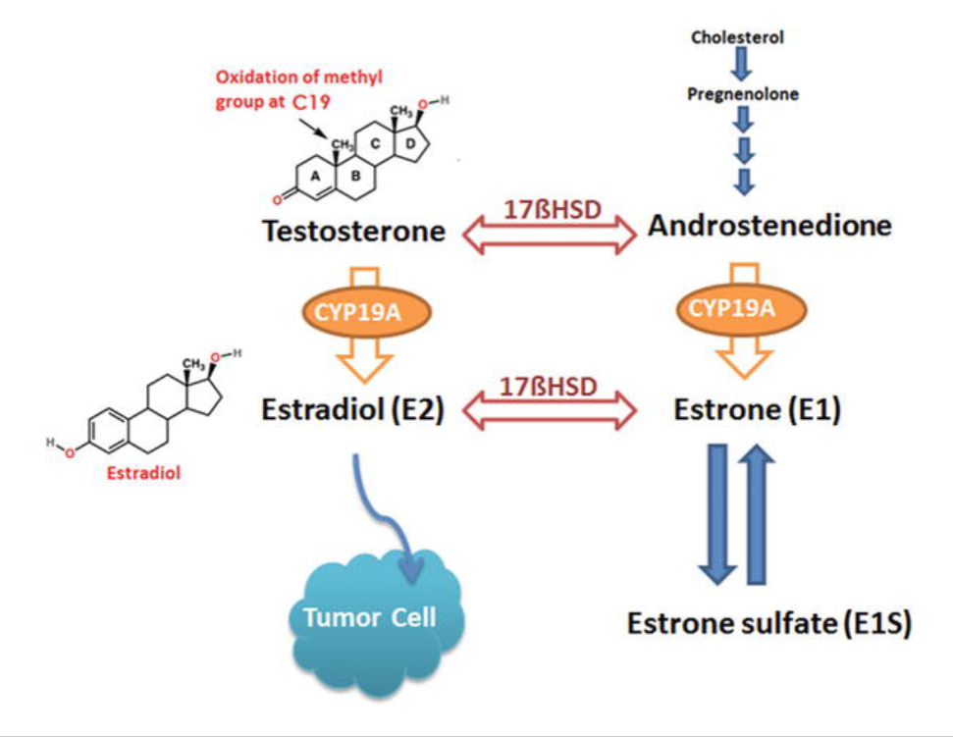

Slide 32
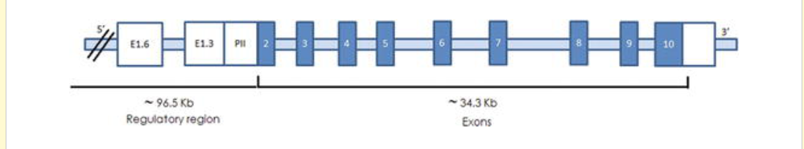
AROMATASE EXCESS SYNDROME
Aromatase is the key enzyme for estrogen biosynthesis. The aromatase gene (also referred to as CYP19) on chromosome 15q21.2 .
Estrogen Excess Associated with Novel Gain-of-Function Mutations Affecting the Aromatase Gene The new england jurnal of medicine 2003

Slide 33
To date, three types of cryptic genomic rearrangements have been identified in patients with AEXS:
duplication type
deletion type (two subtypes)
inversion type (four subtypes)
Aromatase Excess Syndrome: Identification of Cryptic Duplications and Deletions Leading to Gain of Function of CYP19A1 J Clin Endocrinol Metab, June 2011

Slide 34
Pattern of inheritance:
Autosomal dominant
Dominant Transmission of Prepubertal Gynecomastia Due to Serum Estrone Excess The Journal of Clinical Endocrinology & Metabolism2005

Slide 35
What is the differential diagnosis?
What is the reason of amenorrhea and low AMH?
What is the diagnosis?
What are the symptoms and signs of the disease?
How can we treat the disease?

Slide 36
Clinical manifestations
Excess estrogen in boys causes gynecomastia, a premature growth spurt, early fusion of epiphyses, and decreased adult height.
Affected females may show several clinical features such as macromastia, precocious puberty, irregular menses, enlarged uterus and short adult height.
Aromatase excess syndrome in a Chinese boy due to a novel duplication at 15q21.2 J Pediatr Endocrinol Metab 2018

Slide 37
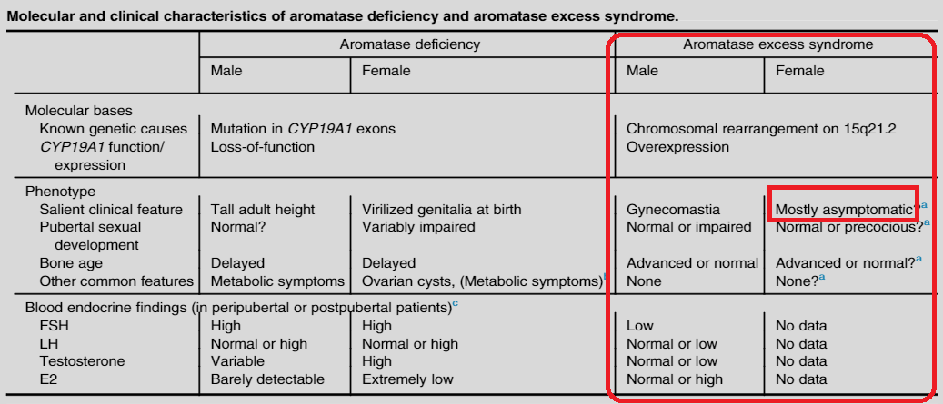

Slide 38
small testes and fairly preserved masculinization in most cases, obvious or relative tall stature in childhood and grossly normal or relative short stature in adulthood, and age-appropriate or mildly advanced bone ages.
Aromatase excess syndrome in a Chinese boy due to a novel duplication at 15q21.2 J Pediatr Endocrinol Metab 2018

Slide 39
estrogen excess in AEXS permits normal fertility in males and produces early menarche in females.
Estrogen Excess Associated with Novel Gain-of-Function Mutations Affecting the Aromatase GeneThe new england jurnal of medicine 2003

Slide 40
The phenotype and genotype correlation of AEXS has been identified recently. It has been reported that patients with duplication-type mutation generally manifest milder gynecomastia compared to those with deletion-type or inversion-type mutations.
Aromatase excess syndrome in a Chinese boy due to a novel duplication at 15q21.2 J Pediatr Endocrinol Metab 2018

Slide 41
phenotypic features such as gynecomastia tended to be more severe in the deletion type than in the duplication type under similar endocrine profiles.
Aromatase Excess Syndrome: Identification of Cryptic Duplications and Deletions Leading to Gain of Function of CYP19A1 and Assessment of Phenotypic Determinants J Clin Endocrinol Metab, June 2011

Slide 42
clinical features of affected males and carrier females and endocrine profiles of affected males are apparently milder in the duplication and the deletion types than in the inversion type.
Aromatase excess syndrome in a family with upstream deletion of CYP19A1 Clinical Endocrinology (2014)

Slide 43
Indeed, aromatase converts androstenedione into estrone.
The undetectable levels of E2 in this syndrome, despite apparent gynaecomastia can be explained by assuming that circulating E1 rather than E2 mediates the development of gynaecomastia in pre- or peripubertal boys.
Aromatase excess syndrome in a family with upstream deletion of CYP19A1 Clinical Endocrinology (2014)

Slide 44
Blood endocrine studies revealed that LH values were grossly normal at the baseline and variably responded to GnRH stimulation
whereas FSH values were low at the baseline and responded poorly to GnRH stimulation.
Androstendione, T, and dihydrotestosterone values were low or normal.
In most cases, estrone values were elevated, E2 values were normal or elevated, and E2/T ratios were elevated.
Aromatase Excess Syndrome: Identification of Cryptic Duplications and Deletions Leading to Gain of Function of CYP19A1 and Assessment of Phenotypic Determinants J Clin Endocrinol Metab, June 2011

Slide 45
although testis volume appears somewhat small, fertility (spermatogenesis) is normally preserved in the three types. This would be consistent with the FSH-dominant hypogonadotropic hypogonadism because FSH plays only a minor role in male fertility (spermatogenesis).
and Deletions Leading to Gain of Function of CYP19A1 and Assessment of Phenotypic Determinants J Clin Endocrinol Metab, June 2011Aromatase Excess Syndrome: Identification of Cryptic Duplications

Slide 46
What is the differential diagnosis?
What is the reason of amenorrhea and low AMH?
What is the diagnosis?
What are the symptoms and signs of the disease?
How can we treat the disease?

Slide 47
Treatment
Treatment with an aromatase inhibitor decreased serum estrogen levels and normalized gonadotropin and testosterone levels.
aromatase inhibitor (AI) plus GH might provide a better growth-promoting approach for AEXS patients.
Aromatase excess syndrome in a Chinese boy due to a novel duplication at 15q21.2 J Pediatr Endocrinol Metab 2018

Slide 48
AI is the target drug for AEXS. Despite a small number of cases, the present evidence was strongly in favor of offlabel use of AI in AEXS. In male patients, AI normalized the hormone profile, delayed epiphyseal closure and further prevented gynecomastia development after mastectomy .
Aromatase excess syndrome in a Chinese boy due to a novel duplication at 15q21.2 J Pediatr Endocrinol Metab 2018

Slide 49
In female patients, AI led to the normalization of menstrual cycles and regression of breast volume. Consistent with genotype-phenotype correlation, the dose of AI varies with different rearrangement types. Empirically, the hormone profile was normalized by using anastrozole 1 mg per day in the duplication- or deletion-type and 2–4 mg per day in the inversion-type.
Aromatase excess syndrome in a Chinese boy due to a novel duplication at 15q21.2 J Pediatr Endocrinol Metab 2018

Slide 50
the accelerated bone growth may occur years before the onset of gynecomastia, and AI monotherapy failed to fully compensate for the potential growth loss. As AI/GH co-treatment would further improve linear growth in other short-stature conditions.
Aromatase excess syndrome in a Chinese boy due to a novel duplication at 15q21.2 J Pediatr Endocrinol Metab 2018

Slide 51
we report an 8-year-old boy diagnosed with AEXS by chromosomal array that revealed a 1.1 Mb novel de novo duplication at 15q21.2, with a predicted final height of 157.4 cm. We prescribed letrozole and growth hormone (GH) to maximize his linear growth. Without further bone age advancement, his height increased from 137.7 cm to 144 cm after an 8-month treatment period.
Aromatase excess syndrome in a Chinese boy due to a novel duplication at 15q21.2 J Pediatr Endocrinol Metab 2018

Slide 52
Thanks for your attention

