Slide 1
In the name of god
Prolactinoma in pregnancy
Dr maryam dehghani

Slide 2
AGENDA
1- Prolactinoma & infertility
2- Prolactinoma & pregnancy ( effect of dopamine agonist on early fetal development )
3- Pregnancy & prolactinoma ( prolactinoma size )
4- Management of prolactinoma Before, During & After pregnancy
5- Case discussion

Slide 3
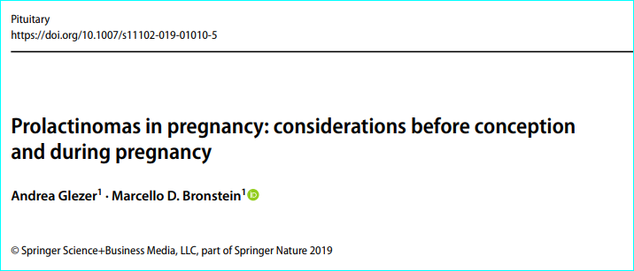
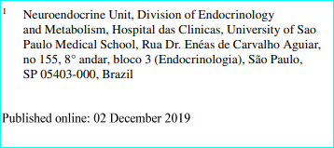
Brazil 2019

Slide 4
PROLACTINOMA & INFERTILITY

Slide 5
INTRODUCTION
Presentation: galactorrhea, menstrual disorders, infertility.
Pituitary adenomas can affect fertility .
Lactotroph adenomas (prolactinomas) cause infertility because of :
1- The inhibitory effect of prolactin
2- The mass effect of a macroadenoma
=> on gonadotropin secretion => anovulation & estradiol & progesterone secretion.
UPTODATE2020

Slide 6
Prolactin & fertility
Kisspeptin:A protein made by neurons in arcuate & periventricular nuclei of hypothalamus:stimulates GNRH release Mediated by : Suppressing the generation of kisspeptin.
1- Hyperprolactinemia
Suppression of GNRH
Decrease LH pulse amplitude & frequency
The main mechanism involves inhibition of GNRH pulsatility, via kisspeptin ,but also direct effects on inhibition of gonadotrophins secretion & gonadal steroidogenesis are described. ( 2019)
2- Hyperprolactinemia
loss of +ive estrogen feedback on gonadotropin (mid-cycle)
MOLITCH 2015

Slide 7
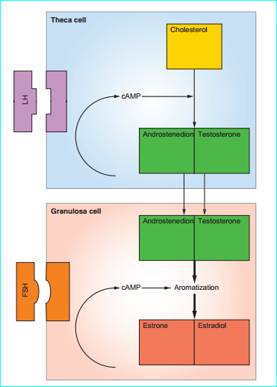
Prolactin & fertility
Although at low levels (<20 ng/ml) PRL is necessary for progesterone production in granulosa cell, at hyperprolactinemic levels it inhibits progesterone production
Direct PRL effects on ovarian granulosa cells
Stimulation of the expression of type 2 3β-hydroxysteroid dehydrogenase
Catalyzing the final step in progesterone biosynthesis & secretion of IGF2.
Directly suppresses progesterone & estrogen from ovaries
Direct effects on ovarian aromatase activity & by blocking the stimulatory effects of FSH.
MOLITCH 2015

Slide 8
Restoration of ovulation
prolactin between 50 - 100 ng/Ml : typically cause either amenorrhea or oligomenorrhea
levels greater than 100 ng/mL result in deficient estradiol & progesterone secretion & amenorrhea.
(DA usually normalizes prolactin & removes inhibition of gonadotropin secretion & restores normal ovulation & fertility. )
Regular menstrual cycles during treatment indicates that the woman is probably ovulating.
Correction of hyperprolactinemia : 80 % will ovulate, pregnancy rates of 70 to 80 % can be achieved .
UPTODATE2020

Slide 9
PROLACTINOMA & PREGNANCY

Slide 10
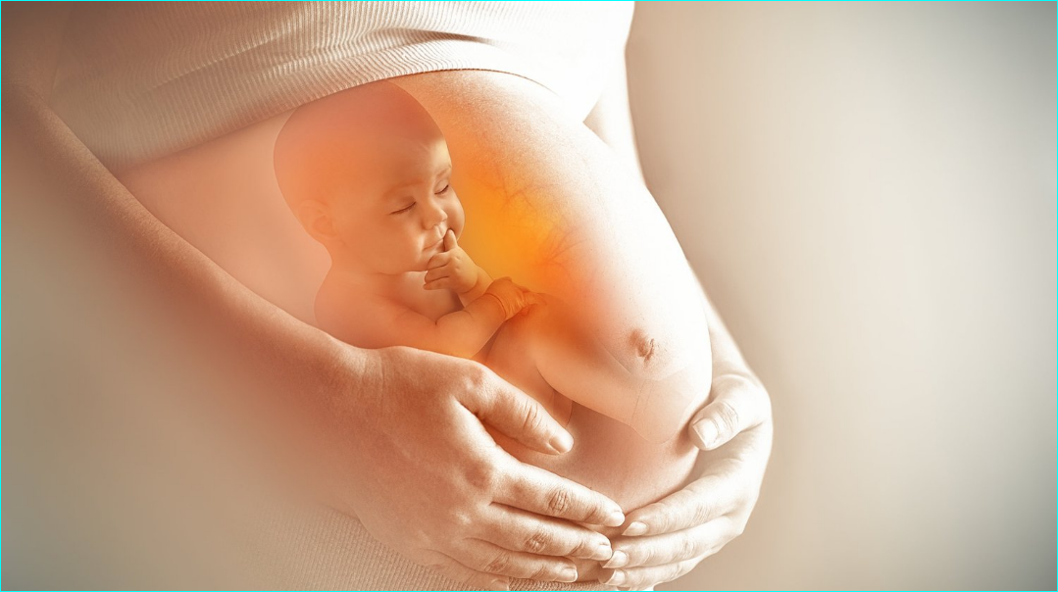
Prolactinoma in pregnancy
When women with prolactinomas get pregnant, 2 important issues arise:
(1) The effects of the DA on early fetal development
(2) The effect of pregnancy on prolactinoma size
Endocrinol Metab Clin N Am - (2019)

Slide 11
Effects of Dopamine Agonists on the Developing Fetus

Slide 12
Bromocriptine has been shown to cross the placenta in human studies;
Cabergoline has been shown to do so in animal studies but such data are lacking in humans.
Although DA is usually withdrawal after pregnancy confirmation, embryo is exposed to drug in an important embryogenesis period .(2019)
To limit the exposure time of the developing fetus to DA:
1- know what the normal menstrual cycle timing is.
2- Mechanical contraception : first 2 to 3 cycles will give the inter-menstrual interval.
3- When she has missed a menstrual period, a pregnancy test performed quickly
4- The DA can be stopped if pregnancy is confirmed.
In this way, the DA will have been given for only about 3–4 weeks of the gestation.
Endocrinol Metab Clin N Am - (2019) MOLITCH 2015

Slide 13
bromocriptine
Short-term exposure of generally <6 weeks : has not been found to cause any increase in spontaneous abortions, ectopic pregnancies, trophoblastic disease, multiple pregnancies, or congenital malformations.
Data from over 6000 pregnancies : bromocriptine during the first mo of pregnancy does not harm the fetus [MOLITH 2011], In this series, the incidence of:
Spontaneous abortions (9.9 %)- Multiple births (1.7 %)- Malformations (1.8 %)
was no higher than in the general population.
A follow-up study of 64 children between 6 mo & 9 years whose mothers took bromocriptine : no ill effects on their development .
Throughout gestation : Continuous use of bromocriptine in 100 women : congenital malformations did not higher than non exposed pregnancies, only one case of undescended testis & one talipes deformity .
European Journal of Endocrinology 2015) 172, R205–R213

Slide 14
cabergoline
Exposure to cabergoline in pregnancy : more than 1000 cases, 12 years’ follow-up after exposure .
no increase in malformations or other adverse pregnancy outcomes,
Throughout gestation : Regarding CAB maintenance ;we reviewed 15 pregnancies resulting in 14 healthy newborns & one fetal death (34W) related to preeclampsia .
More recently, Rastogi et al. described 3 malformations (neural tube defect) only in the group of patients on CAB throughout gestation (n = 25), compared to no cases in the group of withdrew the DA after pregnancy confirmation (n = 23) .
32 pregnancies induced by CAB , drug was maintained in six, without evidences of harmful outcomes
Endocrinol Metab Clin N Am - (2019)
Brazil 2019

Slide 15
Endocrinol Metab Clin N Am - (2019)

Slide 16
In contrast with the earlier reassuring information regarding cabergoline & bromocriptine, Hurault-Delarue & colleagues: reported adverse outcomes of DA use:
Of the 57,408 mother-baby outcome pairs, 183 (0.3%) received DA at some time during their pregnancies (75% in the first trimester). Compared with control group:
DA exposure was associated with an increased risk of preterm birth & early pregnancy loss & an insignificant increase in fetal malformations but no difference in psychomotor development at ages 9 & 24 months.
There were no differences between the DAs with respect to these outcomes.
Endocrinol Metab Clin N Am - (2019)

Slide 18
To evaluate the maternal–fetal outcomes of CAB-induced pregnancies in patients with prolactinoma in a large cohort.
Methods: The prevalence of tumor growth, miscarriage, preterm, low birth weight, congenital malformations & impairment in neuropsychological development in children among women treated with CAB were assessed in a Brazilian multicenter retrospective observational study,
Results: 194 women ,43% micro adenomas & 56% macro adenomas, at prolactinoma diagnosis.
In 233 pregnancies, CAB was withdrawn in 89%, after pregnancy confirmation. Symptoms related to tumor growth occurred in 25 cases, more frequently in macro adenomas.
Amongst the live-birth deliveries: preterm occurred in 12%, low birth weight in 6% , congenital malformations in 4.3%. Neuropsychological development impairment was reported in 7% of cases.
The overall miscarriage rate was 11%, although higher in the subgroup of patients with CAB maintainance after pregnancy confirmation (38% vs. 7.5%)

Slide 19
Clinical, laboratory and cabergoline treatment features in patients who presented miscarriage
The overall rate of miscarriage : 11% at a median gestational age of 8 weeks.
A significant difference in miscarriage rates was found when comparing patients who were withdrawn from CAB at pregnancy confirmation (Group A) with patients in whom CAB was maintained by medical indication or inadvertent patient´s demeanor (Group B); the rates were 7.5% (14/187) in Group A versus 38% (12/31) in Group B, p < 0.001 (HR 7.8; 95% CI 3.16–19.3).

Slide 20
Conclusions
With the exception of the miscarriage rate, all other maternal (symptomatic tumour growth) & fetal (prematurity, low birth weight, malformations & neurodevelopmental impairment) outcomes were found at rates similar to those reported in previous literature, including BRC-induced pregnancies and those in the general population.
Although the miscarriage rate was associated with CAB maintenance after pregnancy confirmation, its causal relation should be confrmed by further studies

Slide 21
quinagolide
A non-ergot DA, with selective D-2 R agonist - long-lasting prolactin lowering effect . In a review of 176 pregnancies, quinagolide ( used for median duration 37 days) :
24 spontaneous abortions, 1 ectopic pregnancy, 1 stillbirth at 31 weeks of gestation, 9 fetal malformations.
Thus, quinagolide does not seem to be safe for pregnancy.
Endocrinol Metab Clin N Am - (2019)

Slide 22
Effect of Pregnancy on Prolactinoma Size

Slide 23
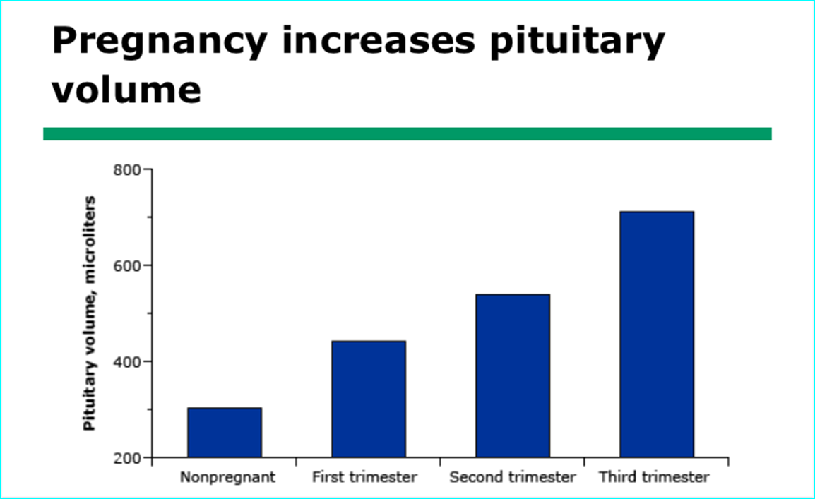
Adenoma growth — Principal risk to mother , cause neurologic symptoms, importantly visual impairment.
- In normal pregnancy, MRI : gradual increase in pituitary volume to a final height of 12 mm..
Hyperestrogenemia ( high placental estrogen) causes lactotroph hyperplasia
20 NL nonpregnant - 32 NL pregnant : greater increase in pituitary size (MRI), volume during 3rd trimester more than double in nonpregnant women .
UPTODATE2020
Endocrinol Metab Clin N Am - (2019)

Slide 24
The risk that the increase in size of a PROLACTINOMAS will be clinically important depends upon the size of the adenoma before pregnancy.
Microadenoma —risk of growth is very low .
A review of 15 studies reporting a total of 800 patients with lactotroph microadenomas showed that only 2.5 % exhibited a symptomatic increase in size of adenoma during pregnancy .
Macroadenoma — The risk of growth of a lactotroph macroadenoma during pregnancy is substantially higher.
- In the same review as above, only 4.7 % of 148 women who had macroadenomas ( treated by prior surgery or radiation ) developed clinically significant enlargement during pregnancy,
- but 18.1 % of 288 women who had not had such treatment did.
Enlargement not accompanied by symptoms or visual field deficit was not counted.
UPTODATE2020

Slide 25
The risk of symptomatic tumor enlargement in pregnant women with microprolactinomas is 2.5% , 18.1% for macroprolactinomas with no prior surgery or irradiation, 4.7% for macro adenomas with prior surgery/irradiation.
Endocrinol Metab Clin N Am - (2019)

Slide 26
MRI scans of an interstellar prolactin-secreting
macro adenoma in a woman before conception
At 7 months of gestation
at which time the patient was complaining of headaches.

Slide 27
BEFORE PREGNANCY

Slide 28
OVERVIEW
Management should begin before lowering the prolactin concentration with a discussion about the risks of adenoma growth during pregnancy & potential effects of exposure to DA on the fetus.
neither bromocriptine nor cabergoline use during the first mo of pregnancy harms the fetus.
However, few data are available about the risk of either drug later in pregnancy.
UPTODATE2020

Slide 29
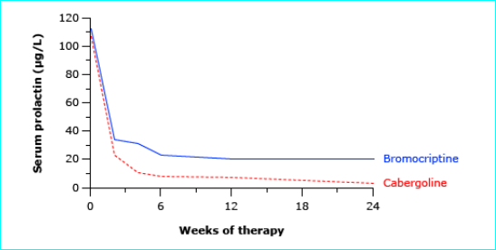
TREATMENT BEFORE PREGNANCY: MICROADENOMAS
Dopamine agonist therapy —usually normalizes prolactin & thereby removes inhibition of gonadotropin secretion & restores normal ovulation & fertility.
A marked reduction in the serum prolactin often occurs within 2-3 weeks .
Serum prolactin in women with hyperprolactinemic amenorrhea treated with DA. Both drugs lowered prolactin into normal range
UPTODATE2020

Slide 30
Non pregnancy : CAB, due to better tolerability & higher affinity to D2R as compared to BRC, is preferred DA.
pregnancy-induction : BRC is still preferred due to its larger published data & shorter half-life, with a faster clearance, as compared to CAB .
Although, BRC & CAB were formerly classified as category B by the FDA
In Australian classification :
BRC is category A (no human risks, similar miscarriage rates, no increase malformations & teratogenic effects)
CAB is category B (no animal risks, waiting for more human data) .
In contrast, should pregnancy at an advanced stage be discovered in a woman taking DA, the data are reassuring & do not justify therapeutic abortion.
Brazil 2019

Slide 31
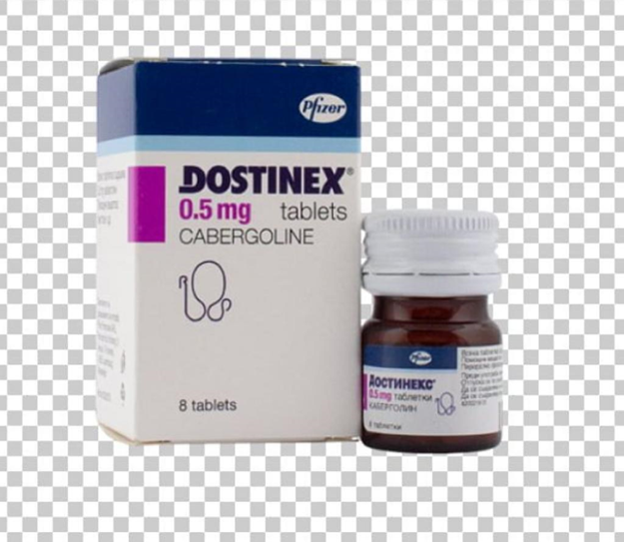
Dosing is as follows:
For cabergoline:
Start at 0.25 mg twice a week.
If the serum prolactin is not normal after 1 to 2 months : can be increased to 0.5 mg twice a week or, if necessary, 1 mg twice a week.
Sometimes, even higher doses are needed.
Patients with Parkinson treated with high doses of cabergoline (eg, >20 mg per week) have an increased risk of valvular heart disease, but this risk has not been demonstrated using the lower doses used for lactotroph adenomas .
UPTODATE2020

Slide 32
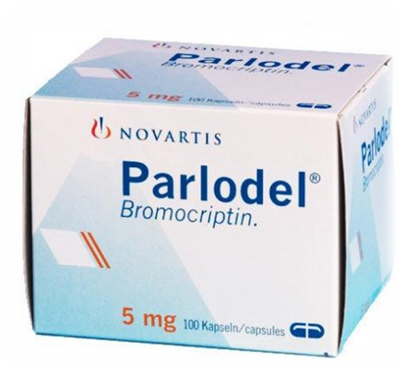
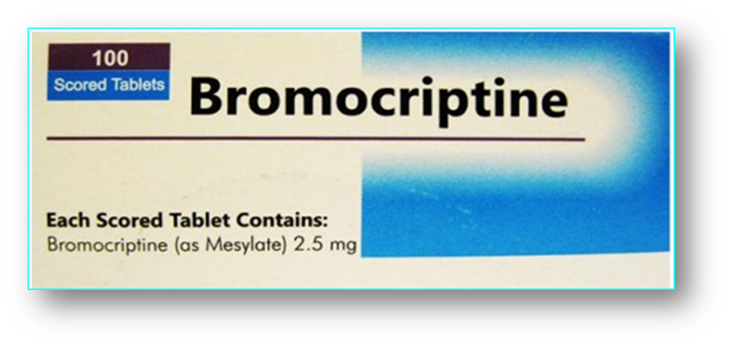
For bromocriptine:
Start : 1.25 mg at bedtime for 1 wk, then 1.25 mg twice a day for 1 to 2 mo.
If prolactin does not fall to near normal or normal by then : can be increased to 2.5 mg twice a day and, if necessary, to 5 mg twice a day.
If nausea or prolactin does not decrease to normal, consider changing to cabergoline.
Rarely, DA is resumed during pregnancy if adenoma size increases so much as to impair vision.
UPTODATE2020

Slide 33
For women who do not ovulate or do not conceive with DA therapy, clomiphene citrate may be added
If unsuccessful, gonadotropin therapy may be needed, although this therapy is associated with high serum estradiol concentrations during treatment & a significant risk of multiple gestations.
Radiotherapy is not warranted for micro adenomas because of long-term sequelae, especially hypopituitarism.
We suggest stopping the DA in women with either a micro- or macroadenoma once pregnancy has been confirmed because the safety of continued usage has not been established.
UPTODATE2020

Slide 34
TREATMENT BEFORE PREGNANCY: MACROADENOMAS
For macroadenoma, adenoma size should be reduced & ovulation should be restored before pregnancy is attempted.
DA: We recommend a DA as the initial treatment, whether or not adenoma is elevating the optic chiasm.
PERMISSION : Once adenoma size has decreased dramatically & well within the confines of the sella & ovulation has been restored, pregnancy can be attempted.
Reduction in size in this way should reduce the chance of clinically important enlargement during pregnancy .
UPTODATE2020

Slide 35
TSS :
If the adenoma elevates the optic chiasm & does not shrink substantially in response to a DA , we recommend TSS .
We also recommend surgery in a woman whose macro adenoma is unresponsive to DA, even if it is not elevating the optic chiasm, because medical treatment would not likely be effective if the adenoma enlarges during pregnancy.
-Therefore TSS indication:
Despite effectiveness & relative safety of pituitary surgery, (mainly in MIC) this approach should be reserved for resistant/intolerant tumors or patient preference.
surgery may be indicated for another complication related to pregnancy: pituitary tumor apoplexy with severe neurologic & visual symptoms.
UPTODATE2020.
Brazil 2019

Slide 36
SURGERY
Colao reviewing large series from the literature, including both genders, reported hyperprolactinemia remission in 73% of 1211 MICs & in 38% of 1480 MACs .
Concerning surgical series addressing only women at child-bearing age, data are limited. In one study, in 138 patients harboring prolactinomas younger than 40 yrs submitted to TSS , normal PRL levels were achieved in 86% of 21 MIC and in 74% of 117 MAC, with better results in non-invasive cases. Hypopituitarism was described in only two patients (1.5%).
-TSS causes a permanent reduction of PRL levels in only 60% to 70% of cases .
Brazil 2019
Endocrinol Metab Clin N Am - (2019)

Slide 37
As far as radiotherapy is concerned, the long time span until normoprolactinemia achievement in addition to complications as hypopituitarism, limit its indication for patients in reproductive age, except for those harboring aggressive/ invasive tumors .
Therefore, in patients with extrasellar tumors, pregnancy should be allowed only after tumor shrinks within sellar boundaries ,especially those with suprasellar extension, preferably after at least 1 year of treatment .
Resistant cases both regarding PRL normalization & tumor reduction should be operated on.
Brazil 2019

Slide 38
Concerning The Follow-up Of Pregnant Women Harboring Prolactinomas, The Following Recommendations Can Be Made:
1. Before conception:
• DA of choice: BRC has been the recommended drug for pregnancy induction, although cumulative data do not point to harmful outcomes with CAB.
• MIC & intrasselar MAC: pregnancy can be recommended once the gonadotrophic axis is restored.
• Expansive/invasive MAC: pregnancy can be recommended once the gonadotrophic axis is restored & only after tumor is reduced within the sellar boundaries, especially in those with suprasellar expansion. Otherwise, pituitary surgery is indicated.
2. Pregnancy confirmation:
• MIC and intrasselar MAC: DA should be withdrawn.
• Expansive/invasive MAC: DA maintenance at the physician discretion & frequent monitoring.
-Pregnancy can generally be achieved in more than 85% of patients with DA or surgery.
Brazil 2019- N AM

Slide 39
During Pregnancy

Slide 40
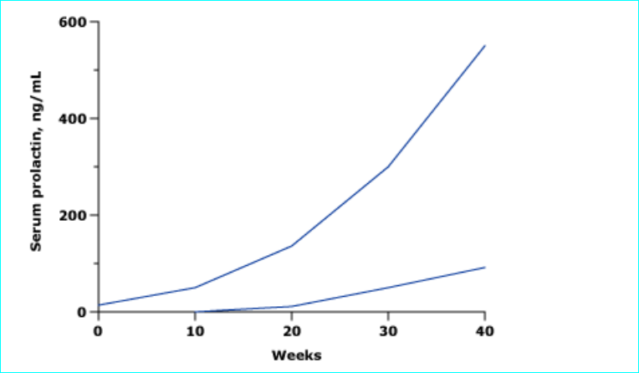
Serum prolactin — During normal pregnancy, serum prolactin increase to as high as 400 ng/mL.
PRL increase to10 times the non-pregnant at the end of third trimester (2019)
Prolactinoma may experience an increase in prolactin to pretreatment levels .
Endocrine Society guidelines recommend against measuring prolactin during pregnancy, because it s difficult to distinguish normal pregnancy-associated rise in prolactin or adenoma growth .
Therefore, periodic checking of PRL is not recommended.
1-Because of the low incidence of tumor enlargement.
2-PRL do not always increase during pregnancy in women with prolactinomas, even in those with tumor enlargement & PRL levels may rise significantly without any tumor size increase.
UPTODATE2020
Endocrinol Metab Clin N Am - (2019)

Slide 41
MONITORING
Visit : routine intervals & ask headaches & changes in vision (as indicators of potential adenoma growth).
Microadenomas :should be seen every 3 months.
Macroadenomas : should also be seen at least every 3 months & more often the larger adenoma.
UPTODATE2020

Slide 42
Visual field testing
1- women who develop visual symptoms during pregnancy should have visual field testing.
2- women whose macroadenomas extend above sella should undergo visual field testing
before pregnancy & every 3 months during pregnancy, even if the patient has no visual symptoms.
(Macro adenomas treated (DA or after surgery), careful follow-up with monthly to 3-monthly formal visual field testing is warranted. (N am 2019)
If a visual field defect : consistent with a sellar mass is found bitemporal hemianopsia, MRI without contrast should be performed.
UPTODATE2020

Slide 43
-In patients with a larger macroadenoma, it is helpful to have a baseline MRI scan just before pregnancy.
Pituitary MRI — Routine pituitary MRI is not indicated, because risk of adenoma growth is very low.
If severe headache or visual field abnormalities =>pituitary MRI without contrast .
-In clinical practice, it is important to document a significant increase in tumor size before intervention, such as restarting a DA or surgery.
-1st-trimester gadolinium exposure: slight increases stillbirths, neonatal deaths, broad outcome of any rheumatological, inflammatory, infiltrative skin condition .
- late 2end or 3rd trimesters: No adverse effects from MRI with or without gadolinium
UPTODATE2020
Endocrinol Metab Clin N Am - (2019)

Slide 44
In patients with a larger macro adenoma :
There is no best therapeutic approach in such patients:
*If there was substantial shrinkage of a very large tumor with DA , then stopping the drug abruptly might cause a sudden enlargement of the tumor ->wisest course : continue the DA .
*Another approach is to debulk via TSS
After surgical debulking, a DA is generally required to normalize PRL levels & allow ovulation.
*A third approach : DA continuously throughout gestation, but data regarding effects on the fetus are meager; therefore, such treatment cannot be recommended without reservation.
Macro adenomas treated (DA or after surgery), careful follow-up with monthly to 3-monthly formal visual field testing is warranted.
larger macroadenoma, it is helpful to have a baseline MRI scan just before pregnancy.
Endocrinol Metab Clin N Am - (2019)

Slide 45
Patients with a microadenoma or a small intrasellar macroadenoma_ who were treated with a DA & had medication withdrawal after conception need only to be followed clinically throughout gestation.
Treatment of enlarging adenoma — If the adenoma has enlarged to a degree that could account for the headaches and/or visual field defect :
1- should be treated with cabergoline or bromocriptine throughout remainder of the pregnancy.
We suggest using the same DA, patient took & tolerated previously.
2- she should be seen at least once a month to reevaluate symptoms & visual fields.
- If bromocriptine is used first & adenoma does not respond, cabergoline should then be tried.
-If cabergoline is not successful in alleviating severely compromised vision after several weeks, we suggest TSS in 2end trimester.
In contrast, in the 3rd trimester, surgery for persistent visual symptoms should be deferred until after delivery, if possible.
UPTODATE2020

Slide 46
During pregnancy:
• MIC & intrasselar MAC: clinical evaluation each trimester, serum PRL level evaluation not indicated. If symptoms related to tumor growth, sellar MRI without contrast & neuro ophtalmologic evaluation must be performed.
• Expansive/invasive MAC: DA maintenance at the physician discretion. Monthly clinical evaluation & visual assessment each trimester is recommended. If symptoms related to tumor mass effect, sellar MRI without contrast must be performed.
• If sellar MRI depicts significant tumor growth related to clinical picture, reintroduction of DA is the first approach. In case of failure, neurosurgery is indicated, preferentially at the 2end trimester. If gestation is near-term, delivery can be considered.
Brazil 2019

Slide 47
Pituitary apoplexy —refers to sudden hemorrhage into the pituitary.Although pituitary apoplexy during pregnancy is an exceedingly rare event, with an estimated prevalence of 1 per 10,000 gestations in one series , the prevalence amongst women with DA induced pregnancy is not established
Apoplexy can occur in patients with pituitary micro or macroadenomas, including women with lactotroph macroadenomas during pregnancy.
most dramatic presentation: sudden onset of excruciating headache, diplopia (pressure on oculomotor nerves) , hypopituitarism.
All pituitary hormonal deficiencies can occur, but the sudden onset of ACTH & cortisol deficiency is the most serious because it can cause life-threatening hypotension. It should be treated with high-dose hydrocortisone.
UPTODATE2020, BRASIL2019

Slide 48
During the intrapartum stage, there is no indication for continuous electronic fetal monitoring.
Duration of pushing is in accordance with NICE Intrapartum Care Guidelines unless there is symptomatic tumour enlargement. In which case a *planned caesarean* section should be considered to prevent pituitary apoplexy.
Often DA are discontinued at 36 wks of pregnancy to allow successful breastfeeding.
An MRI scan is required in the postpartum period to assess for tumour growth. If there is evidence of enlargement, DA should be restarted, however this will cause suppression of lactation impact on breastfeeding.

Slide 49
AFTER PREGNANCY

Slide 50
Breastfeeding & Das — Breastfeeding increases serum prolactin but does not increase the risk of adenoma growth ( Versus previous data1987: lactation dose not increase PRL)
Breastfeeding is an option for micro & macroadenomas that remained stable in size during pregnancy.
DA should be withheld until breastfeeding is completed.
Breastfeeding is contraindicated in visual field impairment (should be treated with DA.)
Normalization of prolactin after pregnancy
Serum prolactin normalizes within 6 to 12 weeks postpartum in women who do not breastfeed.
To evaluate the need for further DA after pregnancy, serum prolactin should be measured approximately 3 months after delivery in women who do not breastfeed & after cessation of breastfeeding in those who do.
Reinstitution of DA has to await the cessation of breastfeeding & is done only in women who remain anovulatory. (2019)
UPTODATE2020

Slide 51
Recurrence was slightly greater in those who had macroadenomas than in those who had microadenomas.
In a study of 104 pregnancies in 73 patients with lactotroph adenomas treated with a dopamine agonist prior to pregnancy, 41 % had a normal serum prolactin concentration a median of 22 months after delivery or cessation of lactation
Postpartum PRL & tumor sizes often decrease compared with values before pregnancy.(N AM 2019)

Slide 52
Brazil 2019

Slide 53
CASE DISCUSSION

Slide 54
Case 1
Ms. D is 24 years old and was seen for inability to conceive. Her initial screen results showed an elevated prolactin level of 64 μg/L (normal level is 2 to 15 μg/L).
A subsequent MRI scan confirmed the presence of a 5mm pituitary adenoma.
She was given Bromocriptine 3 years ago, which normalized her menstruation as well as her prolactin level.
One year ago she asked if she could start Cabergoline instead because of its less frequent dosage. She was switched to Cabergoline 0.5 mg twice a week and her prolactin levels have remained normal.
She called your clinic yesterday to inform you that she was pregnant.
How would you manage this patient?

Slide 55
Medical management:
Continue current dopamine agonist therapy throughout pregnancy
Discontinue Cabergoline and switch to Bromocriptine due to better safety data
Discontinue dopamine agonist therapy as soon as pregnancy is confirmed
Refer for surgical excision of the tumour
Recommend therapeutic abortion

Slide 56
Biochemical monitoring:
Continue regular monitoring of serum prolactin during pregnancy
Discontinue monitoring serum prolactin during pregnancy
Measure serum prolactin only if patient complains of new onset headaches and/or vision changes

Slide 57
Pituitary imaging:
Perform regular pituitary imaging during pregnancy to exclude tumour enlargement
Perform pituitary imaging if serum prolactin is thought to be out of proportion with your clinical judgment
Perform pituitary imaging only if patient complains of new-onset headaches and/or vision changes

Slide 58
Visual field testing:
Perform regular formal visual field testing throughout pregnancy
Perform formal visual field testing only if patient complains of new-onset headaches and/or vision changes
Never perform formal visual field testing
Only perform informal (clinical) visual field testing

Slide 59
Case 2
Mrs. S a 37-year-old teacher, had originally presented with milky breast discharge about 5 years ago.
Subsequent investigations revealed an elevated prolactin level of 654 μg/L (normal level is 2-15μg/L)
Pituitary MRI confirmed a 2.1cm pituitary macroadenoma. Visual field testing revealed a defect in her left superior temporal field. She was started immediately on Cabergoline 1.0 mg twice a week, and within 6 months, her serum prolactin level returned to normal, and her tumor shrank to 1.2 cm. Her visual field test results were normal.
She has been under yearly surveillance and her serum prolactin level has remained normal she is now 4 weeks pregnant.

Slide 60
Medical management:
Continue current dopamine agonist therapy throughout pregnancy
Discontinue Cabergoline and switch to Bromocriptine due to better safety data
Discontinue dopamine agonist therapy as soon as pregnancy is confirmed
Refer for surgical excision of the tumour
Recommend therapeutic abortion

Slide 61
Biochemical monitoring:
Continue regular monitoring of serum prolactin during pregnancy
Discontinue monitoring serum prolactin during pregnancy
Measure serum prolactin only if patient complains of new onset headaches and/or vision changes

Slide 62
Pituitary imaging:
Perform regular pituitary imaging during pregnancy to exclude tumor enlargement
Perform pituitary imaging if serum prolactin is thought to be out of proportion with your clinical judgment
Perform pituitary imaging only if patient complains of new-onset headaches and/or vision changes

Slide 63
Visual field testing:
Perform regular formal (Goldmann or Humphrey) visual field testing throughout pregnancy
Perform formal visual led testing only if patient complains of new-onset headaches and/or vision changes
Never perform formal visual field testing
Only perform informal (clinical) visual eld testing

Slide 64
Case 3
Mrs. Wong, a 30-year-old nulliparous realtor, is 10 weeks pregnant. She was told 6 years ago that she had a large prolactinoma and was given Bromocriptine. She last saw her specialist more than 3 years ago. She has been getting her prescription through her family physician and takes her medication intermittently.
Her menstruation has always been irregular and when she started gaining weight 2 weeks ago she did the pregnancy test, which was positive. This was later confirmed by her family physician.
She last took Bromocriptine about 3 months ago. When you examined her, she had bitemporal hemianopia on clinical visual field testing and you requested an urgent MRI which showed a 2.9 cm sellar tumor compressing the optic chiasm. Her serum prolactin level was 2400 μg/L.

Slide 65
Medical management:
Restart previous dopamine agonist therapy (Bromocriptine) throughout pregnancy
Start Cabergoline due to its better efficacy
Discontinue dopamine agonist therapy as soon as pregnancy is confirmed
Refer for surgical excision of the tumour
Recommend therapeutic abortion

Slide 66
Pituitary imaging:
Perform regular pituitary imaging during pregnancy to exclude tumour enlargement
Perform pituitary imaging if serum prolactin is thought to be out of proportion with your clinical judgment
Perform pituitary imaging only if patient complains of headaches and/or further worsening of vision

Slide 67
Visual field testing:
Perform regular formal (Goldmann or Humphrey) visual field testing throughout pregnancy
Perform formal visual led testing only if patient complains of headaches and/or further worsening of vision
Never perform formal visual field testing
Only perform informal (clinical) visual field testing

Slide 69
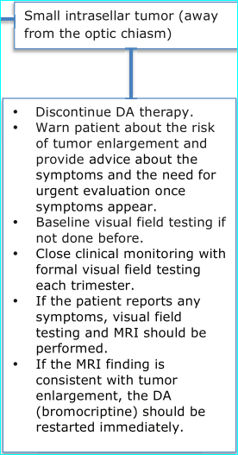
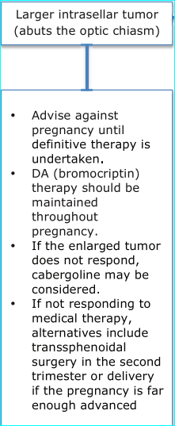
MA
C
R
O

Slide 71
To evaluate long-term outcomes, including menstrual recovery, after TSS Observational study.
Results: 63 female patients were included.
Based on MRI findings before surgery, 31 (49.2%) microadenoma, 32 (50.8%) macroadenoma.
The median follow-up after TSS was 53 months
long-term surgical remission achieved in 50 (79%) patients, 28 (90 %) micro & 22 (68%) macroadenomas.
No meningitis or persistent CSF leaks occurred. Only 1 case suffered from persistent DI at follow-up.
No severe pituitary dysfunction was observed in microprolactinoma .
Of patients with menstrual disorders, 85% regained regular menstrual cycles after surgery. 19 patients in this cohort desired pregnancy & 15 of them successfully gave birth after surgery.
All 17 microadenoma with modern surgical indications achieved normal prolactin & regular menstrual cycles with only 1 patient on drug therapy at follow-up.

Slide 72
Serum prolactin level (ng/mL) before surgery

Slide 73
Characteristics of patients with micro-& macroprolactinomas

Slide 75
Outcomes of modern surgical indications for prolactinoma at post-operative day and follow-up

Slide 76
Conclusion : Long-term follow-up showed a high remission rate in female prolactinoma patients, especially in microadenoma patients, after surgery.
Transsphenoidal surgery performed by experienced neurosurgeons may offer a valuable approach to treat female microprolactinoma patients of child-bearing age with modern indications for surgery.

