Slide 1
ECTOPIC CUSHING &NET

Slide 3
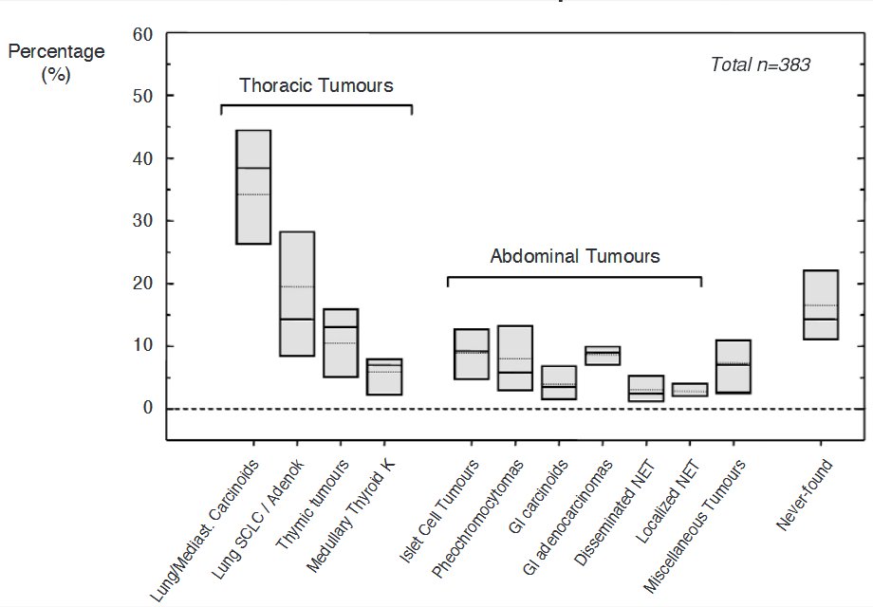

Slide 4
CLASSIFICATION

Slide 6
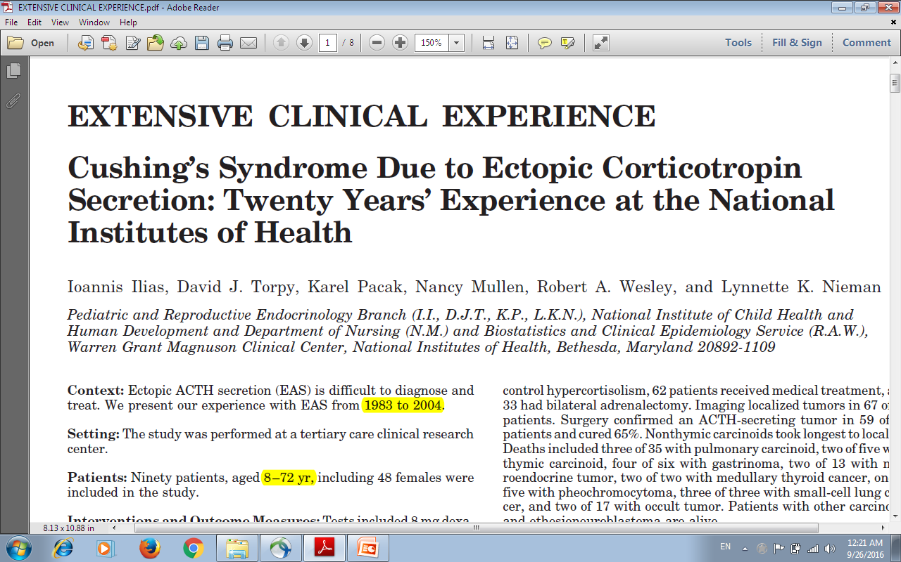

Slide 7
RESULTS
86 to 94% of patients did not respond to CRH or dexamethasone suppression test.
66 of 67 had negative IPSS.
Nonthymic carcinoids took longest to localize.
Deaths included 3of 35 with pulmonary carcinoid, two of five with thymic carcinoid, four of six with gastrinoma, 2 of 13 with neuroendocrine tumor, two of two with MTC, one of five with pheochromocytoma, three of three with small-cell lung cancer,and two of 17 with occult tumor.

Slide 8
RESULTS
IPSS best identifies EAS.
Initial failed localization is common and suggests pulmonary carcinoid false positive HDDST.
Although only 47% achieved cure,
Survival is good except in patients with SCLC
MTC, and gastrinoma.

Slide 9
2015 European Society of Endocrinology.

Slide 11
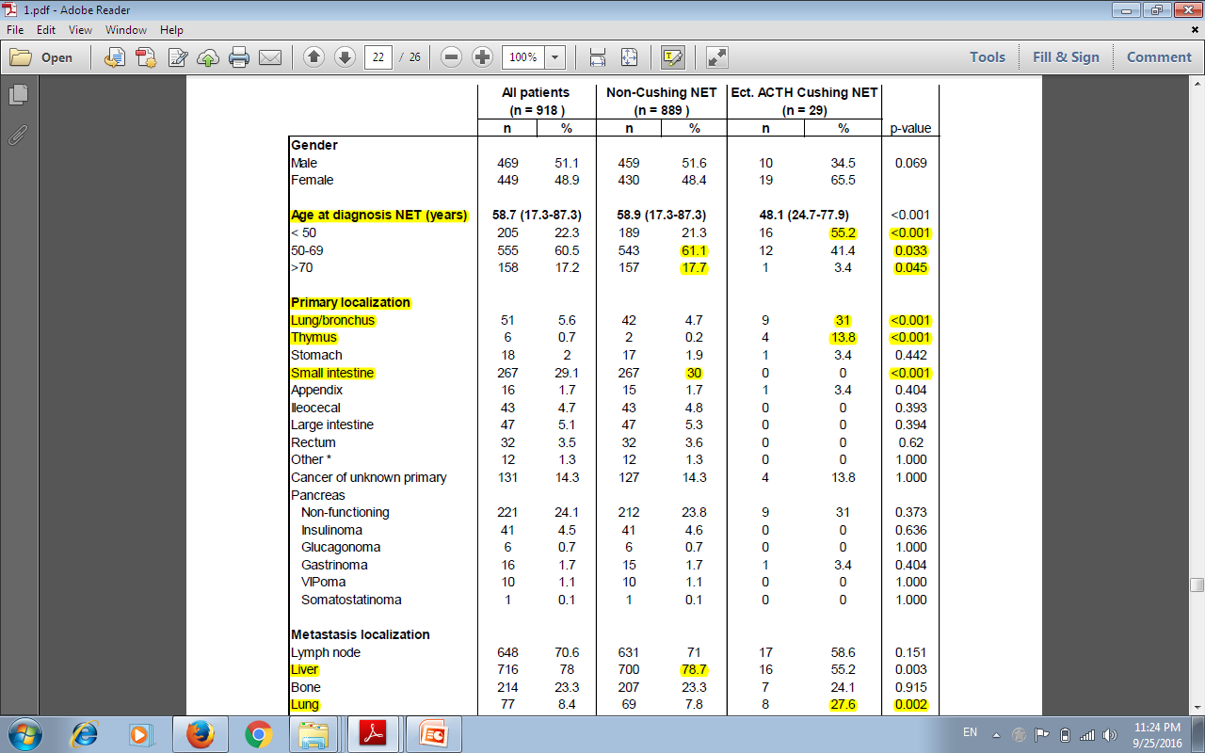

Slide 13
Overall survival & 5-year survival of EAS (n=29) versus non-EAS Thoracic and GEP-NET (n=889)

Slide 14
Survival curves by Tumor Grade (EAS vs. non-EAS patients)

Slide 15
Survival curves by ENETs Tumor Stage (EAS vs. non-EAS patients)

Slide 16
DIAGNOSIS
LAB TEST:
22–40% of EAS patients demonstrate either serum or urinary cortisole suppression on the (HDDST)
Patients with bronchial carcinoids can show a significant degree of cortisol suppression (approximately 60%)
10–15% of patients with EAS have been shown to respond to CRH administration,
IPSS is the method of choice.

Slide 18
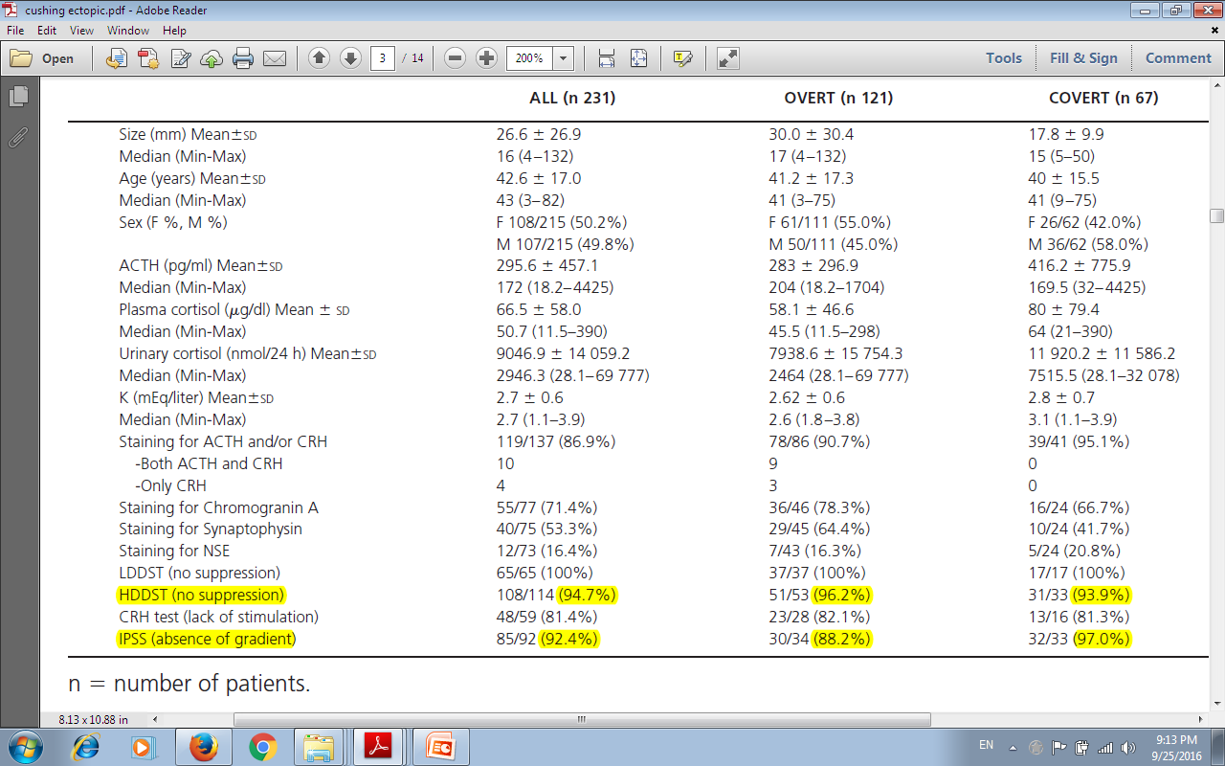

Slide 19
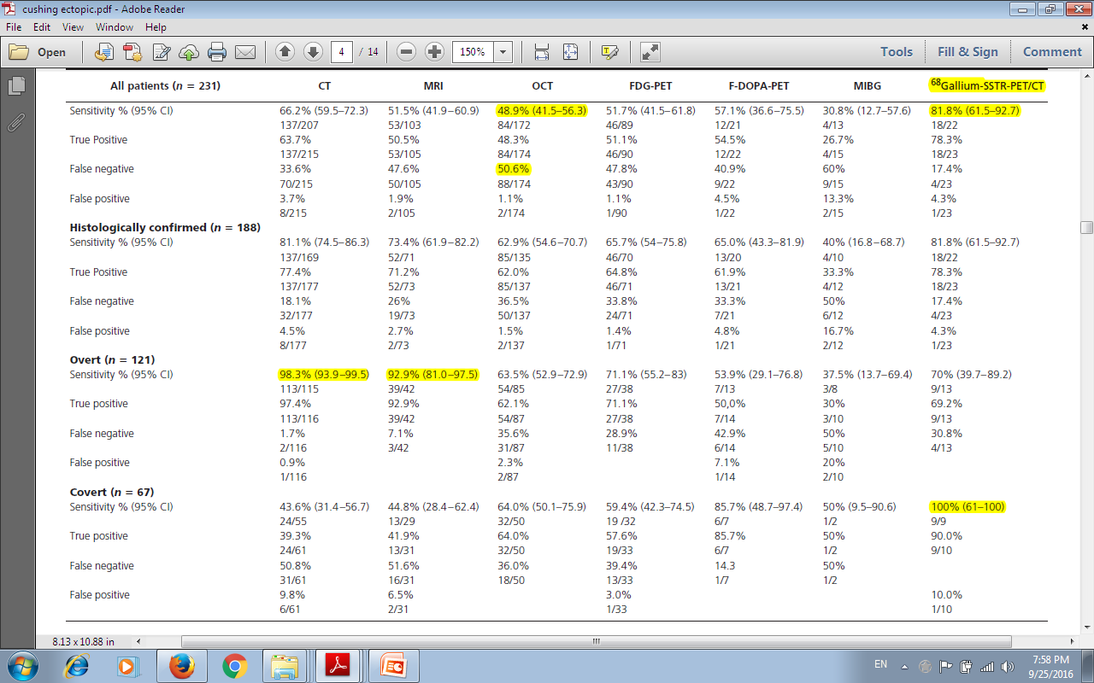

Slide 22
TREATMENT

Slide 23
Somatostatin Analogues
All five subtypes of somatostatin receptors are expressed in carcinoid tumors.
The receptors are expressed on tumor cells and in peri tumoral veins.
An antiproliferative effect probably through a combination of SSTR2 and SSTR5 activities
Anti angiogenesis
The recommended dose is 100 to 150 μg two or three times a day, a standard treatment,
Some patients require higher doses, up to a total of 3000 μg/day

Slide 24
TREATMENT
Debulking procedures and bypass :should always be considered and can be performed at any time during the course of treatment.
Liver transplantation:
In younger patients (<50 years of age)
With a life-threatening uncontrolled carcinoid syndrome during medical therapy or tumor-targeted radioactive treatment
Without known metastatic spread outside the liver

Slide 25
TREATMENT
Hepatic artery embolization:
Reduces the tumor size and improves the
carcinoid syndrome in about 50% of the patients.
The therapeutic effect may last for 9 to 12 months, and the procedure can be repeated.
May result in serious side effects (nausea, vomiting, liver pain, fever)
Major complications (hepatorenal syndrome, sepsis, gallbladderperforation, and intestinal necrosis).
Complications are seen in 5% to 7% of patients

Slide 27
PROGNOSIS
Negative prognostic factors:
Old age at diagnosis
Carcinoid heart disease
Liver tumor load
High WHO grade.
peritoneal carcinomatosis.
Male gender

