Slide 1
IN THE NAME OF GOD

Slide 2
Update on Differential Diagnosis of Diabetes Insipidus

Slide 6
Diabetes Insipidus:
DI is a rare disease with a prevalence of ~1 in 25,000 individuals
The disorder can manifest at any age,
and the prevalence is similar among males and females
acquired forms of DI are much more common than familial forms.

Slide 14
‘bright spot’, is normally observed in the posterior part of the sella turcica in sagittal views on t1-weighted images and is thought to result from the t1-shortening effects AVP which is stored in neurosecretory granules of the posterior lobe of the pituitary.

Slide 22
As the chronic polydipsia in patients with primary polydipsia leads to a downregulation of the AQP2 channels in the kidneys, the renal medullary concentration gradient is reduced, making any diagnostic evaluation of the urinary measures difficult

Slide 25
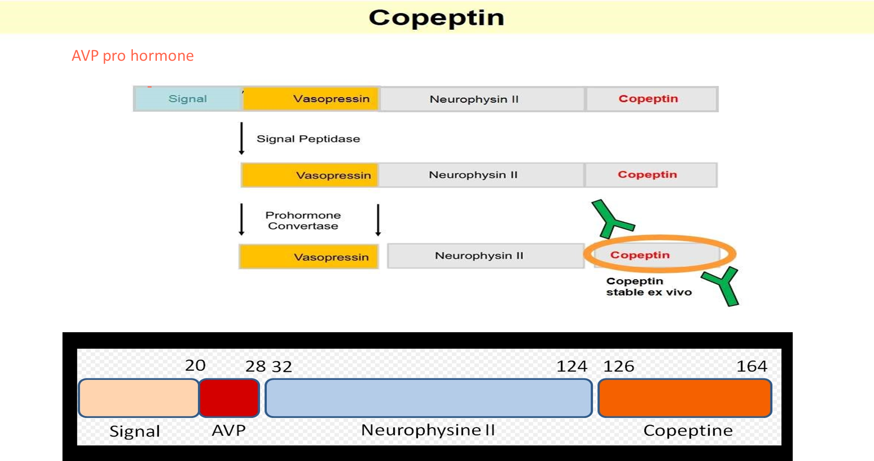
The prohormone is packaged into neurosecretory granules of magnocellular neurons. During axonal transport of the granules from the hypothalamus to the posterior pituitary, enzymatic cleavage of the prohormone generates the final products: AVP, neurophysin and the COOH-terminal glycoprotein copeptin.

Slide 29
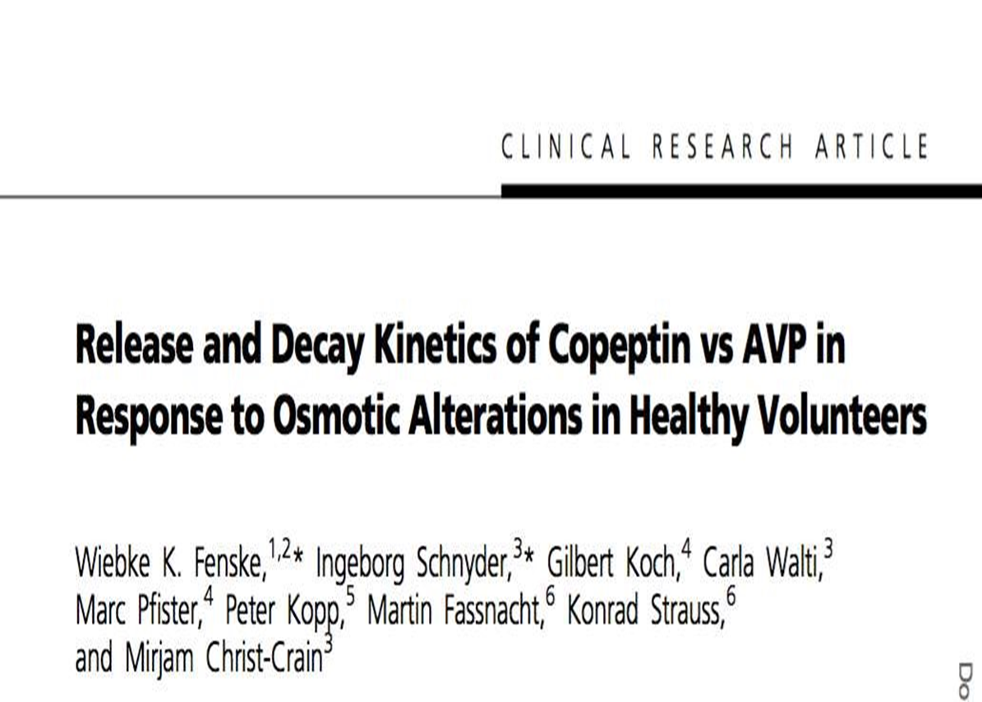
Plasma AVP and copeptin concentrations measured during water load and hypertonic saline tests are shown as scatter plot

Slide 30
A strong correlation between plasma AVP and copeptin levels has been demonstrated in healthy volunteers with a correlation index of r = 0.8 .
Notably, the correlation with plasma osmolality was even stronger for copeptin than for AVP.
The main stimuli for copeptin are similar to AVP, that is an increase in osmolality and a decrease in arterial blood volume and pressure

Slide 35
Figure 2. Shown are the ROC curves for the discriminative accuracy of the HSI and the indirect WDT. Panel A shows the discriminative accuracy of hypertonic saline–stimulated
copeptin levels in differentiating primary polydipsia
from CDI Panel B shows the discriminative
accuracy of the indirect WDT(which measures the change in urine osmolality before and after
administration of desmopressin) in differentiating primary
polydipsia from CDI

Slide 40
Arginine-stimulated copeptin measurements in the differential diagnosis of diabetes insipidus: a prospective diagnostic study Bettina Winzeler, Nicole Cesana-Nigro, Julie Refardt, Deborah R Vogt, Cornelia Imber, Benedict Morin,
Between May 24, 2013, and Jan 11, 2017, 52 patients were enrolled in the development cohort (12 [23%] with complete diabetes insipidus, nine [17%] with partial diabetes insipidus, and 31 [60%] with primary polydipsia)alongside 20 healthy adults and 42 child controls.
Between Oct 24, 2017, and June 27, 2018, 46 patients were enrolled in the validation cohort (12 [26%] with complete diabetes insipidus, seven [15%] with partial diabetes insipidus, and 27 [59%] with primary polydipsia) alongside 30 healthy adult controls (two patients in this cohort were excluded from the main analysis because of early vomiting during the test)

Slide 41
Arginine-stimulated copeptin measurements in the differential diagnosis of diabetes insipidus: a prospective diagnostic study
Bettina Winzeler, Nicole Cesana-Nigro, Julie Refardt, Deborah R Vogt, Cornelia Imber, Benedict Morin, Milica Popovic, Michelle Steinmetz,
Clara O Sailer, Gabor Szinnai, Irina Chifu, Martin Fassnacht, Mirjam Christ-Crain
standardized arginine infusion starting at 0800 h, after an overnight fast of 8 h and fluid restriction for 2 h (children were allowed to drink water until test start)
30 min before test start, participants were settled in a supine position and a catheter was placed in an antecubital vein.
Arginine at a dose of 0·5 g/kg bodyweight, diluted in 500 mL of 0·9% sodium chloride solution, was infused over 30 min.
At baseline and 30, 45, 60, 90, and 120 min after the start of arginine infusion, blood pressure and pulse rate were monitored and blood was drawn for copeptin measurement

Slide 49
Thank You For
Your Attention

